Slide 1
Linear Programming I David Woodruff

Slide 2
Outline
Definition of linear programming and examples
A linear program to solve max flow and min-cost max flow
A linear program to solve minimax-optimal strategies in games
Algorithms for linear programming

Slide 3
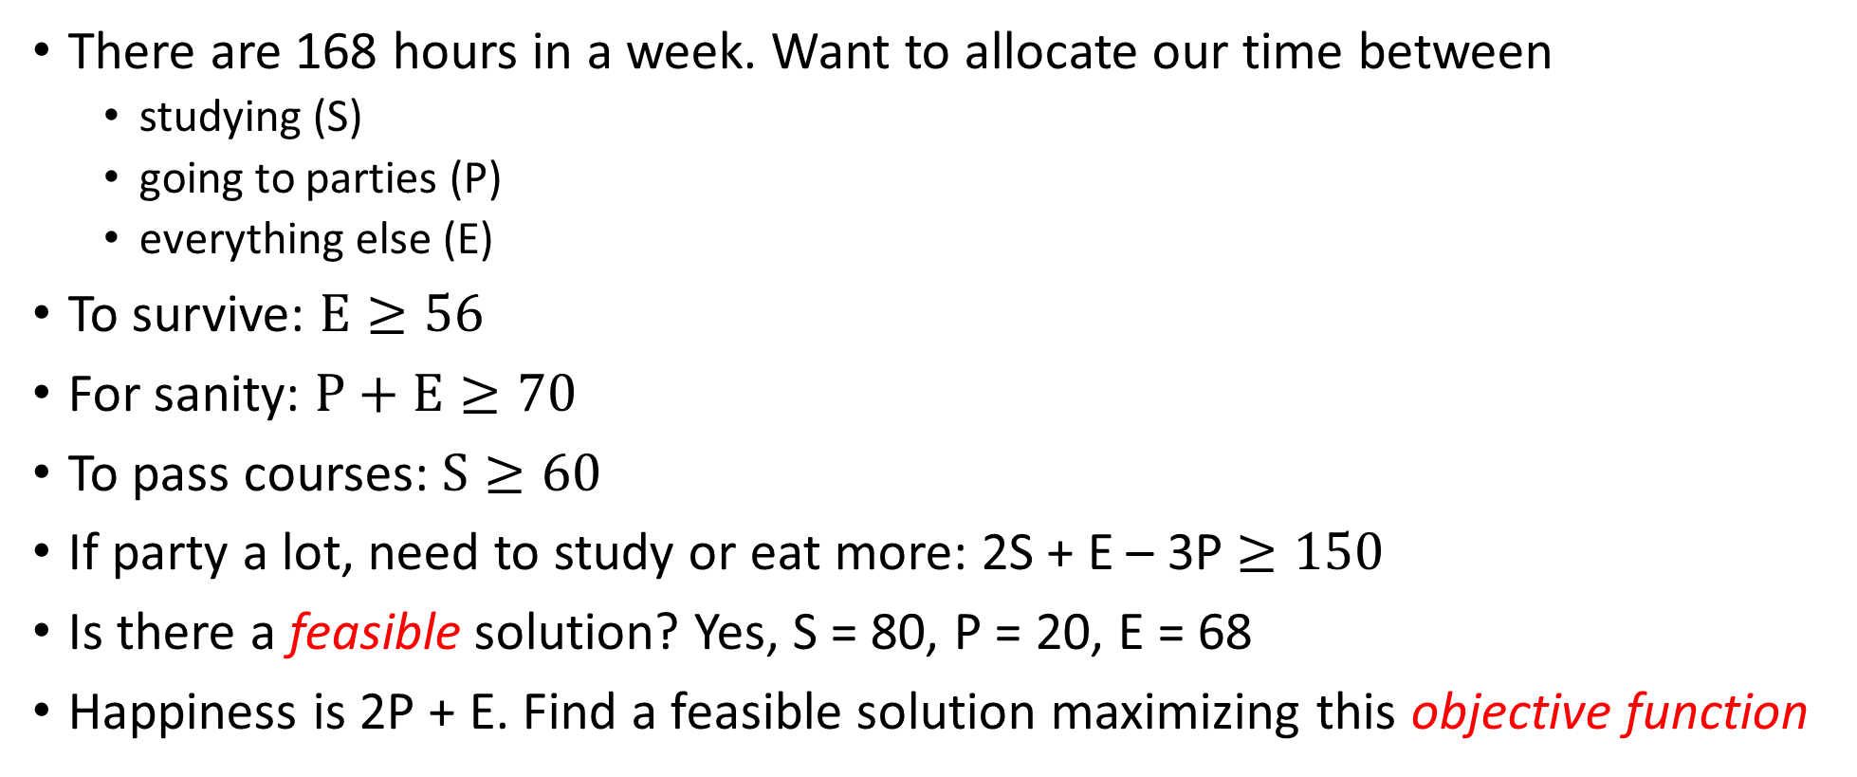
Example
There are 168 hours in a week. Want to allocate our time between
studying (S)
going to parties (P)
everything else (E)
To survive: $E≥56$
For sanity: $P+E≥70$
To pass courses: $S≥60$
If party a lot, need to study or eat more: 2S + E – 3P $≥150$
Is there a feasible solution? Yes, S = 80, P = 20, E = 68
Happiness is 2P + E. Find a feasible solution maximizing this objective function

Slide 4
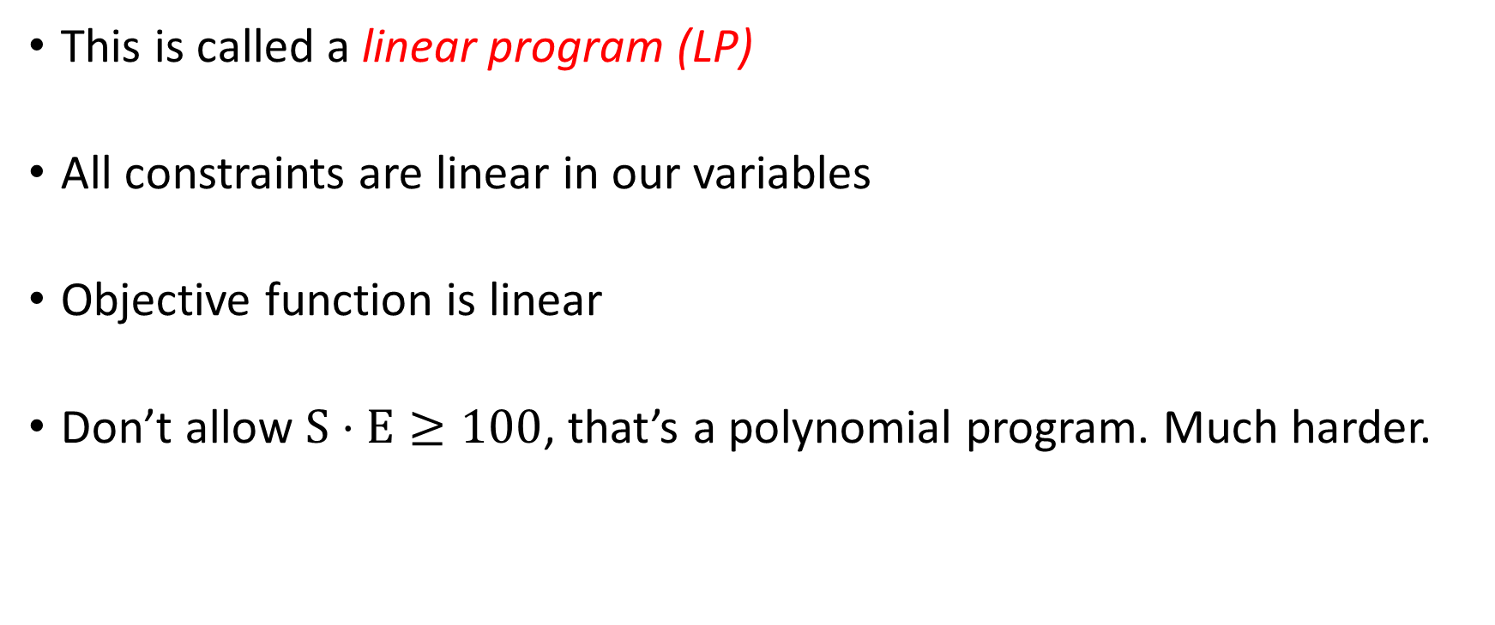
Linear Program
This is called a linear program (LP)
All constraints are linear in our variables
Objective function is linear
Don’t allow $S⋅E≥100$, that’s a polynomial program. Much harder.

Slide 5
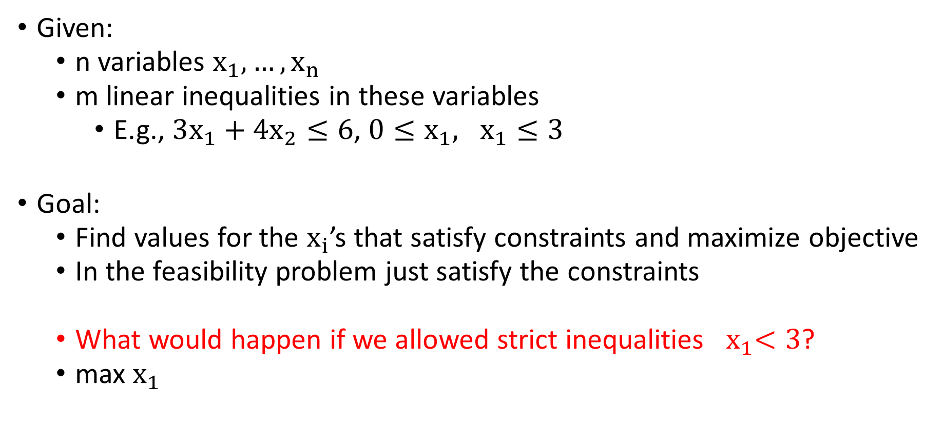
Formal Definition
Given:
n variables $x_{1},…, x_{n}$
m linear inequalities in these variables
E.g., $3x_{1}+4x_{2}≤6$, $0≤x_{1}, x_{1}≤3$
Goal:
Find values for the $x_{i}$’s that satisfy constraints and maximize objective
In the feasibility problem just satisfy the constraints
What would happen if we allowed strict inequalities ${ x}_{1}<3$?
max $x_{1}$

Slide 6

Time Allocation Problem
Variables: S, P, E
Objective: Maximize 2P + E subject to
Constraints: S + P + E = 168
$E≥56$
$S≥60$
2S + E – 3P $≥150$
P + E $≥70$
$P≥0$

Slide 7
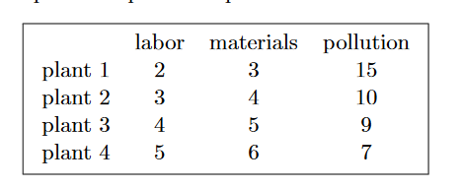
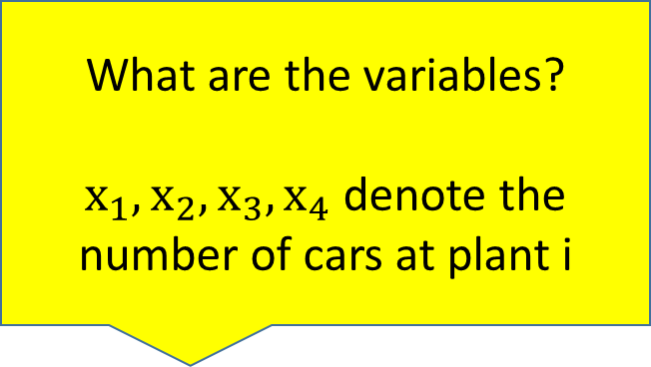
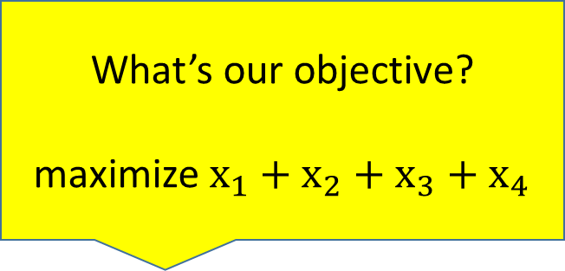
Operations Research Problem
What are the variables?
$x_{1},x_{2},x_{3},x_{4}$ denote the number of cars at plant i
What’s our objective?
maximize $x_{1}+x_{2}+x_{3}+x_{4}$
Required to make at least 400 cars at plant 3
Have 3300 hours of labor and 4000 units of material
At most 12000 units of pollution
Maximize number of cars made

Slide 8

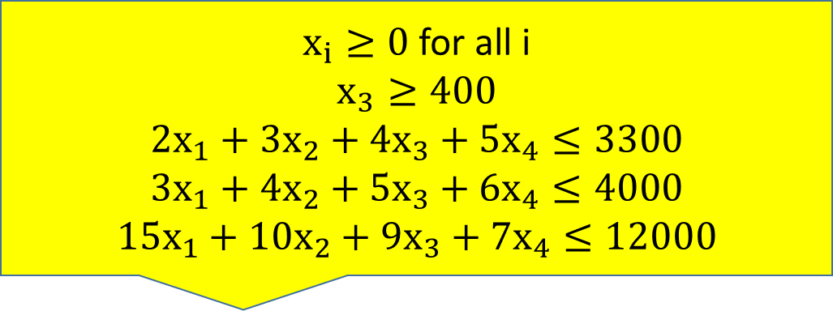

What are the variables?
$x_{1},x_{2},x_{3},x_{4}$ denote the number of cars at plant i
What’s our objective?
maximize $x_{1}+x_{2}+x_{3}+x_{4}$
Make at least 400 cars at plant 3
3300 hours of labor and 4000 units of material
At most 12000 units of pollution
Maximize number of cars made
Note: linear programming does not
give an integral solution (NP-hard)
$x_{i}≥0$for all i
$$x_{3}≥400$$
$$2x_{1}+3x_{2}+4x_{3}+5x_{4}≤3300$$
$$3x_{1}+4x_{2}+5x_{3}+6x_{4}≤4000$$
$$15x_{1}+10x_{2}+9x_{3}+7x_{4}≤12000$$
Constraints:

Slide 9
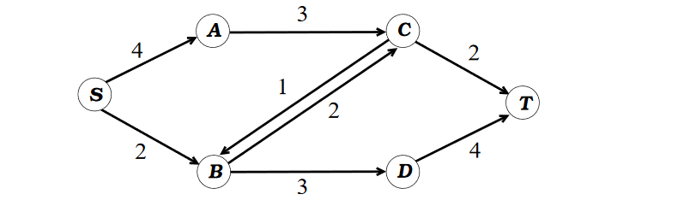

Modeling Network Flow
Variables: $f_{uv}$ for each edge (u,v), representing positive flow
Objective: maximize $\sum_{u}{f_{ut}}−\sum_{u}{f_{tu}}$
Constraints: For all edges (u,v) $0≤f_{uv }≤c\left(u,v\right)$ (capacity constraints)
For all v $∉\left\{s,t\right\}, \sum_{u}{f_{uv}=}\sum_{u}{f_{vu}}$ (flow conservation)

Slide 10
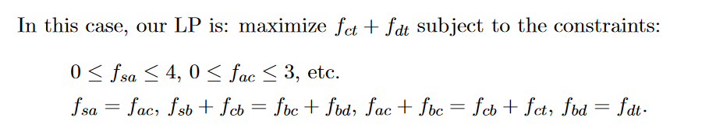
Modeling Network Flow

Slide 11
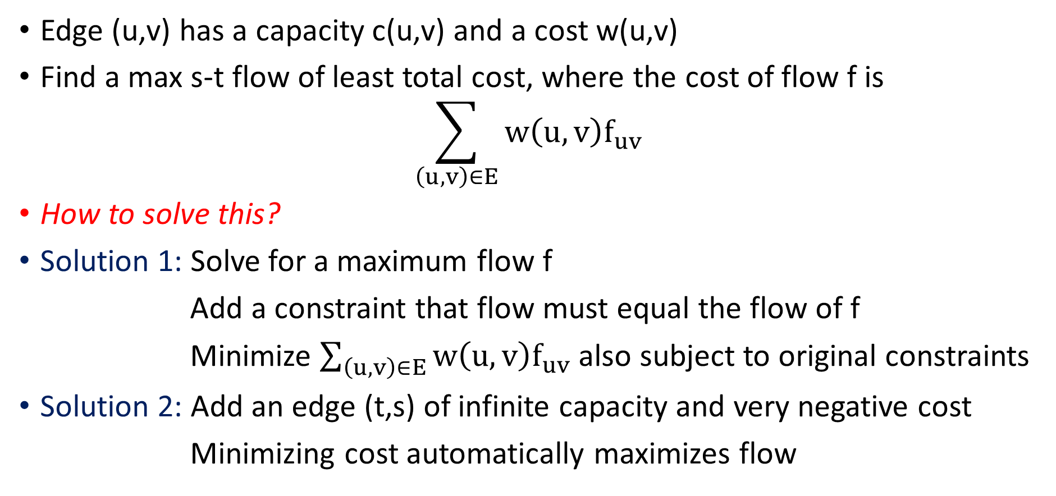
Min Cost Max Flow
Edge (u,v) has a capacity c(u,v) and a cost w(u,v)
Find a max s-t flow of least total cost, where the cost of flow f is
$$\sum_{\left(u,v\right)∈E}{w\left(u,v\right)f_{uv}}$$
How to solve this?
Solution 1: Solve for a maximum flow f
Add a constraint that flow must equal the flow of f
Minimize $\sum_{\left(u,v\right)∈E}{w\left(u,v\right)f_{uv}}$also subject to original constraints
Solution 2: Add an edge (t,s) of infinite capacity and very negative cost
Minimizing cost automatically maximizes flow

Slide 12




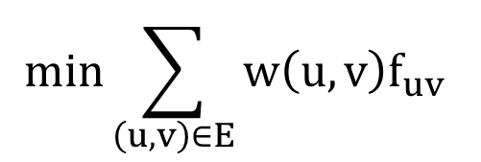
Min Cost Max Flow
$$min\sum_{\left(u,v\right)∈E}{w\left(u,v\right)f_{uv}}$$
$$f_{ts}=f_{sa}+f_{sb}$$
$$f_{ct}+f_{dt}=f_{ts}$$
$$∞$$
$$w\left(t,s\right)=−∞$$

Slide 13
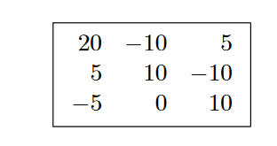
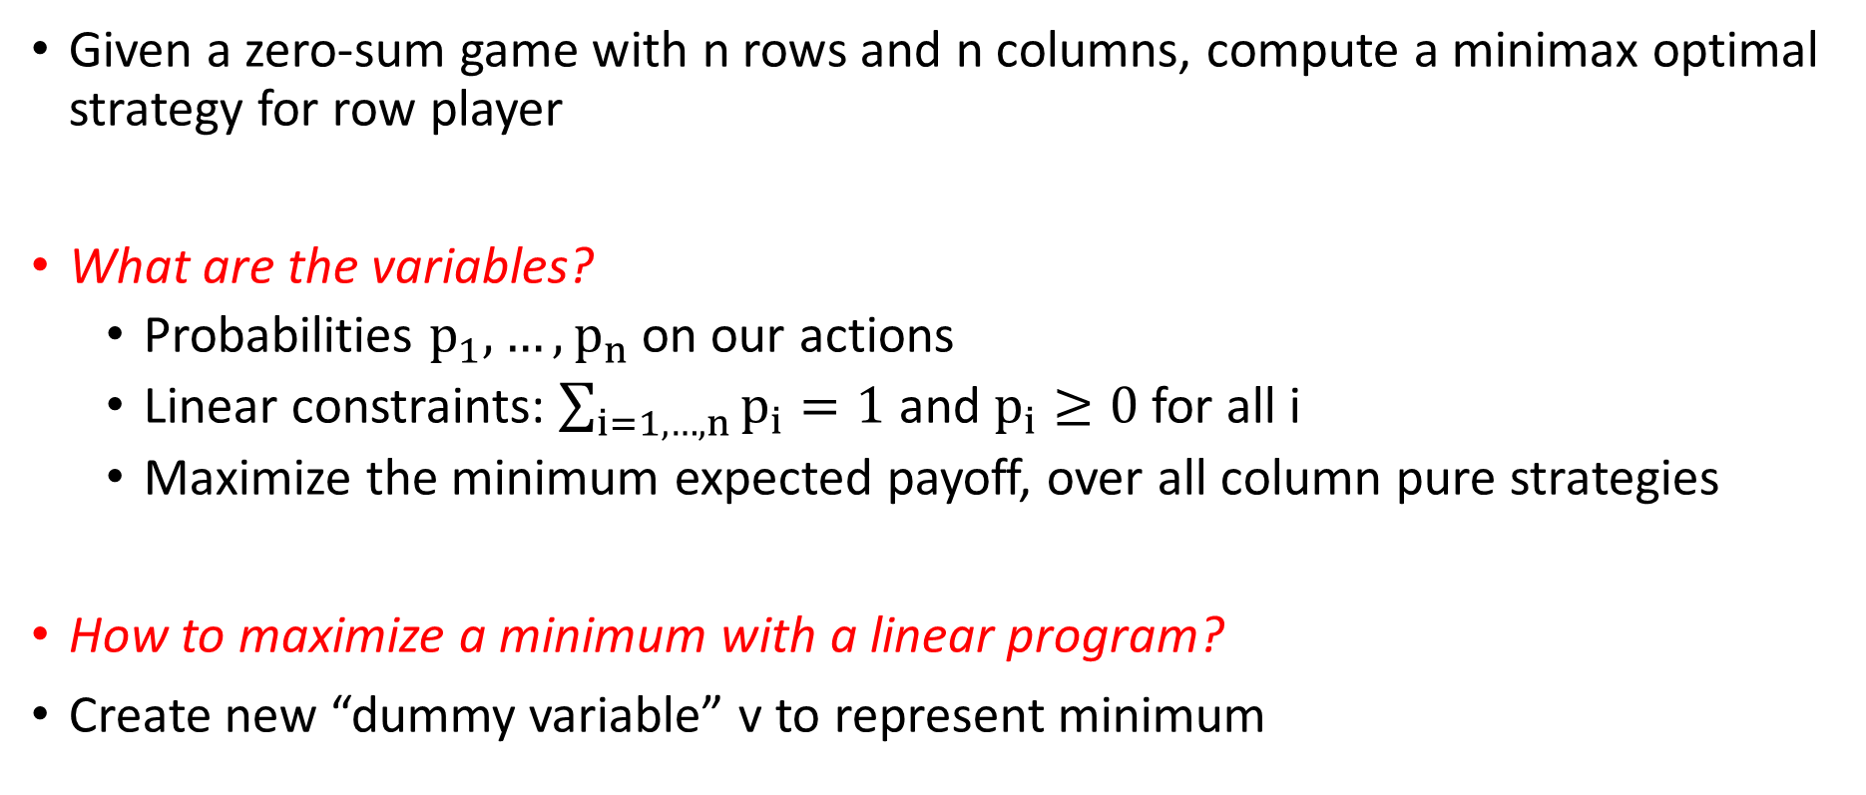
Zero Sum Games
Row payoffs:
Given a zero-sum game with n rows and n columns, compute a minimax optimal strategy for row player
What are the variables?
Probabilities $p_{1},…, p_{n}$ on our actions
Linear constraints: $\sum_{i=1, …, n}{p_{i}}=1$ and $p_{i}≥0$ for all i
Maximize the minimum expected payoff, over all column pure strategies
How to maximize a minimum with a linear program?
Create new “dummy variable” v to represent minimum

Slide 14
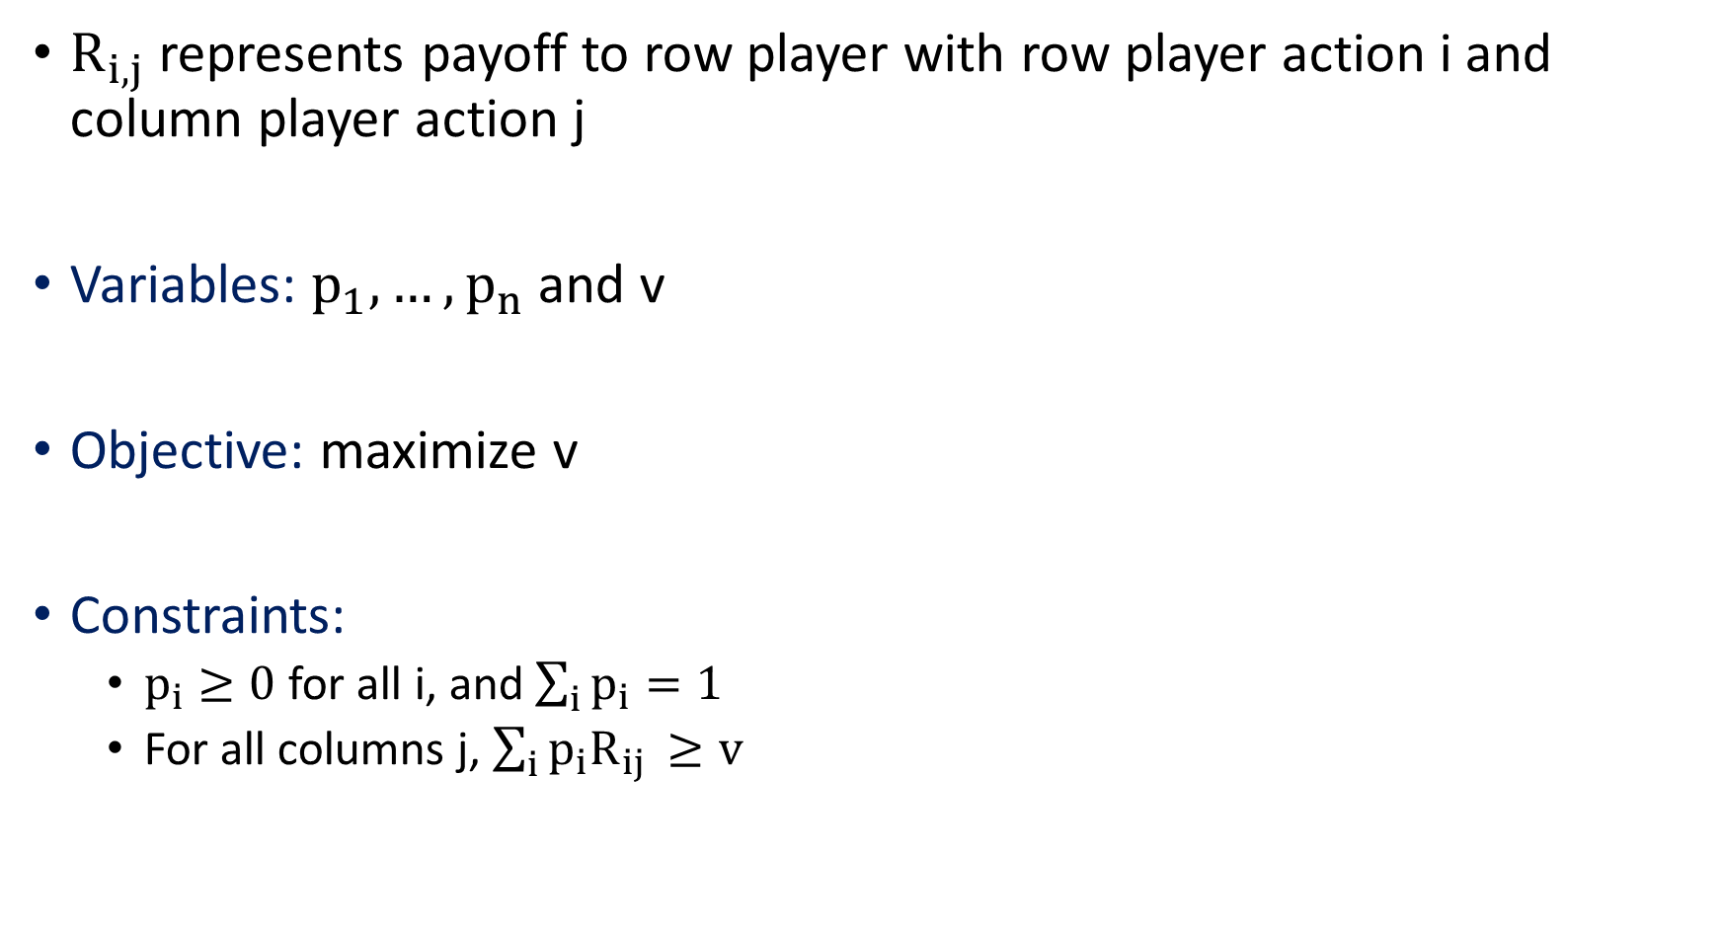
Zero Sum Games
$R_{i,j}$ represents payoff to row player with row player action i and column player action j
Variables: $p_{1},…, p_{n}$ and v
Objective: maximize v
Constraints:
$p_{i}≥0$ for all i, and $\sum_{i}{p_{i}=1}$
For all columns j, $\sum_{i}{p_{i}R_{ij }≥v}$

Slide 15
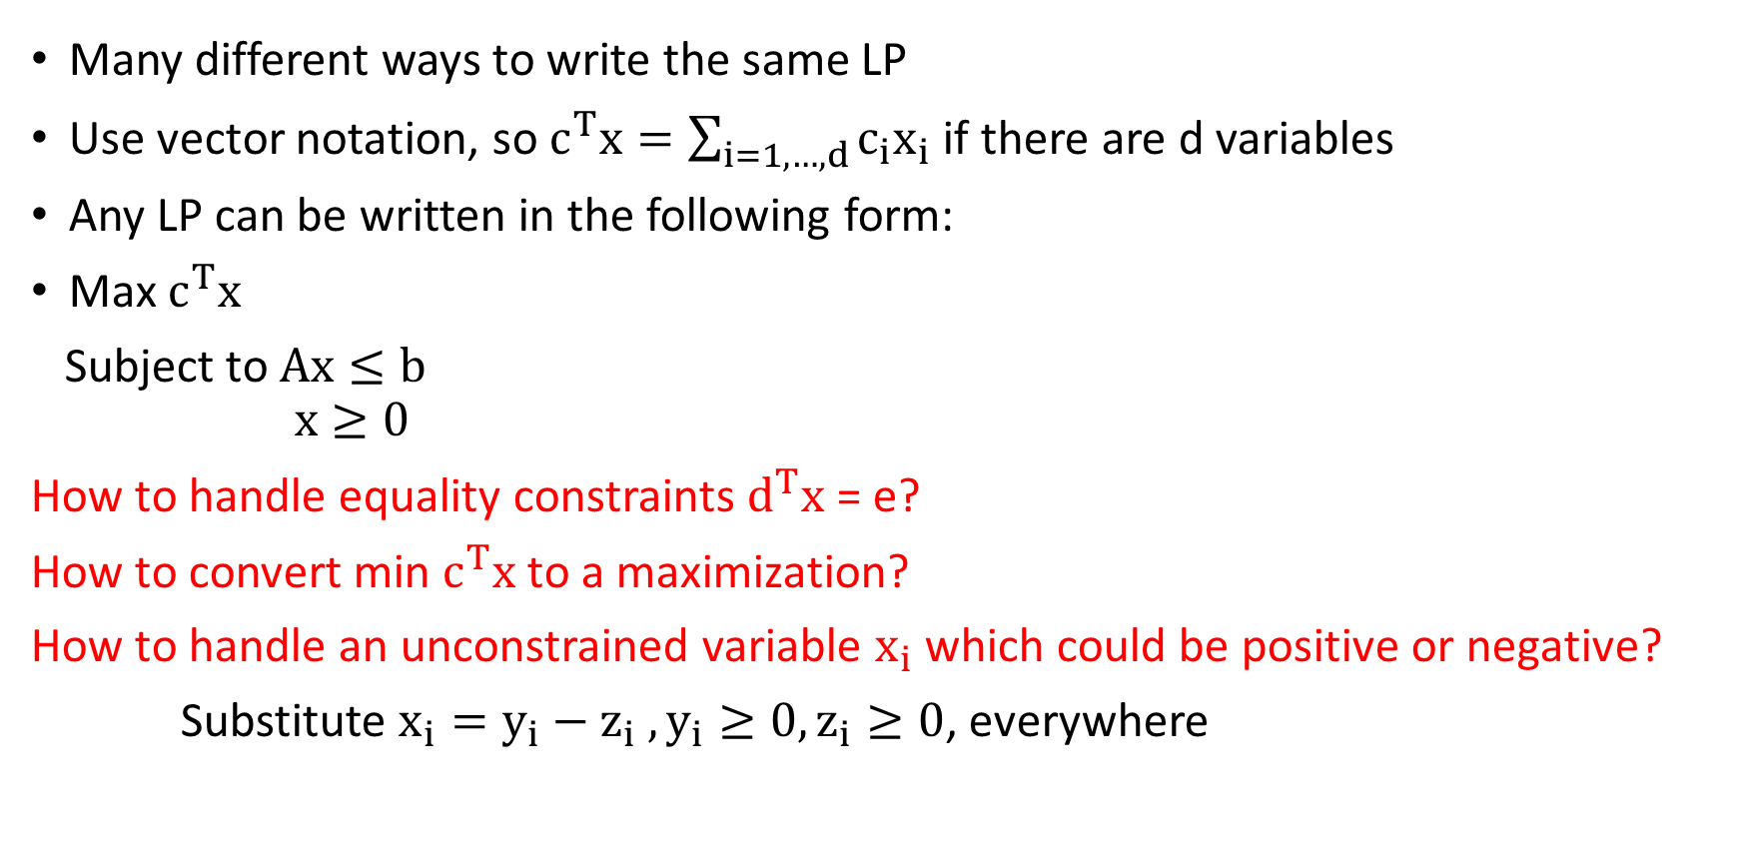
Linear Programs in Standard Form?
Many different ways to write the same LP
Use vector notation, so $c^{T}x=\sum_{i=1,…,d}{c_{i}x_{i}}$ if there are d variables
Any LP can be written in the following form:
Max $c^{T}x$
Subject to $Ax≤b$
$$x≥0$$
How to handle equality constraints $d^{T}x$ = e?
How to convert min $c^{T}x$ to a maximization?
How to handle an unconstrained variable $x_{i}$ which could be positive or negative?
Substitute $x_{i}=y_{i}−z_{i} , y_{i}≥0, z_{i}≥0$, everywhere

Slide 16
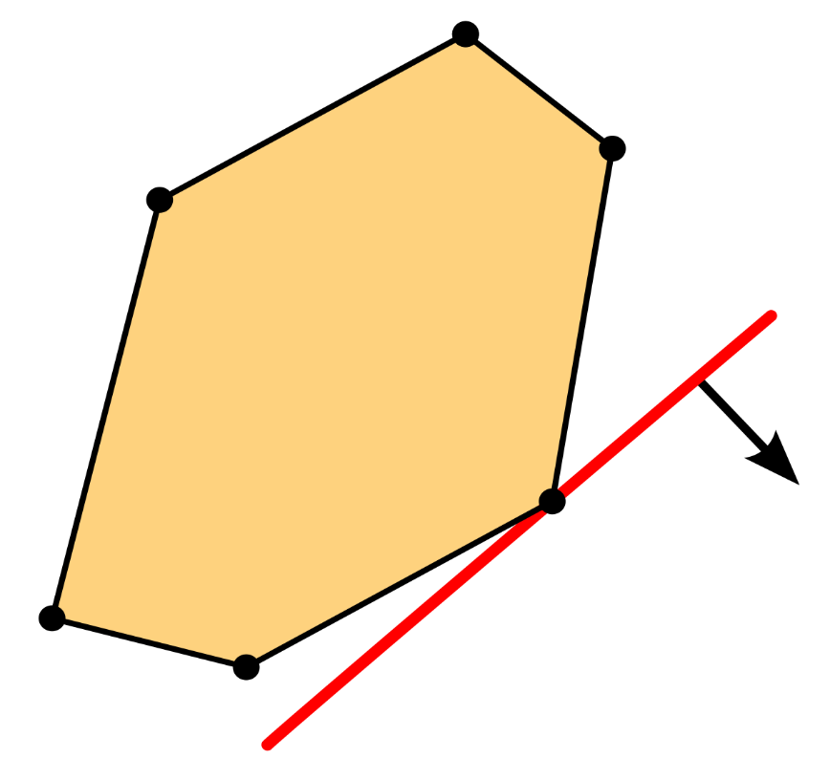
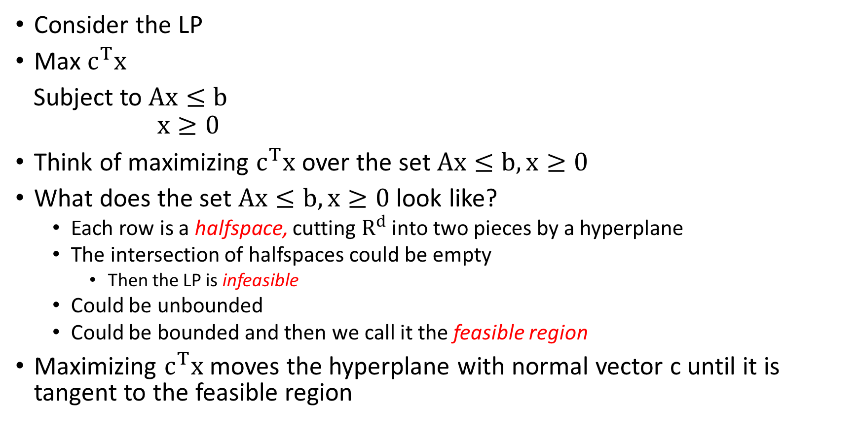
Facts about Linear Programs
Consider the LP
Max $c^{T}x$
Subject to $Ax≤b$
$$x≥0$$
Think of maximizing $c^{T}x$ over the set $Ax≤b, x≥0$
What does the set $Ax≤b, x≥0$ look like?
Each row is a halfspace, cutting $R^{d}$ into two pieces by a hyperplane
The intersection of halfspaces could be empty
Then the LP is infeasible
Could be unbounded
Could be bounded and then we call it the feasible region
Maximizing $c^{T}x$ moves the hyperplane with normal vector c until it is tangent to the feasible region

Slide 17
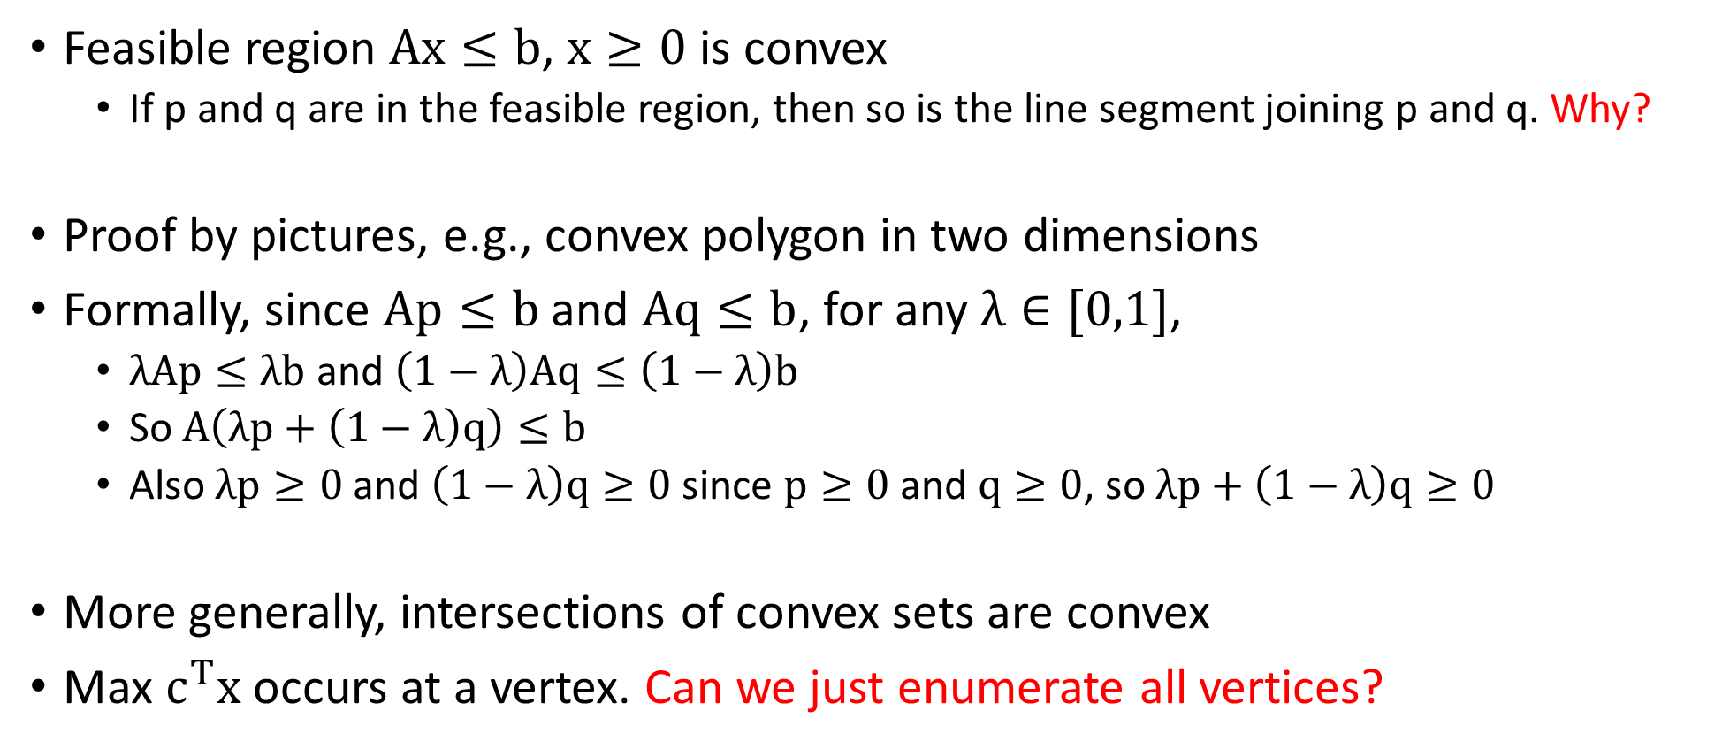
Convexity Properties
Feasible region $Ax≤b$, $x≥0$ is convex
If p and q are in the feasible region, then so is the line segment joining p and q. Why?
Proof by pictures, e.g., convex polygon in two dimensions
Formally, since $Ap≤b$ and $Aq≤b$, for any $λ∈[0,1]$,
$λAp≤λb$ and $\left(1−λ\right)Aq≤\left(1−λ\right)b$
So $A\left(λp+\left(1−λ\right)q\right)≤b$
Also $λp≥0$and $\left(1−λ\right)q≥0$ since $p≥0$ and $q≥0$, so $λp+\left(1−λ\right)q≥0$
More generally, intersections of convex sets are convex
Max $c^{T}x$ occurs at a vertex. Can we just enumerate all vertices?

Slide 18
Algorithms for Linear Programming
Simplex Algorithm
Practical, but exponential time in the worst-case
Ellipsoid Algorithm
First polynomial time algorithm, but slow in practice
Karmarkar’s Algorithm (interior point)
Polynomial time algorithm and competitive in practice
Software: LINDO, CPLEX, Solver (in Excel)

Slide 19
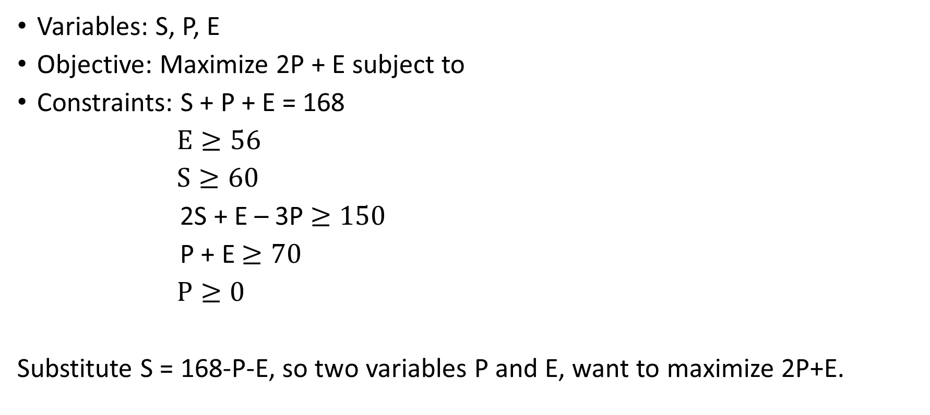
Time Allocation Problem
Variables: S, P, E
Objective: Maximize 2P + E subject to
Constraints: S + P + E = 168
$E≥56$
$S≥60$
2S + E – 3P $≥150$
P + E $≥70$
$P≥0$
Substitute S = 168-P-E, so two variables P and E, want to maximize 2P+E.

Slide 20
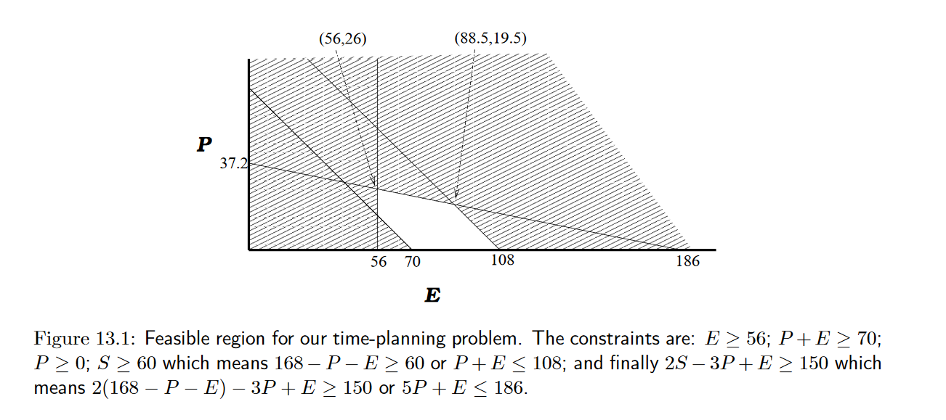
Intuition for Linear Programming
Maximizing P occurs at (56,26). Maximizing 2P+E occurs at (88.5, 19.5)

Slide 21
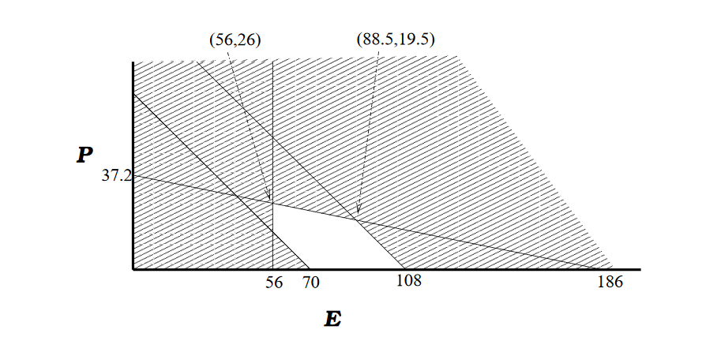
Simplex Algorithm
Start at vertex of the feasible region (polyhedron in high dimensions)
Look at cost of objective function at each neighbor
Move to neighbor of maximum cost
Always make progress, but could take exponential time (in high dimensions)

Slide 22
Simplex Algorithm
Get stuck in local maximum?
No, since feasible set is convex

Slide 23
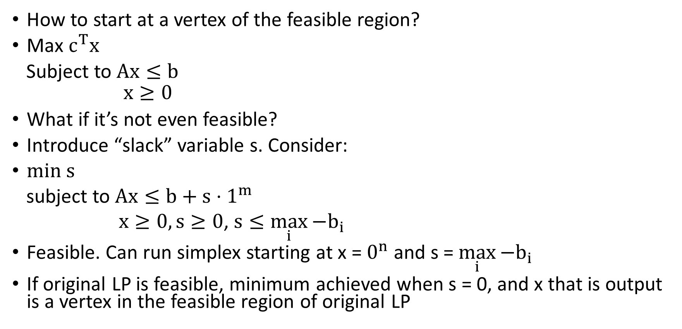
Other Annoyances I
How to start at a vertex of the feasible region?
Max $c^{T}x$
Subject to $Ax≤b$
$$x≥0$$
What if it’s not even feasible?
Introduce “slack” variable s. Consider:
min s
subject to $Ax≤b+s⋅1^{m}$
$x≥0, s≥0$, $s≤\max_{i}{{−b}_{i}}$
Feasible. Can run simplex starting at x = $0^{n}$ and s = $\max_{i}{{−b}_{i}}$
If original LP is feasible, minimum achieved when s = 0, and x that is output is a vertex in the feasible region of original LP

Slide 24
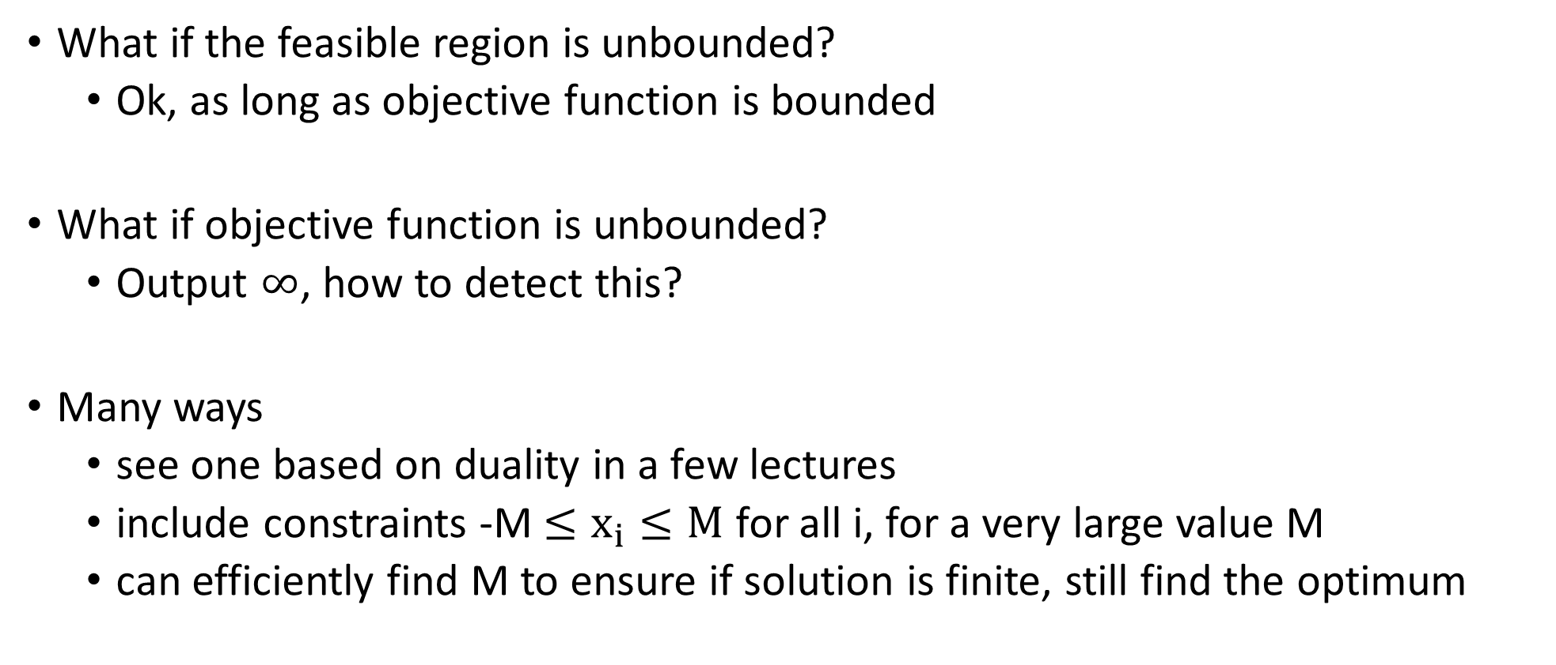
Other Annoyances II
What if the feasible region is unbounded?
Ok, as long as objective function is bounded
What if objective function is unbounded?
Output $∞$, how to detect this?
Many ways
see one based on duality in a few lectures
include constraints -M$≤x_{i}≤M$ for all i, for a very large value M
can efficiently find M to ensure if solution is finite, still find the optimum

Slide 25
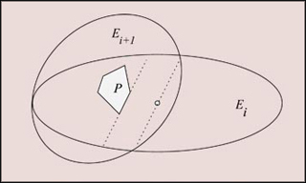
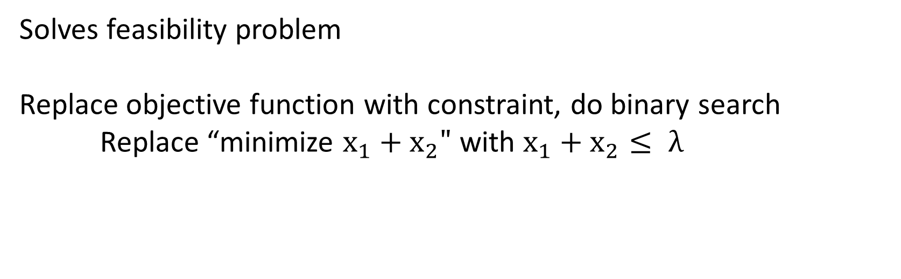
Ellipsoid Algorithm
Solves feasibility problem
Replace objective function with constraint, do binary search
Replace “minimize $x_{1}+x_{2}"$with $x_{1}+x_{2}≤ λ$
Can handle exponential
number of constraints if
there’s a separation oracle

Slide 26
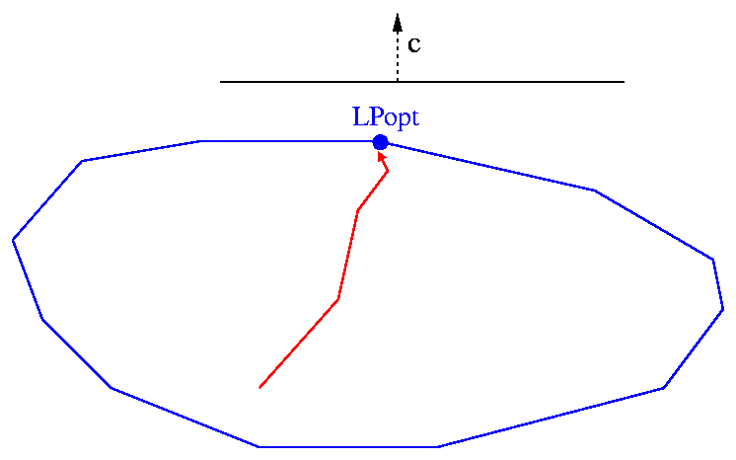
Karmarkar’s Algorithm
Works with feasible points but doesn’t go corner to corner
Moves in interior of the feasible region – “interior point method”

