Slide 1
Linear Programming II
David Woodruff

Slide 2
Outline
Another linear programming example – l1 regression
Seidel’s 2-dimensional linear programming algorithm
Ellipsoid algorithm, and continued discussion of simplex algorithm

Slide 3
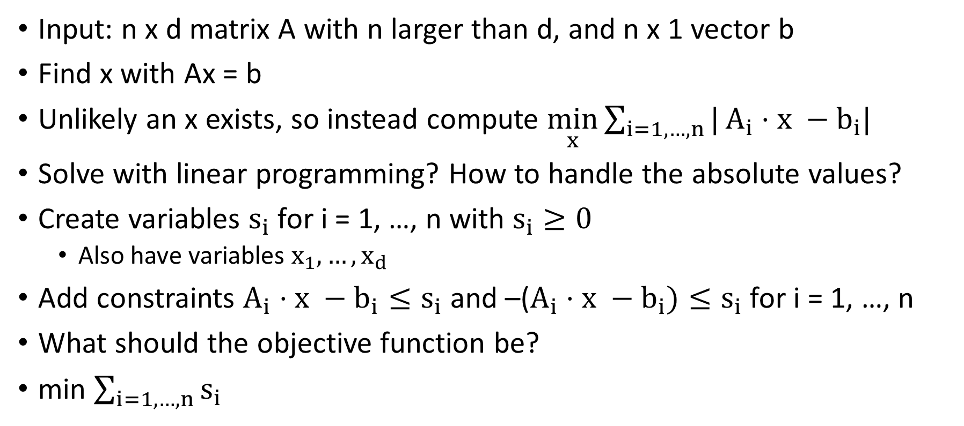
L1 Regression
Input: n x d matrix A with n larger than d, and n x 1 vector b
Find x with Ax = b
Unlikely an x exists, so instead compute $\min_{x}{\sum_{i=1, …,n}{|}A_{i}⋅x −b_{i}|}$
Solve with linear programming? How to handle the absolute values?
Create variables $s_{i}$ for i = 1, …, n with $s_{i}≥0$
  Also have variables $x_{1}, …, x_{d}$
Add constraints $A_{i}⋅x −b_{i}≤s_{i}$ and –($A_{i}⋅x −b_{i})≤s_{i}$ for i = 1, …, n
What should the objective function be?
min $\sum_{i=1, …, n}{s_{i}}$

Slide 4
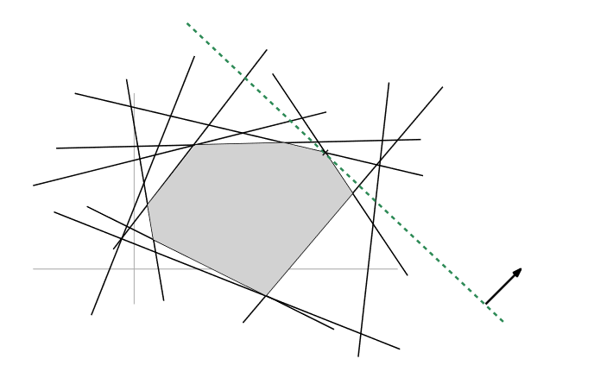
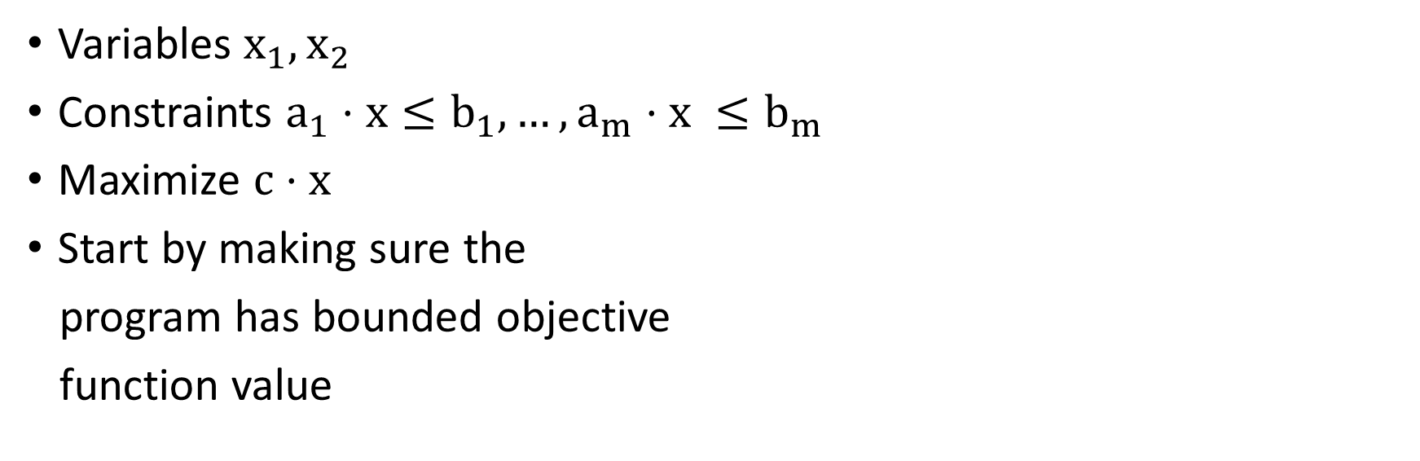
Seidel’s 2-Dimensional Algorithm
Variables $x_{1}, x_{2}$
Constraints $a_{1}⋅x≤b_{1}, …, a_{m}⋅x ≤b_{m}$
Maximize $c⋅x$
Start by making sure the
program has bounded objective
function value

Slide 5
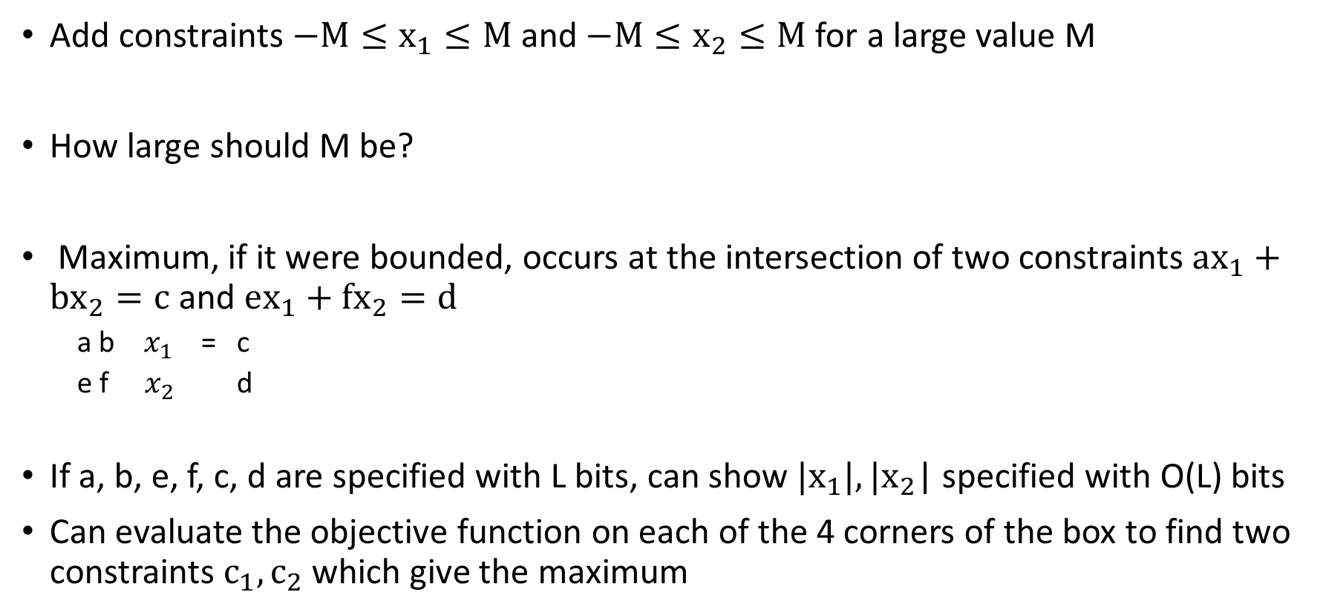
What if the LP is unbounded?
Add constraints$−M≤x_{1}≤M$and $−M≤x_{2}≤M$ for a large value M
How large should M be?
Maximum, if it were bounded, occurs at the intersection of two constraints $ax_{1}+bx_{2}=c$ and $ex_{1}+fx_{2}=d$
  a b $x_{1}$ = c
  e f $x_{2}$ d
If a, b, e, f, c, d are specified with L bits, can show $|x_{1}|,|x_{2}$| specified with O(L) bits
Can evaluate the objective function on each of the 4 corners of the box to find two constraints $c_{1},c_{2}$ which give the maximum
[
[
[
[
[
[

Slide 6
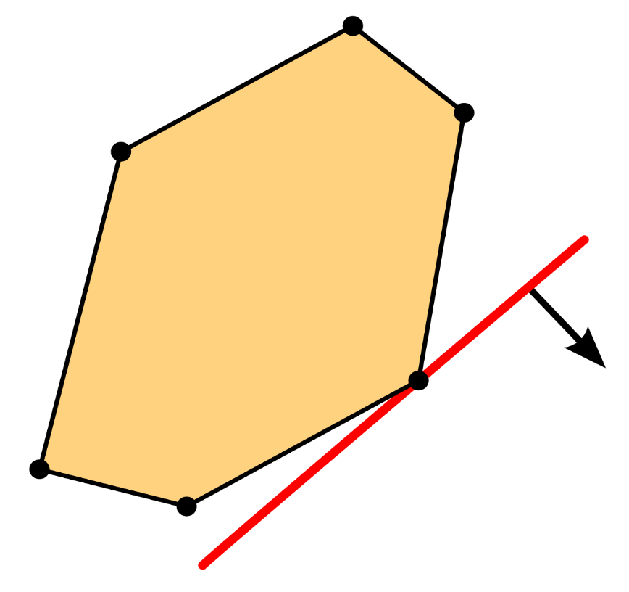
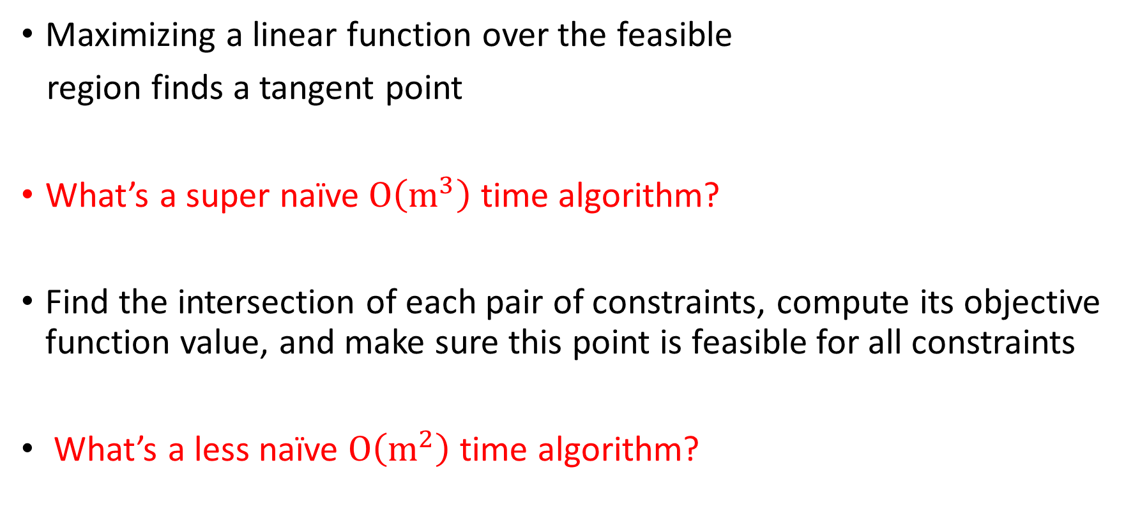
What Convexity Tells Us
Maximizing a linear function over the feasible
region finds a tangent point
What’s a super naïve $O\left(m^{3}\right)$ time algorithm?
Find the intersection of each pair of constraints, compute its objective function value, and make sure this point is feasible for all constraints
What’s a less naïve $O\left(m^{2}\right)$ time algorithm?

Slide 7
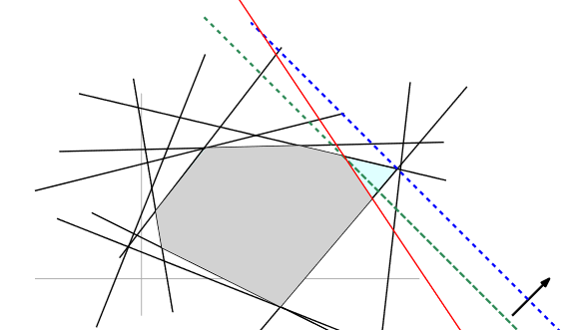
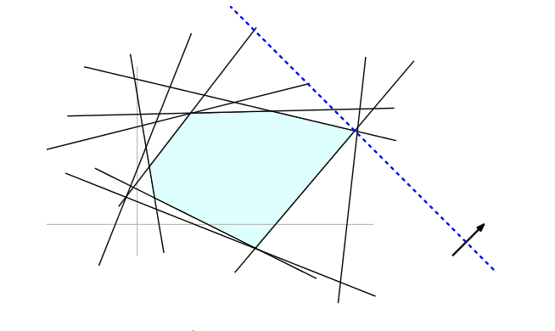
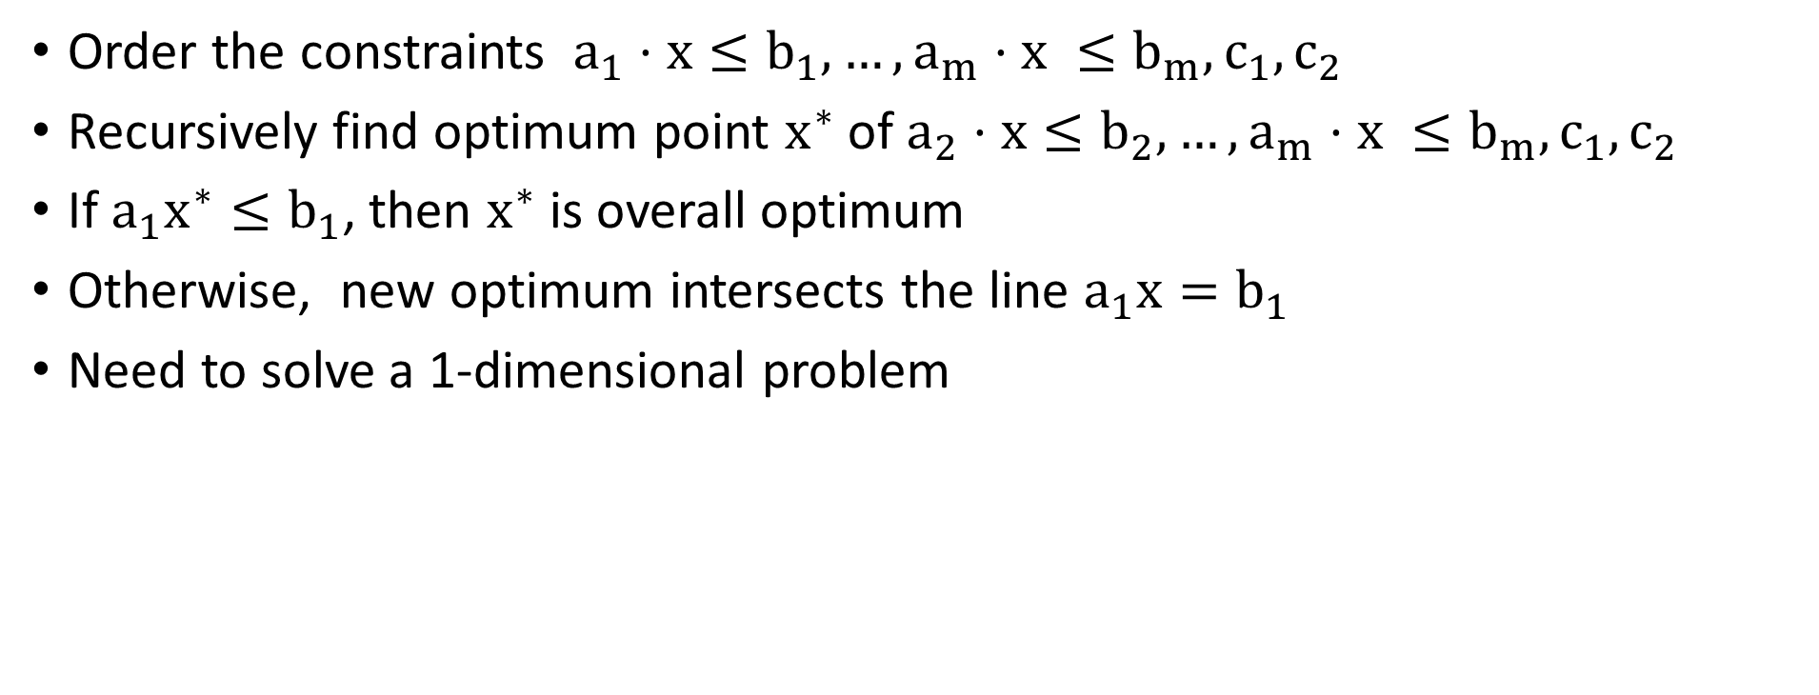

An $O\left(m^{2}\right)$ Time Algorithm
Order the constraints $a_{1}⋅x≤b_{1}, …, a_{m}⋅x ≤b_{m}, c_{1}, c_{2}$
Recursively find optimum point $x^{∗}$ of $a_{2}⋅x≤b_{2}, …, a_{m}⋅x ≤b_{m}, c_{1}, c_{2}$
If ${a_{1}x}^{∗}≤b_{1}$, then $x^{∗}$ is overall optimum
Otherwise, new optimum intersects the line $a_{1}x=b_{1}$
Need to solve a 1-dimensional problem

Slide 8
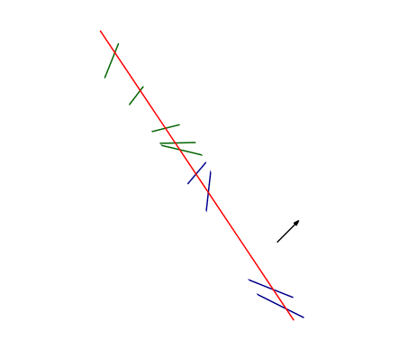
1-Dimensional Problem
Takes O(m) time to solve
Note: new optimum might not be determined by one of the two
constraints determining the old optimum

Slide 9
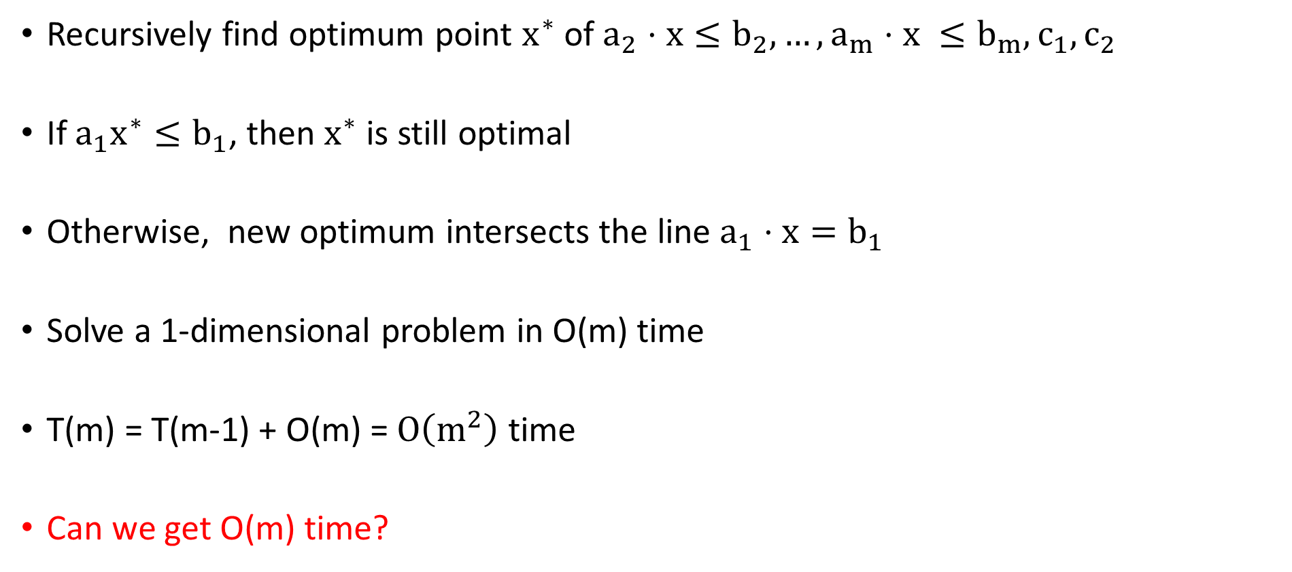
An $O\left(m^{2}\right)$ Time Algorithm
Recursively find optimum point $x^{∗}$ of $a_{2}⋅x≤b_{2}, …, a_{m}⋅x ≤b_{m}, c_{1}, c_{2}$
If ${a_{1}x}^{∗}≤b_{1}$, then $x^{∗}$ is still optimal
Otherwise, new optimum intersects the line $a_{1}⋅x=b_{1}$
Solve a 1-dimensional problem in O(m) time
T(m) = T(m-1) + O(m) = $O\left(m^{2}\right)$ time
Can we get O(m) time?

Slide 10
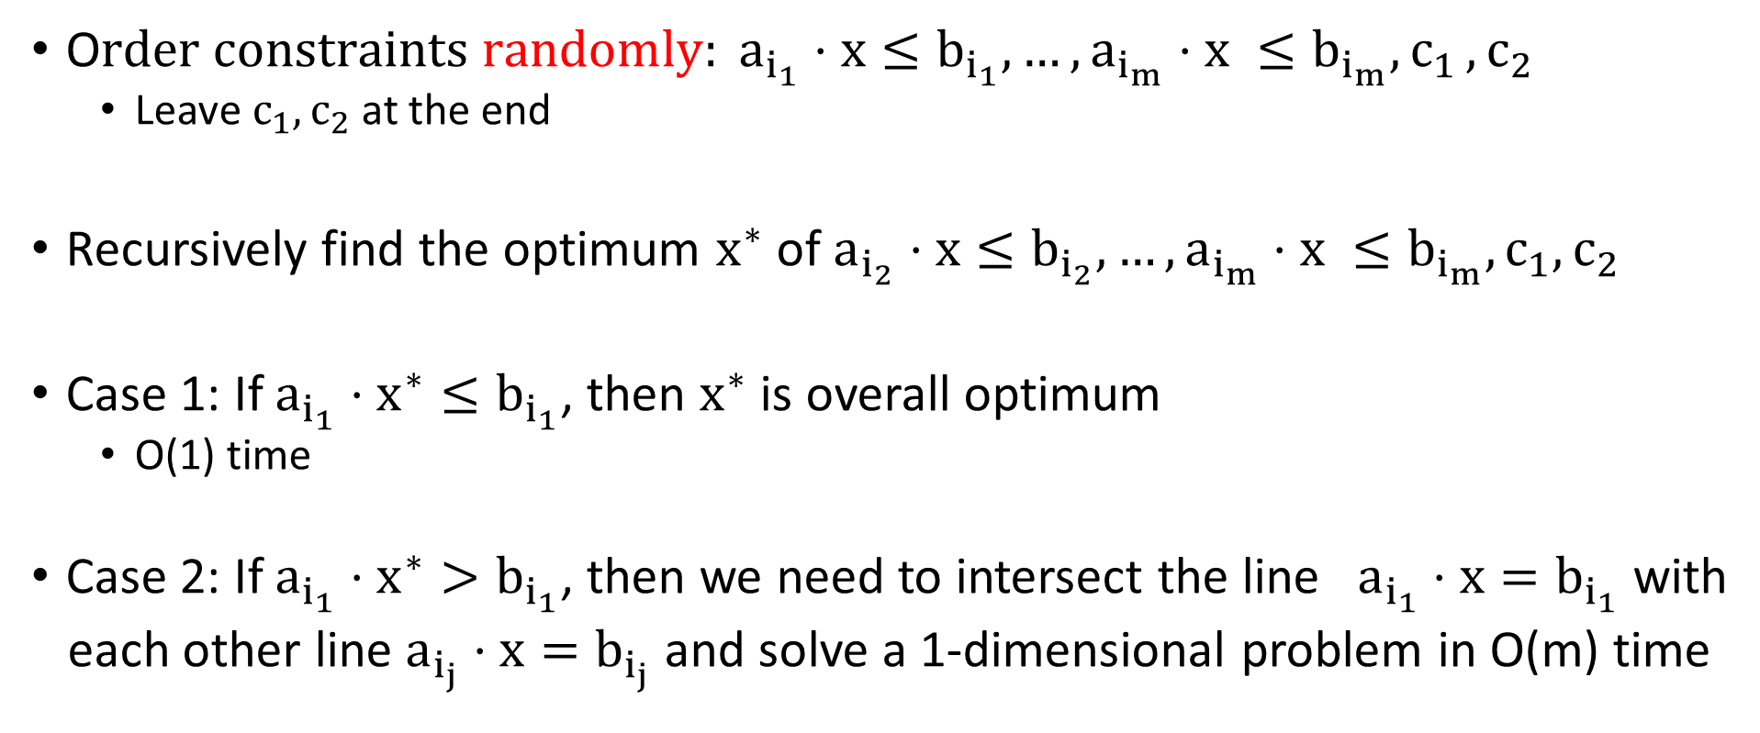
Seidel’s O(m) Time Algorithm
O$rder constraints randomly: a_{i_{1}}⋅x≤b_{i_{1}}, …, a_{i_{m}}⋅x ≤b_{i_{m}}{, c}_{1}, c_{2}$
  Leave $c_{1}, c_{2}$ at the end
Recursively find the optimum $x^{∗}$ of $a_{i_{2}}⋅x≤b_{i_{2}}, …, a_{i_{m}}⋅x ≤b_{i_{m}},c_{1}, c_{2}$
Case 1: If ${a_{i_{1}}⋅x}^{∗}≤b_{i_{1}}$, then $x^{∗}$ is overall optimum
  O(1) time
Case 2: If ${a_{i_{1}}⋅x}^{∗}>b_{i_{1}}$, then we need to intersect the line $a_{i_{1}}⋅x=b_{i_{1}}$ with
each other line $a_{i_{j}}⋅x=b_{i_{j}}$ and solve a 1-dimensional problem in O(m) time

Slide 11
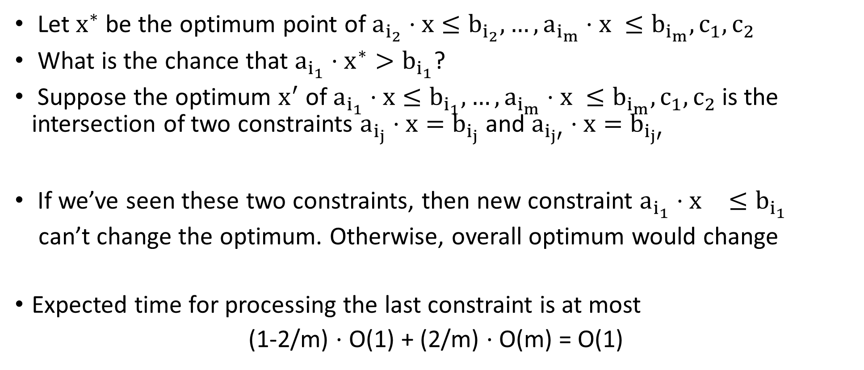
Backwards Analysis
Let $x^{∗}$ be the optimum point of $a_{i_{2}}⋅x≤b_{i_{2}}, …, a_{i_{m}}⋅x ≤b_{i_{m}},c_{1}, c_{2}$
What is the chance that ${a_{i_{1}}⋅x}^{∗}>b_{i_{1}}$?
Suppose the optimum $x^{′}$ of $a_{i_{1}}⋅x≤b_{i_{1}}, …, a_{i_{m}}⋅x ≤b_{i_{m}},c_{1}, c_{2}$is the intersection of two constraints $a_{i_{j}}⋅x=b_{i_{j}}$ and $a_{i_{j′}}⋅x=b_{i_{j′}}$
If we’ve seen these two constraints, then new constraint ${a_{i_{1}}⋅x}^{}≤b_{i_{1}}$
can’t change the optimum. Otherwise, overall optimum would change
Expected time for processing the last constraint is at most
(1-2/m) $⋅$ O(1) + (2/m) $⋅$ O(m) = O(1)

Slide 12
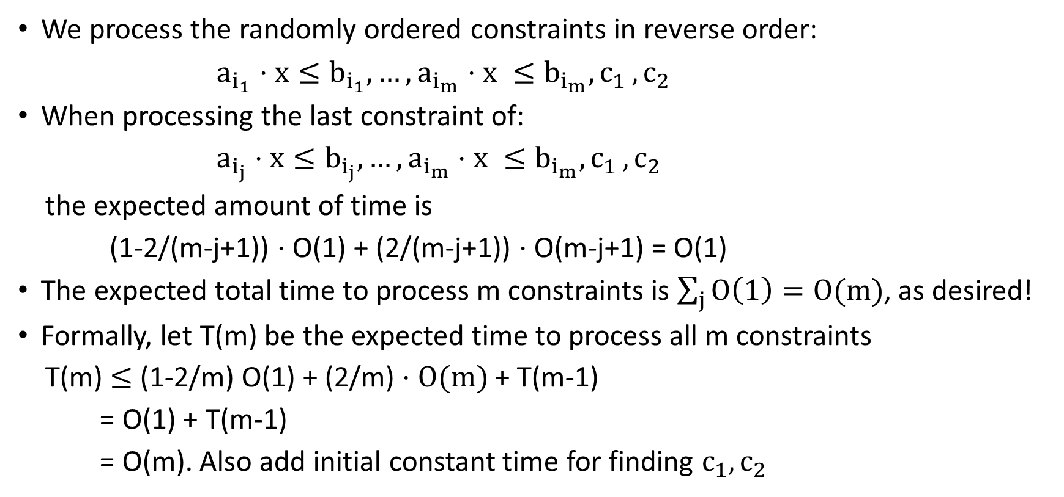
Backwards Analysis
We process the randomly ordered constraints in reverse order:
$a_{i_{1}}⋅x≤b_{i_{1}}, …, a_{i_{m}}⋅x ≤b_{i_{m}}{, c}_{1}, c_{2}$
When processing the last constraint of:
$a_{i_{j}}⋅x≤b_{i_{j}}, …, a_{i_{m}}⋅x ≤b_{i_{m}}{, c}_{1}, c_{2}$
the expected amount of time is
(1-2/(m-j+1)) $⋅$ O(1) + (2/(m-j+1)) $⋅$ O(m-j+1) = O(1)
The expected total time to process m constraints is $\sum_{j}{O\left(1\right)=O(m)}$, as desired!
Formally, let T(m) be the expected time to process all m constraints
T(m) $≤$ (1-2/m) O(1) + (2/m) $⋅O(m)$ + T(m-1)
= O(1) + T(m-1)
= O(m). Also add initial constant time for finding $c_{1}, c_{2}$

Slide 13
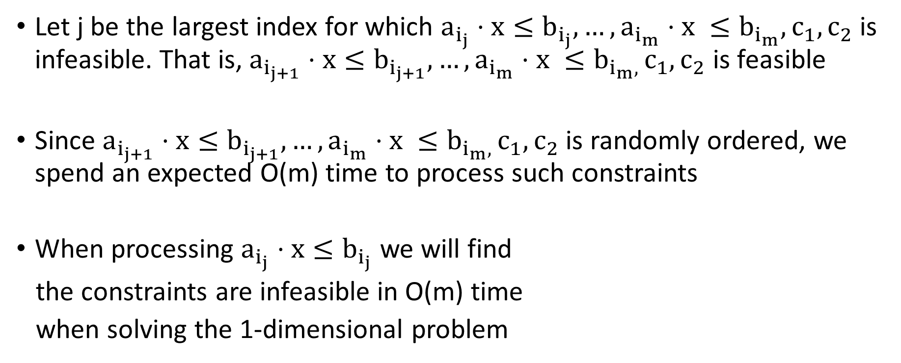
What if the LP is Infeasible?
Let j be the largest index for which $a_{i_{j}}⋅x≤b_{i_{j}}, …, a_{i_{m}}⋅x ≤b_{i_{m}},c_{1}, c_{2}$ is infeasible. That is, $a_{i_{j+1}}⋅x≤b_{i_{j+1}}, …, a_{i_{m}}⋅x ≤b_{i_{m}, }c_{1}, c_{2}$ is feasible
Since $a_{i_{j+1}}⋅x≤b_{i_{j+1}}, …, a_{i_{m}}⋅x ≤b_{i_{m}, }c_{1}, c_{2}$ is randomly ordered, we spend an expected O(m) time to process such constraints
When processing $a_{i_{j}}⋅x≤b_{i_{j}}$ we will find
the constraints are infeasible in O(m) time
when solving the 1-dimensional problem

Slide 14
What If More than 2 lines Intersect at a Point?
2 of the constraints “hold down” the optimum
Additional constraints can only help you

Slide 15
Higher Dimensions?
The probability that our optimum changes is now at most d/m instead of 2/m
When we find a violated constraint, we need to find a new optimum
New optimum inside this hyperplane
  Project each constraint into this hyperplane
  Solve a (d-1)-dimensional linear program on m-1 constraints to find optimum
  Time is O(d!m)

Slide 16
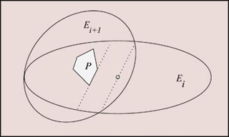
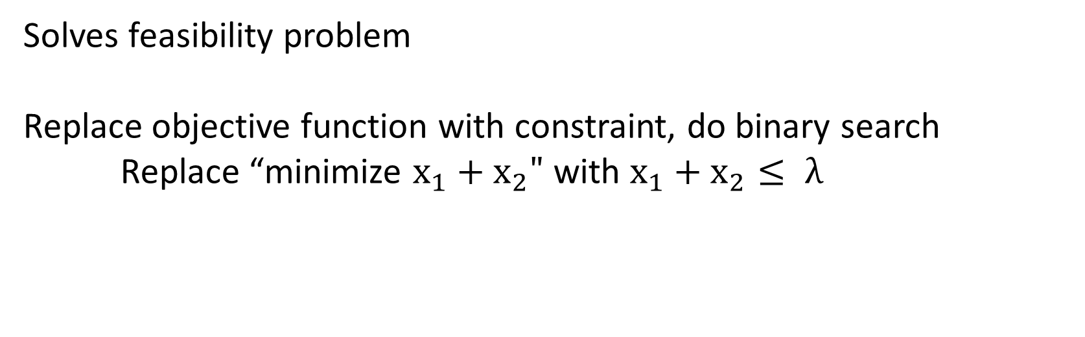
Ellipsoid Algorithm
Solves feasibility problem
Replace objective function with constraint, do binary search
Replace “minimize $x_{1}+x_{2}"$with $x_{1}+x_{2}≤ λ$
Can handle exponential
number of constraints if
there’s a separation oracle

Slide 17
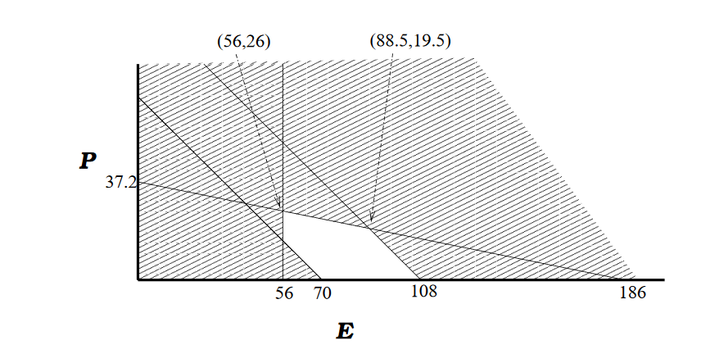
Simplex Algorithm
Start at vertex of the feasible region (polyhedron in high dimensions)
Look at cost of objective function at each neighbor
Move to neighbor of maximum cost
Always make progress, but could take exponential time (in high dimensions)

Slide 18
Simplex Algorithm
Get stuck in local maximum?
No, since feasible set is convex

Slide 19
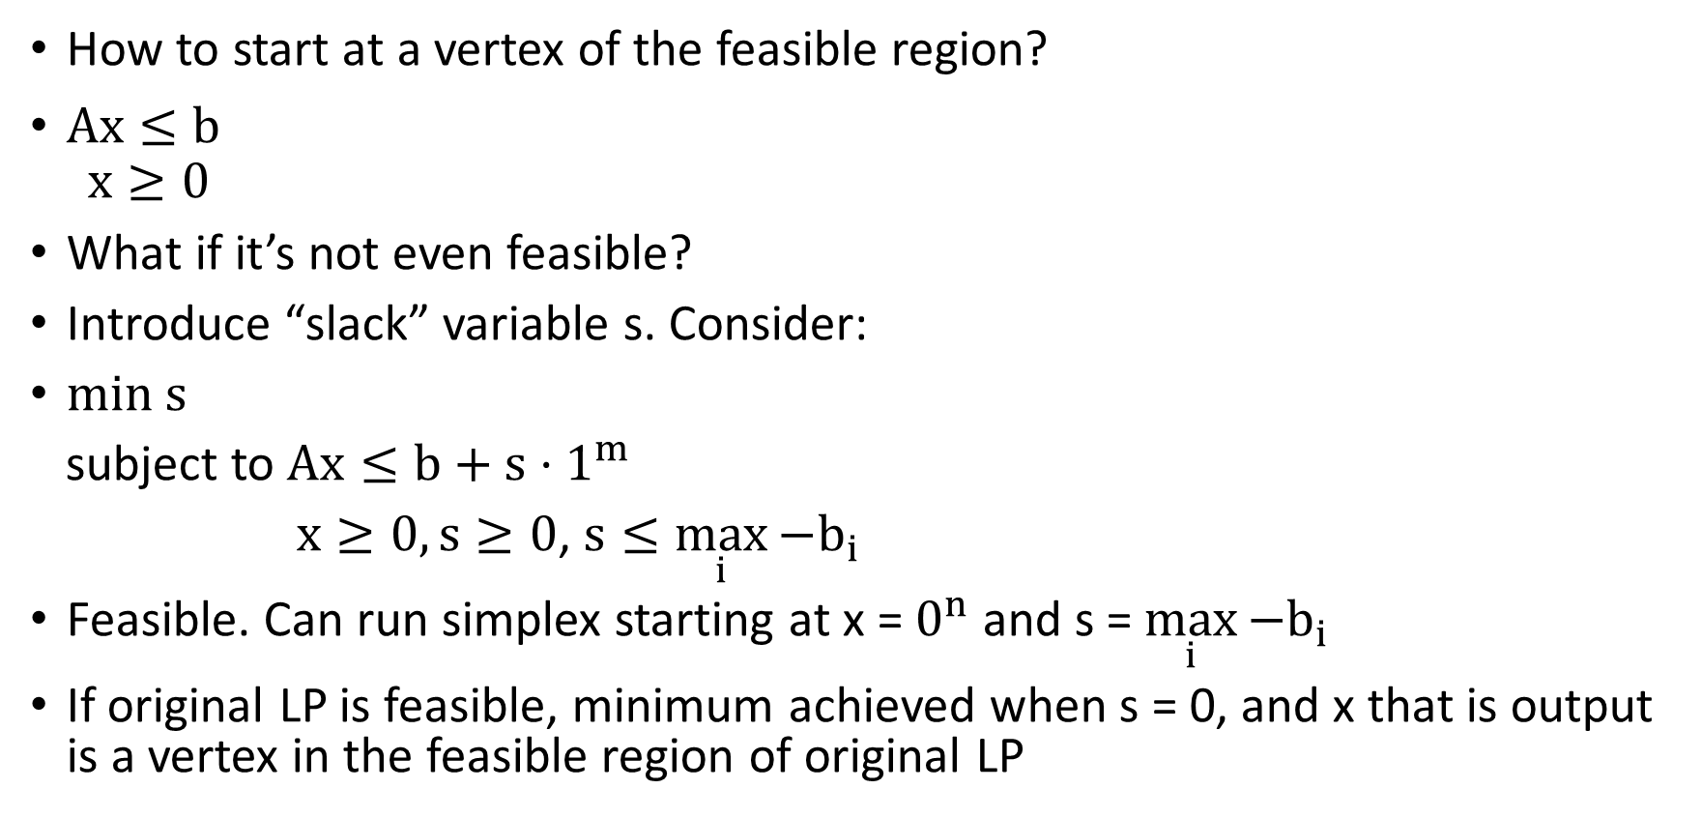
Other Annoyances I
How to start at a vertex of the feasible region?
$Ax≤b$
$$x≥0$$
What if it’s not even feasible?
Introduce “slack” variable s. Consider:
min s
subject to $Ax≤b+s⋅1^{m}$
$x≥0, s≥0$, $s≤\max_{i}{{−b}_{i}}$
Feasible. Can run simplex starting at x = $0^{n}$ and s = $\max_{i}{{−b}_{i}}$
If original LP is feasible, minimum achieved when s = 0, and x that is output is a vertex in the feasible region of original LP

Slide 20
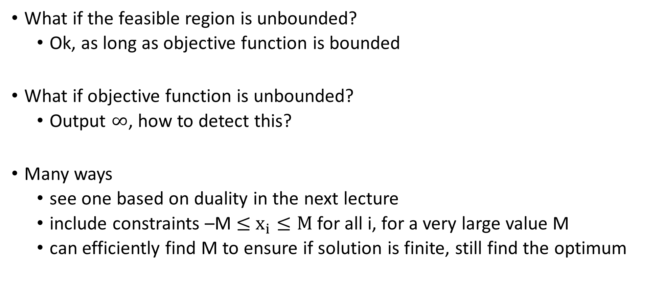
Other Annoyances II
What if the feasible region is unbounded?
  Ok, as long as objective function is bounded
What if objective function is unbounded?
  Output $∞$, how to detect this?
Many ways
  see one based on duality in the next lecture
  include constraints –M $≤$ $x_{i}≤M$ for all i, for a very large value M
  can efficiently find M to ensure if solution is finite, still find the optimum

