Slide 1
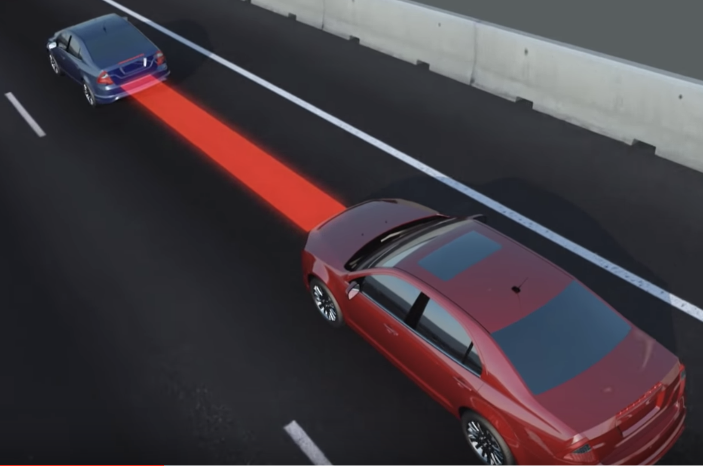
Course Project Presentation
Adaptive Cruise Control System
Zhaofeng Tian
gy8217@wayne.edu
Advisor: Gary Witus

Slide 2
Study Topic and Rationale
Adaptive Cruise Control System
Topic: Adaptive Cruise Control in Car-following Condition and Constant Speed Condition
Adaptive cruise control (ACC) is an available cruise control system for vehicles that automatically adjusts the vehicle speed to maintain a safe distance from vehicles ahead. As of 2019, it is also called by 20 unique names that describe that basic functionality. This is also known as Dynamic cruise control.
Control is based on sensor information from on-board sensors. Such systems may use a radar or laser sensor or a camera setup allowing the vehicle to brake when it detects the car is approaching another vehicle ahead, then accelerate when traffic allows it to.
ACC technology is widely regarded as a key component of future generations of intelligent cars.

Slide 3
Study Scope , ODD & Technical Objective
Study Scope:
This project focus on the implementation of Adaptive Cruise Control System (ACC ) in two common scenarios including 9 specific operating conditions while also the comparison between several algorithms by using simulation method.
1. Car-following scenario (Adaptive Cruise Control mode) including 5 conditions.
2. Car-following /Constant-speed Switching scenario(ACC /CC switching) including 4 conditions.
Leading car accelerates
Leading vehicle decelerates
Steady following
Leading vehicle departs, following another leading vehicle
Other vehicle cuts in the front
ACC Mode
ACC system
CC Mode
Encounter leading vehicle (CC to ACC)
Leading vehicle departs, no another leading vehicle. (ACC to CC)
Leading vehicle departs, encountering another leading vehicle (CC to ACC)
Leading Vehicle overspeed and move far away (ACC to CC)
ACC / CC Switching Logic

Slide 4
Study Scope , ODD & Technical Objective
ODD: Operational Design Domain
Highway driving, sunny day, focusing on ego line.
Technical Objective:
Design a simulation model which should contain the control logic and controlled plant to implement the following requirements for ACC system:
For Car-following (ACC) scenario, ego car will follow the leading car in the same lane adjusting the speed to keep an appropriate safety distance which could help vehicle avoid possible collision by employing throttle and brake signal. When using Variable Time Headway algorithm, it could adjust the distance to avoid other cars cutting in.
For Car-following / Constant-speed switching scenario (ACC to CC or CC to ACC), ego car could instantly evaluate the change occurred to driving condition and response to it depending on the preestablished control logic.

Slide 5



Study Technical Approach Details
Simulation Software Selection:
Carsim
Matlab
Simulink
Approach:
Soft Ware Combination: Using two combinations of software to implement aforementioned scenarios by simulations and compare the results.
Combination 1: Carsim + Matlab +Simulink
Combination 2: Matlab + Simulink
Build structure diagram of designed ACC system.
Leading Vehicle
State
Superstratum Control
ACC Logic
CC Logic
ACC/CC
Switching Logic
Substratum
Control
Ego Vehicle
State
3. Multiple algorithms
Two distance-keeping algorithms (ACC)
Constant Time Headway algorithm
Variable Time Headway algorithm
Two control algorithms (CC)
PID control algorithm
Fuzzy PID control algorithm

Slide 6
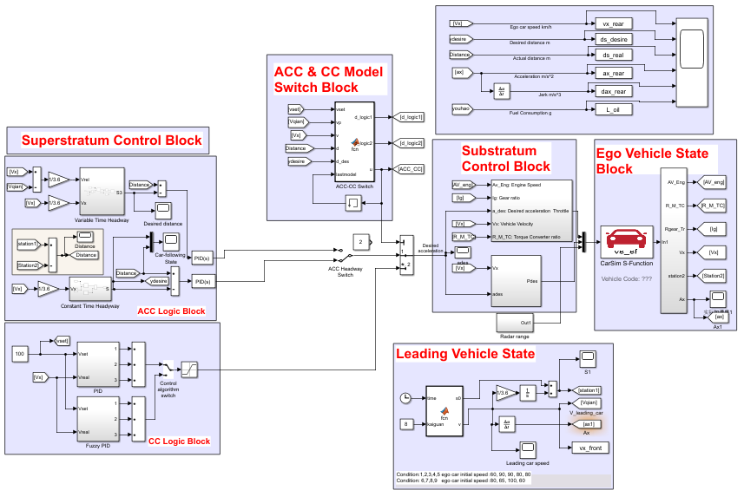
Simulation Model: ACC system
Simulink: Implement system structure and algorithms

Slide 7
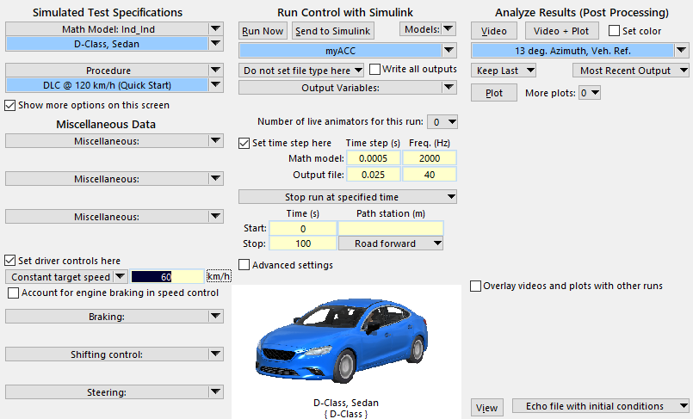
Simulation Model: Vehicle Modelling
Carsim: building vehicle model including Constant target speed, Mass Dynamic parameters and so on.

Slide 8
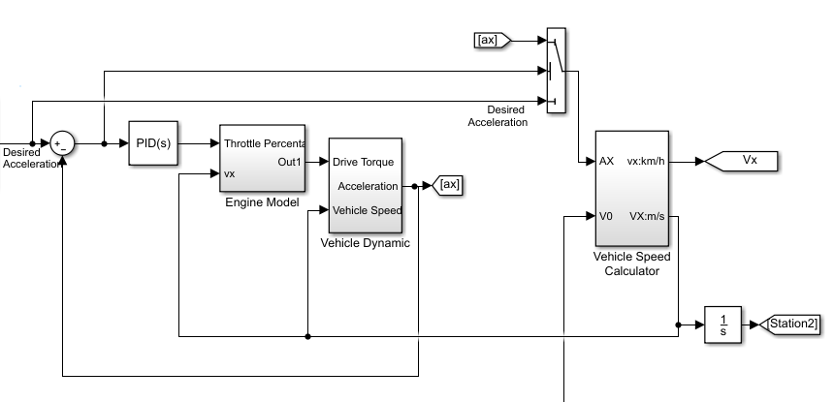
Simulation Model: Vehicle Modelling
Simulink: In the combination of Simulink and Matlab, the vehicle model could be built in Simulink as well.

Slide 9
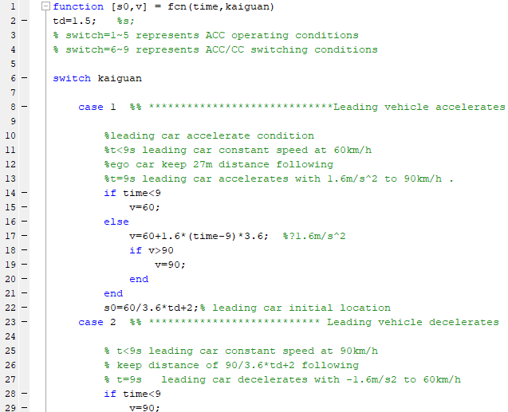
Simulation Model: Conditions & Parameters
Matlab: 9 specific operating condition and parameters codes in Matlab

Slide 10
Simulation Results
Software Combination & Control Algorithms | Carsim + Matlab + Simulink | Matlab + Simulink
PID Control Algorithm (CC) | Result 1 | Result 3
Fuzzy PID Control Algorithm (CC) | Result 2 | Result 4
Constant Time Headway (ACC) | Result 5 | Result 6
Variable Time Headway (ACC) | Result 7 | Result 8
Considering 9 specific operating conditions, this simulation study could product 8*9=72 sets of results and when taking CC operating conditions into account, it would product more results.

Slide 11
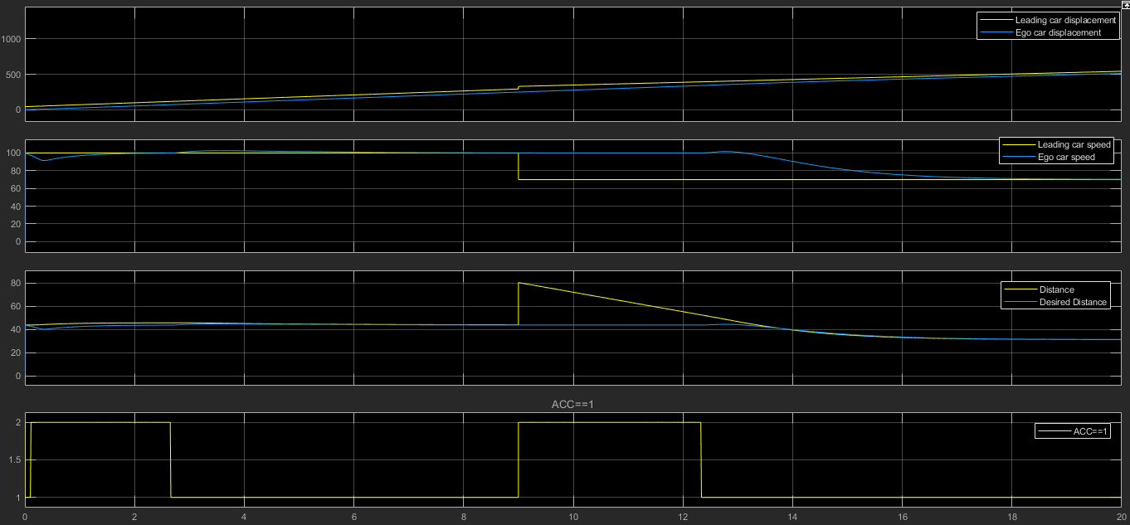
Simulation Results
Operating Condition 8 (Carsim combination, Constant Time Headway algorithm): Ego car firstly accelerates to preset speed 100 km/h at CC mode. Then switches to ACC mode to following a leading car.
9 seconds,The former leading car departs , then trace another leading car 80m ahead at 70km/h, so that the distance could increase here. Because the distance 80m is beyond the preset ACC distance, ego car still CC at preset 100 km/h. When distance decreases to the preset distance, ego car starts ACC , following the leading car decreasing speed itself to 70.

Slide 12
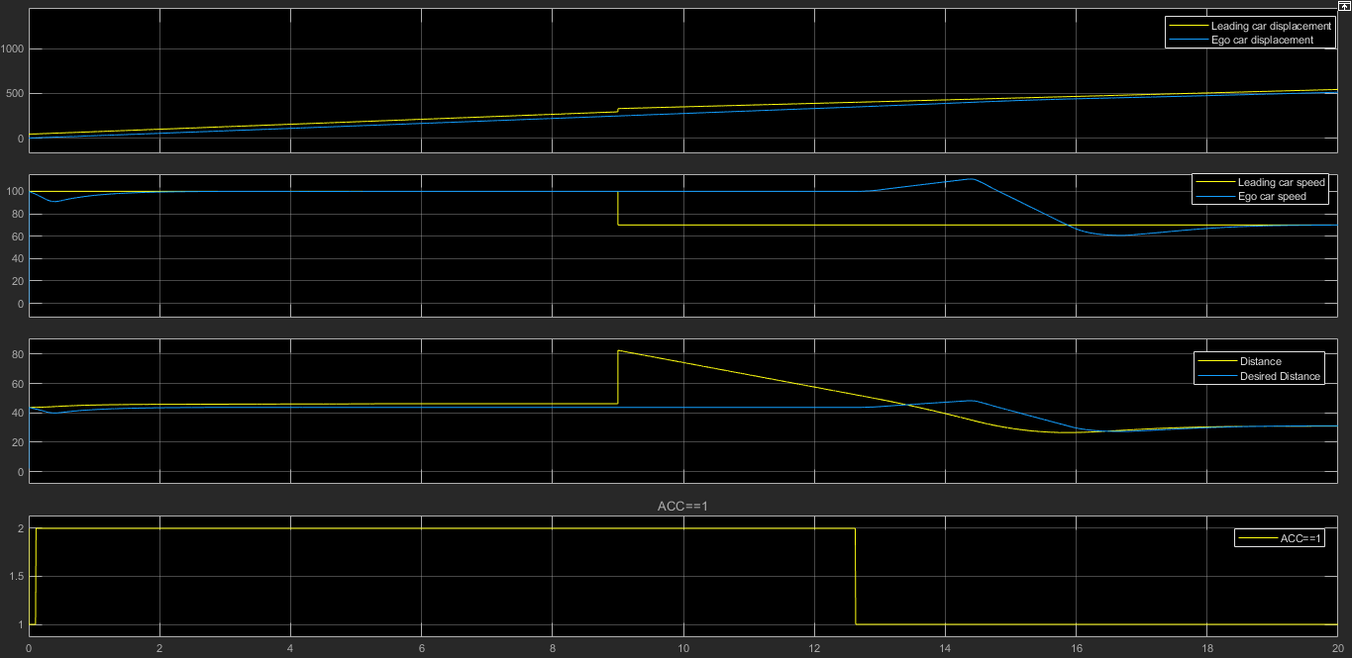
Simulation Results
Switch to Variable Time Headway algorithm, ego car could adjust the desired distance to the leading car corresponding to the speed difference between two cars.
When speed difference increases, desired distance increase. Then correspondingly, ego car will decrease speed itself. When speed is getting lower, desired distance is getting lower too, which is beneficial to avoiding other cars cutting in.

Slide 13
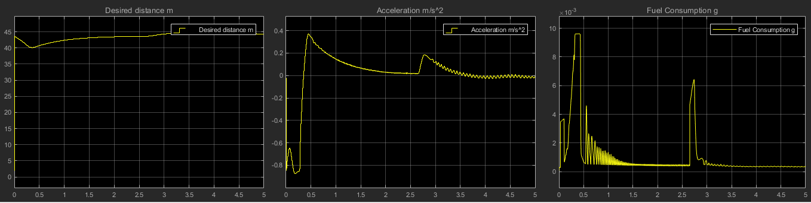
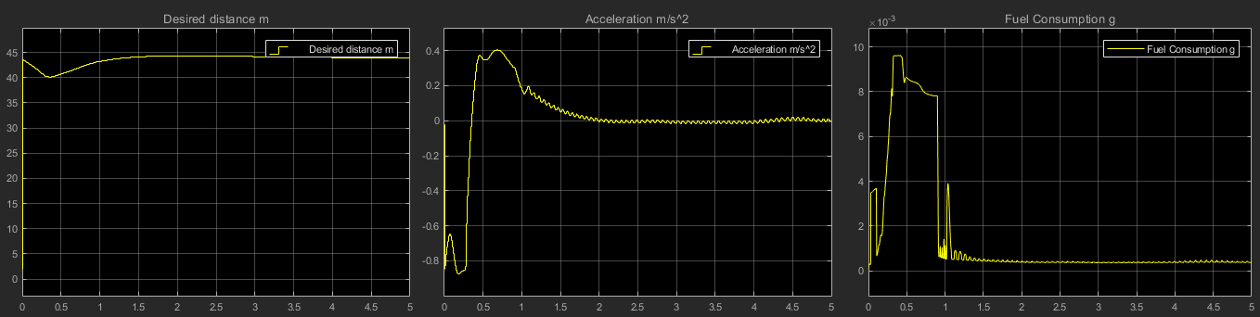
Simulation Results
Comparison between PID control and Fuzzy PID control algorithm in CC mode (first 5s in the condition 8 and using Carsim combination and Constant Time Headway algorithm in ACC mode )
PID: Perturbation occurs in acceleration and fuel consumption waveform
Fuzzy PID: Little perturbation, system is more stable than PID, providing more comfort for drivers

Slide 14
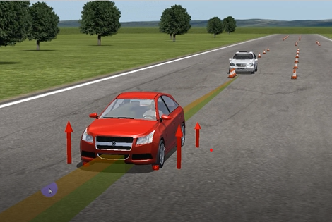
Simulation Results
Visualization in Carsim

Slide 15
Conclusion
Demonstration of Achievement
This study successfully implement the aforementioned technical objectives about ACC system as the results part shows. Ego car could accelerate to a target constant speed and cruise at the speed both in PID and Fuzzy PID control algorithms. Meanwhile, ego car could implement adaptive cruise control following a leading car both in two different headway algorithms. In addition, ACC/CC switching logic works efficiently to meet the driving and safety requirements.
Engineering Gap This Study Filled
Gap in my engineering education:
This study Improved my operating skills of software and deep perception of fundamental technology theories
Gap in the world of engineering:
This study deployed two software combination and several algorithms to implement ACC system and product large number of results which could provide plenty resource for engineers to complete further research and analysis based on the simulation results and several sets of comparison.

Slide 16
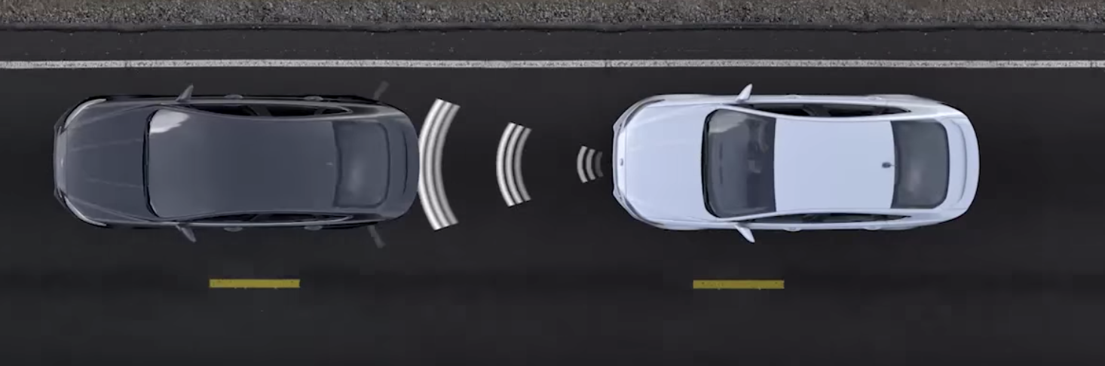
Further Goal
Further Goal
There are plenty of research fields and industry domains engaged in autonomous vehicle, which means the knowledge of autonomous vehicle could be very comprehensive and interdependent. For example, in the Adaptive Cruise Control, problems will not be addressed solely by control strategies but also by sensors like Lidar and camera. So, there is high possibility that I will learn more knowledge about sensor fusion and digital technology of the on-board system.
Questions and suggestions are welcome!
Thank you all!

