Slide 1
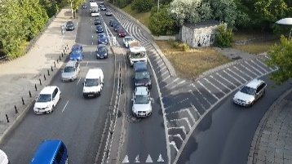
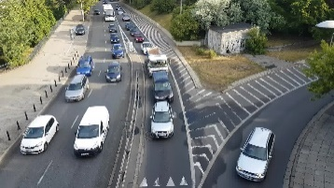
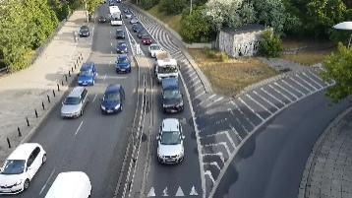

AutoConfigure:
DQN Based Auto
Configuration Agent
Spatial and temporal features
Reward Feedback
1080p
…
(e.g., 320p,640p,960p,1024p)
Origin
Video
(ffmpeg)
Frame Rate
Selection
(Resize) Resolution
Selection
（Model Zoo）
Object Detection
Model Selection
Inference
Results
(e.g., 1,5,10,…,30 fps）
(e.g., SSD+ResNet152V1, FasterRCNN+ ResNet50V1, FasterRCNN+ InceptionResNetV2)

