Slide 1
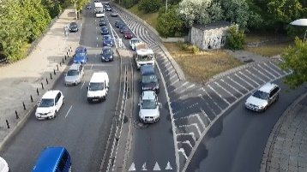
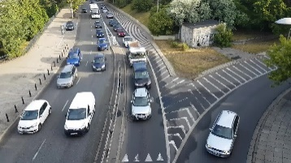
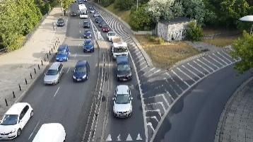

AutoConfigure:
DQN Based Auto
Configuration Agent
Origin
Video
1080p
Configurations:
FPS
Resolution
Model
partition video
…
(e.g., 640p)
(ffmpeg)
Frame Selection
(Resizing) Resolution
Selection
（Object Detection）
Model Selection
Inference
Results
Video Chunks
(e.g., 15 fps）
(e.g., FasterRCNN+ResNet50V1)

