Slide 1





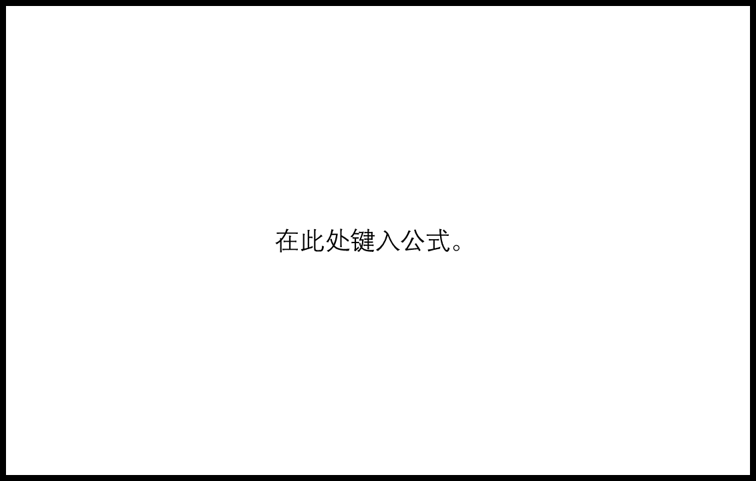




Reward
RL framework
Inference
Past configurations
Configuration 1
$$c_{1}$$
$$c_{2}$$
$$c_{3}$$
Configuration 2
Spatial features
State
.
.
.
$$e_{1}$$
$$e_{2}$$
$$e_{3}$$
Configuration 48
Temporal features
RL Agent
$$e_{2}−e_{1}$$
$$e_{3}−e_{1}$$
train
write
Memory buffer
Training controller
read

