Slide 1
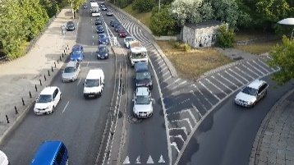
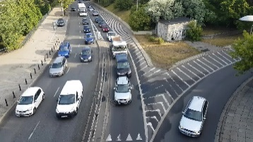
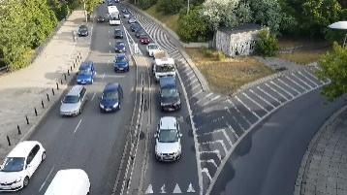

AutoConfigure:
DQN Based Auto
Configuration Agent
Origin
Video
1080p
Configurations:
FPS
Resolution
Model
partition video
(e.g., 640p)
…
Video Chunks
(ffmpeg)
Frame Selection
(Resizing) Resolution
Selection
（Object Detection）
Model Selection
Inference
Results
(e.g., 15 fps）
(e.g., FasterRCNN+ResNet50V1)

Slide 2
Fixed Configuration
1080p
Configurations:
FPS
Resolution
Model
(e.g., 1080p)
…
Origin
Video
Object Detection
Model
Inference
Results
Frame Rate
Resolution
(e.g., 30 fps）
(e.g., FasterRCNN+ InceptionResNetV2)

Slide 3
Fixed Configuration
1080p
Configurations:
FPS
Resolution
Model
(fixed 1024p)
…
Origin
Video
Object Detection
Model
Inference
Results
Frame Rate
Resolution
(fixed 30 fps）
(fixed FasterRCNN+ InceptionResNetV2)

Slide 4
AutoConfigure:
DQN Based Auto
Configuration Agent
Spatial and temporal features
Reward Feedback
1080p
…
(e.g., 640p,1024p)
Origin
Video
(ffmpeg)
Frame Rate
Selection
(Resize) Resolution
Selection
（Model Zoo）
Object Detection
Model Selection
Inference
Results
(e.g., 1,5,10,…,30 fps）
(e.g., SSD+ResNet152V1, FasterRCNN+ ResNet50V1, FasterRCNN+ InceptionResNetV2)

Slide 6
AutoConfigure:
DQN Based Auto
Configuration Agent
Origin
Video
……
Video chunk 1
Video chunk 2
Video chunk 3
Video chunk n
partition video

Slide 7
AutoConfigure:
DQN Based Auto
Configuration Agent
Origin
Video
……
Video chunk 1
Video chunk 2
Video chunk 3
Video chunk n
partition video

