Slide 1
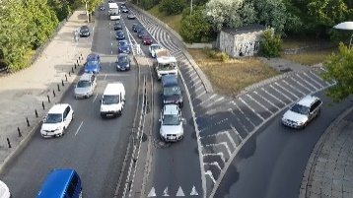
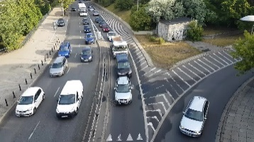
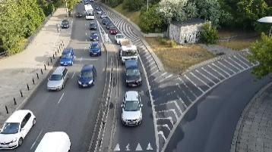

Fixed Configuration
1080p
Configurations:
FPS
Resolution
Model
(fixed 1024p)
…
Origin
Video
Object Detection
Model
Inference
Results
Frame Rate
Resolution
(fixed 30 fps）
(fixed FasterRCNN+ InceptionResNetV2)

