Slide 1
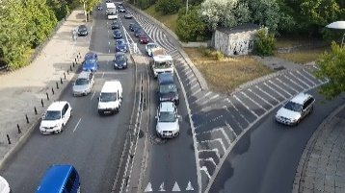
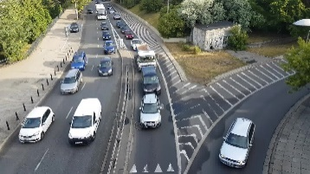
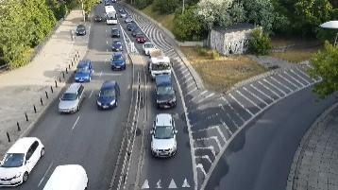

Spatial and temporal features
AdaConfigure:
DQN Based Adaptive
Configuration Agent
Reward Feedback
Configurations:
FPS
Resolution
Model
(e.g., 320p,640p,960p,1024p)
…
Origin
Video
(Resize)
Resolution
Selection
（Model Zoo）
Object Detection
Model Selection
Inference
Results
(ffmpeg)
Frame Rate
Selection
(e.g., SSD+ResNet152V1, FasterRCNN+ ResNet50V1, FasterRCNN+ InceptionResNetV2)
(e.g., 1,5,10,…,30 fps）

