Slide 1
Security Cloud File Storage System

Slide 2
Team member:
zhaonan li
    implement functions for encrytion and decryption of original file
chen zhao
    check timestamp and functions preventing replay attack.
zinan liu
    data modification detection and HMAC related funtions

Slide 3

data processing application
User stores on and later retrieve files from a cloud server

Slide 4
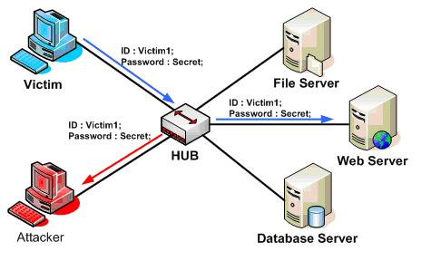
security issues
Data eavesdropping
Files may include information that people don't want to share with other people (e.g. final exam paper).
We can not guarantee every node between user host and server is secure.

Slide 5
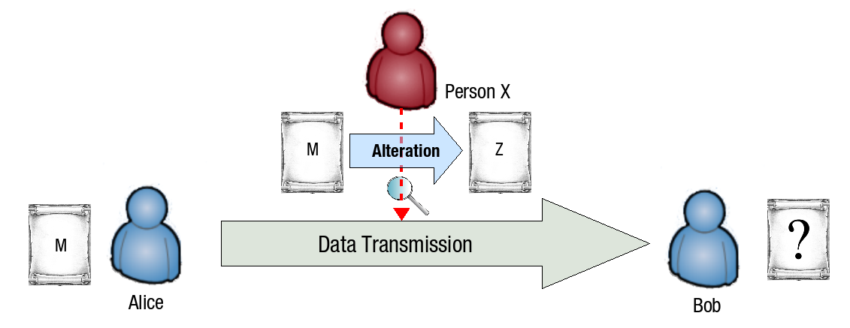
security issues
Data modification
For example, user stores a program source code on server, and attacker inject some malicious code in it, which may cause serious problems.

Slide 6
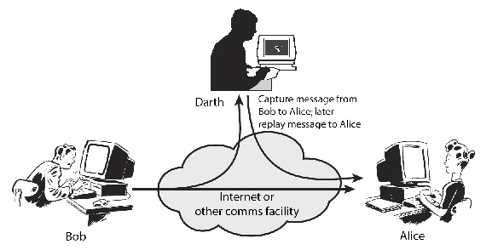
security issues
Data replay
Messages between user and server may be sniffed by attacker. Attacker may retransmit the message later without being detected since the message is valid data.

Slide 7
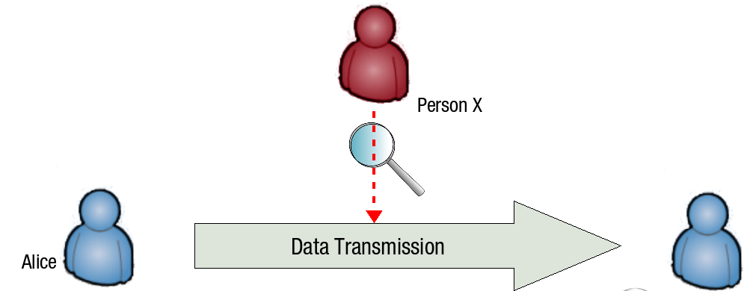
Solutions
Data eavesdropping
In order to prevent information disclosure, we encrypt the file before sending it over the internet.
User keep the key so that only himself can read the data.
There are several encryption schemes to choose. Consider both efficiency and security, we apply AES CBC mode here for message encryption.

Slide 8
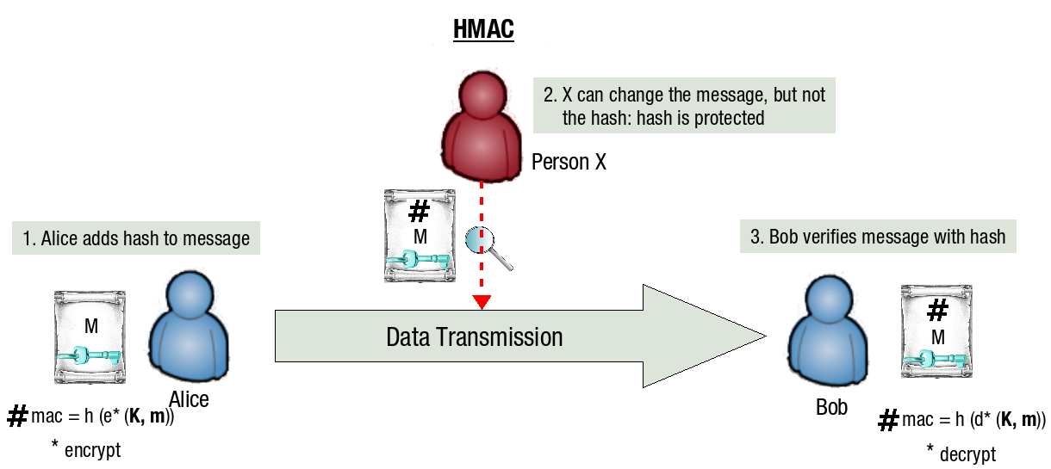
Solutions
Data modification
Here we use Hash-based message authentication code(HMAC) to verify data integrity.
User keep the key, so if an attacker intercepts and modifies data, creates a hash, there is no way it will come out correctly.
We choose HMAC-SHA256 to create HMAC.

Slide 9
Solutions
Data replay
Use timestamp to prevent replay attack.
For each packet the user received, we will check the timestamp and compare it with local time. if the difference window between these two values is enough small, user can accept it, otherwise drop it.

Slide 10
Implement
Upload:
step 1:Client uses AES-CBC encrypting the file.
step 2:Client calculate the HMAC of the encrypted file.
step 3:Client upload file attached with HMAC to cloud server.

Slide 11
Implement
Download:
step 1:Client check timestamp to decide if accept this packet.
step 2:Client check HMAC to detect alterations in data.
step 3:Client decrypt the data and get the original file.

Slide 12
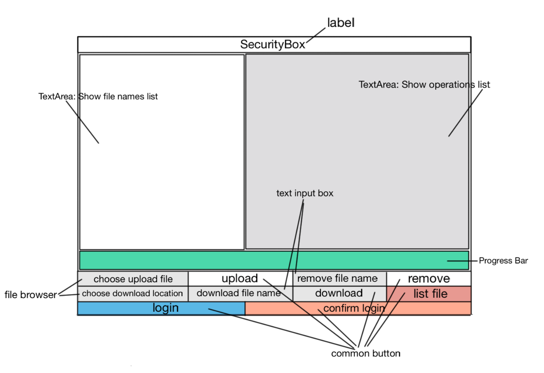

Slide 13
Demonstration

