Slide 1
1. Preliminary Result

Slide 2
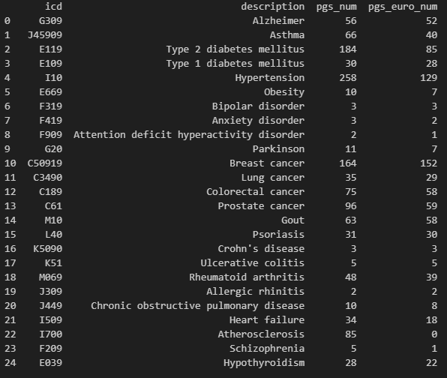
Trait & PGS selection
On my local PC:
Manually select 25 traits (identified by ICD10CM IDs).
For each trait, search by PGS catalog API, retrieve all PGS IDs.
For each PGS ID, search by PGS catalog API, filter by European ancestry, and get the corresponding URL with hmPOS_GRCh38. (838 PGS)

Slide 3
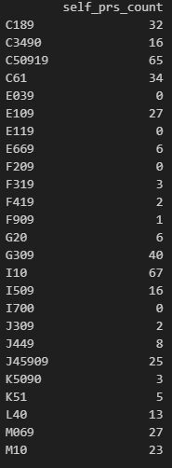
PGS evaluation
On All of Us workbench (Google Cloud Platform, GCP):
Download, unzip, and prepare .score file for all PGS. (431 PGS)
Push .score file to Google Cloud Bucket.
Compute PGS score with multi-thread PLINK2 (16 thread, 3h 20min) (421 PGS)
Prepare a binary outcome for the 25 traits, push to cloud.
Compute AUC trait by trait (1 thread, 5 min)
Directly compute if in rsid. Dropped if in chromosome number & loc.
Dropped if none of the rsid in PGS is provided in All of Us srWGS.

Slide 4
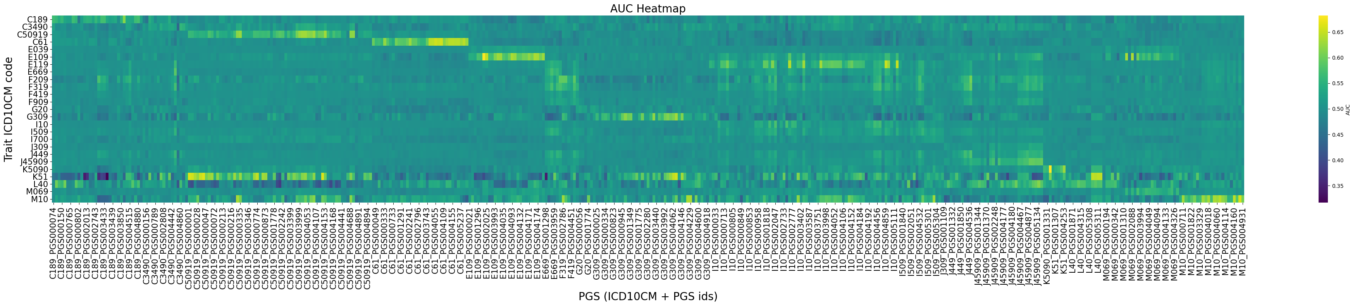
Results

Slide 5
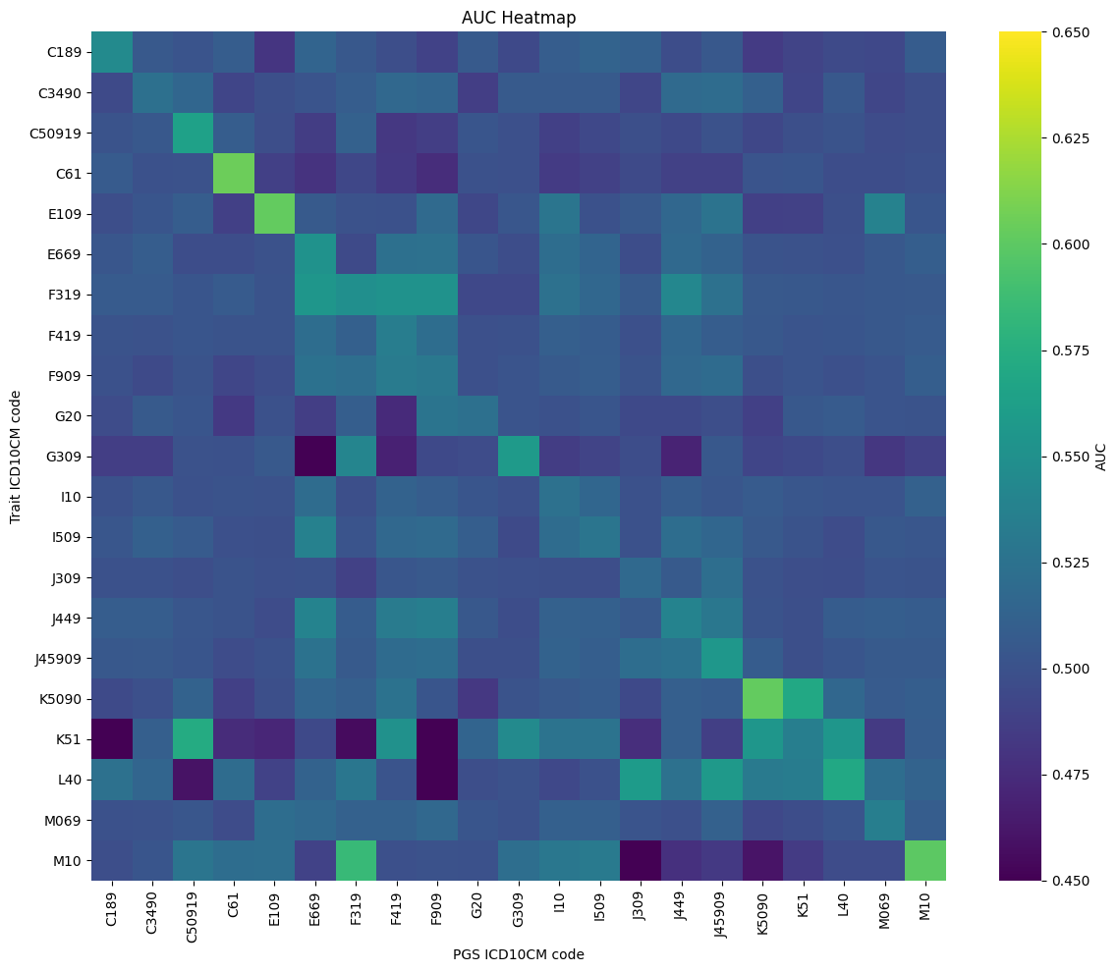
Avg PRS Performance

Slide 6
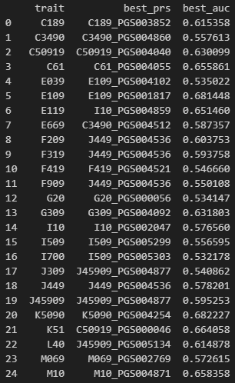
Best performing PRS for each trait and corresponding AUC

Slide 7
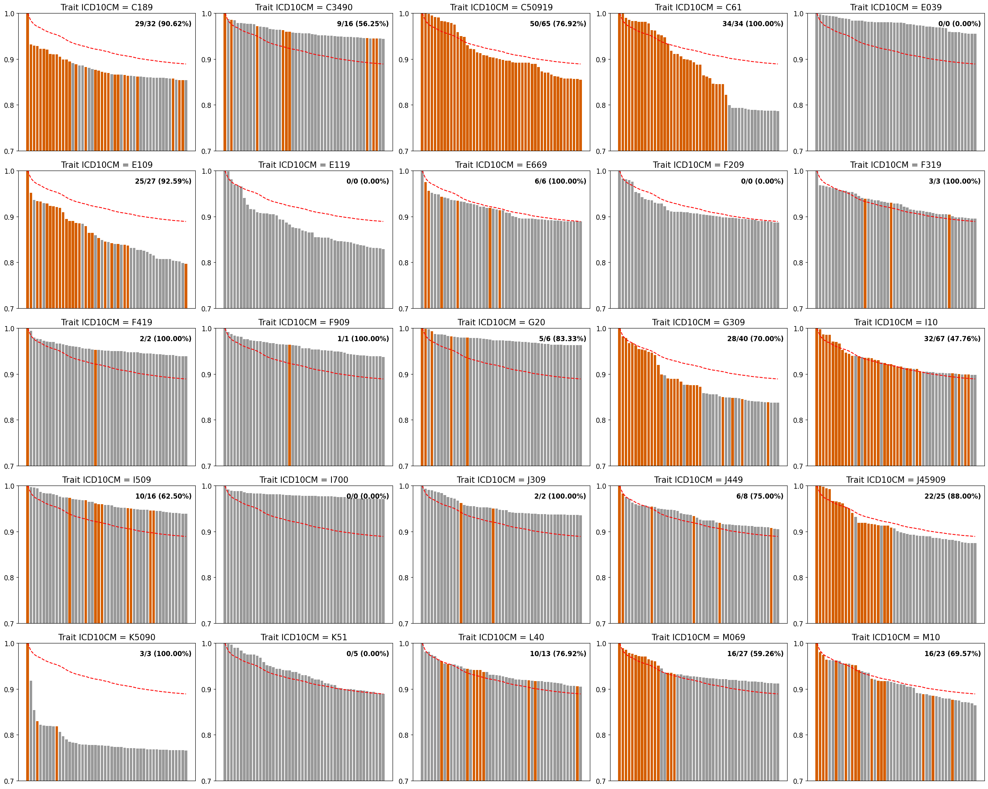
Top 50 PRS Performance for each trait
(Normalized to the best performing PRS)
And the percentage of self-PRS contained
Crohn's disease

Slide 8
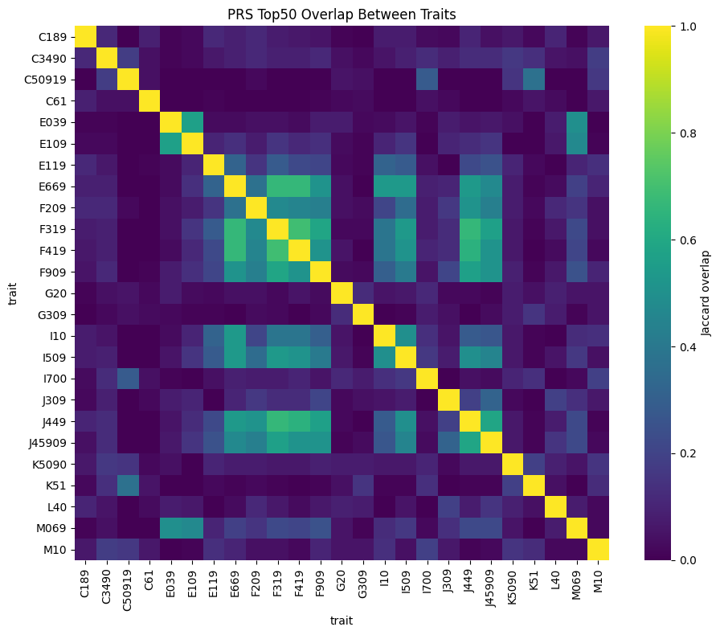
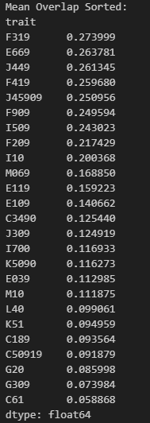
Top 50 PRS set overlap between traits
(Jaccard Index)
Bipolar disorder
Obesity
Endocrine, nutritional, and metabolic diseases
Circulatory system diseases
Respiratory system diseases
Cancer

Slide 9
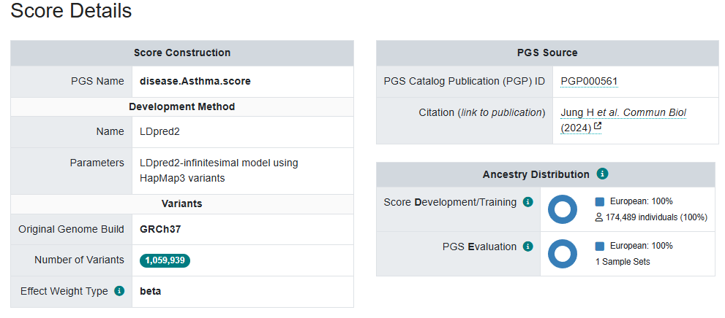
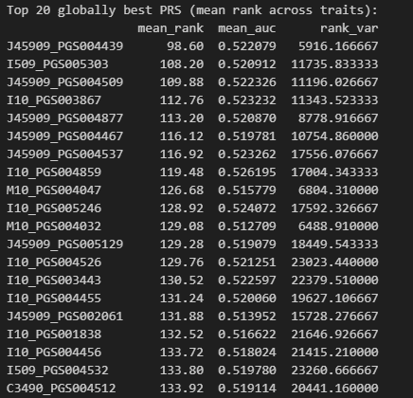
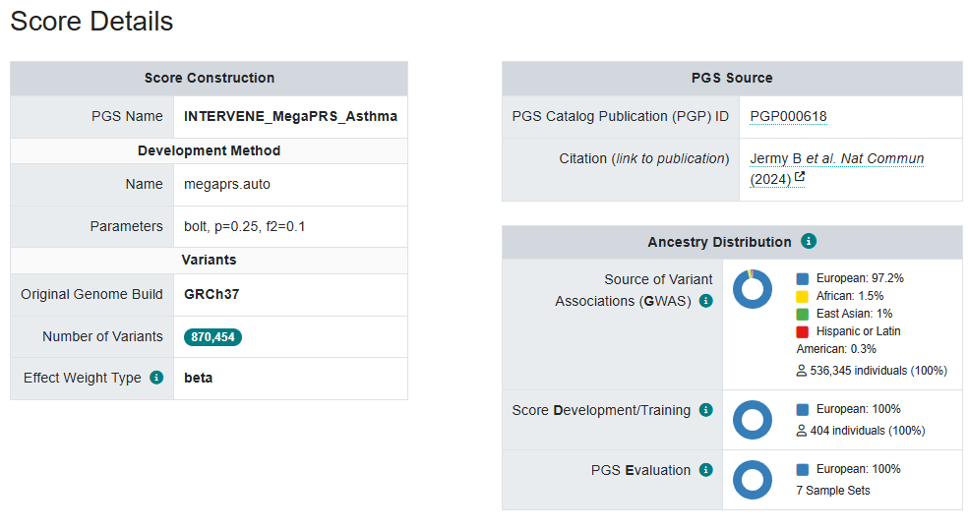
PRS ranking
PGS004439
Asthma
Hypertension
Gout
PGS004877

Slide 10
2. AoU European Result

Slide 11
Trait & PGS selection (disease, binary)
PGS traits selection:
Filter all traits within the list of categories (ontology identifier, #traits = 260): ["Cancer", "Cardiovascular disease", "Digestive system disorder", "Immune system disorder", "Metabolic disorder", "Neurological disorder", "Other disease“]
Map ontology with ICD10CM IDs by terms, manually check, and drop vague traits (#traits = 229, #ICD10CM Root = 140, #ICD10CM Children = 180).
For each trait, search by the PGS catalog API, and retrieve all PGS IDs.
For each PGS ID, search by PGS catalog API and get the corresponding URL with hmPOS_GRCh38 (#PGS = 1839).
European sample size: 151,123
Traits: #ICD10CM Root = 140, #ICD10CM Children = 180
PGS: #PGS IDs = 1839

Slide 12
Trait & PGS selection (measurement, continuous)
PGS traits selection:
Filter all traits within the list of categories (ontology identifier, #traits = 66): ["Body measurement", "Cardiovascular measurement", "Hematological measurement", "Inflammatory measurement", "Lipid or lipoprotein measurement"]
Map ontology with LOINC IDs by terms, manually check, and drop vague traits (#traits = 42, #LOINC = 42).
For each trait, search by the PGS catalog API, and retrieve all PGS IDs.
For each PGS ID, search by PGS catalog API and get the corresponding URL with hmPOS_GRCh38 (#PGS = 1155).
European sample size: 151,123
Traits: #LOINC = 42
PGS: #PGS IDs = 1155

Slide 13
Trait & PGS selection (preprocess)
PCA Computation (Instead of using loading data):
To compute PCs, we pruned autosomal variants with MAF >1% across the pooled dataset, using an 𝑟2 threshold of 0.1, a window size of 500kb with PLINK2 (--indep-pairwise). The first 10 PCs were then computed separately within each genetic ancestry group and within the pooled dataset using PLINK2 (--pca-approx).
Dias, J. A (2025). Evaluating multi-ancestry genome-wide association methods: Statistical power, population structure, and practical implications. The American Journal of Human Genetics, 112(10), 2493-2508.
AoU Trait Preprocess:
Binary traits are organized in ICD10CM Children code. Continuous traits are organized in Loinc code.
Cutoff by case number bigger than 10 (# of available ICD10CM = 16056, # of available Loinc = 2731)
Root code case is retrieved by combining all children’s code (e.g., I10.1 + I10.3 + … = I10)

Slide 14
Trait & PGS selection (preprocess)
AoU srWGS preprocess:
The All of Us WGS ACAF dataset is too large to be easily used in PGS calculations. To overcome this, we will first extract a subset of variants using a custom list containing the most relevant genomic positions for PGS calculation (pgsc_all+hm3_variants_hg38_[DATE].txt.gz, available from the resources folder on our FTP). This file comprises merged data representing ~17.9 million genomic positions extracted from ~5,000 PGS Catalog scoring files and the HapMap3+ dataset.
PGS score computation:
PGS Catalog Calculator. 12 batch with each batch ~200 PGS (~13h) (2135 PGS -- > 1846 PGS)
Performance matrix score computation (adjust for sex, age, and top 10 PCs):
Binary Traits: Adjusted AUC: The “roc.binary” function within the R package RISCA. 200 batch with each batch 5 PGS (~1h); Conditional OR;
Continuous Traits: Adjusted Beta; Incremental R2
Post quality control: Number of cases > 200.

Slide 15
Trait & PGS selection (summary)
Binary Traits (Identified by ICD10CM):
# Traits = 124, #PGS = 3087, Performance Metrics: Conditional OR; Adjusted AUC
Continuous Traits (Identified by LOINC):
# Traits = 36, #PGS = 3087, Performance Metrics: Adjusted Beta; Incremental R2

Slide 16
2.1 Binary Traits

Slide 17
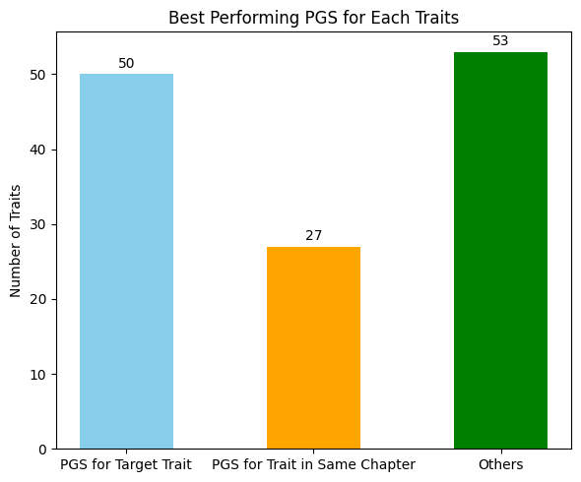
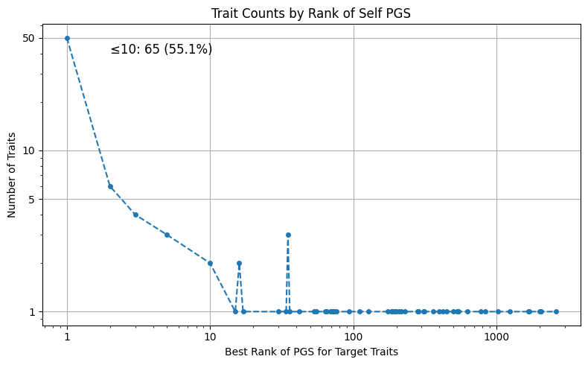
Most traits’ best performing PGS is their target PGS or trained for traits within the same chapter (59.2%)
Most traits’ best performing target PGS appears with in top10 performing PGS (55.1%)
D64 I49 M47 R94

Slide 18
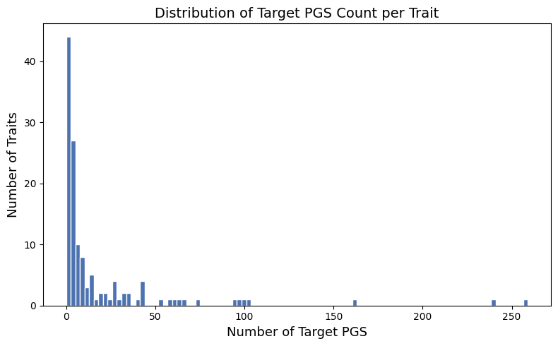
Target PGS Distribution Per Trait
I25
I10

Slide 19
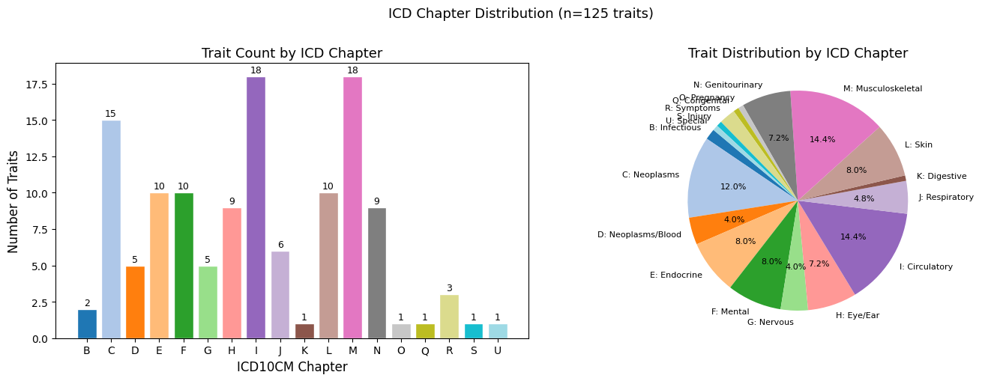
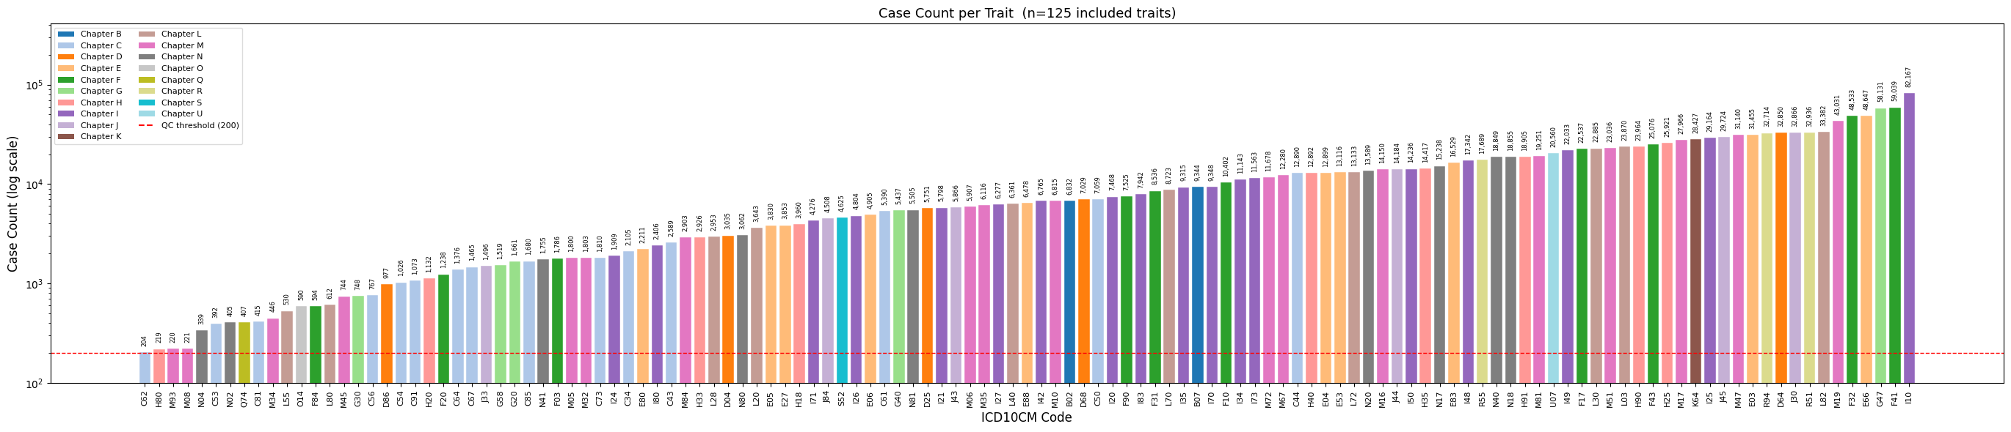
Trait case count distribution

Slide 20
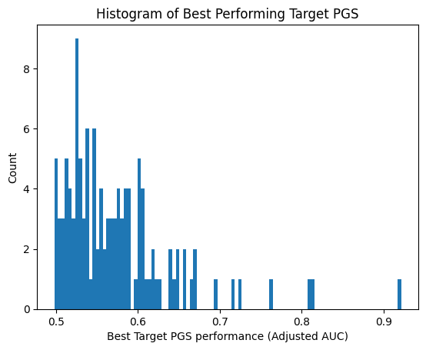
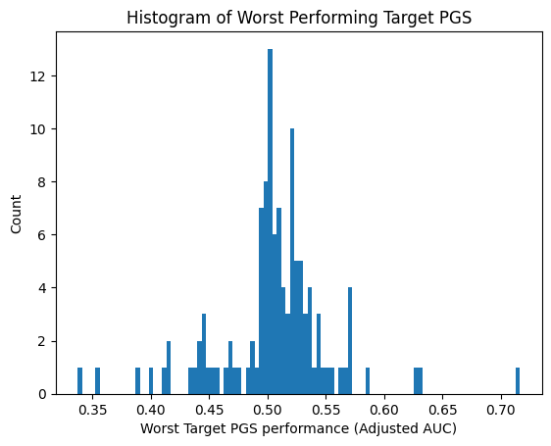
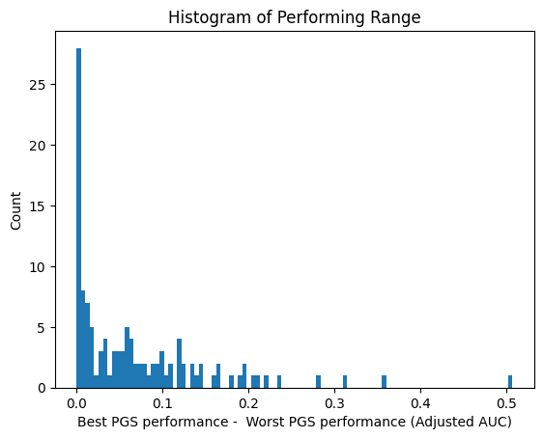
Restrict available PGS to Target PGS (Adjusted AUC)
C62
C62

Slide 21
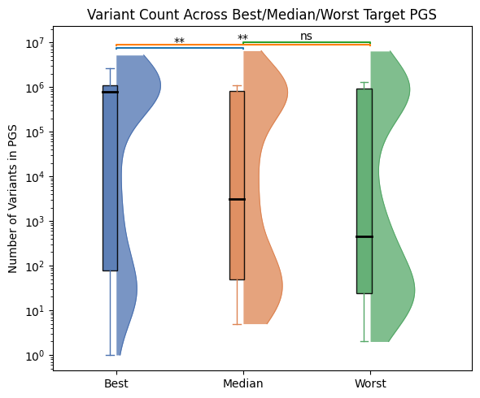
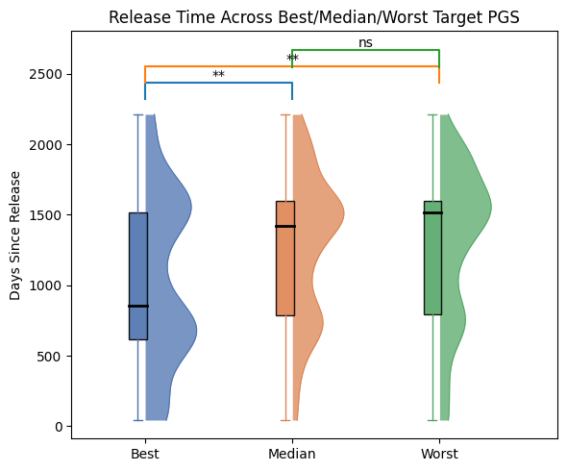
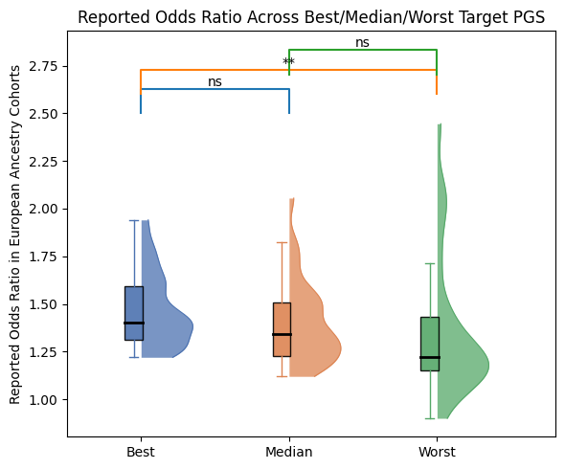
Best / Median / Worst in PGS rank is correlated with PGS meta information.
The best PGS have significantly more variants
The best PGS are released more recently
The best PGS have higher reported Odds Ratio performance (controlled to European evaluation cohorts)

Slide 22
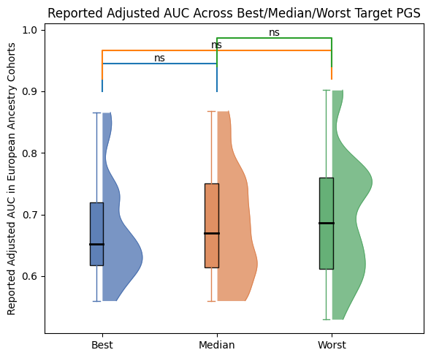
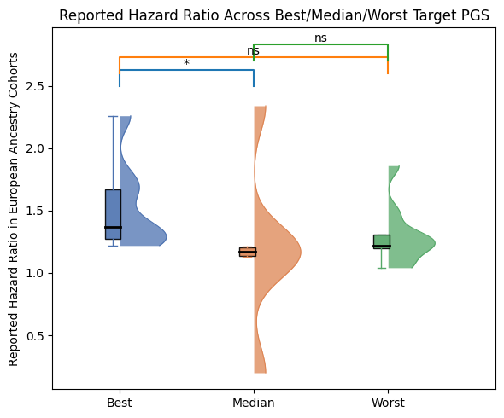
Other performance matrices do not show significant correlation.

Slide 23
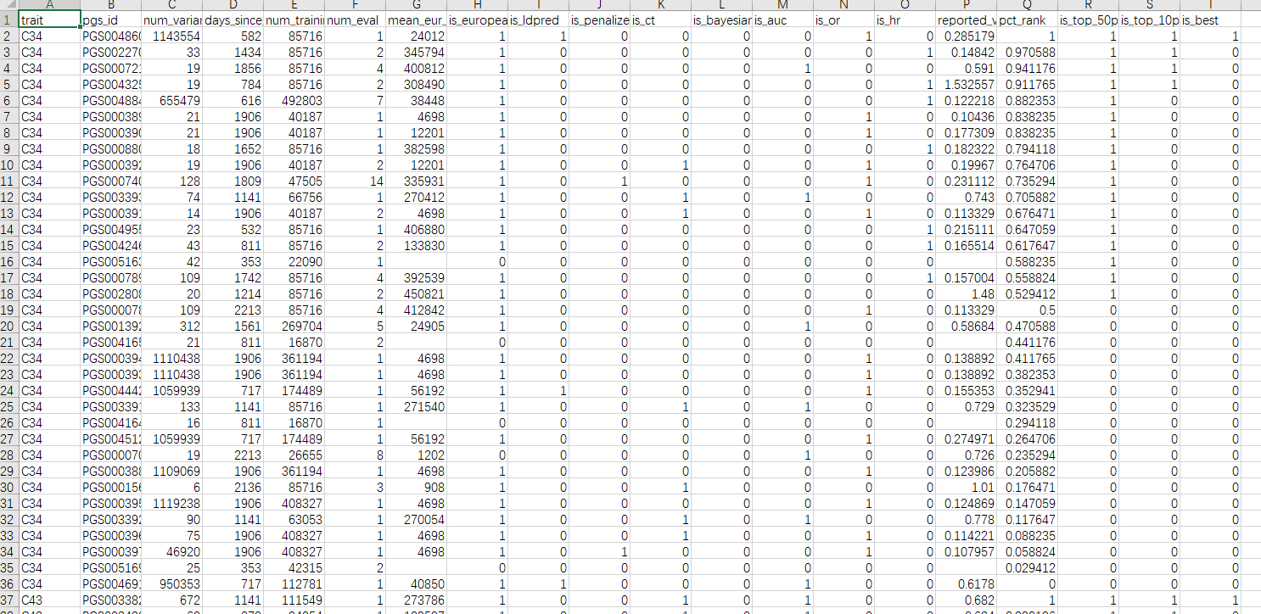
Regression / Classification model treating metadata as predictors.
Predictors
Continuous Regression
Binary classification

Slide 24
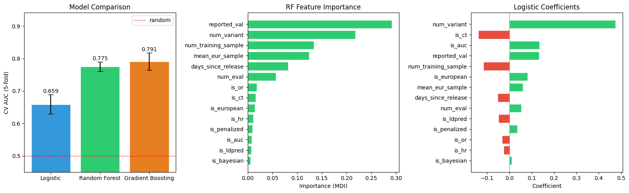
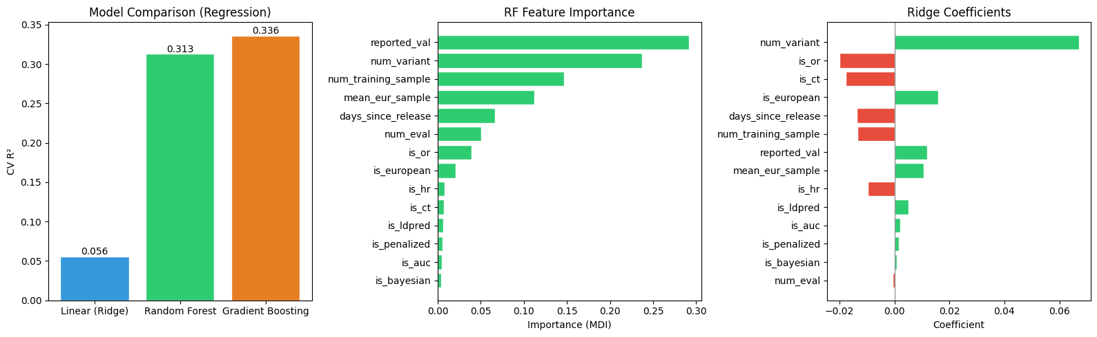
Classification model performance (select top 50% target PGS, cv=5).
Regression model performance.

Slide 25
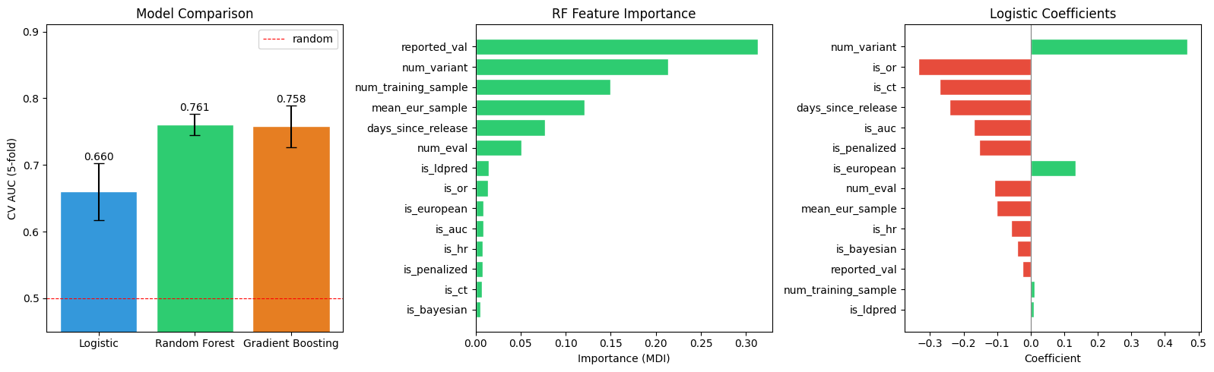
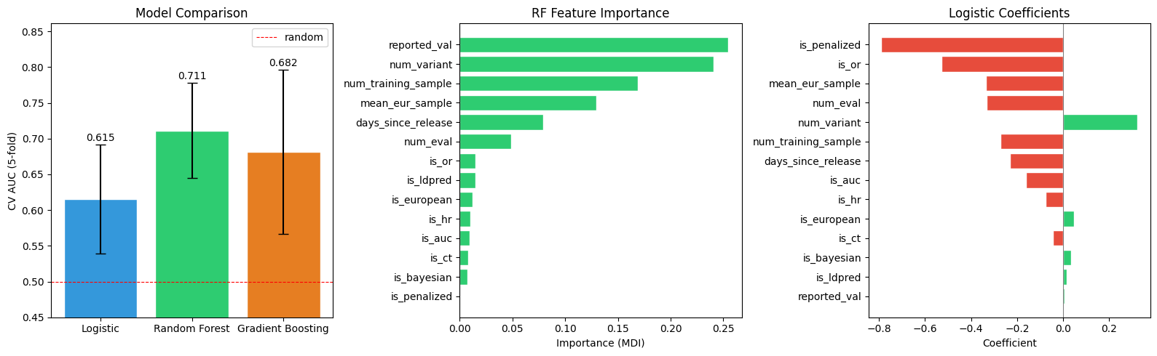
Classification model performance (select top 10% target PGS).
Overall Recall@Best : 0.1944 ± 0.4014 Overall Precision@Best: 0.1707 ± 0.3809 Mean overlap count : 0.17 / 0.88
Overall Recall@10% : 0.2210 ± 0.3204
Overall Precision@10% : 0.2163 ± 0.3208
Mean overlap count : 0.83 / 4.34
Overall Recall@50% : 0.6833 ± 0.1508
Overall Precision@50% : 0.6725 ± 0.1540 Mean overlap count : 15.02 / 22.63
Classification model performance (select the best target PGS).

Slide 26
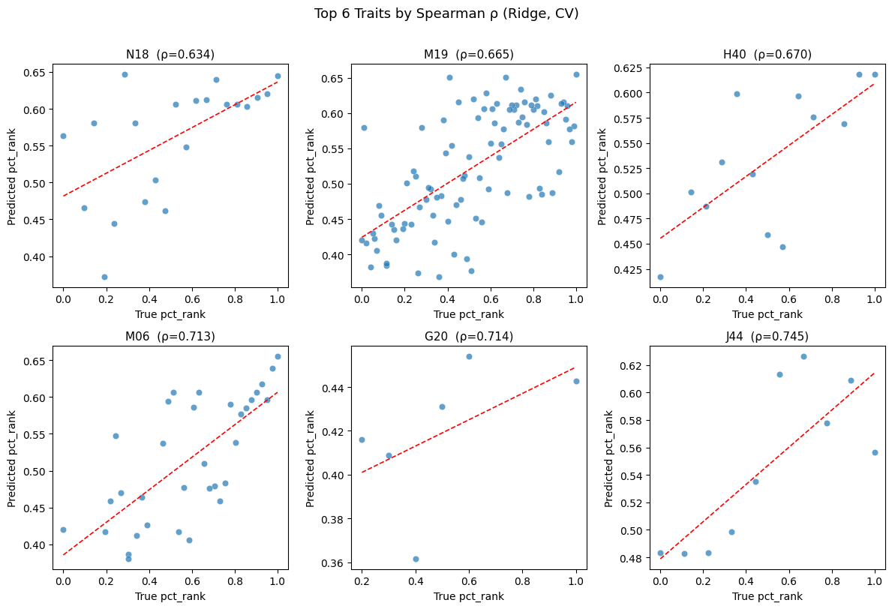
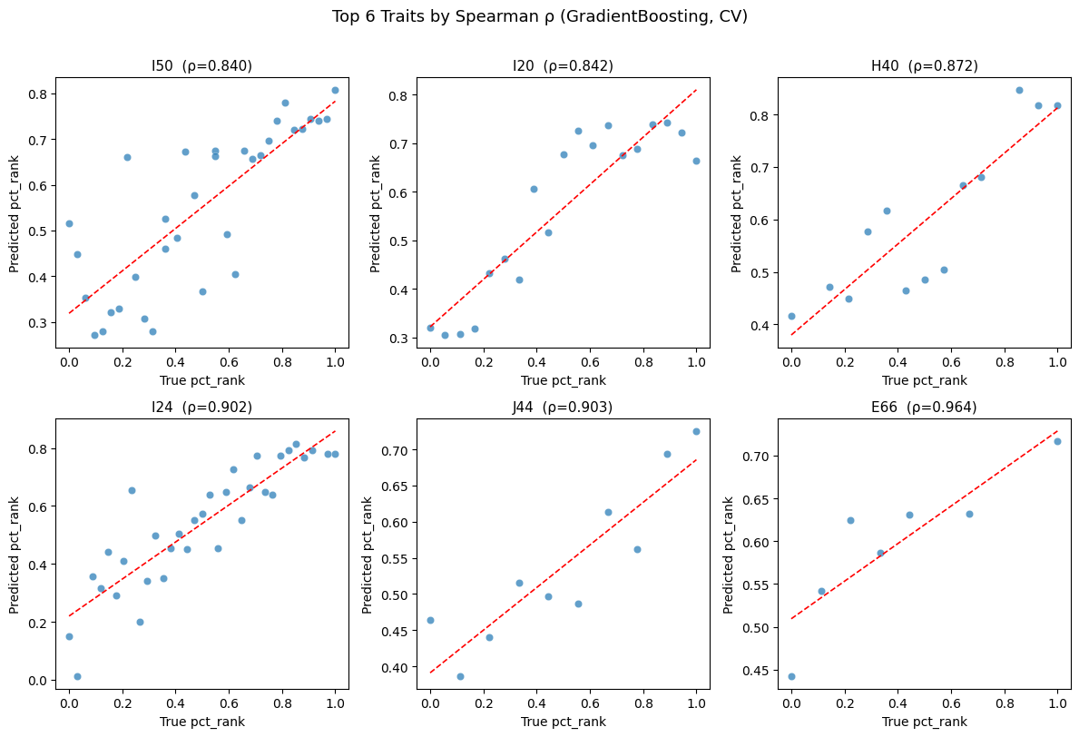
Regression model performance (pred Vs true label)

Slide 27
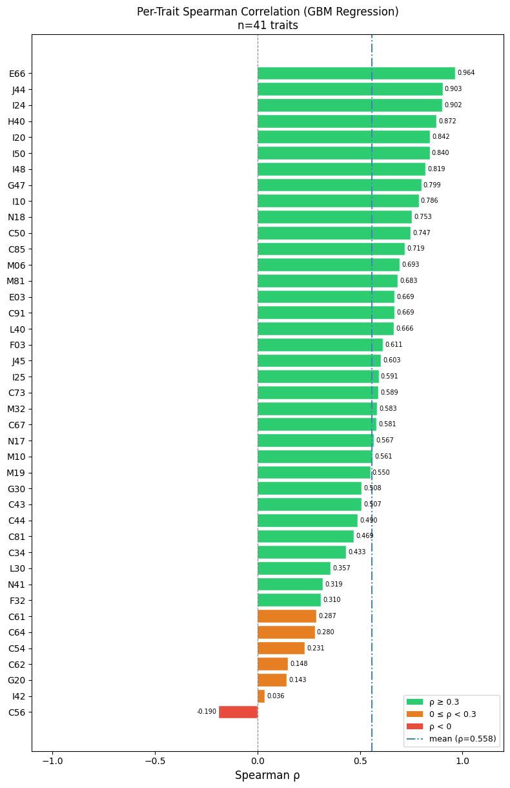
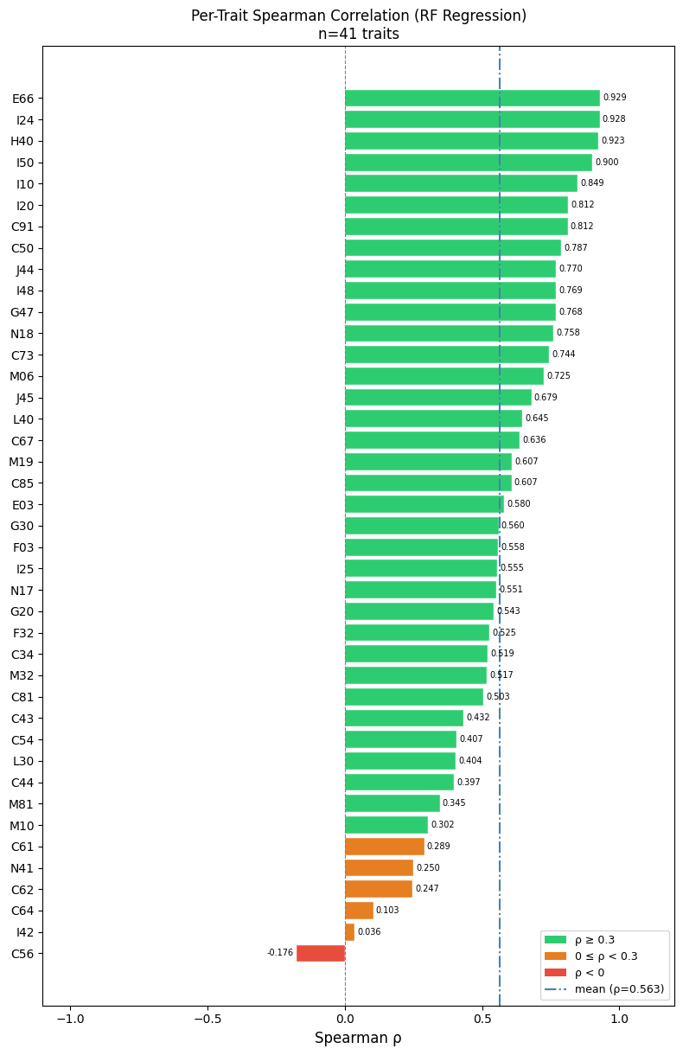
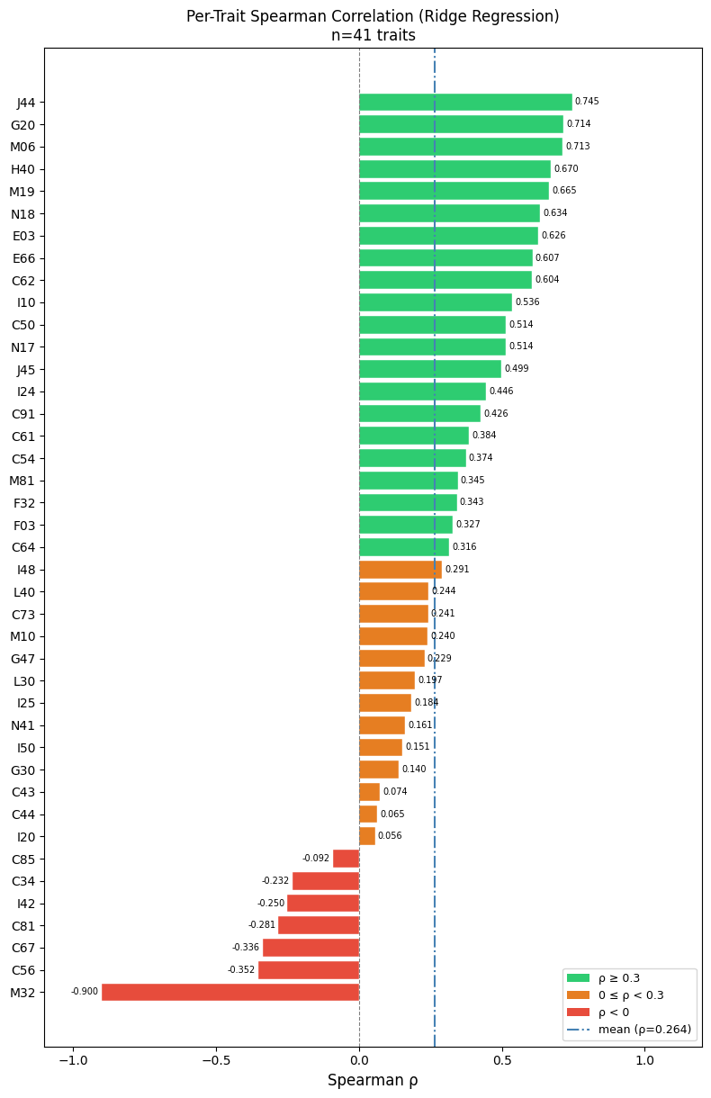
Regression model performance (R2 low, but Spearman r high, i.e., rank is good).

Slide 28
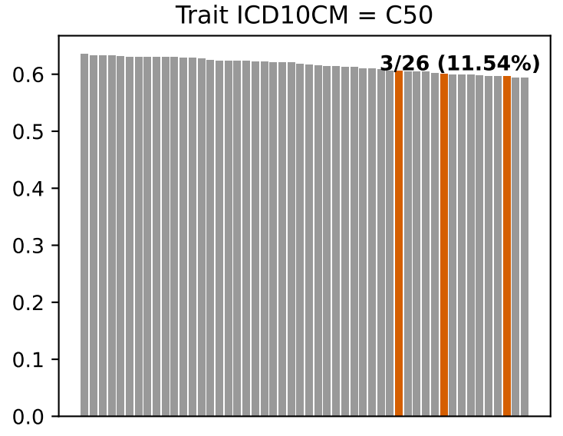
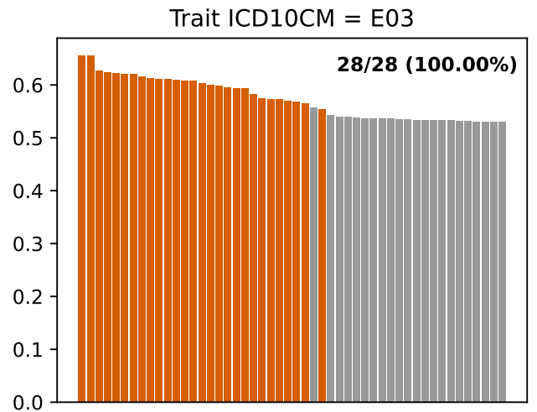

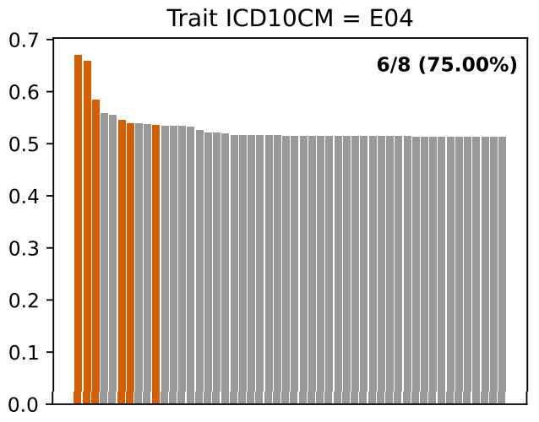
Particular traits show distinguishable results between target PGS / non-target PGS.
Target PGS shows no advantage
Target PGS shows advantages

Slide 29
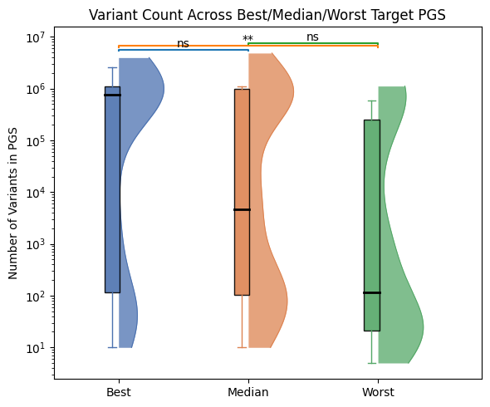
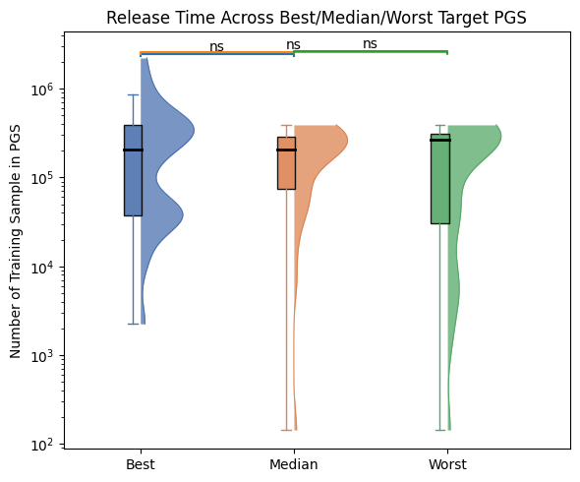
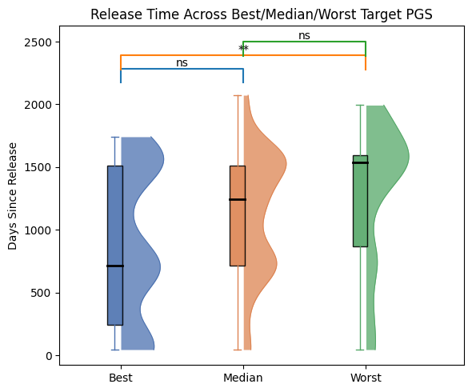
Selected trait set (N = 37) show similar results

Slide 30
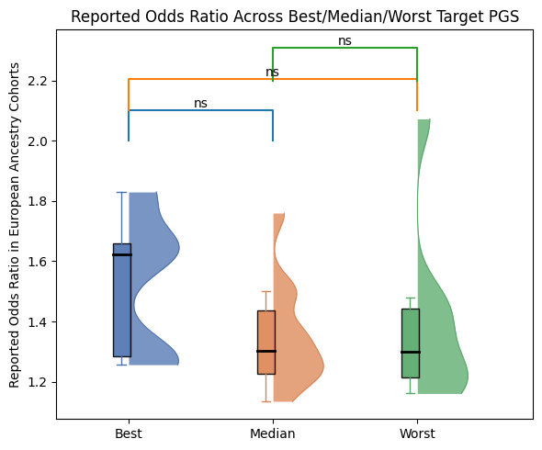
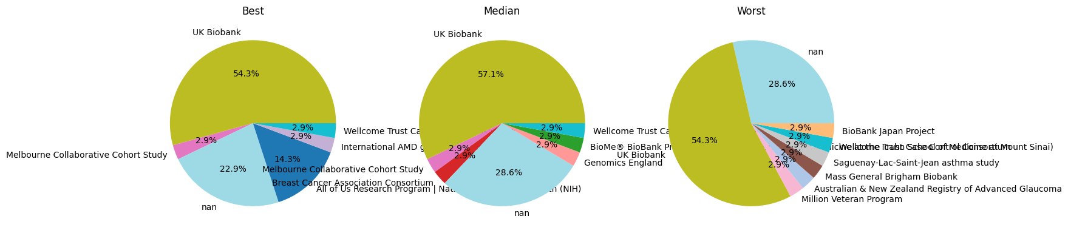
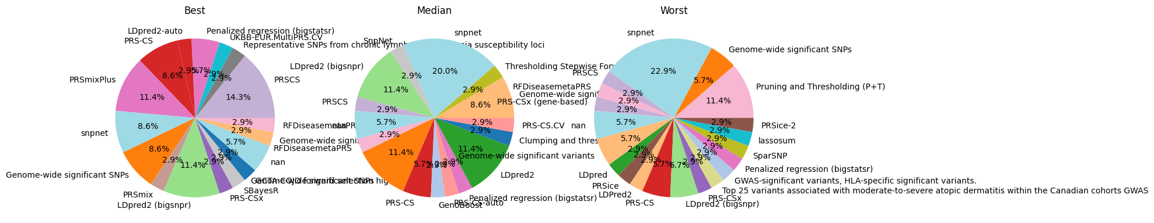
Selected trait set (N = 37) show similar results

Slide 31
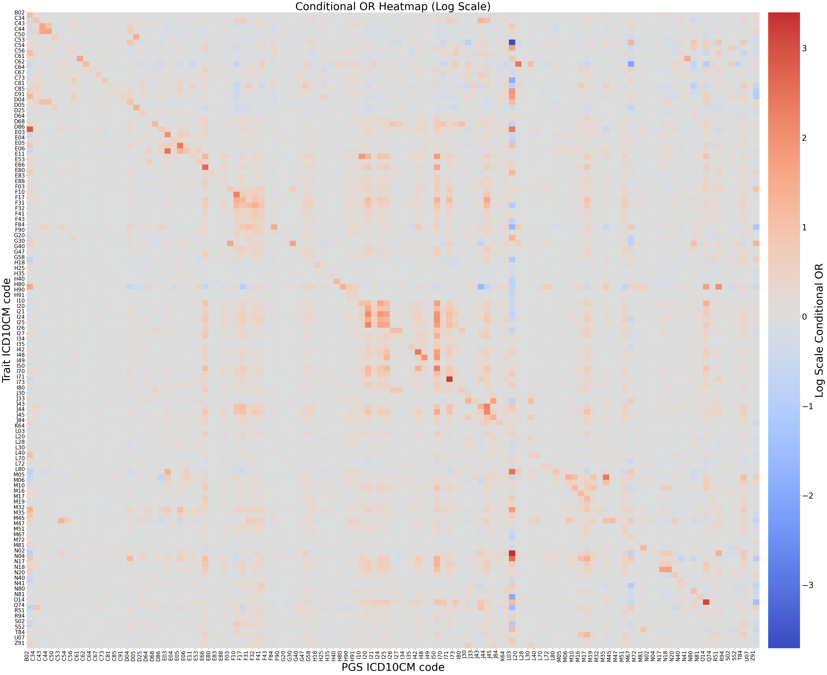
Conditional OR presents a similar result with adjusted AUC (when dropping outliers)

Slide 32
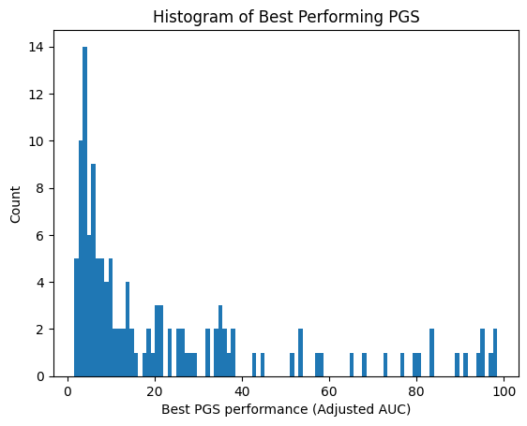
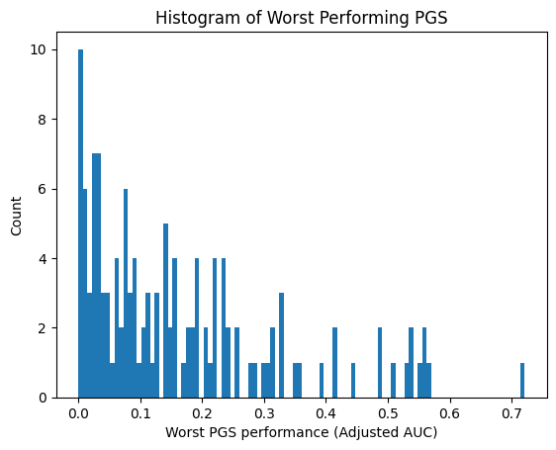
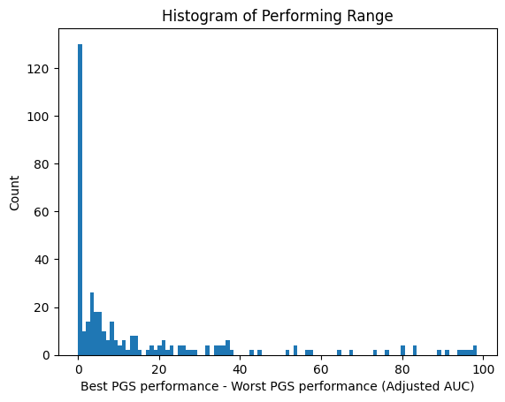
C62, C73, E11, I21, I50, I71, M08

Slide 33
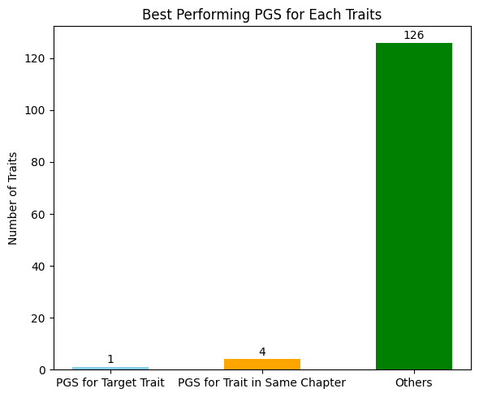
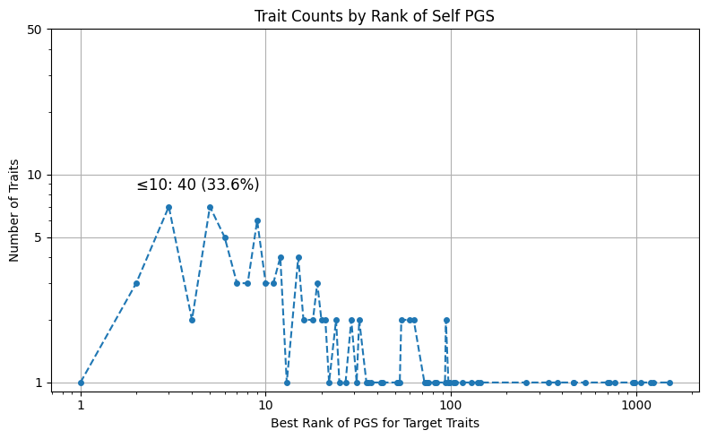
Trend is not significant
Most traits’ best performing target PGS appears within top10 performing PGS (33.6%)

Slide 34
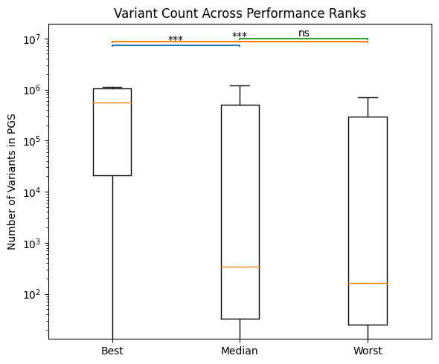


Best / Median / Worst in PGS rank correlation with PGS meta information is not significant

Slide 35
2.2 Continuous Traits

Slide 36


Most traits’ best performing PGS is their target PGS (52.6%)
Most traits’ best performing target PGS appears with in top10 performing PGS (65.8%)
3084-1 4544-3 788-0 789-8

Slide 37

Target PGS Distribution Per Trait
29463-7 Body weight

Slide 38

Trait case count distribution

Slide 39



Restrict available PGS to Target PGS (Incremental R)
10835-7
lipoprotein a measurement
10835-7
29463-7
Body weight
29463-7
10835-7

Slide 40



Best / Median / Worst in PGS rank is correlated with PGS meta information.
Trend is not statistically significant

Slide 41

Target PGS performance distribution.

Slide 42


Deeper slope in continuous trait compared to binary

Slide 43


Adjusted Beta seems not suitable for analysis (even if after dropping outliers)

Slide 44
2.3 Cross Traits

Slide 45


23% of PGS achieve their best rank at their target trait (enrichment 27.3x)
Most PGS shows significant specificity
PGS002161
Body mass index (BMI)
PGS004760
Depression
PGS005203
Body mass index (BMI)
PGS003525
Body mass index (BMI)
PGS004819
rheumatoid arthritis
PGS005199
Body mass index (BMI)

Slide 46




The more recent release performs better than the overall (stratified to each year 2023 - 2026)
It becomes harder to achieve better performance (less PGS is released in PGS catalog)

Slide 47


Quantify correlation by Spearman Correlation in Top500 PGS
29463-7 E66 0.838320
BMI (Body Mass Index): Obesity
8462-4 I10 0.887572
Diastolic BP: Essential (primary) hypertension
8480-6 I10 0.839638
Systolic BP: Essential (primary) hypertension
8867-4 E83 0.808310
Heart rate: Disorders of mineral metabolism
95% quantile

Slide 48



Construct Network base on Spearman correlation
N17, Acute kidney failure
G47, Sleep Disorders under Diseases of the Nervous System
D64, Anemias
U07, COVID-19
L03, Cellulitis and Acute Lymphangitis
R55, Syncope and collapse (fainting)
I50, Heart Failure
N17, Acute kidney failure
G47, Sleep Disorders under Diseases of the Nervous System

Slide 49



Construct Network base on Spearman correlation and form clusters
Breast Cancer: Carcinoma in situ of breast: Hemoglobin: Eosinophils
Cardiac module: I21, I20, I25, I50, I42, I70, I73.
Mental module: F31, F32, F41, F20, F10, F43
Metabolic: E66, 29463-7, 30522-7, E52, E88.
Inflammatory: I26, I80, I83, D68
Asthma: Allergic rhinitis: Personal history of allergy
Diastolic BP: Essential (primary) hypertension: Systolic BP

Slide 50
2.4 Problem

Slide 51
1. Vague Trait in PGS catalog (identified by ontology):
e.g.,
Substance-related disorder（物质相关障碍 / 物质使用障碍） → F10–F19
Respiratory tract infectious disorder（呼吸道感染性疾病） → J00–J06 / J09–J18 / J20–J22
Respiratory system cancer（呼吸系统癌） → C30–C39
Peripheral nervous system disease（周围神经系统疾病） → G50–G64
Self-injurious behavior（自伤行为） → X60–X84
Soft tissue disease（软组织疾病） → M60–M79
Spondyloarthropathy（脊柱关节病 / 强直性脊柱炎及相关疾病） → M45–M49
2. Particular trait performance is inconsistent: C53, C62, O14 in adjusted AUC
Checked case numbers 392, 204, 590 (relatively small but not the smallest)

Slide 52


3. Performance metrics are not consistent
Change Incremental R2 – Adjusted Beta
Correlation becomes not significant

Slide 53
3. Auxiliary Information

Slide 54

Root ICD Code Results
Avg PRS Performance
PRS performance meets expectations on target traits.
PRS performance across traits shows genetic correlation between traits.
Some traits have abnormal PRS results, e.g., O14, C62

Slide 55

Children ICD Code Results
Avg PRS Performance

Slide 56



Root ICD Code Results
Best / Worst / Range of all available PGS
Some traits have abnormal PRS results, e.g., O14, C62
C62
O14
O14
O14
C62
C62

Slide 57








congenital vitamin k-dependent coagulation factors deficiency
lymphoid leukemia
sarcoidosis
Hypothyroidism
Nontoxic multinodular goiter

Slide 58









