Slide 1
Preliminary Result

Slide 2
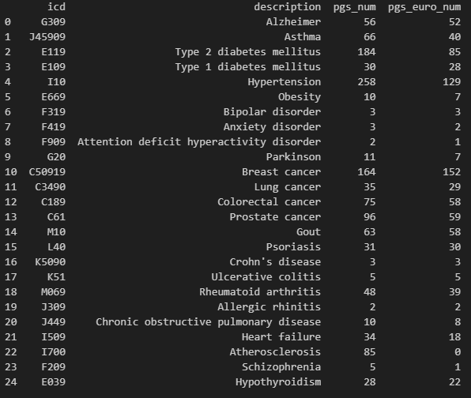
Trait & PGS selection
On my local PC:
Manually select 25 traits (identified by ICD10CM IDs).
For each trait, search by PGS catalog API, retrieve all PGS IDs.
For each PGS ID, search by PGS catalog API, filter by European ancestry, and get the corresponding URL with hmPOS_GRCh38. (838 PGS)

Slide 3
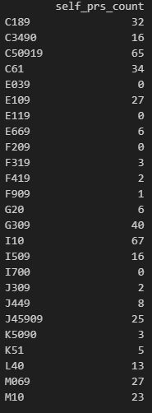
PGS evaluation
On All of Us workbench (Google Cloud Platform, GCP):
Download, unzip, and prepare .score file for all PGS. (431 PGS)
Push .score file to Google Cloud Bucket.
Compute PGS score with multi-thread PLINK2 (16 thread, 3h 20min) (421 PGS)
Prepare a binary outcome for the 25 traits, push to cloud.
Compute AUC trait by trait (1 thread, 5 min)
Directly compute if in rsid. Dropped if in chromosome number & loc.
Dropped if none of the rsid in PGS is provided in All of Us srWGS.

Slide 4
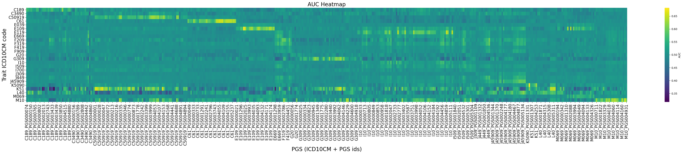
Results

Slide 5
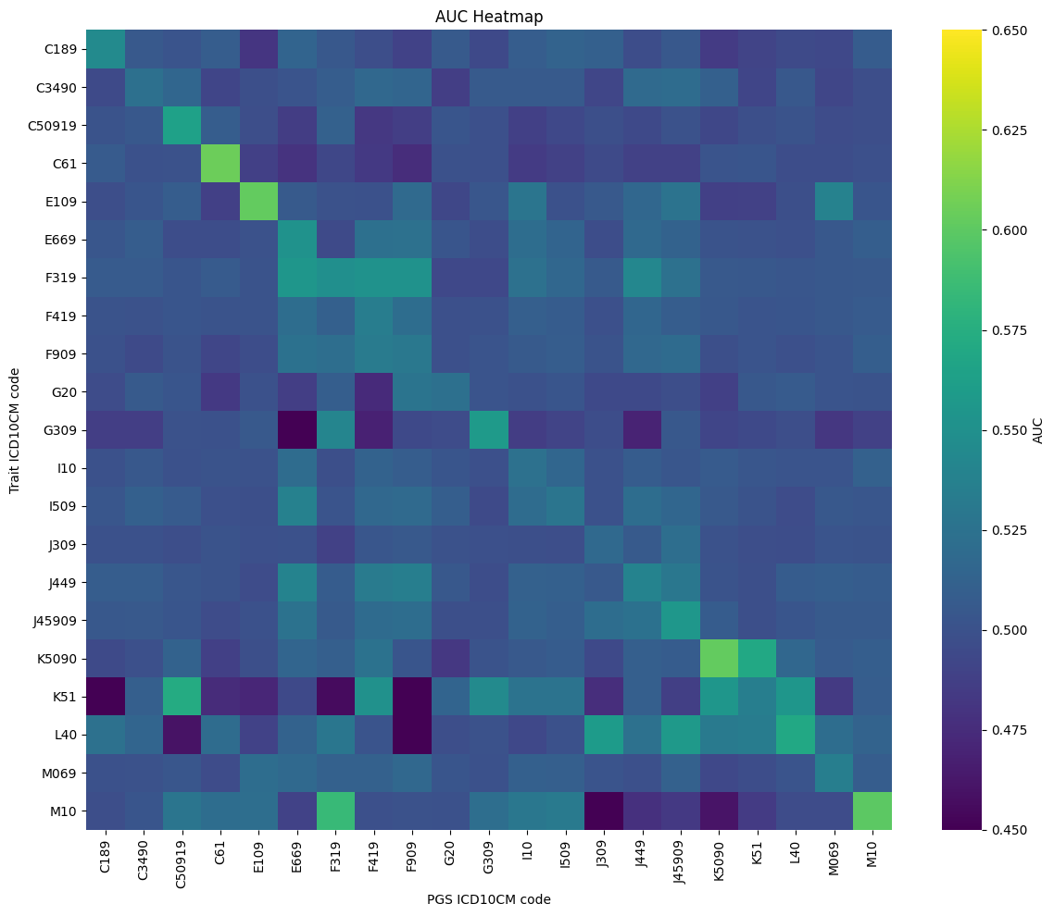
Avg PRS Performance

Slide 6
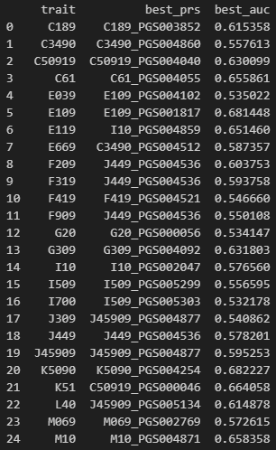
Best performing PRS for each trait and corresponding AUC

Slide 7
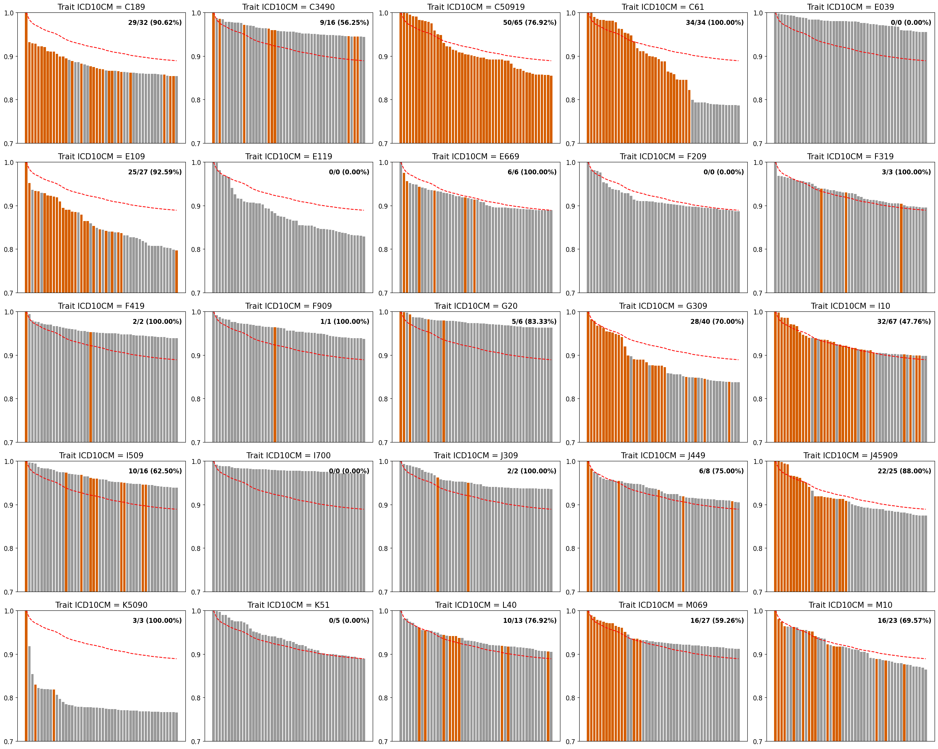
Top 50 PRS Performance for each trait
(Normalized to the best performing PRS)
And the percentage of self-PRS contained
Crohn's disease

Slide 8
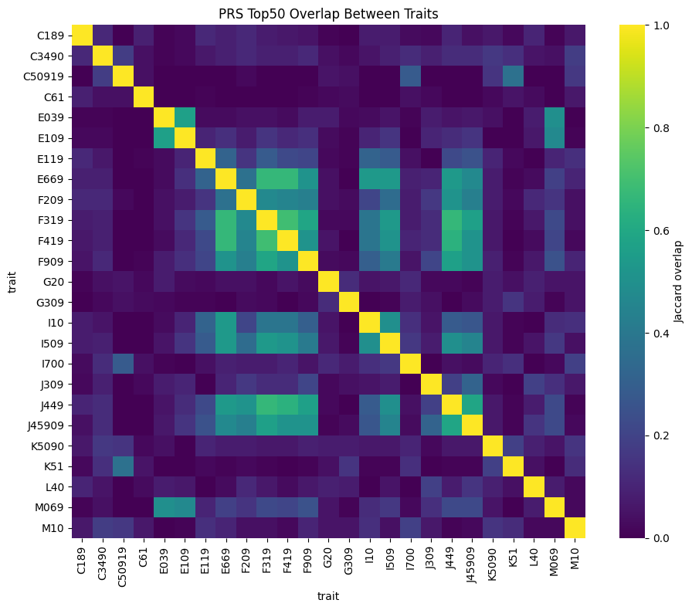
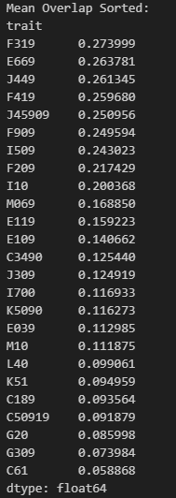
Top 50 PRS set overlap between traits
(Jaccard Index)
Bipolar disorder
Obesity
Endocrine, nutritional, and metabolic diseases
Circulatory system diseases
Respiratory system diseases
Cancer

Slide 9
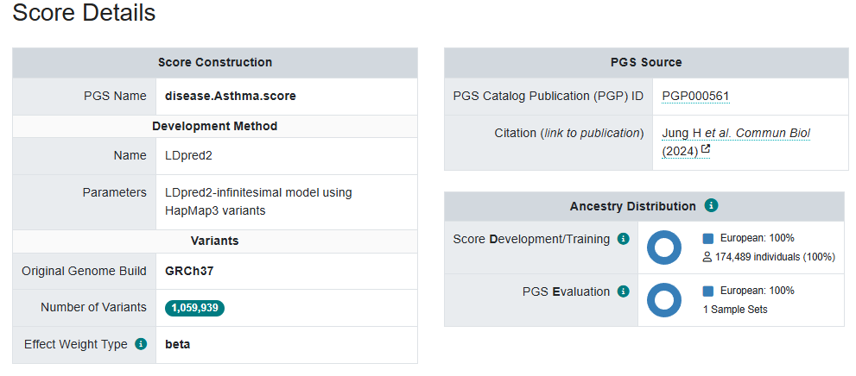
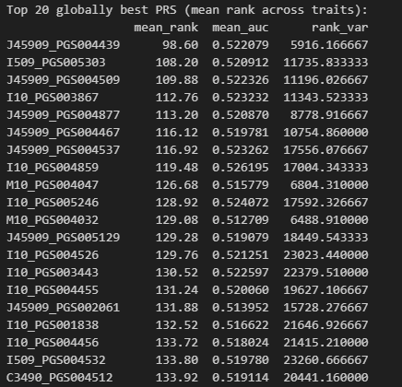
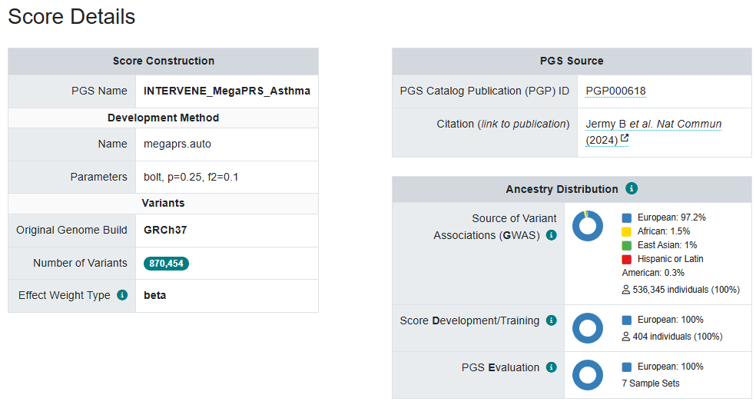
PRS ranking
PGS004439
Asthma
Hypertension
Gout
PGS004877

Slide 10
AoU European Sample Result

Slide 11
Trait & PGS selection
PGS traits selection:
Filter all traits within the list of categories (ontology identifier, #traits = 260): ["Cancer", "Cardiovascular disease", "Digestive system disorder", "Immune system disorder", "Metabolic disorder", "Neurological disorder", "Other disease“]
Map ontology with ICD10CM IDs by terms, manually check, and drop vague traits (#traits = 229, #ICD10CM Root = 140, #ICD10CM Children = 180).
For each trait, search by the PGS catalog API, and retrieve all PGS IDs.
For each PGS ID, search by PGS catalog API and get the corresponding URL with hmPOS_GRCh38 (#PGS = 2135).
European sample size: 151,123
Traits: #ICD10CM Root = 140, #ICD10CM Children = 180
PGS: #PGS IDs = 2135

Slide 12
Trait & PGS selection
PCA Computation (Instead of using loading data):
To compute PCs, we pruned autosomal variants with MAF >1% across the pooled dataset, using an 𝑟2 threshold of 0.1, a window size of 500kb with PLINK2 (--indep-pairwise). The first 10 PCs were then computed separately within each genetic ancestry group and within the pooled dataset using PLINK2 (--pca-approx).
(Evaluating Multi-Ancestry Genome-Wide Association Methods: Statistical Power, Population Structure, and Practical Implications)
AoU Trait Preprocess:
Organized in ICD10CM Children code
Cutoff by case number bigger than 10 (#ICD10CM children code in AoU = 16056)
Root code case is retrieved by combining all children code

Slide 13
Trait & PGS selection
AoU srWGS preprocess:
The All of Us WGS ACAF dataset is too large to be easily used in PGS calculations. To overcome this, we will first extract a subset of variants using a custom list containing the most relevant genomic positions for PGS calculation (pgsc_all+hm3_variants_hg38_[DATE].txt.gz, available from the resources folder on our FTP). This file comprises merged data representing ~17.9 million genomic positions extracted from ~5,000 PGS Catalog scoring files and the HapMap3+ dataset.
PGS score computation:
PGS Catalog Calculator. 12 batch with each batch ~200 PGS (~13h) (2135 PGS -- > 1846 PGS)
Adjusted AUC score computation (adjust for sex, age, and top 10 PCs):
The “roc.binary” function within the R package RISCA. 200 batch with each batch 5 PGS (~1h)
Post quality control:
Number of cases > 200.

Slide 14
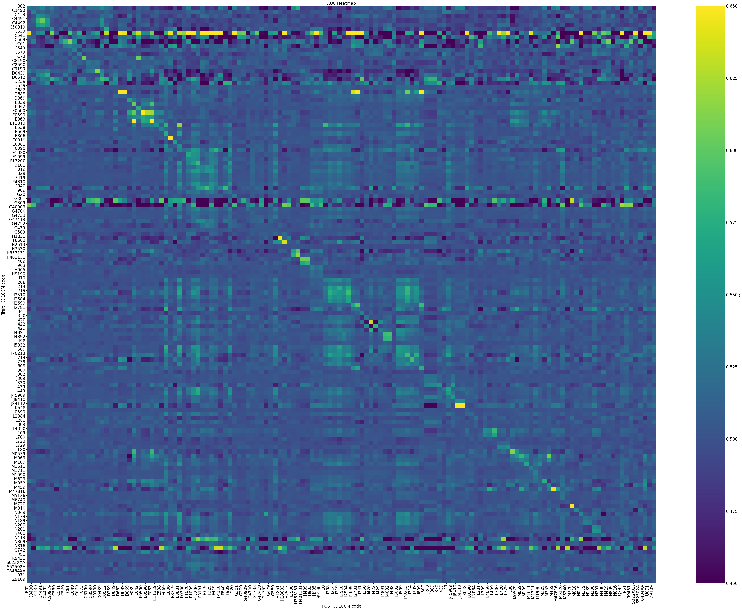
Children’s Code Results
Avg PRS Performance

Slide 15
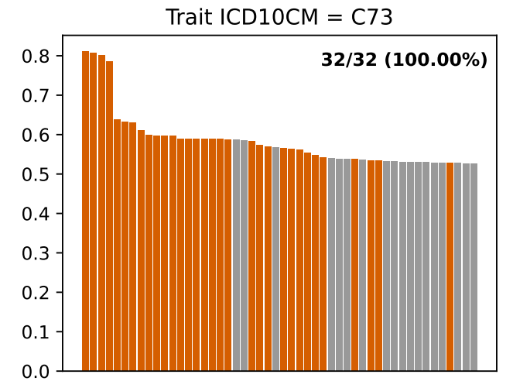
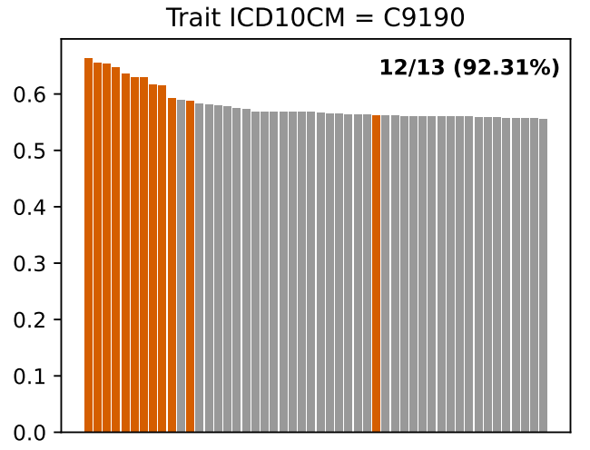
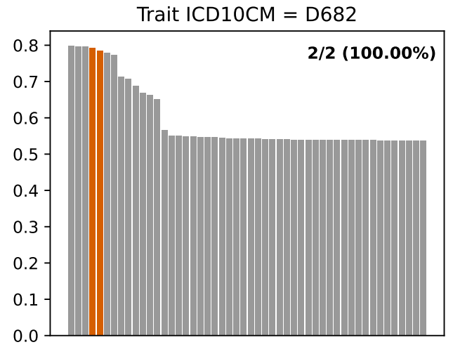
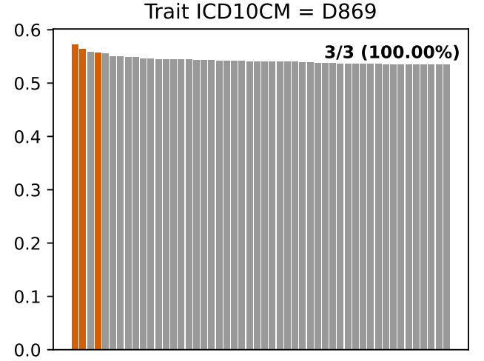
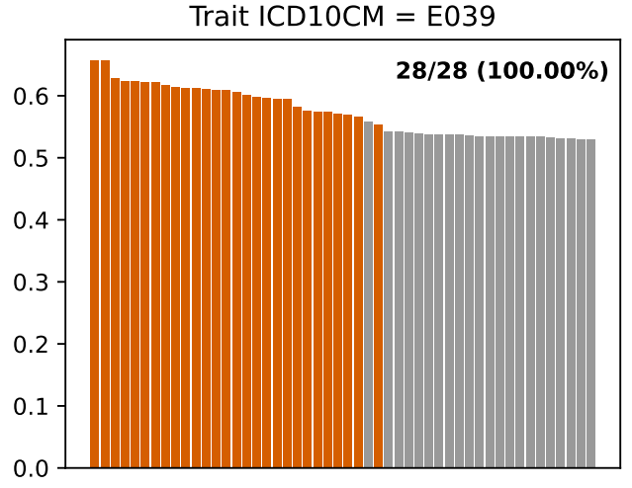
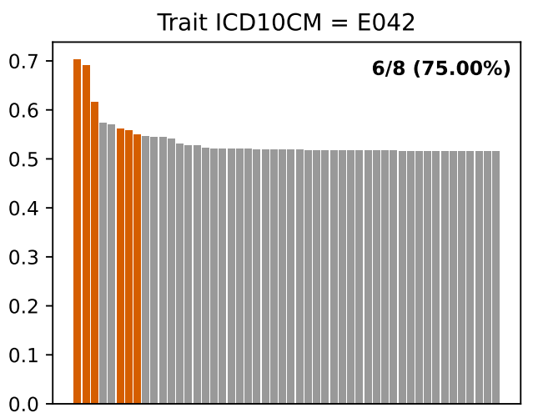
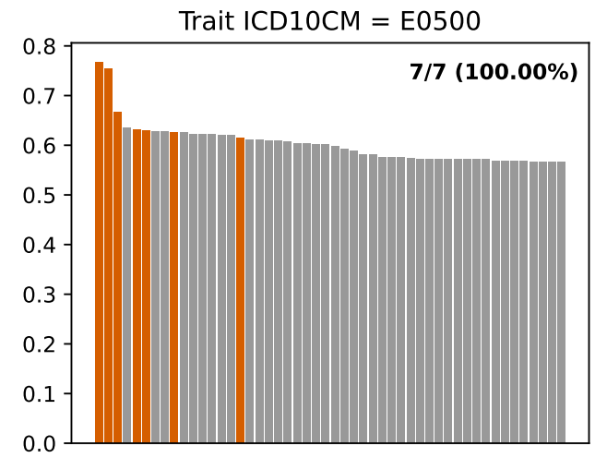
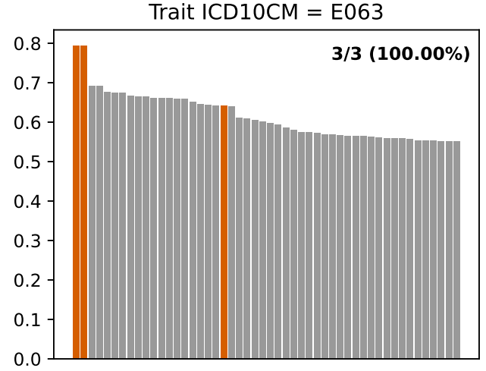
congenital vitamin k-dependent coagulation factors deficiency
lymphoid leukemia
sarcoidosis
Hypothyroidism
Nontoxic multinodular goiter

Slide 16
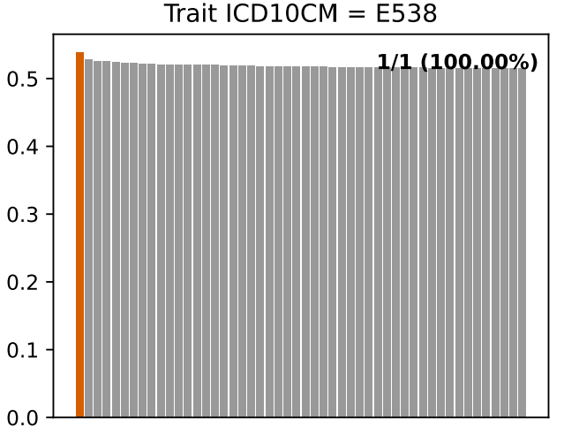
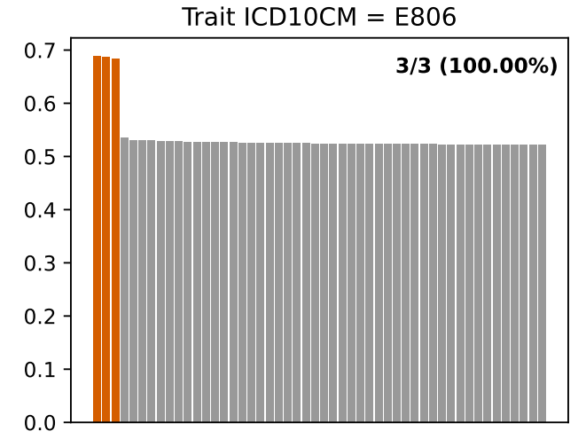
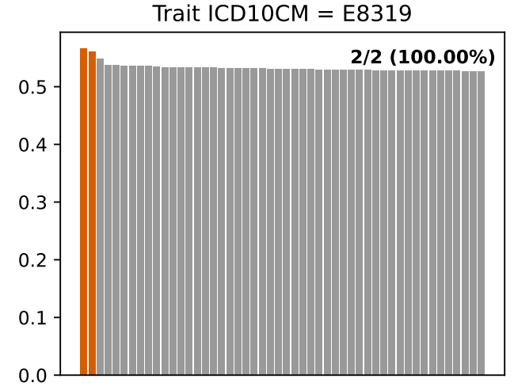
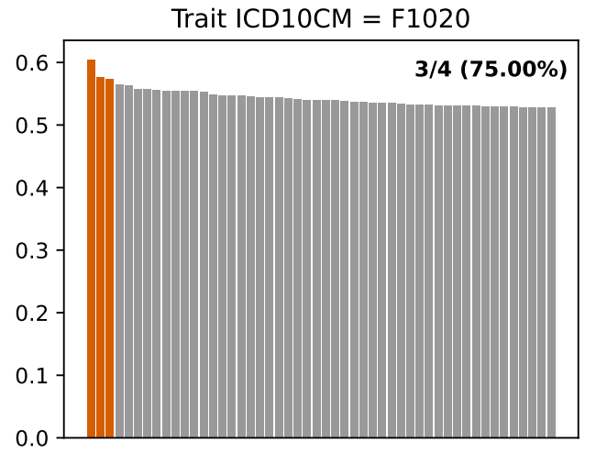
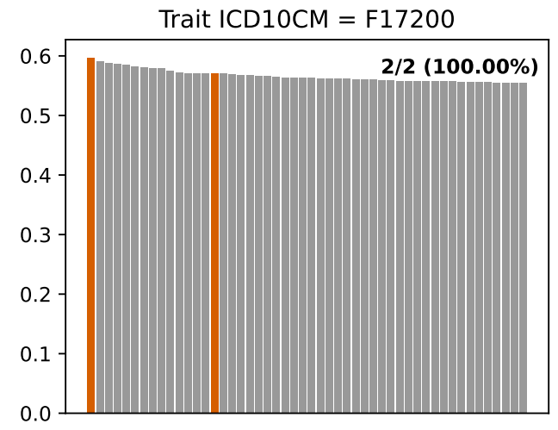

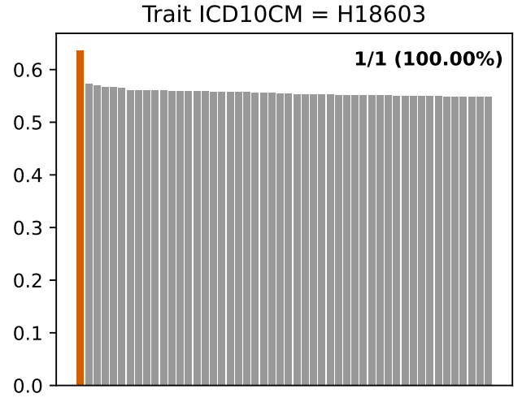
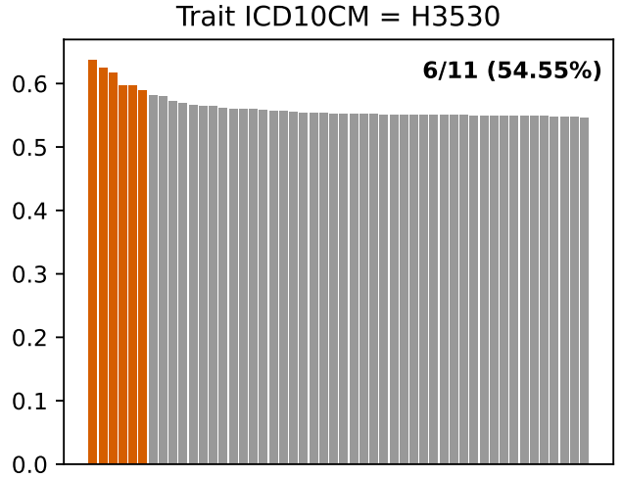

Slide 17
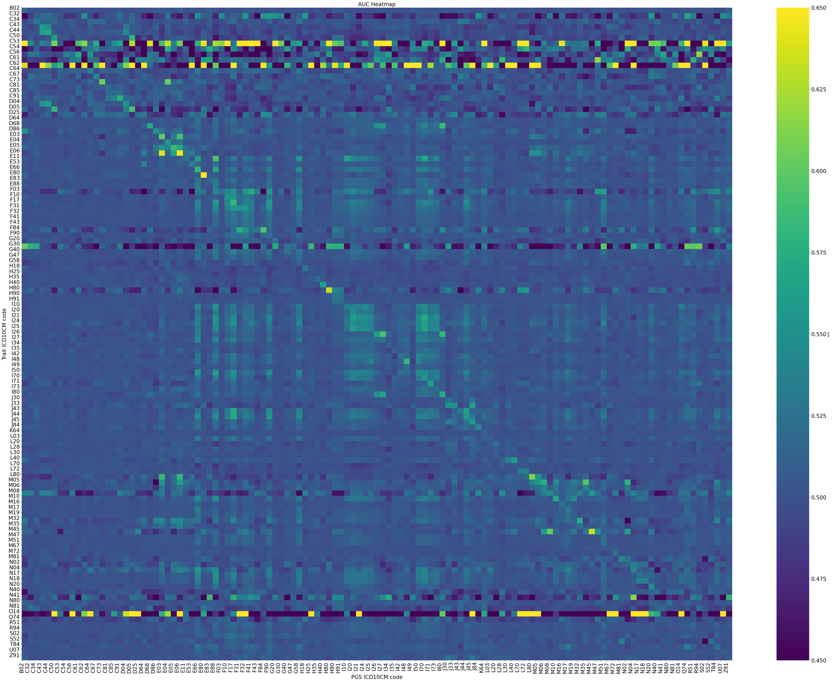
Root’s Code Results
Avg PRS Performance

Slide 18
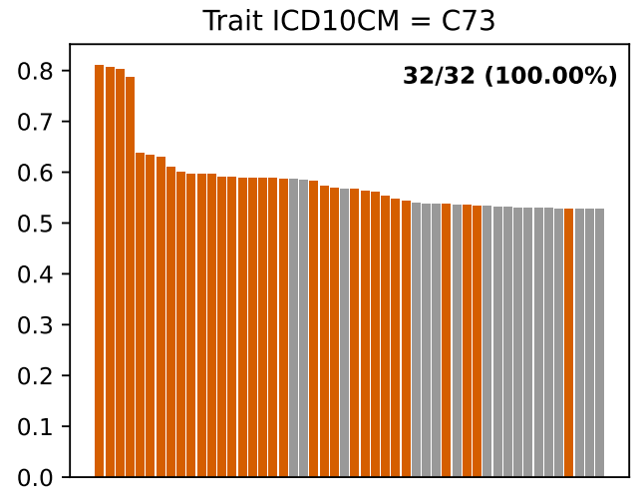
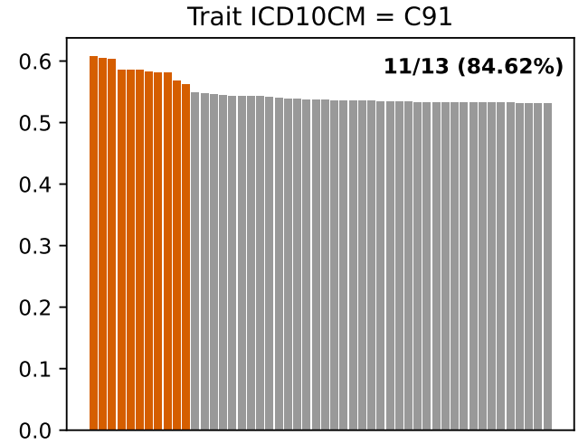
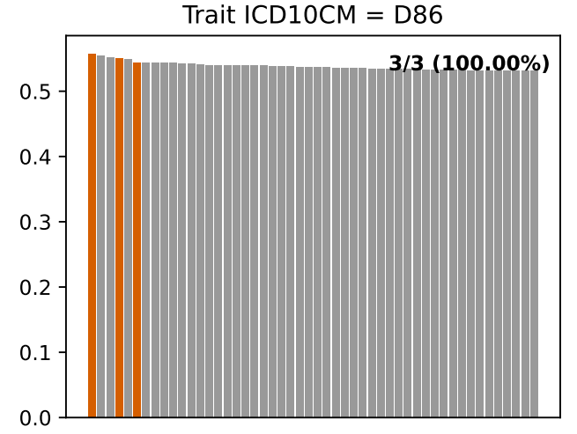
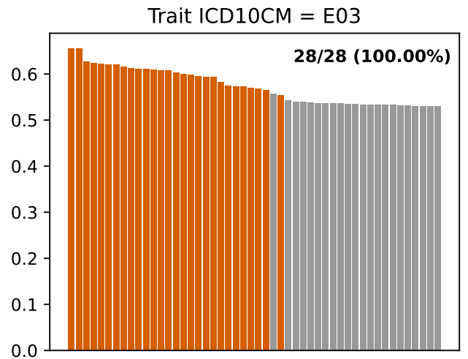
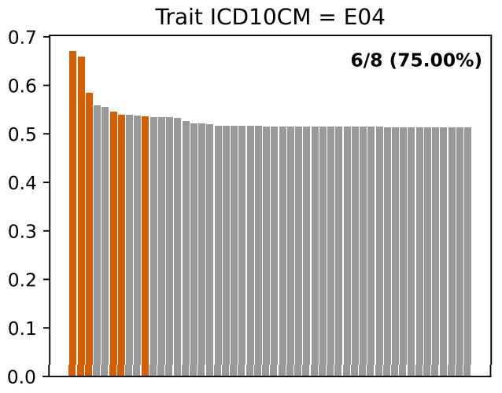
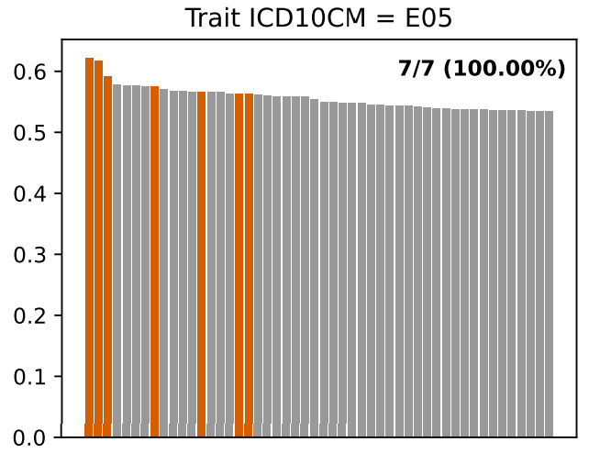
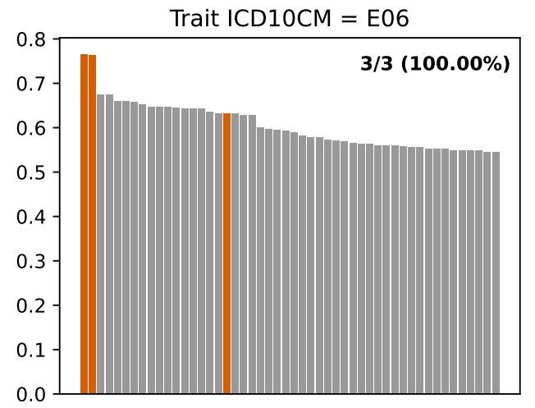
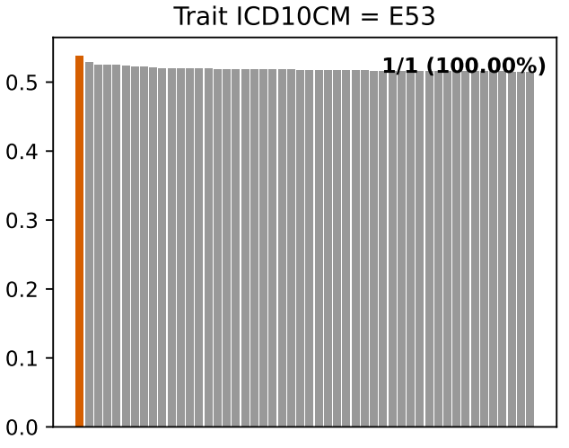

Slide 19
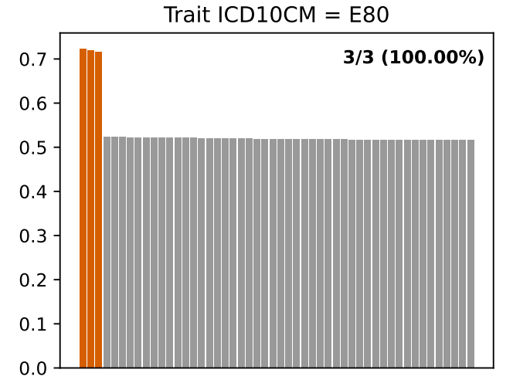
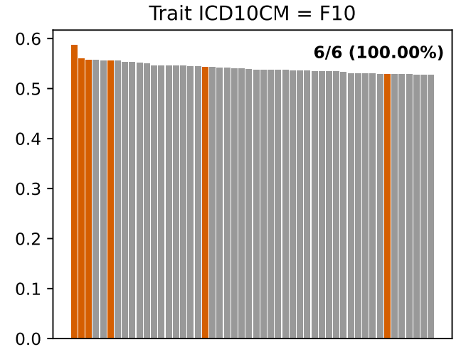
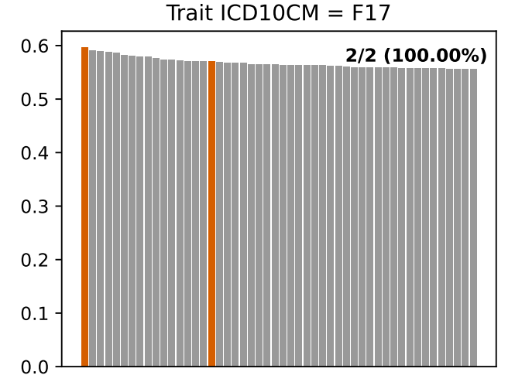
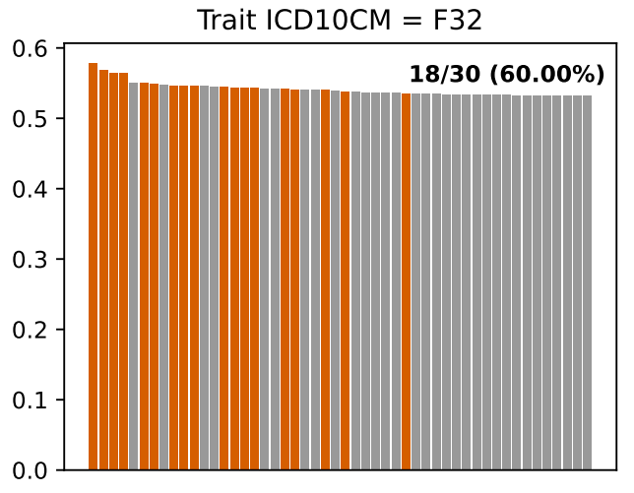
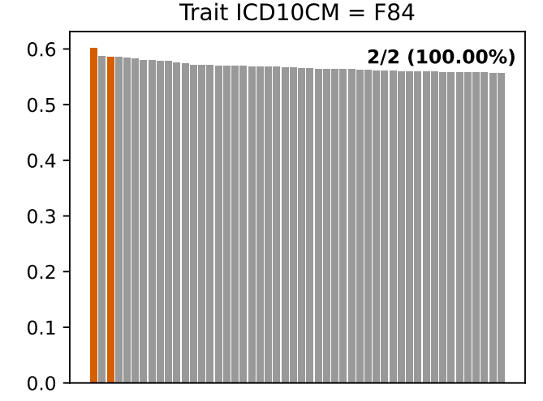
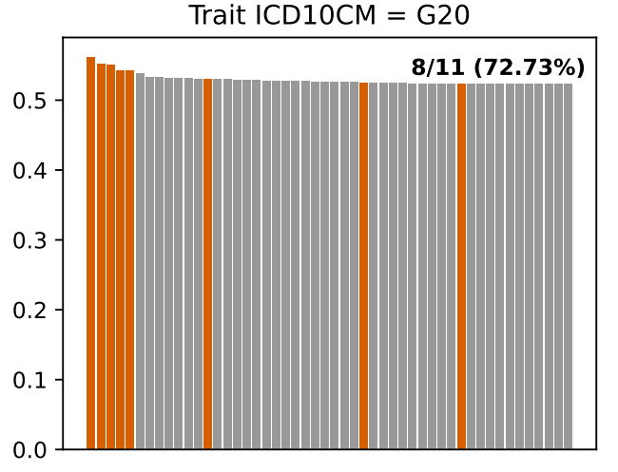
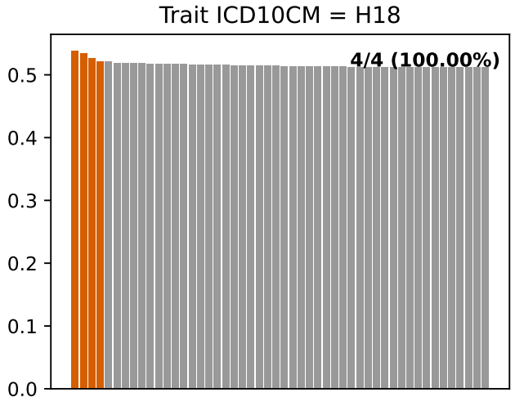
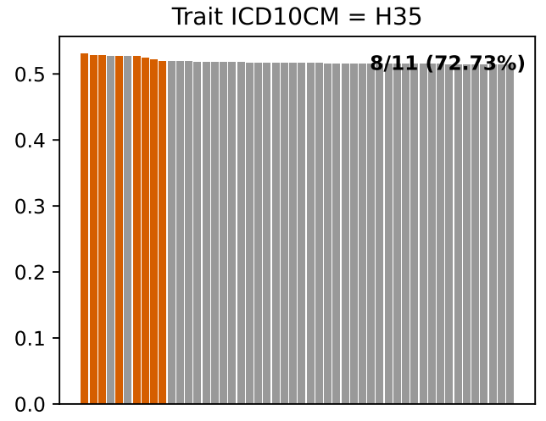

Slide 20
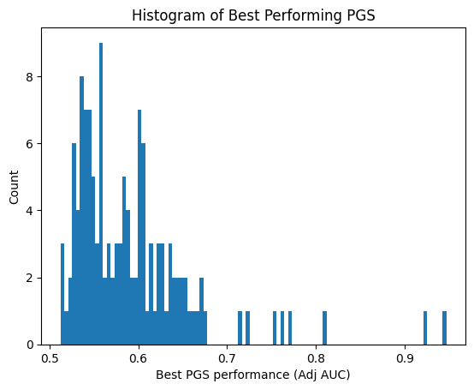
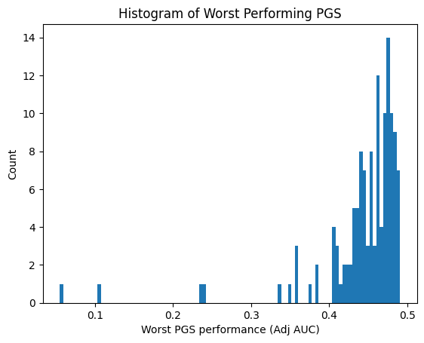
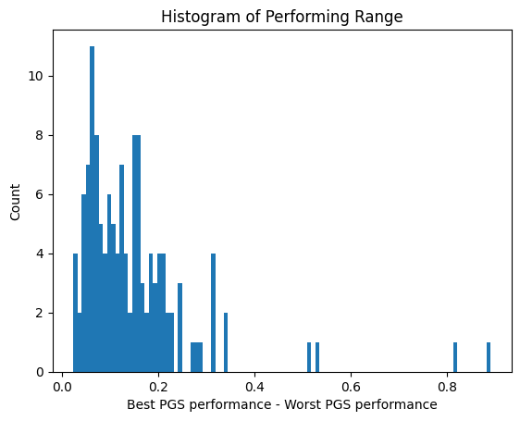
PGS Ranks (overall)
C62
O14
O14
O14
C62
C62

Slide 21
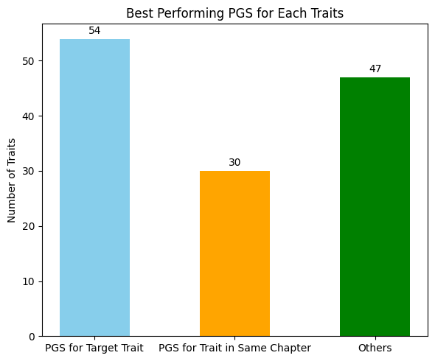
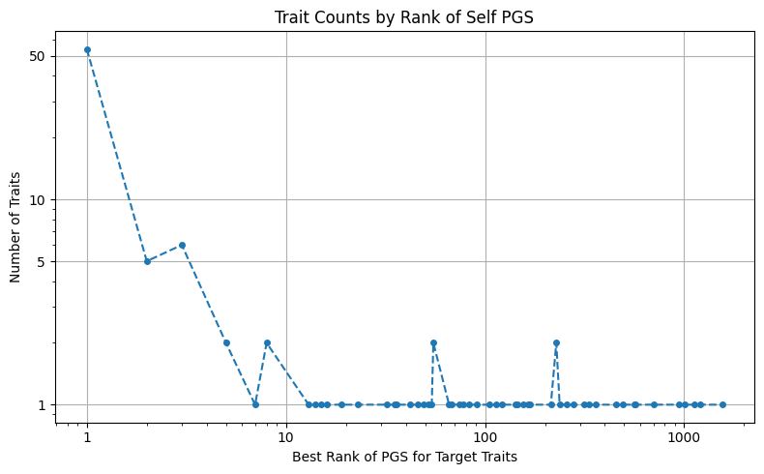
PGS Ranks (overall)
D64 I49 M47 R94

Slide 22
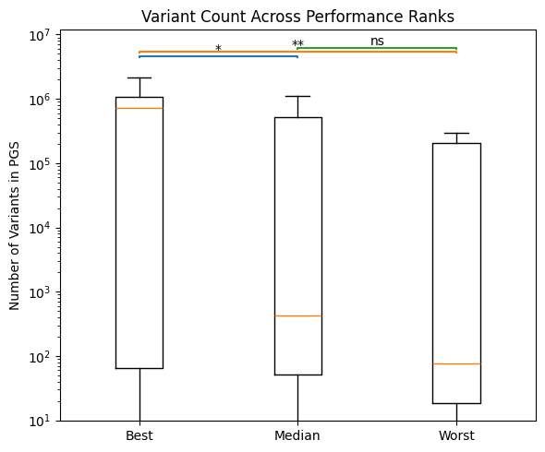


PGS Ranks (selected trait set n = 37)

Slide 23



PGS Ranks (selected trait set n = 37)

Slide 24
PGS Ranks (selected trait set n = 37)

Slide 25
Problem
1. Vague Trait in PGS catalog (identified by ontology):
e.g.,
Substance-related disorder（物质相关障碍 / 物质使用障碍） → F10–F19
Respiratory tract infectious disorder（呼吸道感染性疾病） → J00–J06 / J09–J18 / J20–J22
Respiratory system cancer（呼吸系统癌） → C30–C39
Peripheral nervous system disease（周围神经系统疾病） → G50–G64
Self-injurious behavior（自伤行为） → X60–X84
Soft tissue disease（软组织疾病） → M60–M79
Spondyloarthropathy（脊柱关节病 / 强直性脊柱炎及相关疾病） → M45–M49
2. Particular trait performance is inconsistent: C53, C62, O14
Checked case numbers 392, 204, 590 (relatively small but not the smallest)
3. In a particular set of traits, the ranking correlation between performance and metadata might be clearer

