Slide 1
Book1
File created on: 11/27/21 10:14:03 PM CST

Slide 2
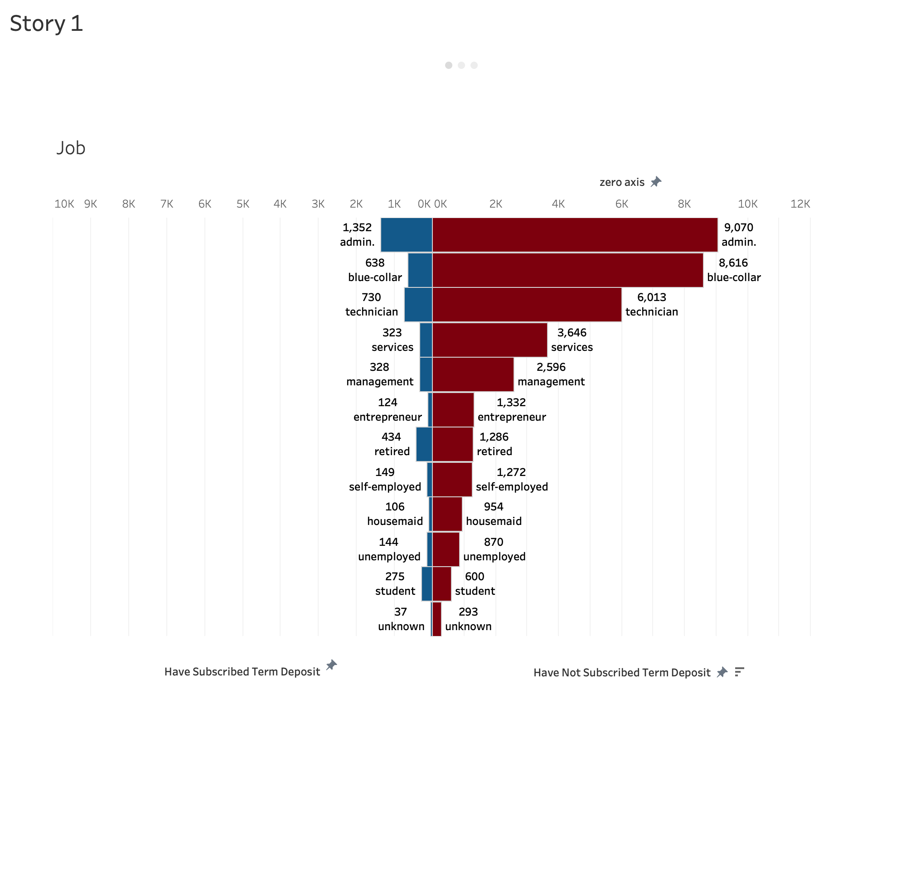

Slide 3
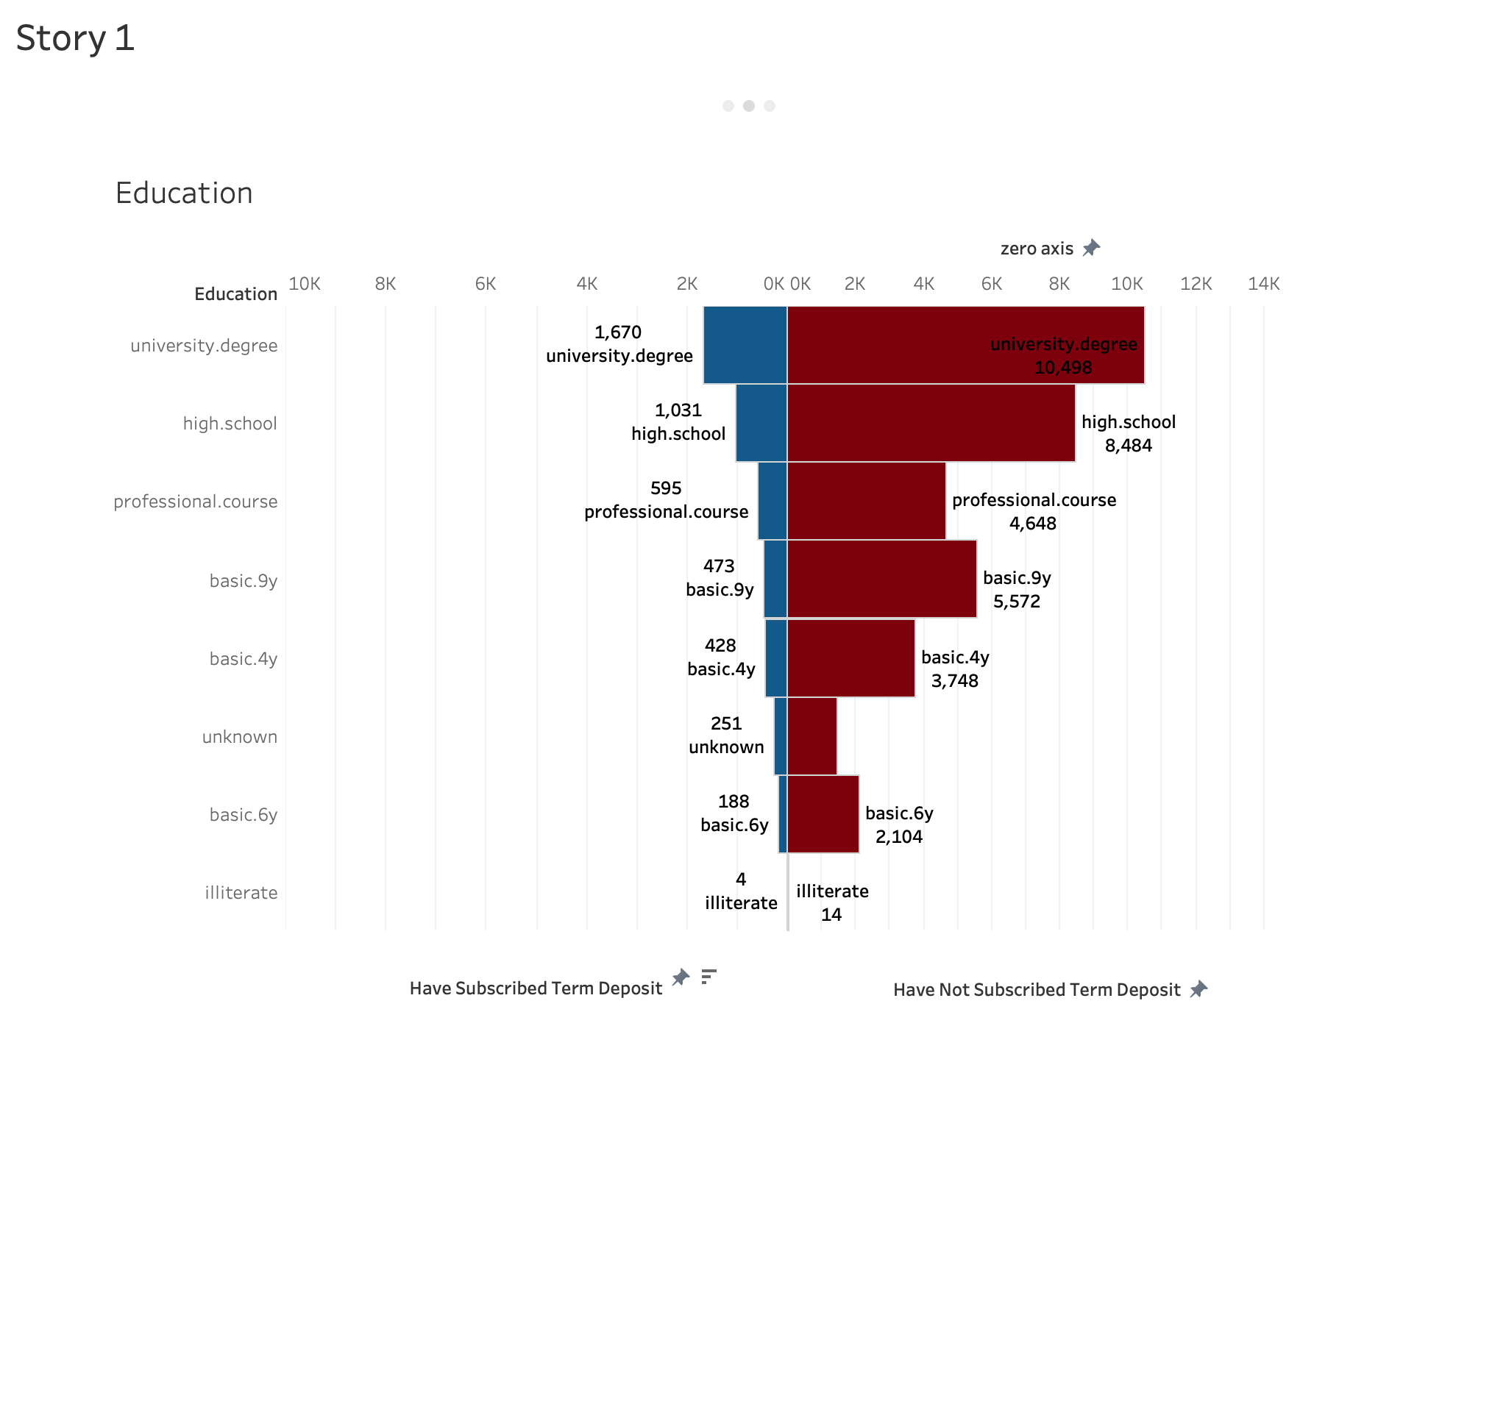

Slide 4
