Slide 1





Slide 2


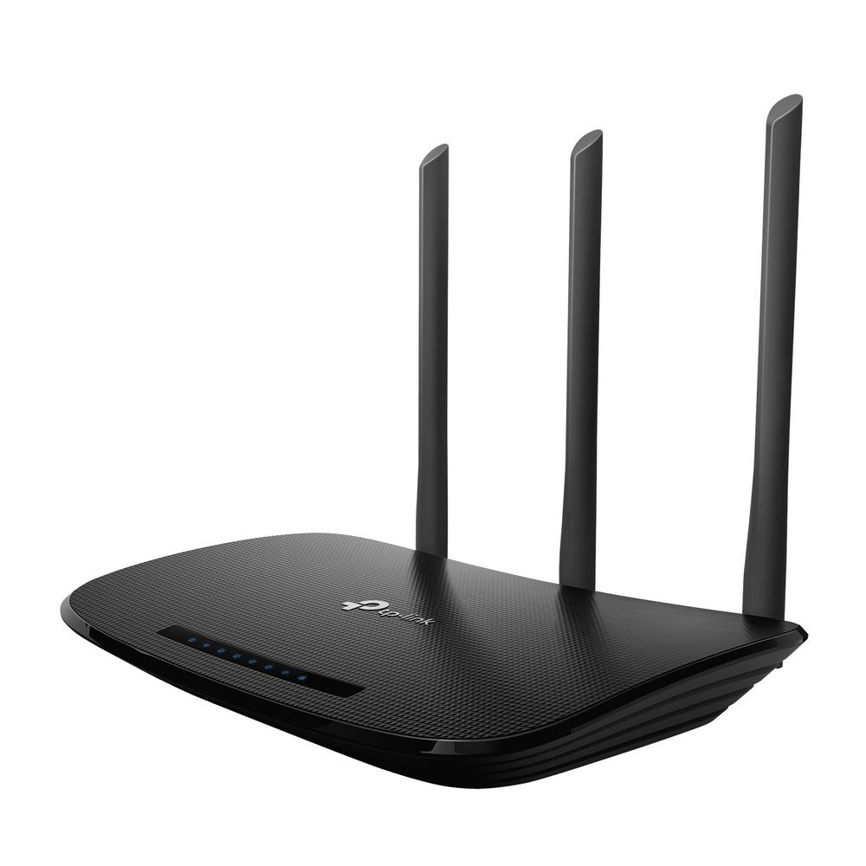
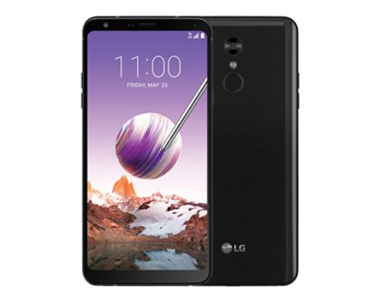
Internet
AP
Data center

Slide 3
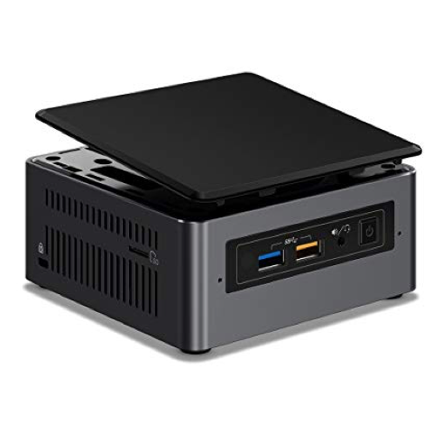
Internet
XDN AP
Data center

Slide 4
U
End user
S₁
S₂
s
Service replica
RC
Reconfigurator
RC₁
Cloud
RC₂
S₂
control plane
S₁
gateway
RC₃
U
AP

