Slide 1
FoodQQ SE-1 project
Com-18
Zharkyn Askat kyzy Nuraim Askat kyzy

Slide 2



Tools for our project:
Programming Language:
Java
Software Platform:
JavaFX
Visual layout tool:
Scene Builder

Slide 3
Briefly about application:
Where you could reach our code: https://github.com/Zharkyn20/FoodQQ
Application gives information about products calories information and food quality;
Application calculates the calorie of the product;
Application gives information about the amount of some products in terms of tablespoons.

Slide 4
Team members
Team members:
Name | Surname | email | GitHub account | Phone number
Nuraiym | Askat kyzy | nurayim.askatkyzy@iaau.edu.kg | https://github.com/Nuraim | 0 999 108 994
Zharkyn | Askat kyzy | zharkin.askatkyzy@iaau.edu.kg | https://github.com/Zharkyn20 | 0 500 123 323

Slide 5
Individual qualifications and strengths:
 | Individual qualifications and strengths
Nuraiym | Programming, Presentation, Organization, QA Expert
Zharkyn | Programming, Design, Documentation, Management

Slide 6
Steps of software development process
1. Analysis and Planning
2. Requirements.
3. Design and Prototyping.
4. Software Development.
5. Testing.
6. Deployment
7. Maintenance and Updates.

Slide 7
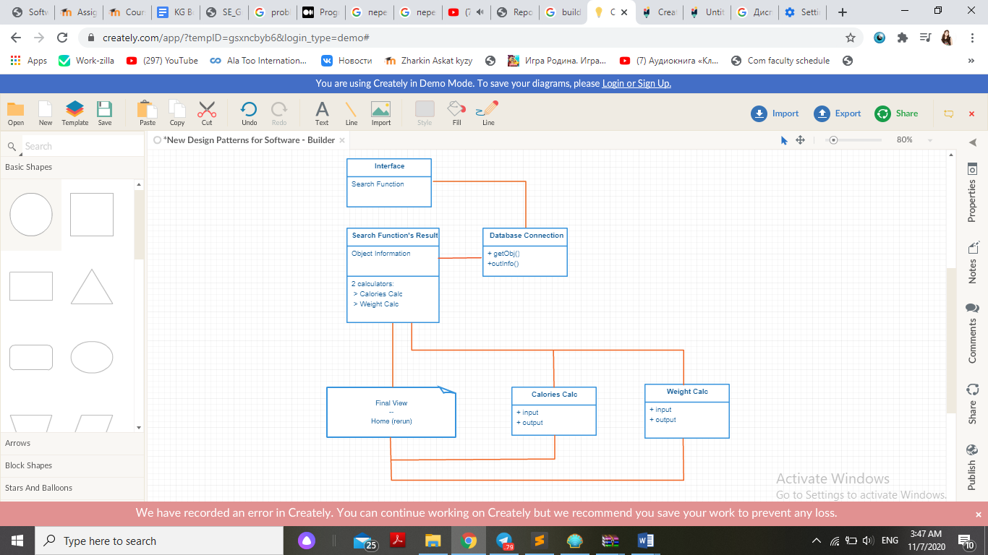
Information processing

Slide 8
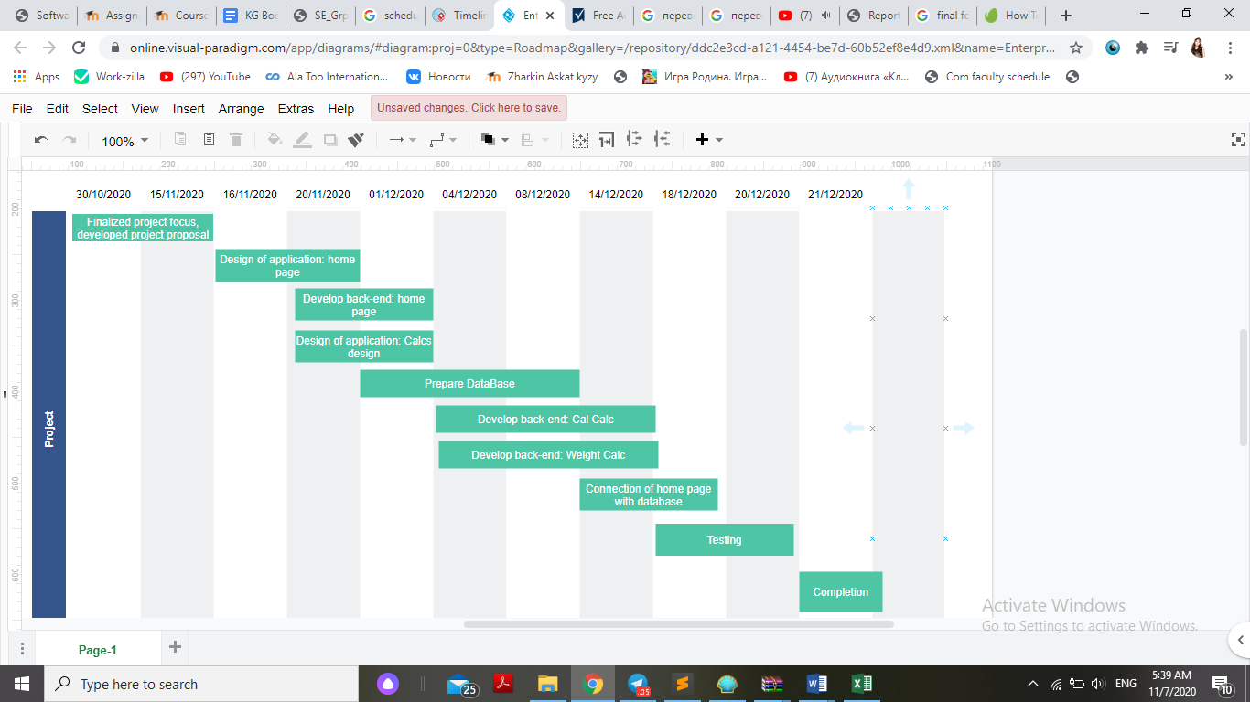
Schedule of the project

Slide 9
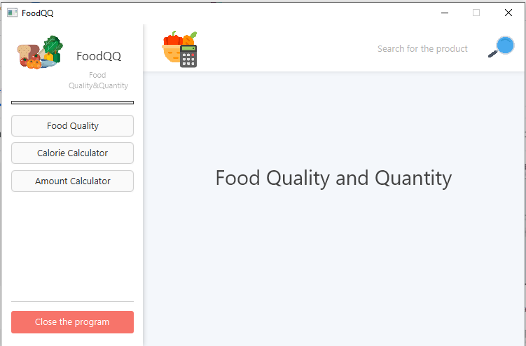
Front-End
Front-End developed with the help of JavaFX and Scene Builder.

Slide 10
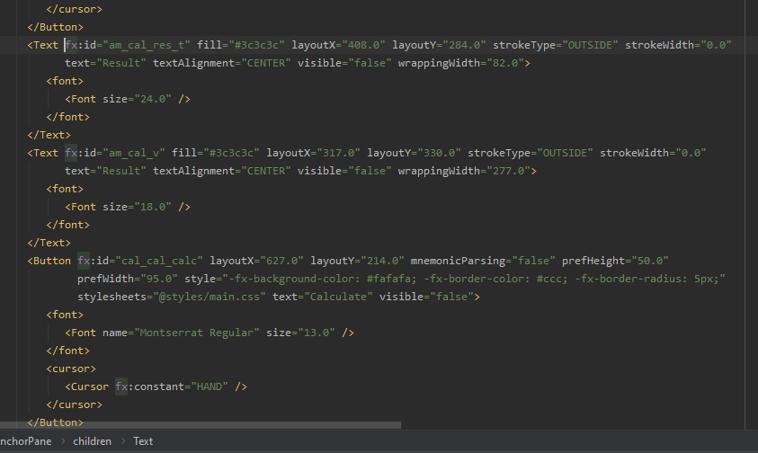
Front-End
There is one file named as sample.fxml
In that file all information about all items, which we see on application

Slide 11
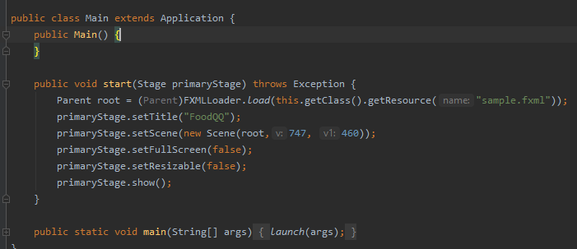
Back-End
Back-End written on the Java Programming Language.
There are 2 class: Main and Controller.
In the Main Controller initializes and functioning due to the needs.

Slide 12
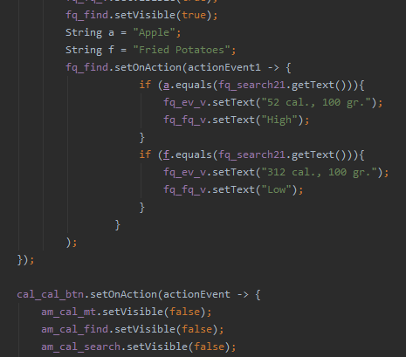
Back-End
In the Controller class written the way how the button should work.

Slide 13
Thanks for your attention!!!

