Slide 1
Qadam Delivery
Local delivery for small businesses
in Almaty through Telegram
Primary Market Research
& Opportunity Defense
Task 3 / Midterm defense / October 2026
Early courier interviews and registration. Market figures include assumptions.
Notes:
Good afternoon. We are presenting Qadam Delivery, a local delivery platform designed mainly as a Telegram Mini App. Our initial business focus is small shops in Almaty. Our primary research so far has focused on couriers. We interviewed approximately eight to ten couriers and registered couriers on our platform. Today, we will explain what this early evidence shows, introduce our market assumptions, and describe the next tests needed before scaling.
Sources and evidence status:
PROJECT_BRIEF.md; README.md. Interview and registration facts: project team, approximately 8–10 couriers, reported 23 October 2026.

Slide 2
Our first customer: a small shop in Almaty
A business-side hypothesis to test in a B2B pilot
Who makes the decision
6.7
A shop owner or administrator
who arranges delivery to the buyer.
hours of coordination per month
Initial customer segment
Flower and gift shops, and small sellers
who take orders through social media.
40 deliveries × 10 minutes ÷ 60
Assumption: time spent finding a courier, sharing addresses and checking order status.
Qadam Delivery
02
Notes:
Our target paying customer is a small shop owner or administrator who arranges delivery to a buyer. We initially consider flower shops, gift shops, and small sellers using social media. Our hypothesis is that coordinating deliveries takes time. For example, forty monthly deliveries at ten minutes of coordination each would require about six point seven hours. These are working assumptions. We still need customer interviews and measurements to establish how serious this problem is for businesses.
Sources and evidence status:
PROJECT_BRIEF.md. Coordination time and order frequency are illustrative assumptions.

Slide 3
Primary research: courier interviews
Completed interviews and registration. Follow-up questions appear on the right.
8–10
01
Describe your last completed delivery.
02
How did you find that order?
couriers interviewed (approx.)
03
What were the payout and travel costs?
Qualitative research focused on
potential delivery partners.
04
When did you last wait without orders?
Couriers registered on Qadam
05
Which orders have you declined, and why?
An early step in building local supply
Qadam Delivery
03
Notes:
We started with the courier side of the platform. We interviewed approximately eight to ten couriers and registered couriers on Qadam. This gave us direct contact with potential delivery partners and an initial group to involve in testing. Our sample size is approximate. For the next research round, we will apply The Mom Test principles by asking about specific past deliveries, actual payouts, travel costs, and rejected orders. These follow-up questions will help us turn conversations into more detailed evidence.
Sources and evidence status:
Project team: approximately 8–10 couriers interviewed and courier registration completed. Follow-up method: https://www.momtestbook.com/

Slide 4
Early evidence from the courier side
Research scope: courier interviews and registration on the platform
Evidence | What it shows | What remains unknown
About 8–10 courier interviews | Access to potential partners | Quantified pain and common themes
Couriers registered on Qadam | Accounts ready for pilot invitations | Regular availability and engagement
Order acceptance and delivery | Next stage of testing | Completion rate and repeat activity
Paying business customers | Future customer-side research | Willingness to pay and volume
Next evidence: availability, accepted orders and repeat activity
Qadam Delivery
04
Notes:
Our strongest evidence at this stage is that courier interviews took place and that we registered couriers on the platform. Registration gives us an initial group to invite into operational testing. Our next task is to observe actual behavior: when couriers are available, whether they accept suitable orders, and whether they return after their first delivery. Customer demand also needs separate research. We have not interviewed businesses yet, so willingness to pay and order frequency remain open questions.
Sources and evidence status:
Project team report. No interview quotations or quantified themes are available for this presentation.

Slide 5
Kazakhstan’s e-commerce market is growing
Retail e-commerce turnover, KZT trillion, including marketplaces
24.3%
CAGR for 2022–2025
[(3.7688 / 1.9635)^(1/3) − 1] × 100%
Nominal growth in goods turnover.
Courier-sector growth requires
a separate estimate.
Source: Bureau of National Statistics of Kazakhstan, E-commerce, 2025
Qadam Delivery
05
Notes:
For market context, we used official data from Kazakhstan’s Bureau of National Statistics. Retail e-commerce turnover increased from approximately one point nine six trillion tenge in 2022 to three point seven seven trillion in 2025. The compound annual growth rate is about twenty-four point three percent over three years. This calculation measures nominal goods turnover. It provides context for delivery needs, while the growth rate of courier services and demand for Qadam require separate analysis.
Sources and evidence status:
https://stat.gov.kz/ru/industries/economy/local-market/publications/346330/

Slide 6
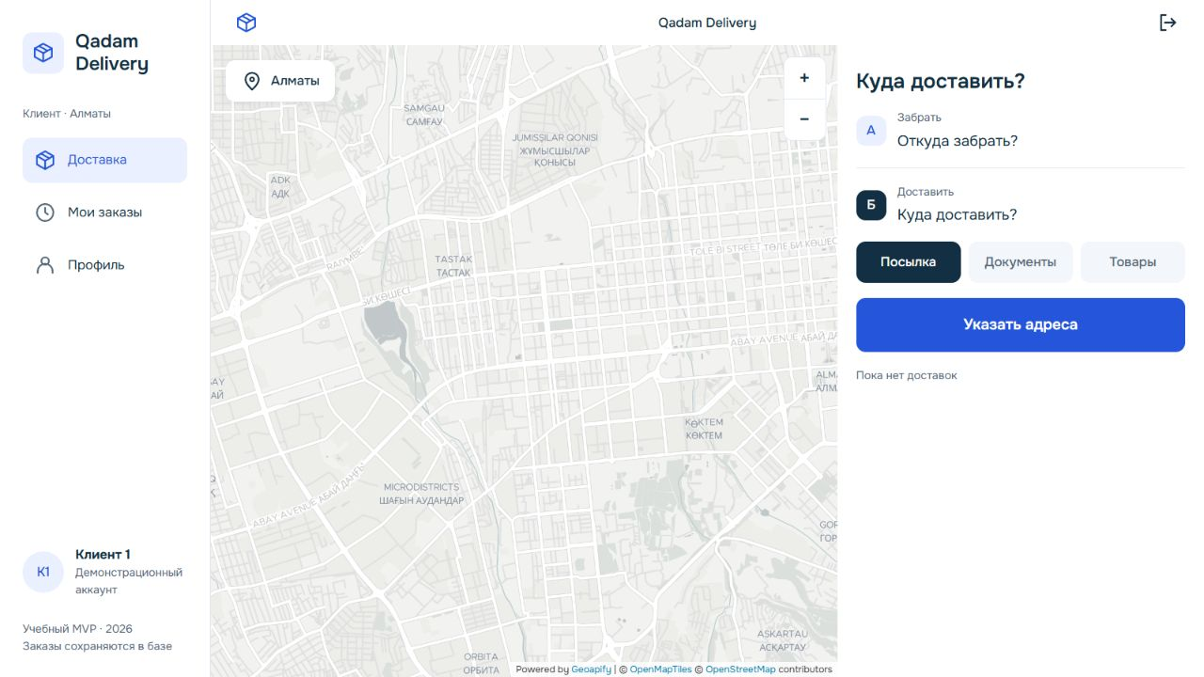
The current Qadam Delivery MVP
A Telegram Mini App and browser version for the delivery workflow
01
Create a delivery order
02
Courier accepts
03
Update delivery status
04
Restore order history
Russian-language demo.
Shared flow for B2B pilots.
GPS updates while the app is open
and permission is granted.
Qadam Delivery
06
Notes:
Our MVP provides a practical workflow for the next tests. A customer creates a delivery request, a courier accepts it, and the courier updates its status through completion. The platform stores orders and restores their history after reopening. The current interface uses Russian, which suits our initial local demo. The business pilot can use the existing customer workflow. Location updates require an open application and permission, so the map shows the courier’s last reported position and its update time.
Sources and evidence status:
README.md; PROJECT_BRIEF.md. Actual product screenshot: https://qadam-delivery.vercel.app/, 23 October 2026. Map attribution: Geoapify, OpenMapTiles and OpenStreetMap.

Slide 7
Digital alternatives and market penetration
Business-side penetration remains unmeasured: interviews covered couriers only
14.3%
Current alternative | Evidence to collect
Delivery service | Frequency, price and reasons for use
Regular courier | Availability and replacement options
Manual arrangements | Time spent and handover errors
Online sales as a share of
Kazakhstan’s retail turnover, 2025
This measures sales turnover.
Courier registration is an early
onboarding signal. Local penetration
needs a defined market denominator.
Penetration = n / N × 100%
n = businesses using a digital delivery service
N = all surveyed businesses in the target segment
Qadam Delivery
07
Notes:
Market penetration describes how many target customers already use digital delivery alternatives. The official fourteen point three percent figure measures online sales within national retail turnover. We need a different measure for Qadam: the share of eligible businesses using a digital delivery service. We would divide that number by all surveyed businesses in the target segment. Since our interviews covered couriers only, we cannot calculate this business-side rate yet. Courier registration is a separate onboarding indicator.
Sources and evidence status:
https://stat.gov.kz/ru/industries/economy/local-market/publications/346330/

Slide 8
TAM / SAM / SOM: a working scenario
All customer counts, delivery volumes and platform fees below are assumptions
Market scope | Eligible businesses | Annual Qadam revenue
TAM: Kazakhstan | 10,000 | KZT 1.44bn
SAM: Almaty | 1,500 | KZT 216m
SOM: first 1–2 years | 50 | KZT 7.2m
50 businesses × 40 deliveries × KZT 300 × 12 = KZT 7.2m
KZT 300 is assumed platform revenue per order. Courier compensation is separate.
SOM is annual revenue at the target scale, before expenses.
Qadam Delivery
08
Notes:
We estimated the opportunity with a bottom-up scenario. We assume ten thousand eligible businesses across Kazakhstan, fifteen hundred accessible businesses in Almaty, and an initial target of fifty active businesses within one to two years. We also assume forty deliveries per business per month and three hundred tenge in platform revenue per delivery. This gives a TAM of one point four four billion tenge, a SAM of two hundred sixteen million, and a SOM of seven point two million per year. These are assumptions about annual platform revenue before expenses.
Sources and evidence status:
Illustrative bottom-up model. All eligible business counts, activity and platform revenue assumptions require validation.

Slide 9
Revenue sensitivity and the path to SOM
Scenarios with 50 active businesses. Illustrative calculations, not sales forecasts.
Scenario | Monthly deliveries per business | Revenue per order | Annual revenue
Conservative | 25 | KZT 200 | KZT 3.0m
Base | 40 | KZT 300 | KZT 7.2m
High | 60 | KZT 350 | KZT 12.6m
2,000
deliveries
per month
in the base
scenario
Acquisition plan: 5 pilot businesses, 20 active businesses by month 12, and 50 by month 24.
Registration alone does not establish availability, delivery capacity or repeat participation.
Qadam Delivery
09
Notes:
We also checked how sensitive the model is to activity and pricing. With fifty businesses, the conservative scenario gives three million tenge annually, the base scenario gives seven point two million, and the high scenario gives twelve point six million. The base case requires two thousand deliveries per month. Reaching this volume will depend on customer acquisition, retention, and reliable courier availability. Our registrations provide a starting point, and operational testing will establish how much delivery capacity that group can actually provide.
Sources and evidence status:
Illustrative sensitivity and acquisition scenarios. No claimed sales forecast or measured courier capacity.

Slide 10
Next step: a pilot with real deliveries
Proposed four-week pilot: 5 businesses and registered couriers, aiming for 50 deliveries
Test | Proposed continuation criterion
Paying demand | 3 of 5 businesses pay for the agreed pilot
Repeat use | 3 of 5 businesses order again after week one
Value and reliability | 30% less coordination time. ≥90% delivered on time
Order economics | Positive contribution after variable costs
Courier interviews and registration give us a starting point
The pilot will test paying demand, repeat use and delivery economics.
Qadam Delivery
10
Notes:
Our next proposed step is a four-week pilot with five businesses and registered couriers, aiming for fifty completed deliveries. We will track paid participation, repeat orders, coordination time, and deliveries completed within an agreed window. We will also calculate contribution after variable costs. Our early progress is direct contact with couriers and registration on Qadam. The next stage will connect that supply to real customer orders and test whether the service creates enough value for both sides. Thank you. We are ready for your questions.
Sources and evidence status:
Proposed pilot design and success thresholds. These are future targets, not completed results.

