Slide 1


Understanding Programming Bugs in Java Programs Using Counterexamples
-Optimizing minimal counterexamples
Zhaoyu Zhang
Github Link: https://github.com/Zhayu517/Software-Security-Seminar

Slide 2

Counterexample produced by BMC relation to SS
Identify and locate programming errors
Produce counterexample of current problem
Ensure correctness of software systems by understanding the identified error
Usage
Input: .class file or .jar (Java ARchive) file
Output: Errors, Transitions, Snapshots, Results and Data Statistics

Slide 3
Problem and Objectives
Problem:
BMC tools often produce counterexamples that are either too large or difficult to be
understood mainly because of the software size and the values chosen by the
respective solver.
Objectives:
• Develop a method to automatically collect and manipulate counterexamples
produced by a BMC tool to generate new instantiated code to reproduce the
identified error.
• Employ a Bounded Model Checker for Java Bytecode called JBMC to show
the effectiveness of the proposed method over publicly available benchmarks
from the Software Verification Competition (SV-COMP)

Slide 4
Related Work:Existing Java Bytecode BMCs
Existing BMC for Java Bytecode | logic/Method Used | Holds for | SMT/SAT Solvers | Counter example generation
Java PathFinder (JPF) | performs an optimized explicit-state model check for program properties DFS algorithm^{[3]} to store states and backtrack | Invariants,Deadlocks, Race conditions, Static and Runtime | Unknown | Yes
JayHorn | Verifying annotated Java programs with assertions expressing safety conditions by using Horn clauses^{[4]} | Single Thread, Static Classes, Synchronization | Soot, SPACER, Eldarica | Yes
Extended Static Checking for Java (ESC/Java) | examines inconsistencies between the design decisions and the actual code, also warns of potential runtime errors^{[5]} | Static,compile-time, Deadlocks, Race conditions, | PREfix^{[1]} | Yes
Java Bounded Model Checker(JBMC) | processes Java bytecode together with a model of the standard Java libraries and checks a set of desired properties^{[6]} | Synchronization, Runtime, Overflow, violations | CPROVER, CBMC | Yes
Bandera | Enables the aotumatic extraction of safe, compact finite-state transition models^{[7]} | Synchronization, Runtime | Soot/Jimple^{[2]} | Yes
References:
[1]W. R. Bush, J. D. Pincus, and D. J. Sielaff. A static analyzer for finding dynamic programming errors. SP&E, 30(7):775–802, June 2000.
[2]R. V alle-Rai, L. Hendren, V. Sundaresan, P . Lam, E. Gagnon, and P. Co. Soot - a Java optimization framework. InProceedings of CASCON'99, Nov. 1999.
[3]Brat, Guillaume & Havelund, Klaus & Visser, Willem. (2000). Java PathFinder - Second Generation of a Java Model Checker.
[4]Rümmer, Philipp. (2019). JayHorn: a Java model checker. FTfJP '19: Proceedings of the 21st Workshop on Formal Techniques for Java-like Programs. 1-1. 10.1145/3340672.3341113.
[5]Nelson, Greg. (2004). Extended Static Checking for Java. Sigplan Notices - SIGPLAN. 37. 1-1. 10.1007/978-3-540-27764-4_1.
[6]Cordeiro, Lucas & Kroening, Daniel & Schrammel, Peter. (2019). JBMC: Bounded Model Checking for Java Bytecode: (Competition Contribution). 10.1007/978-3-030-17502-3_17.
[7]Corbett, James & Dwyer, Matthew & Hatcliff, John & Laubach, Shawn & Pasareanu, C.S. & Apriadi, Robby & Zheng, Hongjun. (2000). Bandera: Extracting finite-state models from Java source code. Proceedings - International Conference on Software Engineering. 439 - 448. 10.1109/ICSE.2000.870434.

Slide 5
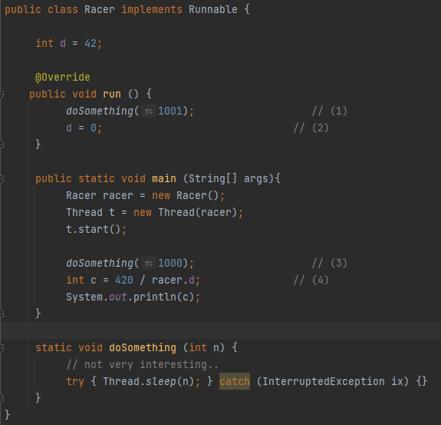
JPF (Java PathFinder) Example

Slide 6
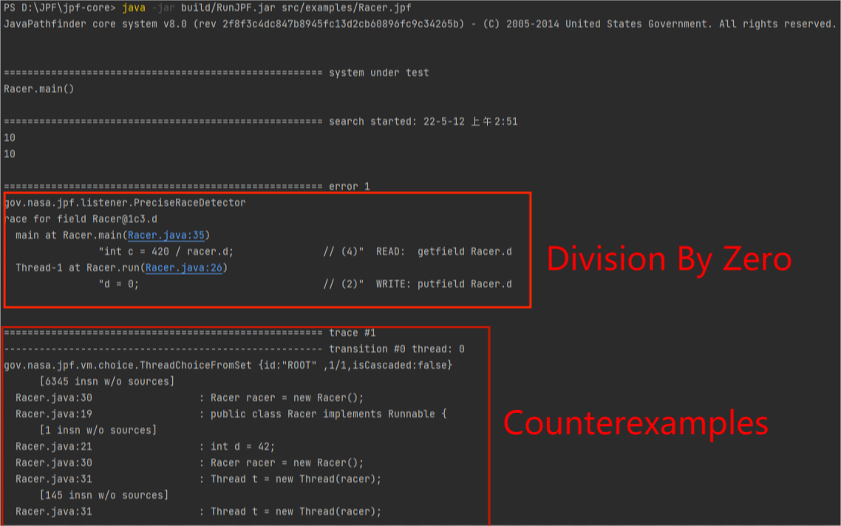
JPF (Java PathFinder) Example

Slide 7
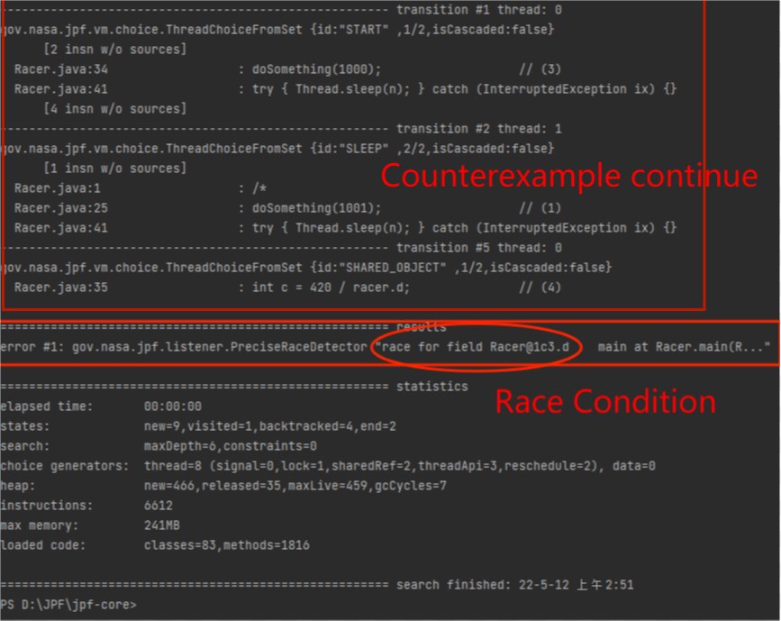
JPF (Java PathFinder) Example

Slide 8
JPF (Java PathFinder) Example
JPF JVM states:
State backtracking: explore the executions for all values in the range. JPF implements this by storing and restoring the entire JVM state of the program being checked
State comparison: performs a stateful search and stops an execution path if it encounters a previously seen state
State representation: encodes each object simply as a Java integer array (int[ ]) and based on type information, interprets a field as either a primitive value or a pointer to another object. JPF encodes the entire heap effectively as an array of integer arrays (int[ ][ ] in Java).
Bytecode execution: provides classes that implement the semantics of Java bytecodes by manipulating the special state representation, whose goal is to make the overall exploration fast even if it makes one straight-line execution path slow
Model Java Interface (MJI):provides a mechanism for executing parts of application code on the host JVM. MJI allows the host JVM to manipulate the JPF state representation, e.g., to read or write field values or to create new objects.

Slide 9
Collect Counterexamples: Abstraction Implementation
Every path in the abstracted program where all assignments are deterministic has a corresponding path in the concrete (unabstracted) program^{[1]}
if an abstract system is deterministic, then it is equivalent to the concrete system
(i.e., there is a simulation equivalence between the concrete and abstract systems)
every deterministic abstract path has a corresponding path in the concrete program
Reference:
[1](Theorem 5)Sa¨ıdi, H.: Model checking guided abstraction and analysis. In: Palsberg, J. (ed.), Proc. 7th International Static Analy_x0002_sis Symposium (SAS’00), Lecture Notes in Computer Science,
vol. 1824. Springer, Berlin Heidelberg New York, 2000, pp.377–396

Slide 10
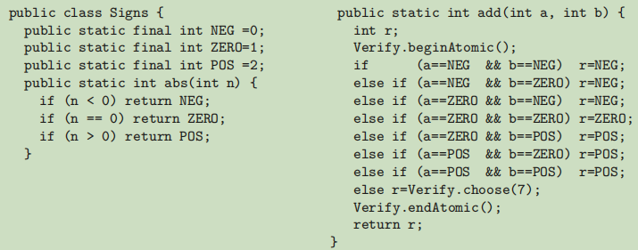
Collect Counterexamples: Abstraction Implementation
Java representation of the signs AI(Abstract Functions)
Abstract tokens are implemented as integer values, and the abstraction function and operations
have straightforward implementations as Java methods

Slide 11
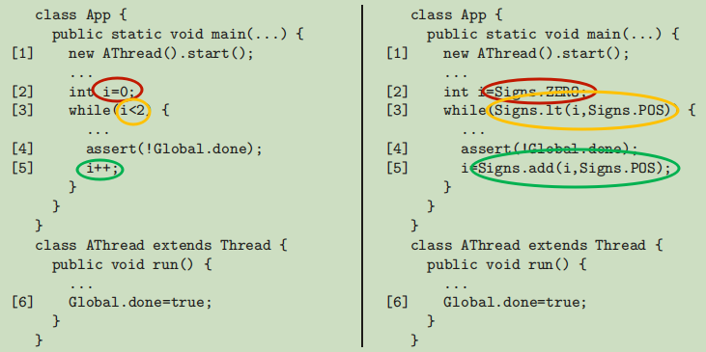
Collect Counterexamples: Abstraction Implementation
nondeterminism is introduced when implements abstract operation for integer <
i becomes POS,
so Signs.lt(i,Signs.POS)
can return true or false
At First it is true
Concrete(Left) Abstract(Right)
selects a set of AIs for a program’s data components
type inference is used to calculate the abstractions for the remaining program data
the Java class that implements each AI’s abstraction function and abstract operations is retrieved from abstraction library
finally the concrete Java program is traversed, and concrete literals and operations are replaced with calls to classes that implement the corresponding abstract literals and operations

Slide 12
Collect Counterexamples: Abstraction Implementation
nondeterminism is introduced when implements abstract operation for integer <
i becomes POS,
so Signs.lt(i,Signs.POS)
can return true or false
At First it is true
Concrete(Left) Abstract(Right)
Steps in the path contain additional information, such as the class name and line number of the executing thread, that can be used to determine the execution context. When executing the concrete system using the error-path generated from analysis of the abstract system we check whether the class name and line number expected by the error path is matched by the execution in the system. A mismatch indicates that the abstract path is not feasible in the concrete system.
The counter-example does not contain nondeterministic choices since the value returned by Signs.lt(i,Signs.POS), when i is zero, is uniquely true.

Slide 13
Manipulate Counterexamples:Minimizing Implementation
A model checking counterexample is intended to be read by a person and used for debugging.
Ideally, such a counterexample would be the most succinct and easily comprehensible witness to the existence of an error. The utility of small (in various senses, including length) counterexamples is widely recognized.
Previous work on minimization of counterexamples has concentrated either on producing counterexamples of minimal length or on removing irrelevant information from a counterexample.
Proposed a technique that can be used to minimize counterexample length, but focuses on a semantic minimization, with respect to the type system of the language
=> minimizes the values of variables in the counterexample

Slide 14
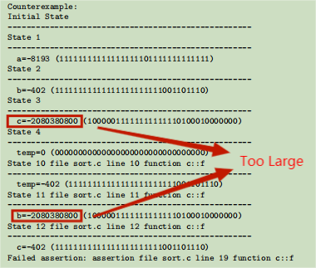
Manipulate Counterexamples:Minimizing Implementation
A very unfortunate choice for the initial value
Reason of Large Value Variables in Counter Examples:
The SAT solvers used to check these formulas for satisfiability typically return the first satisfying assignment produced. The counterexample values, therefore, are highly dependent on the decision heuristics used by the SAT solver. These choices may result in needlessly large values for the actual program variables

Slide 15
Manipulate Counterexamples:Minimizing Implementation
Abstract counter-example makes it easier to collect counter-example,
then we want to minimize the counter-example produced to generate new instantiated code to reproduce the identified error from a smaller value of detected error-related variables.
Minimization of counterexample values can be considered as a 0-1 ILP(Integer Linear Programming) problem
A pseudo-Boolean constraint solver(PBS) which, given a SAT instance in CNF and a set of integer coefficients for SAT variables, will solve optimization problems over the constraints
The length of the counterexample is minimized before values are minimized. Each guard bit is given a weight equal to the number of program statements guarded by that condition.
The psuedo-Boolean optimization problem is to minimize the weighted sum (the number of executed program statements).
Counterexample length minimization is completed and guard values are locked before value minimization begins.

Slide 16
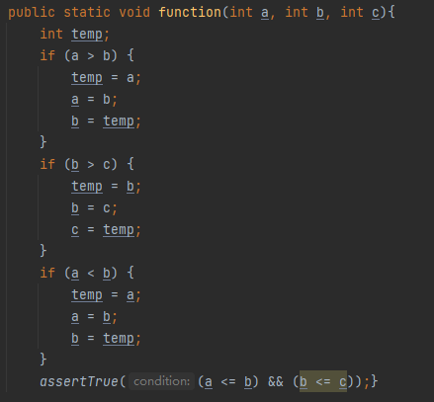
Experiments
TODO:
Minimize the sum of |a| + |b| + |c| + |temp|
Theory:
each of these variables may take on different
values during execution of the program. Therefore, the sum that is minimized is over all program variables after loop unrolling and static single assignment(SSA)
Actual:
Minimize the sum of |a#0| + |a#1| + |a#2| + |a#3| + |a#4| + |b#0| + ... + |b#6| + |c#0| + |c#1| + |c#2| + |temp#0| + ... + |temp#6|

Slide 17
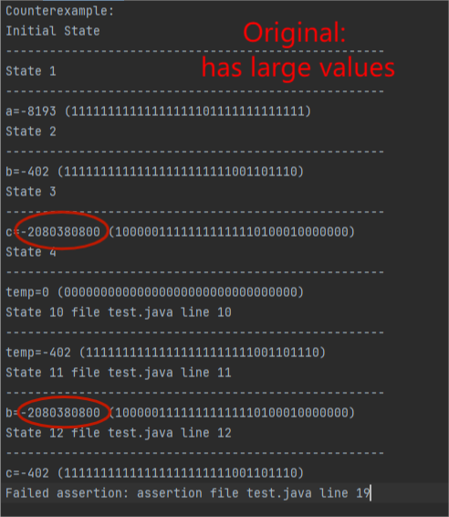
Experiments

Slide 18
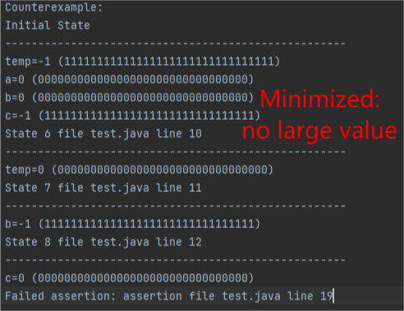
Experiments

Slide 19
Experiments
Experiment ID | Normal Result |  |  | Minimized Result
 | Time(s) | Sum of Variables | length in steps | Time(s) | Sum of Variables | length in steps
test1.java (sorting) | 0.70 | 4.161 × 10⁹ | 7 | 25.72 | 2 | 7
test2.java (Race Condition) | 1.30 | 111,905 | 13 | 13.35 | 9,734 | 13
test3.java (Deadlock) | 1.20 | 747,623 | 25 | 14.55 | 9,524 | 25
Sum of variables significantly reduces
length in steps of the counterexample does not change
Running time(JPF build time) increases, depends on code logic

Slide 20
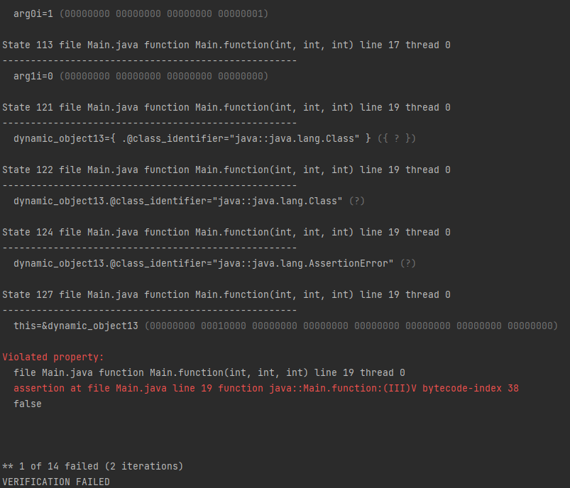
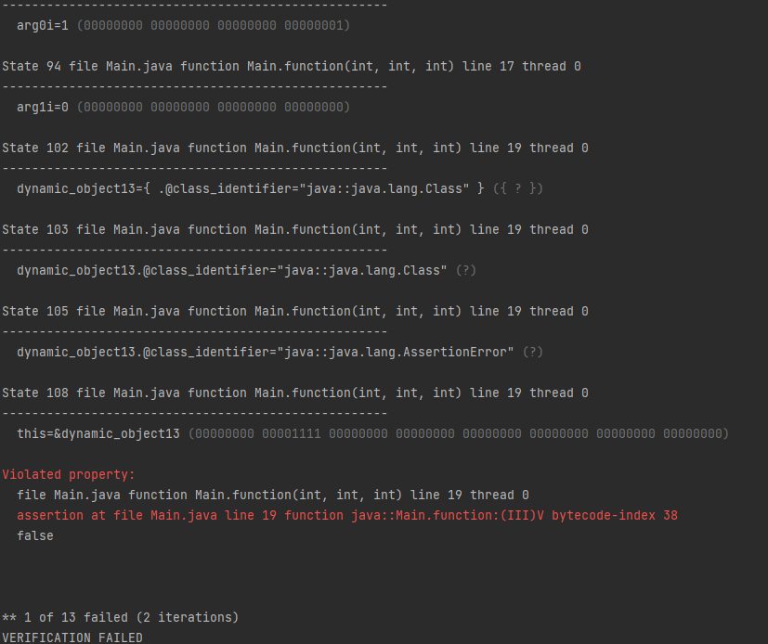
Employ JBMC(Java Bounded Model Checker) over SV-COMP

Slide 21
Employ JBMC(Java Bounded Model Checker) over SV-COMP
All benchmarks were checked by employing JBMC using proposed method
Number of states changes from 127 to 108
Sum of variables changes from 164 to 23
Elapsed Time changes from 0.0109139s to 0.0101328s

Slide 22
Limitation. Future Work & Open Challenges
minimizing algorithm are considerably slower than plain BMC without minimization
investigate SAT solvers with decision heuristics that are aware of a metric for counterexample simplicity: the idea being to make favoring simple counterexamples a part of the search algorithm, instead of a post-processing step.
For programs does not include linear algebra logics

Slide 23
THANKS FOR WATCHING !

