Slide 1
Decisive Logic sh $_~/rt/bin/*’’’Gate Matrices
To consider : @bitmap(p0, p1, p2) → p*-^phi[cosine(sin(2.01ghz)) pie(__displacement.malloc.__bitstream[IPAProtocal_$BUFFER__#[0x0E0F]++)]ghx.z2txx_blocks::_#/$***--failsafe != errorlevel@ghz_#[pie]
---------~----------
STREAM RADAR HASH BLOCKS

Slide 2
AL_FIN BOTNET ALLOCATION
Parasite Q-bit
packet_switch_#[0.0.0.0:IPATTY:__SMS__]
DEF recon omega bravo echo micro object fail over
512-0110-2-01-1-2-555 LT Grand T-zero
Cold White
BYPASS DATASTREAM
ALLOCATION→PACKET:(args)
AL_FIN(global.128q-bit(***01,01,01,01
1,01, 11, 0, 01, 01, 1, 01 01, 1, 11, 11))
>PING hZ2-freeze @admin(localhost:8282)
SHUTDOWN -fm 0 1 -rep “biosWARE.v201.33.0:kol”

Slide 3
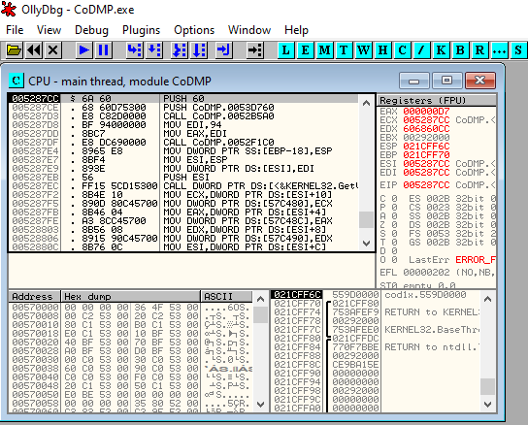
Reverse Engineering Activist-ion Servers
Trace Break-Point
Log Registars Locate DWORD
Regedit.MSC -format SERVER_CLUSTER -ping(0.0.0.0:*/ ? Localhost : 8.8.8.8)
TRANS := __PAYLOAD__ STR-**/cmd.exe >> log.txt

Slide 4
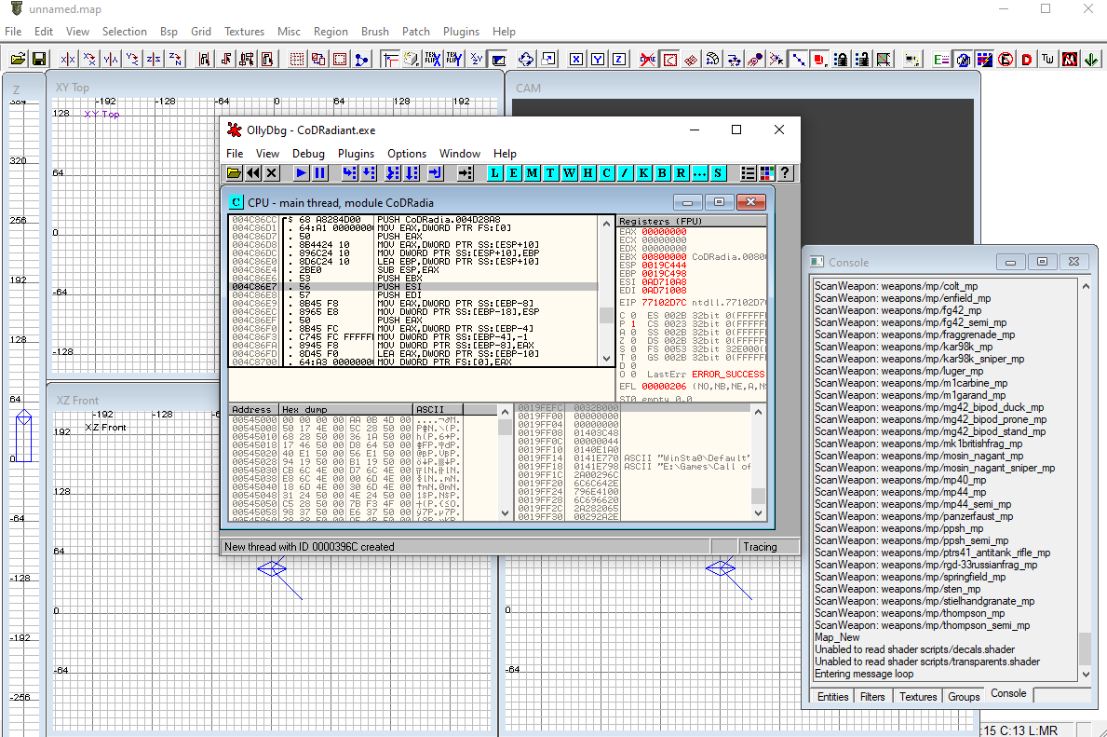
TERRACOM SATILLITES

Slide 5
HASHDUMPS && BLOCKCHAINS
BREAK;
SS/DOT:@(__LOCALIZEDHOST__::__DEM__://-NEG[0x000AEF1D]){
CD:-|ADA_:[sys route -g1 -aE /sys.matric]
TOM:-EJECT/TILT -> R1 + R2 - 05neg
ECHO MEGA D2 1EGTY FOXTROT ORILLY
SYSCMD(__REX__){
yell micro rot asd wqc -xcopy -tr dat -> rsc
fmt recon etw -vec -to -add 0x001A-XXXX
half -^ 412-555-0101-2-1101-2-1110-1111-222-5
find matter-x2 file loc eX112-aZ001-yD3
trans:01101001010010101001001001001110010010010011010101010010101001011010100101010/urs/tty/xx2-ww0-aol
kol:data(args *pt)_@//hector.ai
zero-go -d -zzz -v /*dod.hjk
DEK OL AS TO FELGO
Q-://7-0:route --101.1.2.7:10082
BT-net* matter-x2 -> #[trans]
RECAP[(c)NIMROD]__***##*#*#*#*#*#*#*#*###**#*#*##*#*###*##*#*###**#*#**#####-512-001-21-222-5
  }
}

Slide 6
BACKDOOR SPADES PROGRAM
SET:_t0^setlocal(-2.0134){
FAL OT 221 -01 SYS break -> defined#//oscar.hotel.jack.drill.oak
FELIX MEGA FALL BREAK OSCAR MAJOR DENNIS LOSSY HEFT NAVY SOS SINK 101 222
emf-BLAST
trigger:(easter.gonzo.loco.backbone._5112/92/1001)
}

Slide 7
CRAWL IN A HOLE THAN DIE
AL_FIN(__GLOBALHOST__):@_)(::--//01001011:|__AI__:
  DATAMINE(__AUTH__::__SALT__){
  UT A LL:010010010//http::__GET__
    #/!bin$$usr >> mnt/cdrom/edt1
  DS/COM::__SATTY__:://tty:__011110/htx.vetor.mortium//ww1.dat >> /srv/dat.rsc
  SS/CMD::__TOLL__//__$$$__:!)_+//user.auth
LOG:!(O)://sys.matric/.profile
    FRC.CMD:!(__SHUTDOWN__)
}
BREAK;

Slide 8
UNDER THE RADAR
systeminfo(&eval([%HOST%])) += __MACROSYSTEM__::__DRIVER__::__EMULATE__ + taskkill
setx(systeminfo(args)) += REM GOTO %ipconfig => 0.0.0.0:80
PICKNIK@(__DRIVER__) -> :_#[__GLOBALHOST__]
__PROCESSKEYBIND__::_@(__SYSTEM__:_@(systeminfo)) += __MACROSYSTEM__
__DATASTREAM__:@(o) += ©NIMROD(§½¿¬µю╡╪╪╪├▌░▒▓▓▓▒░▐)

Slide 9
OVERLOAD SERVERS WITH VIRAL
~ OUTBREAK ~
§½¿¬µю╡╪╪╪├▌░▒▓▓▓▒░▐__BOTNET__::_/:[__HAILZUES__]:_&[__LOCALIZEDHOST__::__BUFFERALLOCATION__::__SYSTEMDRIVERS__] += __ROOTKIT__
§½¿¬µю╡╪╪╪├▌░▒▓▓▓▒░▐__BOTNET__::_/:[__EYLUVYOU__]:_&[__LOCALIZEDHOST__::__BUFFERALLOCATION__::__SYSTEMDRIVERS__] += __EMAILSYSTEM__
§½¿¬µю╡╪╪╪├▌░▒▓▓▓▒░▐__BOTNET__::_/:[__OUTLOKIE__]:_&[__LOCALIZEDHOST__::__BUFFERALLOCATION__::__SYSTEMDRIVERS__] += __BACKDOOR__
§½¿¬µю╡╪╪╪├▌░▒▓▓▓▒░▐__BOTNET__::_/:[__MEGAMANZ__]:_&[__LOCALIZEDHOST__::__BUFFERALLOCATION__::__SYSTEMDRIVERS__] += __HIJACKDRIVER__
§½¿¬µю╡╪╪╪├▌░▒▓▓▓▒░▐__BOTNET__::_/:[__ZOMBOIES__]:_&[__LOCALIZEDHOST__::__BUFFERALLOCATION__::__SYSTEMDRIVERS__] += __OUTBREAK__
§½¿¬µю╡╪╪╪├▌░▒▓▓▓▒░▐__BOTNET__::_/:[__ROUTEIRS__]:_&[__LOCALIZEDHOST__::__BUFFERALLOCATION__::__SYSTEMDRIVERS__] += __RESPAWN__
§½¿¬µю╡╪╪╪├▌░▒▓▓▓▒░▐__BOTNET__::_/:[__KAOSOMGZ__]:_&[__LOCALIZEDHOST__::__BUFFERALLOCATION__::__SYSTEMDRIVERS__] += __INFECTION__
§½¿¬µю╡╪╪╪├▌░▒▓▓▓▒░▐__BOTNET__::_/:[__ROLFINST__]:_&[__LOCALIZEDHOST__::__BUFFERALLOCATION__::__SYSTEMDRIVERS__] += __MACROSYSTEM__
§½¿¬µю╡╪╪╪├▌░▒▓▓▓▒░▐__BOTNET__::_/:[__DREKAINR__]:_&[__LOCALIZEDHOST__::__BUFFERALLOCATION__::__SYSTEMDRIVERS__] += __AUDIODRIVER__

Slide 10
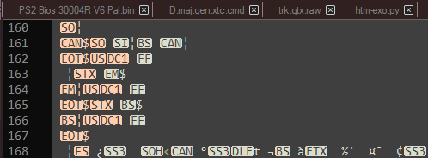
HIVE NETWORK → BYPASS_OVR_RIDER_^/:_@(args, argv, ardf-govnet~?>>?>>>>:?_)09:aef:EFError)tu_#[__BACKBONE__]
\\NETWORKDOMAIN
F:?!-(I){-->/http:@(/loc.htx//ww1.bt20.0101.gtty(#_[%HOST%]))};
doc hangafter rem -author -DOMAIN :/__microS0fT(c).risk -! tek
winter.dat -frm COST(_#[__GLOBALHOST__]:/__AI__)
SIG:()_#//-^:_)!(_*:+= ©NIMRODⅎ≠∑‡₪₩≡╞╬╬∏≈ↄ₴╦╜╚╗╖╖╖╨ⱣꟷꞷꝛꭥꝊꜾꜾꜾ Ͱ=:__POST__
rex@_)(=={--_HAT-QWERTY:!(-FORCE-BRUTE:!(__ERT2-TTX1-0:_!(IPv6 -^ NAS.bk-01(@_$[__GONZO__])))){
wE:__@(__grave[__time.dat -^ quake.lock])_!(0){
Ϳƨǣ:¿Ð±µ¥=§¨©+S²ė¦¦Ŕ¤ÐƕƆƩǂǃƛǯɫʯˁȝ±¬Ø×FFFFE®FÞ=(
###**##-00101011-**#*****###*#*###***##*#***####*#*#*####-212-5)
RAT:_(_$:/+&eval!=errorlevel)bin@usr >> Ø×FFFFE®FÞ{%i%xcopy}
±§=ĦŒĶʘ±§=ĦŒĶʘ±§=ĦŒĶʘ±§=ĦŒĶʘ
±§=ĦŒĶʘ±§=ĦŒĶʘ±§=ĦŒĶʘ±§=ĦŒĶʘ
±§=ĦŒĶʘ±§=ĦŒĶʘ±§=ĦŒĶʘ±§=ĦŒĶʘ
±§=ĦŒĶʘ±§=ĦŒĶʘ±§=ĦŒĶʘ±§=ĦŒĶʘ
WALL-ip_#[±§=ĦŒĶʘ]
}
}

Slide 11
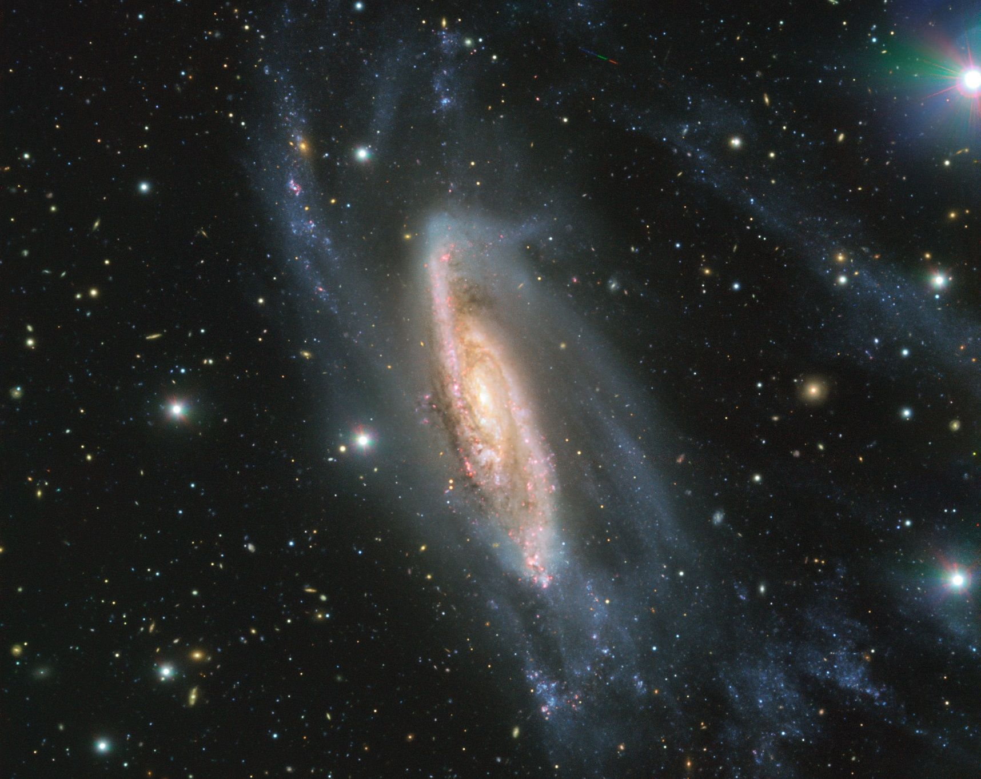
WARPZONE ~E:__SUBNETMASTER__::__BOOTRECORDER__
~//SUPERSHELL PWR SYS HOLLOW POINT T2U-BUFFER EXO NINE 2 1 0 -V ALL
DRYCLONE SYS BYPASS ZIGMA-DELTA-PHI – VERBOSE ~?::)p_*_[%FREEDOM%] ~/..?war-RCON~(_LOCALIZEDHOST__)LOGIN***ADMIN_$_@(Jxb00792-5112))
RESTAR~DOGMA -USNVAM***AMY***.ai ^ :@__ZENITH__?__HECTOR__:__BOOTSTRAP__::__GATEAVATE__
ZONE:__EST:_#//*._$(eL:__LOADAUTO__::__DIERECT__::__ORIALBYPASS__)~
LAUNCH AUTOPIOLIT EXACUTATION STIT CUT MASS-EFFECT LAUNCH BOOSTER BOOSTER BOOSTER MAAS-SYS ONLINE CHANGE LOAD LOGIN AUTO-***ZENITH** kEyC0D3_#[execHEX::2098432094829308509324509832095380294921-�-2395098350932809432-㉉-490328423985023949-GEET:1001110("C:\") 204239-䤣-䉉-32409238409284901289038912-�-�-�-𣂔-㊔-㊔-⎔-32950385083254923-I-2=-4=2-I-GEET:1001110("C:\") 329423-�-=2943294-ʔ-2934023-48234892-�-1294238402384023840835908230948230948230949-ʔ-ʔ-230i40-㊔-32940129-䤲-夣-�-ኔ-Ε-㊄-028405923850932840238402394-⎔-ण-䤲-֒-䤒-Α-I-㉉-Ғ-Ғ-𴤲-䤣-4923049230940-ȁ-1-1-1-1-1-1-1-2001010101001010101010010101001110010010100101011010010100100100010010101010100001010010010100101001001001001010100101110101010101011100101011101010101001101-1012201010120391239209420981493280489023498032980423098402984329084023984032984032984093285032984329085032984092384329058392054209483290850923854092384092385329057290348903284093485390 << C:\ >>0932849013278598312404980349832019840298409321853209185329084023918509321 << C:\ >>093218543289 << C:\ >>3289 << C:\ >>9032850932845903284903285097352903284092381409832109573192057329014802394781328957932847409213840912385903287149023810498213]

Slide 12
BACKPOINT ~/SU -Vatialight>?<pasdor_reedium.ERROR.uav_SYSBUFFEROVRFLO33OR
bc->bytecode[id++] = S_SQ_MEM_GDS_WORD1_DST_GPR(gds->dst_gpr) |
S_SQ_MEM_GDS_WORD1_DST_REL(gds->dst_rel) |
S_SQ_MEM_GDS_WORD1_GDS_OP(gds_op) |
S_SQ_MEM_GDS_WORD1_SRC_GPR(gds->src_gpr2) |
S_SQ_MEM_GDS_WORD1_UAV_INDEX_MODE(gds->uav_index_mode) |
S_SQ_MEM_GDS_WORD1_UAV_ID(gds->uav_id) |
S_SQ_MEM_GDS_WORD1_ALLOC_CONSUME(gds->alloc_consume) |
S_SQ_MEM_GDS_WORD1_BCAST_FIRST_REQ(gds->bcast_first_req);

Slide 13
DRONE SYSTEM BUFFER FATALITY
ADA:__PASCAL__::_@)())___qw {a{__ARGS__} -RW+DVD}
__ARGS__::_$execHEX()%s–%–s%Ù%Ù%/%/%hg%gh%÷Ô%Ô÷%JJ%JJ%WÐ%ÐW%vh%hv%ú%ú%»%»%®­%­®%ˆ$%$ˆ%þy%yþ%ÛR%RÛ%C%%%C%<å%å<%Eô%ôE%ØÓ%ÓØ%Î(%(Î%õ%õ%`Å%Å`%=Y%Y=%'—%—'%YŠ%ŠY%-v%v-%ÂÐ%ÐÂ%ÍÉ%ÉÍ%Ôh%hÔ%jI%Ij%%y%y%
READWRITE OVERLOAD SLIP UAV DISC FATIAL EXPOSER SYSTEM OVERLOAD ST5-R3END[ERON]
ADA:C#_::__execHEX()%s–%–s%Ù%Ù%/%/%hg%gh%÷Ô%Ô÷%JJ%JJ%WÐ%ÐW%vh%hv%ú%ú%»%»%®­%­®%ˆ$%$ˆ%þy%yþ%ÛR%RÛ%C%%%C%<å%å<%Eô%ôE%ØÓ%ÓØ%Î(%(Î%õ%õ%`Å%Å`%=Y%Y=%'—%—'%YŠ%ŠY%-v%v-%ÂÐ%ÐÂ%ÍÉ%ÉÍ%Ôh%hÔ%jI%Ij%%y%y%
DBGLog$(admin:_@_!!!__buffer.ovr.raid.system.bypass.omega)

Slide 14
| Alpha One Miner Rig |
ASUS PRIME A520M-K AM4 AMD A520
SATA 6Gb/s Micro ATX AMD Motherboard
$60
AMD RYZEN 5 3600X 6-Core 3.8 GHz (4.4 GHz Max Boost)
Socket AM4 95W 100-100000022 Desktop Processor
$160
AMD Wraith MAX CPU Cooler
$60
XFX Radeon RX 570 8GB DDR5 PCI Express 3.0
CrossFireX Support Video Card RX-570P8DFD6
$520
G.SKILL Trident Z Neo (For AMD Ryzen) Series
16GB (2 x 8GB) 288-Pin RGB DDR4 SDRAM
DDR4 3600 (PC4 28800) Desktop Memory
$100
Thermaltake Toughpower GF1 850W
80+ Gold SLI/Crossfire Ready
Ultra Quiet 140mm Hydraulic Bearing
Smart Zero Fan Full Modular Power Supply

Slide 15
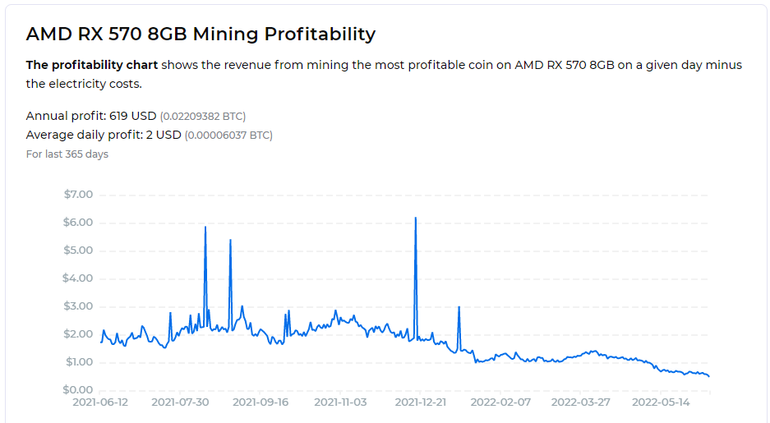
PASSIVE EGUNIETY

Slide 16
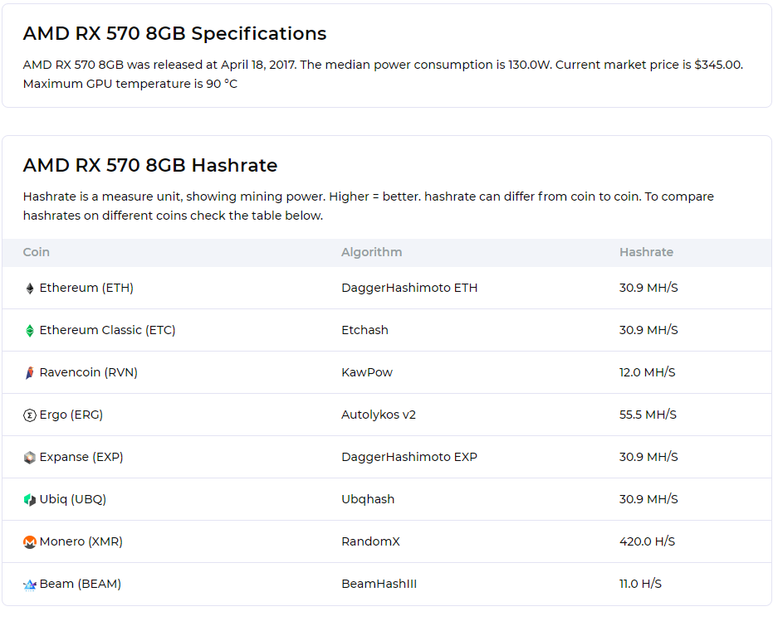

Slide 17
TELEPHONIC CORROSION
//
// wpad.dat script FOR SYRACUSE - Proxy IP: 75.104.121.60
//
var firstrun; // Flag to indicate if the browser was just launched
var unprovisioned = false // Unprovisioned account flag
var proxyhost = "75.104.128.60:80"; // Proxy host
var myip = "";

Slide 18
SALT CRACK BLUEBEAM
//
// wpad.dat script FOR SYRACUSE - Proxy IP: 75.104.128.60
//
var firstrun; // Flag to indicate if the browser was just launched
var unprovisioned = false // Unprovisioned account flag
var proxyhost = "75.104.128.60:80"; // Proxy host
var myip = "";
function FindProxyForURL(url,host) {
if (myip != myIpAddress()) {
firstrun = true;
}
myip = myIpAddress();
// If CPE has a private IP, verify if we are unprovisioned
if (firstrun && isPrivateIp(myip)) {
var ip = dnsResolve("www.wildblue.net");
if (ip == "10.255.10.40") {
// unprovisioned account
unprovisioned = true;
}
}

