Slide 1

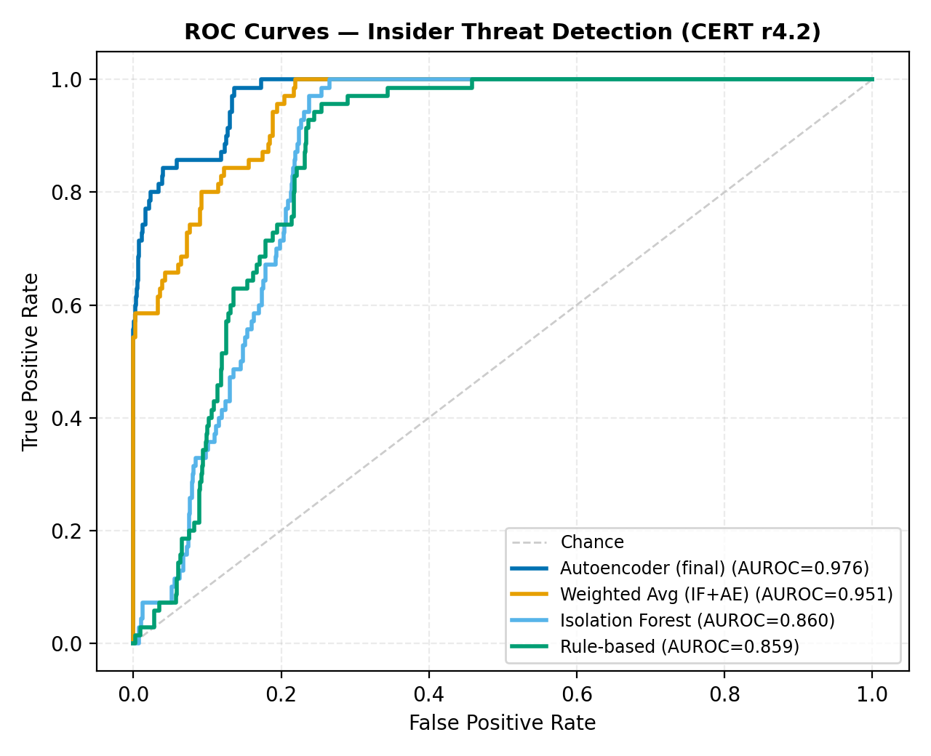
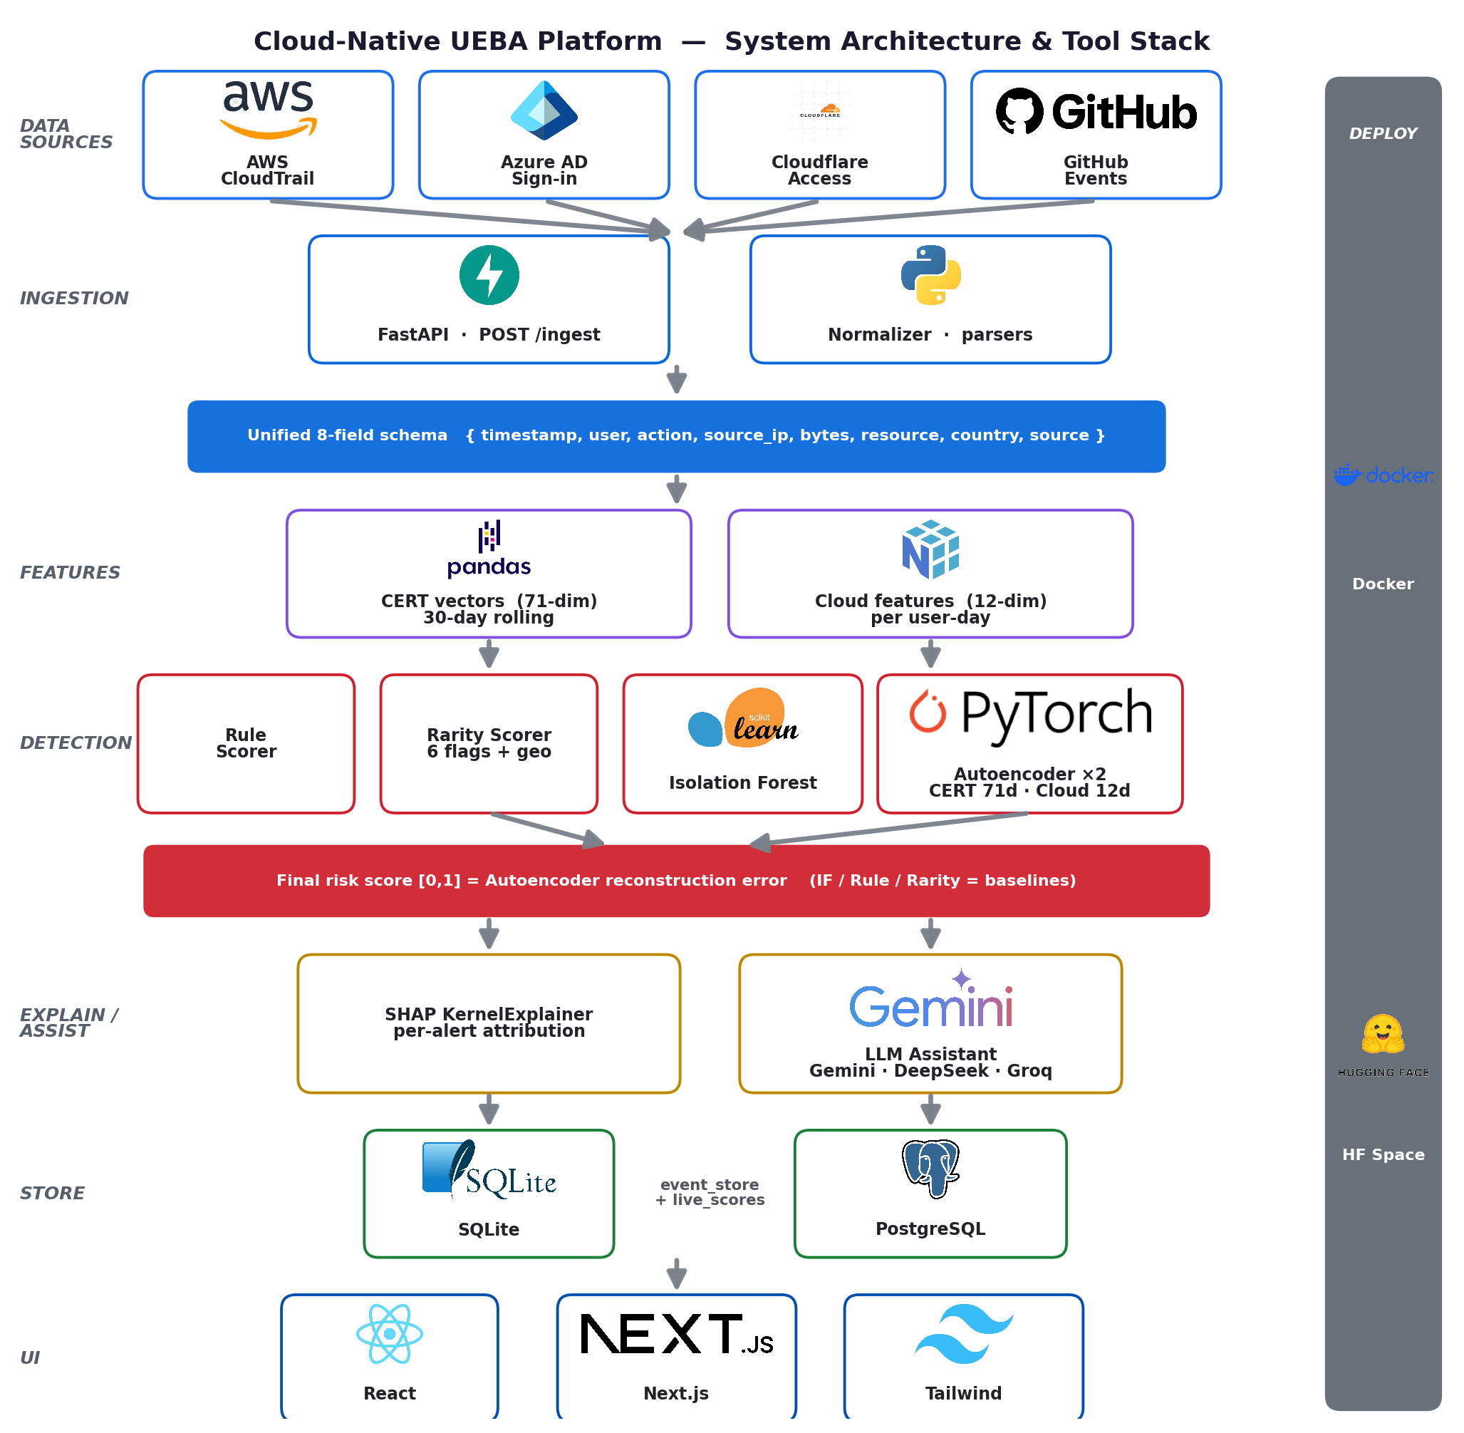
UM iFEST 2026 · UG FYP
Cloud-Native UEBA Platform for Insider Threat Detection
Unsupervised, explainable anomaly detection across four real cloud log sources
Yap Zhe Cheng (23004982) · Supervisor: Firdaus Sahran
Faculty of Computer Science and Information Technology, Universiti Malaya
INTRODUCTION
RESULTS & DISCUSSION
Insider threats drive ~60% of breaches and cost organisations an average of USD 17.4 million per year. Because insiders act with legitimate credentials, signature-based defences are structurally blind to them.
Existing open-source UEBA tools (Wazuh, OpenUBA, HELK) are rule-based, single-source, and opaque — they cannot explain why a user is flagged. This project closes four gaps at once: multi-cloud normalisation, adaptive baselining, label-free detection, and per-alert explainability.
Model | AUROC | AUPRC | F1
Autoencoder (final) | 0.976 | 0.851 | 0.787
Weighted IF+AE | 0.951 | 0.740 | 0.726
Isolation Forest | 0.860 | 0.206 | 0.379
Rule-based | 0.859 | 0.207 | 0.367
OBJECTIVES
Table 1. Detector performance on CERT r4.2 (1,000 users, 70 insiders).
• Normalise heterogeneous multi-cloud logs into one unified 8-field schema.
• Detect insider behaviour with unsupervised models — no labelled attacks.
• Explain every alert via SHAP attribution and an LLM analyst assistant.
• Evaluate against the CERT r4.2 insider-threat benchmark and real cloud data.
METHODOLOGY — SYSTEM ARCHITECTURE
A decoupled, layered pipeline: source-specific parsers feed one schema; per-user behavioural features and peer-group baselines feed two Autoencoders; SHAP and an LLM explain each score on a React dashboard, deployed via Docker + HuggingFace.
Fig. 2. ROC curves — Autoencoder vs. baselines.
The label-free Autoencoder reaches ~90% of supervised accuracy (AUROC 0.976) and decisively beats rule and isolation baselines. A live-replay harness confirms the deployed /ingest path preserves this ranking (AUROC 0.917); on real flaws.cloud AWS data the cloud model reaches AUROC 0.724 against privilege-escalation attacks.
CONCLUSIONS
• An unsupervised Autoencoder detects insiders at near-supervised accuracy with no labels.
• Four real cloud sources unified; SHAP + LLM make every alert explainable.
• Deployed live (Docker + HuggingFace Space + Vercel).
• Future: Transformer sequence model, MITRE ATT&CK mapping, streaming ingestion.
REFERENCES
Inayat et al. (2024). Insider threat mitigation: systematic review. Ain Shams Eng. J.
Kotb et al. (2025). Deep synthesis-based insider intrusion detection. Sci. Reports.
Datta et al. (2021). Real-time threat detection in UEBA. IEEE IEMENTech.
Verizon (2025). Data Breach Investigations Report.
Fig. 1. Layered pipeline: ingestion → features → detection → explainability → dashboard.
KEY CONTRIBUTIONS & IMPACT
AUROC 0.976
Label-free detection — near-supervised accuracy with zero labelled attacks.
4 cloud sources
AWS · Azure · Cloudflare · GitHub unified into one 8-field schema.
Explainable
SHAP attribution + LLM analyst give the reason behind every alert.
Live AUROC 0.917
Production /ingest validated; deployed on Docker + HF Space + Vercel.

