Slide 1

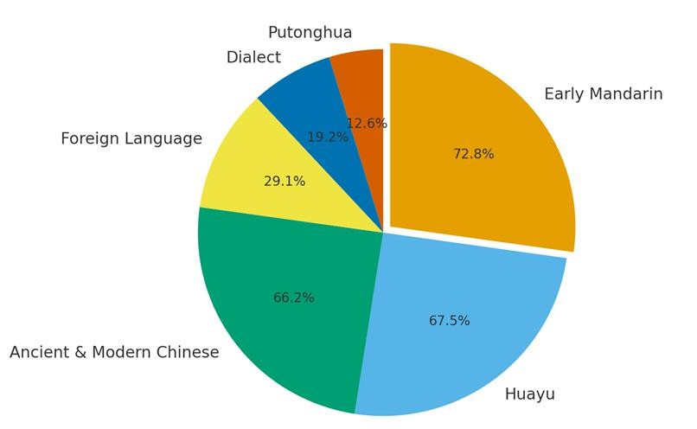
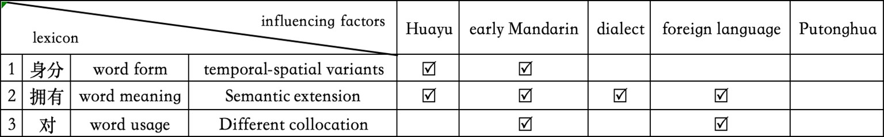
UM iFEST 2026 - ST-AI-0122
Lexical Usage Characteristics in the Malaysian Chinese Language from a Global Chinese Perspective
YAP ZHE CHENG, FIRDAUS SARHAN
Department of Chinses Studies, Faculty of Arts and Social Sciences, Universiti Malaya, Kuala Lumpur, Malaysia
INTRODUCTION
This study applied Diao Yanbin’s (2022) “Six
RESULTS AND DISCUSSION
found
Significant lexical between the
differences
were
Perspectives” Mandarin, Putonghua, Chinese—to
framework—Huayu, Early
Malaysian
Chinese
Dialect, Foreign and Ancient and
Language, Modern
language and Putonghua in word form,
meaning, and usage.
examine lexical differences
Major
influences
came
from
Early
between the Malaysian Chinese language and Putonghua. Using Sin Chew Daily news (Jan–
Guoyu, Huayu, and Classical/Early Modern Chinese.
lexicon shows systematicity, inheritance, evolution,
Mar 2025), the study found that all six
The
Malaysian
Chinese
perspectives influenced Malaysian Chinese to varying degrees.
and multi-sourcedness, with a clear tendency toward disyllabification.
RESEARCH SIGNIFICANCE
Filled a research gap in the systematic study of lexical usage in the Malaysian Chinese language.
Applied Diao Yanbin’s (2022) “Six Perspectives” theory for the first time in Malaysian Chinese language research.
METHODOLOGY
Theoretical Framework
Adopted Diao Yanbin’s (2022) Six Perspectives theory as the analytical foundation.
Fig. 2. Proportion of Influences on the Malaysian Chinese Lexicon
CONCLUSIONS
This study was the
first to apply Diao
Yanbin’s Six Perspectives framework to Malaysian Chinese language research,
Research Methods
Corpus Analysis: Based on Sin Chew
Daily news (Jan–Mar 2025) written by Malaysian local journalists.
Comparative Analysis: Examined lexical
confirming its theoretical suitability.
It highlighted the unique lexical features of Malaysian Chinese and promoted diversity and inclusiveness within the Global Huayu community.
REFERENCES
Diao Yanbin (2022a). Six Perspectives on the Study of Chinese Language. Folklore, Classics and Scripts, (2), 257-272.
Guo Xi (2004). On "Hua Yu". Journal of the School of Chinese Language Jinan University, (2), 56-65.
differences between the Malaysian Chinese
language and Putonghua.
Inductive Analysis: Categorized findings into word form, meaning, and usage, summarizing the lexical features and formative causes of the Malaysian Chinese language.
Fig. 1. Examples of Lexical Differences and Their Influencing Factors

