Slide 1
Application Acceleration with High-Level Synthesis – Lab A (Interface synthesis)
111061545 陳揚哲

Slide 2
Lab A (Interface synthesis)
Lab 1 Block-Level Protocol
Lab 2 Port-Level Protocol
Lab 3 Array Interface
Lab 4 AXI Interface

Slide 3
Lab 1 (Block-level Protocol)
The block-level I/O protocol control RTL design by the control signal. (Independent of data I/O ports)
The block-level control ports contain ap_start, ap_ready, ap_done, ap_idle, and ap_continue.

Slide 4
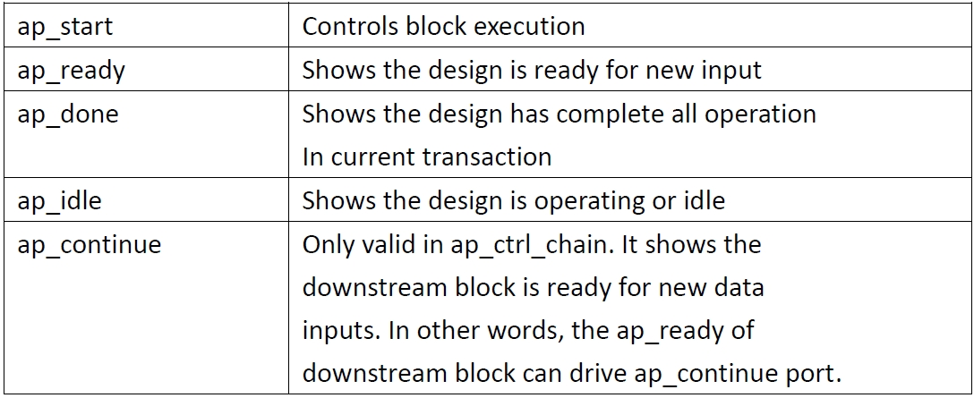

Slide 5
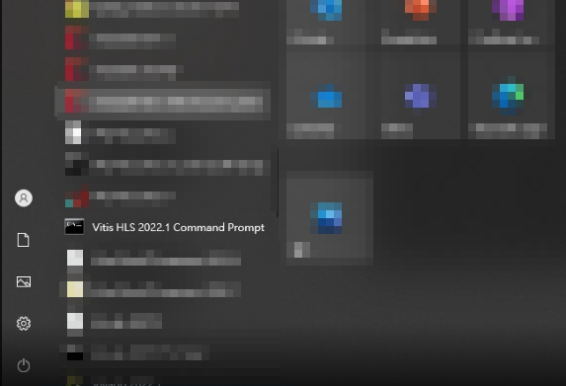
Lab1 procedure
1. Open the Vitis HLS 2022.1 command prompt.

Slide 6
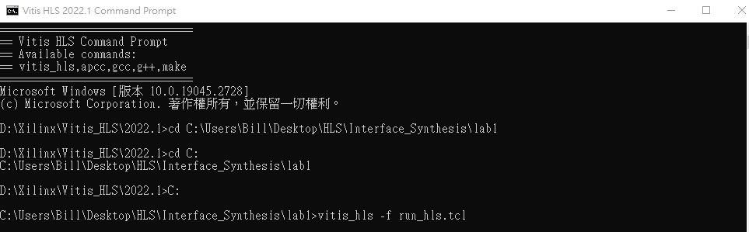
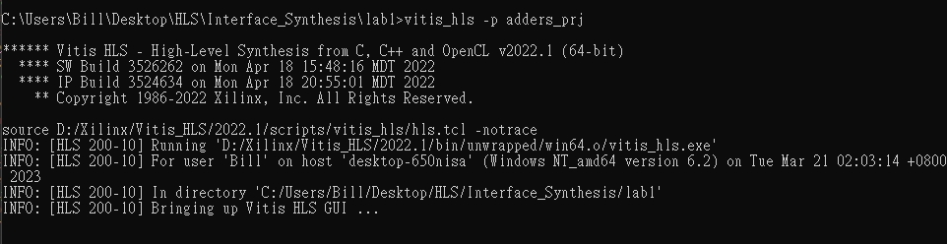
2. Change the directory to the folder of lab1
3. Type command “vitis_hls -f run_hls.tcl” to set up the environment
4. Open the project with command “vitis_hls -p adders_prj”

Slide 7
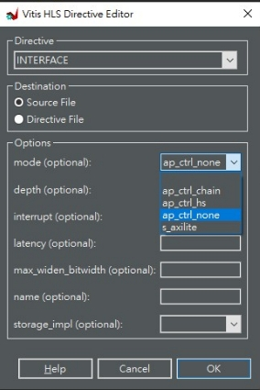
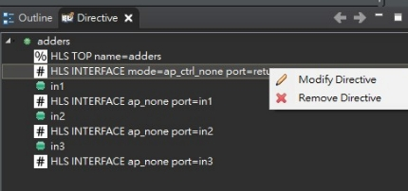
5. Set interface of in1, in2 and in3 as ap_none.
6. Set interface of adders(top function) as ap_ctrl_none, ap_ctrl_hs, and ap_ctrl_chain.
7. C simulation C Synthesis Cosimulation

Slide 8
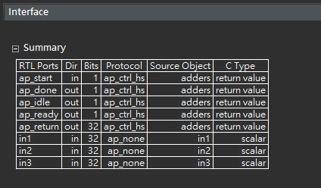
ap_ctrl_hs

Slide 9
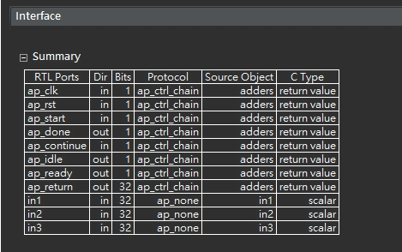
ap_ctrl_chain

Slide 10
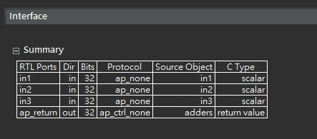
ap_ctrl_none

Slide 11
Error in Co-simulation with ap_ctrl_none
Co-simulation requires a block-level I/O protocol to sequence the test bench.
The ap_ctrl_none doesn’t add the block level I/O ports. It can’t operate co-simulation.
However, in our case, this is a combinational logic, so we can operate co-simulation.

Slide 12
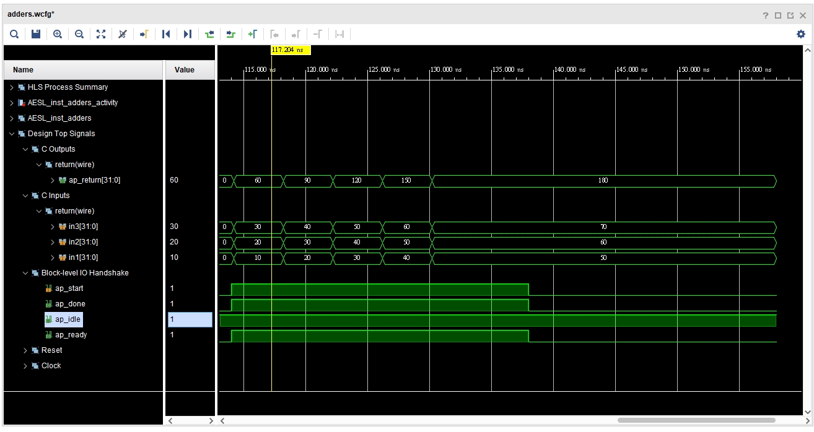
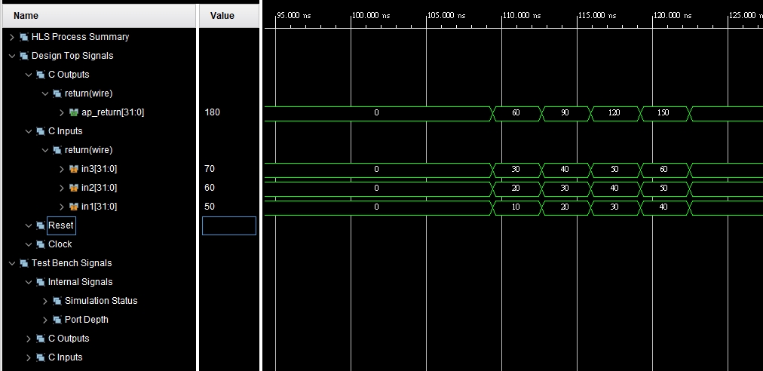
Notes:
理論上在ap_ctrl_none的情形下是無法進行cosimulation的,但在這個地方卻可以執行
我認為原因可能是因為此情形純粹是combinational logic 並未涉及sequential logic 因此仍然可進行合成

Slide 13
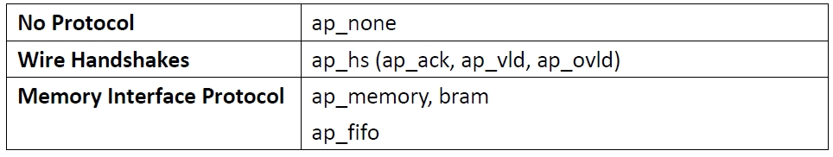
Lab 2 (Port-level protocol)
The port-level I/O protocol is the data flow I/O ports.
There’re three different kinds port-level protocol.

Slide 14
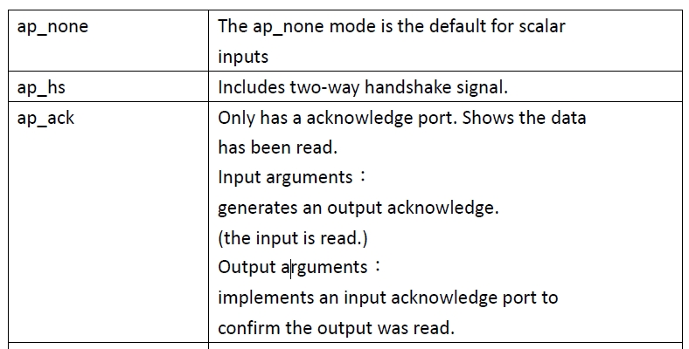
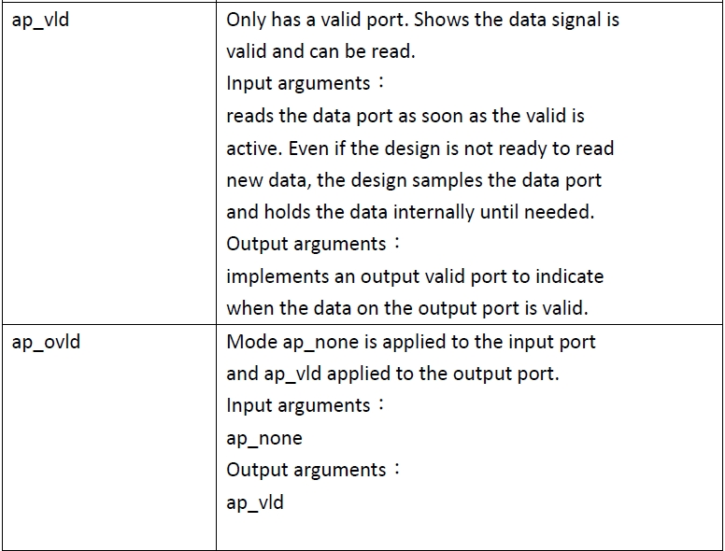
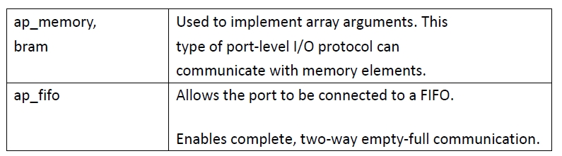
Notes:
ap_ack 資料是否被讀取 (output)
ap_vld 資料是否可被讀取 (input)
ap_memory和bram是用於array 的形式. 此I/O protocol 可以communicate with memory elemnents
ap_fifo 則是將此訊號與FIFO結合在一起.

Slide 15
Lab2 procedure
Use same steps from 1 to 4 as lab1.
Change interface of in1, in2 and in3 as ap_vld, ap_ack, and ap_hs.
C simulation C Synthesis Cosimulation

Slide 16
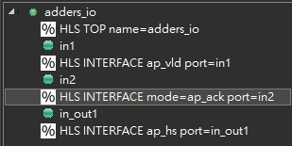
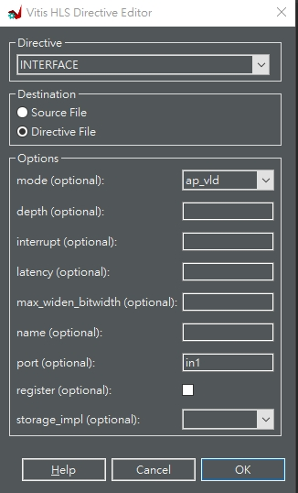
Set In1=ap_vld, In2=ap_ack, out1=ap_hs

Slide 17
Notes:
1. The data on port in1 is only read when port in1_ap_vld is active-High.
2. Port in2_ap_ack will be active-High when data port in2 is read.
3. inout_i associated input valid port inout1_i_ap_vld and output acknowledge port inout1_i_ap_ack.
4. inout_o associated output valid port inout1_o_ap_vld and input acknowledge port inout1_o_ap_ack.

Slide 18
Discuss
We only have ap_ack without ap_vld. How do the kernel knows it can read the data of In2 (Input)
We can observe the waveform of
1. The In1 I/O protocol remains ap_vld. The In2 I/O protocol assign as ap_hs.
2. The In1 I/O protocol remains ap_hs. The In2 I/O protocol assign as ap_ack.

Slide 19
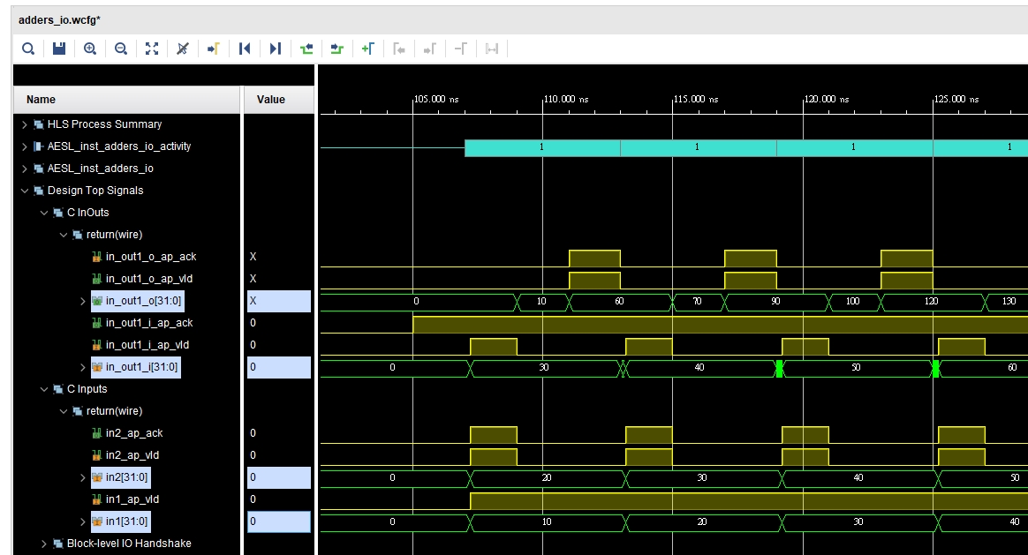
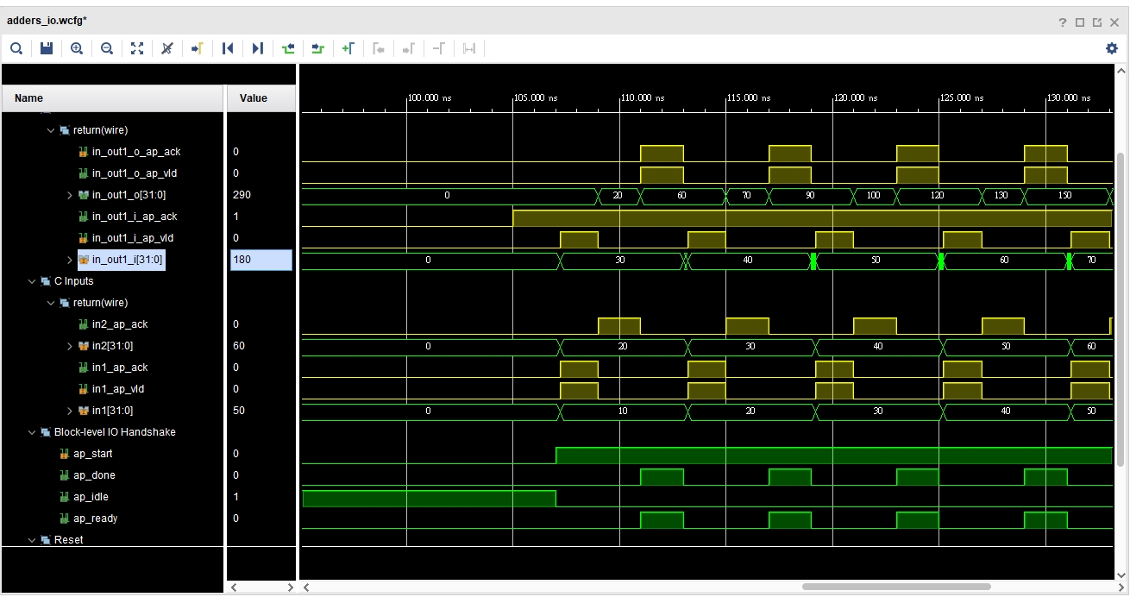
Notes:
我們可以發現 如果我們提供In2 一個ap_vld的input, ap_ack可以提前到ap_vld=1時便可開始讀取
然而如果我們並未提供ap_ack一個關於ap_vld的input, 那in2只會等到in1讀取完畢後才會開始讀取 因此ap_ack的時間較為偏後

Slide 20
Lab 3 (Array Interface)
This lab specifies implement different type of RTL port for array arguments.
If we use two-port RAM interface, this design can accept input data at twice rate of single port. Therefore, the estimated time of two port are lower.

Slide 21
Lab3 procedure
Use same steps from 1 to 4 as lab1.
Set interface of d_o as ap_fifo.
Set bind storage of d_i type as ram_2p and impl as bram.
Insert directive of for loop as unroll .
C simulation C Synthesis Cosimulation

Slide 22
Set array partition of d_o as factor = 4 and d_i as factor = 2 (type = block).
C simulation C Synthesis Cosimulation
Set array partition of d_o and d_i as type = Complete.
C simulation C Synthesis Cosimulation

Slide 23
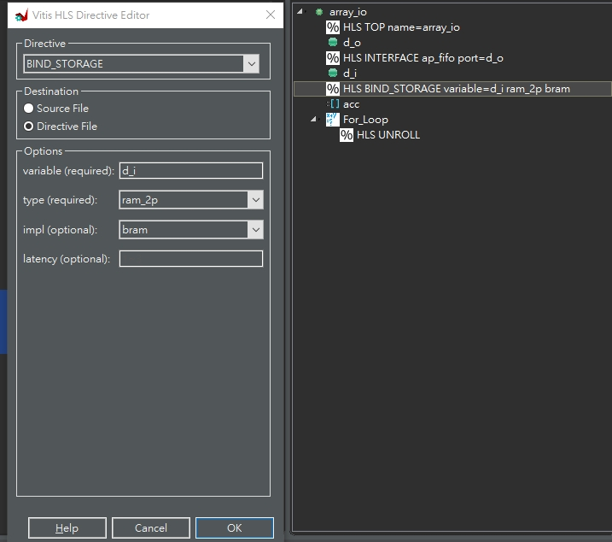
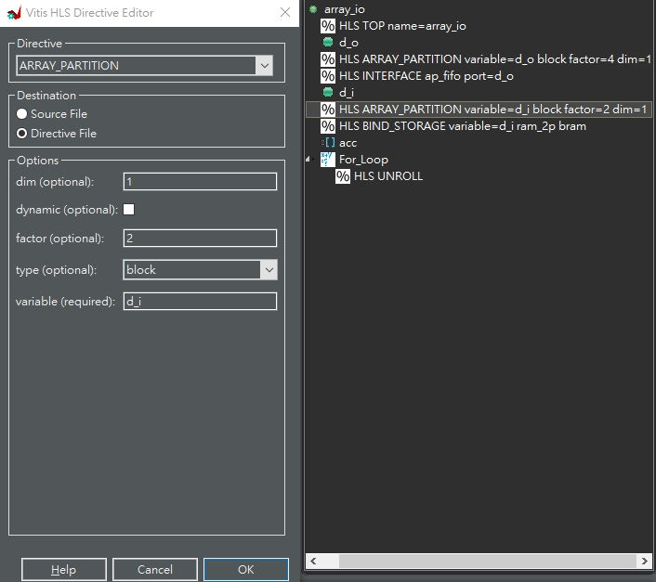

Slide 24
We can compare single port and Dual Port.
Solution 1 : Single port
(Type = Block)
Solution 2 : Dual port Unroll (Type = Block)

Slide 25
What if apply roll loop.
In rolled loop, loop is executed in turn.
This implementation code limits the logic to one read on d_i in each iteration.
In other word, reading d_i once in each loop. Thus, the estimated time wouldn’t be faster (solution5).

Slide 26
Solution 1 : Single port (Type = Block)
Solution 2 : Two port unroll (Type = Block)
Solution 5 : Two port roll (Type = Block)

Slide 27
What if apply unroll in single port.
It’s difficult to apply unroll in single port (ram_1p). Since we should carefully set the clock and fifo of I/O ports.
Therefore, it automatically transform it into dual port (ram_2p)

Slide 28
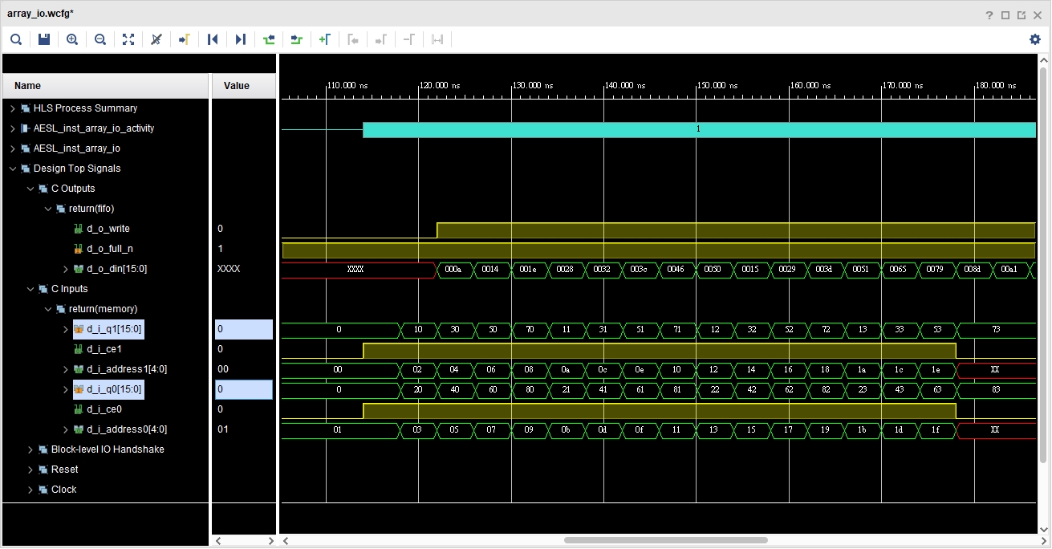
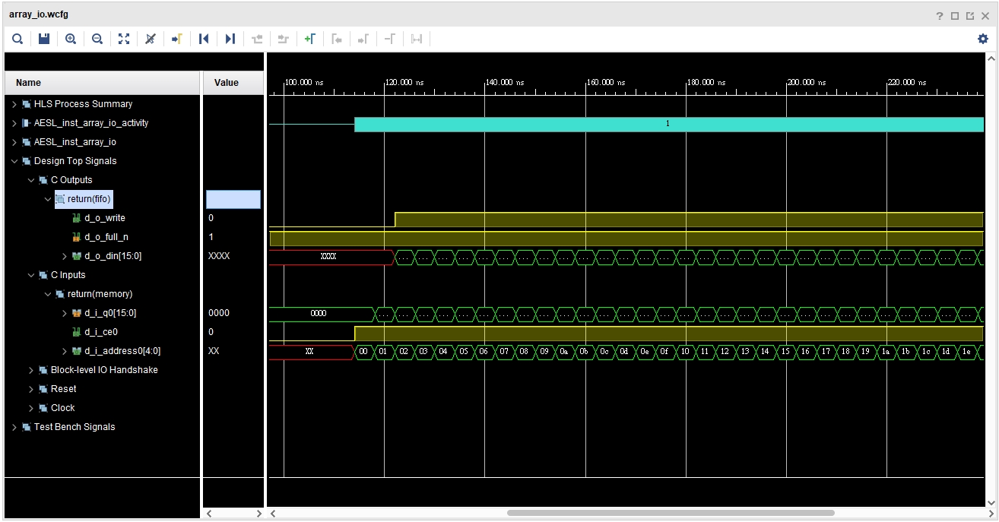
Notes:
ram_1p (unroll)
ram_1p (roll)

Slide 29
Array Partition
The input d_i will separate into the numbers of array partition factor RAM interfaces.
The output d_o will be divided into the numbers of array partition FIFO interfaces.
In this lab, we divide d_i into 2 seperated RAM interfaces and d_o into 4 FIFO interfaces. We also divide d_i and d_o completely.

Slide 30
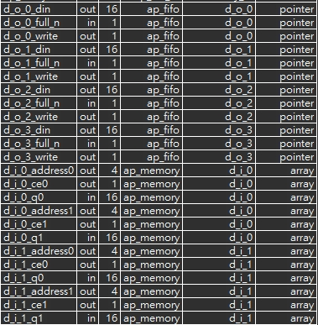
The interface of array partition(d_o = 4, d_i=2)

Slide 31
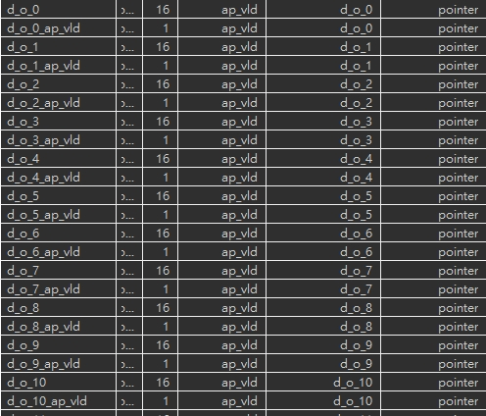
The interface of array partition(Complete)

Slide 32
Solution 3:
d_i = 2, d_o = 4
Solution 6:
d_i = 2, d_o = 2
Solution 8:
d_i = 4, d_o = 4
Solution 9:
d_i = 4, d_o = 2
Solution 4:
complete
Notes:
If we change the factor of d_i and d_o. we should first know the d_i = 2, d_o =4 means there’re two separate two port ram. If we change into d_i = 2, d_o
=2 or d_i = 4, d_o =4. These situations only have the single port interface. Further, if we set the d_o = 4, it means the output port only output 4 values at once. Thus, it’s no benefit for reading inputs higher than 4.

Slide 33
Block v.s. Cyclic
For cyclic type, the smaller arrays are generated by interleaving elements from original array.
In this lab, the cyclic type is faster than block type.

Slide 35
Lab 4 (AXI Interface)
In this lab, we try to set up the optimal design. Setting the interface as AXI4-stream.
We separate the d_o = 8 and d_i = 8 in axis protocol (AXI4-stream).
Compared to lab2, we can observe the data separation.

Slide 36
Lab4 procedure
Use same steps from 1 to 4 as lab1.
Set the array partition of d_o as type = cyclic, factor = 8
Set the array partition of d_i as type = cyclic, factor = 8
Set the interface of d_o and d_i as mode = axis
Insert the directive of for loop as unroll and the factor = 8.
Insert the directive of for loop as PIPELINE and rewind.
C simulation C Synthesis Cosimulation

Slide 37
8. Insert the directive of top function as s_axilite
Export RTL to create IP Package
Open the hw.h file

Slide 38
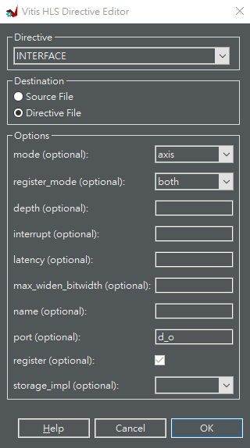
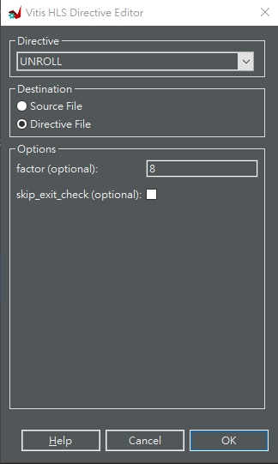
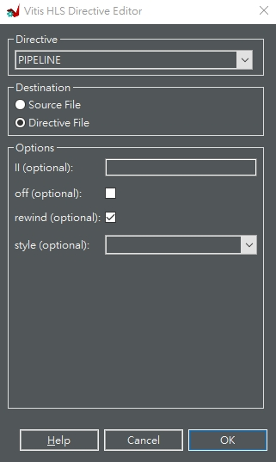
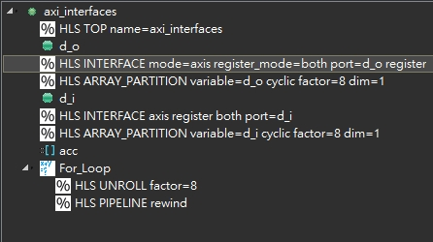

Slide 40
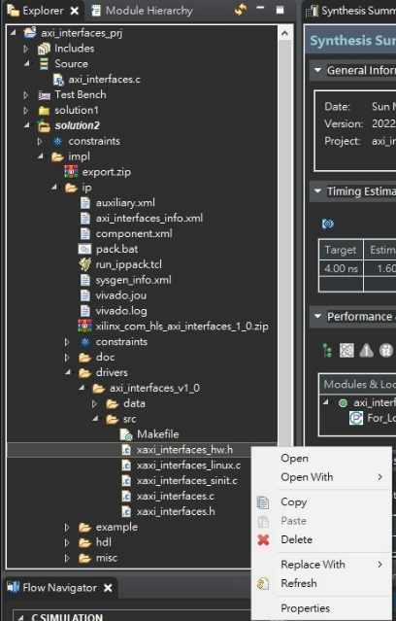
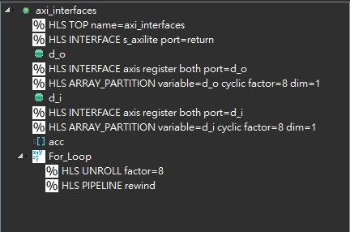

Slide 41
Block-level interface signals
The hw.h file shows the addresses to access and control the block-level interface signals.
It shows how host program control the Axilite.

Slide 42
For instance, if the bit 0 is set to value 1. The ap_start will be enabled.

