Slide 1
Application Acceleration with High-Level Synthesis – Lab A (Interface synthesis)
111061545 陳揚哲

Slide 2
Lab A (Interface synthesis)
Lab 1 Block-Level Protocol
Lab 2 Port-Level Protocol
Lab 3 Array Interface
Lab 4 AXI Interface

Slide 3
Lab 1 (Block-level Protocol)
The block-level I/O protocol control RTL design by the control signal. (Independent of data I/O ports)
The block-level control ports contain ap_start, ap_ready, ap_done, ap_idle, and ap_continue.

Slide 4
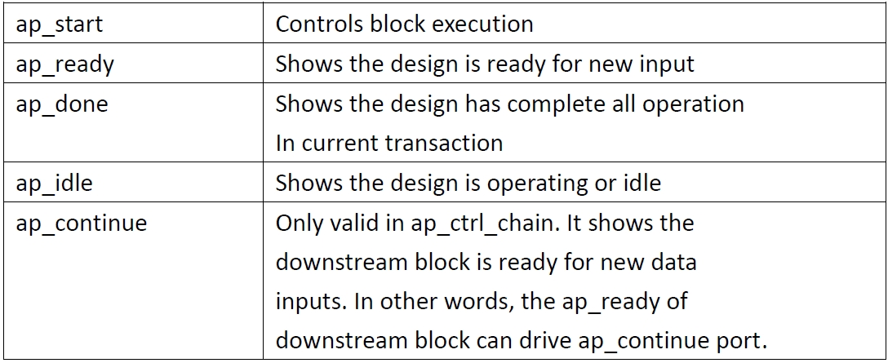

Slide 5
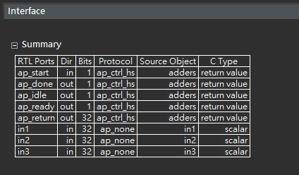
ap_ctrl_hs

Slide 6
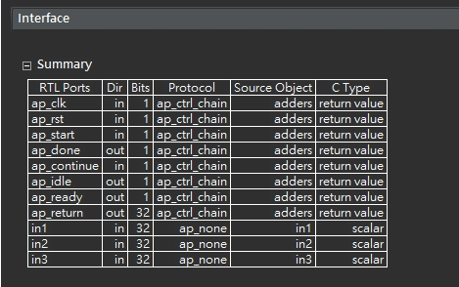
ap_ctrl_chain

Slide 7
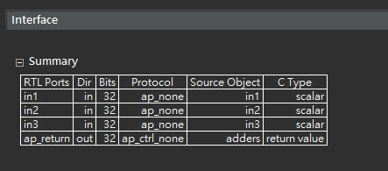
ap_ctrl_none

Slide 8
Error in Co-simulation with ap_ctrl_none
Co-simulation requires a block-level I/O protocol to sequence the test bench.
The ap_ctrl_none doesn’t add the block level I/O ports. It can’t operate co-simulation.
However, in our case, this is the combinational logic, so we can operate co-simulation.

Slide 9
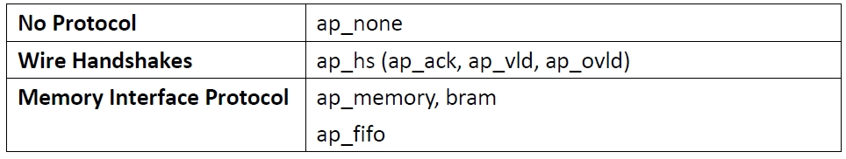
Lab 2 (Port-level protocol)
The port-level I/O protocol is the data flow I/O ports.
There’re three different kinds port-level protocol.

Slide 10
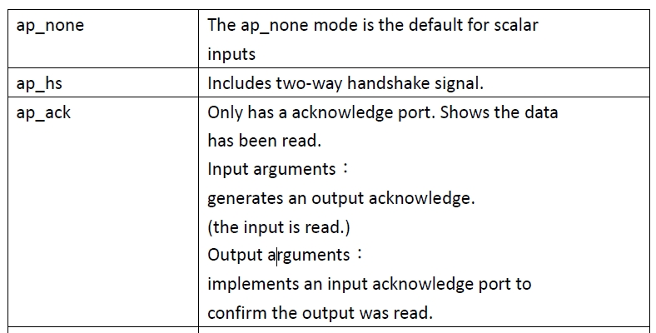
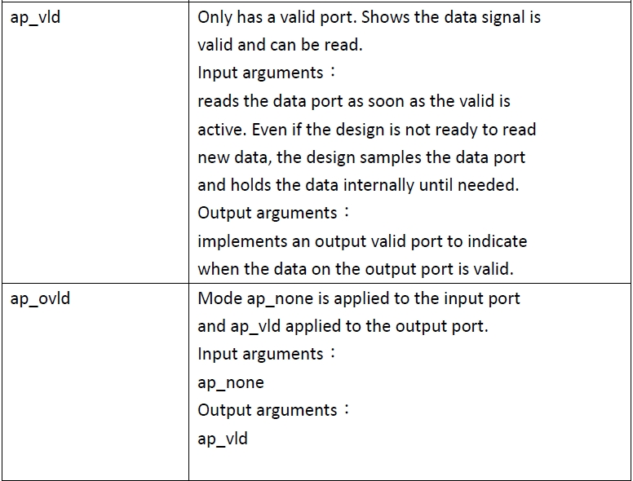
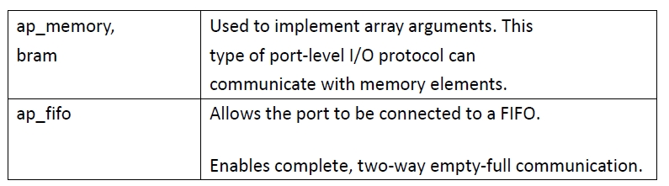

Slide 11
Set In1=ap_vld, In2=ap_ack, out1=ap_hs

Slide 12
Notes:
1. The data on port in1 is only read when port in1_ap_vld is active-High.
2. Port in2_ap_ack will be active-High when data port in2 is read.
3. inout_i associated input valid port inout1_i_ap_vld and output acknowledge port inout1_i_ap_ack.
4. inout_o associated output valid port inout1_o_ap_vld and input acknowledge port inout1_o_ap_ack.

Slide 13
Lab 3 (Array Interface)
This lab specifies implement different type of RTL port for array arguments.
If we use two-port RAM interface, this design can accept input data at twice rate of single port. Therefore, the estimated time of two port are lower.

Slide 14
Solution 1 : Single port
(Type = Block)
Solution 2 : Two port Unroll (Type = Block)

Slide 15
What if apply in rolled loop.
In rolled loop, loop is executed in turn.
This implementation code limits the logic to one read on d_i in each iteration.
In other word, reading d_i once in each loop. Thus, the estimated time wouldn’t be faster (solution5).

Slide 16
Solution 1 : Single port (Type = Block)
Solution 2 : Two port unroll (Type = Block)
Solution 5 : Two port rolled (Type = Block)

Slide 17
Array Partition
The input d_i will separate into the numbers of array partition factor RAM interfaces.
The output d_o will be divided into the numbers of array partition FIFO interfaces.
In this lab, we divide d_i into 2 seperated RAM interfaces and d_o into 4 FIFO interfaces. We also divide d_i and d_o completely.

Slide 19
Solution 3:
d_i = 2, d_o = 4
Solution 6:
d_i = 2, d_o = 2
Solution 8:
d_i = 4, d_o = 4
Solution 9:
d_i = 4, d_o = 2
Solution 4:
complete
Notes:
If we change the factor of d_i and d_o. we should first know the d_i = 2, d_o =4 means there’re two separate two port ram. If we change into d_i = 2, d_o
=2 or d_i = 4, d_o =4. These situations only have the single port interface. Further, if we set the d_o = 4, it means the output port only output 4 values at once. Thus, it’s no benefit for reading inputs higher than 4.

Slide 20
Block v.s. Cyclic
For cyclic type, the smaller arrays are generated by interleaving elements from original array.
In this lab, the cyclic type is faster than block type.

Slide 22
Lab 4 (AXI Interface)
In this lab, we set the interface as AXI4-stream.
We separate the d_o = 8 and d_i = 8 in axis protocol (AXI4-stream).
Compared to lab2, we can observe the data separation.

Slide 24
Block-level interface signals
The hw.h file shows the addresses to access and control the block-level interface signals.
It shows how host program control the Axilite.

Slide 25
For instance, if the bit 0 is set to value 1. The ap_start will be enabled.

