Slide 1
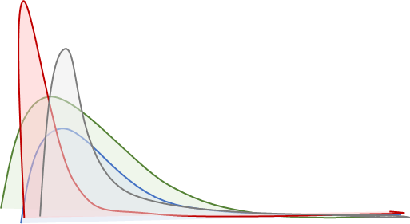
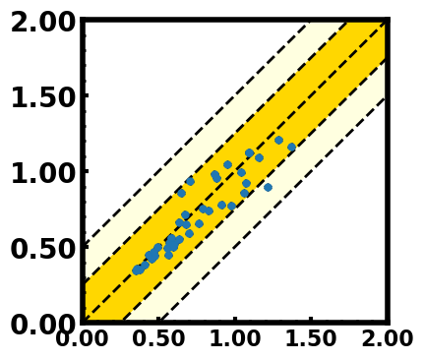
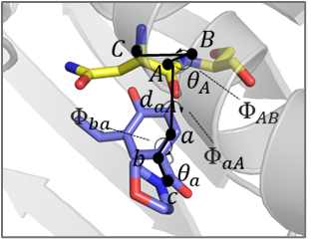





Faster Convergence
High Phase-Space Overlap
Find the Best geometric
quantities ($d$,$θ$,$Φ$…)
P($∆U_{res}$)
${∆G}_{res}^{12λ}$(kcal/mol)
$$∆U_{res}(\text{K}\text{B}\text{T})$$
${ ∆G}_{res}^{2λ}$(kcal/mol)

Slide 2
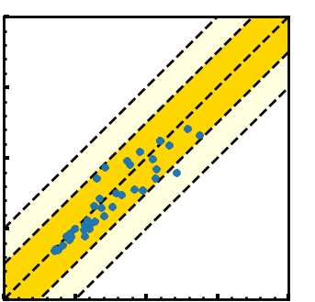





REPF
Restrain atoms: A, B, C, a, b, c
Fast Convergence
High Phase-Space Overlap
Find the Best geometric
quantities ($d$,$θ$,$Φ$…)
$∆G^{12λ}$(kcal/mol)
P($∆U_{res}$)
$$∆U_{res}(\text{K}\text{B}\text{T})$$
$∆G^{2λ}$(kcal/mol)

