Slide 1
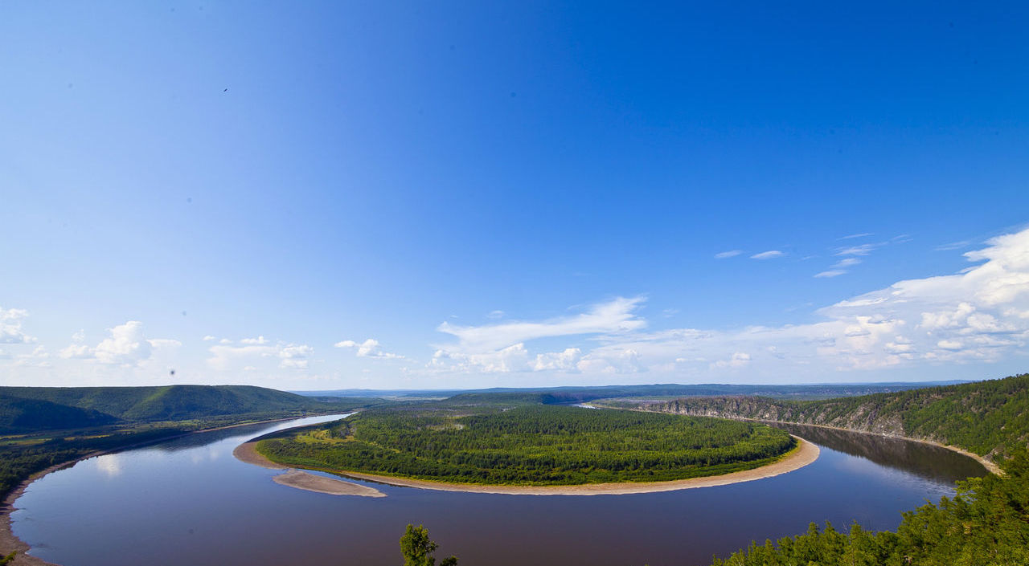
Sino-Russian Transboundary Aquifer in the Middle Reaches of Amur River Basin
By Yong Wang ; Zhechen Zhang

Slide 2

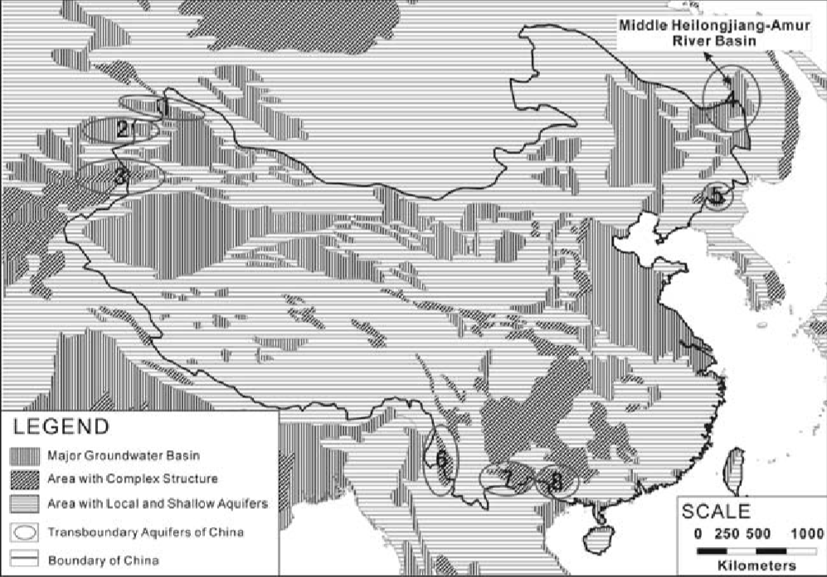
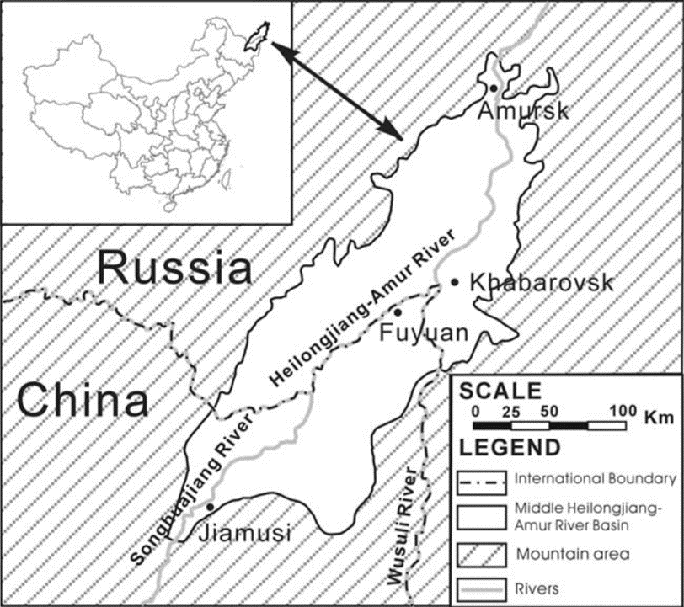
Location
Sino-Russian Transboundary Aquifer
Situated at the border between China and Russian Far East，Heilongjiang-Amur River Basin
West Xiaoxingan Mountains; Northwest Buren heights in Russia; East Sihote-Aline mountain range South Wanda mountain of China.
Heilongjiang-Amur River, Wusuli River and Songhua River run cross the area and form a valley plain.
Size 100000km²
The elevation is about 100m.

Slide 3
Sino-Russian Transboundary Aquifer
Hydrogeological Characteristics
Amur River Basin in the middle reaches of Heilongjiang-Amur River is a large basin with mountains and abundant water resources.
Around the basin, there are various strata with weak permeability and magmatic rocks in low mountains and hills, forming the water resisting boundary of the aquifer.
The aquifer is divided into single unconﬁned aquifer and semi-conﬁned aquifers.
The Tertiary mudstone and the whole bedrock distributed in the basement are the water repellent boundary of the lower plane.
Therefore, the groundwater system of Heilongjiang Province is a relatively independent and unified system, and the state of groundwater is still in equilibrium.

Slide 4
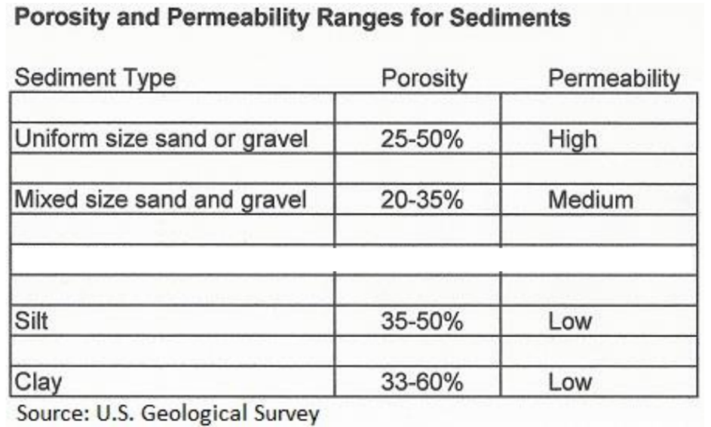
Sino-Russian Transboundary Aquifer
Porosity and Permeability
The lithology of the aquifer is fine sand, medium sand and sand gravel, and the hydraulic conductivity is 12-35m/d.
Unconfined aquifer : mixed sand and gravel
Porosity:20-35 % Permeability : medium
Confined aquifer : coase sand
Porosity:35-50% Permeability : low

Slide 5
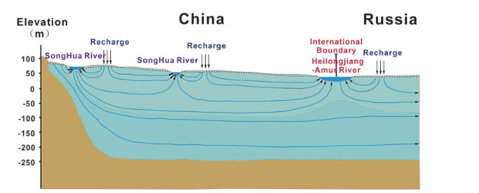
Sino-Russian Transboundary Aquifer
Conceptual model
The groundwater recharged by precipitation, river water and irrigation
The main flow direction of groundwater is Songhua River in the south, which provides basic flow and partial flow direction for Heilong River
The discharge comes from river, evaporation and lateral runoff
The river at this area is winding intensively and the groundwater and surface water exchange frequently

Slide 6
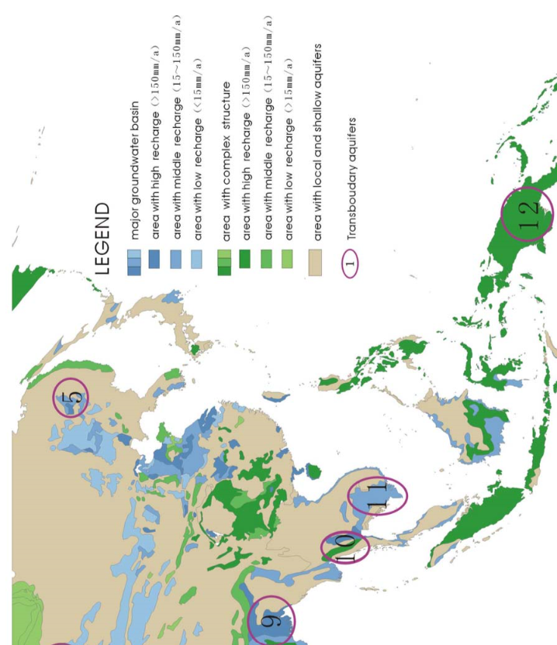
Sino-Russian Transboundary Aquifer
Recharge

Slide 7
Sino-Russian Transboundary Aquifer
Recharge
 | China | Russia
Annual average groundwater recharge(10⁸m³） | 51.4 | 47.3
Annual average groundwater withdraw capacity (10⁸m³） | 37.1 | 11.6
The two parts’ hydrogeological condition are similar, and the groundwater resources are basically the same.
The equilibrium conditions of groundwater recharge in China are as follows(10⁸m³)
Vertical | River | Swamp and marsh | Lateral runoff | Precipitation infilltration | Irrigation
33.8 | 5.8 | 7.3 | 4.5 | 27.8 | 6
The equilibrium conditions of groundwater discharge in China are as follows(10⁸m³)
River | Swamp and marsh | Evaporation | Lateral runoff
2.2 | 1.4 | 4.6 | 6.1
The total discharge of groundwater is equal to the total recharge. The groundwater is in a balanced state, and the natural circle of groundwater in the whole area is good.

Slide 8
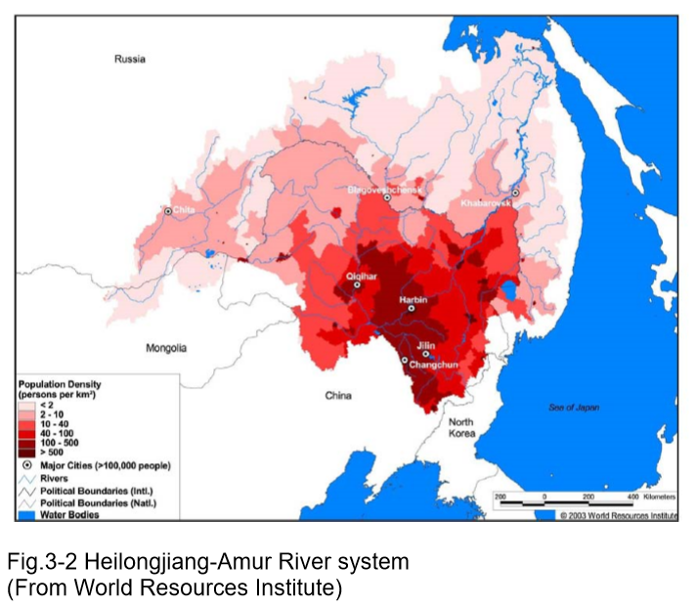
Sino-Russian Transboundary Aquifer
Groundwater usage
Purpose: water supply for life and irrigation of China and Russia.
Jiamusi in China and Khabarovsk in Russia rely on underground water sources along the Songhua River and the Amur River as their urban water supplies.
The actual amount of underground water extracted in China was 21.3*10⁸m³/a, about 2/3 of the amount of underground water extracted.
Population density
The underground water extracted in Russia is limited to 100 meters, and the actual amount extracted is far less than the underground water reserves.
Groundwater recharge and groundwater discharge are generally in balance, and groundwater runoff is basically in its natural state.

Slide 9
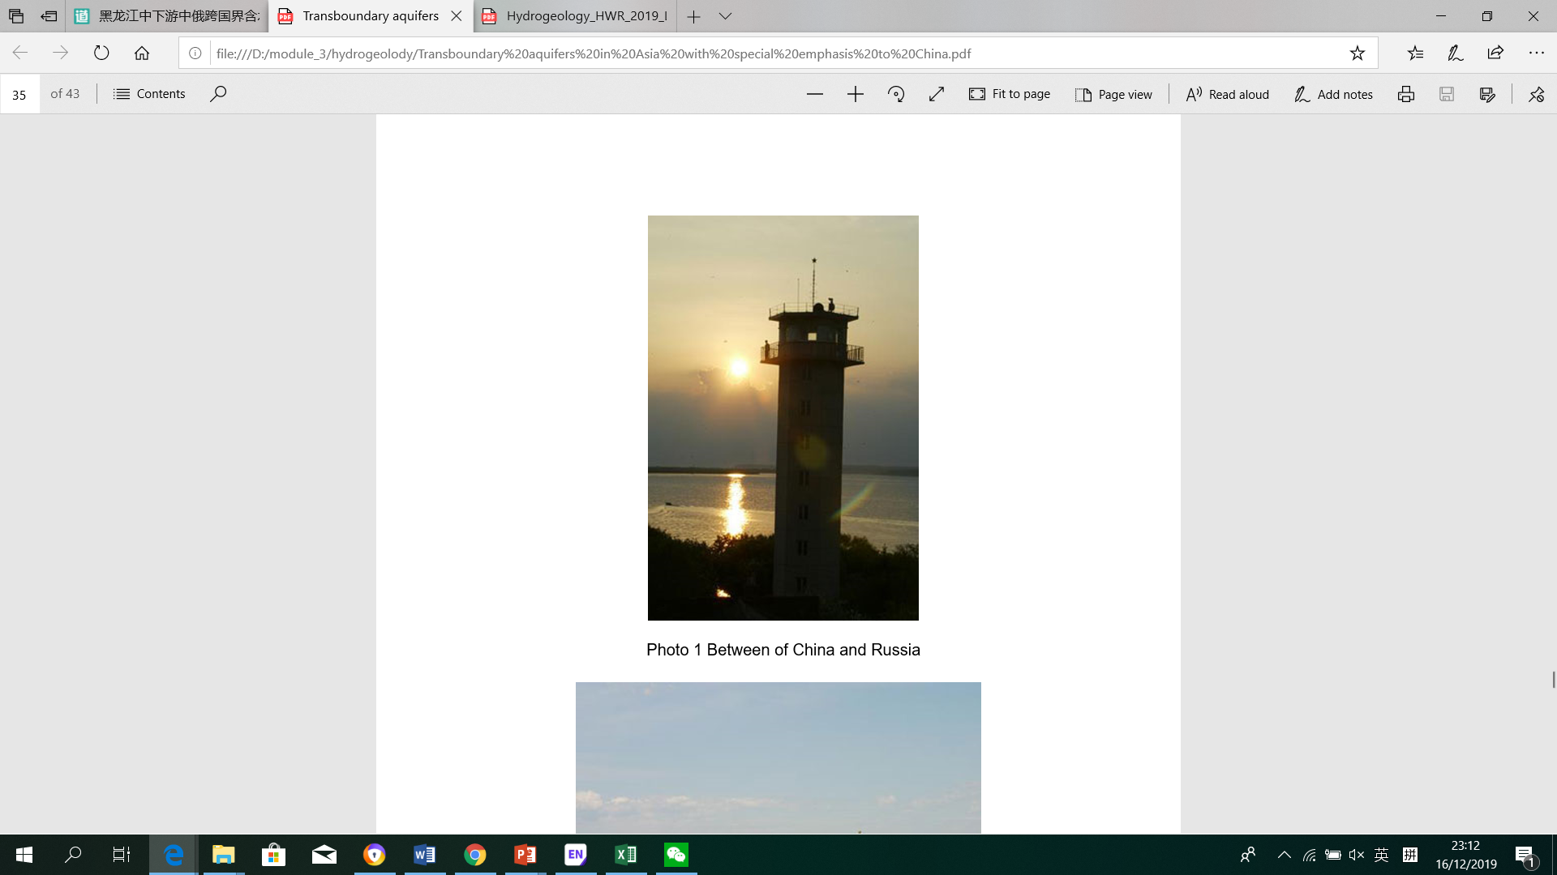
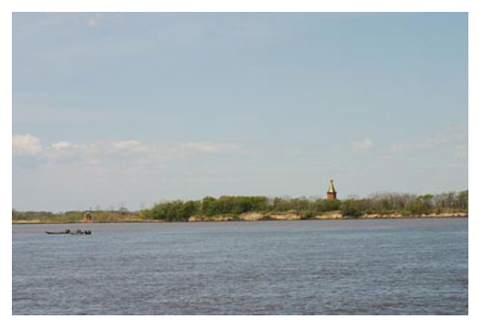
Sino-Russian Transboundary Aquifer
Groundwater quality
China part: the groundwater chemical type of the pore water of Quaternary unconsolidated sediment is mainly HCO3-Ca.Mg, besides HCO3-Ca, HCO3-Na.Ca.The pore water of Quaternary unconsolidated sediments was mostly suitable for drinking and irrigation.
Russian part: mineralization degree is high. The quality of groundwater near Khabarovsk is closely related to the needs of residents and industry, so Russia is using modern technology to directly depress the content iron and manganese in groundwater

Slide 10
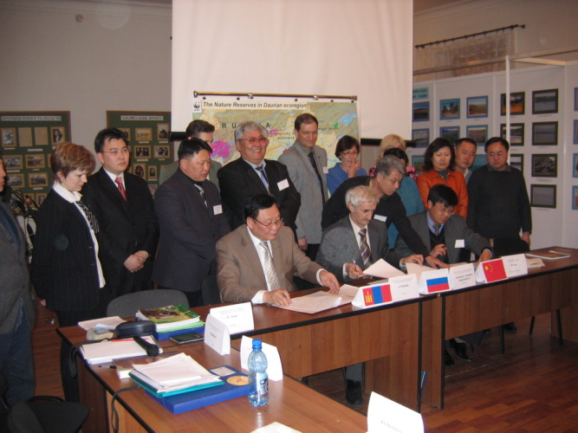
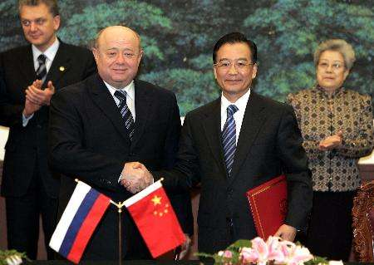
Sino-Russian Transboundary Aquifer
Cooperation between China and Russia
In February 2002, China and Russia signed a memorandum to solve the problem of water quality in the border river.
Since December 2005, the geological survey department of China has sampled and tested aquifer groundwater along the Songhua River from Jilin to Heilongjiang province.
During the 34th international congress on hydrogeology, held in October 2006, UNESCO hosted a workshop on transboundary aquifers in Asia. Chinese and Russian geologists have held face-to-face discussions and exchanges on this aquifer.
With the active promotion of the Chinese and Russian governments and the attention of the international community, the research on this aquifer is progressing continuously.

Slide 11


Sino-Russian Transboundary Aquifer

Slide 12
Sino-Russian Transboundary Aquifer
References
Zaisheng, H., Jayakumar, R., Ke, L., Hao, W. and Rui, C. (2008) Review on transboundary aquifers in People's Republic of China with case study of Heilongjiang-Amur River Basin. Environmental Geology 54(7), 1411-1422.
Han Zaisheng , Wang, Hao , Chai Rui , Jayakumar, R. , Liu Ke , Wang Jin (2006) Transboundary aquifers in Asia with special emphasis to China. UNESCO programme and meeting document.
Zektser IS, Everett LG (2004) Groundwater resources of the world and their use. UNESCO IHP-VI, series on groundwater 6. UNESCO, Paris
Sergey A, Kozlov (2006) Quality of groundwater of the Middle-Amur artesian basin (The Far East of Russia). 34th IAH Congress paper

Slide 13
Sino-Russian Transboundary Aquifer
Thanks for your attention!

