Slide 1

Effects of Mandatory Seat Belt Laws in the US
Group 9 : Zhe Yang, Zidong Yao, Lei Nie, Xiaoyin Li

Slide 2
Catalog
Initial linear model & adjusted linear model
GLS model
Data overview & variables analysis
Backward Variable Selection

Slide 3

Data Overview
Traffic accidents are a major source of fatalities and serious injuries.
This presentation is based on the USSeatbelts data to predict the number of fatalities per million of traffic miles
The balanced panel data is for the years 1983–1997 from 50 US States, plus the District of Columbia, for assessing traffic fatalities and seat belt usage
The dataset contains a total of 12 variables. There are some missing values which reveal NAs. We removed the missing values and then analyze the variables.

Slide 4
Variables Analysis
state: factor indicating US state (abbreviation).
year: factor indicating year.
miles: millions of traffic miles per year.
fatalities: number of fatalities per million of traffic miles (absolute frequencies of fatalities = fatalities times miles).
seatbelt: seat belt usage rate, as self-reported by state population surveyed.
speed65: factor. Is there a 65 mile per hour speed limit?
speed70: factor. Is there a 70 (or higher) mile per hour speed limit?
drinkage: factor. Is there a minimum drinking age of 21 years?
alcohol: factor. Is there a maximum of 0.08 blood alcohol content?
income: median per capita income (in current US dollar).
age: mean age.
enforce: factor indicating seat belt law enforcement ("no", "primary", "secondary").

Slide 5
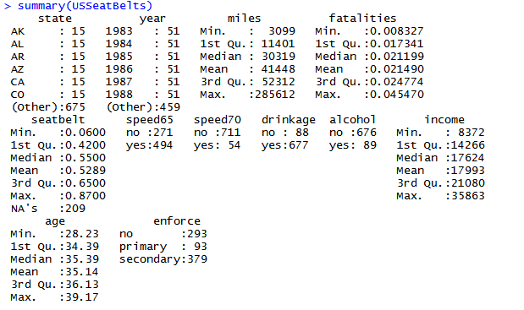
Summary

Slide 6
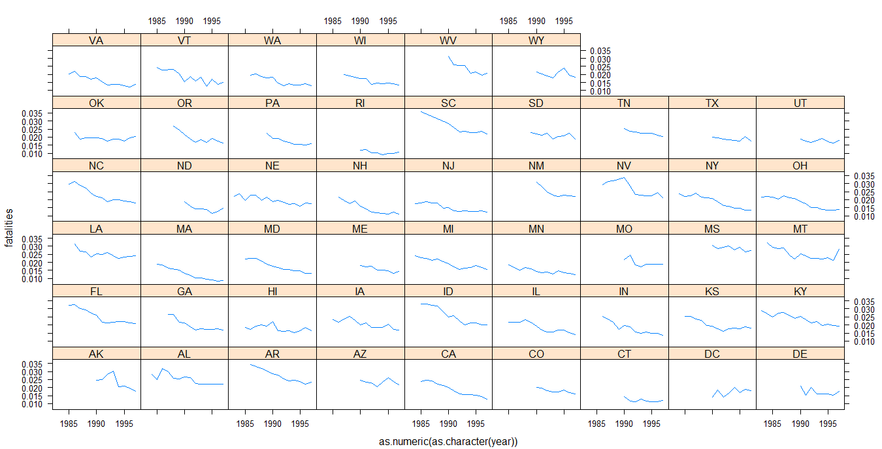
Example

Slide 7
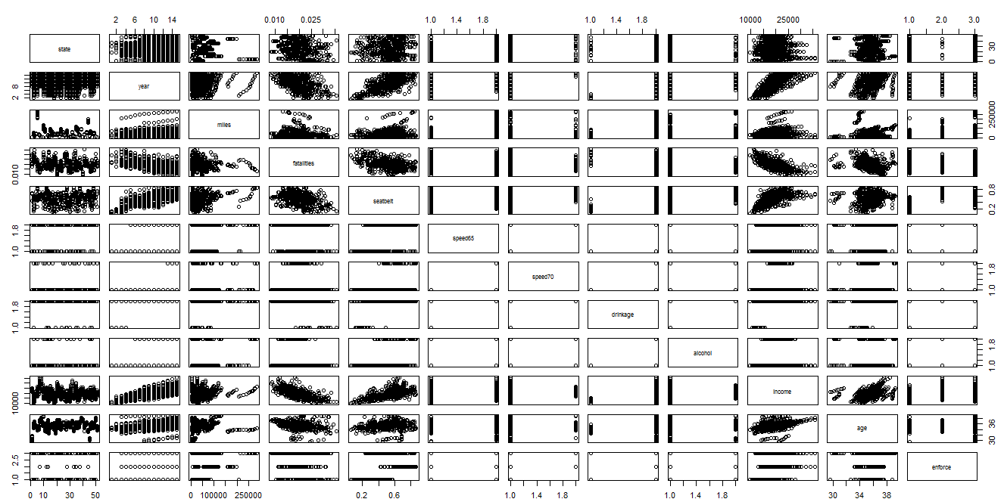
Scatterplot matrix

Slide 8
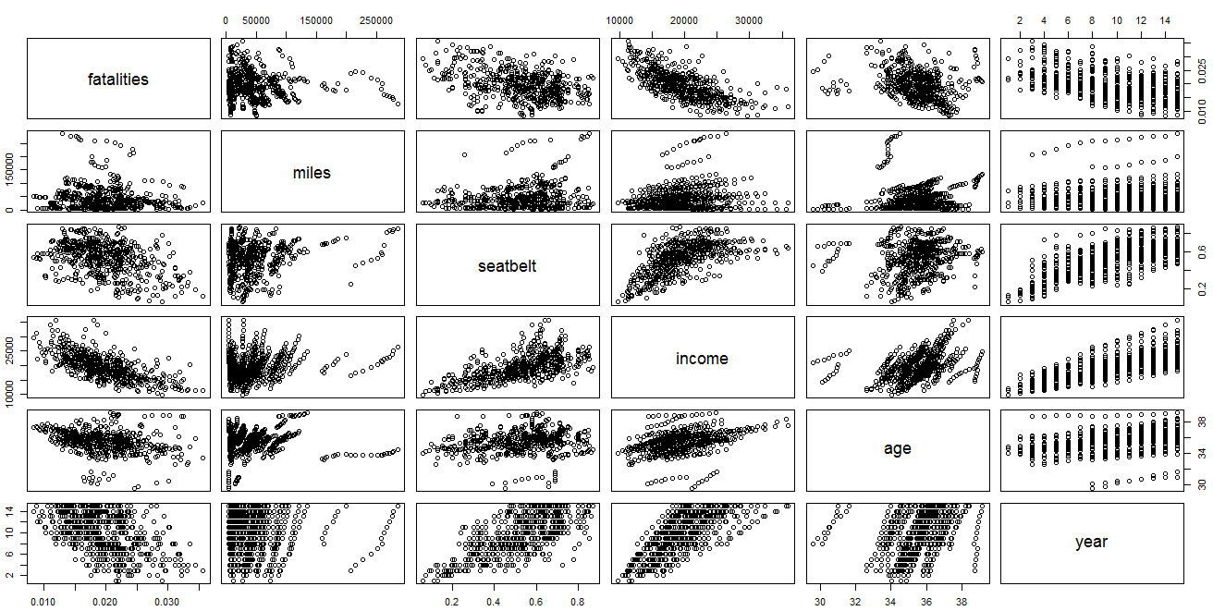
Scatterplot matrix

Slide 9
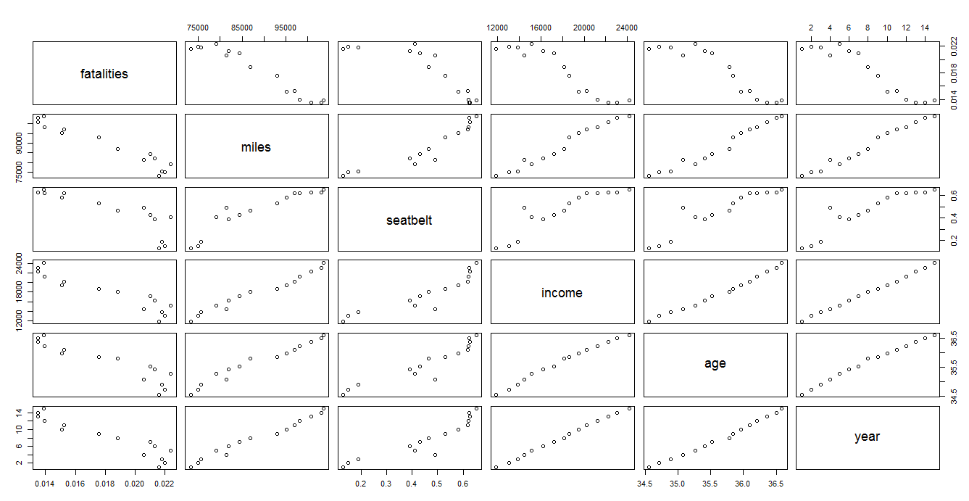
Scatterplot matrix

Slide 10
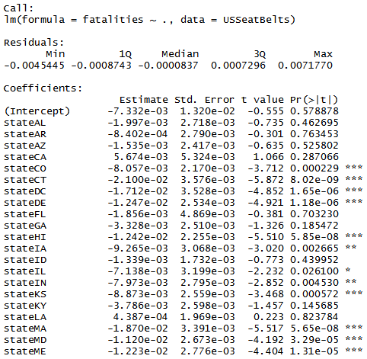
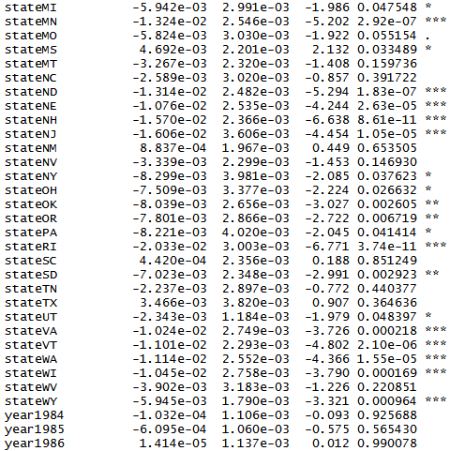
Initial Linear Model

Slide 11
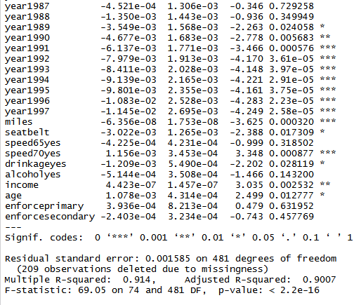
Initial linear model

Slide 12
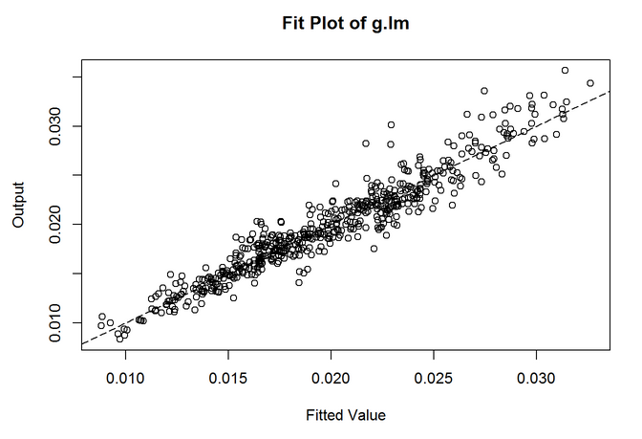
Fit Plot

Slide 13
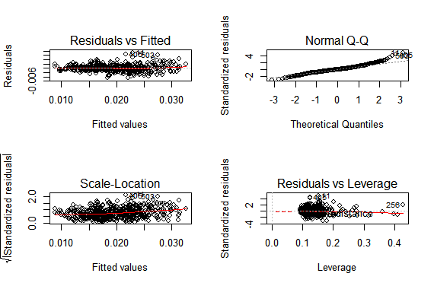
Other Plots

Slide 14
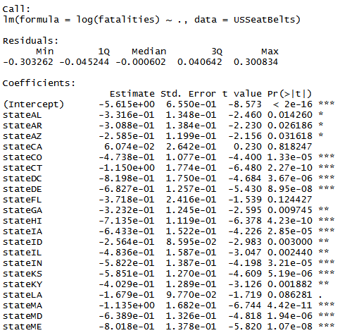
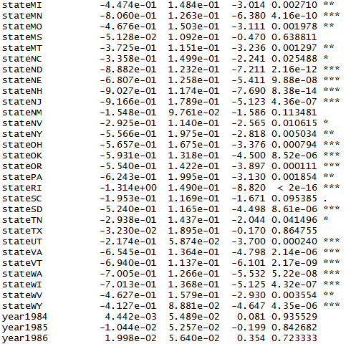
Linear Model - Adjusted(log)

Slide 15
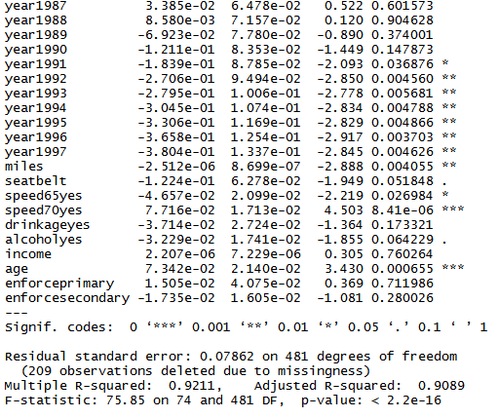
Linear Model - Adjusted(log)

Slide 16
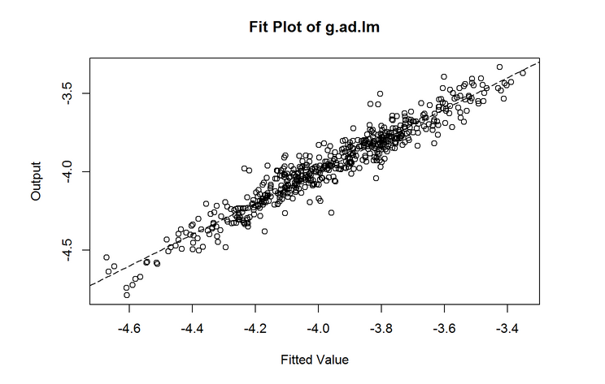
Fit Plot

Slide 17
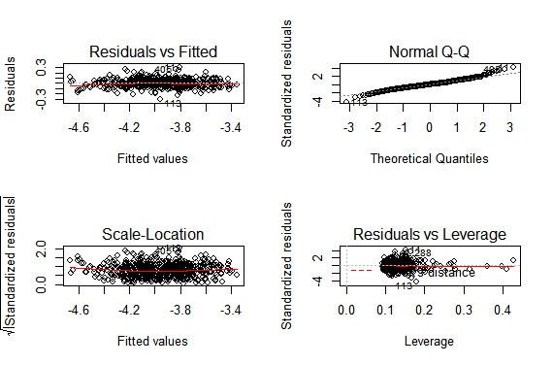
Other Plots

Slide 18
Fit Plot Comparison

Slide 19
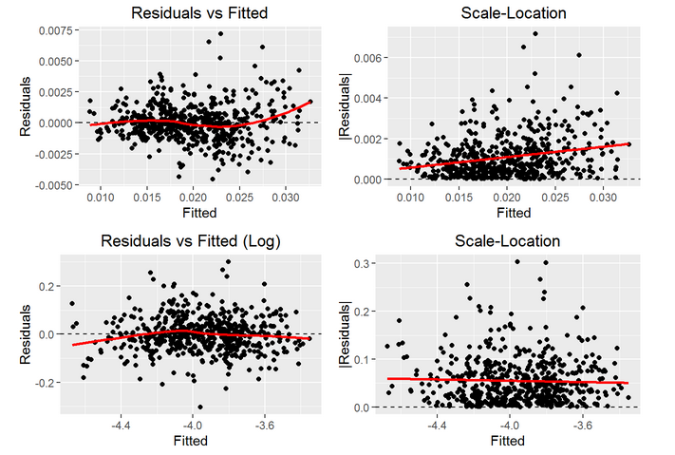
Residual plots comparison

Slide 20
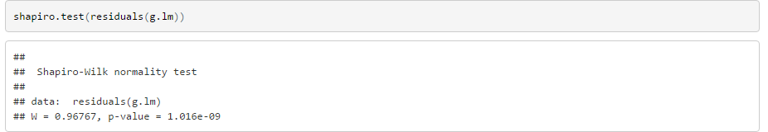
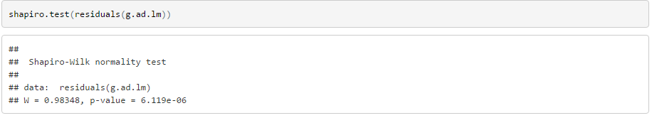
shapiro.test comparison
According to the shapiro test we can see that residuals in g.lm model are not normal density distribution becuase the p-value is less than 0.05, and when we use the log to adjust our model, the p-value is bigger than g.lm, but it is still less than 0.05.

Slide 21
durbinwatson test comparison
According to the durbinwatson test we can see that the durbinwatson test in these two model are both less than 1.5, which means that the residuals are highly positive serial dependent, and this result is not good for linear model.

Slide 22
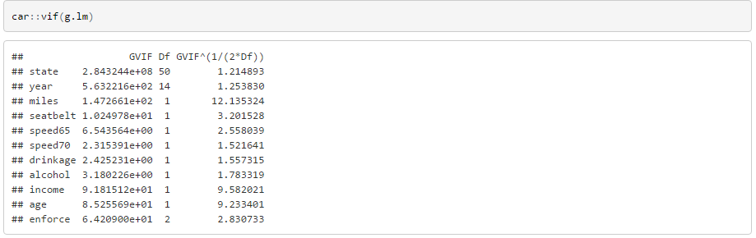
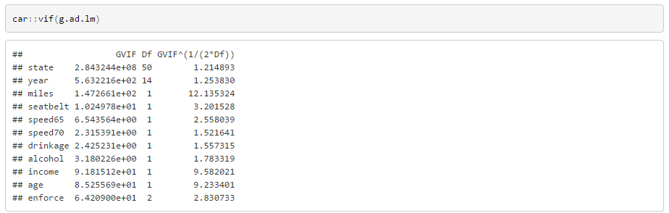
VIF comparison
According to the VIF test we can see that the VIF value of three variables miles, alcohol, age are bigger than 4, which means that these three variables have linear relationship with ohter variables, and this means multilinearity. It is bad for a linear model.

Slide 23
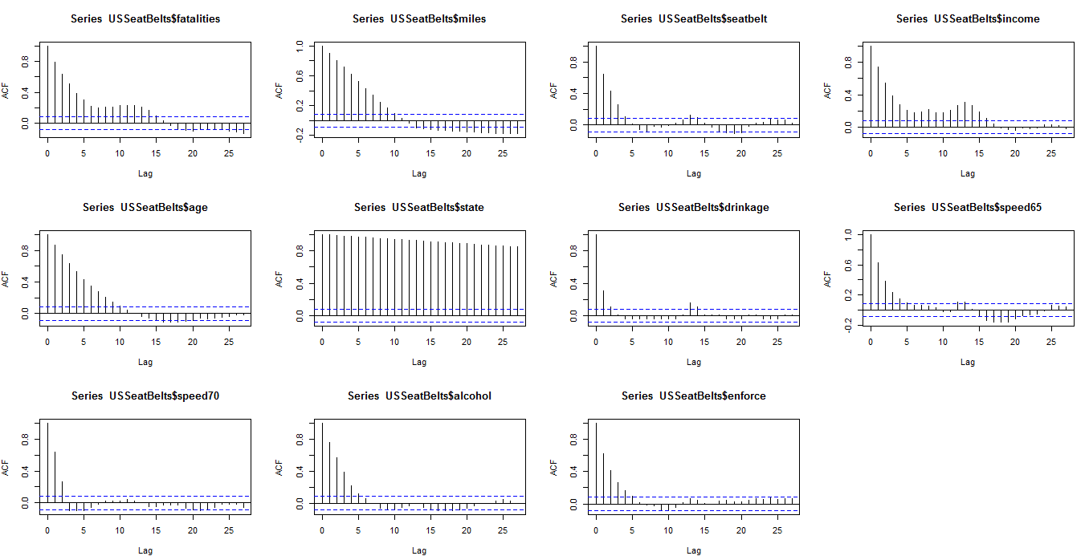
ACF Plots

Slide 24
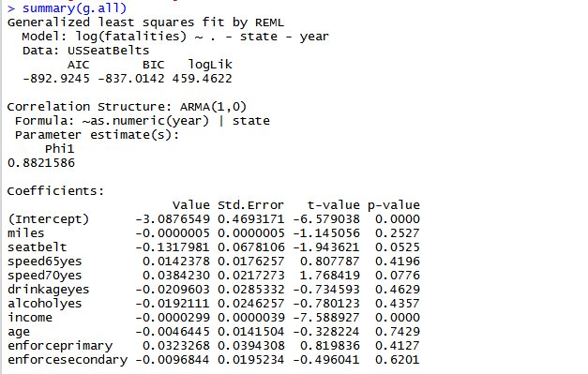
GLS Model

Slide 25
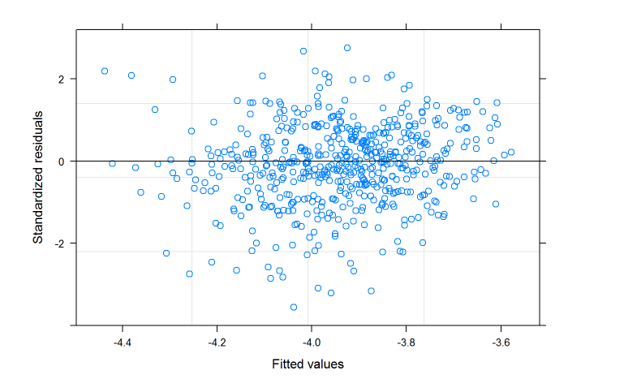
Fit Plot

Slide 26
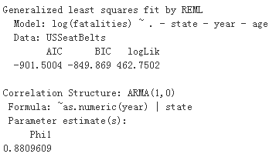
Backward Variable Selection
Step.1 Remove age ( the P-value of "age" is 0.7429 )

Slide 27
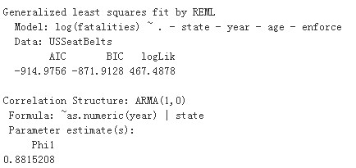
Backward Variable Selection
Step.2 Remove enforce ( the P-value of "enforce" is 0.4114 )

Slide 28
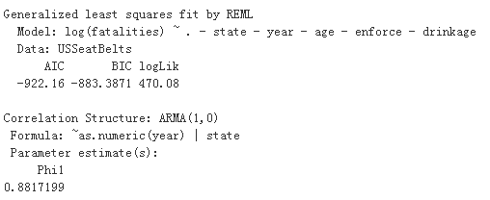
Backward Variable Selection
Step.3 Remove drinkage ( the P-value of "drinkage" is 0.6444 )

Slide 29
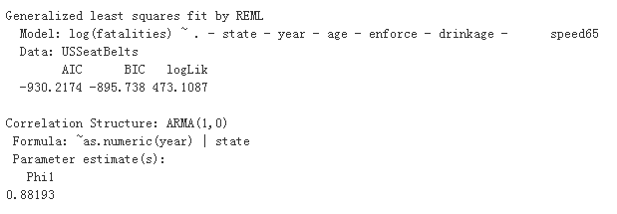
Backward Variable Selection
Step.4 Remove speed65 ( the P-value of "speed65" is 0.6092 )

Slide 30
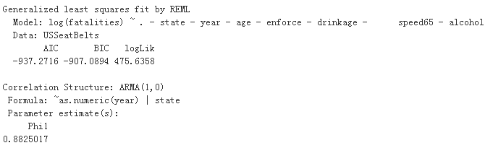
Backward Variable Selection
Step.5 Remove alcohol ( the P-value of "alcohol" is 0.4687 )

Slide 31
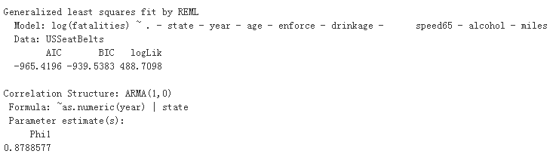
Backward Variable Selection
Step.6 Remove miles ( the P-value of "miles" is 0.2620 )

Slide 32
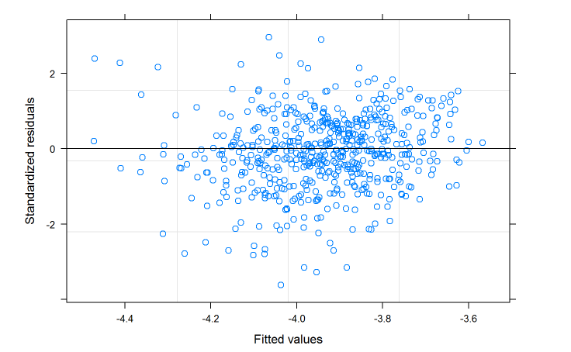
Fit Plot

Slide 33
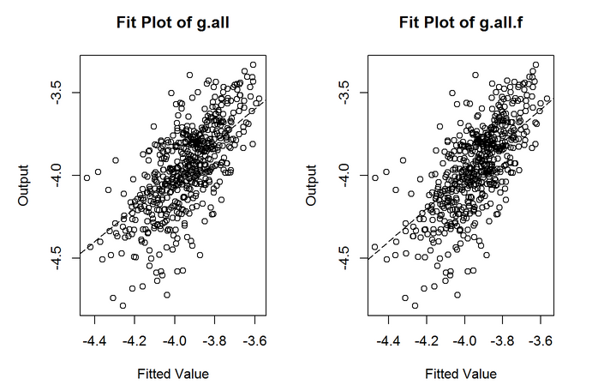
Fit Plot Comparison

Slide 34
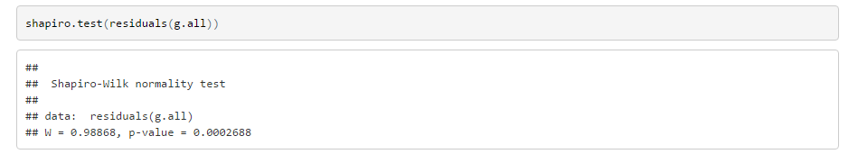
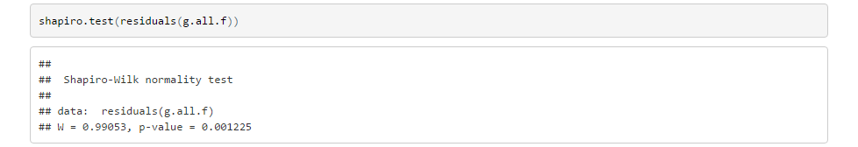
shapiro test

Slide 35
AIC Comparison
AIC of g.all is -892.9245
AIC of g.all.f is -965.4196
Obviously g.all.f is better

Slide 36
Conclusion
According to the analysis above, eventually we dicided to use GLS Model to fit our data. And keep variables: “seatbelt”, “income”, “speed70”, “year” and “state” as predictors to predict the number of fatalities per million of traffic miles.

Slide 37


This Is The End
Thank you!

