Slide 1



黄诗佳 17软工12班
2017051604008
博客后台
Notes:
READ PLEASE!
Before you open this template be sure that you have installed these fonts:
GeosansLight.ttf from: http://www.dafont.com/geo-sans-light.font
New Cicle Semi.ttf from: http://www.dafont.com/new-cicle.font
fontawesome-webfont.ttf from: http://fortawesome.github.io/Font-Awesome
All fonts are free for use in commercial projects!
If you have any problems with this presentation, please contact with me from this page: http://graphicriver.net/user/Bandidos

Slide 2
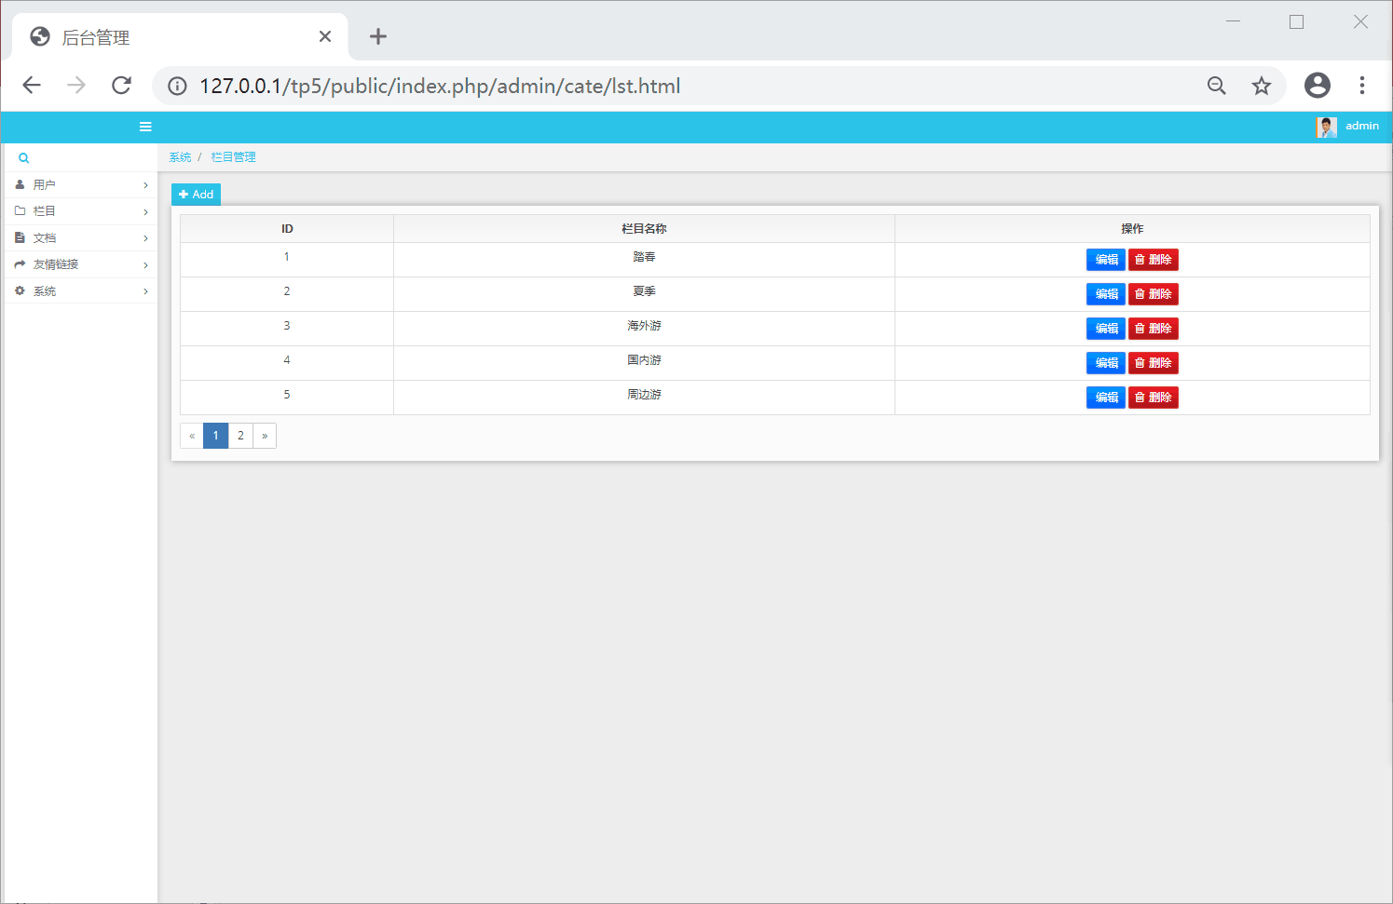
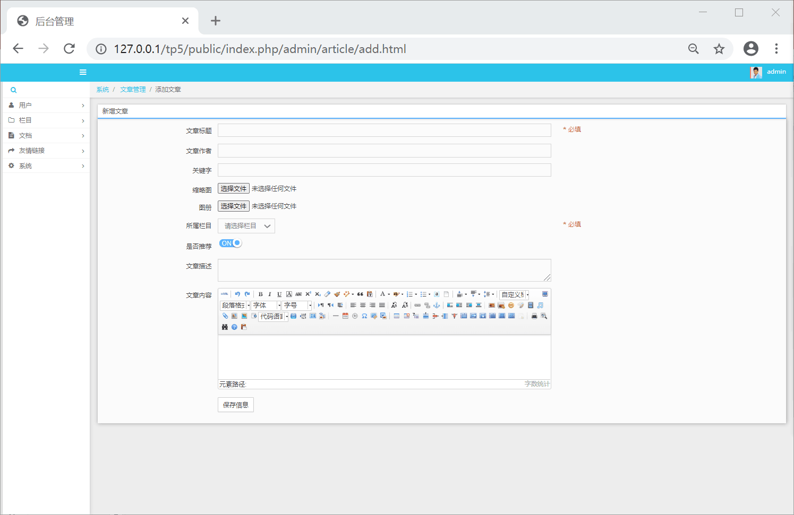
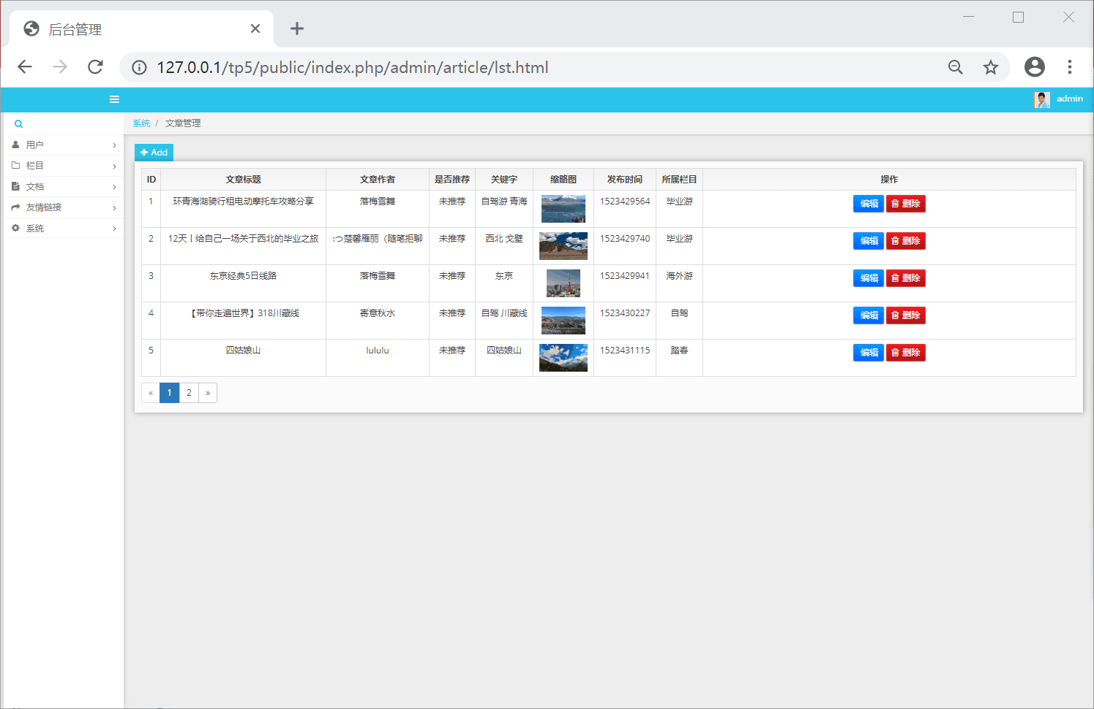
Design Kit

在后台进行对前端的控制，包括用户，文章等等信息。

Slide 3

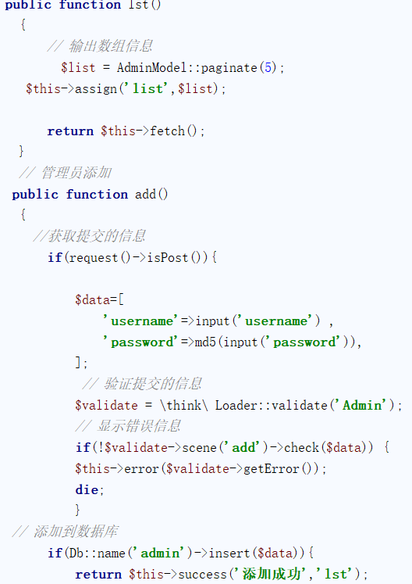
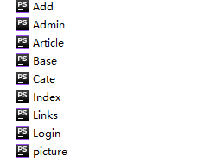
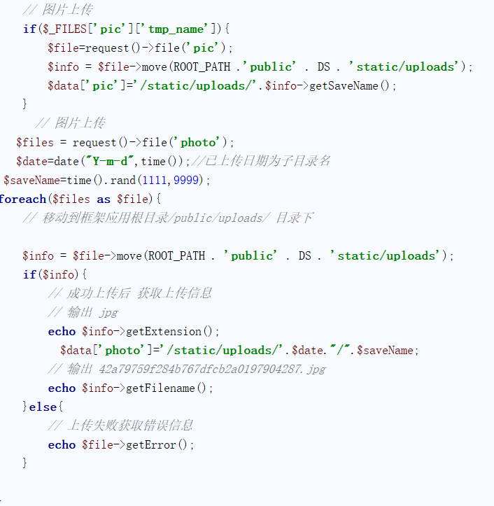
Design Kit

+

Slide 4
use case
博客后台的总用例图

Slide 5
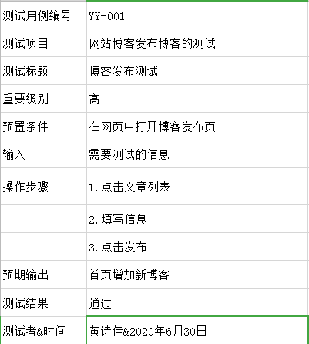
Design Kit
发布博客的测试用例


Slide 6
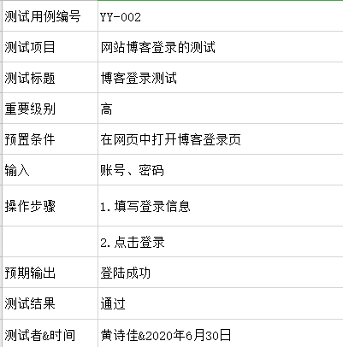
Design Kit
博客登录的测试用例


Slide 7
Personal thinking

经过这次的大作业，发现了自己学过的很多知识好像都没有学透彻，有时候就会和别的知识一起混淆。
经过组内合作，发现大家都各有各的长处，取其所长，一起完成任务。




Slide 8
Thanks for Watching

