Slide 1

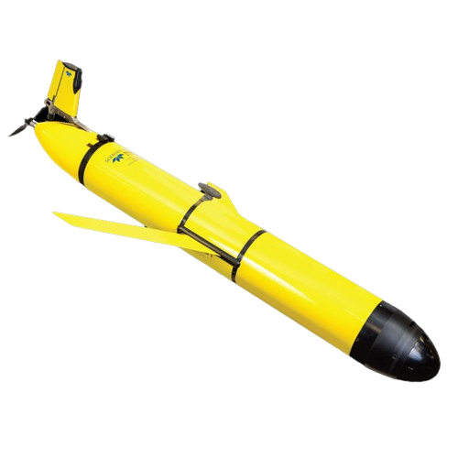
depot
robot
Sample point

Slide 2
