Slide 1
FIVE-MINUTE DECISION DEMONSTRATION
Global Energy
Decision Atlas
Comparing operating cost, electricity sources, and energy trade exposure across 15 countries
For business energy and sustainability teams screening national markets
GLOBAL ENERGY DECISION ATLAS
01 / 06
Notes:
Source: supplied energy-data.csv, accessed 17 September 2026. Dataset source URLs are retained in the repository.

Slide 2
DATA AND METHOD
One supplied dataset, four decision lenses
15
49
0
COUNTRIES
DOCUMENTED FIELDS
RUNTIME DATA REQUESTS
Major energy consumers form a focused comparison set rather than a global census.
Prices, consumption, generation sources, production, imports, exports, dates, units, and source URLs.
The unchanged CSV is validated and bundled with the static site.
2023
2024
December 2025
Missing values
Total energy production and cross-border trade
Total consumption and domestic electricity generation mix
Household and business retail electricity prices
Iranian prices display as N/A and never become zero
GLOBAL ENERGY DECISION ATLAS
02 / 06
Notes:
Source: supplied energy-data.csv, accessed 17 September 2026. Dataset source URLs are retained in the repository.

Slide 3
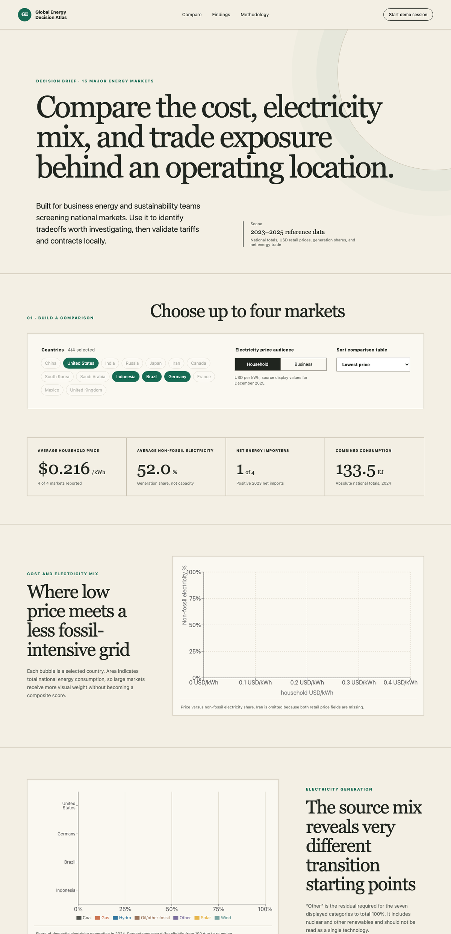
DASHBOARD WORKFLOW
Build a shortlist, inspect the tradeoffs, export the evidence
01 COMPARE
Choose up to four countries and switch between household and business prices.
02 INTERPRET
Read cost, mix, demand, and trade together. No composite score hides the tradeoffs.
03 CONTINUE
Download the selected comparison for facility-level diligence.
GLOBAL ENERGY DECISION ATLAS
03 / 06
Notes:
Source: supplied energy-data.csv, accessed 17 September 2026. Dataset source URLs are retained in the repository.

Slide 4
FINDINGS FROM THE DEFAULT COMPARISON
The four markets show no single best profile
HOUSEHOLD ELECTRICITY PRICE USD PER KWH
NON-FOSSIL ELECTRICITY GENERATION PERCENT
Indonesia reports the lowest household price in the selection. Brazil reports the highest non-fossil generation share. Germany is the only net importer among the four.
GLOBAL ENERGY DECISION ATLAS
04 / 06
Notes:
Source: supplied energy-data.csv, accessed 17 September 2026. Dataset source URLs are retained in the repository. Household prices: United States 0.203, Germany 0.399, Brazil 0.180, Indonesia 0.082 USD/kWh. Non-fossil electricity: 41.88%, 58.64%, 89.45%, and 18.09%, respectively.

Slide 5
RECOMMENDATIONS
Treat the atlas as a screening tool before local diligence
01
Shortlist on cost and generation mix together
A low retail price can coexist with a fossil-heavy grid. Carry both measures into the site screen.
02
Stress-test import exposure
For net importers, assess contract terms, fuel sensitivity, and continuity plans before committing capital.
03
Validate the facility tariff
Request current industrial rates, demand charges, time-of-use rules, and renewable procurement options.
GLOBAL ENERGY DECISION ATLAS
05 / 06
Notes:
Source: supplied energy-data.csv, accessed 17 September 2026. Dataset source URLs are retained in the repository.

Slide 6
LIMITATIONS AND REFLECTION
Cross-sectional evidence narrows questions. It does not prove causes.
What the data supports
Important boundaries
The atlas identifies differences in reported prices, source shares, absolute demand, and trade direction. It helps teams choose where to investigate further.
Reference years differ. Consumption is not per capita. USD prices carry exchange-rate uncertainty. Iran lacks prices. “Other” combines nuclear and other renewables.
What it cannot establish
Use the comparison to form a shortlist, then verify the actual site.
It cannot show why prices differ, predict future tariffs, rank supply reliability, or prove that generation mix causes retail prices.
GLOBAL ENERGY DECISION ATLAS
06 / 06
Notes:
Source: supplied energy-data.csv, accessed 17 September 2026. Dataset source URLs are retained in the repository.

