Slide 1
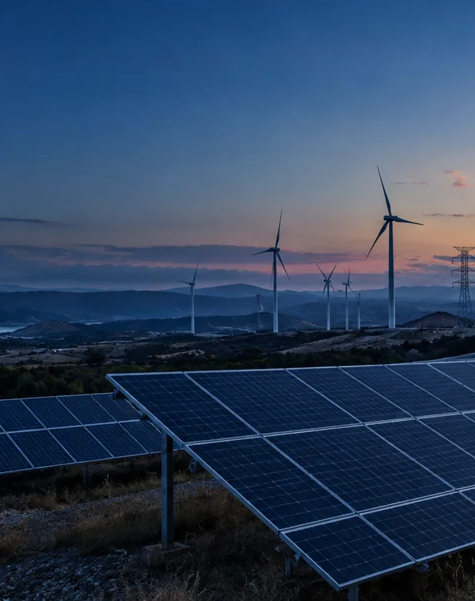
Global Energy Decision Atlas
A diligence shortlist from 50 markets
A five-minute demonstration of the evidence, interpretation, and next data request behind a market screen.
Five-minute site demonstration
GLOBAL ENERGY DECISION ATLAS
01
Notes:
Time budget: 35 seconds.
Talk track: Open with the management question: which markets deserve deeper diligence? The atlas screens 50 markets and returns a traceable shortlist. It keeps cost, generation structure, scale, and energy balance as separate measures.
Sources: local Global Energy Decision Atlas interface; data/energy-data.csv; data/expanded-energy-50-v1.csv; artifacts/analysis-summary.json.

Slide 2
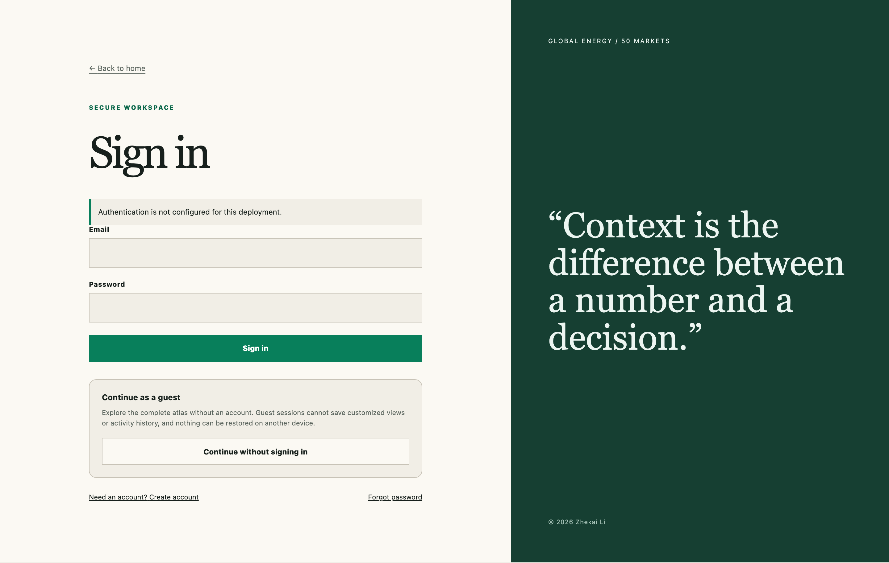
Access, personalization, and saved views
Account
Signed-in users keep saved views, language, and theme settings across devices.
Guest
Guest access opens the evidence without storing customized views or activity history.
Six languages include Arabic RTL. Light, dark, and system themes remain available before and after sign-in.
The entry page explains what persists before the user chooses an access path.
GLOBAL ENERGY DECISION ATLAS
02
Notes:
Time budget: 40 seconds.
Talk track: Show the sign-in and Guest choices. Guest users can review the full atlas. Accounts add cross-device saved views and profile preferences. Point out the language and appearance controls, including Arabic right-to-left layout.
Sources: local Global Energy Decision Atlas interface; data/energy-data.csv; data/expanded-energy-50-v1.csv; artifacts/analysis-summary.json.

Slide 3
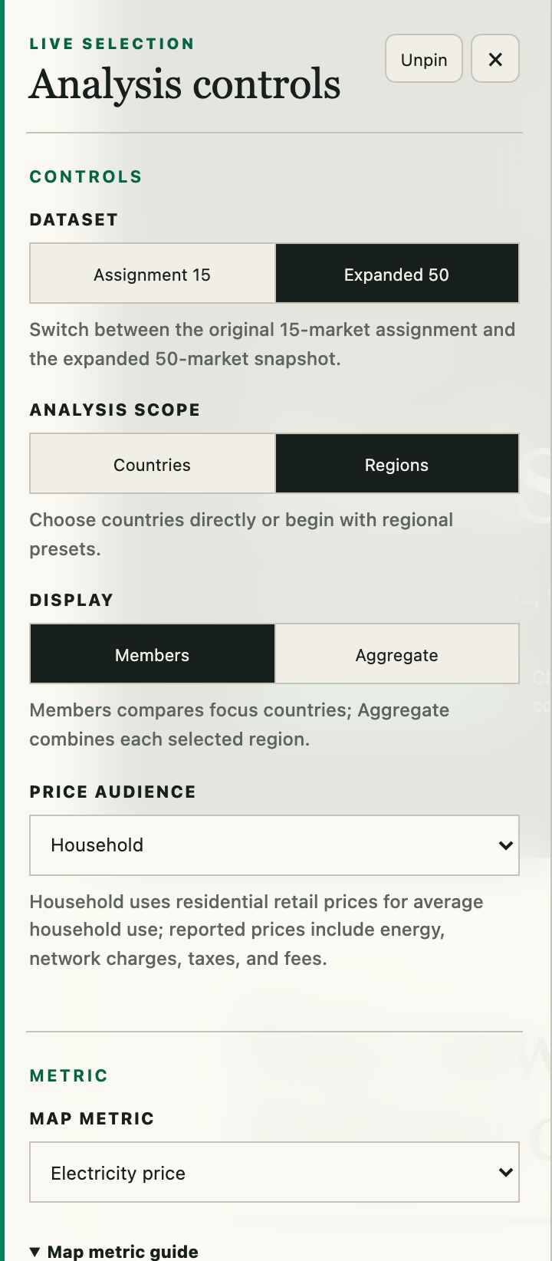
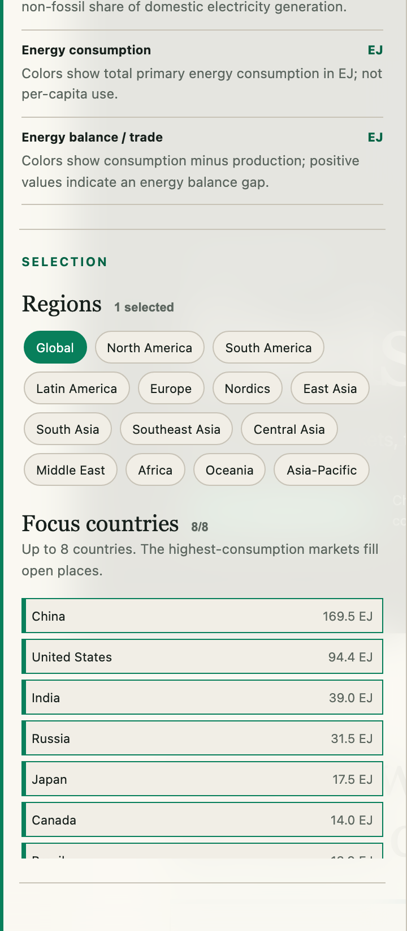
Analysis controls
Dataset
Switch between the supplied 15-country file and the Expanded 50 snapshot.
Scope and display
Choose countries or regions, then compare members or generation-weighted aggregates.
Metric and focus
Set the price audience and map metric. Focus countries control the comparison charts while the wider scope stays visible.
GLOBAL ENERGY DECISION ATLAS
03
Notes:
Time budget: 45 seconds.
Talk track: Open the filter rail. Demonstrate Dataset, countries or regions, Members or Aggregate, Price audience, Map metric, and Focus countries. The rail supports hover, keyboard focus, click, pinning, Escape, and a touch drawer on mobile.
Sources: local Global Energy Decision Atlas interface; data/energy-data.csv; data/expanded-energy-50-v1.csv; artifacts/analysis-summary.json.

Slide 4
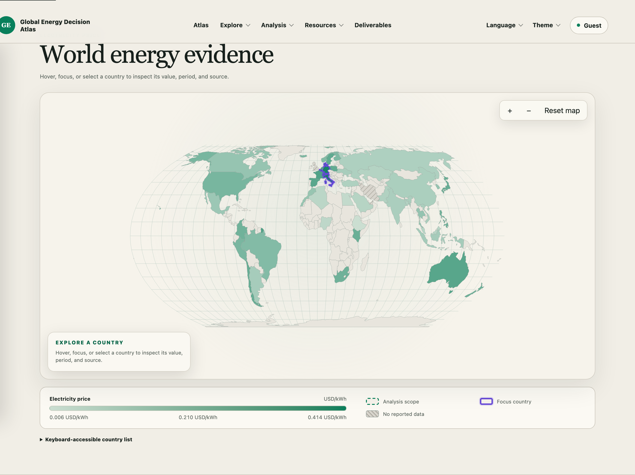
Map evidence
Metric and units
Zoom and reset
Country selection
Scope and focus marks
GLOBAL ENERGY DECISION ATLAS
04
Notes:
Time budget: 40 seconds.
Talk track: Use the map to show that the selected measure controls both color and legend units. Hover or select a country to inspect value, period, and source. Zoom and reset stay inside the component. Separate outlines show analysis scope and focus countries.
Sources: local Global Energy Decision Atlas interface; data/energy-data.csv; data/expanded-energy-50-v1.csv; artifacts/analysis-summary.json.

Slide 5
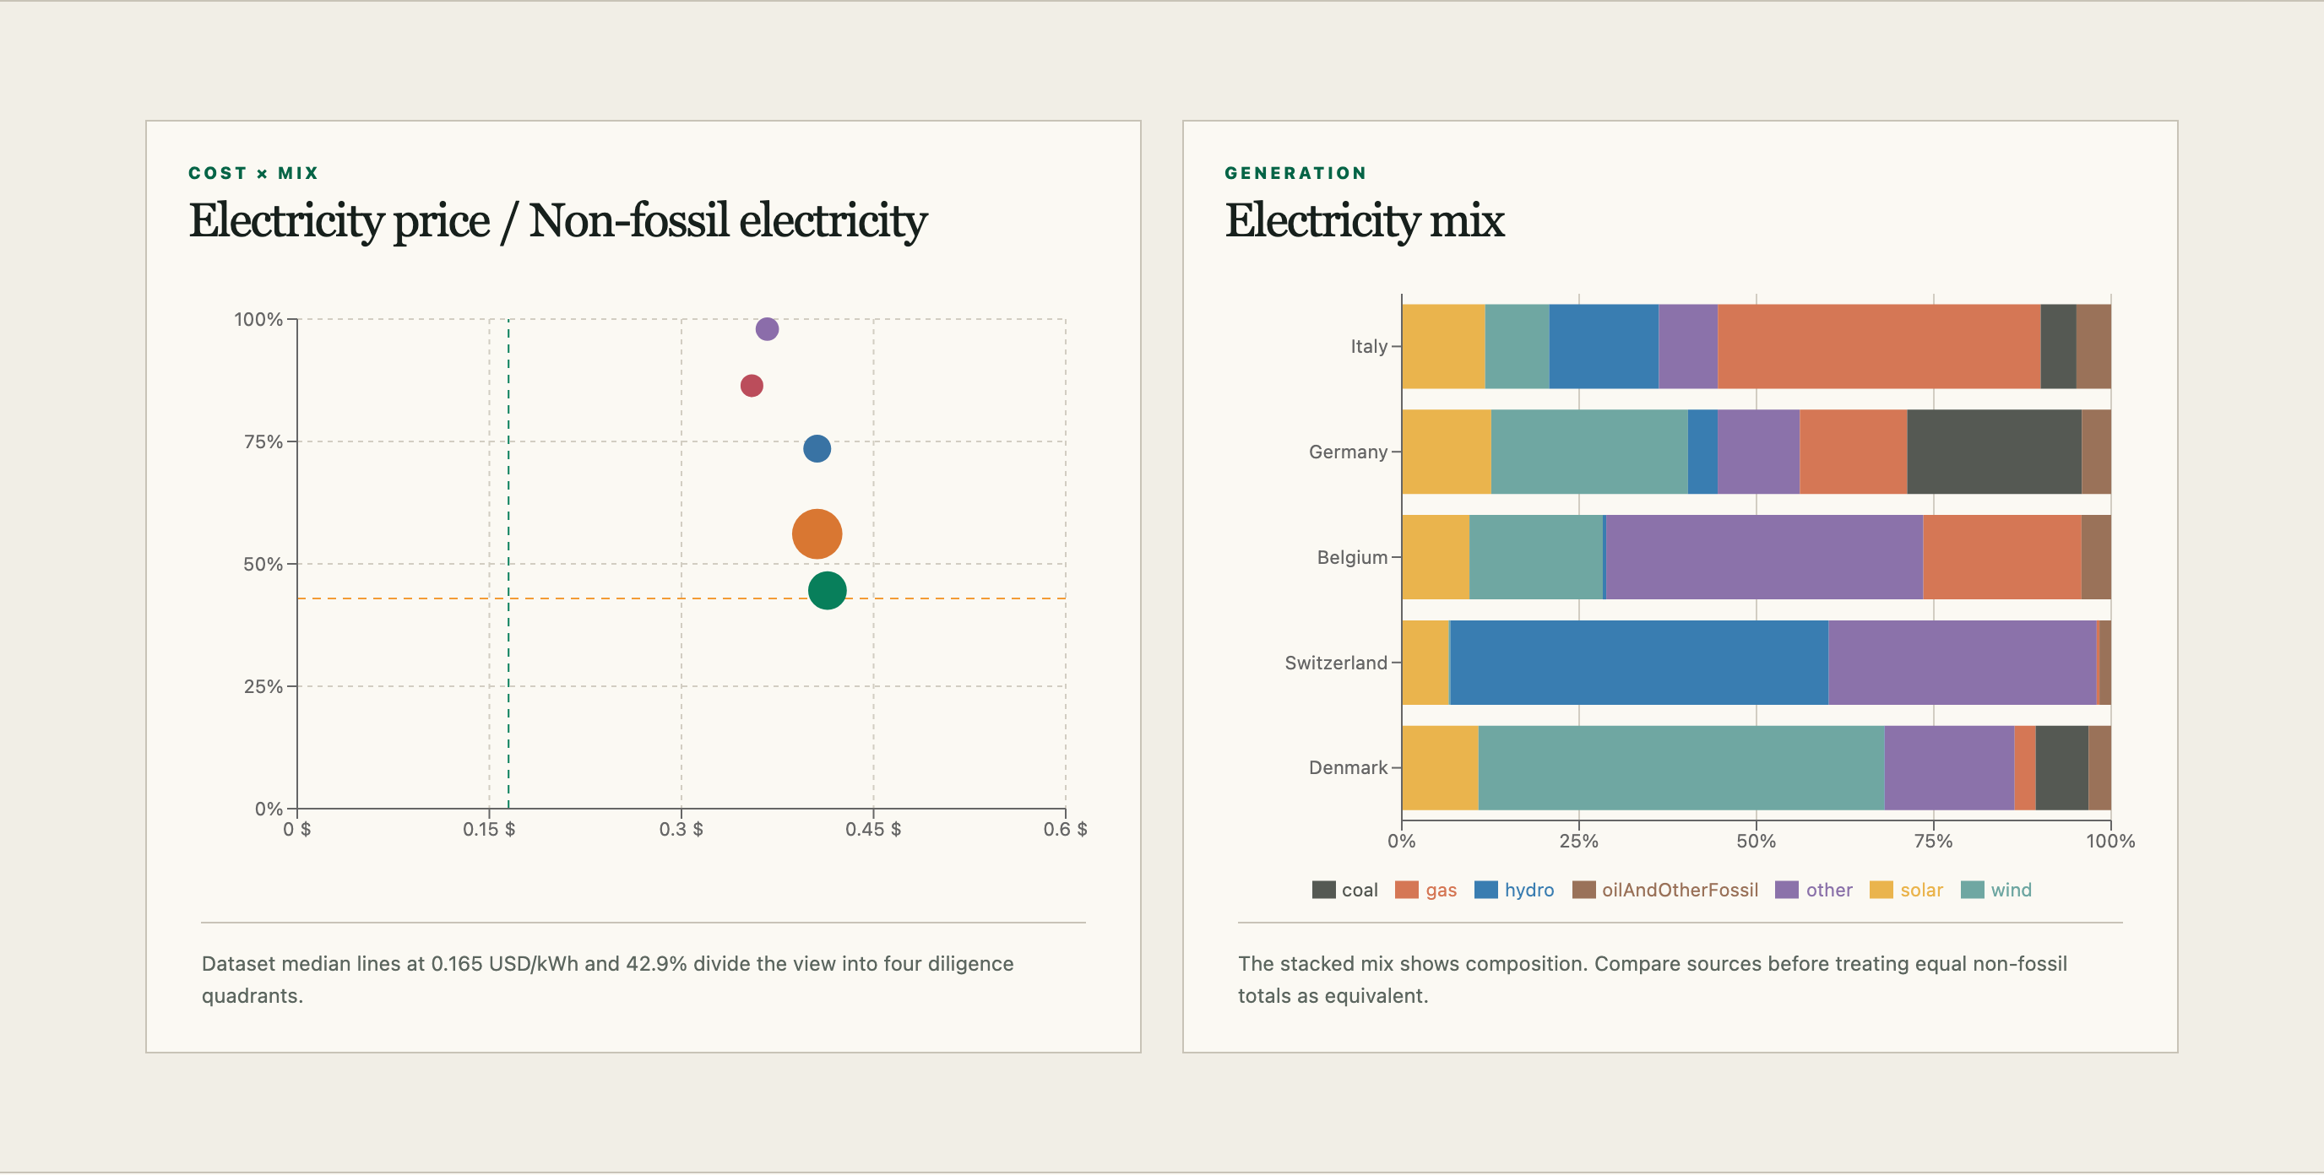
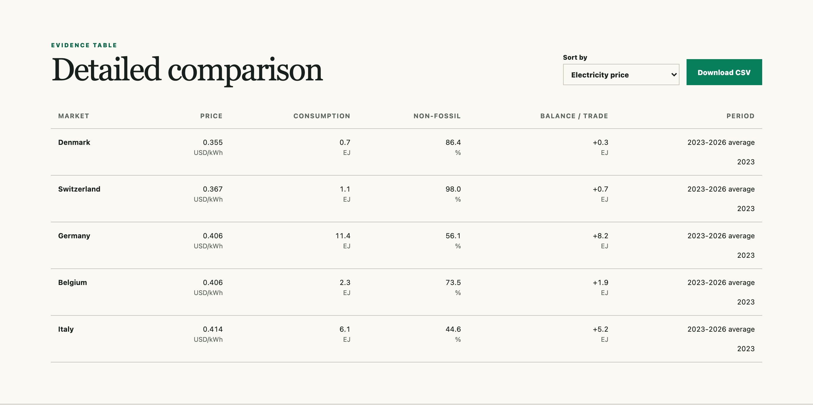
Cost, mix, balance, and records
Cost x Mix and Electricity mix
Balance, Evidence table, and CSV
Median lines frame the price and non-fossil screen. The normalized stacked bars preserve composition and end at 100 percent.
Periods, fallback flags, and stable machine fields carry the visual comparison into the downloadable record.
GLOBAL ENERGY DECISION ATLAS
05
Notes:
Time budget: 45 seconds.
Talk track: Move from Cost x Mix to the normalized Electricity mix and the balance view. Then show the Evidence table. The table carries periods and fallback status, supports sorting, and exports stable CSV fields for the active selection.
Sources: local Global Energy Decision Atlas interface; data/energy-data.csv; data/expanded-energy-50-v1.csv; artifacts/analysis-summary.json.

Slide 6

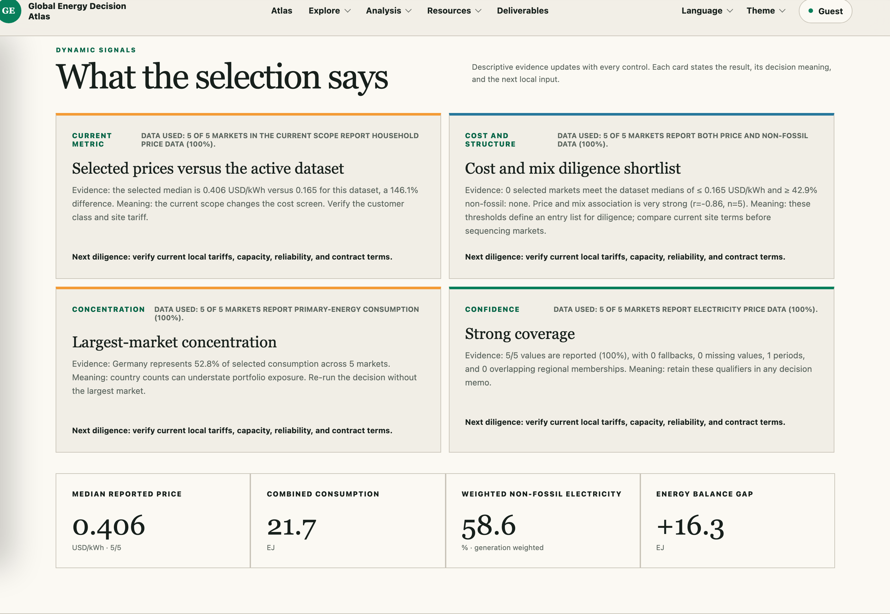
Fixed story views and dynamic Signals
Fixed views
Complete sample language
One action applies the full scope, focus, metric, and sort configuration while keeping language and theme.
Signals name the complete records, denominator, entity type, and measure instead of showing an isolated n and percent.
GLOBAL ENERGY DECISION ATLAS
06
Notes:
Time budget: 50 seconds.
Talk track: Open one of the four fixed story views. The action applies its dataset, countries, focus list, price audience, map metric, and sort order without creating a saved view. Then show the Signals sample sentence. It names complete records, the denominator, and whether the evidence represents markets or regional aggregates.
Sources: local Global Energy Decision Atlas interface; data/energy-data.csv; data/expanded-energy-50-v1.csv; artifacts/analysis-summary.json; https://www.iea.org/reports/italy-2023/executive-summary; https://ec.europa.eu/eurostat/en/web/energy/information-data; https://www.worldbank.org/content/dam/theworldbankgroupasset/document/2026/Ethiopia-National-Energy-Compact-Mission-300.pdf; https://www.iea.org/reports/electricity-2025/executive-summary; https://www.eia.gov/todayinenergy/detail.php?id=62407; https://www.eia.gov/international/content/analysis/countries_long/russia/.

Slide 7
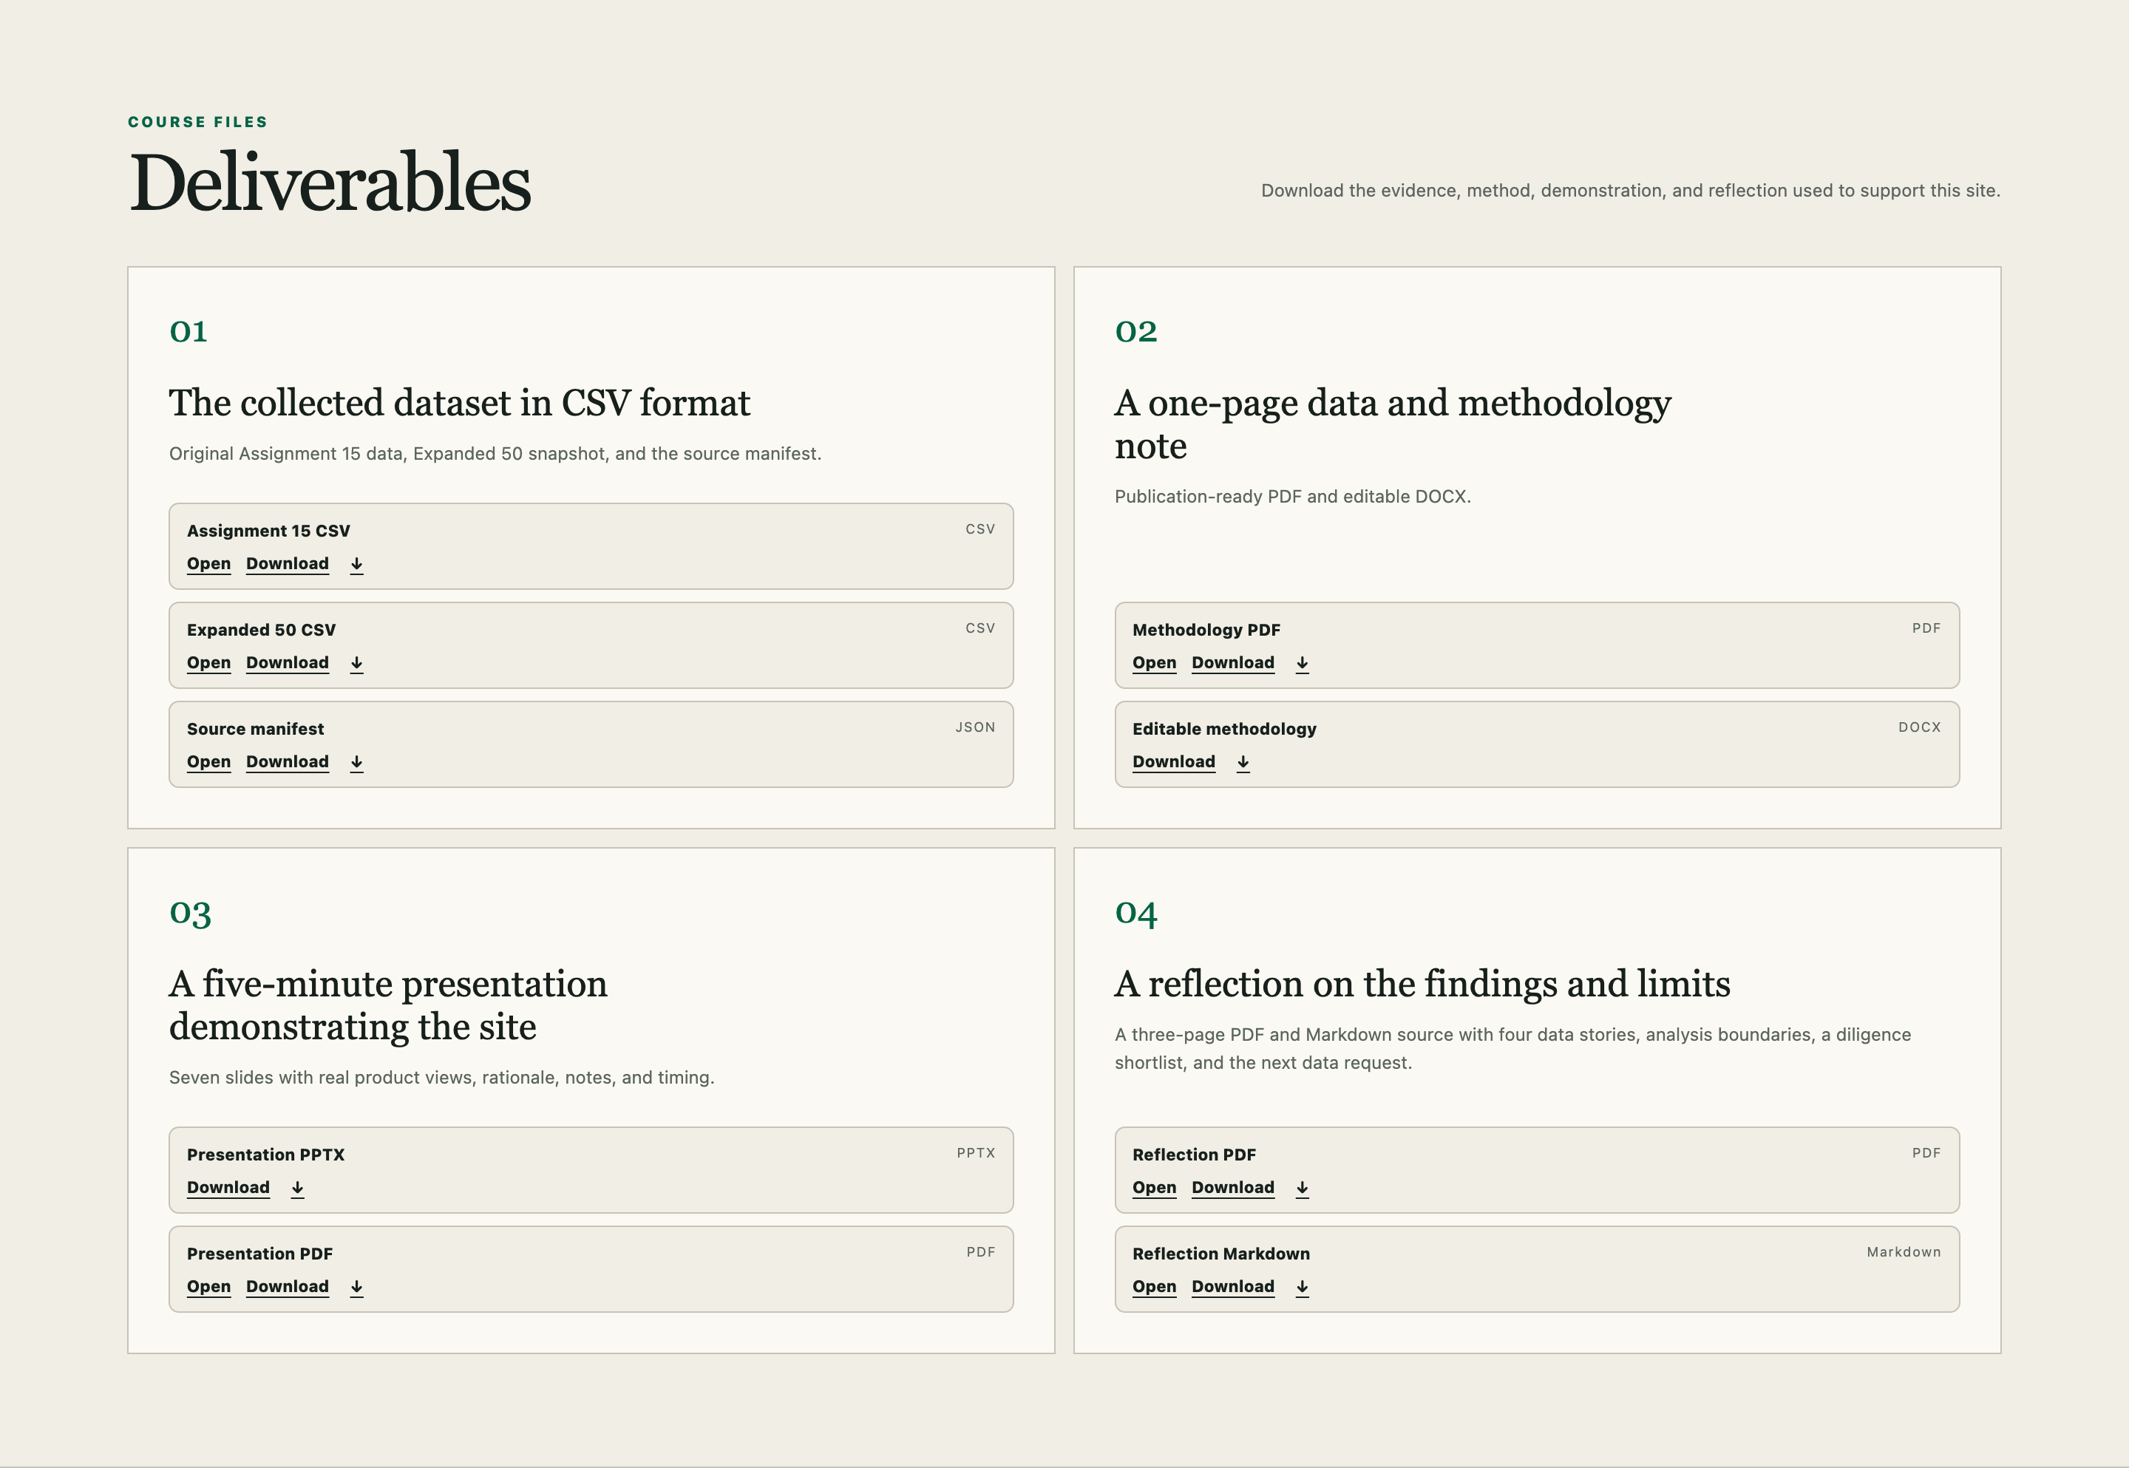
Evidence boundaries and deliverables
Analysis status
Descriptive / performed
Diagnostic / partial
Predictive / not performed
Prescriptive / not performed
Decision boundary
The shortlist orders diligence. It does not prove a best market, forecast future conditions, calculate investment return, or select an optimal site. The balance gap is not an observed trade flow.
9 stable files
global-energy-decision-atlas.vercel.app
/deliverables
The public page opens without sign-in and preserves all nine download names.
GLOBAL ENERGY DECISION ATLAS
07
Notes:
Time budget: 45 seconds.
Talk track: Close with the boundary between completed and unperformed work. Descriptive analysis is performed; diagnostic analysis is partial. Predictive and prescriptive analysis were not performed. The atlas cannot predict future electricity prices, demand, reliability, or emissions. It does not prove a best market, investment return, or optimal site. The balance gap is not an observed trade flow. The public Deliverables page provides all 9 stable files without sign-in.
Sources: local Global Energy Decision Atlas interface; data/energy-data.csv; data/expanded-energy-50-v1.csv; artifacts/analysis-summary.json.

