Slide 1
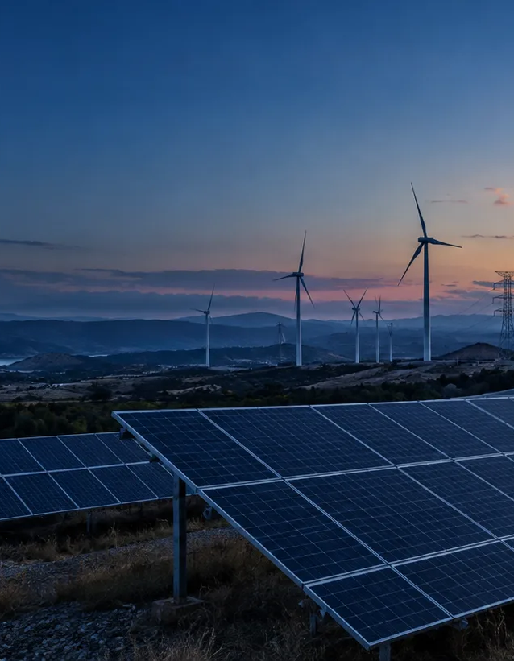
Global Energy Decision Atlas
Which markets deserve deeper energy diligence?
A decision screen for corporate energy and site-selection teams across 50 non-random markets.
Insights and decision use | Five minutes
INSIGHTS AND DECISION USE
01
Notes:
Time budget: 35 seconds.
Talk track: The business question is which markets merit deeper energy diligence. The atlas screens 50 markets for corporate energy and site-selection teams. It compares cost, generation structure, scale, and energy balance as separate signals. The output is an investigation order, not a final market choice.
Sources: artifacts/analysis-summary.json; data/story-presets.json; src/pages/AtlasPage.tsx.

Slide 2
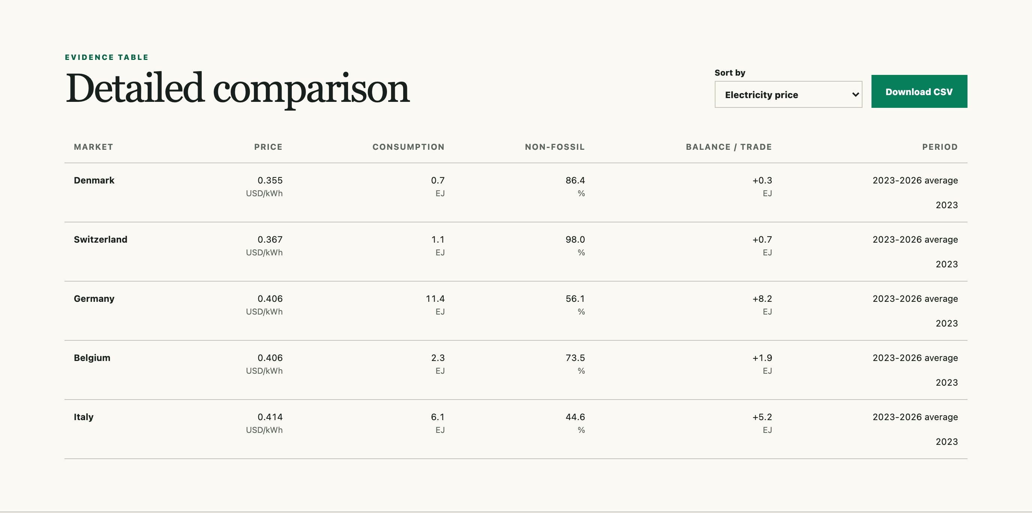
Data scope and general observations
50
47/50
45/50
47/50
non-random markets selected for breadth and data availability
household price records (94% coverage)
business price records (90% coverage)
records for consumption, mix, and balance (94%)
Reference periods differ: prices use 2023-2026 average; consumption, production, and electricity mix use 2023.
Observed ranges: household price 0.006-0.414 USD/kWh; non-fossil share 0.9-100.0%; consumption 0.231-169.459 EJ; balance gap -31.0 to +35.5 EJ.
Complete-case correlations range from r=-0.138 to 0.425 with n=43-45. They describe association only.
INSIGHTS AND DECISION USE
02
Notes:
Time budget: 40 seconds.
Talk track: The Expanded 50 is a non-random screen. Household price, consumption, non-fossil share, and balance each have 47 complete records of 50; business price has 45. Prices average 2023-2026 average; the energy measures use 2023. The ranges are wide, and the complete-case correlations use only 43 to 45 records. Association does not establish cause.
Sources: artifacts/analysis-summary.json; data/story-presets.json; data/expanded-energy-50-v1.csv; data/expanded-energy-50-v1.sources.json.

Slide 3
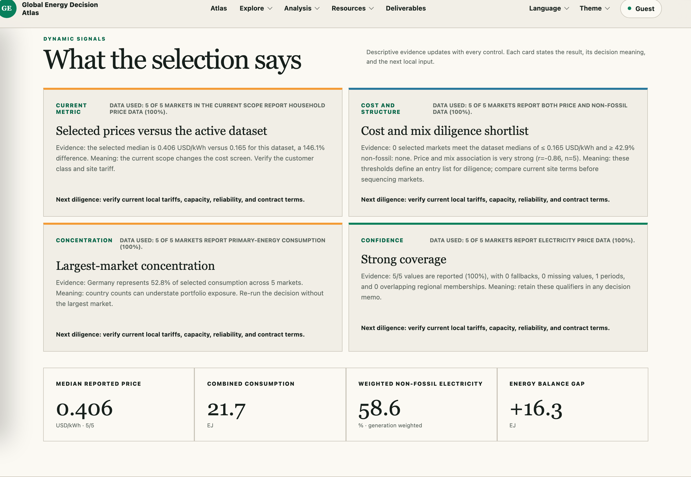
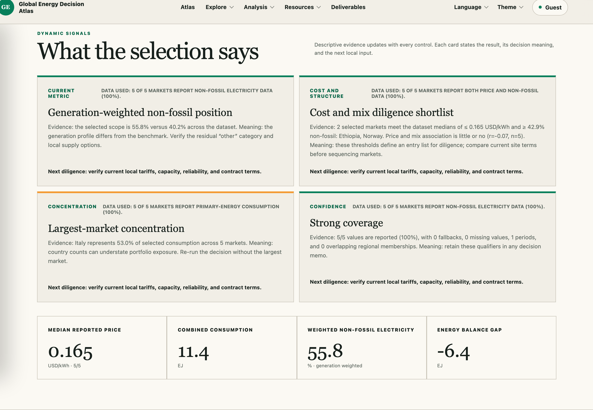
Price and generation contrasts
European price peak
Italy leads household and business prices at $0.414 and $0.411 per kWh. Germany and Belgium each report $0.406 household prices.
Low price does not imply the same generation structure
Ethiopia: $0.006, 100.0% non-fossil
Norway: $0.165, 98.5% non-fossil
Algeria: $0.041, 0.9% non-fossil
Tariff structure, contracts, and local grid conditions require separate checks.
INSIGHTS AND DECISION USE
03
Notes:
Time budget: 45 seconds.
Talk track: Italy is the European price high point at 0.414 dollars per kilowatt-hour for households and 0.411 for business. The structure story shows why price needs a separate mix check: Ethiopia pairs 0.006 with 100.0 percent non-fossil generation, Norway pairs 0.165 with 98.5 percent, and Algeria pairs 0.041 with 0.9 percent. These national averages do not reveal a facility tariff or contract.
Sources: artifacts/analysis-summary.json; data/story-presets.json; https://www.globalpetrolprices.com/electricity_prices/; https://owid-public.owid.io/data/energy/owid-energy-data.csv.

Slide 4
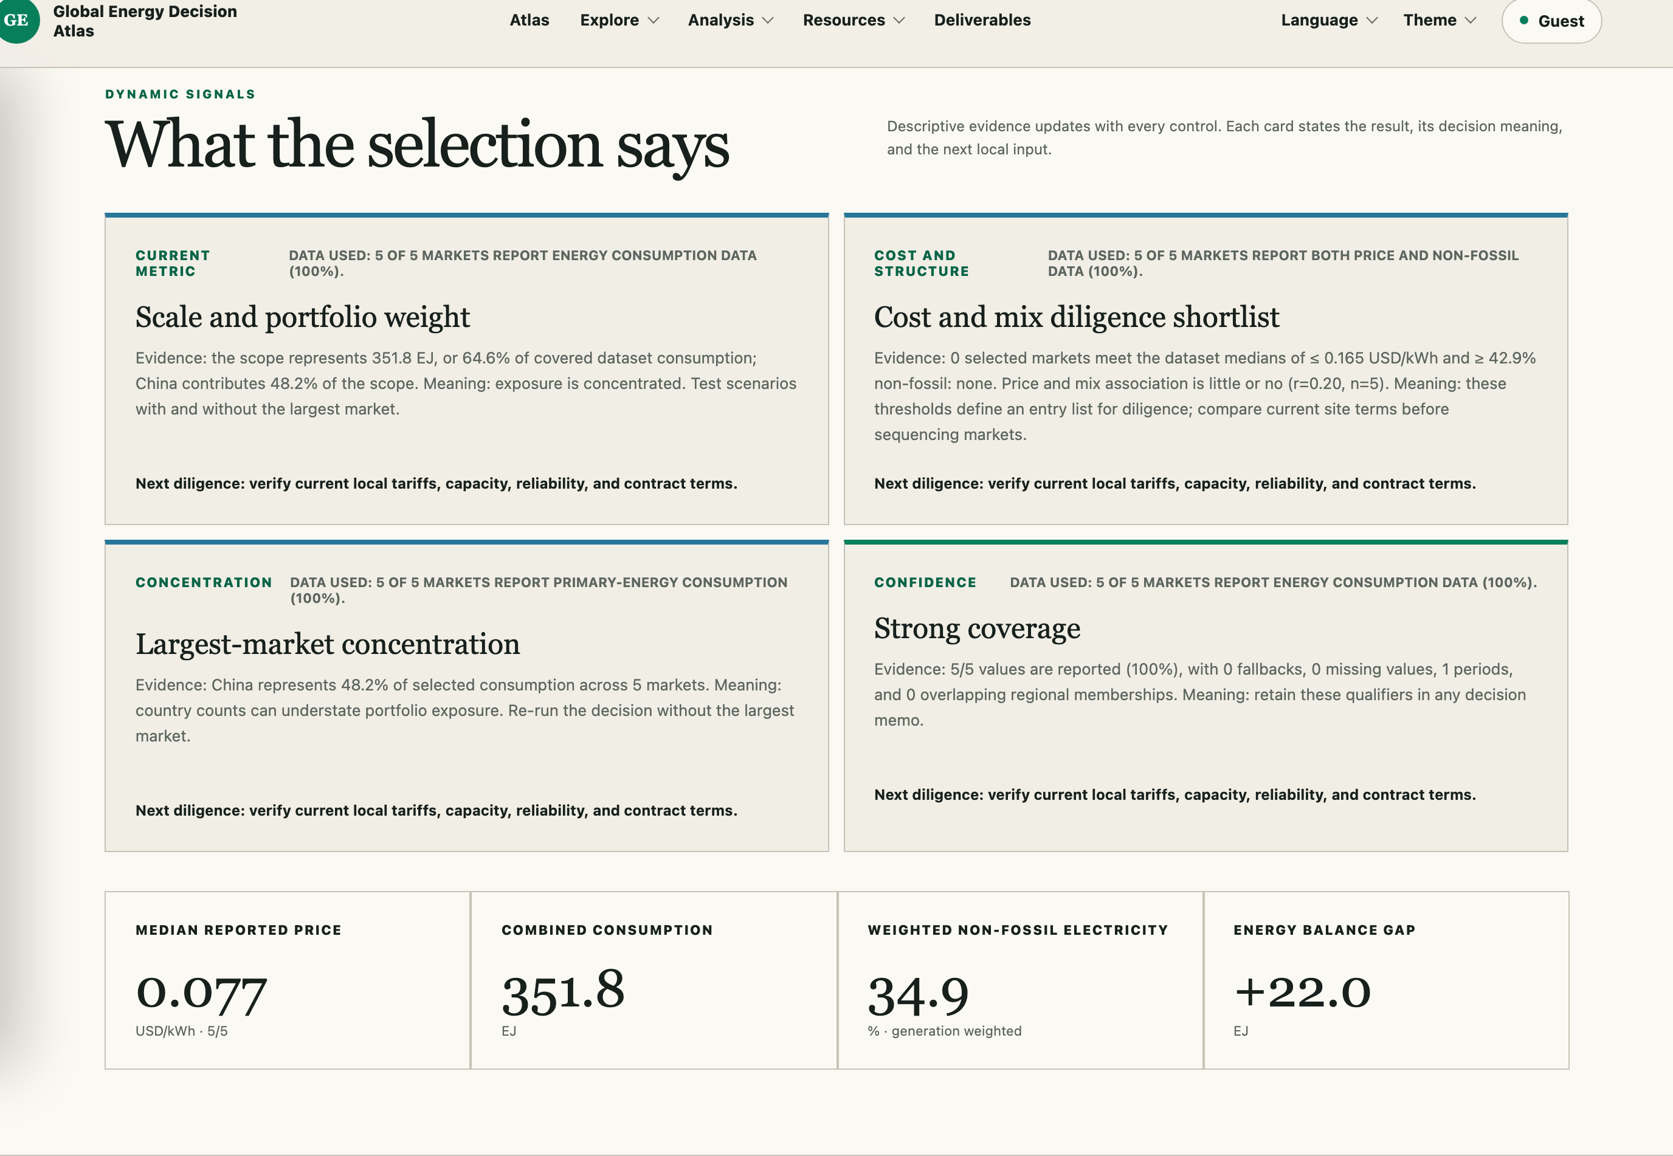
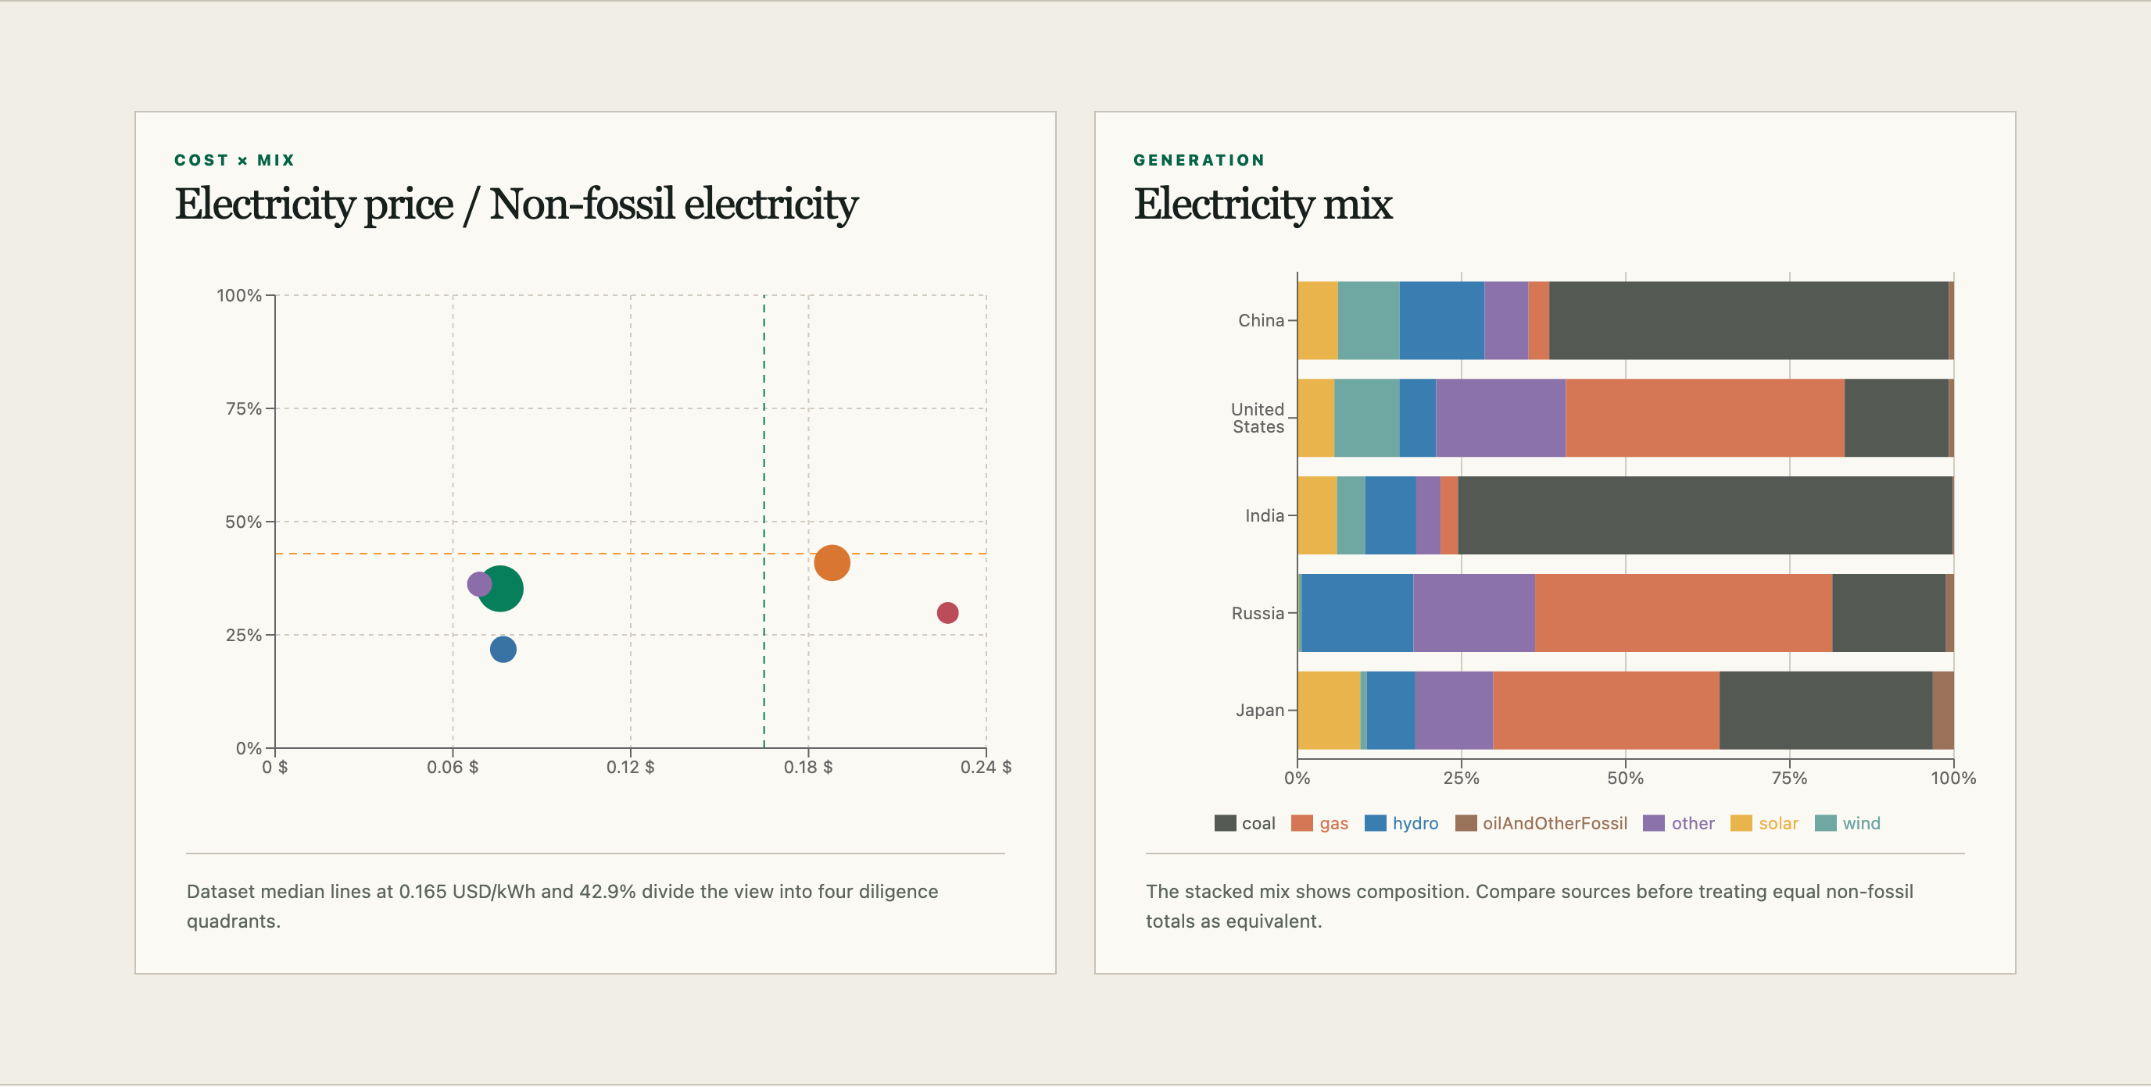
Consumption concentration
31.1%
17.3%
China
United States
48.4%
China plus United States
64.6%
top five markets
Shares use 545.0 EJ reported across complete records. A portfolio with equal country counts can still have a highly concentrated energy footprint.
INSIGHTS AND DECISION USE
04
Notes:
Time budget: 45 seconds.
Talk track: China accounts for 31.1 percent of reported consumption and the United States for 17.3 percent. Together they represent 48.4 percent; the top five represent 64.6 percent of 545.0 reported exajoules. Country counts therefore do not measure portfolio weight. A few large markets can dominate exposure and the value of follow-up work.
Sources: artifacts/analysis-summary.json; data/story-presets.json; data/expanded-energy-50-v1.csv; https://owid-public.owid.io/data/energy/owid-energy-data.csv.

Slide 5
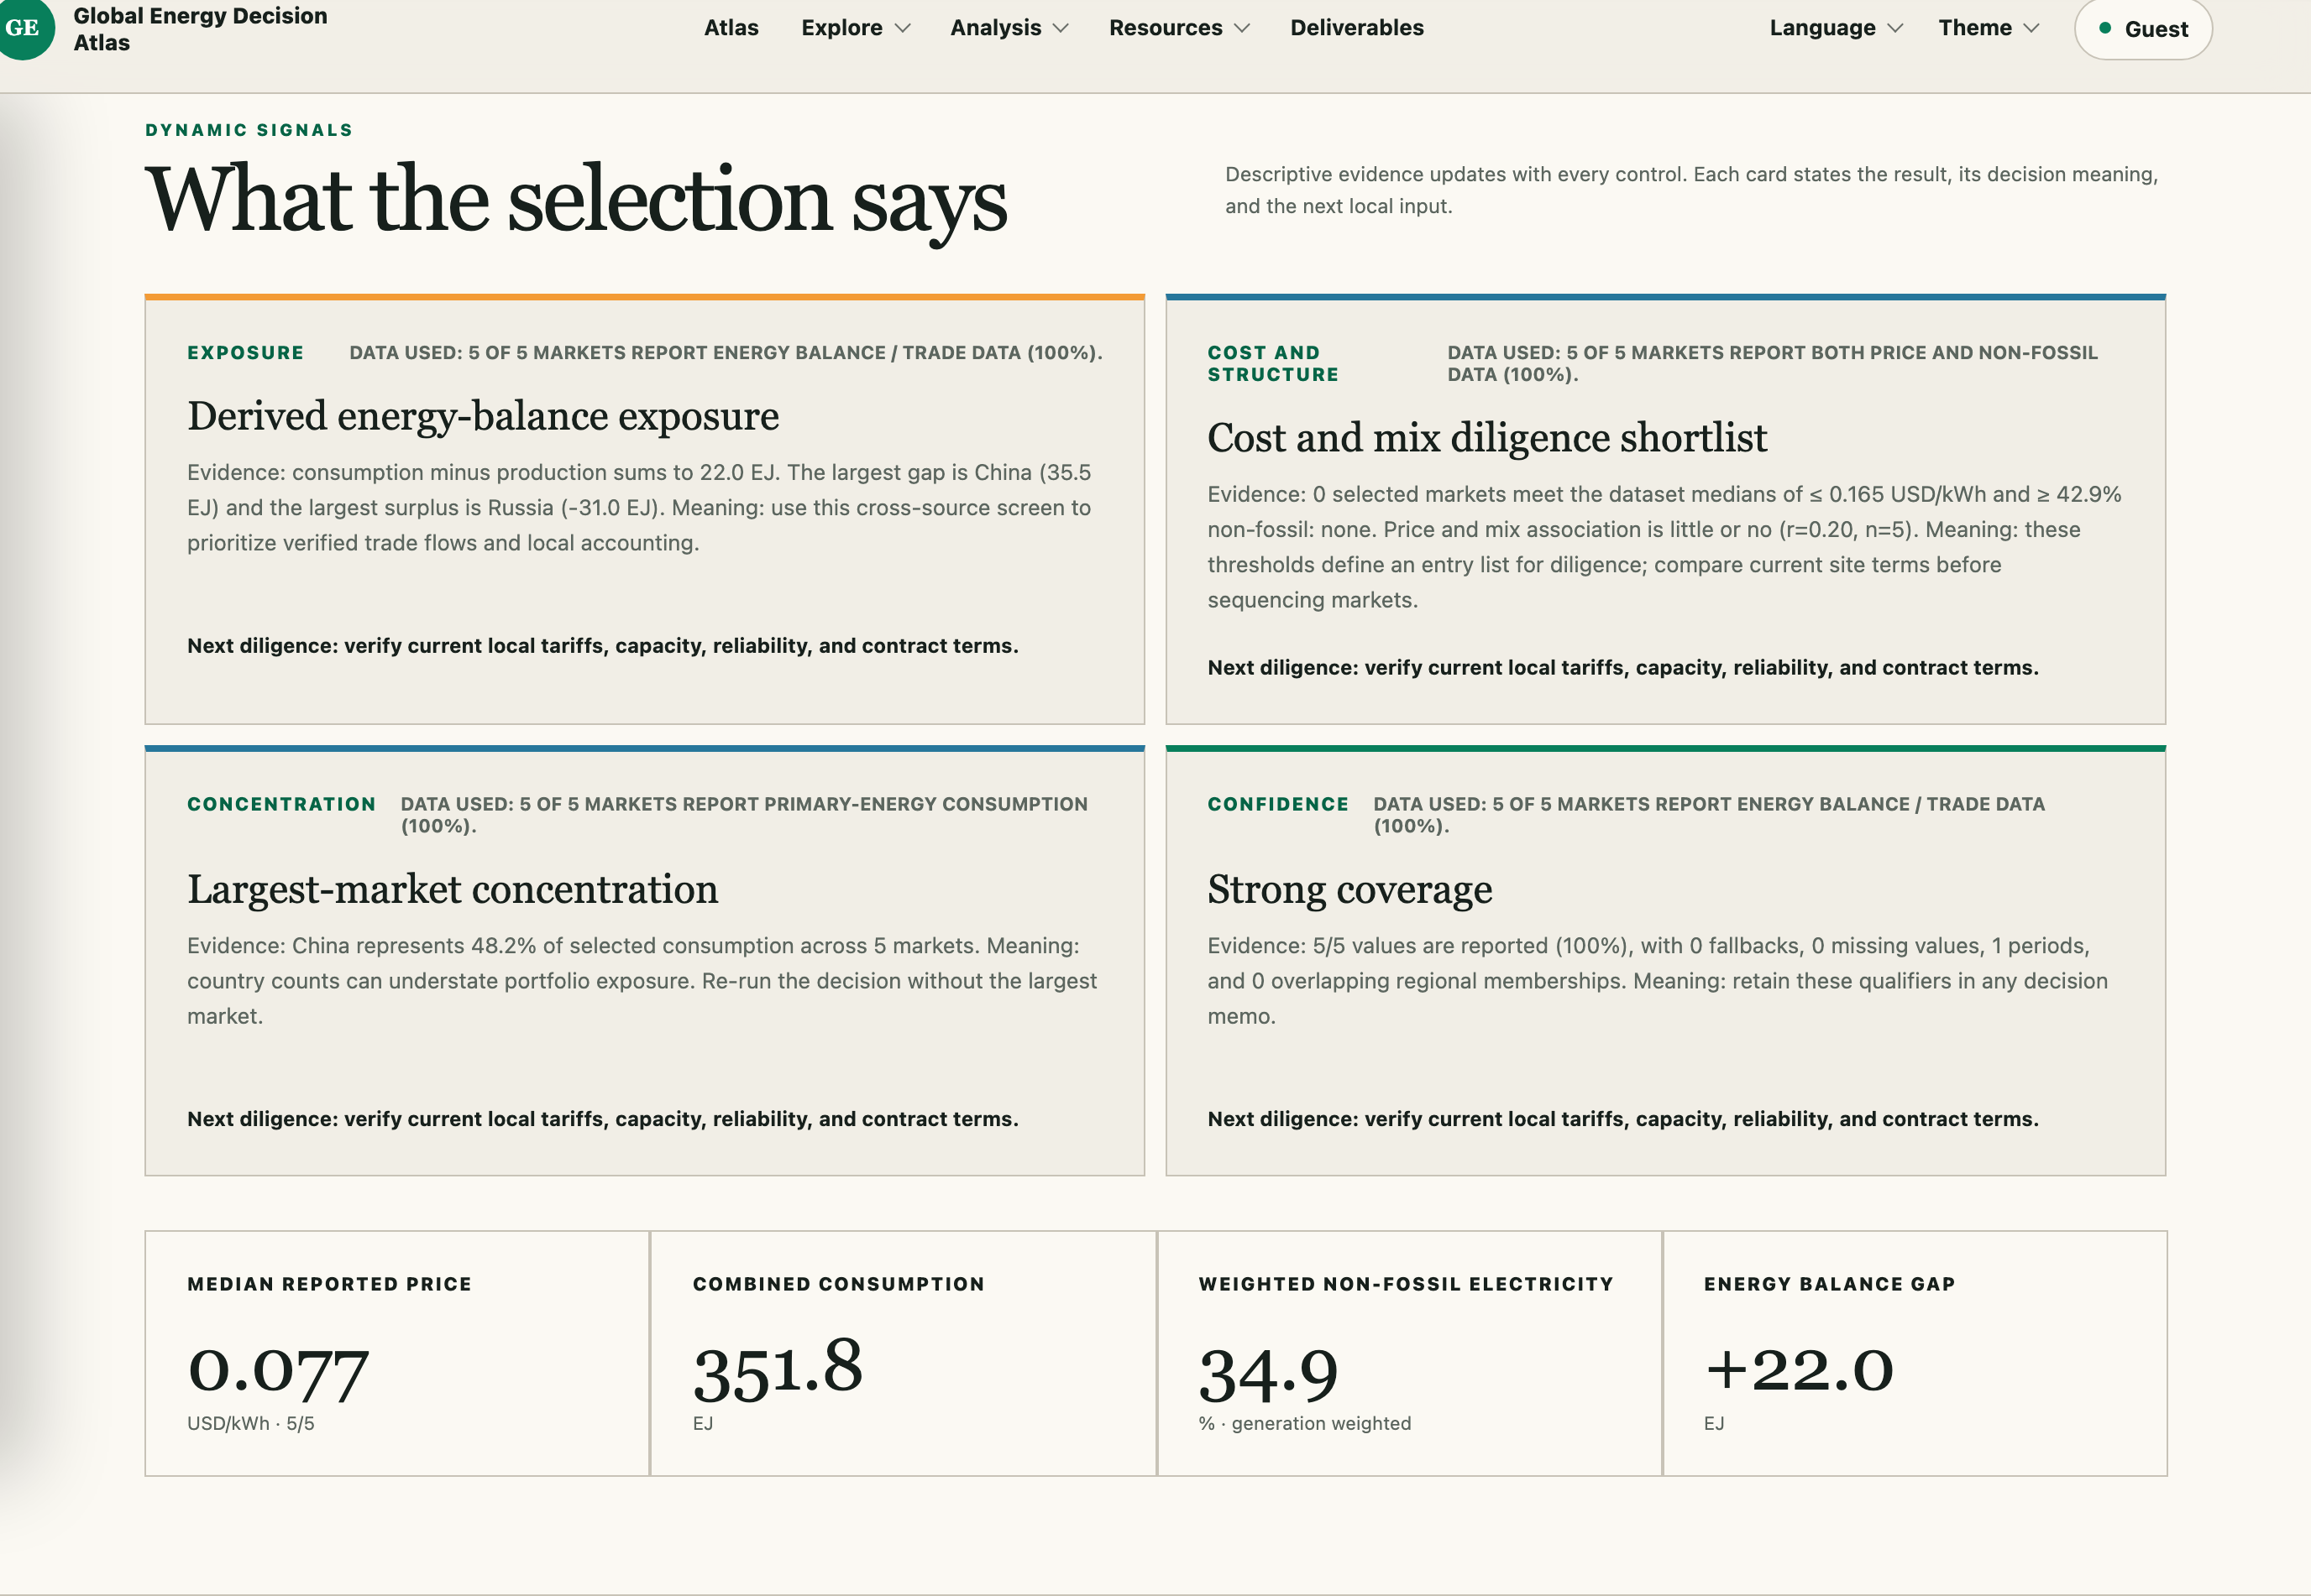
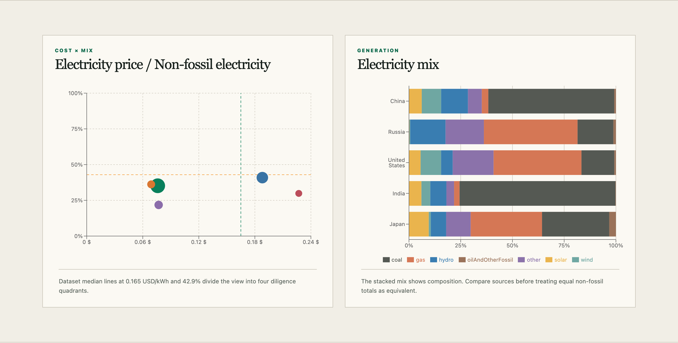
Energy balance positions
Primary energy consumption minus total energy production
+35.5 EJ
+16.2 EJ
China
India
-31.0 EJ
-14.0 EJ
Russia
United States
Positive values indicate a consumption gap. Negative values indicate production above consumption. The measure does not observe actual trade flows.
INSIGHTS AND DECISION USE
05
Notes:
Time budget: 45 seconds.
Talk track: The balance gap is consumption minus production. China is positive 35.5 exajoules and India is positive 16.2. Russia is -31.0 and the United States is -14.0. These positions help order exposure questions. They are not actual import or export flows because the calculation does not observe inventories, transformation losses, or cross-border movements.
Sources: artifacts/analysis-summary.json; data/story-presets.json; data/expanded-energy-50-v1.csv; https://api.eia.gov/bulk/INTL.zip.

Slide 6
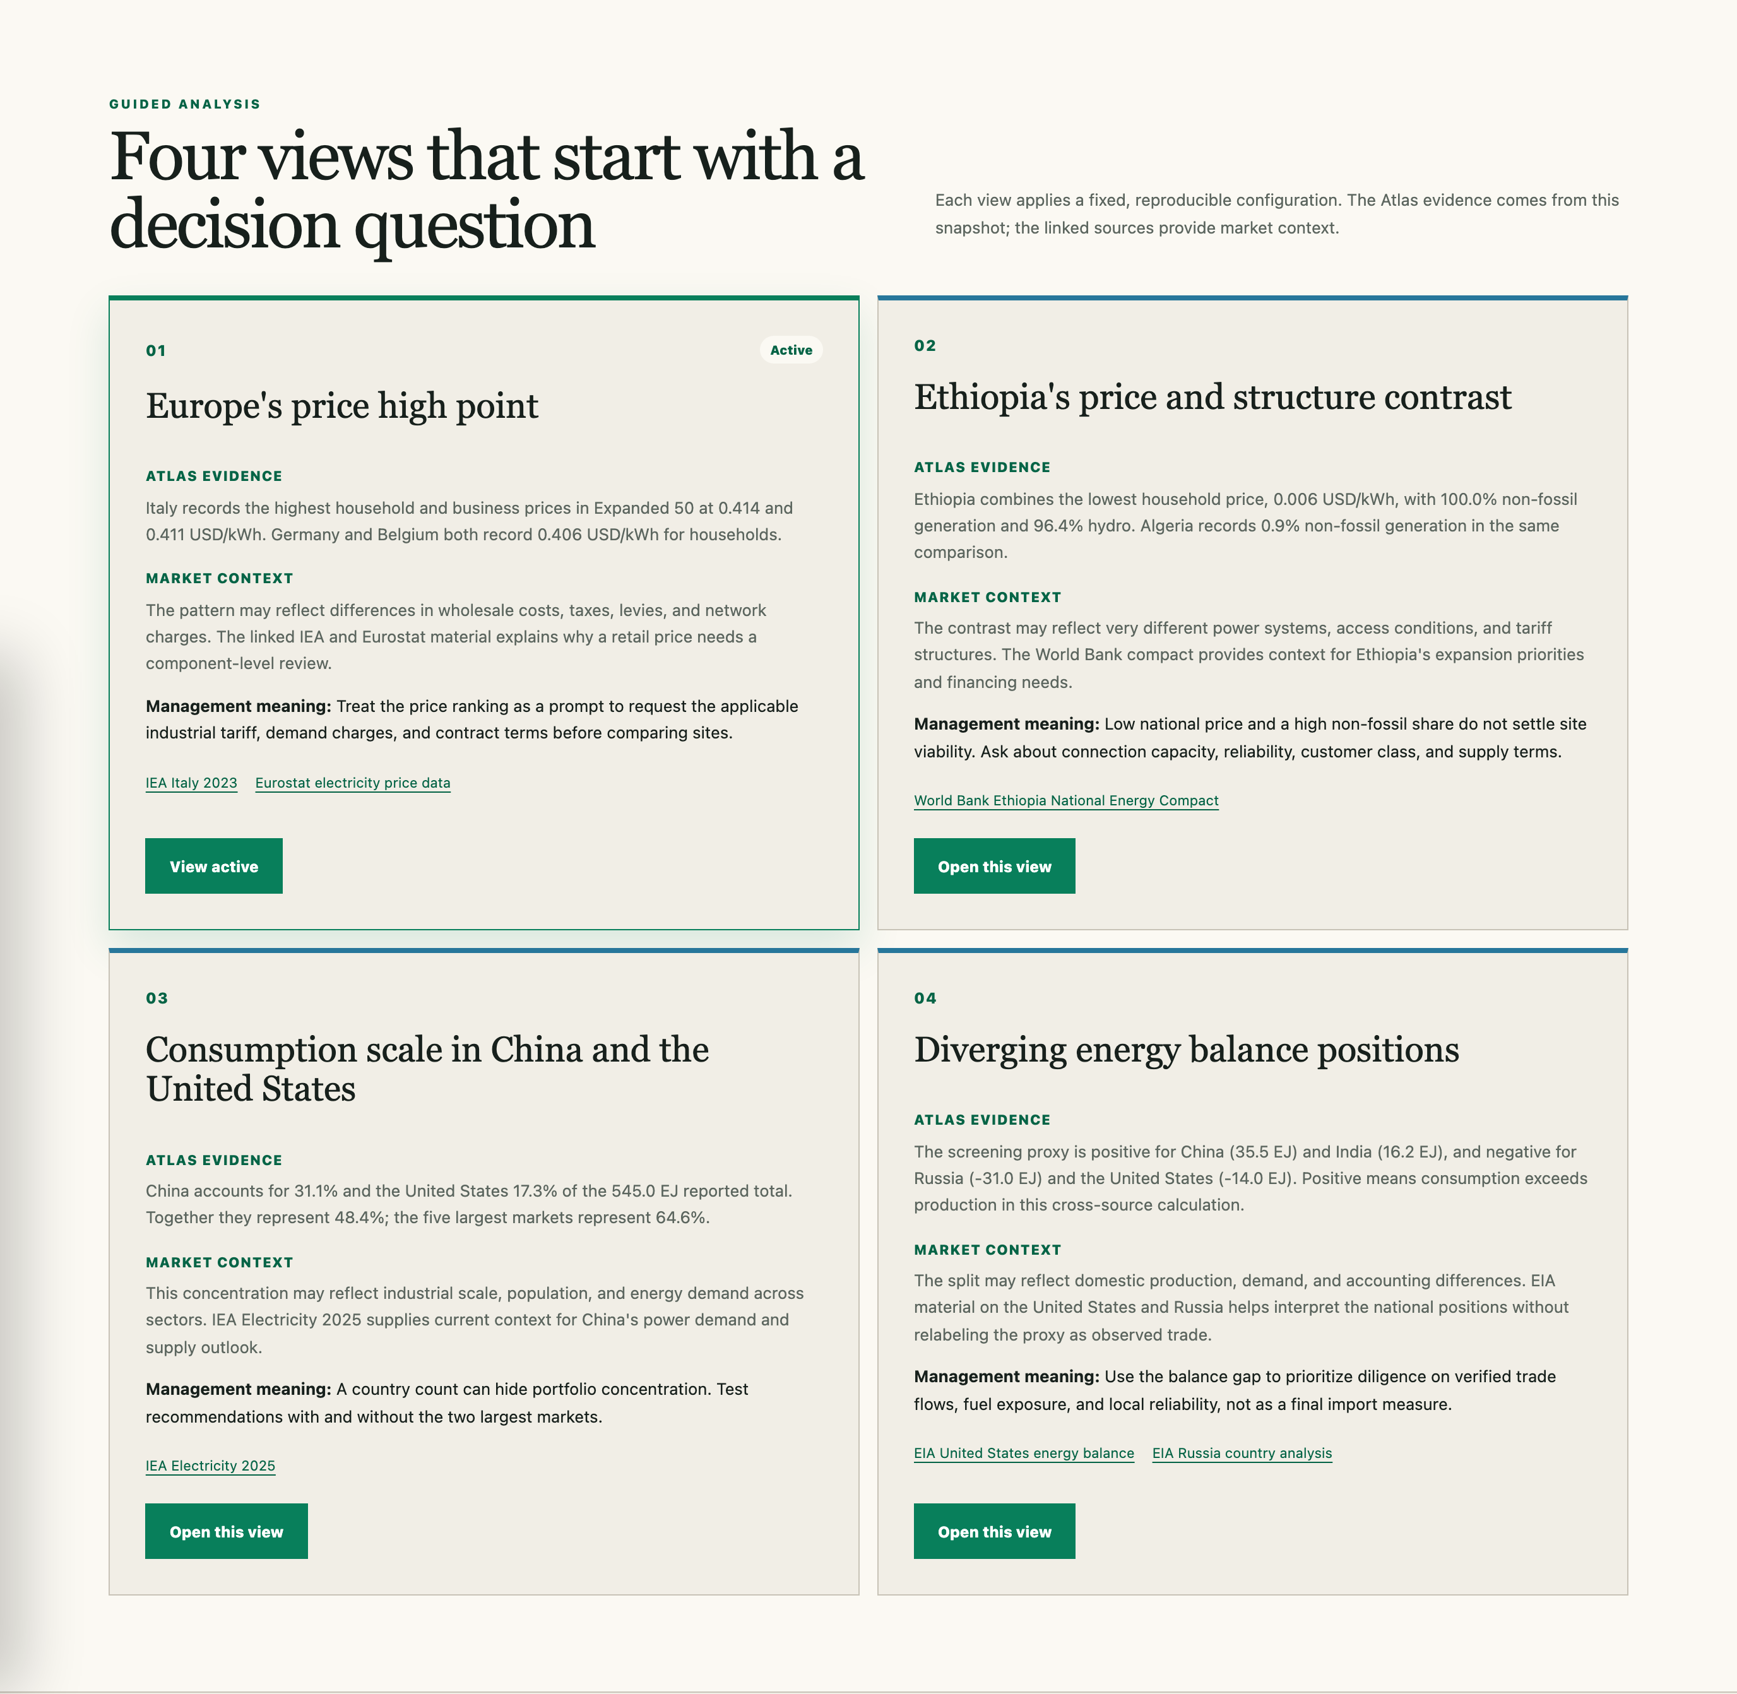
Decision use and diligence shortlist
China, India, and United States
Start with scale and balance exposure.
Ethiopia, Norway, Italy, and Algeria
Test the price and generation contrasts against local operating conditions.
Local checks before a decision
Facility tariff and demand charges
Contract term, indexation, and hedging
Available grid capacity and connection cost
Reliability, curtailment, and outage history
This sequence orders investigation. It does not rank the best market.
INSIGHTS AND DECISION USE
06
Notes:
Time budget: 50 seconds.
Talk track: The shortlist orders investigation rather than ranking the best market. Start with China, India, and the United States for scale and balance exposure. Use Ethiopia, Norway, Italy, and Algeria to test the sharp price and mix contrasts. For every case, replace the national screen with the facility tariff and demand charges, contract terms and hedging, available grid capacity and connection cost, plus reliability and curtailment history.
Sources: artifacts/analysis-summary.json; data/story-presets.json; https://www.iea.org/reports/italy-2023/executive-summary; https://www.worldbank.org/content/dam/theworldbankgroupasset/document/2026/Ethiopia-National-Energy-Compact-Mission-300.pdf.

Slide 7
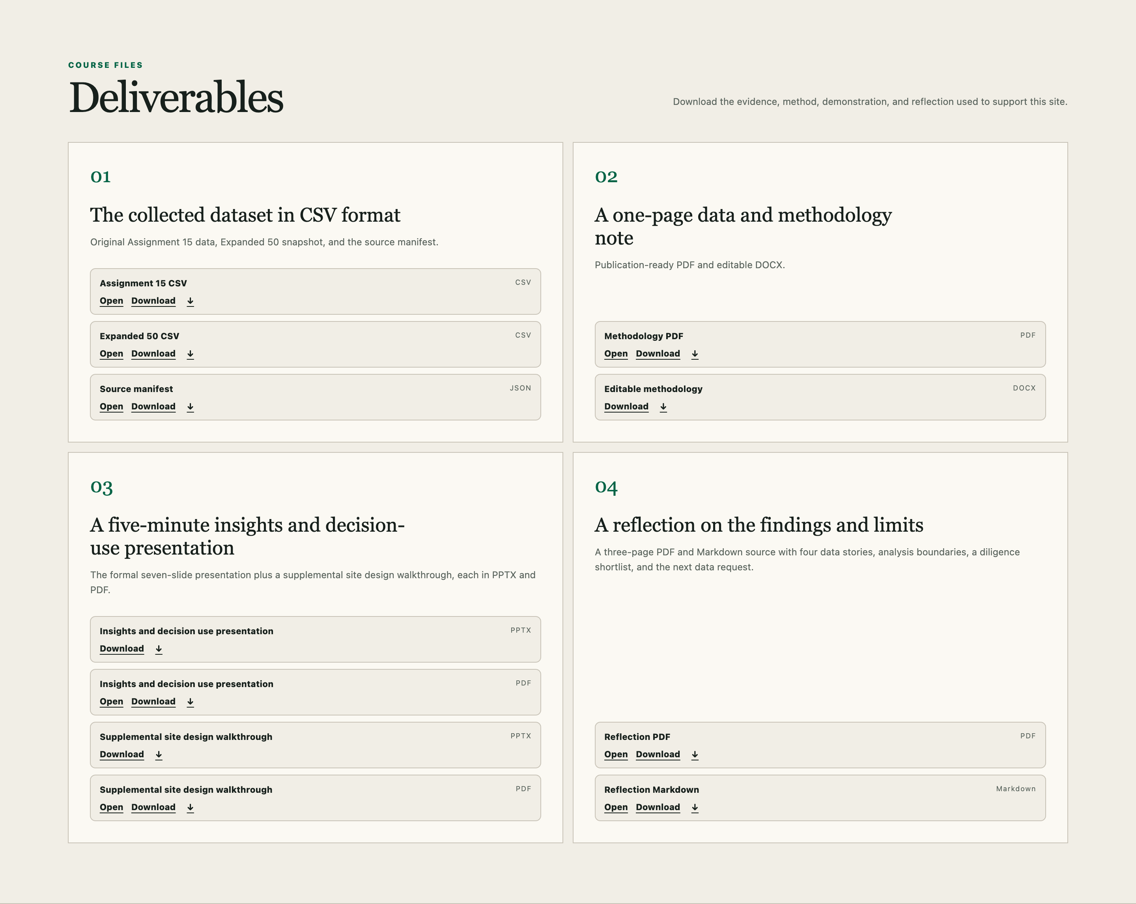
Method, evidence boundaries, and limitations
Analysis status
Descriptive / performed
Diagnostic / partial
Predictive / not performed
Prescriptive / not performed
Limits that affect interpretation
Missing values change denominators. Reference years differ. National averages do not represent a facility contract or connection point. Complete-case correlations do not establish causation.
11 stable files | global-energy-decision-atlas.vercel.app/deliverables
INSIGHTS AND DECISION USE
07
Notes:
Time budget: 40 seconds.
Talk track: Descriptive analysis is performed; diagnostic analysis is partial. Predictive and prescriptive work were not performed. The atlas does not predict future electricity prices, demand, reliability, or emissions, and it does not identify an optimal site. Missing values change denominators, the indicators mix reference years, and national averages do not substitute for facility tariffs or reliability records. The correlations do not establish causation, and the balance gap is not an observed trade flow. The public Deliverables page provides all 11 files without sign-in.
Sources: artifacts/analysis-summary.json; data/story-presets.json; README.md; data/deliverables.json; src/pages/DeliverablesPage.tsx.

