Slide 1
RESEARCH STRATEGY
MAP
Use AI to expand the search space—not choose the research bet
Broaden
COMPARE
Question
VERIFY
Speed can broaden discovery. It cannot decide which problem deserves years of attention.
Test
COMMIT
Author owns
AI-assisted presentation
Evidence reviewed by Zhekai Li
01 · AUDIENCE VIDEO · 3–5 MINUTES

Slide 2
SCHOLAR IN THE LOOP · VIDEO 01
02 / 08
THE USEFUL ASYMMETRY
AI generates options faster than researchers can judge them
CANDIDATE SPACE
Question
Mechanism
OWNER
Human
→
Method
Literature
Treat the output as a candidate space, not a ranked answer set.
Prioritizes and justifies
Alternative
Premise

Slide 3
SCHOLAR IN THE LOOP · VIDEO 01
03 / 08
A STAGED EXPLORATION PATTERN
Survey broadly. Then follow evidence deeply.
01 · BREADTH FIRST
02 · DEPTH FIRST
Map adjacent literatures
Trace mechanisms and citations
Compare questions, methods, mechanisms, and neighboring fields before narrowing.
→
Follow every decisive claim upstream until its evidence and dependencies are visible.
Questions
Methods
Fields
Claim
Source
Dependency
Nature Machine Intelligence commentary · exploration architecture, not proof of correctness

Slide 4
SCHOLAR IN THE LOOP · VIDEO 01
04 / 08
THE HUMAN BOUNDARY
Four responsibilities do not transfer
01
02
03
04
Formulate
Audit
Reproduce
Defend
Define the scientific problem
Challenge model outputs
Rebuild decisive results
Own every material choice
MIT expert perspective · the researcher remains accountable for the intellectual commitment

Slide 5
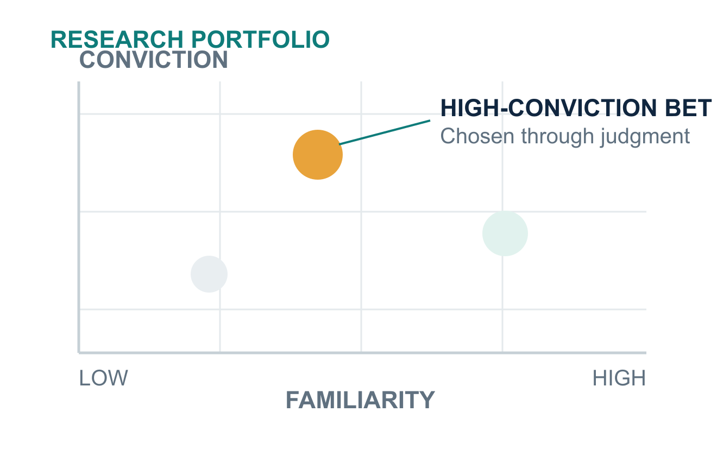
SCHOLAR IN THE LOOP · VIDEO 01
05 / 08
ORIGINALITY IS A JUDGMENT
Accessible patterns are not automatically important problems
A neglected direction may be profound, infeasible, or merely unfashionable.

Slide 6
SCHOLAR IN THE LOOP · VIDEO 01
06 / 08
WHY VERIFICATION SCALES POORLY
One local error can travel through a dependency graph
ASSUMPTION
MANUSCRIPT A
DEPENDENT WORK
→
→
B affected
C affected
Sign error
Argument invalidated
Retraction Watch report · illustrates propagation, not a general failure rate

Slide 7
SCHOLAR IN THE LOOP · VIDEO 01
07 / 08
THE DECISION GATE
Before committing, answer five questions in your own words
01
02
03
04
05
Problem
Importance
Originality
Evidence
Falsifier
What is being explained?
Why does it matter?
What is non-obvious?
What must be true?
What would weaken it?
Many candidates enter. One researcher-justified bet exits.

Slide 8
SCHOLAR IN THE LOOP · VIDEO 01
08 / 08
SOURCES & DISCLOSURE
Trace the argument, not just the presentation
01
Nature Machine Intelligence
Evidence exploration commentary · breadth-first and depth-first search
02
MIT News
Expert perspective · formulation, auditing, reproduction, and defense
03
Latent Space
Practitioner testimony · academia and high-risk research bets
04
Retraction Watch
Reported case · error propagation across dependent manuscripts
Full URLs and timestamps appear in the YouTube description and linked article.

