Slide 1
EVIDENCE DISCIPLINE
FLUENT
Fluent reasoning is not provenance
Readable
TRACEABLE
Source located
A polished answer can be readable, traceable, and still wrong. Build a verification layer.
VERIFIED
Supported
DECISION
Author owns
AI-assisted presentation
Evidence reviewed by Zhekai Li
02 · AUDIENCE VIDEO · 3–5 MINUTES

Slide 2
SCHOLAR IN THE LOOP · VIDEO 02
02 / 08
THREE DIFFERENT QUESTIONS
Do not collapse fluency, provenance, and verification
FLUENCY
PROVENANCE
VERIFICATION
Can I follow the explanation?
Can I locate the source?
Does the evidence support the claim?
Readable
Traceable
Defensible
Each layer helps. Only verification earns evidentiary credit.

Slide 3
SCHOLAR IN THE LOOP · VIDEO 02
03 / 08
REASONING TOKENS
Contribution is not faithful explanation
INPUT
→
Model
→
Answer
Reasoning tokens
Coherence does not prove faithful explanation.
Nature Machine Intelligence Perspective · conceptual analysis

Slide 4
SCHOLAR IN THE LOOP · VIDEO 02
04 / 08
TWO SEPARATE CHECKS
A located source is not yet supporting evidence
CLAIM
Source located
“The method improves reliability.”
→
Claim support still untested
Check method, context, qualifications, and scope, not just the URL.

Slide 5
SCHOLAR IN THE LOOP · VIDEO 02
05 / 08
DEPENDENCY TRACING
Verification must travel upstream
A · UNVERIFIED
B · SOURCE CHECKED
DEPENDENT CLAIMS
→
→
C reproduced
D unverified
Foundational result
Derived construction
Retraction Watch report · one sign error affected three dependent manuscripts

Slide 6
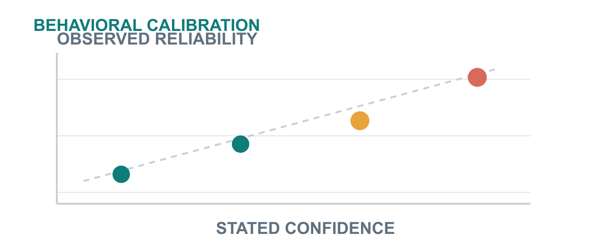
SCHOLAR IN THE LOOP · VIDEO 02
06 / 08
CALIBRATION BEFORE TRUST
Confidence should predict observed behavior
CHECK
Sources and claims
CHARACTERIZE
Limits and failures

Slide 7
SCHOLAR IN THE LOOP · VIDEO 02
07 / 08
THE VERIFICATION LAYER
Five gates between a fluent draft and an author-verified claim
01
02
03
04
05
Open
Align
Reproduce
Trace
Calibrate
Original source
Claim and evidence
Decisive steps
Dependencies
Against outcomes
Reasoning is a candidate. Citations are leads. Confidence must be calibrated.

Slide 8
SCHOLAR IN THE LOOP · VIDEO 02
08 / 08
SOURCES & DISCLOSURE
Trace the argument, not just the presentation
01
Nature Machine Intelligence
Perspective on reasoning tokens · commentary on provenance and validity
02
Retraction Watch
Reported dependency failure in AI-associated mathematics manuscripts
03
SciSpace
Commercial webinar testimony · statement and reference checking
04
Latent Space
Expert panel testimony · calibration and behavioral characterization
Full URLs and timestamps appear in the YouTube description and linked article.

