Slide 1
Learning-Rate-Free Learning by D-Adaptation
ICML 2023 OralPoster (Outstanding paper)
Authors: Aaron Defazio Konstantin Mishchenko
Applicant: Zhekai Liu
Time: 02/2025

Slide 2
CONTENTS
1. Pre-knowledge
2. Motivation
3. D-Adaptation
4. Experimental results and proof

Slide 3
01
Pre-knowledge

Slide 4
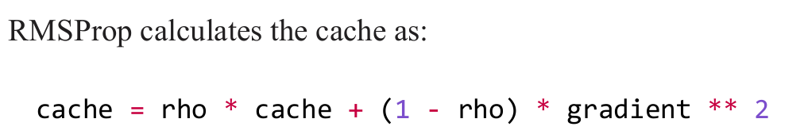
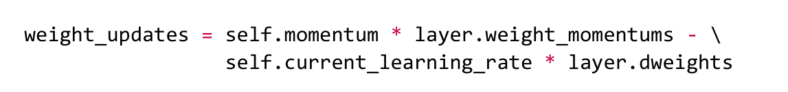
1. Pre-konwledge
2. Motivation
3. D-Adaptation
4. Results and proof
Optimizer: Adam = RMSProp + Momentum
RMSProp:
Momentum:

Slide 5
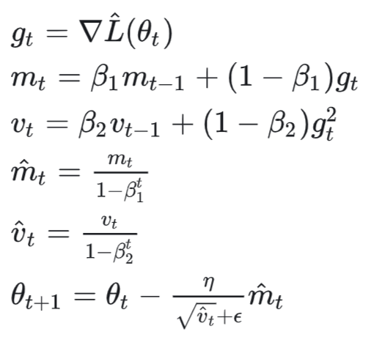
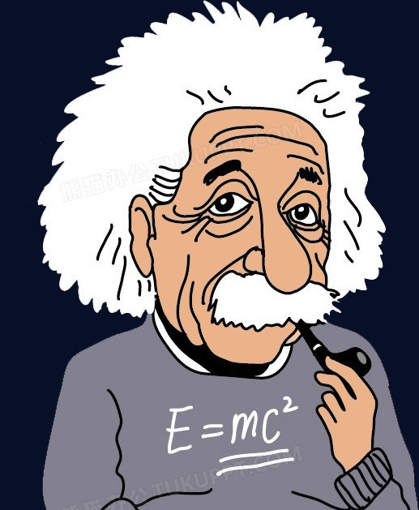
1. Pre-knowledge
2. Motivation
3. D-Adaptation
4. Results and proof
Adam algorithm

Slide 6
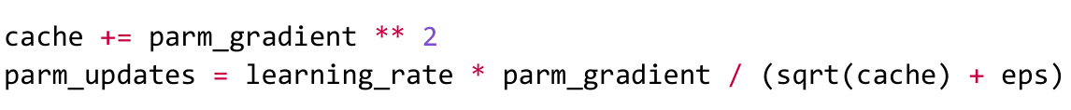
1. Pre-knowledge
2. Motivation
3. D-Adaptation
4. Results and proof
Comparison between RMSProp and AdaGrad technique
RMSProp:
AdaGrad:

Slide 7
02
Motivation

Slide 8
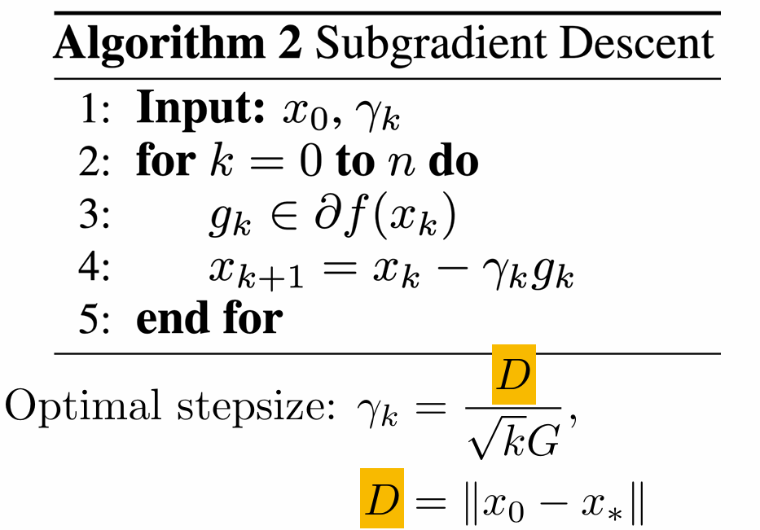
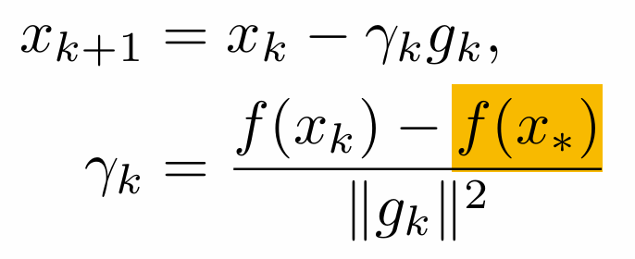
1. Pre-konwledge
2. Motivation
3. D-Adaptation
4. Results and proof
Sub-gradient Descent [7]
Polyak stepsize [5]:

Slide 9
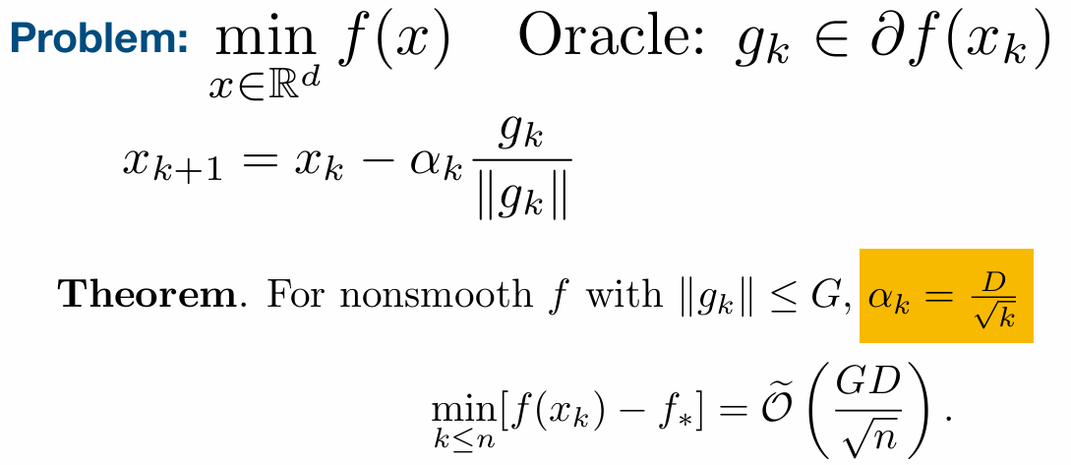
1. Pre-konwledge
2. Motivation
3. D-Adaptation
4. Results and proof
Normalized Gradient by Shor [6][7]

Slide 10
1. Pre-konwledge
2. Motivation
3. D-Adaptation
4. Results and proof
Summary
Algorithm
Requirement
Sub-gradient Descent: D, G or f*
Normalized Gradient by Shor: D
NGD and Ada-Grad : D
Could we design some algorithms without tuning the parameter (e.g. learning rate)?

Slide 11
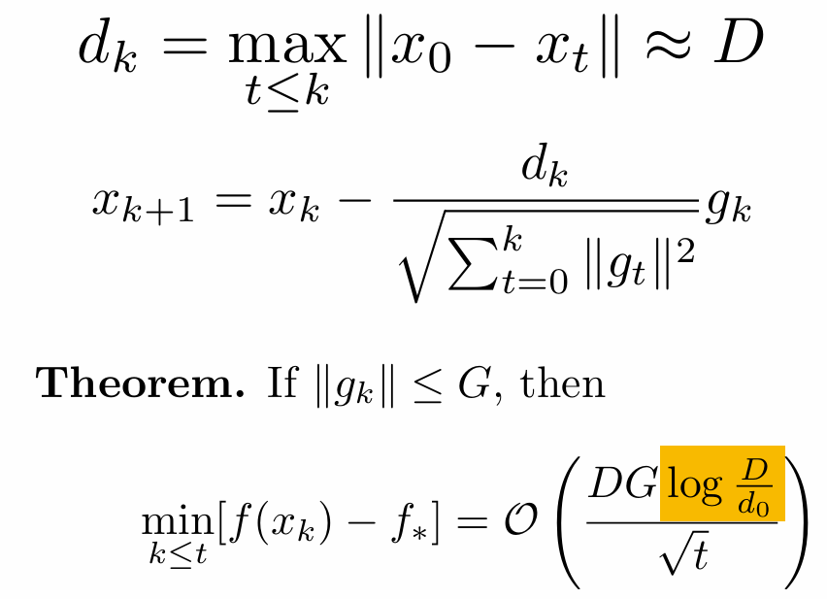
1. Pre-konwledge
2. Motivation
3. D-Adaptation
4. Results and proof
DoG[3][7]

Slide 12
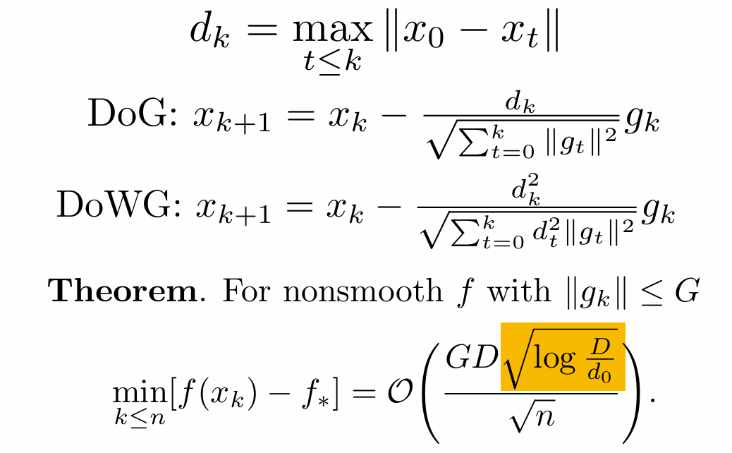
1. Pre-konwledge
2. Motivation
3. D-Adaptation
4. Results and proof
DoWG[4][7]

Slide 13
03
D-Adaptation

Slide 14
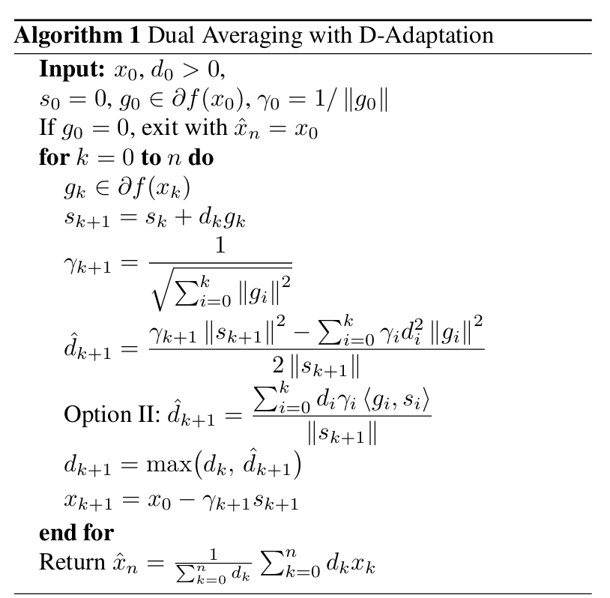
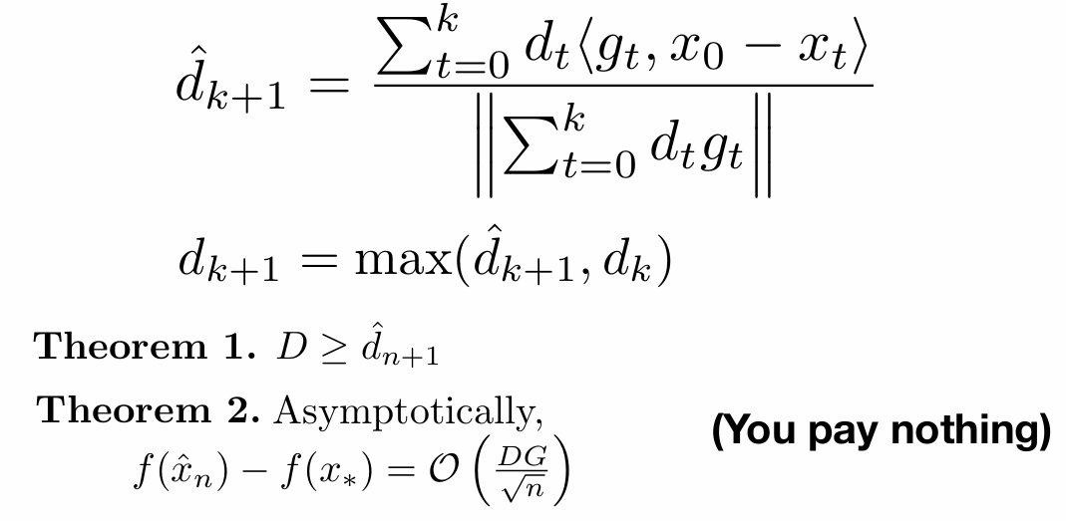
1. Pre-konwledge
2. Motivation
3. D-Adaptation
4. Results and proof
We don’t use the gradient descent for a technical reason: the asymptotic convergence rate has an additional log factor.
Dual Averaging
Ada-Grad
The second contribution
The first contribution

Slide 15
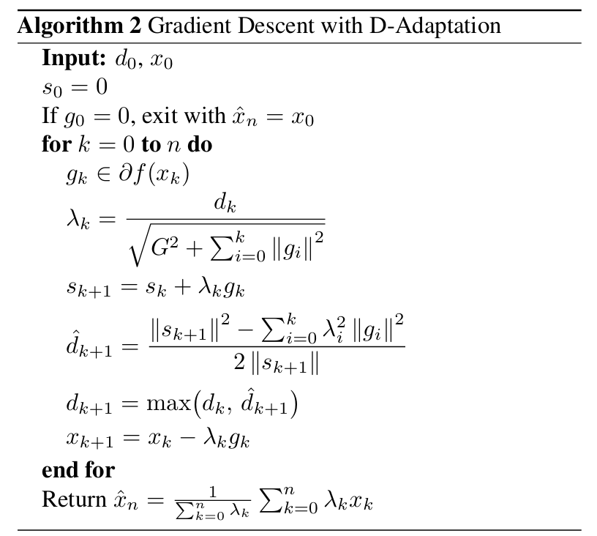
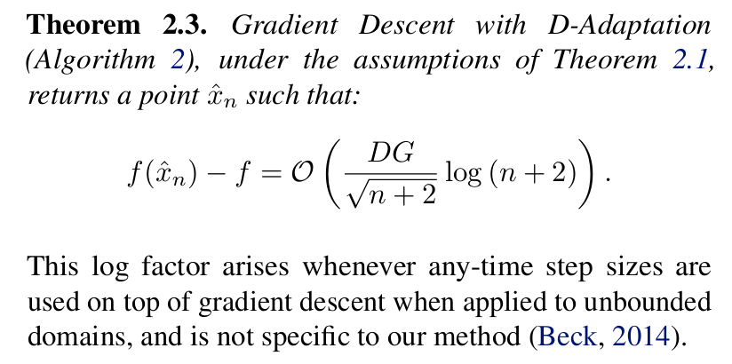
1. Pre-konwledge
2. Motivation
3. D-Adaptation
4. Results and proof
Variants

Slide 16
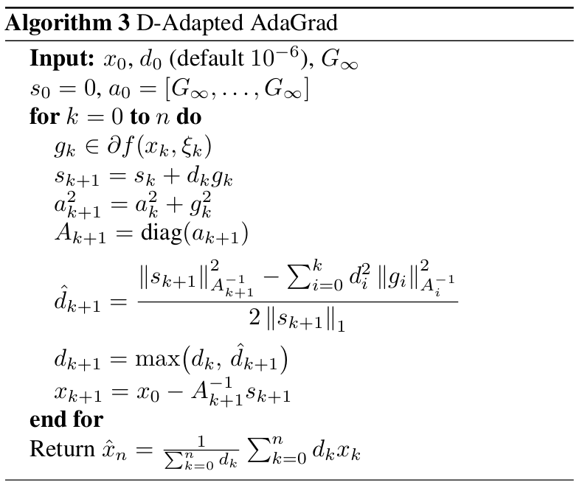
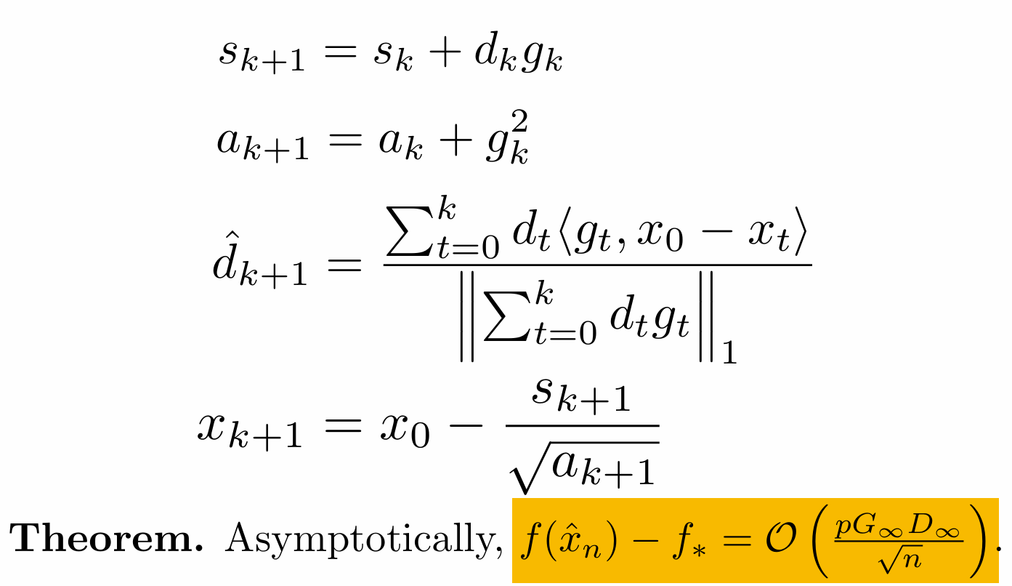
1. Pre-konwledge
2. Motivation
3. D-Adaptation
4. Results and proof
Variants

Slide 17
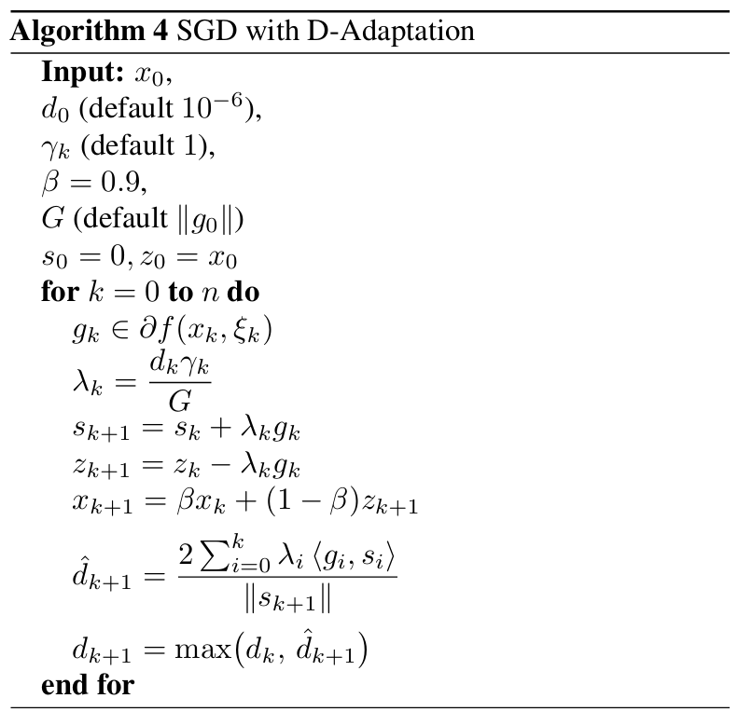
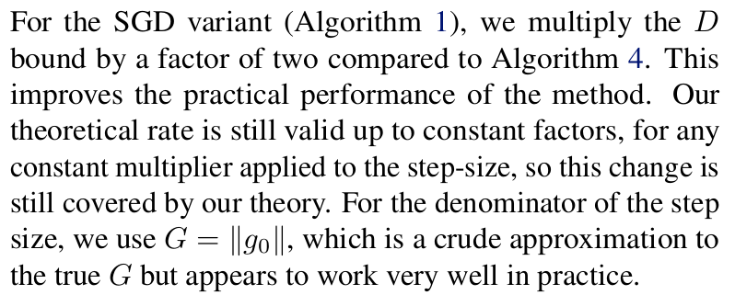
1. Pre-konwledge
2. Motivation
3. D-Adaptation
4. Results and proof
Variants

Slide 18
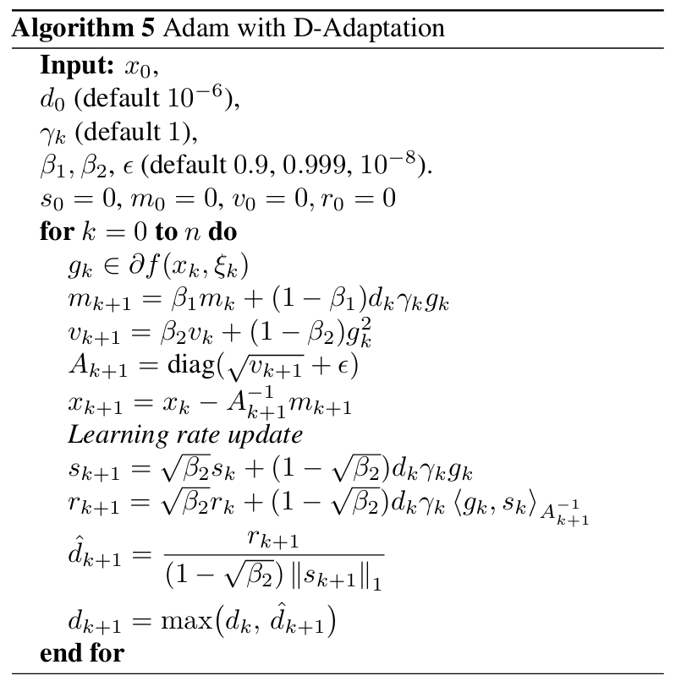
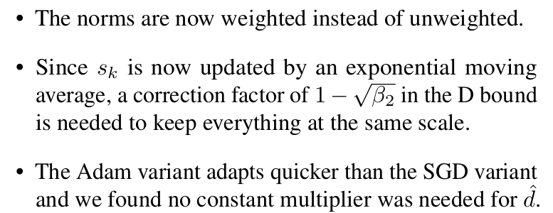
1. Pre-konwledge
2. Motivation
3. D-Adaptation
4. Results and proof
Variants
Modification:

Slide 19
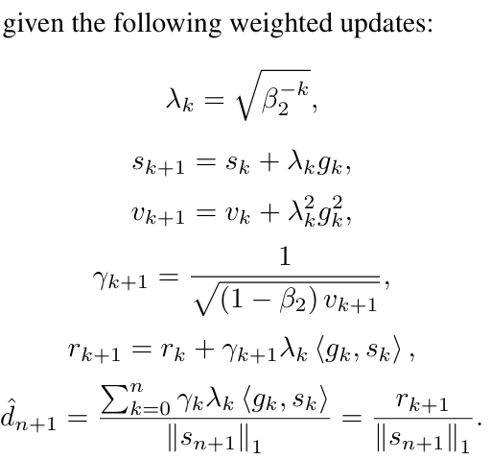


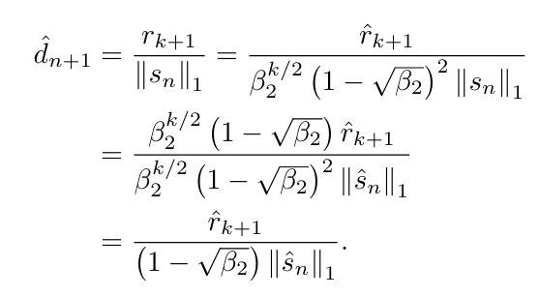

1. Pre-konwledge
2. Motivation
3. D-Adaptation
4. Results and proof
Moving average technique:

Slide 20
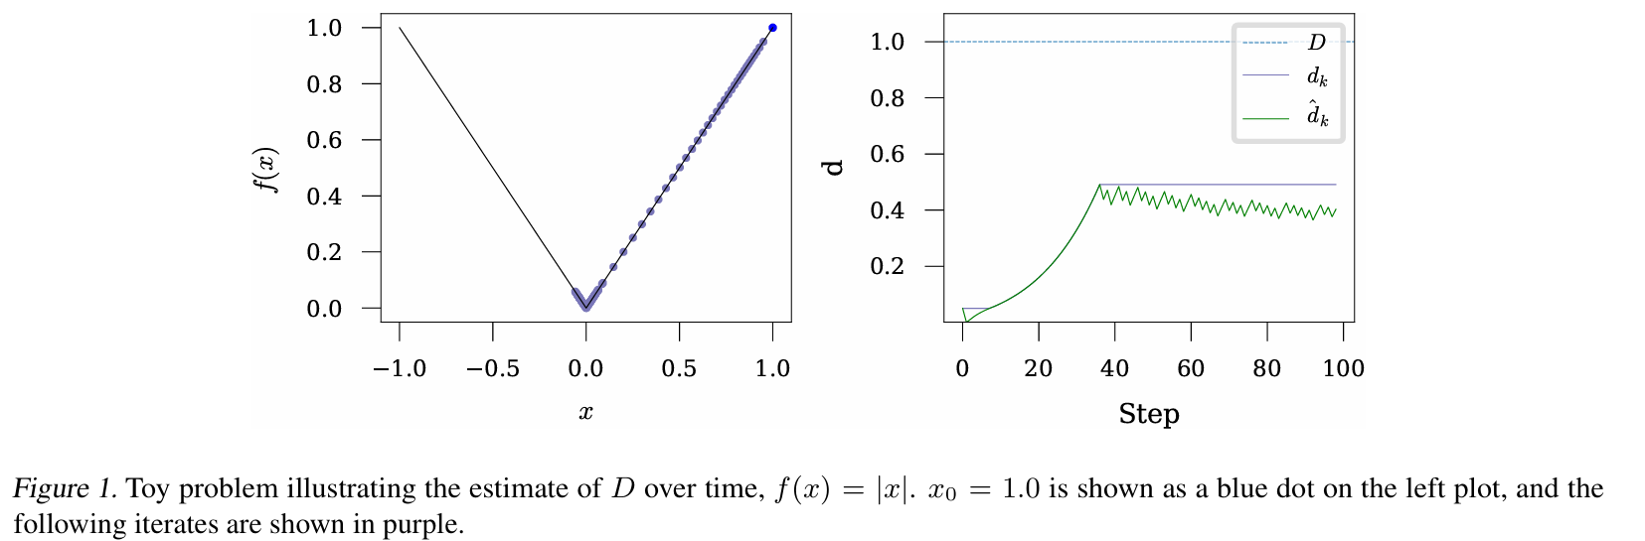
1. Pre-konwledge
2. Motivation
3. D-Adaptation
4. Results and proof
Discussion

Slide 21
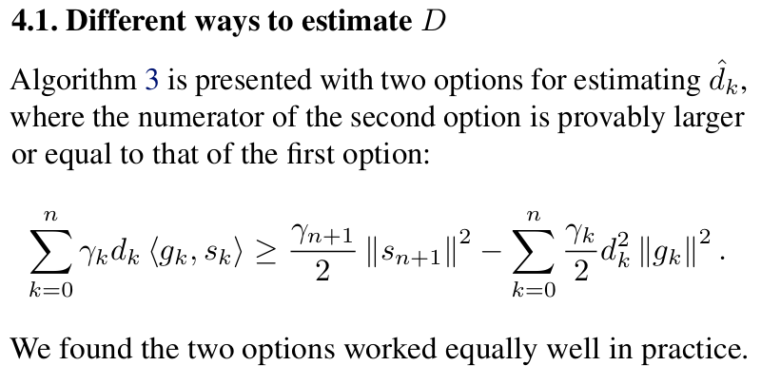
1. Pre-konwledge
2. Motivation
3. D-Adaptation
4. Results and proof
Discussion

Slide 22
04
Experiments

Slide 23
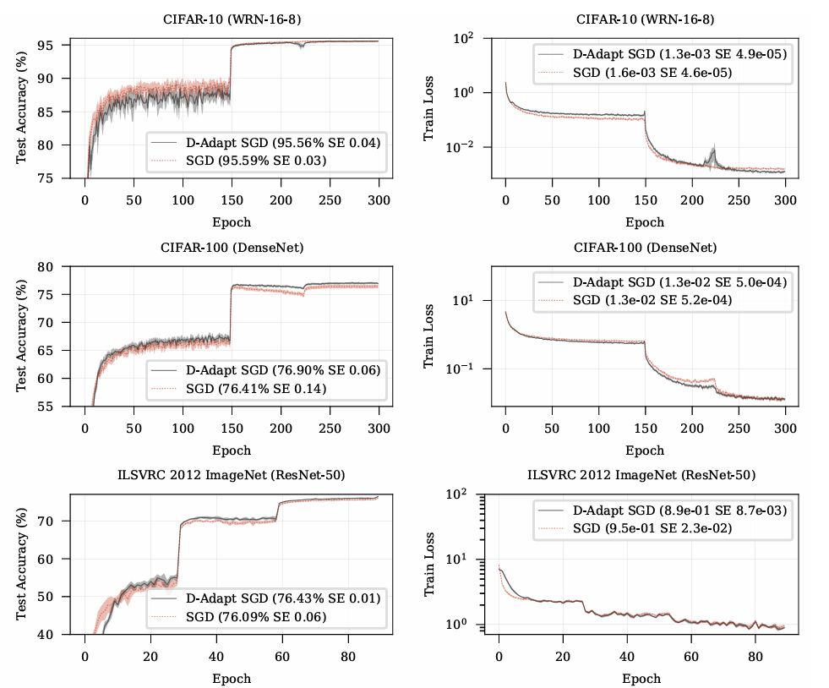
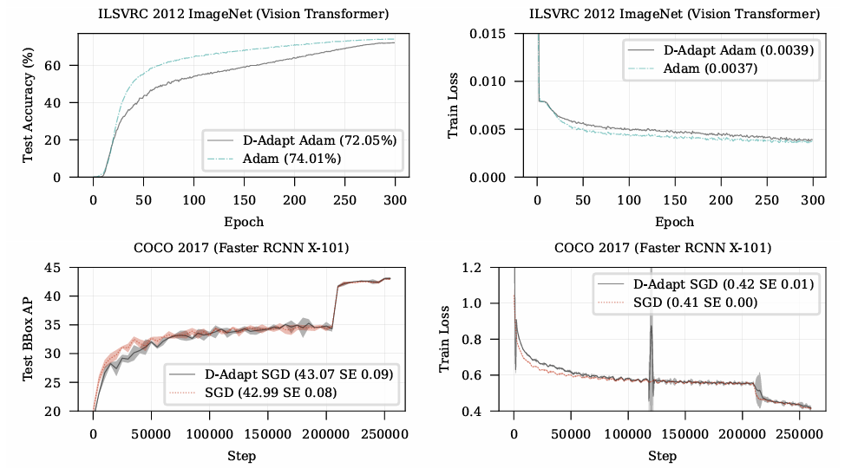
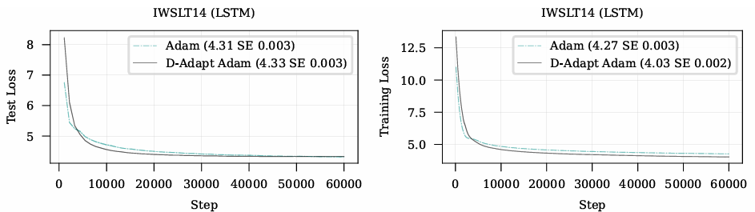
1. Pre-konwledge
2. Motivation
3. D-Adaptation
4. Results and proof
Experimental results

Slide 24
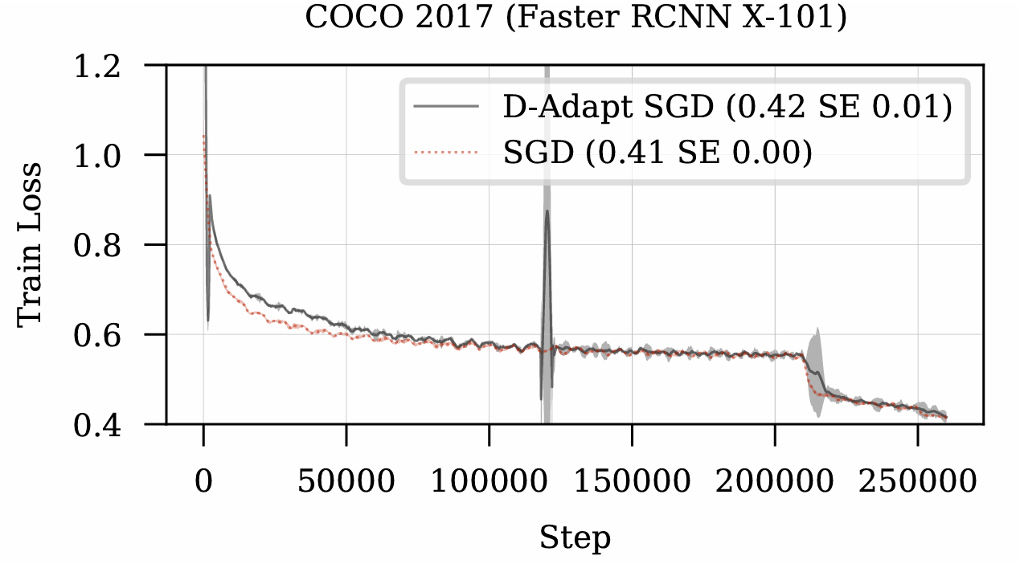
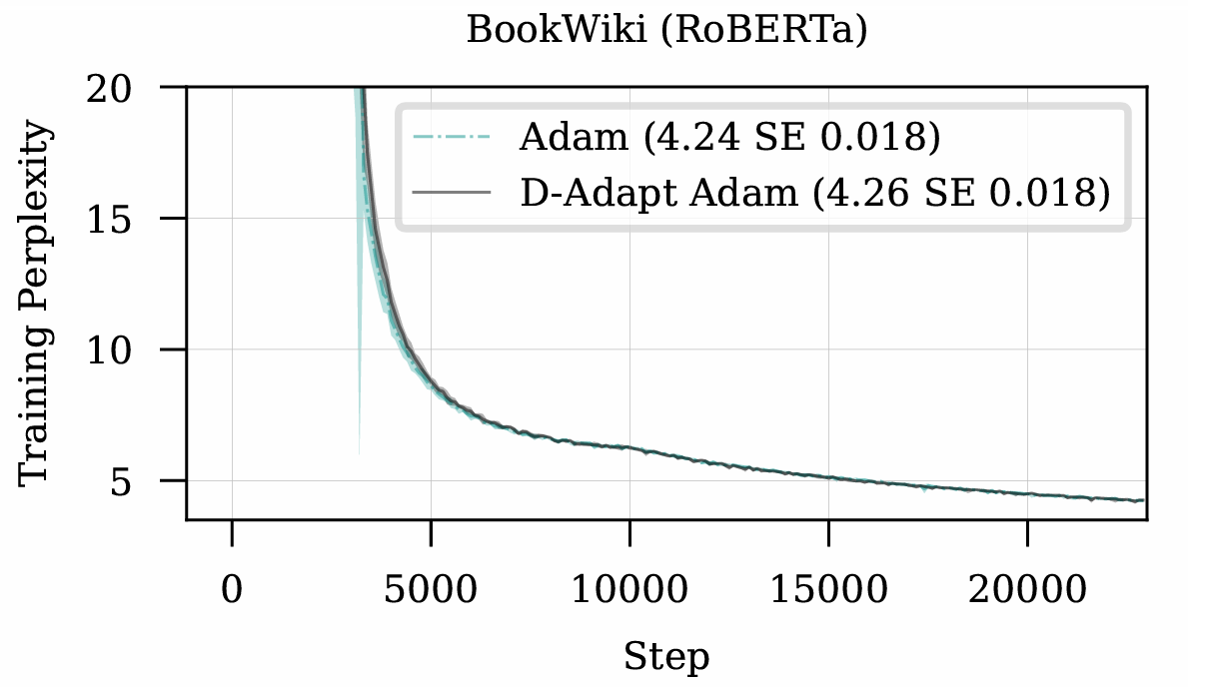
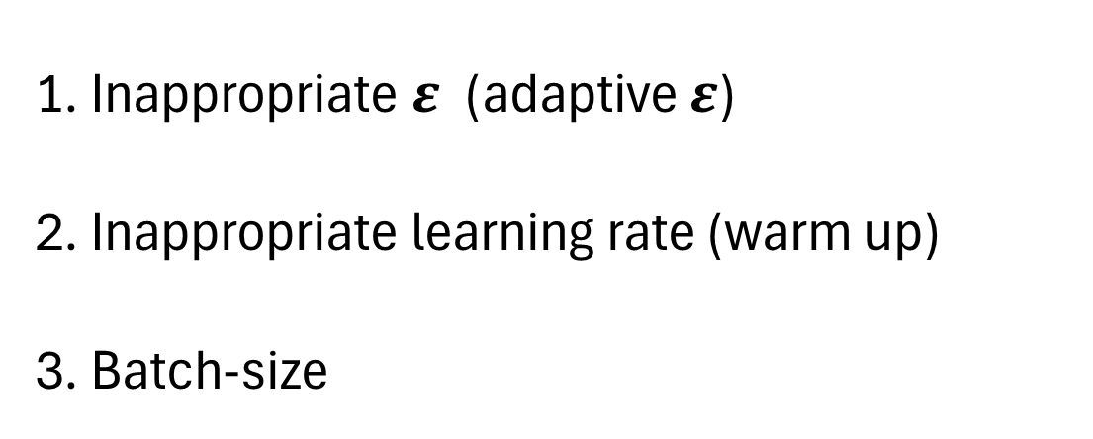
1. Pre-konwledge
2. Motivation
3. D-Adaptation
4. Results and proof
According to the literature:
A Theory on Adam Instability in Large-Scale Machine Learning
https://doi.org/10.48550/arXiv.2304.09871:
Inappropriate $ε$ (adaptive $ε$)
Inappropriate learning rate (warm up)
Batch-size

Slide 25
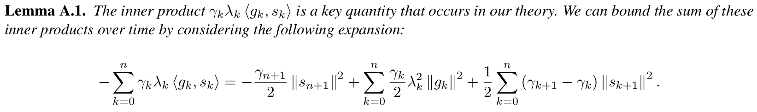
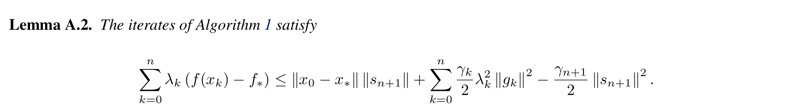
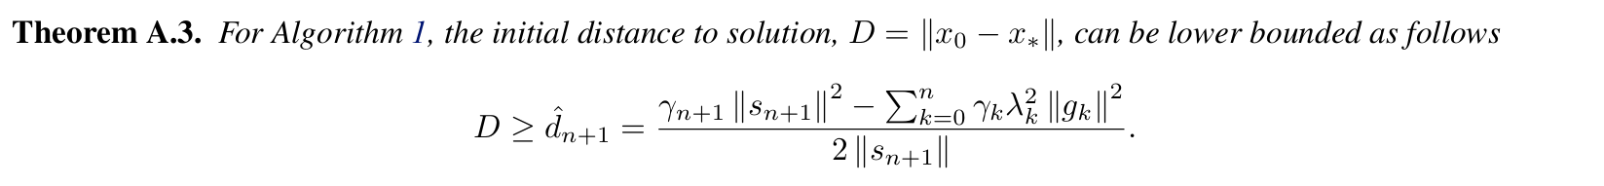
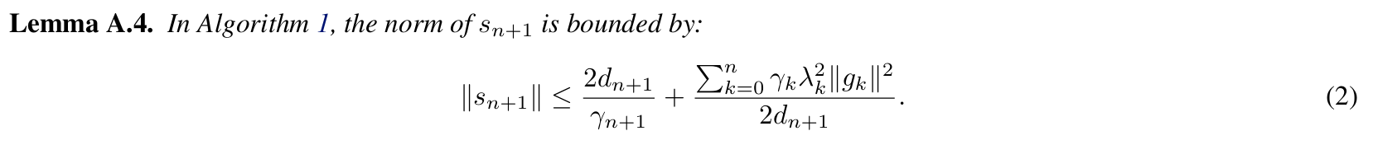

1. Pre-konwledge
2. Motivation
3. D-Adaptation
4. Results and proof
convexity

Slide 26
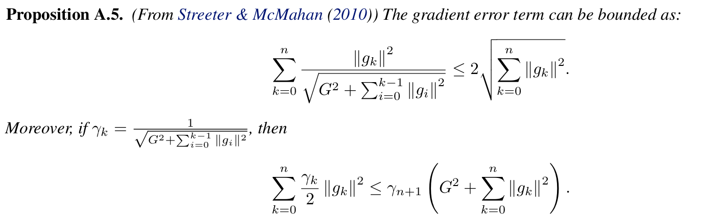
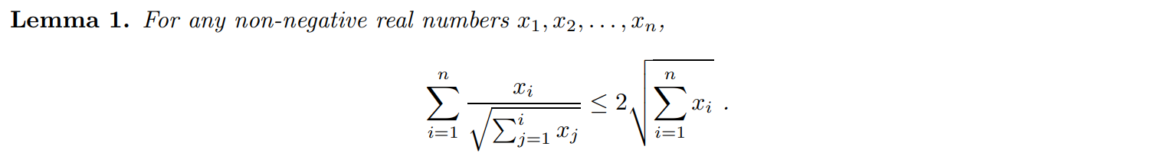
1. Pre-konwledge
2. Motivation
3. D-Adaptation
4. Results and proof

Slide 27

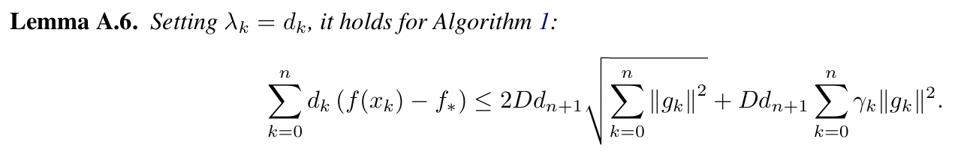
1. Pre-konwledge
2. Motivation
3. D-Adaptation
4. Results and proof
+
=

Slide 28
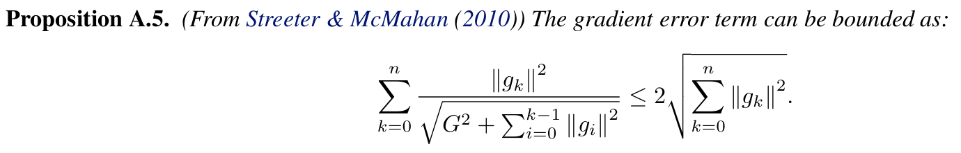
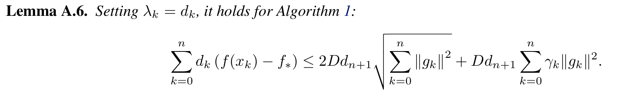
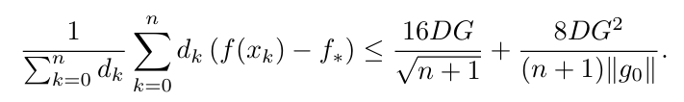
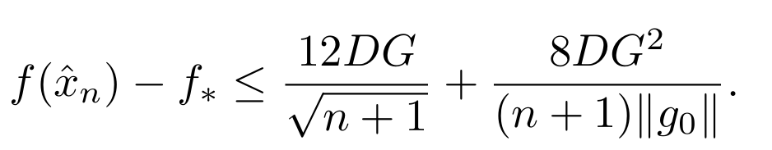
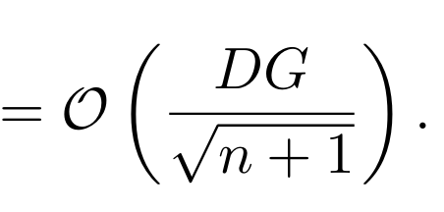
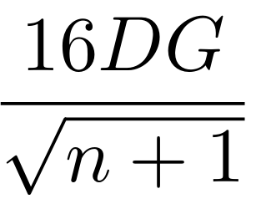
1. Pre-konwledge
2. Motivation
3. D-Adaptation
4. Results and proof
+
=
convexity
Main contribution:

Slide 29
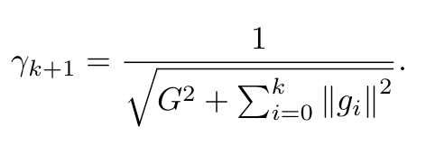
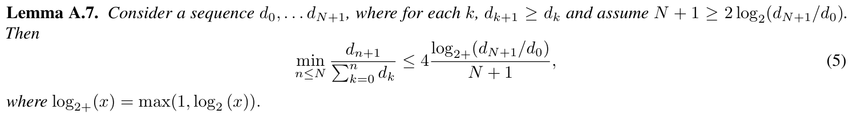
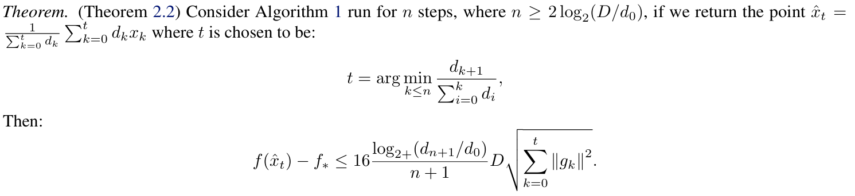
1. Pre-konwledge
2. Motivation
3. D-Adaptation
4. Results and proof
Non-asymptotic situation:
Proposition A.5.
Lemma A.6.

Slide 30
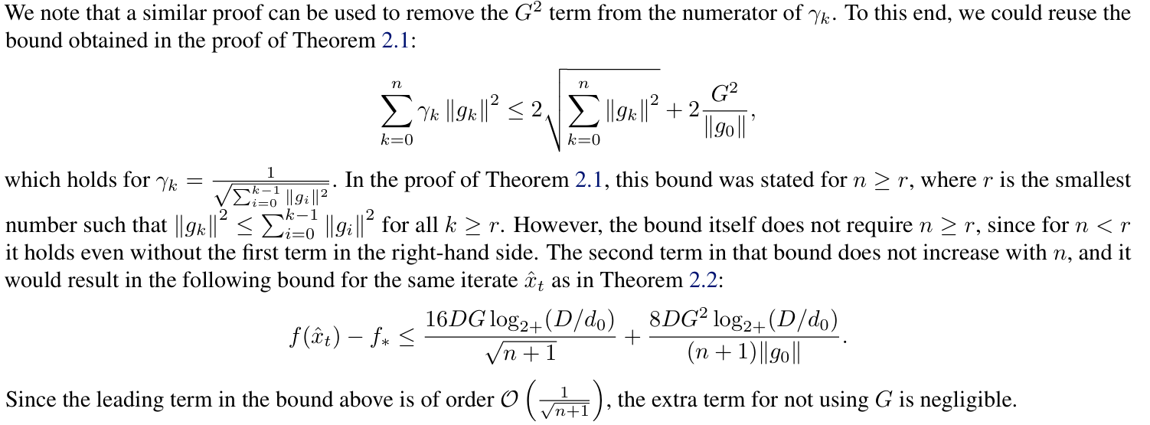
1. Pre-konwledge
2. Motivation
3. D-Adaptation
4. Results and proof
Non-asymptotic situation:

Slide 31
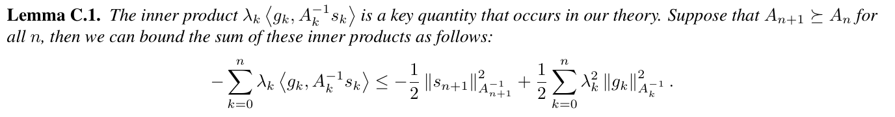
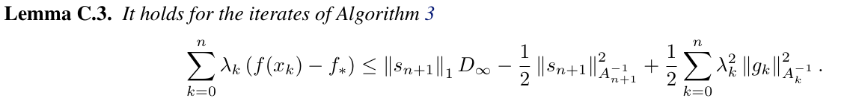
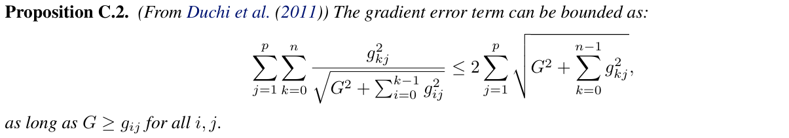
1. Pre-konwledge
2. Motivation
3. D-Adaptation
4. Results and proof
Coordinate-wise setting
Convexity

Slide 32



1. Pre-konwledge
2. Motivation
3. D-Adaptation
4. Results and proof
Lemma C.3.
Proposition C.2.
Theorem 2.1. Lemma C.3. Lemma C.5.

Slide 33

1. Pre-konwledge
2. Motivation
3. D-Adaptation
4. Results and proof

Slide 34



Questions
Confused parts regarding this paper

Slide 35


Question
Confused parts regarding this paper

Slide 36

Question
Confused parts regarding this paper

Slide 37





Latest research
Prodigy

Slide 38
References:
[1]. Aaron Defazio and Konstantin Mishchenko. Learning-rate-free learning by d-adaptation. arXiv preprint arXiv:2301.07733, 2023.
[2]. Neural Networks from Scratch in Python Harrison Kinsley & Daniel Kukieła
[3]. M. Ivgi, O. Hinder, Y. Carmon DoG is SGD's Best Friend: A Parameter-Free Dynamic Step Size Schedule ICML 2023
[4]. A. Khaled, K. Mishchenko, C. Jin DoWG Unleashed: An Efficient Universal Parameter Free Gradient Descent Method NeurIPS 2023
[5]. B. Polyak Minimization of Unsmooth Functionals Zhurnal Vychislitel'noi Matematiki i Matematicheskoi Fiziki, 1987
[6]. N. Shor Minimization Methods for Non-Differentiable Functions page 23, 1985
[7]. Slides: Parameter-Free Adaptive Optimization by Konstantin Mishchenko Based on joint work with Aaron Defazio, Ahmed Khaled, Chi Jin
[8]. Igor Molybog, Peter Albert, Moya Chen, Zachary DeVito, David Esiobu, Naman Goyal, Punit Singh Koura, Sharan Narang, Andrew Poulton, Ruan Silva, Binh Tang, Diana Liskovich, Puxin Xu, Yuchen Zhang, Melanie Kambadur, Stephen Roller, Susan Zhang: A Theory on Adam Instability in Large-Scale Machine Learning, https://doi.org/10.48550/arXiv.2304.09871
[9]. Prodigy: An Expeditiously Adaptive Parameter-Free Learner, https://arxiv.org/pdf/2306.06101

Slide 39
THANKS
Applicant: Zhekai Liu

