Slide 1
Chp8.1 Matching and Cost
CV Group
Presenter: Li Zhekai
May 8

Slide 2
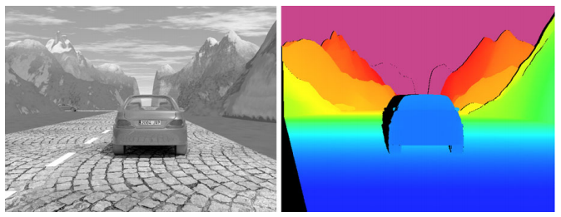
What is DISPARITY?

Slide 3
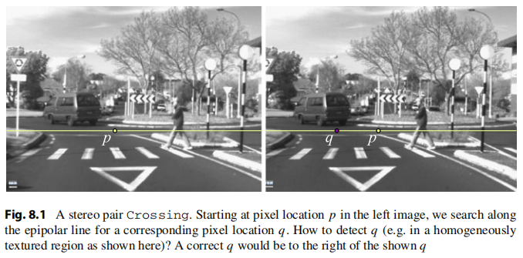
How to find the ACTUAL p?

Slide 4
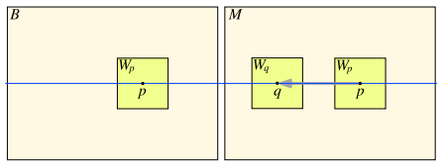
Step 1: apply sliding windows

Slide 5


Step 2: chose an ERROR function

Slide 6

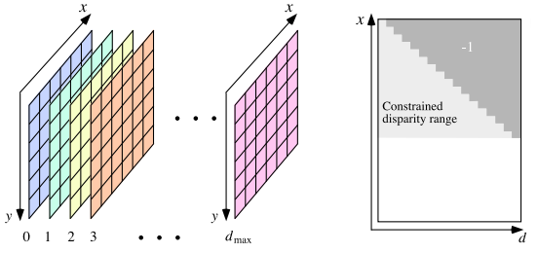
Step 3: construct an 3D cost matrix

Slide 7
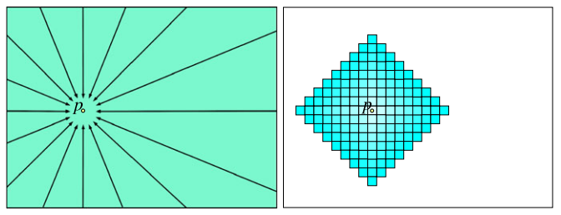
Step 4: use local matching
1. Global matching is a disaster
2. Semi-global matching (left) & belief-propagation matching (right)
3. Finally shrinkage to local matching

Slide 8
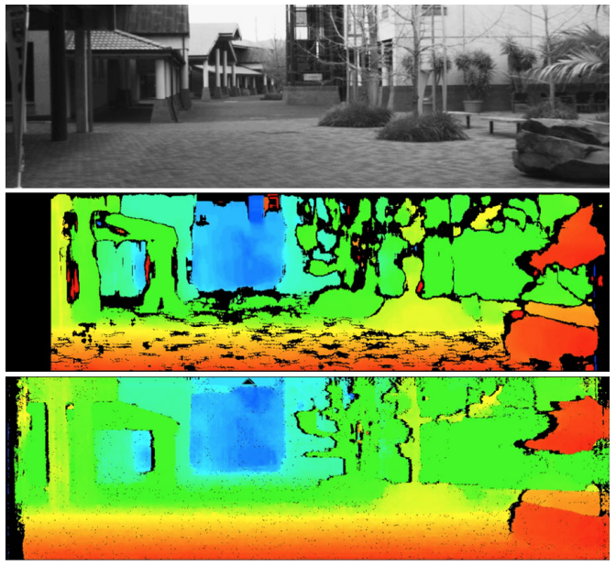
Global vs. Local

Slide 9

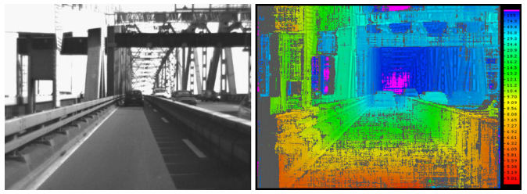
Step 5: go through confidence measures
Replace the resulting disparities with low
confidence with special label -1.

Slide 10
Thanks.

