Slide 1
Stock Price Manipulation Detection using Generative Adversarial Networks

Slide 2

Виды манипуляций
action-based
information-based
trade-based

Slide 3
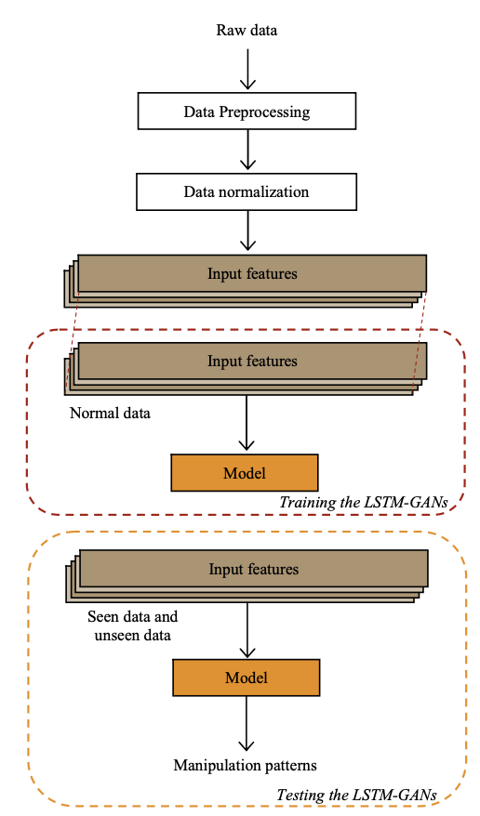
Stock price manipulation detection framework.

Slide 4
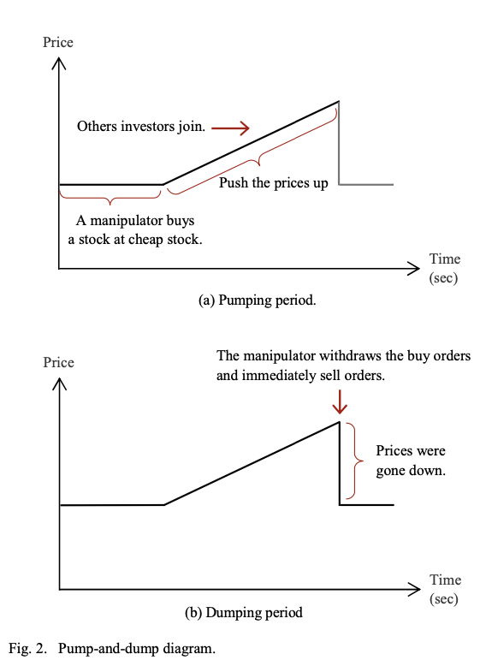
Основное направление исследования
Our research focuses on trade-based manipulations which are difficult to be detected. This method involves manipulators’ expectation to gain their profits by sending crafted orders. Orders can be a mix of genuine (matched) and artificial (with no intention for manipulators to be matched). We studied pump-and-dump which is the most popular manipulation case. This is also similar to ramping or gouging. The main concept of pump-and-dump is to pump a stock price up and then sell the stock at a higher price, which is profitable to the manipulators.
The authors hypothesized that the latent vector of GANs represents the distribution of data.

Slide 5
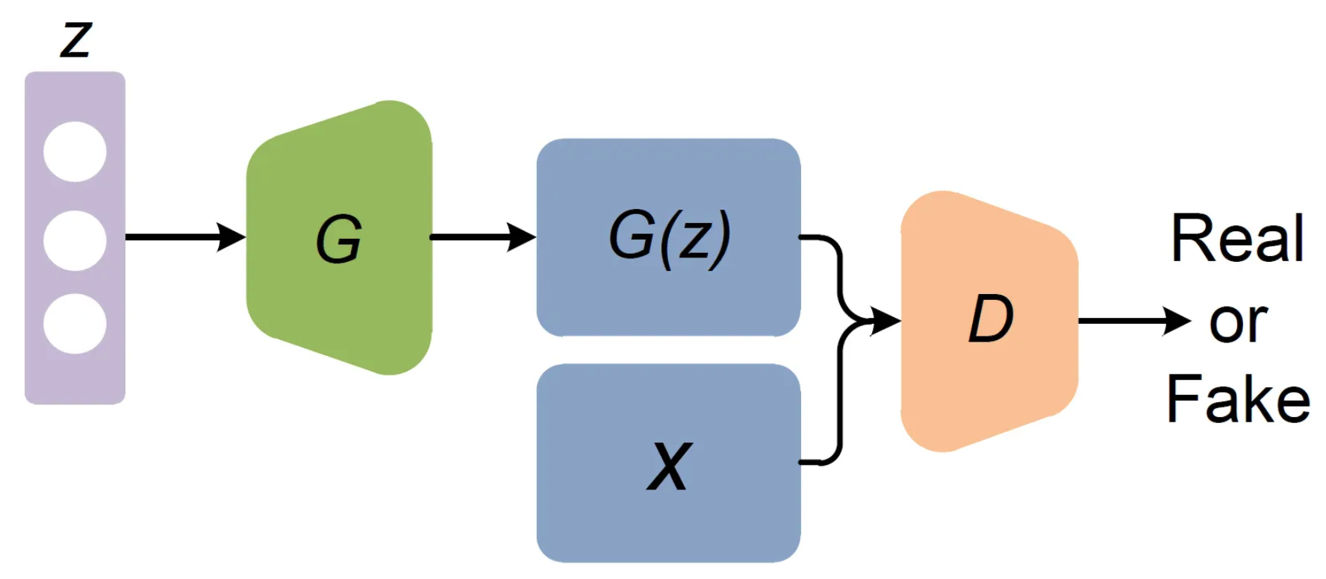
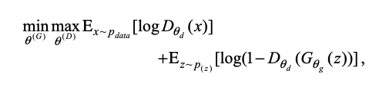
GAN

Slide 6
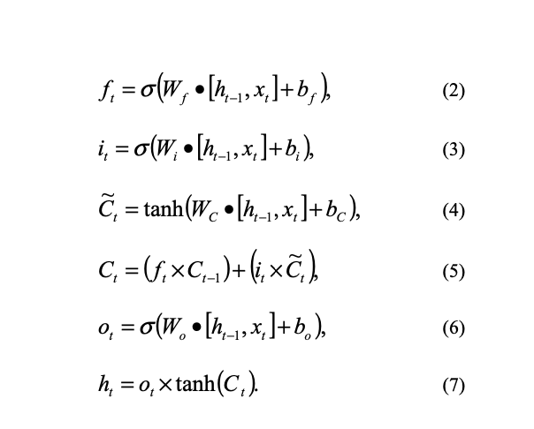
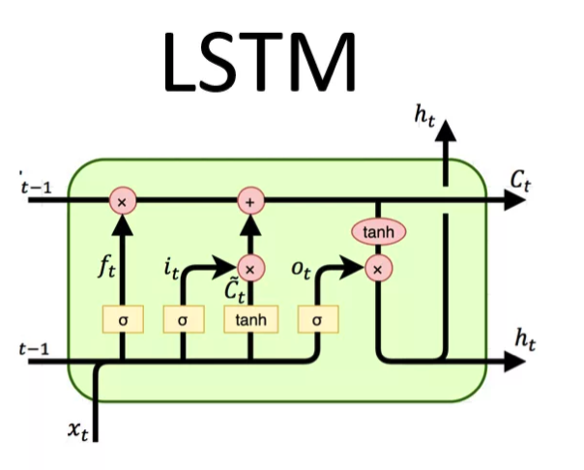
LSTM

Slide 7
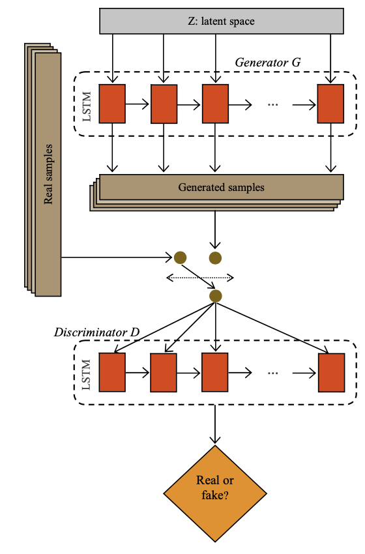
Final GAN model

Slide 8
Костыли Сложности
We had no real manipulation cases for testing the model, because the cases are limit and rare to obtain. Thus, we synthesized and injected manipulative patterns mixing with the normal cases into the models for evaluation. This is the best practice method for researchers in this field.

Slide 9
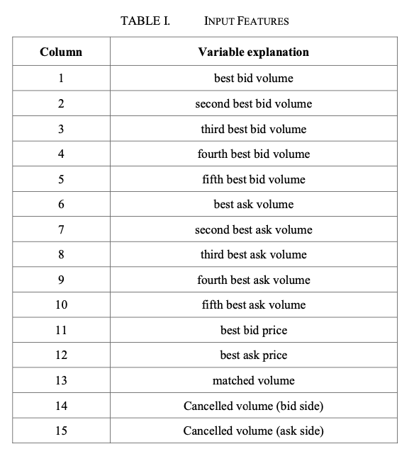
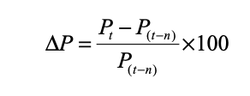
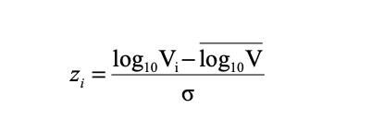
Входные данные
Биржа тайланда.
Limit order book (LOB)

Slide 10
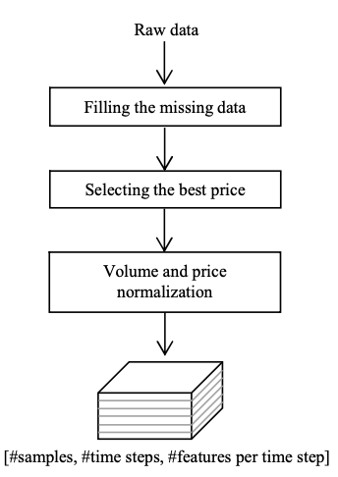
Итоговая работа с данными

Slide 11
Как генерируем манипуляции рынком
We assumed a manipulation period as 5 seconds. The first four seconds were in the pumping period, and the rest were in the dumping period. The increases for both bid and ask prices were a constant rate of 0.1% per second in the pumping period. In this period, bid volumes were also injected with 20% of the normalized volumes in each time step. In the dumping period (the fifth second), the bid orders were then cancelled and the ask orders were quickly executed. So, the cancelled bid volumes and matched volumes were injected four times of the first four normalized volumes.

Slide 12
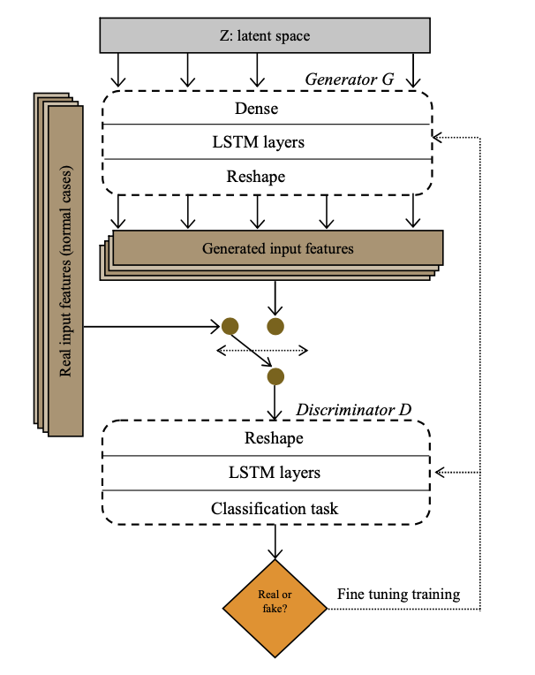
Модель классификации

Slide 13
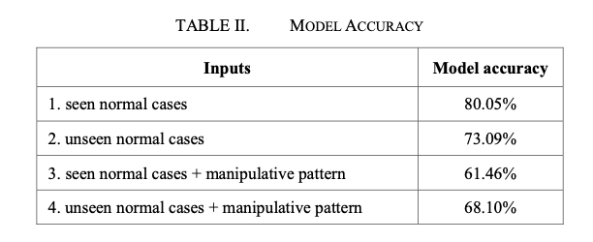
Что получилось

Slide 14
Спасибо за внимание
И что открыли биржу

