Slide 1
Thermostatic
Expansion Valve
Evaporator
Condenser
4-way Valve
INDOOR
OUTDOOR
Compressor

Slide 2
sa_flow
sa_temp
sa_temp_dp
id_power
od_power
Thermostatic
Expansion Valve
ref_flow
Condenser
Evaporator
4-way Valve
oa_temp
oa_temp_dp
zn_temp
zn_temp_dp
Compressor

Slide 3
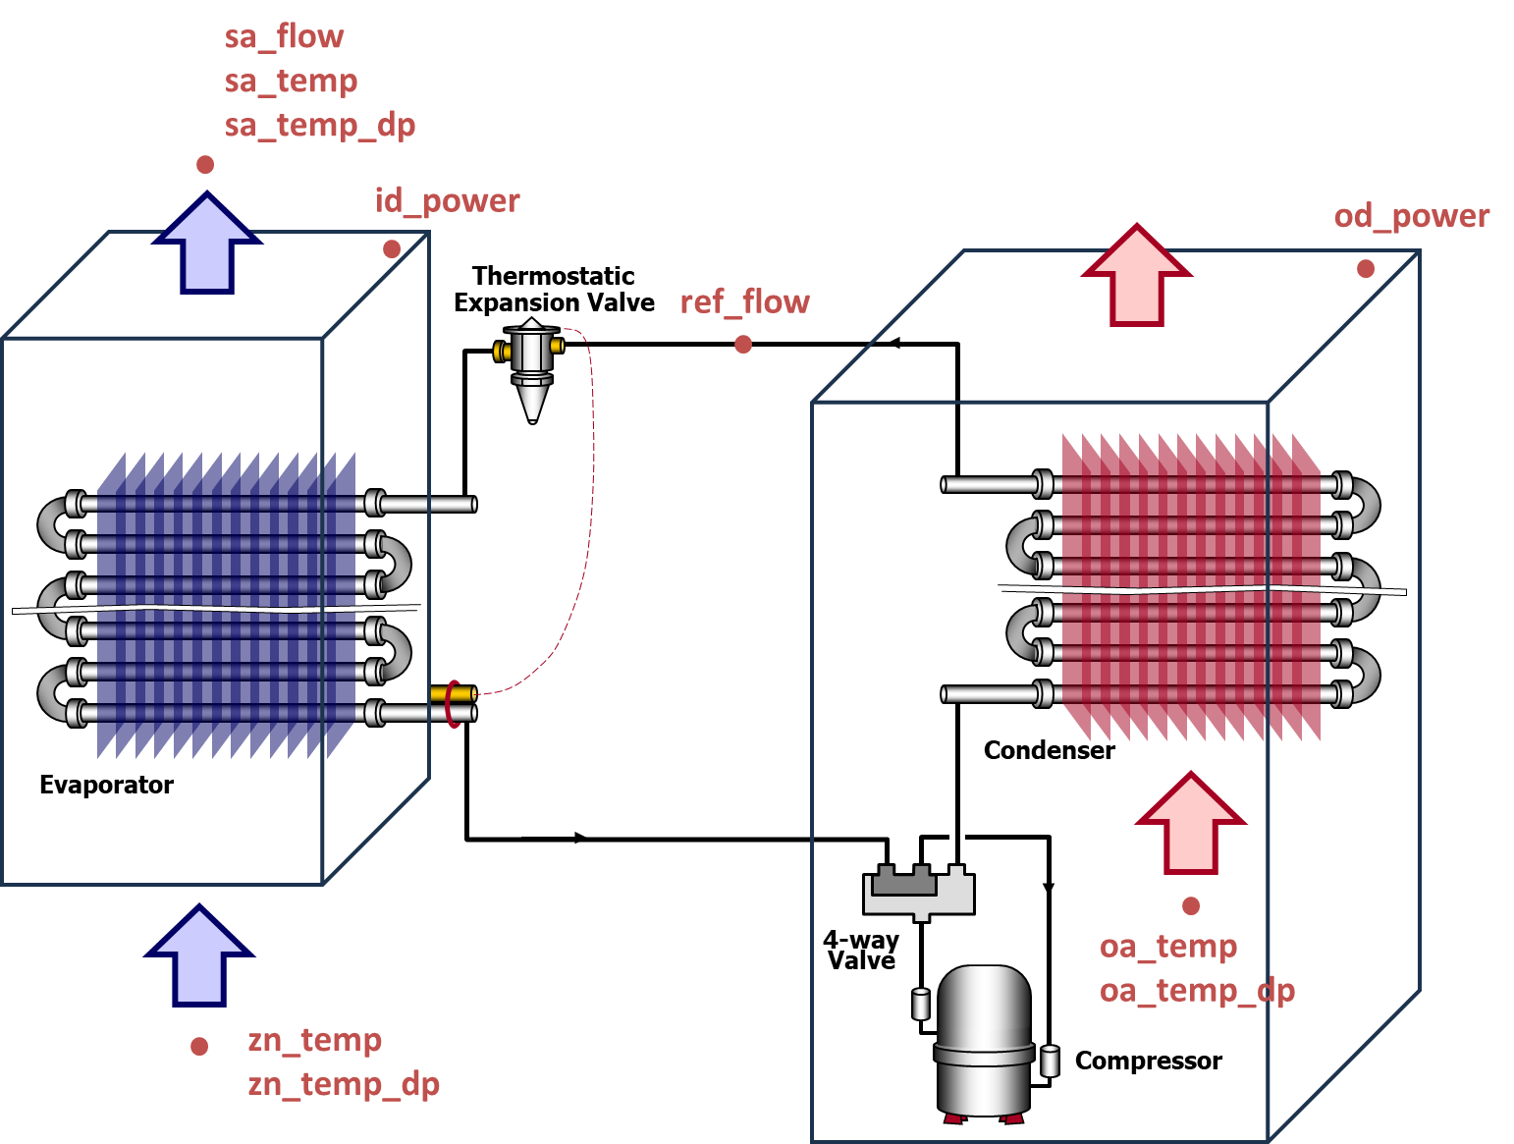

Slide 4
INDOOR
sa_flow
sa_temp
sa_temp_dp
OUTDOOR
id_power
od_power
Thermostatic
Expansion Valve
ref_flow
Condenser
Evaporator
4-way
Valve
oa_temp
oa_temp_dp
zn_temp
zn_temp_dp
Compressor

Slide 5
