Slide 1
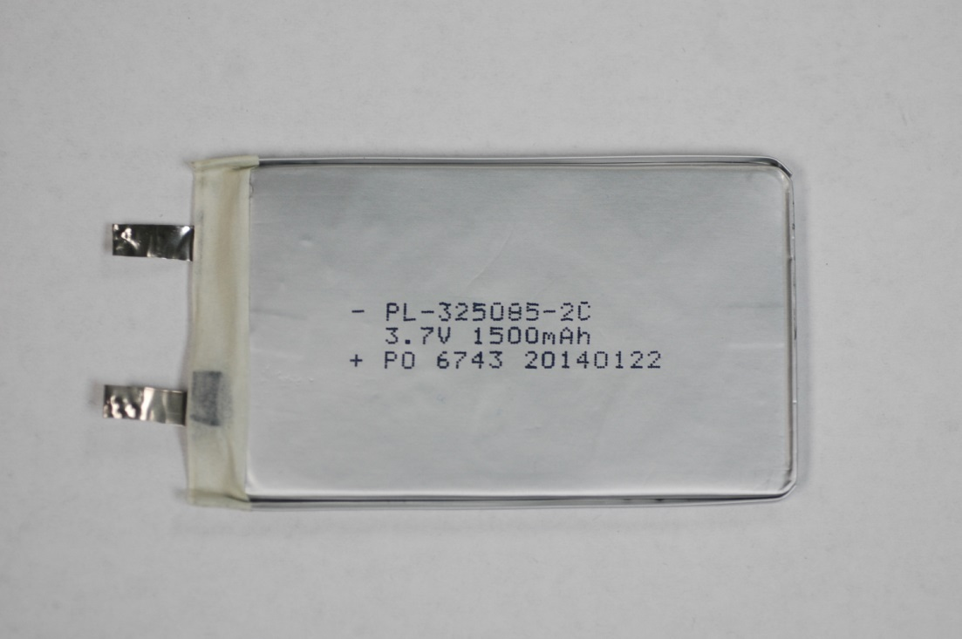
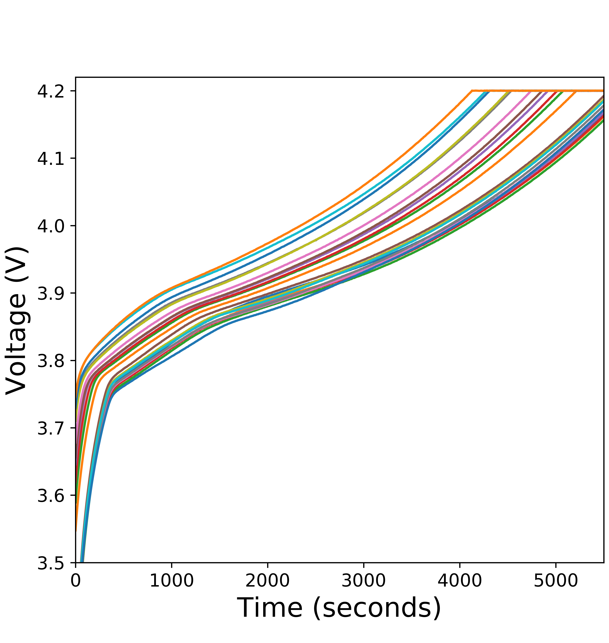
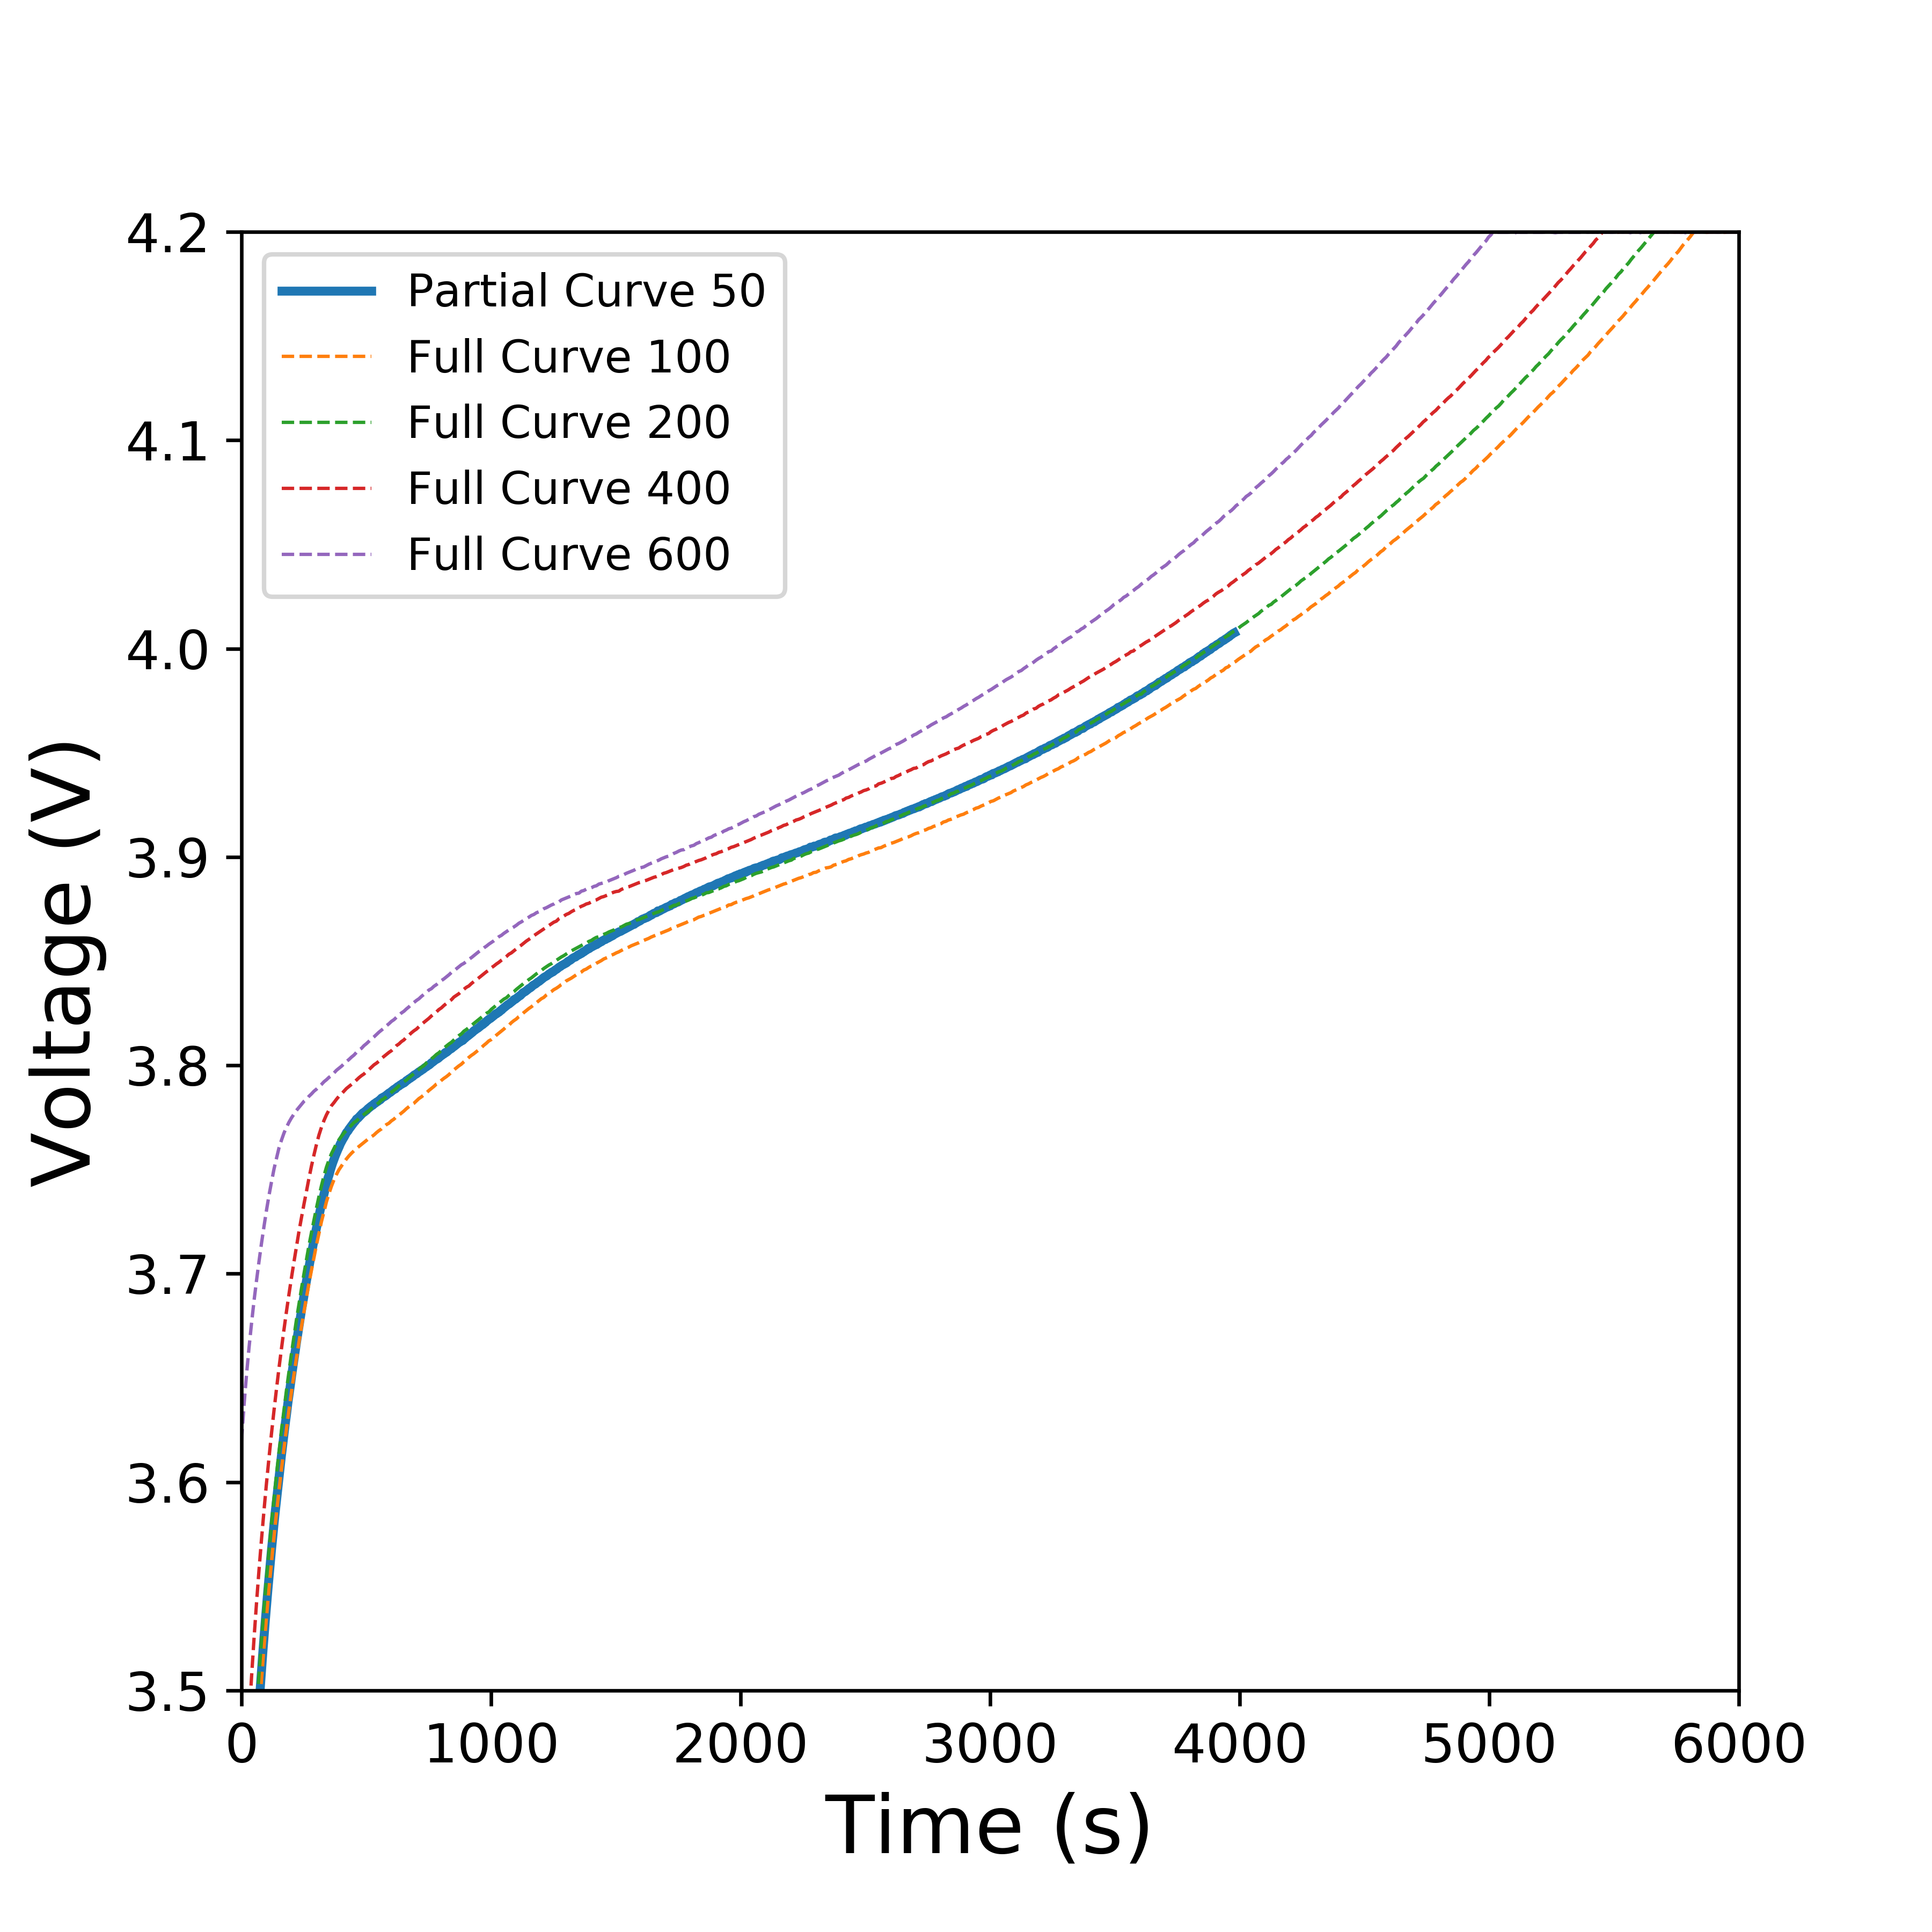
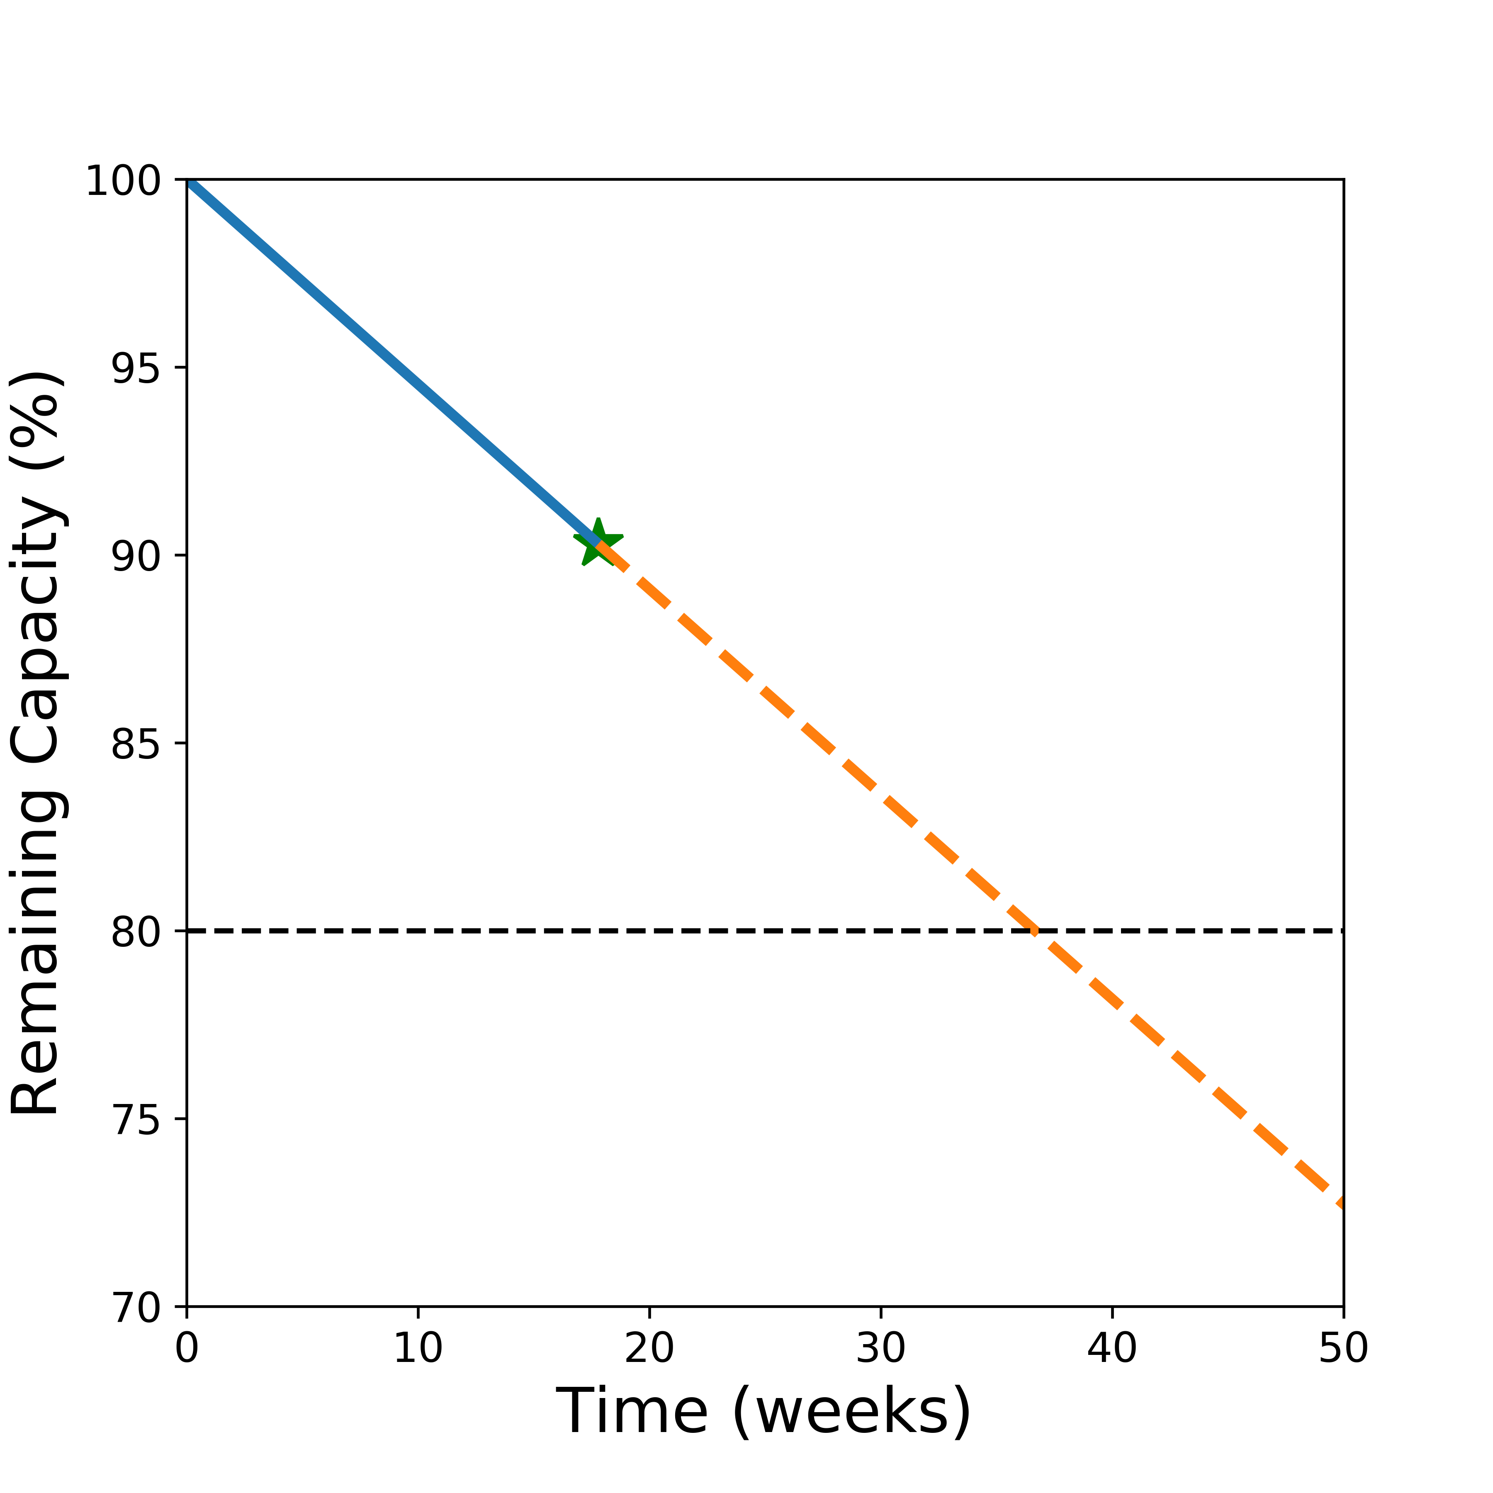
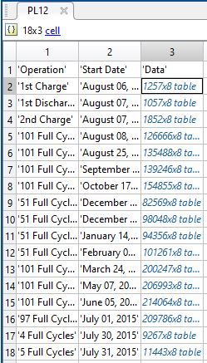
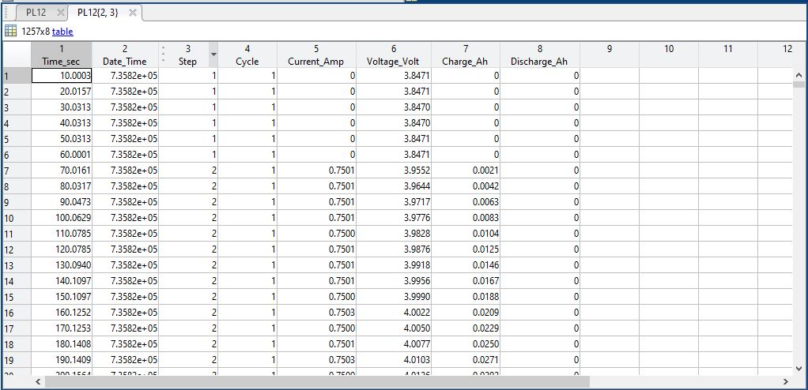
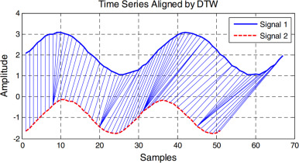







Predicting usable lifetime of lithium-ion batteries
Victor W. Hu, Yusong Liu, Rossana Scavone, Maitri Uppaluri
What Is PULOLB?
The calce battery group has data of full charge/discharge curves across cycles that can be used to predict the cycle, the capacity and the lifetime of the user’s battery.
How Does The Package Work?
The package finally gives an output that describes the …
What does the software do?
Motivation
(Write the story)
The distance between the two time series are calculated using DTW, and using the KNN algorithm, the full curve that has the closest distance to the partial curve gives its cycle number.
The given partial charge or discharge curve is fitted into the bunch of full curves to predict the cycle number of the partial curve.
Once the corresponding cycle number is predicted, the capacity of the battery, and the lifetime are determined.
A graphite/LiCoO2 pouch cell
Data Cleaning
How Does The Package Work?
What our machine learning is: Dynamic Time Warping using FastDTW
Logo?
Using a KNN of sorts to sort distances to return full curve
Used DTW in KNN to find the closest distances.
DTW requires us to filter our voltages to min-max of partial curve, for better prediction.
From the corresponding full curve, it calculates the capacity and hence the lifetime.
Ultimate goal of the user: Input any partial data curve and have our package predict the best corresponding full curve
Tools used to clean the data:
HDFStorage:
H5py:
Steps to clean the data:

