Slide 1
Technology Review
Victor Hu Yusong Liu Rossana Scavone Maitri Uppaluri

Slide 2

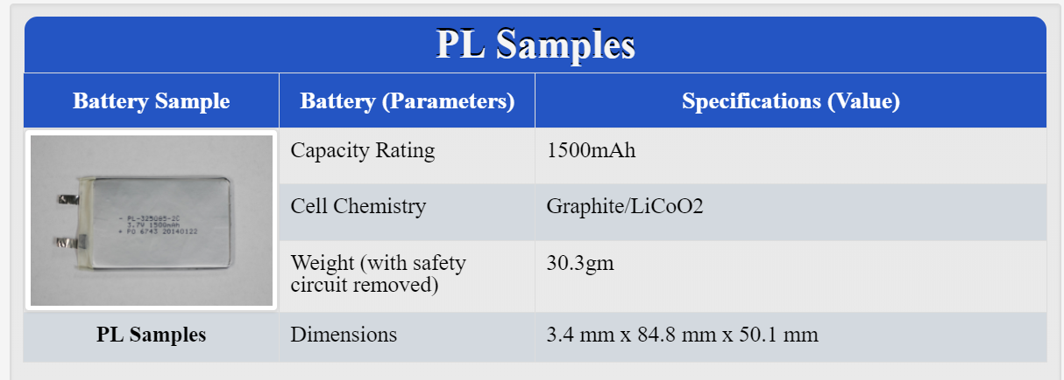
Background
Our data comes in v 5.0 .mat files.
Each table contains cells with datasets inside them
This way of storing data is called HDF5 (multidimensional array of records + structure for grouping objects)
We have 16 .mat files, each containing ~ 20 packed Matlab table structures.

Slide 3
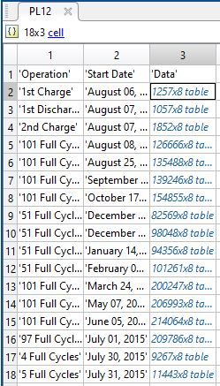
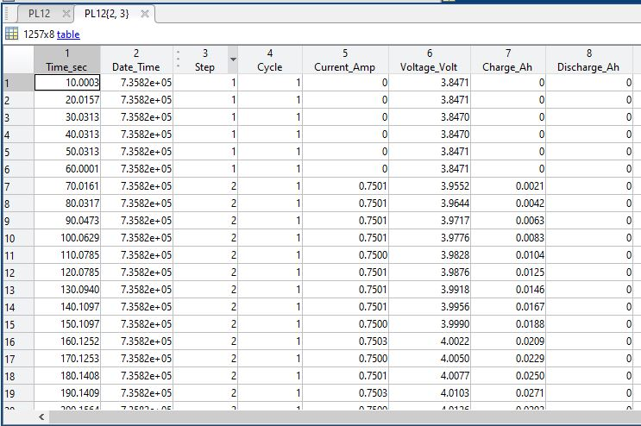
MATLAB Cell Array
MATLAB Table Structure

Slide 4
MATLAB Table Structure
Common way to import .mat files is to use
scipy.io.loadmat(“.mat”)
Cons
Only supports v4.0, v6.0, and v7.0 to v7.2
Can only import cell arrays
Cannot import MATLAB table structures properly

Slide 5
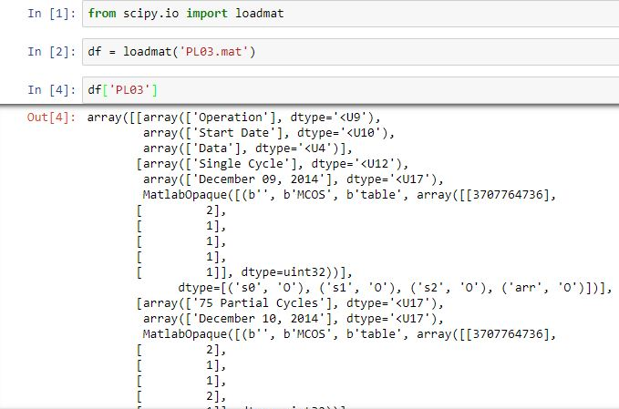
Matlab opaque
When we import the data using scipy.io.loadmat, what we get is an array with labels “MatlabOpaque” instead of our table data

Slide 6
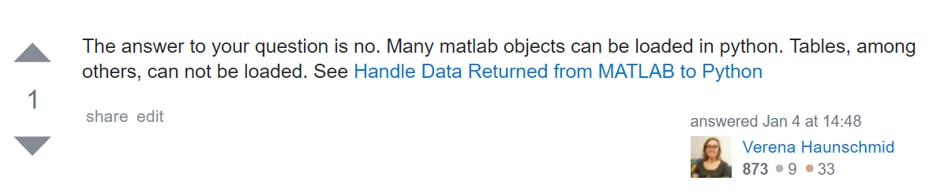
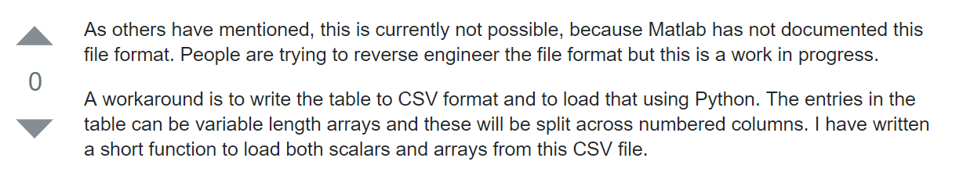
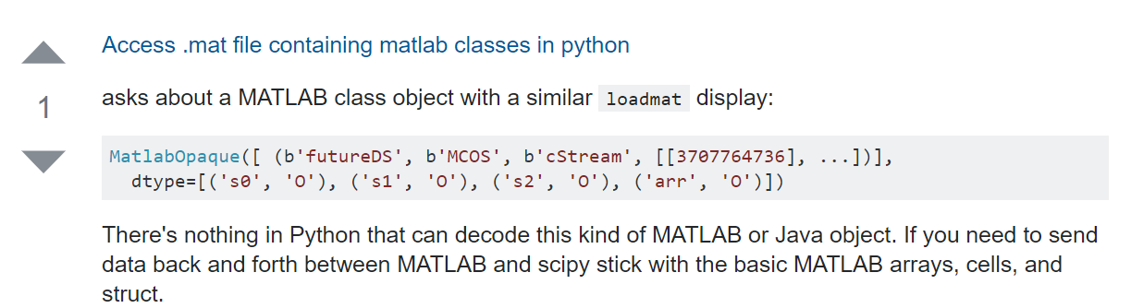
Common way to import .mat files is to use
scipy.io.loadmat(“.mat”)
Cons
Only supports v4.0, v6.0, and v7.0 to v7.2
Can only import cell arrays
Cannot import MATLAB table structures properly
So… at least we’re not alone in this issue…

Slide 7
How hdf5storage works
Hdf5storage is a Python package that allows to read/write Hierarchal Data Format 5 (HDF5) files.
It provides support for .mat v7.3 files, which is based on a HDF5 format
Converts all data into Numpy arrays
Interface with the h5py package, which allows for large datasets and arrays to be stored in Pythonic metaphors, such as Numpy arrays and dictionaries.
Notes:
Different MATLAB .mat versions save data differently based on compression and encoding
https://www.mathworks.com/help/matlab/import_export/mat-file-versions.html
HDF5-based format that stores data in compressed chunks. The time required to load part of a variable from a Version 7.3 MAT-file depends on how that data is stored across one or more chunks. Each chunk that contains any portion of the data you want to load must be fully uncompressed to access the data.
HDF5 Groups: An HDF5 group is a structure containing zero or more HDF5 objects
HDF5 Datasets: A dataset is stored in a file in two parts: a header and a data array.

Slide 8
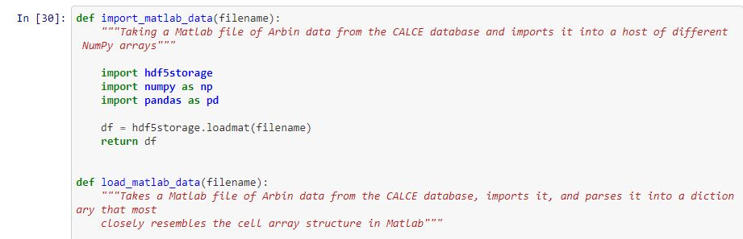
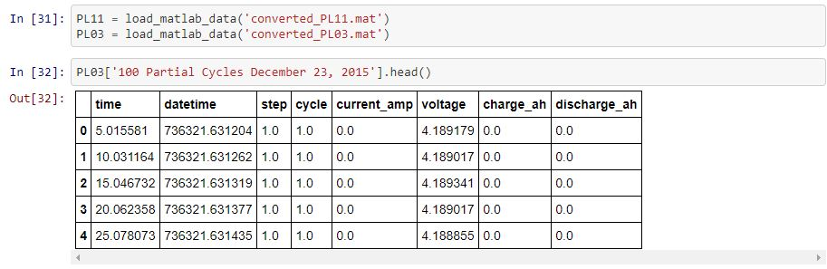

Slide 9
Appeal and Drawbacks
Appeal:
This package provides a way to load the data as a data frame.
The package has a way to import MATLAB table data
By using this package inside a function, we can call it for all our files easily.
Drawbacks:
We need update all the .mat files from 5.0 to 7.3 using MATLAB.
Because of how our data is organized, we need to write flow control around this package to open the data.

