Slide 1
On the Production Modes and Production Rates cross checks.
Zhen Liu

Slide 2
I want to check a few subtilties on the production modes to ensure what Peiran did does not miss some important contributions & effects
Z-\gamma interference
Additional radiation from fixed order calculation
Z\gamma fusion channels
Stability against higher orders (note that Peiran’s calculation actually regulated the IR singularities with finite muon masses. That might not be the correct choice of scale for the calculation.)
The above relative importance will change as the ALP mass changes, so I will check both an 100 GeV ALP and a 1000 GeV ALP

Slide 3
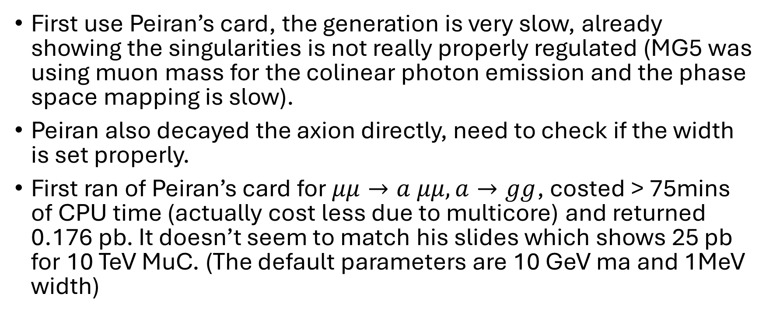
Checks
First use Peiran’s card, the generation is very slow, already showing the singularities is not really properly regulated (MG5 was using muon mass for the colinear photon emission and the phase space mapping is slow).
Peiran also decayed the axion directly, need to check if the width is set properly.
First ran of Peiran’s card for $μμ→a μμ, a→gg$, costed > 75mins of CPU time (actually cost less due to multicore) and returned 0.176 pb. It doesn’t seem to match his slides which shows 25 pb for 10 TeV MuC. (The default parameters are 10 GeV ma and 1MeV width)

Slide 4
Checks
Process | Note | Parameters | Result | COM | Comment
mm->amm, a>gg | Peiran’s default with wrong param. | ma=10 GeV, Wd=1 MeV | 0.176pb | 10 TeV | Do not match Peiran’s slides
mm->amm | Zhen | 10 GeV, 1 MeV | 118 pb | 10 TeV
 | Zhen | 1 TeV, 1 MeV | 25 pb | 10 TeV | Match Peiran old result; Coupling Normalization
mm->amm | Zhen with updated param. PR run card. | 1 TeV, 14.5 MeV | 10.6 ab |  | Matches Peiran 9/19 result. Insensitivity to IR cut might be from the heavy scales here.

Slide 5
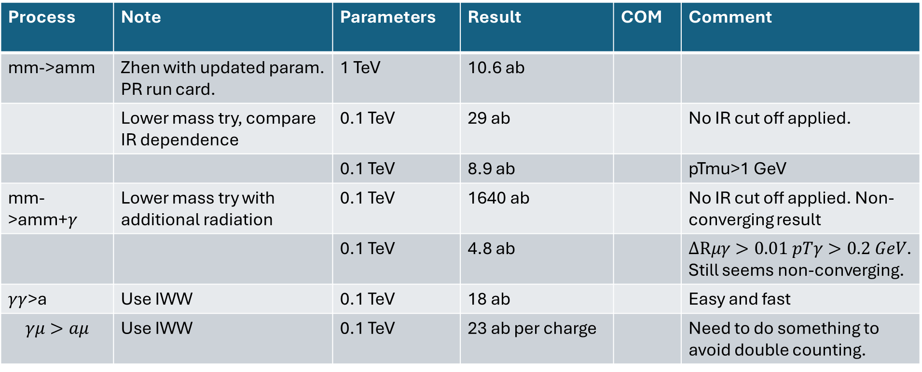
IR regularization & resummation
Process | Note | Parameters | Result | COM | Comment
mm->amm | Zhen with updated param. PR run card. | 1 TeV | 10.6 ab
 | Lower mass try, compare IR dependence | 0.1 TeV | 29 ab |  | No IR cut off applied.
 |  | 0.1 TeV | 8.9 ab |  | pTmu>1 GeV
mm->amm+$γ$ | Lower mass try with additional radiation | 0.1 TeV | 1640 ab |  | No IR cut off applied. Non-converging result
 |  | 0.1 TeV | 4.8 ab |  | $ΔRμγ>0.01 pTγ>0.2 GeV$. Still seems non-converging.
$γγ$>a | Use IWW | 0.1 TeV | 18 ab |  | Easy and fast
$$γμ>aμ$$ | Use IWW | 0.1 TeV | 23 ab per charge |  | Need to do something to avoid double counting.

Slide 6
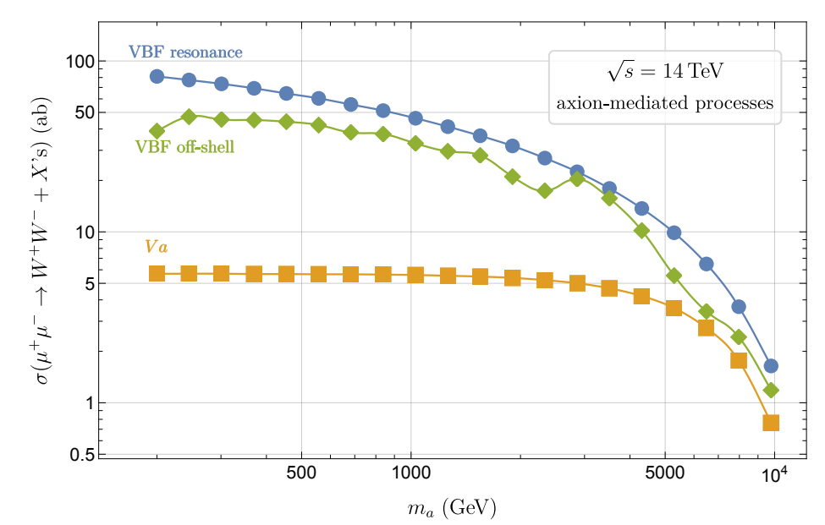
Additional Comparisons
This paper studied the pure aEWEW coupling without aGG.

Slide 7
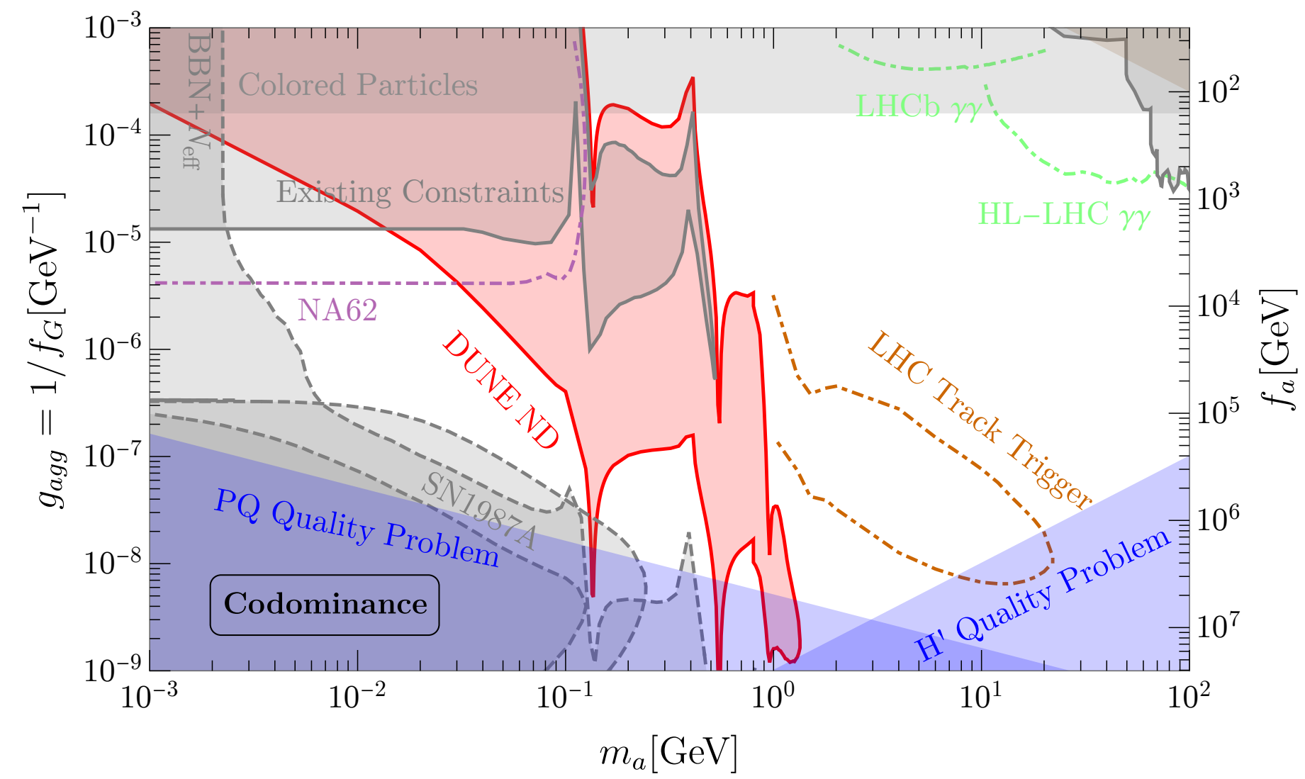

Slide 8
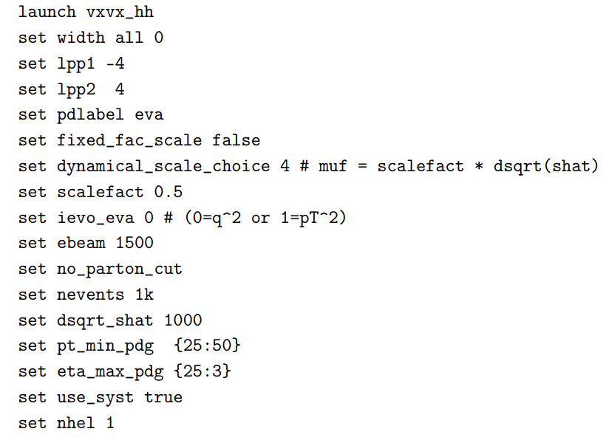
Additional Refs.
https://answers.launchpad.net/mg5amcnlo/+question/701029
Appendix of https://arxiv.org/pdf/2111.02442
Consider either using IWW or EVA

