Slide 1
Axion at Muon Collider
Ravneet Bedi, Tony Gherghetta, Soubhik Kumar, Peiran Li, Zhen Liu

Slide 2
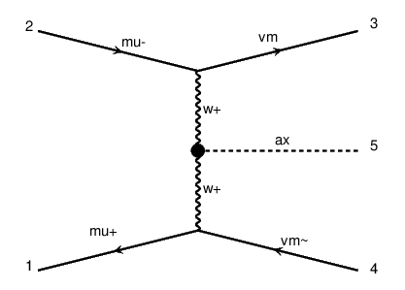
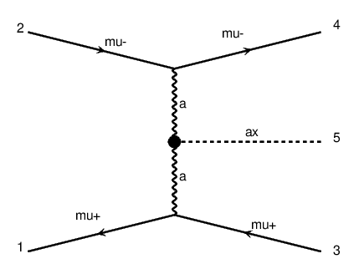

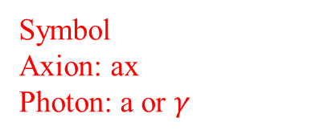

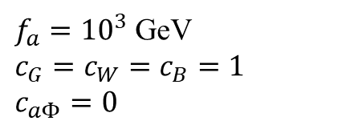
Main production of axion:
Vector Boson Fusion (VBF)
$$\sim GeV<m_{a}<\sim TeV$$
$μμ→νν ax$
$μμ→μμ ax$
$f_{a}={10}^{3}$ GeV
$c_{G}=c_{W}=c_{B}=1$
$c_{aΦ}=0$
Symbol
Axion: ax
Photon: a or $γ$

Slide 3


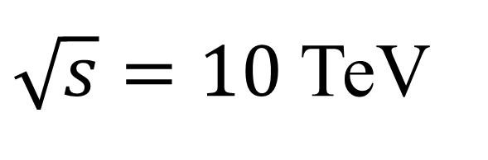
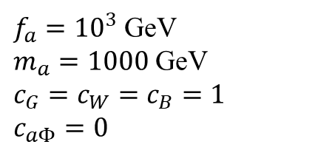

$\sqrt{s}=10$ TeV
Signal production
$$m_{h}<m_{a}<\sim TeV$$
$μμ→νν ax$
$σ=1.7$ pb
$μμ→μμ ax$
$σ=25$ pb
$m_{a}=1000$ GeV
$f_{a}={10}^{3}$ GeV
$m_{a}=1000$ GeV
$c_{G}=c_{W}=c_{B}=1$
$c_{aΦ}=0$

Slide 4
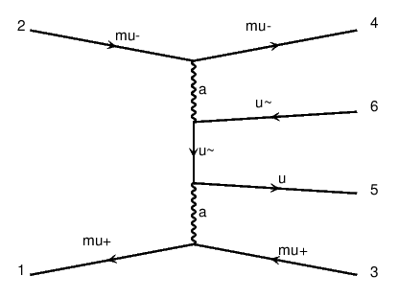
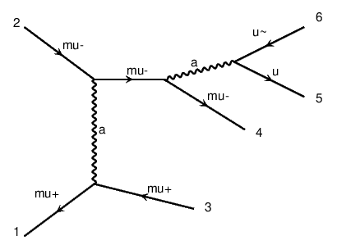
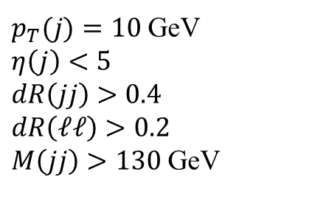
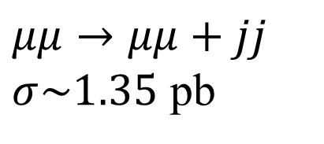
Background
$p_{T}(j)=10$ GeV
$η\left(j\right)<5$
$dR\left(jj\right)>0.4$
$dR\left(ℓℓ\right)>0.2$
$M\left(jj\right)>130$ GeV
$μμ→μμ+jj$
$σ\sim 1.35$ pb

Slide 5
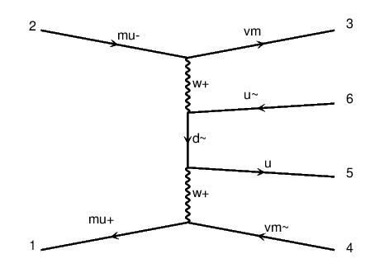
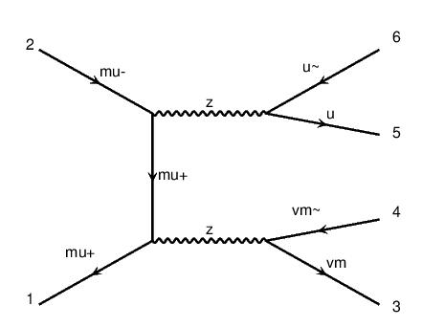
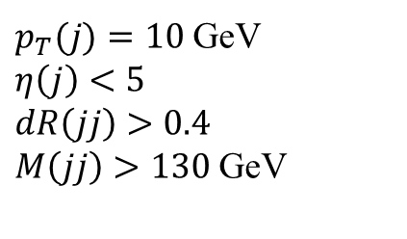
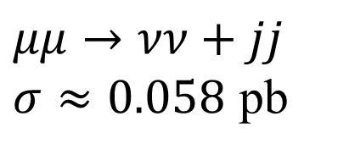
Background
$p_{T}(j)=10$ GeV
$η\left(j\right)<5$
$dR\left(jj\right)>0.4$
$M\left(jj\right)>130$ GeV
$μμ→νν+jj$
$σ≈0.058$ pb

Slide 6
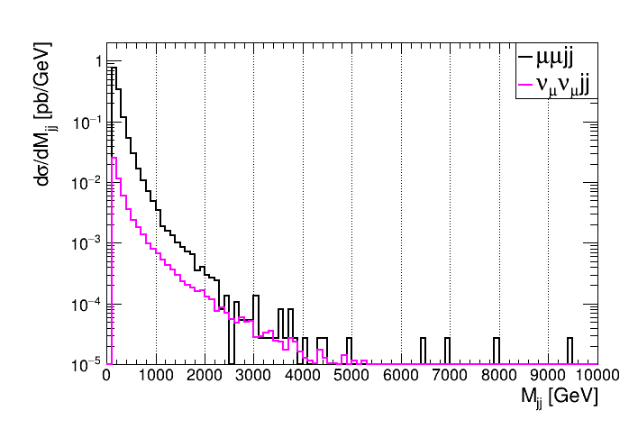


Background $M_{jj}$ distribusion
Mass window: $M\left(jj\right)$ within $m_{a}±5\%m_{a}$

Slide 7
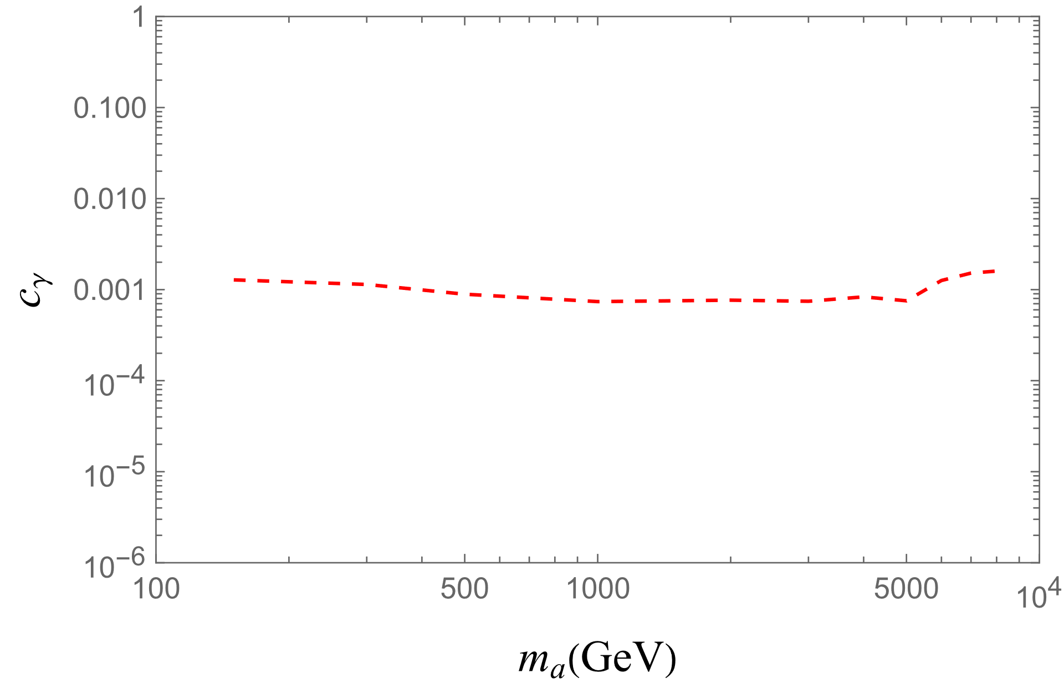


Sensitivity
Mass window: $M\left(jj\right)$ within $m_{a}±5\%m_{a}$
$$c_{γ}=\sin^{2}{θ_{W}}C_{W}+\cos^{2}{θ_{W}}C_{B}$$

Slide 8
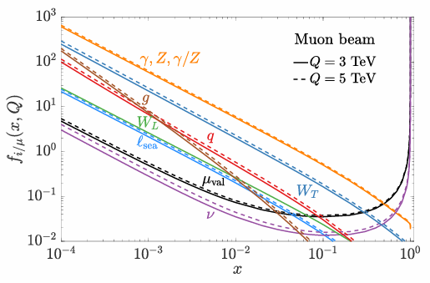
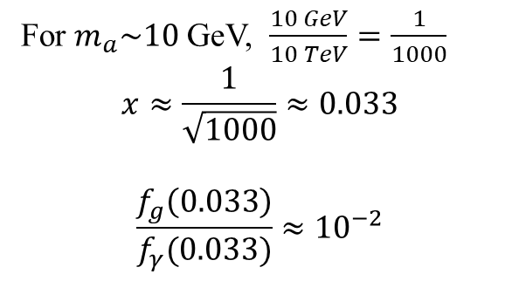
Muon PDF
For $m_{a}\sim 10$ GeV, $\frac{10 GeV}{10 TeV}=\frac{1}{1000}$
$$x≈\frac{1}{\sqrt{1000}}≈0.033$$
$$\frac{f_{g}\left(0.033\right)}{f_{γ}(0.033)}≈{10}^{−2}$$

Slide 9
2024/9/19

Slide 10
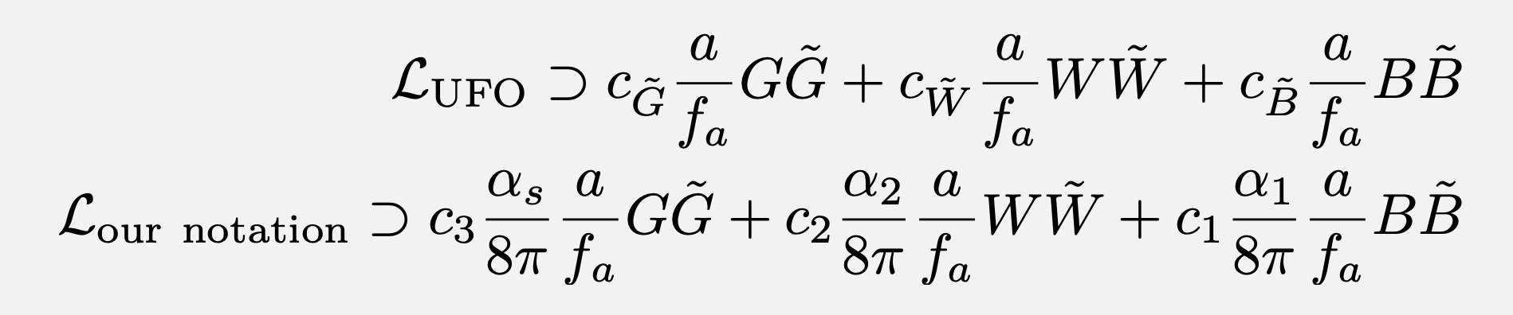
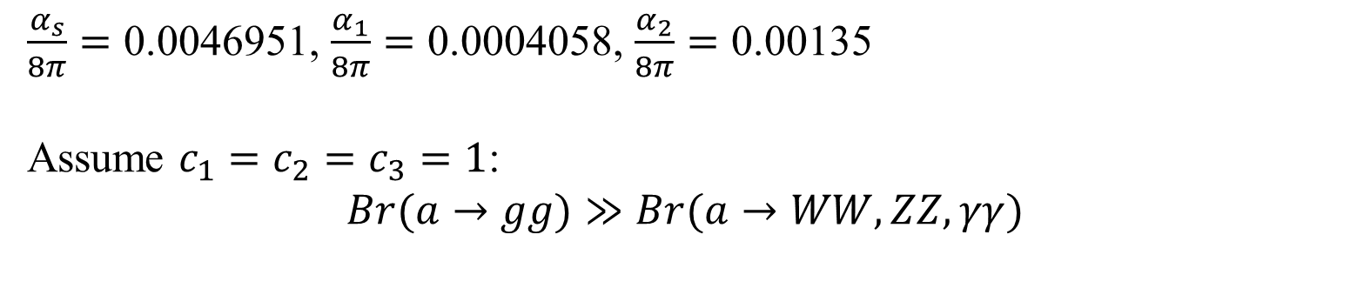
old
$\frac{α_{s}}{8π}=\text{0.0046951}$, $\frac{α_{1}}{8π}=\text{0.0004058}$, $\frac{α_{2}}{8π}=\text{0.00135}$
Assume $c_{1}=c_{2}=c_{3}=1$:
$$Br(a→gg)≫Br(a→WW,ZZ,γγ)$$

Slide 11




Signal ($m_{a}=1 TeV$)
$\frac{α_{s}}{8π}=\text{0.0046951}$, $\frac{α_{1}}{8π}=\text{0.0004058}$, $\frac{α_{2}}{8π}=\text{0.00135}$
$μμ→νν a$
$σ=3×{10}^{−6}$ pb
$μμ→μμ a$
$σ=1×{10}^{−5}$ pb
$$γ$$
Both processes are comparable and need to be included.
$$γ$$

Slide 12

Background
$p_{T}(j)=10$ GeV
$η\left(j\right)<5$
$dR\left(jj\right)>0.4$
$dR\left(ℓℓ\right)>0.2$
$M\left(jj\right)>130$ GeV
$μμ→μμ+jj$
$σ\sim 1.35$ pb
LHC (diphoton, dijet)
$$γ$$

Slide 13
Background
$p_{T}(j)=10$ GeV
$η\left(j\right)<5$
$dR\left(jj\right)>0.4$
$M\left(jj\right)>130$ GeV
$μμ→νν+jj$
$σ≈0.058$ pb

Slide 14
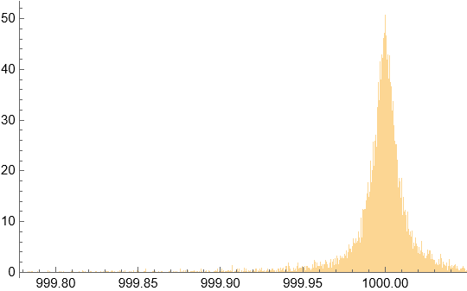
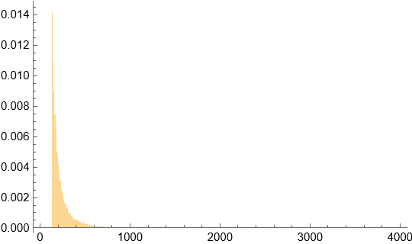
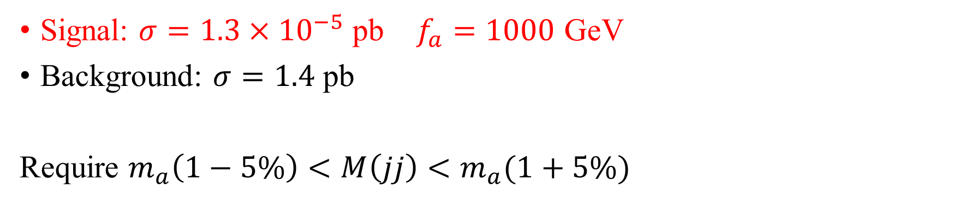


$m_{a}=1 TeV$
Signal: $σ=1.3×{10}^{−5}$ pb $f_{a}=1000$ GeV
Background: $σ=1.4$ pb
Require $m_{a}\left(1−5\%\right)<M\left(jj\right)<m_{a}(1+5\%)$
Probability density
Probability density
Signal
Background
$M\left(jj\right)$ [GeV]
$M\left(jj\right)$ [GeV]

Slide 15
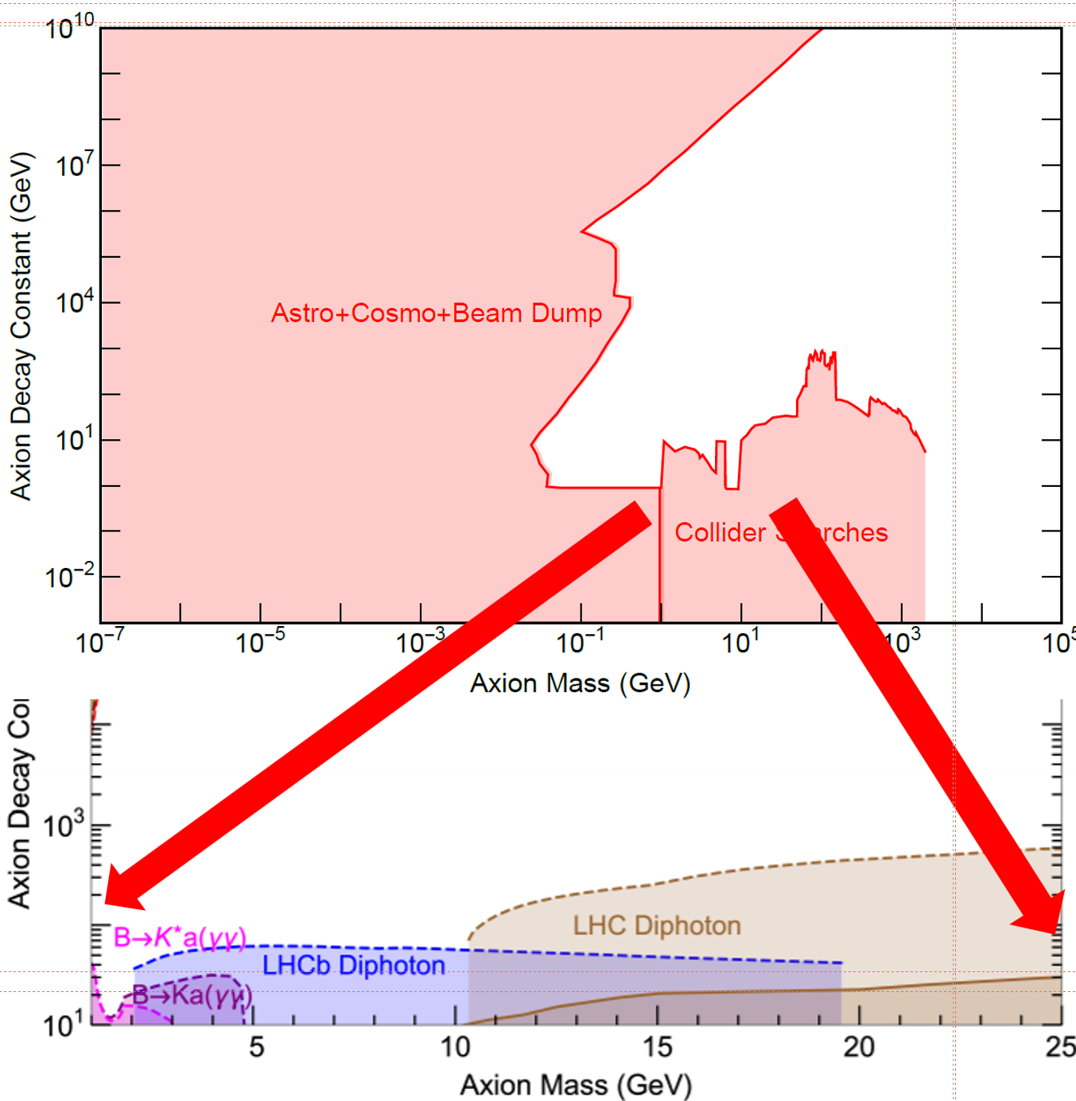

Require N=3
$f_{a}≈6000$ GeV

Slide 16
Backup

Slide 17
