Slide 1
Axion at Muon Collider
Ravneet Bedi, Tony Gherghetta, Soubhik Kumar, Peiran Li, Zhen Liu

Slide 2
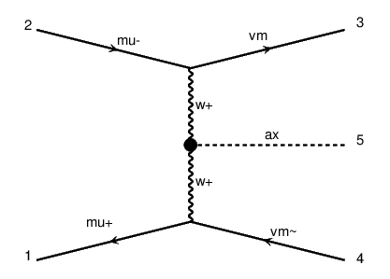
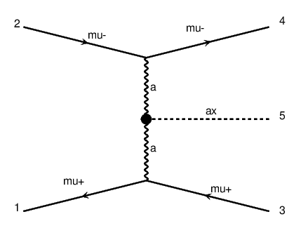

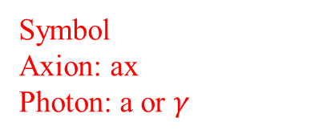

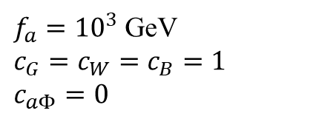
Main production of axion:
Vector Boson Fusion (VBF)
$$\sim GeV<m_{a}<\sim TeV$$
$μμ→νν ax$
$μμ→μμ ax$
$f_{a}={10}^{3}$ GeV
$c_{G}=c_{W}=c_{B}=1$
$c_{aΦ}=0$
Symbol
Axion: ax
Photon: a or $γ$

Slide 3


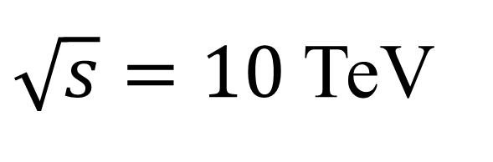
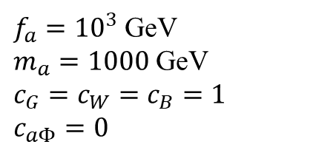

$\sqrt{s}=10$ TeV
Signal production
$$m_{h}<m_{a}<\sim TeV$$
$μμ→νν ax$
$σ=1.7$ pb
$μμ→μμ ax$
$σ=25$ pb
$m_{a}=1000$ GeV
$f_{a}={10}^{3}$ GeV
$m_{a}=1000$ GeV
$c_{G}=c_{W}=c_{B}=1$
$c_{aΦ}=0$

Slide 4
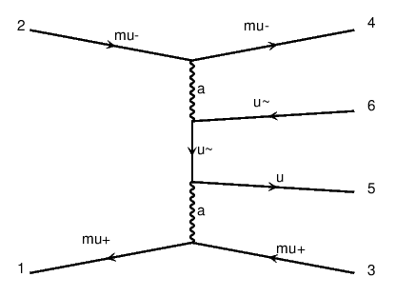
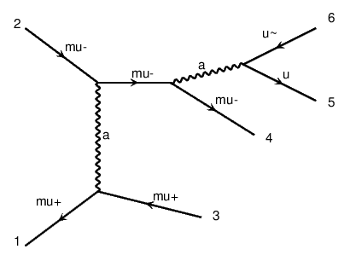
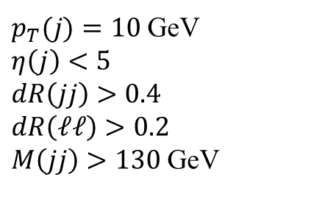
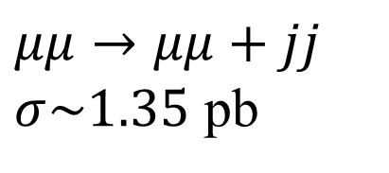
Background
$p_{T}(j)=10$ GeV
$η\left(j\right)<5$
$dR\left(jj\right)>0.4$
$dR\left(ℓℓ\right)>0.2$
$M\left(jj\right)>130$ GeV
$μμ→μμ+jj$
$σ\sim 1.35$ pb

Slide 5
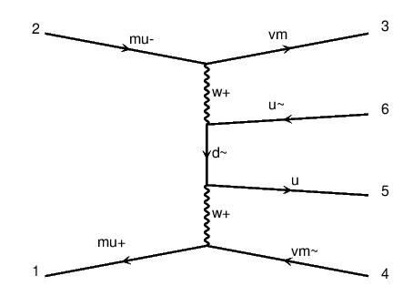
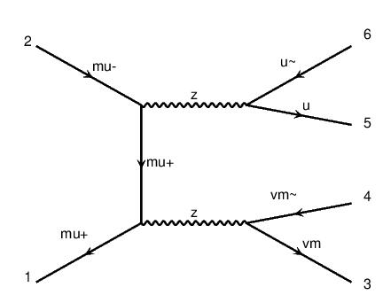
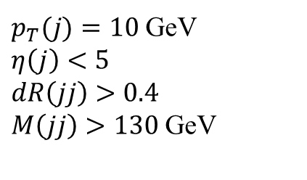
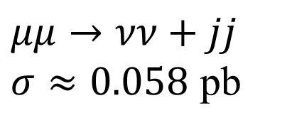
Background
$p_{T}(j)=10$ GeV
$η\left(j\right)<5$
$dR\left(jj\right)>0.4$
$M\left(jj\right)>130$ GeV
$μμ→νν+jj$
$σ≈0.058$ pb

Slide 6
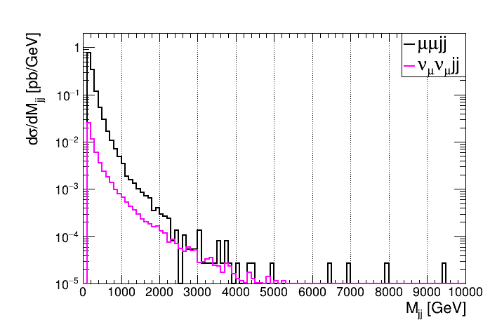


Background $M_{jj}$ distribusion
Mass window: $M\left(jj\right)$ within $m_{a}±5\%m_{a}$

Slide 7
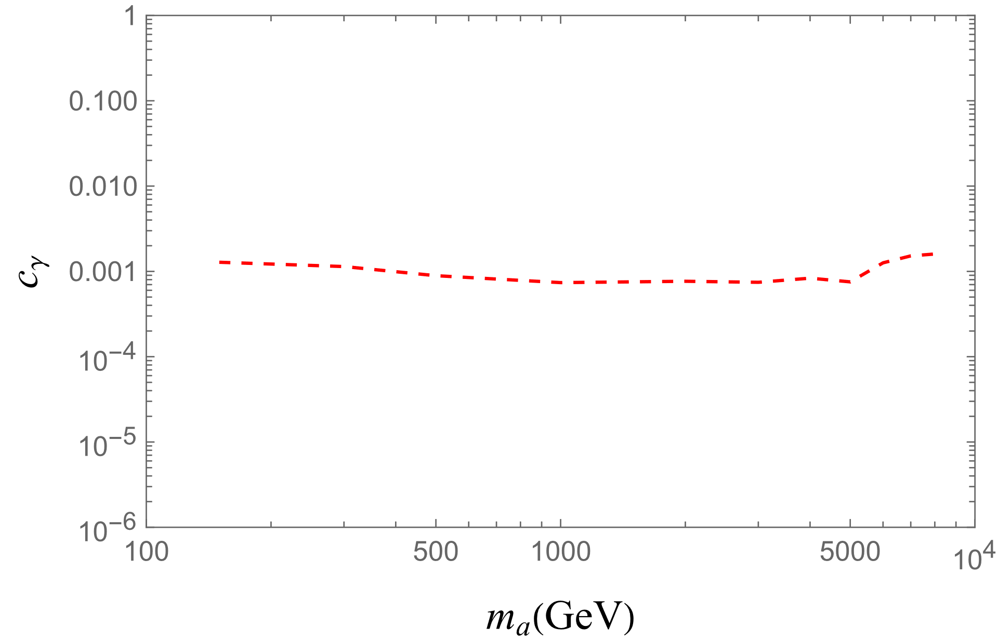


Sensitivity
Mass window: $M\left(jj\right)$ within $m_{a}±5\%m_{a}$
$$c_{γ}=\sin^{2}{θ_{W}}C_{W}+\cos^{2}{θ_{W}}C_{B}$$

Slide 8
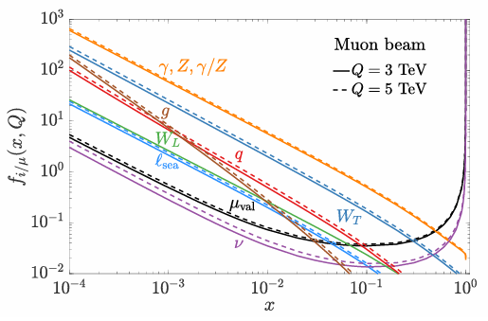
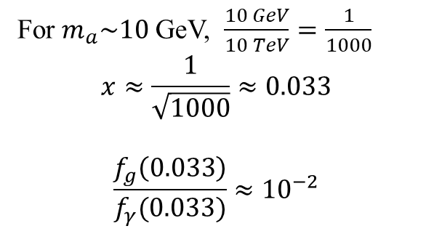
Muon PDF
For $m_{a}\sim 10$ GeV, $\frac{10 GeV}{10 TeV}=\frac{1}{1000}$
$$x≈\frac{1}{\sqrt{1000}}≈0.033$$
$$\frac{f_{g}\left(0.033\right)}{f_{γ}(0.033)}≈{10}^{−2}$$

Slide 9
2024/9/19

Slide 10
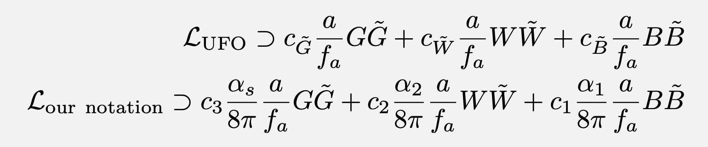
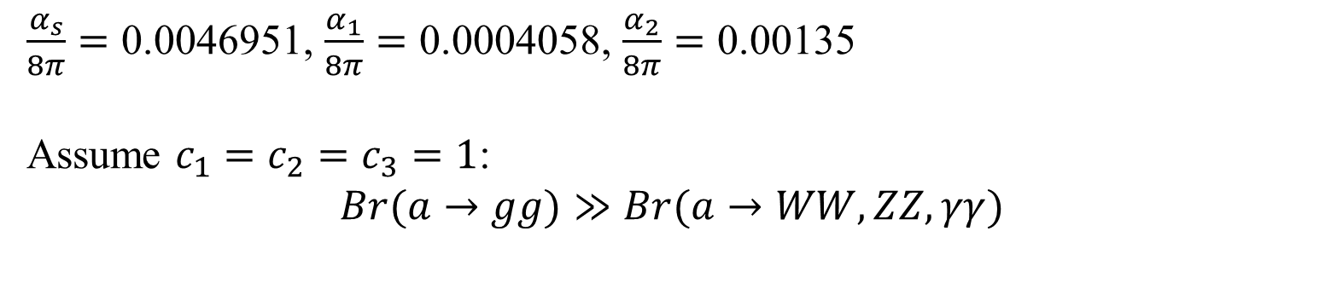
old
$\frac{α_{s}}{8π}=\text{0.0046951}$, $\frac{α_{1}}{8π}=\text{0.0004058}$, $\frac{α_{2}}{8π}=\text{0.00135}$
Assume $c_{1}=c_{2}=c_{3}=1$:
$$Br(a→gg)≫Br(a→WW,ZZ,γγ)$$

Slide 11
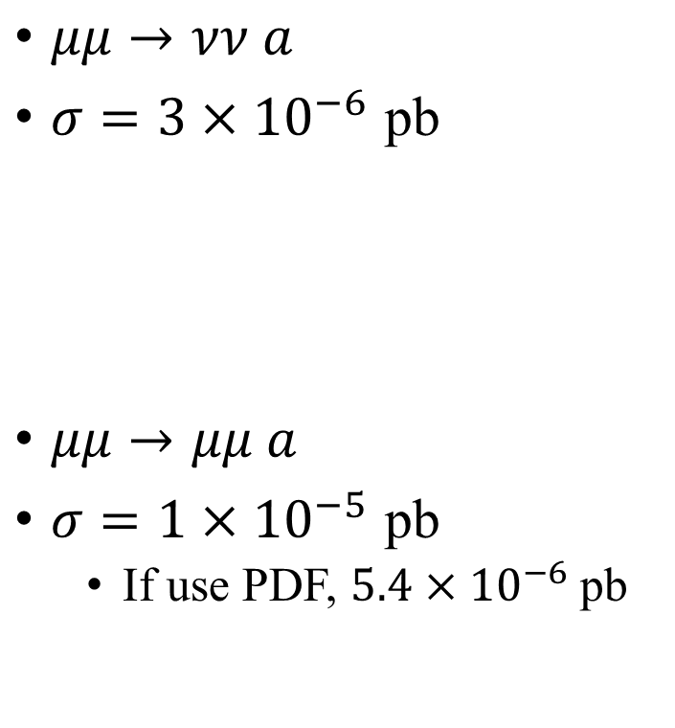

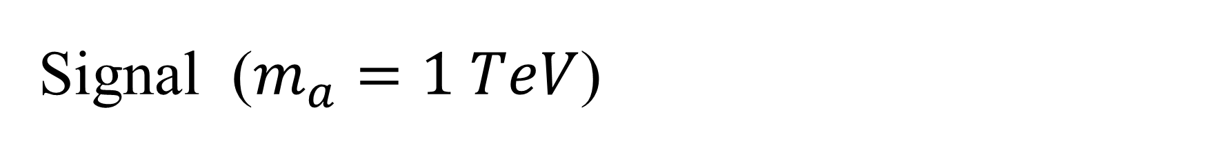

Signal ($m_{a}=1 TeV$)
$\frac{α_{s}}{8π}=\text{0.0046951}$, $\frac{α_{1}}{8π}=\text{0.0004058}$, $\frac{α_{2}}{8π}=\text{0.00135}$
$μμ→νν a$
$σ=3×{10}^{−6}$ pb
$μμ→μμ a$
$σ=1×{10}^{−5}$ pb
If use PDF, $5.4×{10}^{−6}$ pb
Both processes are comparable and need to be included.
$$γ$$
Other papers include both processes?
Yes,https://arxiv.org/pdf/2203.05484
$$γ$$

Slide 12

Background
$p_{T}(j)=10$ GeV
$η\left(j\right)<5$
$dR\left(jj\right)>0.4$
$dR\left(ℓℓ\right)>0.2$
$M\left(jj\right)>130$ GeV
$μμ→μμ+jj$
$σ\sim 1.35$ pb
LHC (diphoton, dijet)
$$γ$$
$$γ$$
$$γ$$
$$γ$$

Slide 13
Background
$p_{T}(j)=10$ GeV
$η\left(j\right)<5$
$dR\left(jj\right)>0.4$
$M\left(jj\right)>130$ GeV
$μμ→νν+jj$
$σ≈0.058$ pb

Slide 14
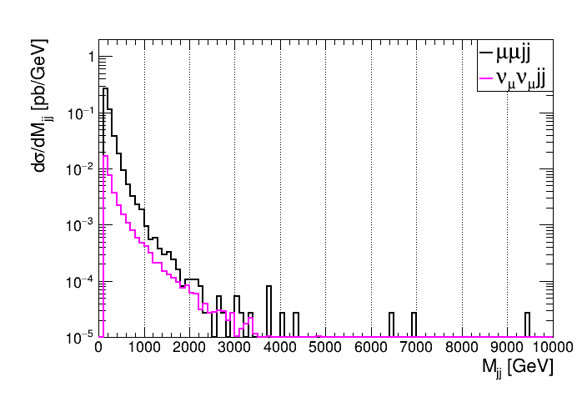
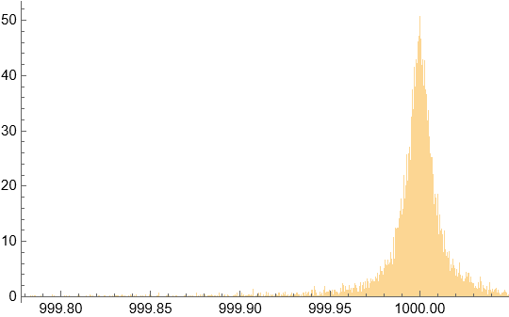
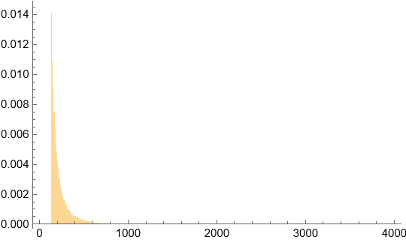
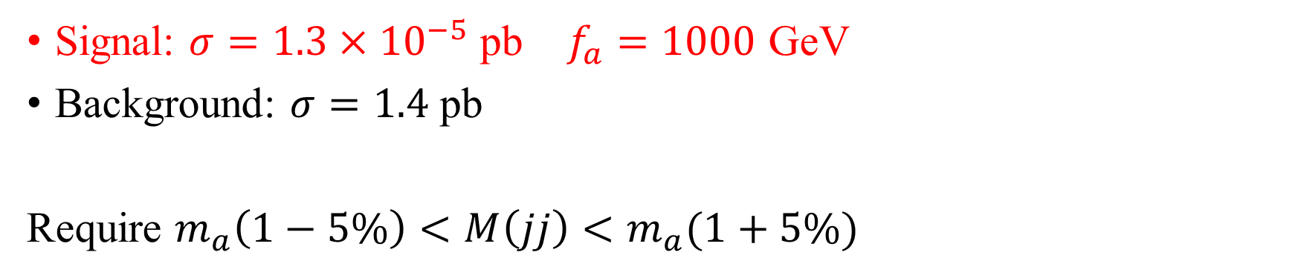


$m_{a}=1 TeV$
Signal: $σ=1.3×{10}^{−5}$ pb $f_{a}=1000$ GeV
Background: $σ=1.4$ pb
Require $m_{a}\left(1−5\%\right)<M\left(jj\right)<m_{a}(1+5\%)$
Probability density
Probability density
Signal
Background
$M\left(jj\right)$ [GeV]
$M\left(jj\right)$ [GeV]

Slide 15
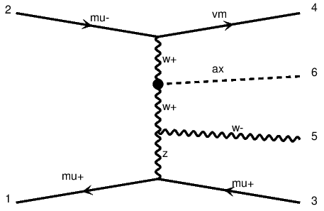
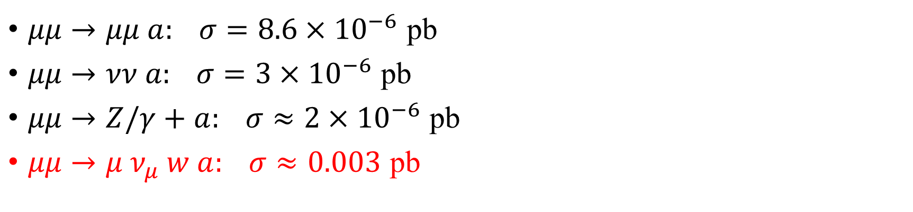
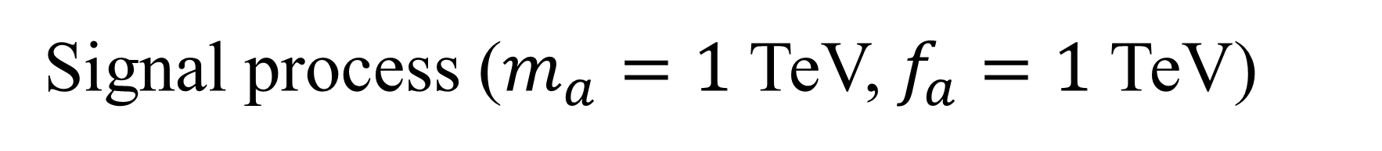
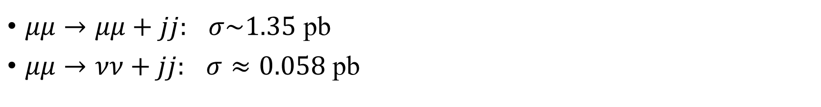
Signal process ($m_{a}=1$ TeV, $f_{a}=1$ TeV)
$μμ→μμ a: σ=8.6×{10}^{−6}$ pb
$μμ→νν a: σ=3×{10}^{−6}$ pb
$μμ→Z/γ+a: σ≈2×{10}^{−6}$ pb
$μμ→μ ν_{μ} w a: σ≈0.003$ pb
Bkg process
$μμ→μμ+jj:$ $σ\sim 1.35$ pb
$μμ→νν+jj:$ $σ≈0.058$ pb

Slide 16
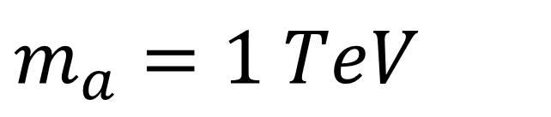


$m_{a}=1 TeV$
Probability density
Probability density
Signal
Background
$M\left(jj\right)$ [GeV]
$M\left(jj\right)$ [GeV]

Slide 17
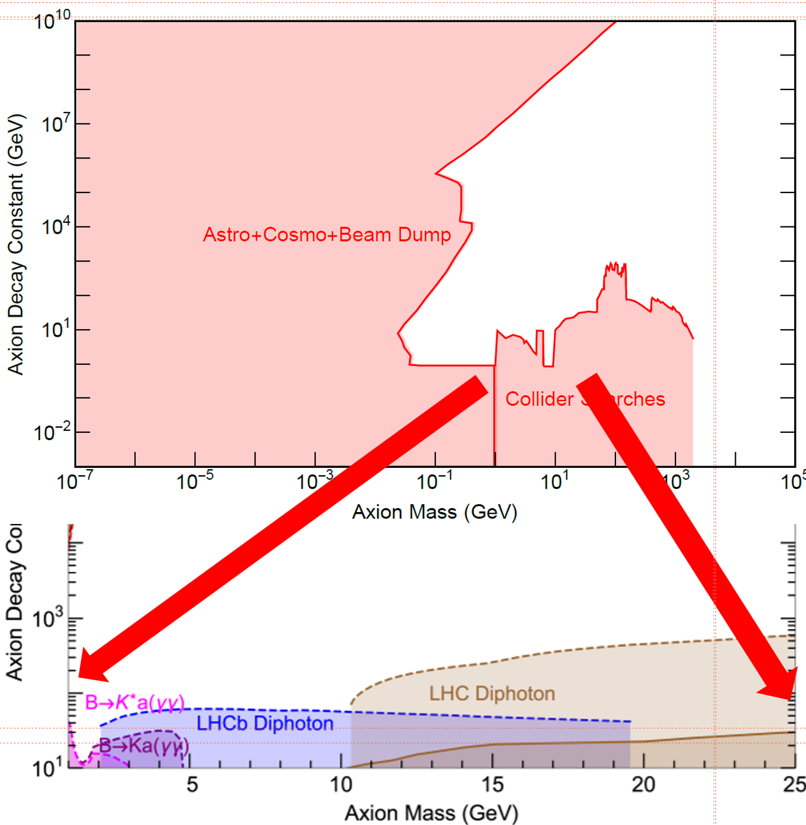
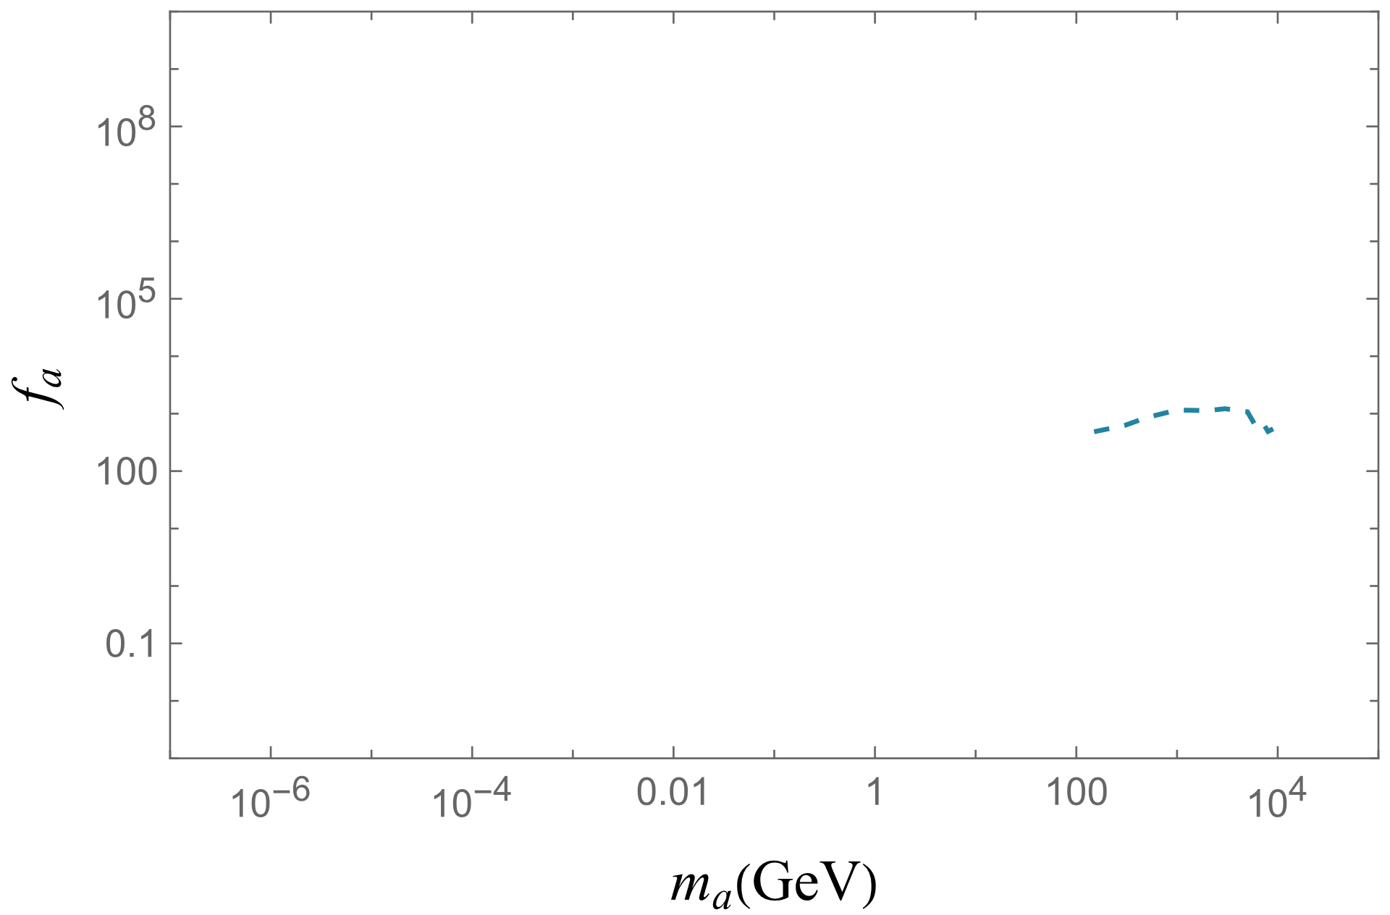
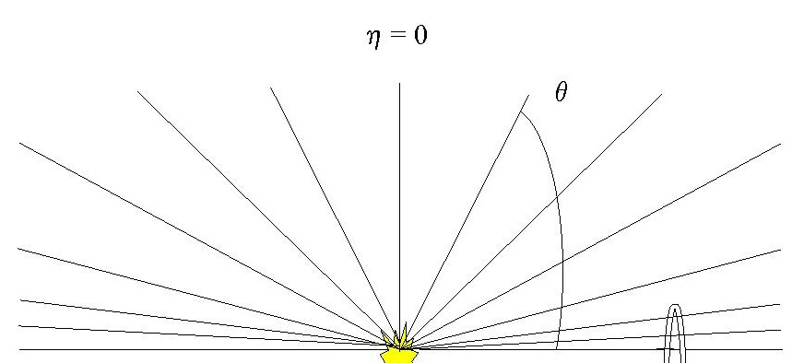
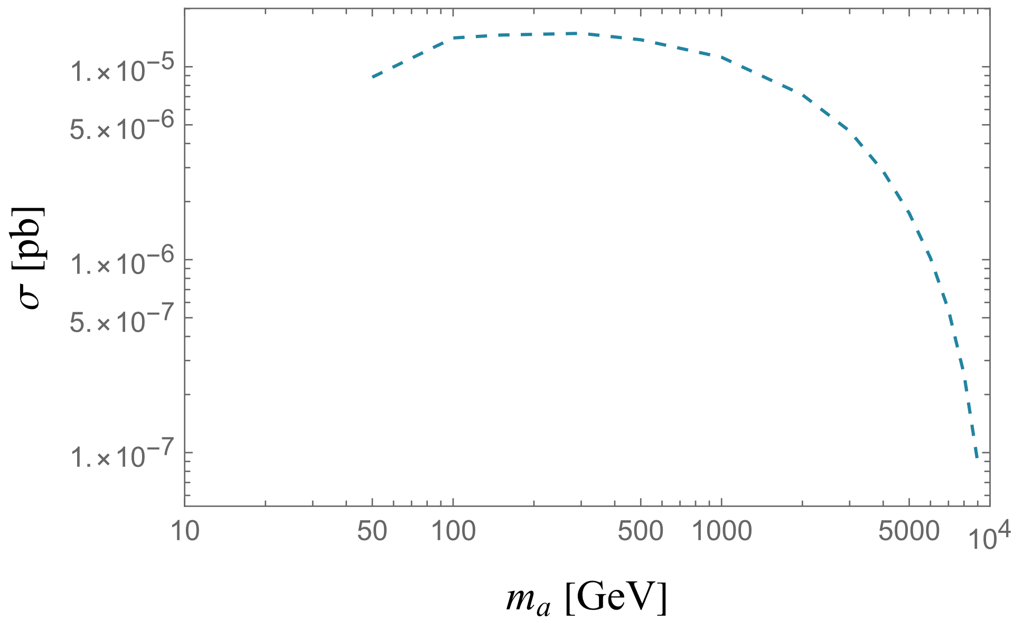

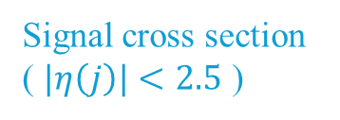
$f_{a}\sim 1000$ GeV
Signal cross section
( $|η\left(j\right)|<2.5$ )

Slide 18
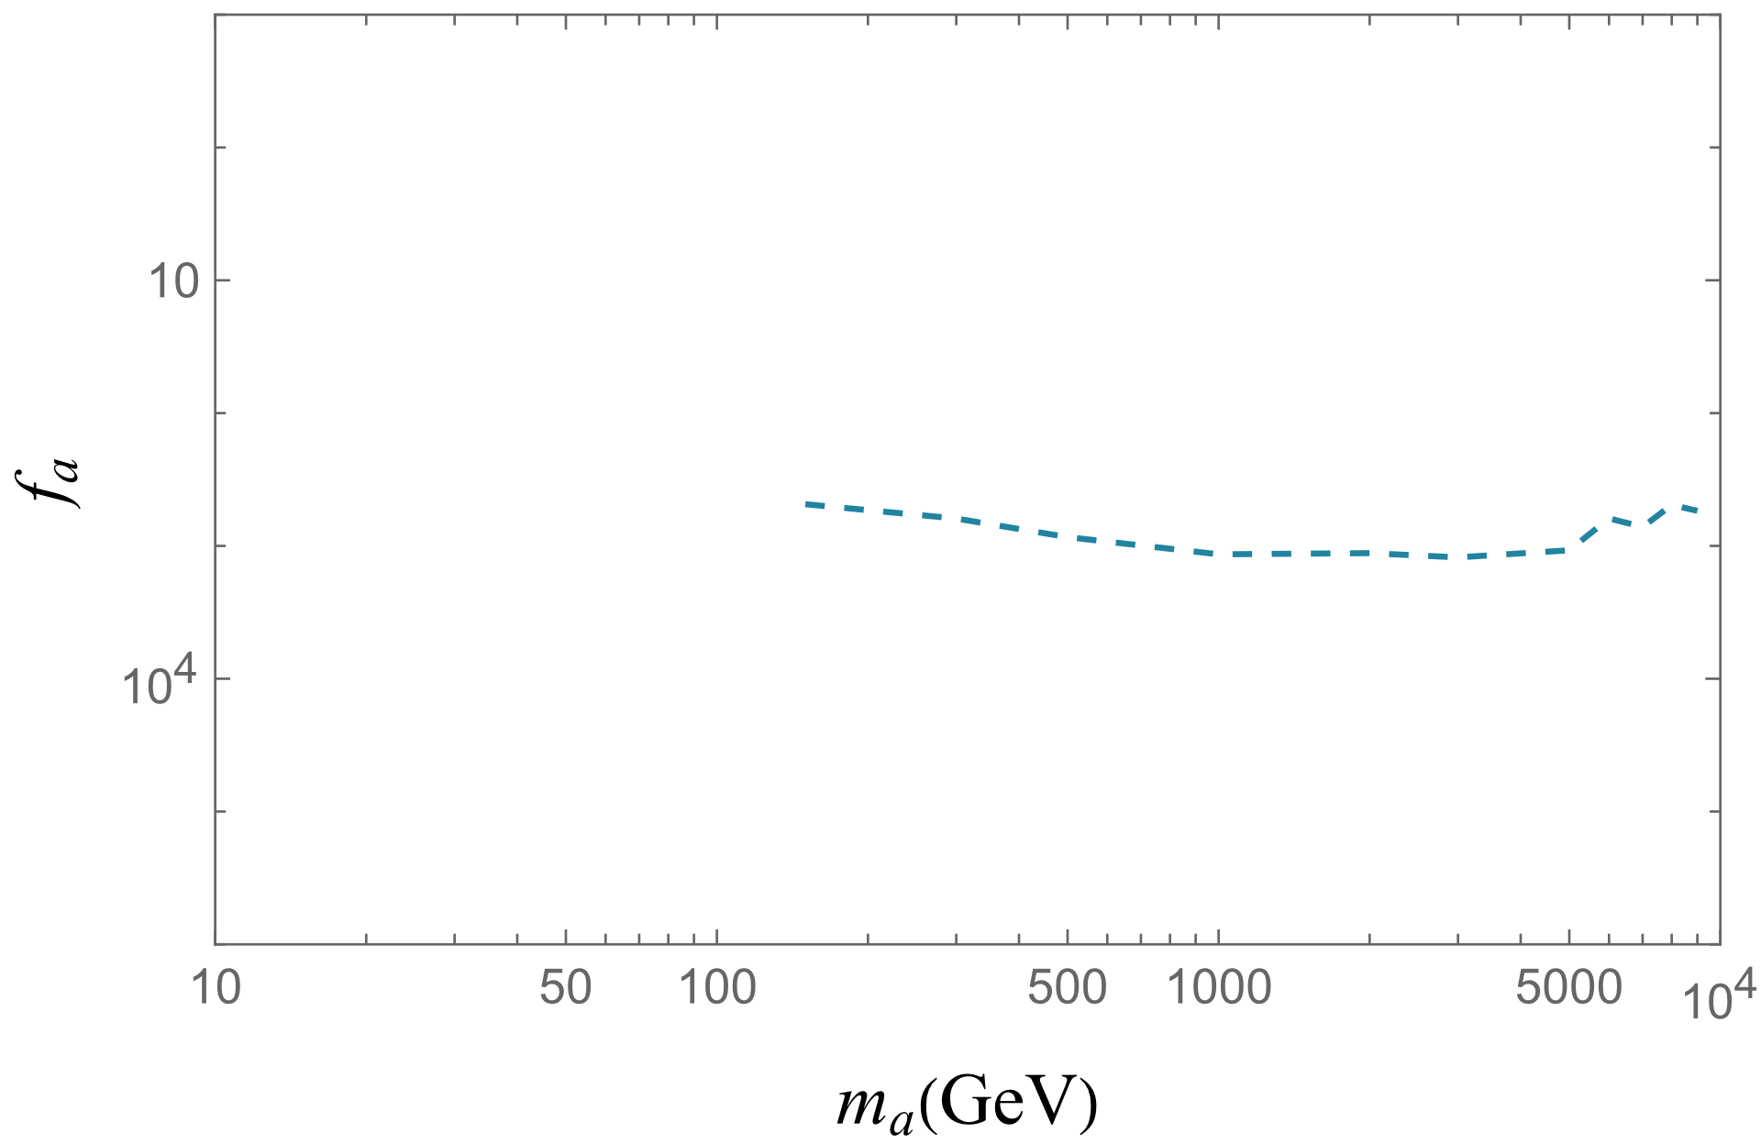
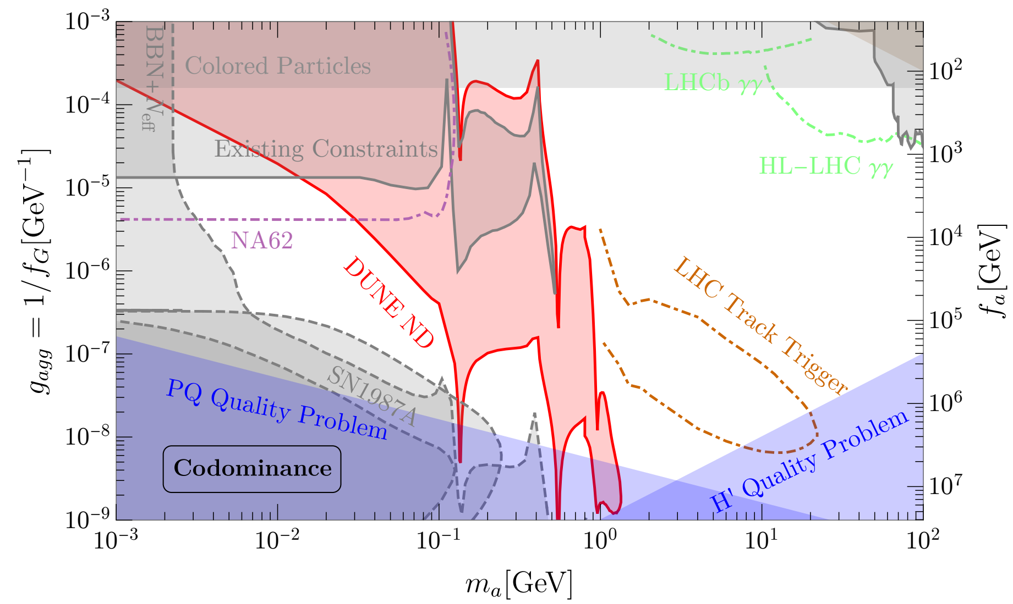

Slide 19
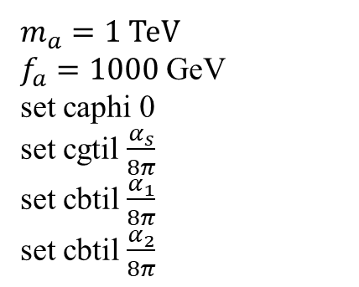
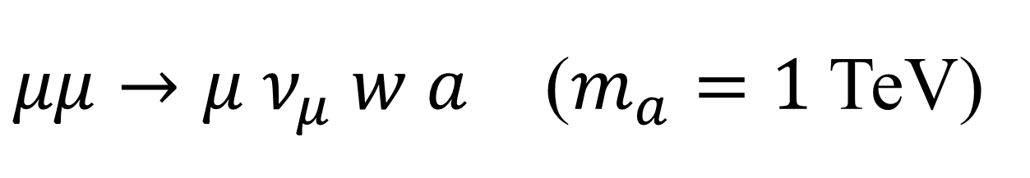

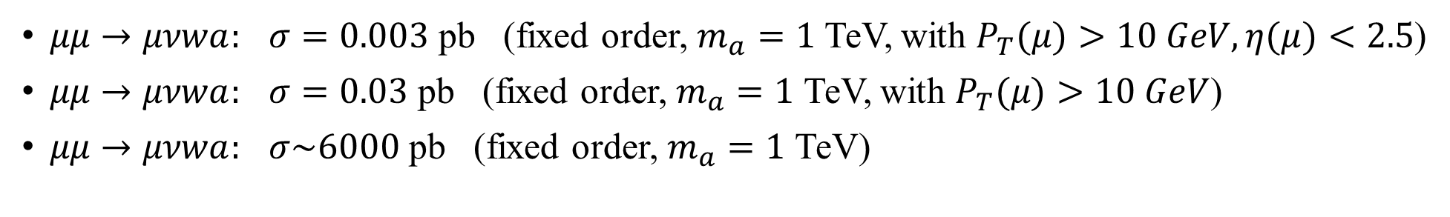
$μμ→μ ν_{μ} w a$ ($m_{a}=1$ TeV)
$μμ→μνwa:$ $σ=0.003$ pb (fixed order, $m_{a}=1$ TeV, with $P_{T}(μ)>10 GeV, η(μ)<2.5$)
$μμ→μνwa:$ $σ=0.03$ pb (fixed order, $m_{a}=1$ TeV, with $P_{T}(μ)>10 GeV$)
$μμ→μνwa:$ $σ\sim 6000$ pb (fixed order, $m_{a}=1$ TeV)
$m_{a}=1$ TeV
$f_{a}=1000$ GeV
set caphi 0
set cgtil $\frac{α_{s}}{8π}$
set cbtil $\frac{α_{1}}{8π}$
set cbtil $\frac{α_{2}}{8π}$
$$γ$$

Slide 20
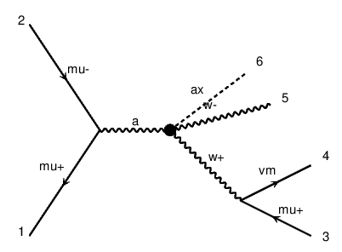

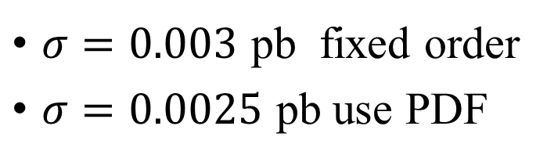

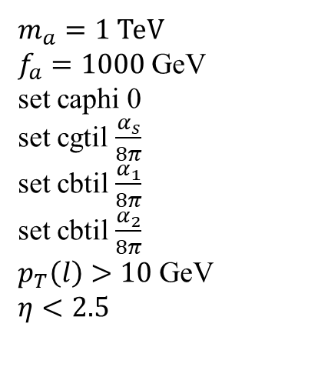
$μμ→μ ν_{μ} w a$ ($m_{a}=1$ TeV)
$m_{a}=1$ TeV
$f_{a}=1000$ GeV
set caphi 0
set cgtil $\frac{α_{s}}{8π}$
set cbtil $\frac{α_{1}}{8π}$
set cbtil $\frac{α_{2}}{8π}$
$p_{T}\left(l\right)>10$ GeV
$η<2.5$
$σ=0.003$ pb fixed order
$σ=0.0025$ pb use PDF
$$Z$$
$$γ$$

Slide 21
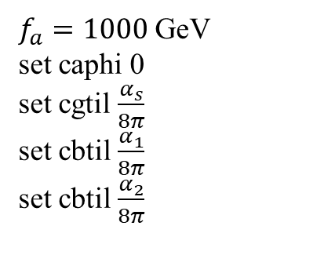
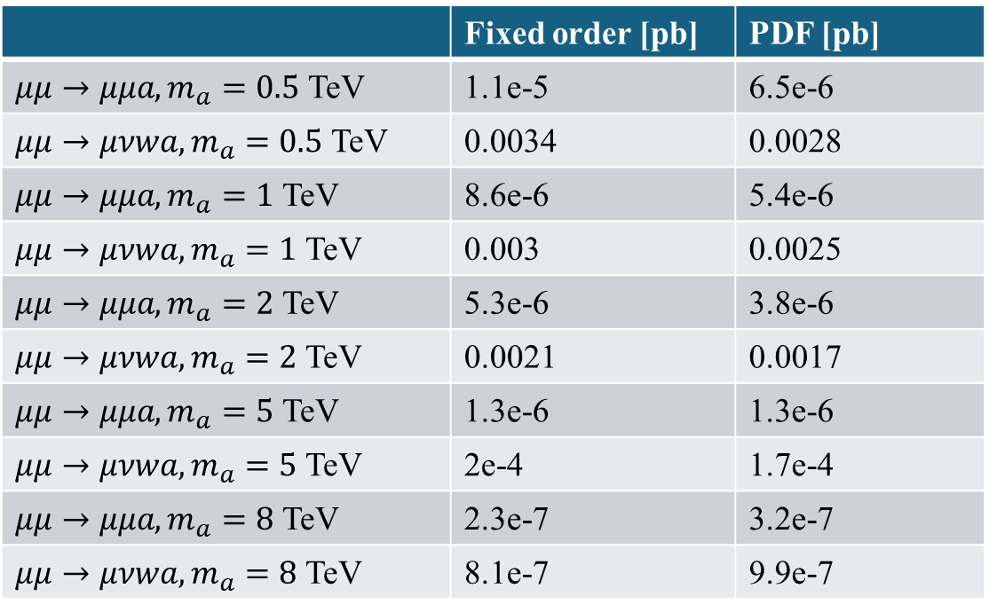
Fixed order vs. PDF computation
$f_{a}=1000$ GeV
set caphi 0
set cgtil $\frac{α_{s}}{8π}$
set cbtil $\frac{α_{1}}{8π}$
set cbtil $\frac{α_{2}}{8π}$
 | Fixed order [pb] | PDF [pb]
$μμ→μμa, m_{a}=0.5$ TeV | 1.1e-5 | 6.5e-6
$μμ→μνwa, m_{a}=0.5$ TeV | 0.0034 | 0.0028
$μμ→μμa, m_{a}=1$ TeV | 8.6e-6 | 5.4e-6
$μμ→μνwa, m_{a}=1$ TeV | 0.003 | 0.0025
$μμ→μμa, m_{a}=2$ TeV | 5.3e-6 | 3.8e-6
$μμ→μνwa, m_{a}=2$ TeV | 0.0021 | 0.0017
$μμ→μμa, m_{a}=5$ TeV | 1.3e-6 | 1.3e-6
$μμ→μνwa, m_{a}=5$ TeV | 2e-4 | 1.7e-4
$μμ→μμa, m_{a}=8$ TeV | 2.3e-7 | 3.2e-7
$μμ→μνwa, m_{a}=8$ TeV | 8.1e-7 | 9.9e-7
For fixed order $μμ→μνwa$, $p_{T}\left(l\right)>10$ GeV and $η\left(l\right)<2.5$

Slide 22
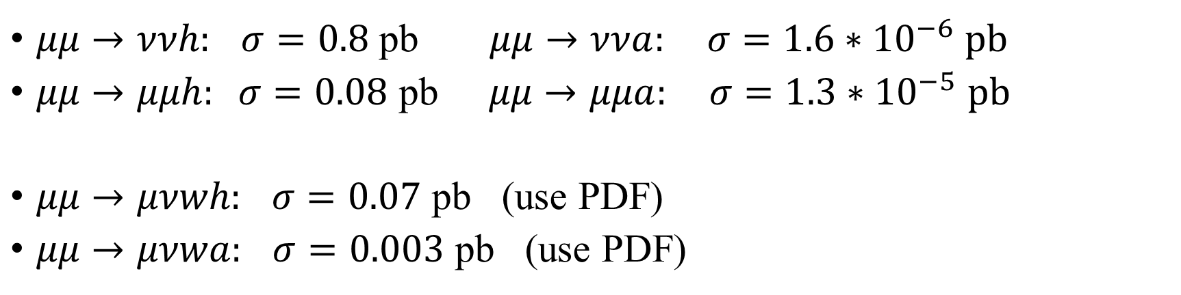
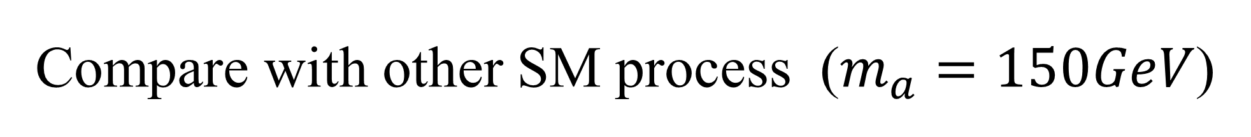
Compare with other SM process ($m_{a}=150GeV$)
$μμ→ννh:$ $σ=0.8$ pb $μμ→ννa: σ={1.6∗10}^{−6}$ pb
$μμ→μμh: σ=0.08$ pb $μμ→μμa: σ={1.3∗10}^{−5}$ pb
$μμ→μνwh:$ $σ=0.07$ pb (use PDF)
$μμ→μνwa:$ $σ=0.003$ pb (use PDF)
$$σ=∫∫f_{W_{L}}(x_{1})f_{γ}(x_{2})∗\hat{σ}\left(W_{L}γ→W+h\right)dx_{1}dx_{2}$$

Slide 23







$m_{a}=125$ GeV
[pb] | $\sqrt{s}$=500GeV | $\sqrt{s}$=1000GeV | $\sqrt{s}$=2000GeV | $\sqrt{s}$=4000GeV | $\sqrt{s}$=6000GeV | $\sqrt{s}$=8000GeV | $\sqrt{s}$=$10^{4}$GeV
$$w_{T}^{−}γ→a w^{−}$$ | 2e-4 | 6.6e-4 | 2.44e-4 | 9.5e-3 | 2.1e-2 | 3.7e-2 | 5.8e-2
$$w_{T}^{−}γ→h w^{−}$$ | 0.24 | 5.7e-2 | 1.35e-2 | 3.3e-3 | 1.46e-3 | 8.2e-4 | 5.2e-4
$$w_{L}^{−}γ→a w^{−}$$ | 2.8e-3 | 4.55e-2 | 7.3e-1 | 11.7 | 59.0 | 186 | 456
$$w_{L}^{−}γ→h w^{−}$$ | 37 | 45 | 47 | 48 | 48 | 48 | 48
PDF | 10TeV PDF
$$w_{T}^{−}γ→a w^{−}$$ | 2.02e-5
$$w_{T}^{−}γ→h w^{−}$$ | 8.2e-4
$$w_{L}^{−}γ→a w^{−}$$ | 2.9e-3
$$w_{L}^{−}γ→h w^{−}$$ | 7.1e-2
$$σ\left(w_{L}^{−}γ→a w^{−}\right)\sim E^{4}$$
$$f_{W_{L}/μ}(x)$$
$$f_{γ/μ}(x)$$

Slide 24




Feynman Amplitude
$ε^{ν}\left(p_{2}\right)\left(ie\right)\left[g^{νβ}{\left(p_{2}+q\right)}^{γ}+g^{βγ}{\left(−q−k_{2}\right)}^{ν}+g^{γν}{\left(k_{2}−p_{2}\right)}^{β}\right]ε^{γ}\left(k_{2}\right)$
$⋅\frac{i\left(−g_{βα}+\frac{q_{β}q_{α}}{m_{W}^{2}}\right)}{q^{2}−m_{W}^{2}}ε^{μ}\left(p_{1}\right)∗\left(\frac{−4i}{f_{a}}\frac{α_{2}}{8π}\right)q^{σ}p_{1}^{δ}ε^{αμσδ}$
$ε^{ν}\left(p_{2}\right)\left(ie\right)\left[g^{νβ}{\left(p_{2}+q\right)}^{γ}+g^{βγ}{\left(−q−k_{2}\right)}^{ν}+g^{γν}{\left(k_{2}−p_{2}\right)}^{β}\right]ε^{γ}\left(k_{2}\right)$
$⋅\frac{i\left(−g_{βα}+\frac{q_{β}q_{α}}{m_{W}^{2}}\right)}{q^{2}−m_{W}^{2}}ε^{μ}\left(p_{1}\right)∗\left(\frac{i}{2}v∗4πα_{2}\right)g^{μα}$
$$\frac{σ_{SM}}{σ_{BSM}}={\left(\frac{M_{h}}{M_{a}}\right)}^{2}\sim {\left(\frac{2πv}{4E^{2}}∗8πf_{a}\right)}^{2}={\left(\frac{4π^{2}{vf}_{a}}{E^{2}}\right)}^{2}={\left(\frac{{10}^{7}}{E^{2}}\right)}^{2}$$
$$q=k_{1}−p_{1}$$

Slide 25

To do
Make a good limit plot, fill the draft on overleaf
Check 2-to-2 process $Wγ→Wa, Wγ→Wh$

Slide 26

Backup
$Γ_{a→γγ}=\frac{α^{2}∗c_{γ}^{2}∗m_{a}^{3}}{256π^{3}f_{a}^{2}}$

Slide 27


