Slide 1
On the Production Modes and Production Rates cross checks.
Zhen Liu

Slide 2
I want to check a few subtilties on the production modes to ensure what Peiran did does not miss some important contributions & effects
Z-\gamma interference
Additional radiation from fixed order calculation
Z\gamma fusion channels
Stability against higher orders (note that Peiran’s calculation actually regulated the IR singularities with finite muon masses. That might not be the correct choice of scale for the calculation.)
The above relative importance will change as the ALP mass changes, so I will check both an 100 GeV ALP and a 1000 GeV ALP

Slide 3
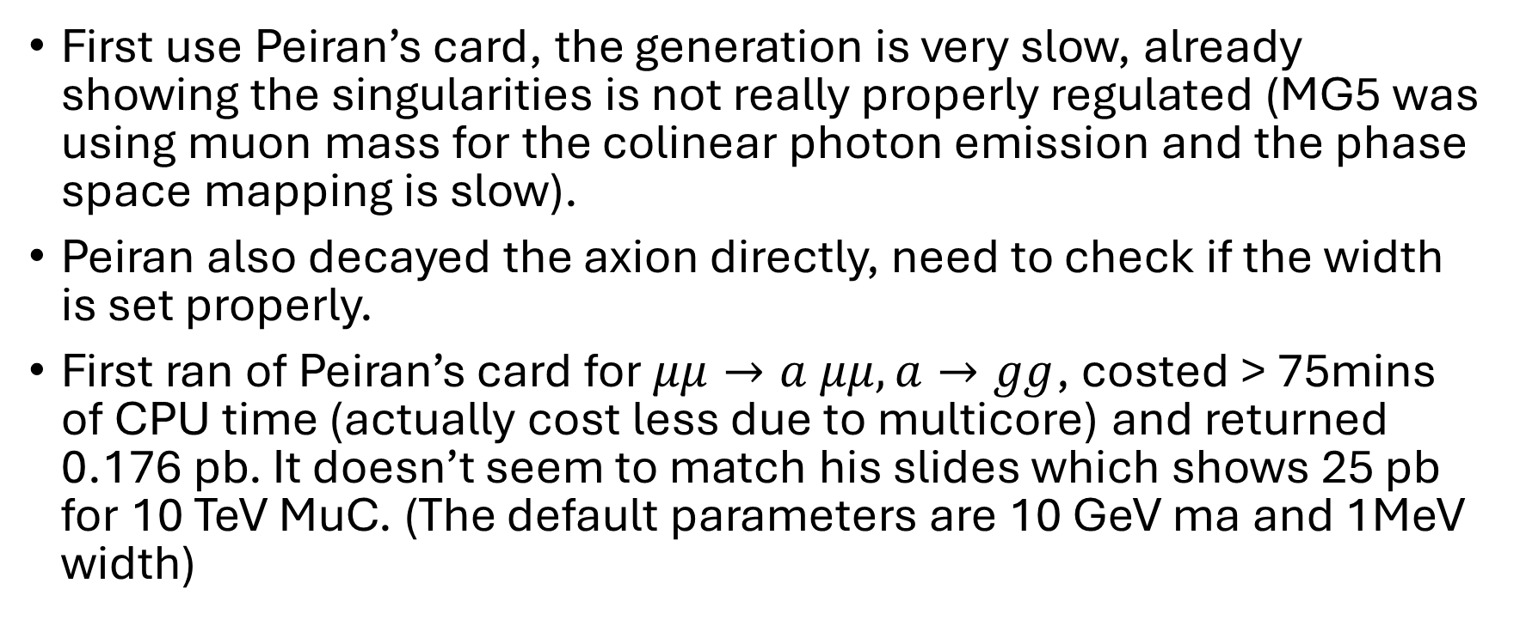
Checks
First use Peiran’s card, the generation is very slow, already showing the singularities is not really properly regulated (MG5 was using muon mass for the colinear photon emission and the phase space mapping is slow).
Peiran also decayed the axion directly, need to check if the width is set properly.
First ran of Peiran’s card for $μμ→a μμ, a→gg$, costed > 75mins of CPU time (actually cost less due to multicore) and returned 0.176 pb. It doesn’t seem to match his slides which shows 25 pb for 10 TeV MuC. (The default parameters are 10 GeV ma and 1MeV width)

Slide 4
Checks
Process | Note | Parameters | Result | COM | Comment
mm->amm, a>gg | Peiran’s default with wrong param. | ma=10 GeV, Wd=1 MeV | 0.176pb | 10 TeV | Do not match Peiran’s slides
mm->amm | Zhen | 10 GeV, 1 MeV | 118 pb | 10 TeV
 | Zhen | 1 TeV, 1 MeV | 25 pb | 10 TeV | Match Peiran old result; Coupling Normalization
mm->amm | Zhen with updated param. PR run card. | 1 TeV, 14.5 MeV | 10.6 ab |  | Matches Peiran 9/19 result. Insensitivity to IR cut might be from the heavy scales here.

Slide 5
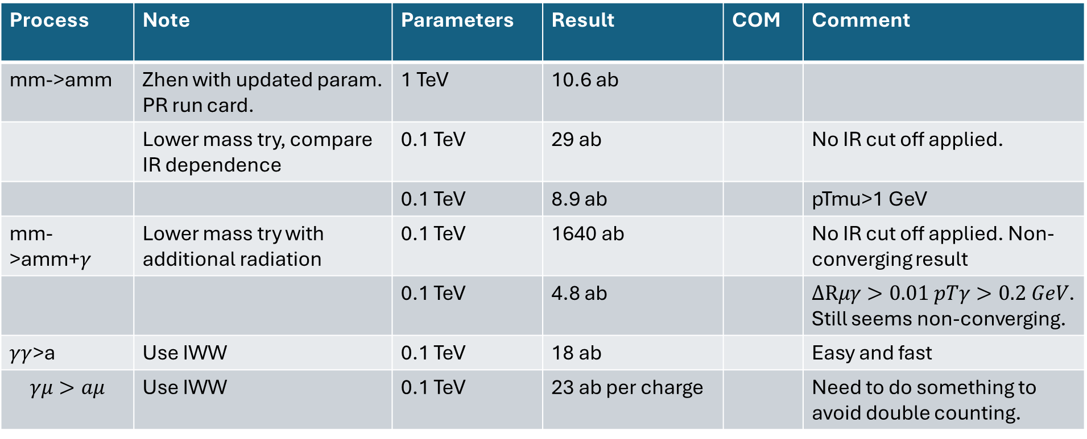
IR regularization & resummation
Process | Note | Parameters | Result | COM | Comment
mm->amm | Zhen with updated param. PR run card. | 1 TeV | 10.6 ab
 | Lower mass try, compare IR dependence | 0.1 TeV | 29 ab |  | No IR cut off applied.
 |  | 0.1 TeV | 8.9 ab |  | pTmu>1 GeV
mm->amm+$γ$ | Lower mass try with additional radiation | 0.1 TeV | 1640 ab |  | No IR cut off applied. Non-converging result
 |  | 0.1 TeV | 4.8 ab |  | $ΔRμγ>0.01 pTγ>0.2 GeV$. Still seems non-converging.
$γγ$>a | Use IWW | 0.1 TeV | 18 ab |  | Easy and fast
$$γμ>aμ$$ | Use IWW | 0.1 TeV | 23 ab per charge |  | Need to do something to avoid double counting.

Slide 6
cross checks

Slide 7
Checking Peiran’s New Process
All of the following used MG5_v3_6_0, which is underdevelopment and always some error message of index out of range thing. Now I want to rerun it from using the stable version MG5_v3_5_6.
Process | Note | Parameters | Result |  | Comment
Mm>ax mm | Lower mass try, compare IR dependence | 0.1 TeV | 29 ab |  | No IR cut off applied.
 |  | 0.1 TeV | 8.9 ab |  | pTmu>1 GeV
mu+ mu- > ax w+ mu- vm~ /ax mu+ h |  |  |  |  | Peiran’s calculation shows about 300x xs with pTl>10 GeV
 | My check | 0.1 TeV | 10^4 pb |  | Non-converging, no cut
 | My check | 0.1 TeV | 39.5 fb |  | 10^3 enhancement with pTl>10 GeV, MG5 convering
 | My check | 0.1 TeV | 140 fb |  | 10^4 enhancement with pTl>5 GeV, MG5 convering
mu+ mu- > ax w+ mu- vm~ /ax mu+ h vm | My check | 0.1 TeV | 140 fb |  | …
mu+ mu- > ax w+ mu- vm~ /ax mu+ h vm a | My check | 0.1 TeV | 2.76 fb |  | …

Slide 8
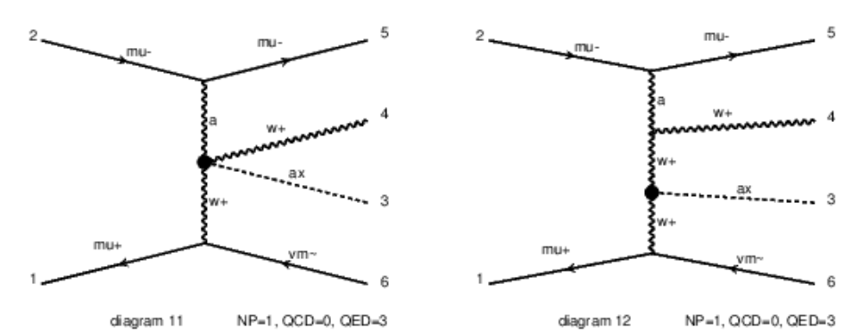
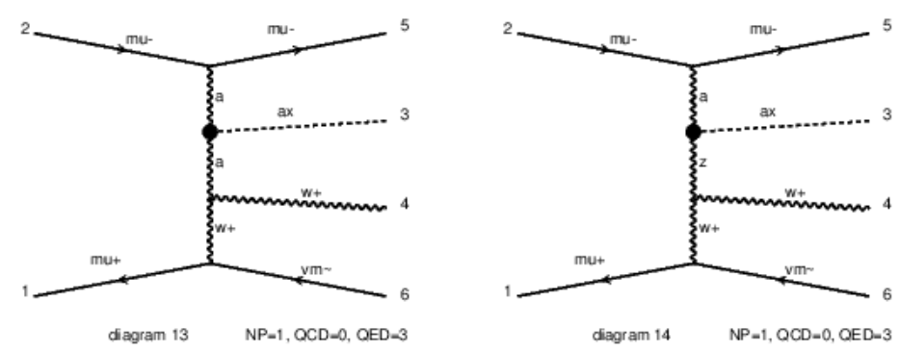
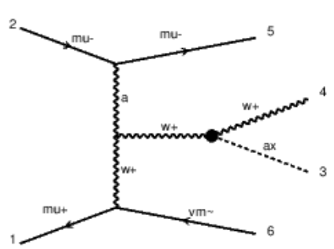
Process | Note | Parameters | Result |  | Comment
mu+ mu- > ax w+ mu- vm~ /ax mu+ h vm | My check | 0.1 TeV | 140 fb |  | …
mu+ mu- > ax w+ mu- vm~ /ax a | My check | 0.1 TeV | 2.75 fb |  | Removed photon
mu+ mu- > ax w+ mu- vm~ /ax mu+ h vm z | My check | 0.1 TeV | 133 fb |  | Removed Diagram#4. Only 8 diagrams left.
a mu+ > ax w+ vm~ / ax mu- h vm z | My check, IWW | 0.1 TeV | 1.3 fb |  | Clearly, the dominant contributions are photon initiated. Now with Photon PDF
a mu+ > ax w+ vm~ | My check, IWW | 0.1 TeV | 2.6 fb |  | …
a mu+ > ax w+ vm~ / ax mu- h vm z a | My check, IWW | 0.1 TeV | 0.64 fb |  | Removed one more photon diagram just to check who dominants. All the remaining are aWW coupling.

Slide 9
Process | Note | Parameters | Result |  | Comment
mu+ mu- > ax w+ mu- vm~ /ax mu+ h vm z | My check | 0.1 TeV | 133 fb |  | Removed Diagram#4. Only 8 diagrams left.
a mu+ > a > ax w+ vm~ / ax mu- h vm z | My check | 0.1 TeV | 0.54 fb |  | 4 diagrams, s-channel photon , not captured by IWW
a mu+ > ax w+ vm~ / ax mu- h vm z | My check, IWW | 0.1 TeV | 1.3 fb |  | Clearly, the dominant contributions are photon initiated. Now with Photon PDF
a mu+ > ax w+ vm~ | My check, IWW | 0.1 TeV | 2.6 fb |  | …
a mu+ > ax w+ vm~ / ax mu- h vm z a | My check, IWW | 0.1 TeV | 0.64 fb |  | Removed one more photon diagram just to check who dominants. All the remaining are aWW coupling.
a mu+ > ax w+ vm~ | My check, IWW | 0.1 TeV | 10^-9 pb |  | Turning off aWW

Slide 10
New cross checks
All of the following used MG5_v3_6_0, which is underdevelopment and always some error message of index out of range thing. Now I want to rerun it from using the stable version MG5_v3_5_6.

Slide 11
Process | Note | Parameters | Result |  | Comment
a mu+ > ax w+ vm~ | IWW | 0.1 TeV | 2.6 fb |  | With v3.6.0, event generation with trouble; cross section fine.
 | IWW | 0.1 TeV | 2.6 fb |  | Changed to v3.5.6 with event generated
 | IWW | 0.1 TeV | 2.6 fb |  | V3.5.6 without aBB coupling
 | IWW | 0.1 TeV | 6*10^-6 fb |  | V3.5.6 without aWW coupling
a mu+ > ax w+ vm~ / mu+ | IWW | 0.1 TeV | 2.6 fb |  | Removed 6 diagrams but still maintain gauge invariance
a mu+ > ax w+ vm~ | IWW | 1 TeV | 2.2 fb |  | Changed mass to TeV and checking the impact
mu+ mu- > vm~ vm ax /a z mu+ | Checking WW fusion | 0.1 TeV | 4.0 ab |  | Checking WW fusion alone.

Slide 12
Process | Note | Parameters | Result |  | Comment
a mu+ > ax w+ vm~ | IWW | 0.1 TeV | 2.6 fb |  | Changed to v3.5.6 with event generated
mu+ mu- > vm~ vm ax /a z mu+ | Checking WW fusion | 0.1 TeV | 4.0 ab |  | Checking WW fusion alone.
mu+ mu- > vm~ vm ax a /a z mu+ | Checking WW fusion+ photon | 0.1 TeV | 47 ab |  | Adding photon enhance it by 10
mu+ mu- > vm~ vm ax a /a z | + with ISR/FSR | 0.1 TeV | 48-51 ab |  | With pta>0.5 GeV (or 0 GeV but failed to generate)
mu+ mu- > vm~ vm ax a | + with ISR/FSR | 0.1 TeV | 179 ab |  | With pta>0.5 GeV
mu+ mu- > vm~ vm ax a | + with ISR/FSR | 1 TeV | 146 ab |  | With pta>0.5 GeV
ZL: I still don’t know how to think about these processes. Why there can be x100 enhancement. Need to look into MG5 diagram-by-diagram calculation I guess.

Slide 13
Process | Note | Parameters | Result |  | Comment
a a > ax | IWW | 0.1 TeV | 18 ab
a a > ax w+ w- | IWW | 0.1 TeV | 194 ab
a a > ax | IWW | 1 TeV | 7.6 ab
ZL: I still don’t know how to think about these processes. Why there can be x100 enhancement. Need to look into MG5 diagram-by-diagram calculation I guess.

Slide 14
Backups

Slide 15
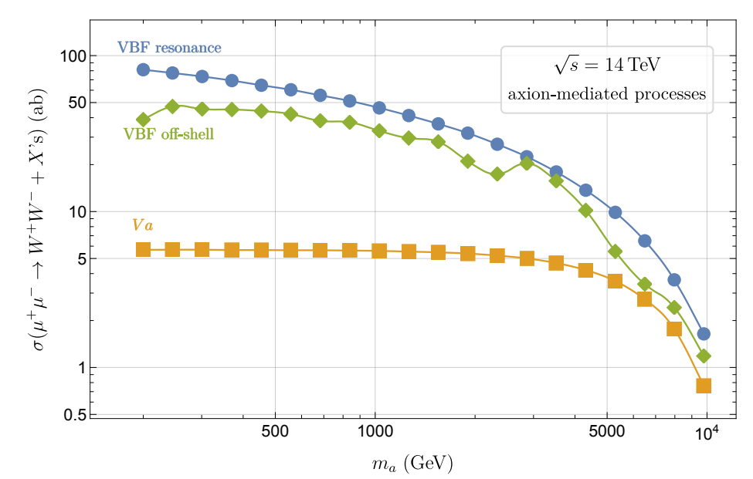
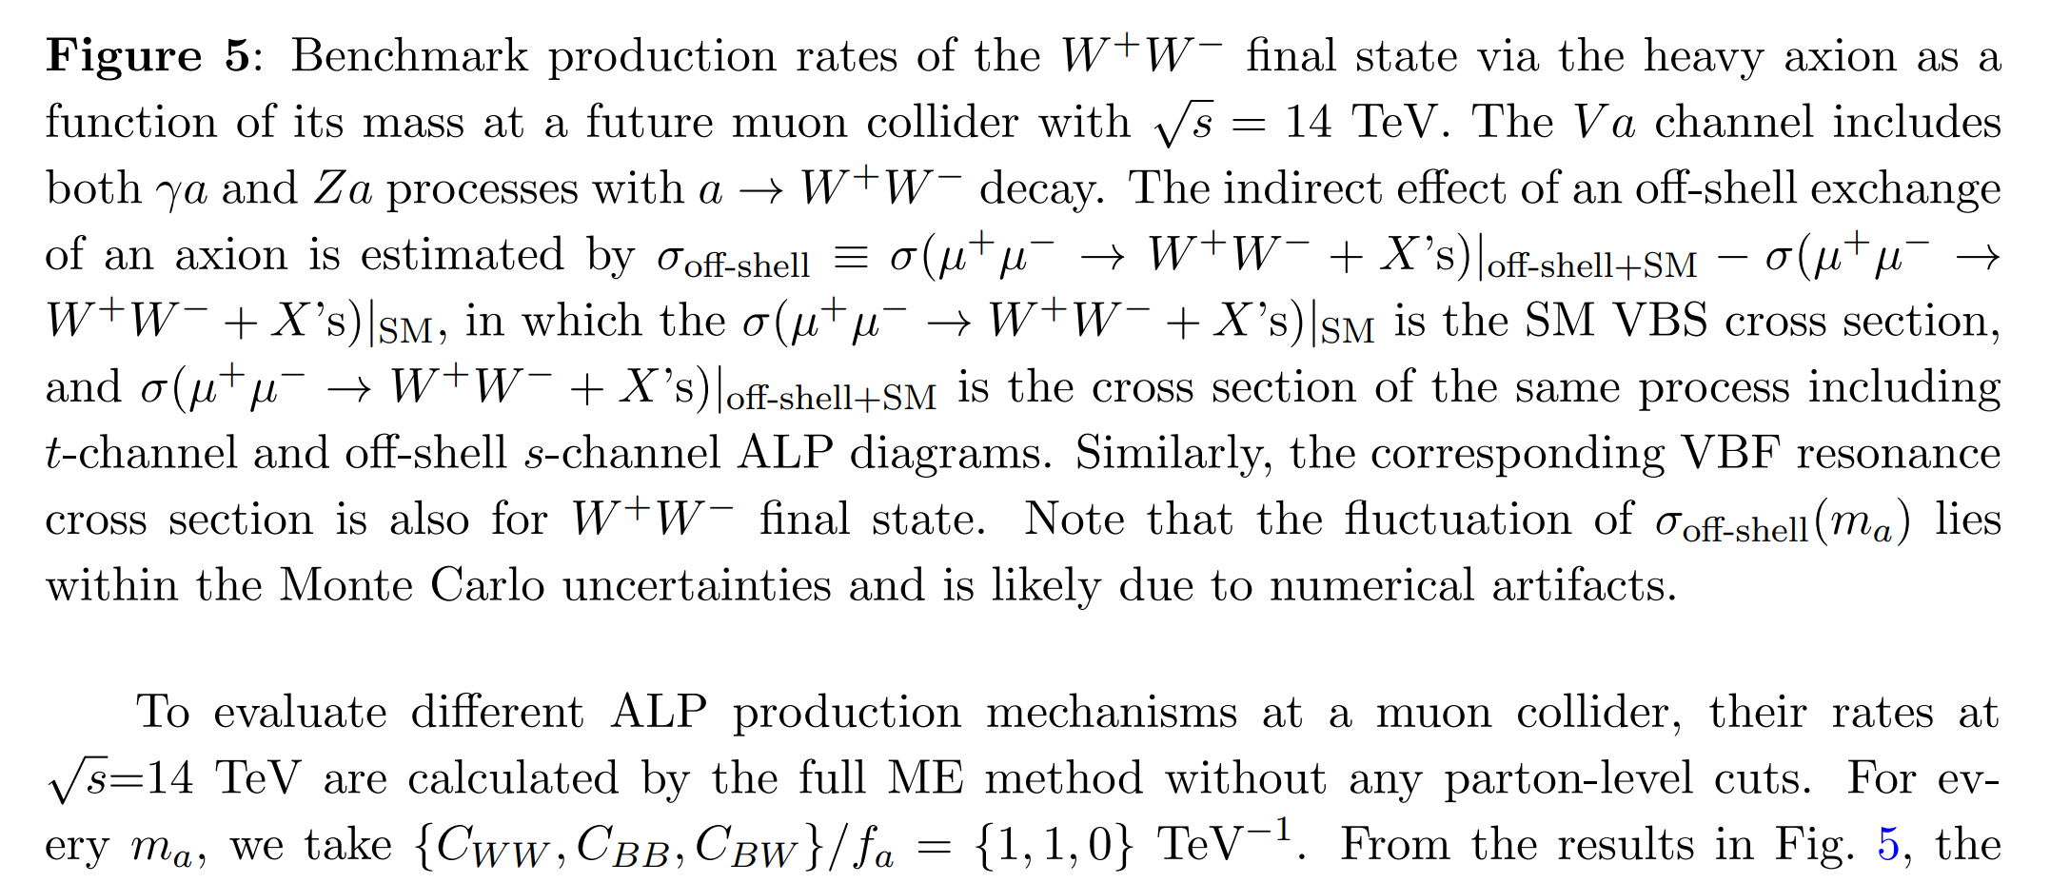
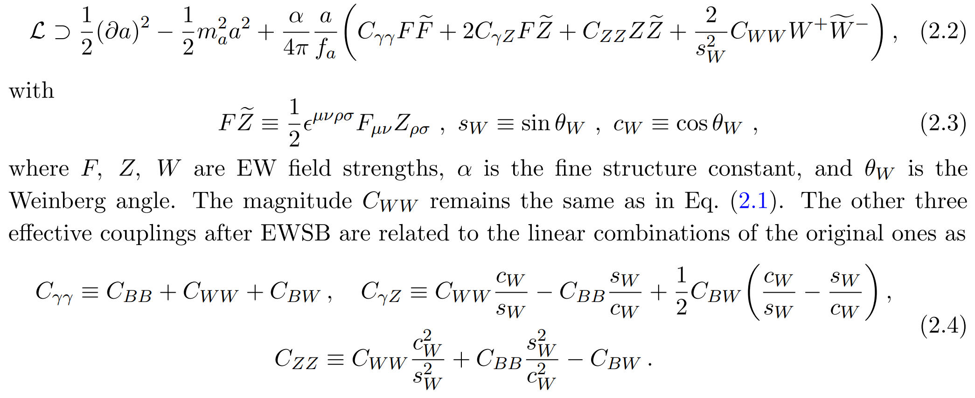
Additional Comparisons
This paper studied the pure aEWEW coupling without aGG.
ZL: looking into this paper in more details it seems to be of very limited reference value.
The CBW operator doesn’t even exist! They are barely using a totally different set of CP-even doublet scalar operators and relations to study axion. I don’t know what to say. How can Jiji and Lingfeng worked out studies like this.

Slide 16
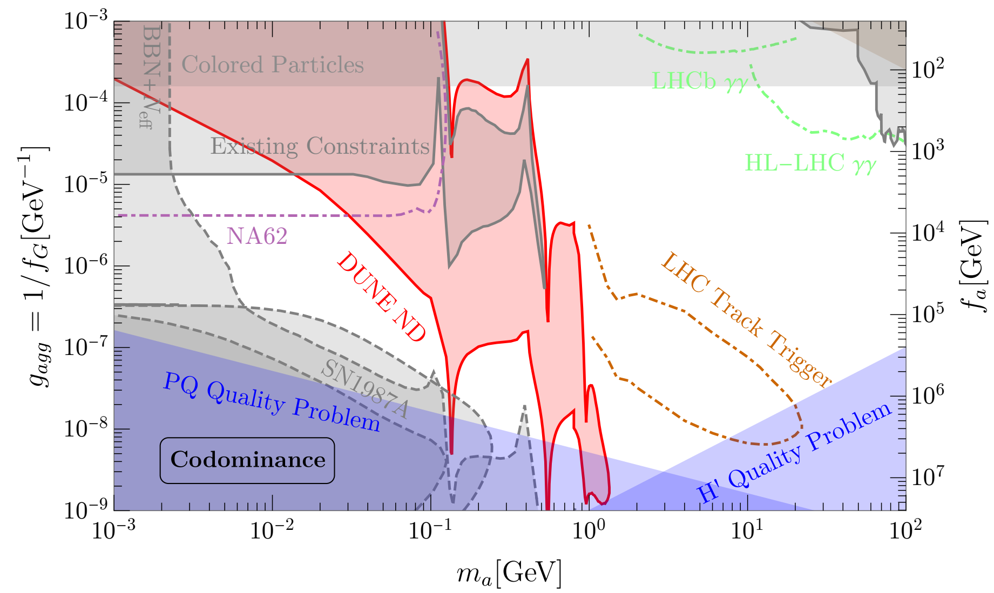

Slide 17
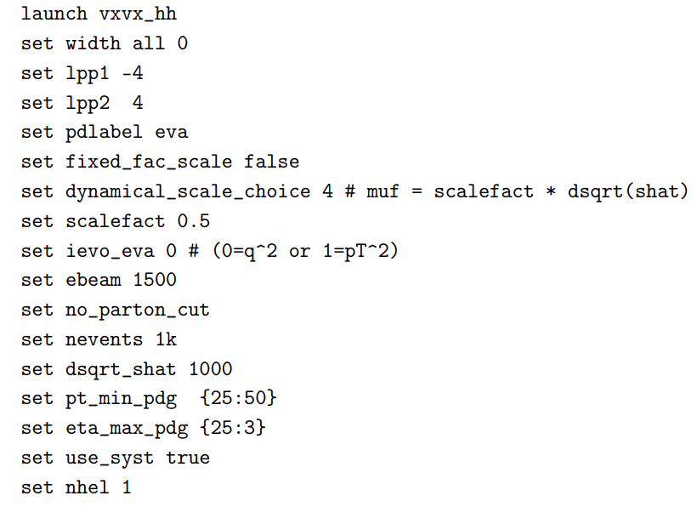
Additional Refs.
https://answers.launchpad.net/mg5amcnlo/+question/701029
Appendix of https://arxiv.org/pdf/2111.02442
Consider either using IWW or EVA

Slide 18
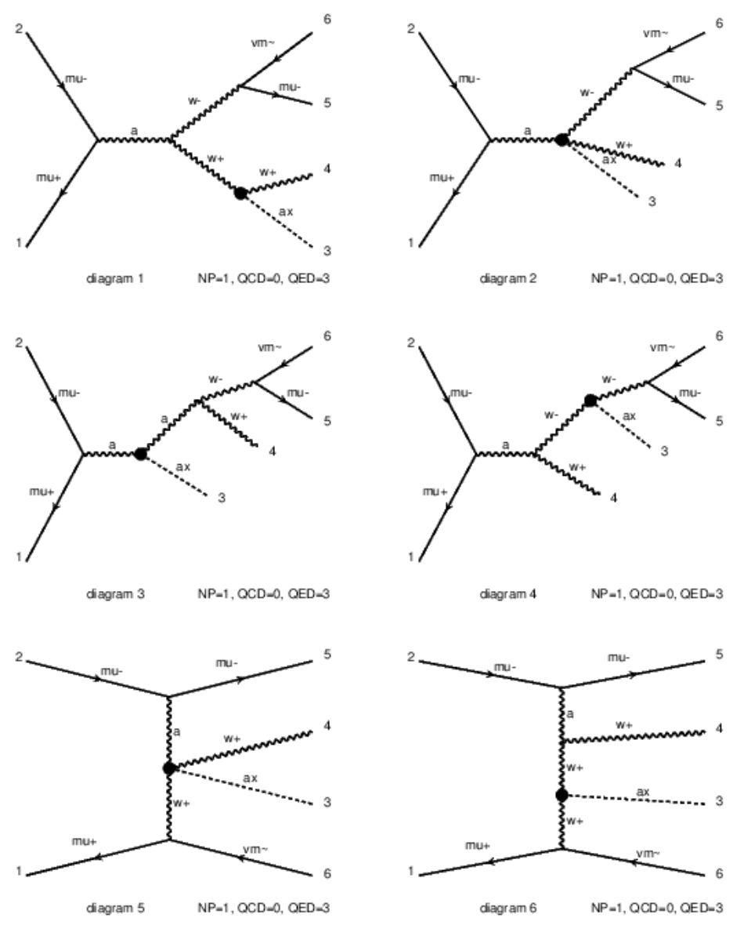
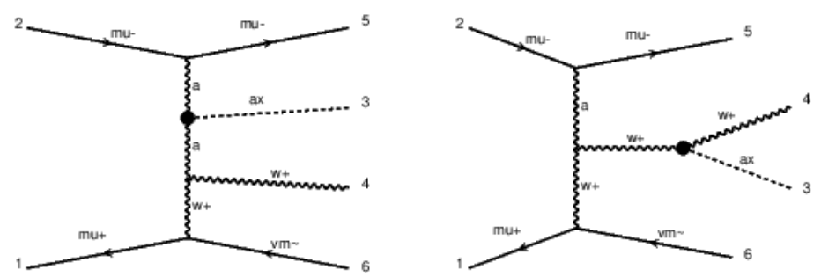
All 8 contributing diagrams
mu+ mu- > ax w+ mu- vm~ /ax mu+ h vm z

Slide 19
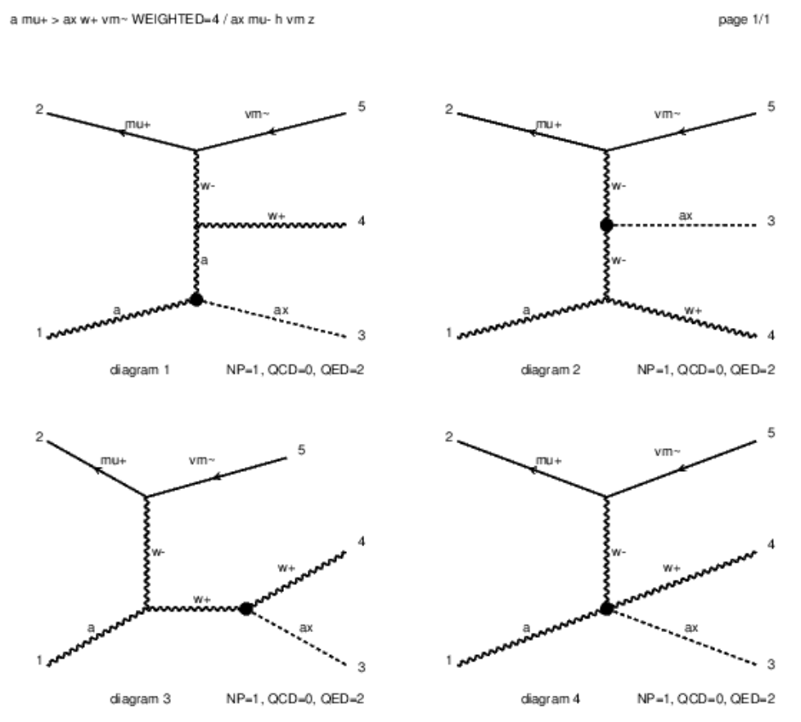
All 4 contributing diagrams
a mu+ > ax w+ vm~ WEIGHTED<=4 / ax mu- h vm z

Slide 20
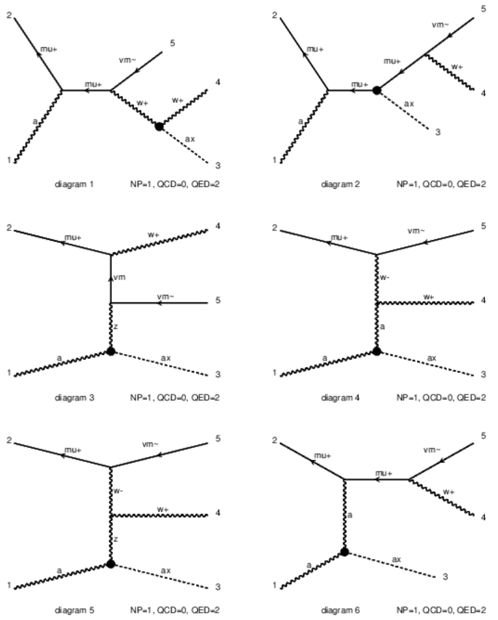
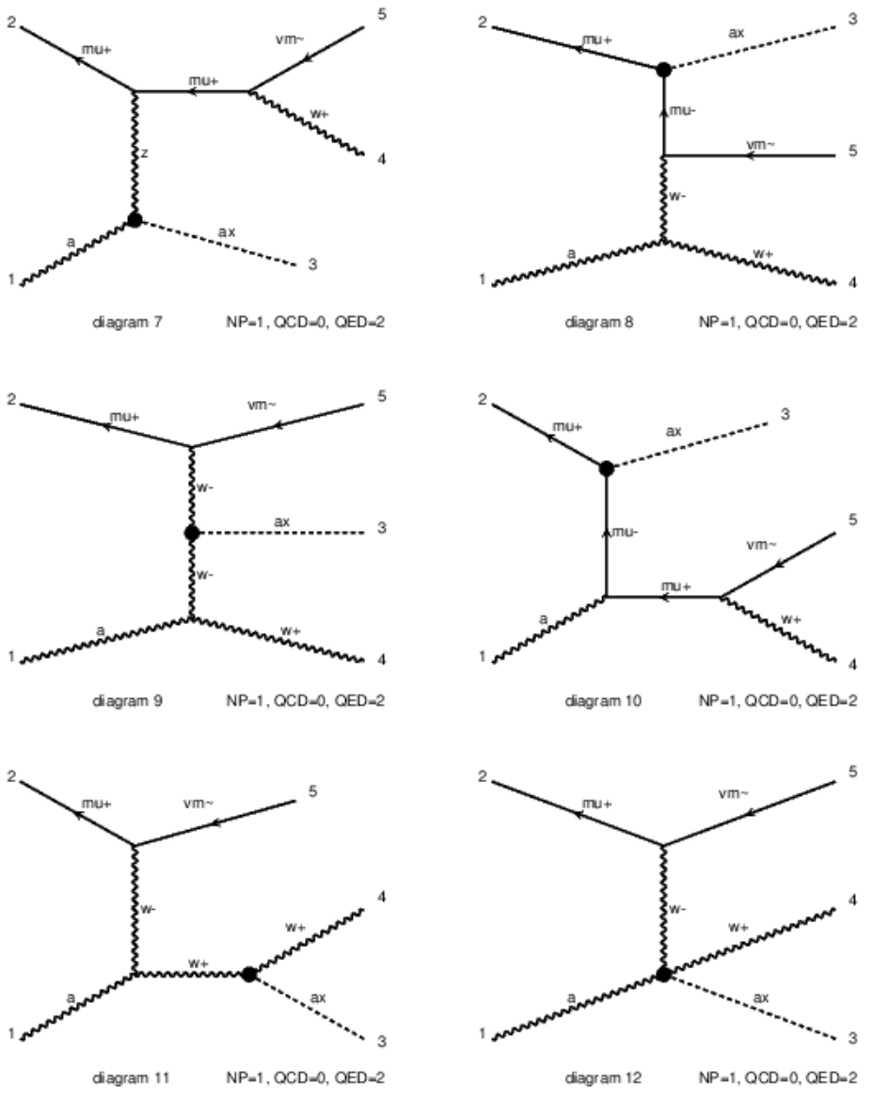
All 12 diagrams contributing with IWW

