Slide 1
Axion at Muon Collider
Ravneet Bedi, Tony Gherghetta, Soubhik Kumar, Peiran Li, Zhen Liu

Slide 2
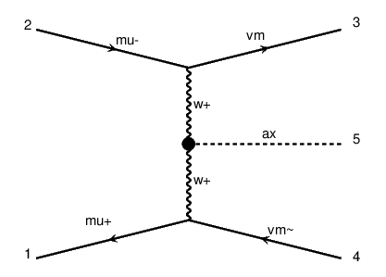
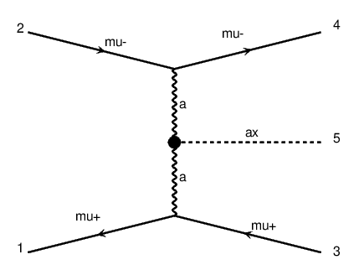


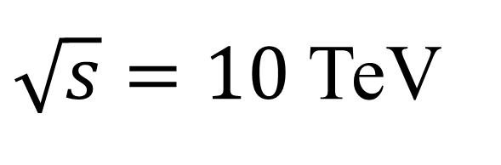
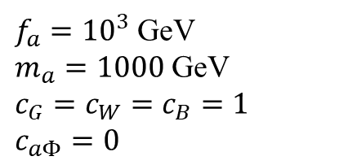

$\sqrt{s}=10$ TeV
Signal production
$$m_{h}<m_{a}<\sim TeV$$
$μμ→νν ax$
$σ=1.7$ pb
$μμ→μμ ax$
$σ=25$ pb
$m_{a}=1000$ GeV
$f_{a}={10}^{3}$ GeV
$m_{a}=1000$ GeV
$c_{G}=c_{W}=c_{B}=1$
$c_{aΦ}=0$

Slide 3
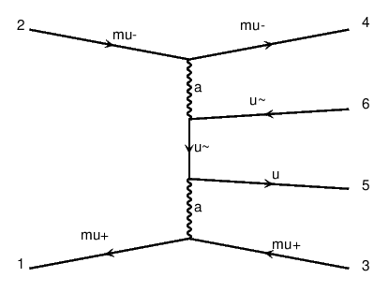
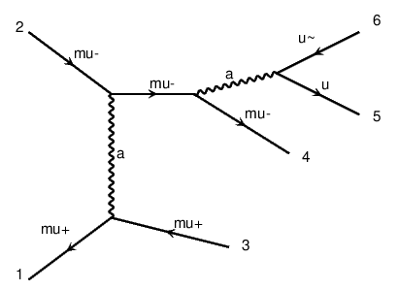
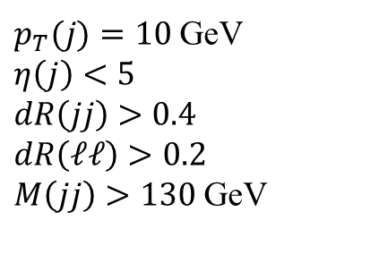
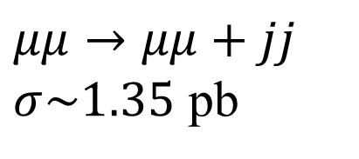
Background
$p_{T}(j)=10$ GeV
$η\left(j\right)<5$
$dR\left(jj\right)>0.4$
$dR\left(ℓℓ\right)>0.2$
$M\left(jj\right)>130$ GeV
$μμ→μμ+jj$
$σ\sim 1.35$ pb

Slide 4
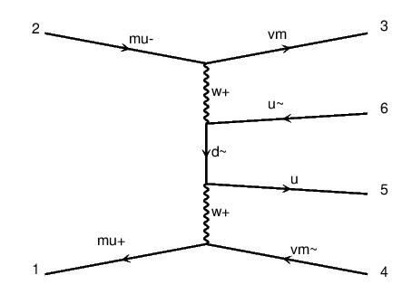
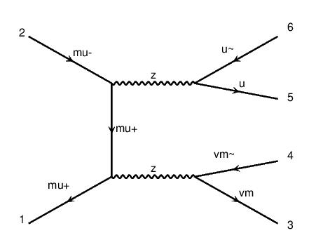
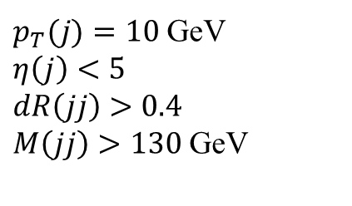
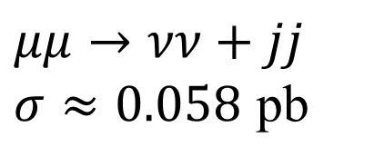
Background
$p_{T}(j)=10$ GeV
$η\left(j\right)<5$
$dR\left(jj\right)>0.4$
$M\left(jj\right)>130$ GeV
$μμ→νν+jj$
$σ≈0.058$ pb

Slide 5
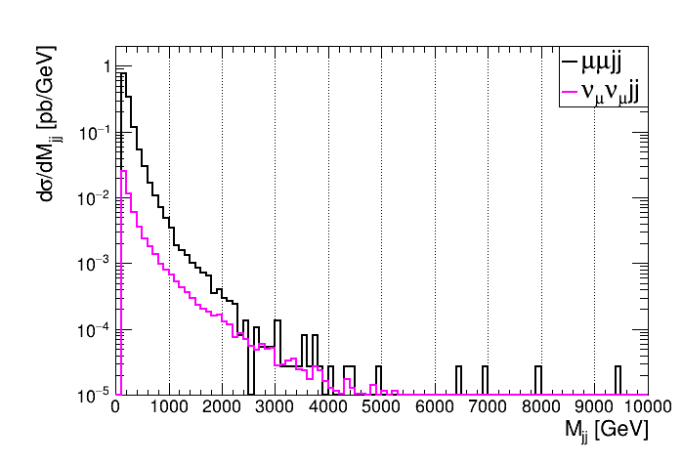


Background $M_{jj}$ distribusion
Mass window: $M\left(jj\right)$ within $m_{a}±5\%m_{a}$

Slide 6
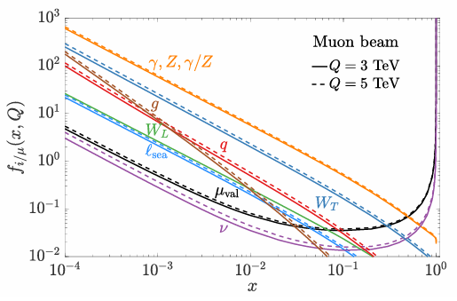
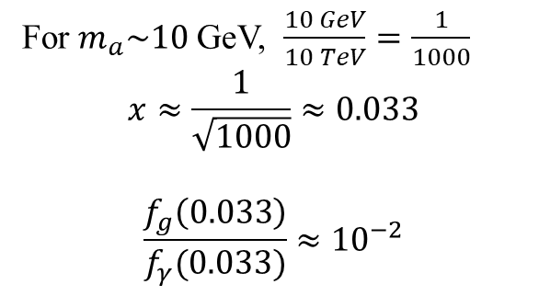
Muon PDF
For $m_{a}\sim 10$ GeV, $\frac{10 GeV}{10 TeV}=\frac{1}{1000}$
$$x≈\frac{1}{\sqrt{1000}}≈0.033$$
$$\frac{f_{g}\left(0.033\right)}{f_{γ}(0.033)}≈{10}^{−2}$$

Slide 7
2024/9/19

Slide 8
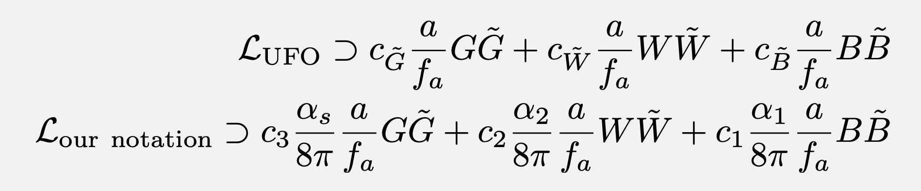
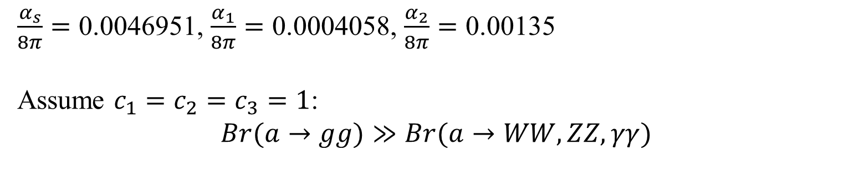
old
$\frac{α_{s}}{8π}=\text{0.0046951}$, $\frac{α_{1}}{8π}=\text{0.0004058}$, $\frac{α_{2}}{8π}=\text{0.00135}$
Assume $c_{1}=c_{2}=c_{3}=1$:
$$Br(a→gg)≫Br(a→WW,ZZ,γγ)$$

Slide 9
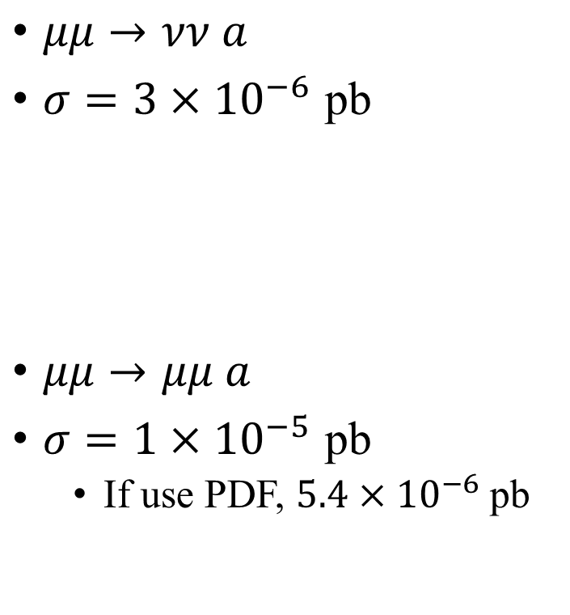

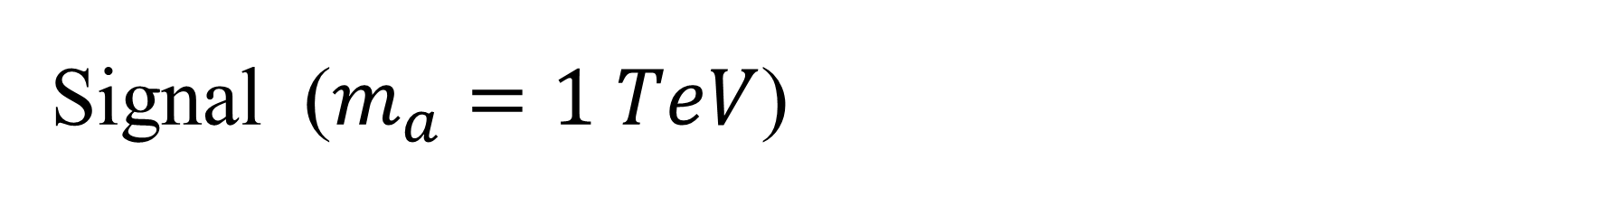

Signal ($m_{a}=1 TeV$)
$\frac{α_{s}}{8π}=\text{0.0046951}$, $\frac{α_{1}}{8π}=\text{0.0004058}$, $\frac{α_{2}}{8π}=\text{0.00135}$
$μμ→νν a$
$σ=3×{10}^{−6}$ pb
$μμ→μμ a$
$σ=1×{10}^{−5}$ pb
If use PDF, $5.4×{10}^{−6}$ pb
Both processes are comparable and need to be included.
$$γ$$
Other papers include both processes?
Yes,https://arxiv.org/pdf/2203.05484
$$γ$$

Slide 10

Background
$p_{T}(j)=10$ GeV
$η\left(j\right)<5$
$dR\left(jj\right)>0.4$
$dR\left(ℓℓ\right)>0.2$
$M\left(jj\right)>130$ GeV
$μμ→μμ+jj$
$σ\sim 1.35$ pb
LHC (diphoton, dijet)
$$γ$$
$$γ$$
$$γ$$
$$γ$$

Slide 11
Background
$p_{T}(j)=10$ GeV
$η\left(j\right)<5$
$dR\left(jj\right)>0.4$
$M\left(jj\right)>130$ GeV
$μμ→νν+jj$
$σ≈0.058$ pb

Slide 12
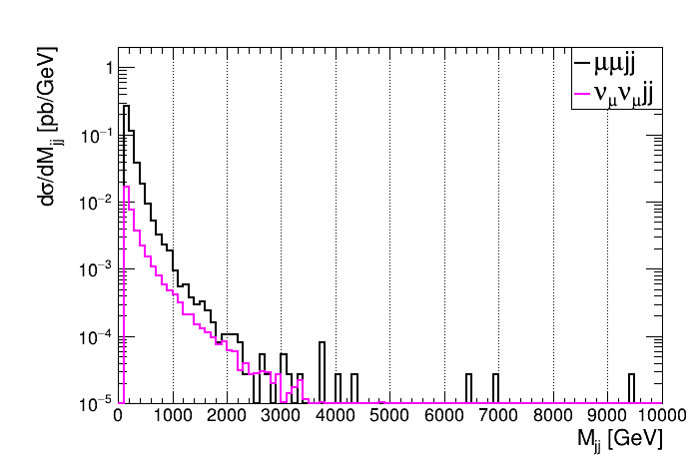
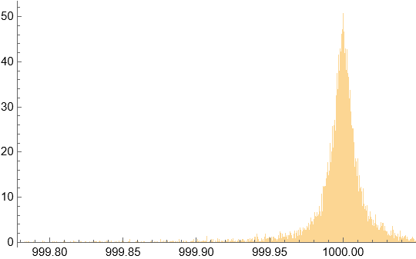
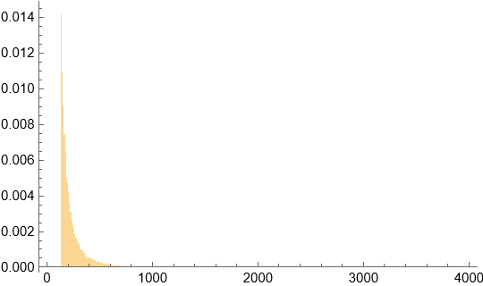
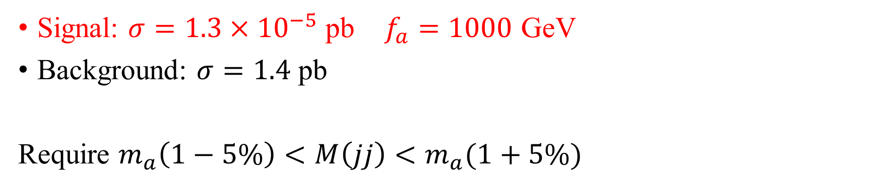


$m_{a}=1 TeV$
Signal: $σ=1.3×{10}^{−5}$ pb $f_{a}=1000$ GeV
Background: $σ=1.4$ pb
Require $m_{a}\left(1−5\%\right)<M\left(jj\right)<m_{a}(1+5\%)$
Probability density
Probability density
Signal
Background
$M\left(jj\right)$ [GeV]
$M\left(jj\right)$ [GeV]

Slide 13
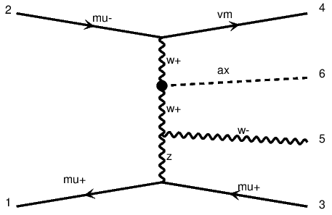
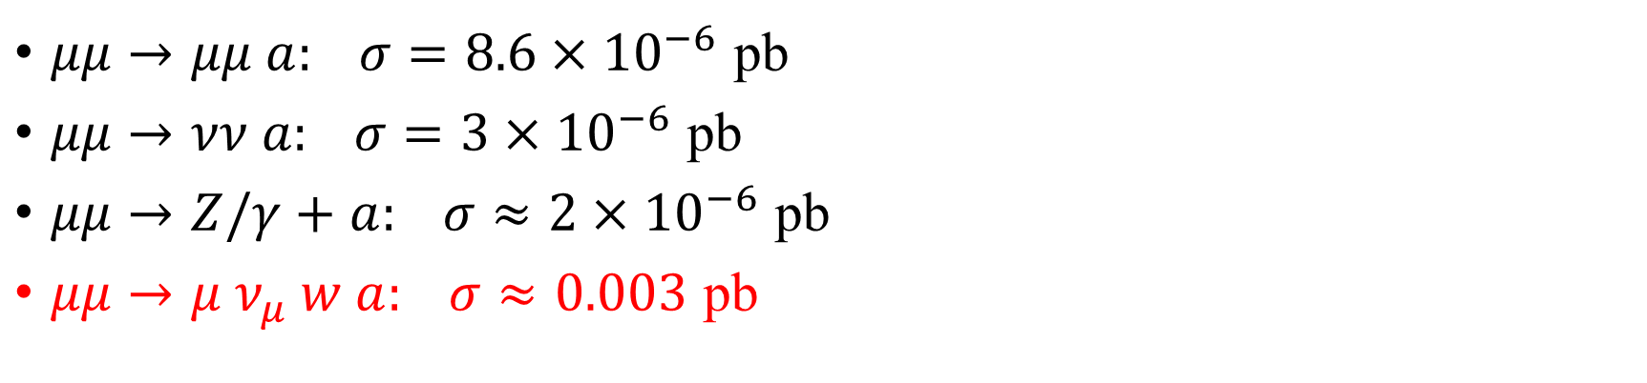
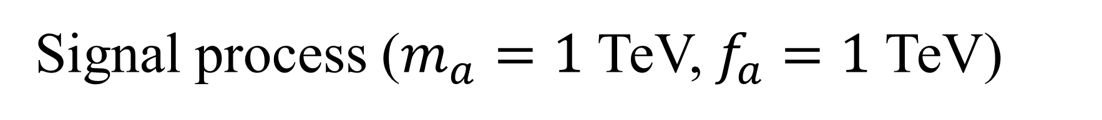
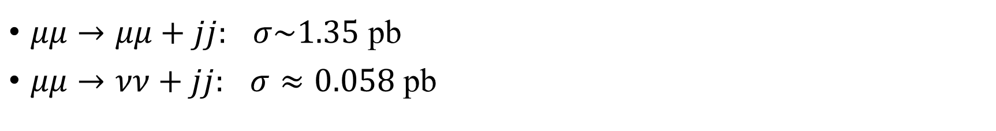
Signal process ($m_{a}=1$ TeV, $f_{a}=1$ TeV)
$μμ→μμ a: σ=8.6×{10}^{−6}$ pb
$μμ→νν a: σ=3×{10}^{−6}$ pb
$μμ→Z/γ+a: σ≈2×{10}^{−6}$ pb
$μμ→μ ν_{μ} w a: σ≈0.003$ pb
Bkg process
$μμ→μμ+jj:$ $σ\sim 1.35$ pb
$μμ→νν+jj:$ $σ≈0.058$ pb

Slide 14
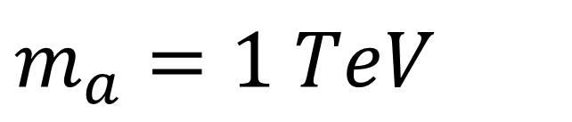


$m_{a}=1 TeV$
Probability density
Probability density
Signal
Background
$M\left(jj\right)$ [GeV]
$M\left(jj\right)$ [GeV]

Slide 15
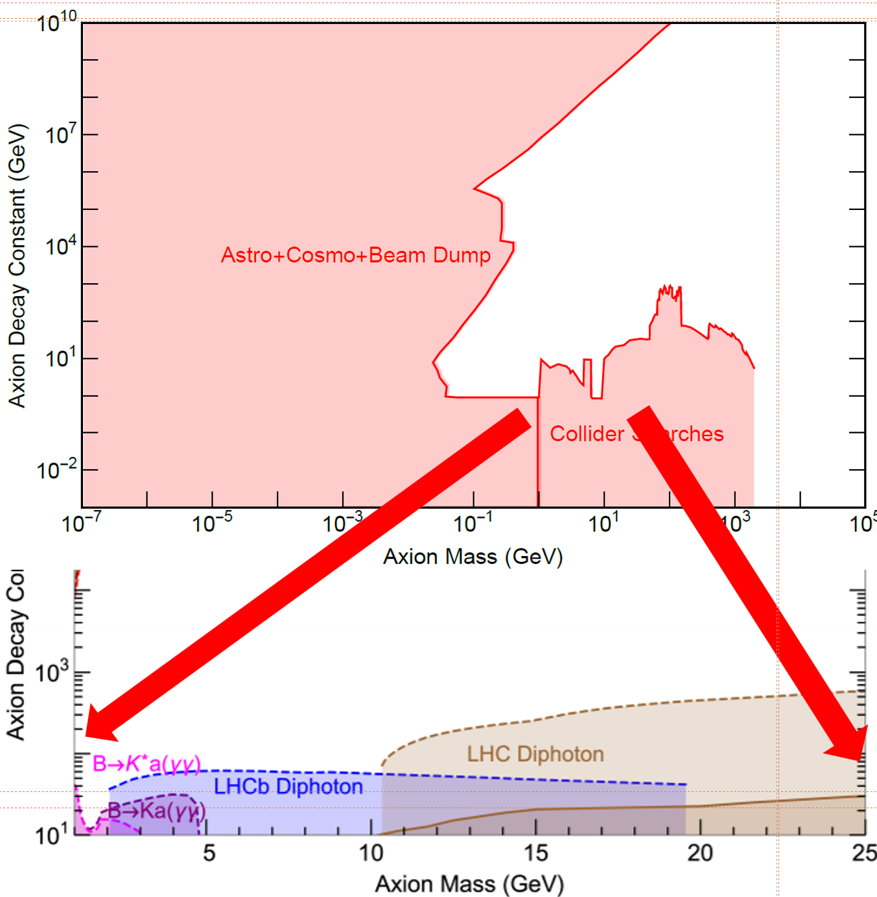
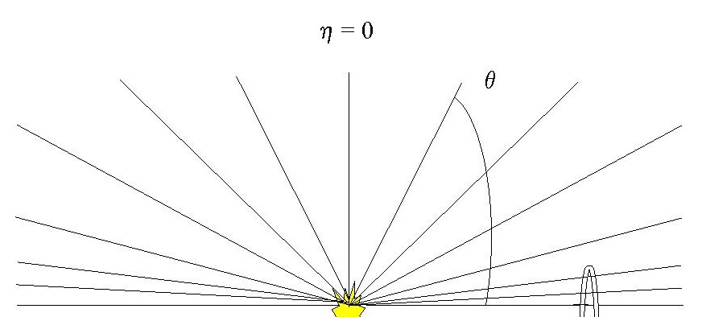
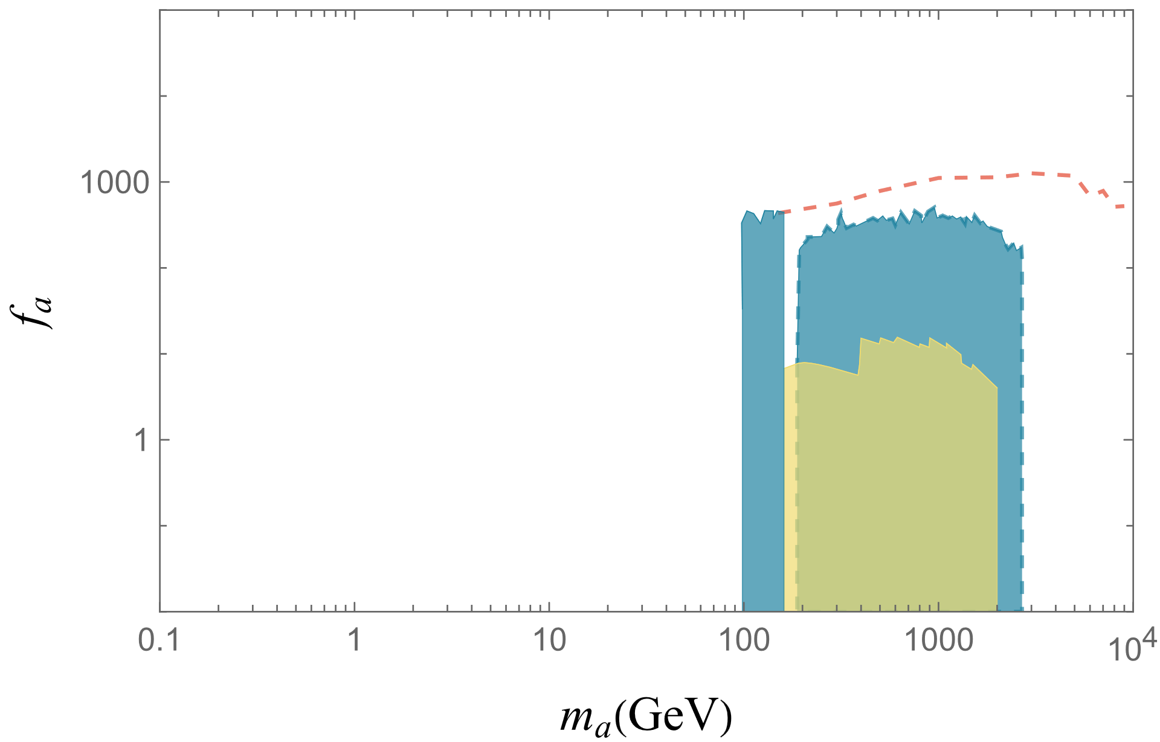
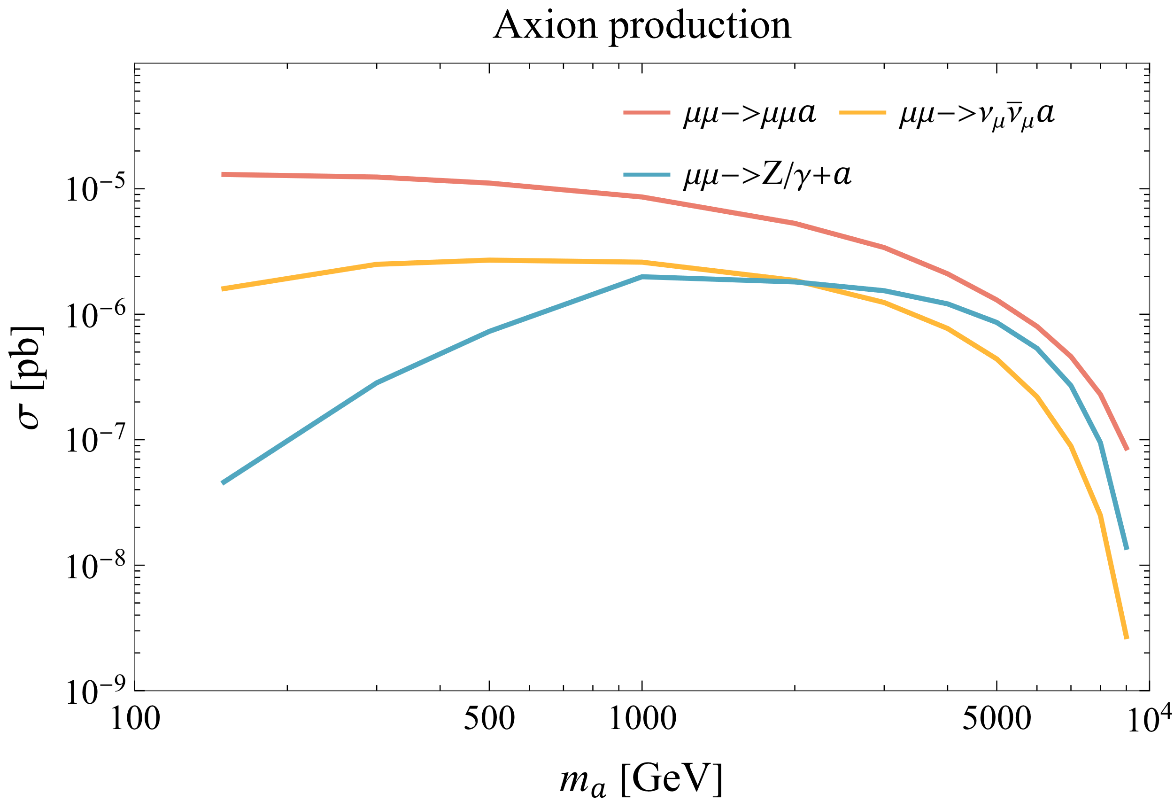

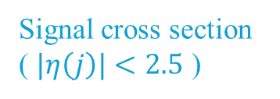
1911.12364
$f_{a}\sim 1000$ GeV
Signal cross section
( $|η\left(j\right)|<2.5$ )

Slide 16
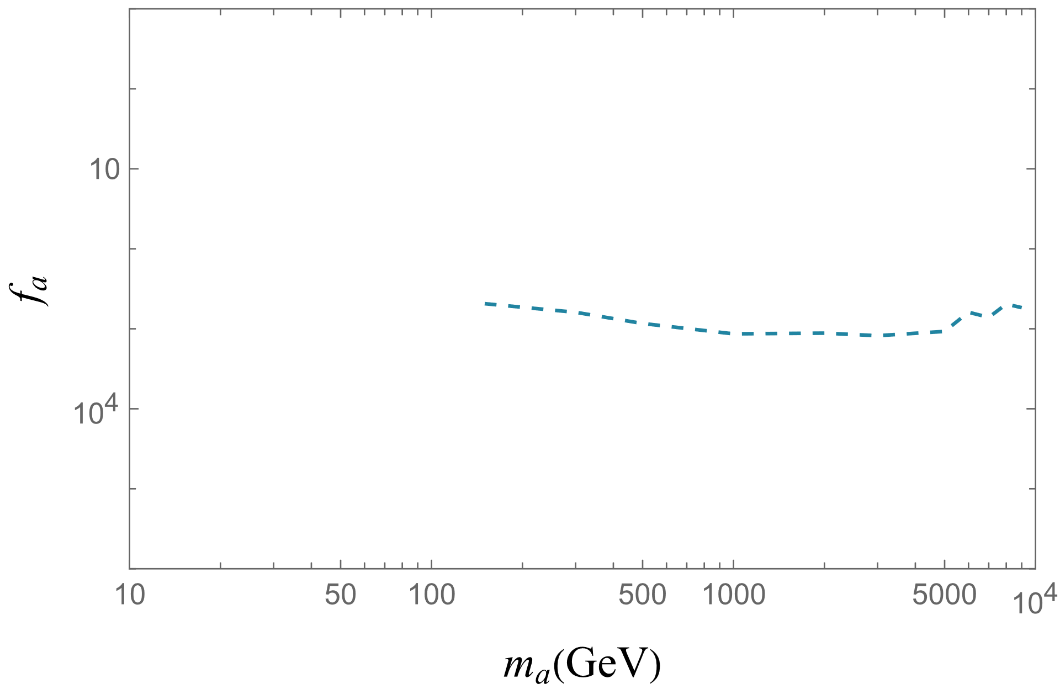
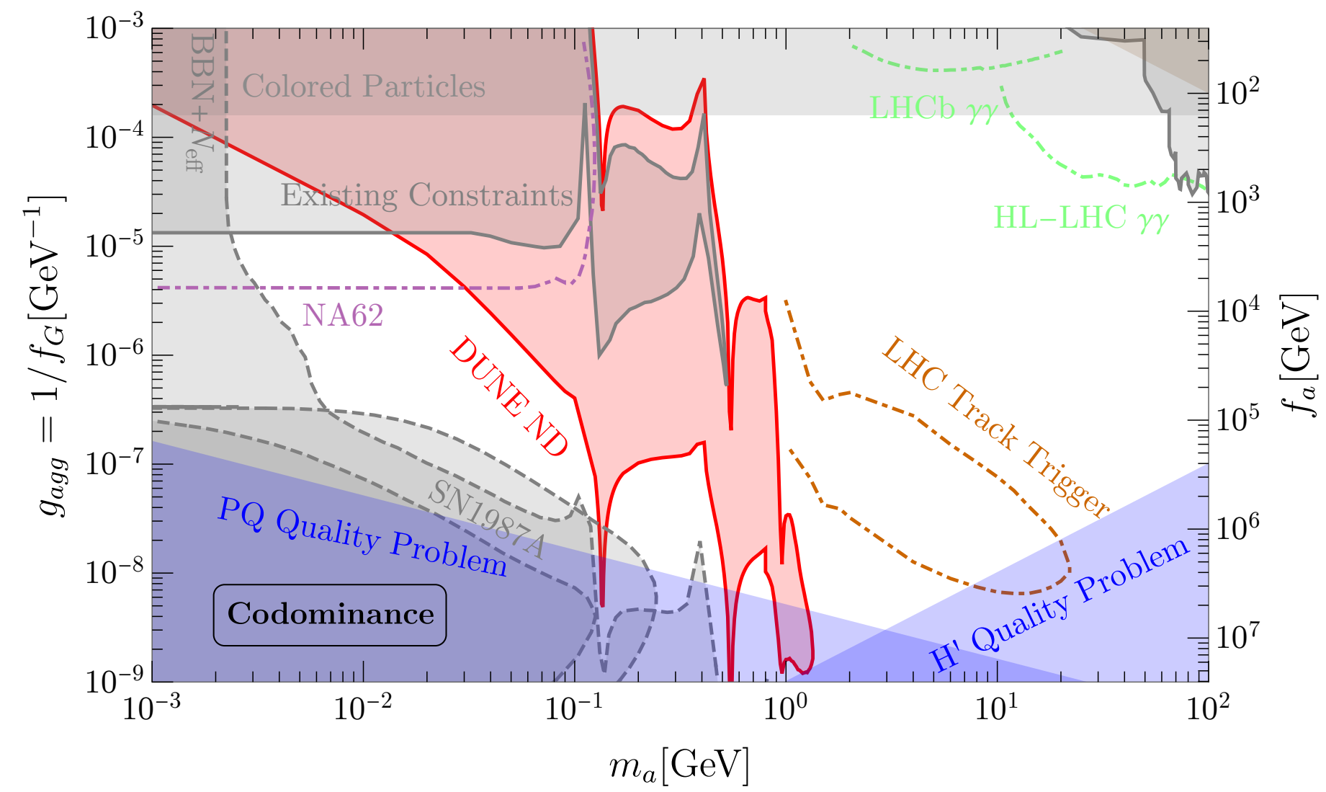

Slide 17
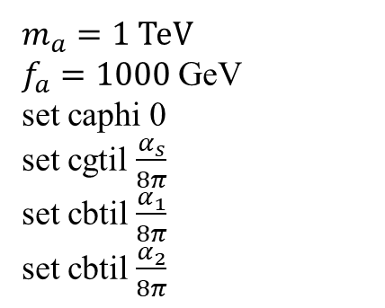
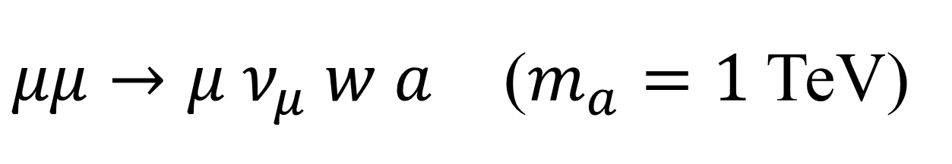

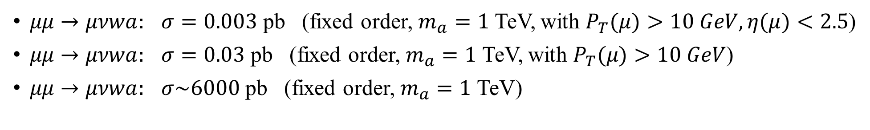
$μμ→μ ν_{μ} w a$ ($m_{a}=1$ TeV)
$μμ→μνwa:$ $σ=0.003$ pb (fixed order, $m_{a}=1$ TeV, with $P_{T}(μ)>10 GeV, η(μ)<2.5$)
$μμ→μνwa:$ $σ=0.03$ pb (fixed order, $m_{a}=1$ TeV, with $P_{T}(μ)>10 GeV$)
$μμ→μνwa:$ $σ\sim 6000$ pb (fixed order, $m_{a}=1$ TeV)
$m_{a}=1$ TeV
$f_{a}=1000$ GeV
set caphi 0
set cgtil $\frac{α_{s}}{8π}$
set cbtil $\frac{α_{1}}{8π}$
set cbtil $\frac{α_{2}}{8π}$
$$γ$$

Slide 18
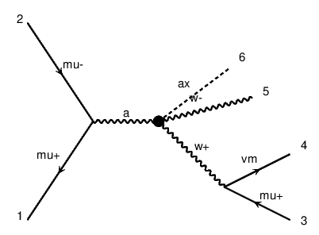

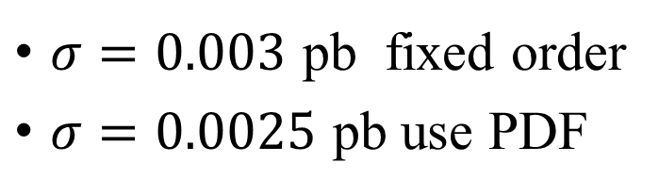

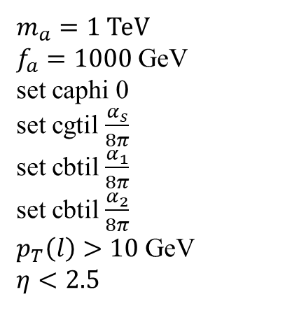
$μμ→μ ν_{μ} w a$ ($m_{a}=1$ TeV)
$m_{a}=1$ TeV
$f_{a}=1000$ GeV
set caphi 0
set cgtil $\frac{α_{s}}{8π}$
set cbtil $\frac{α_{1}}{8π}$
set cbtil $\frac{α_{2}}{8π}$
$p_{T}\left(l\right)>10$ GeV
$η<2.5$
$σ=0.003$ pb fixed order
$σ=0.0025$ pb use PDF
$$Z$$
$$γ$$

Slide 19
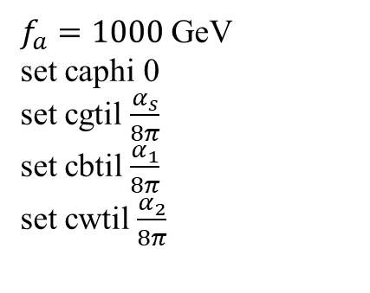
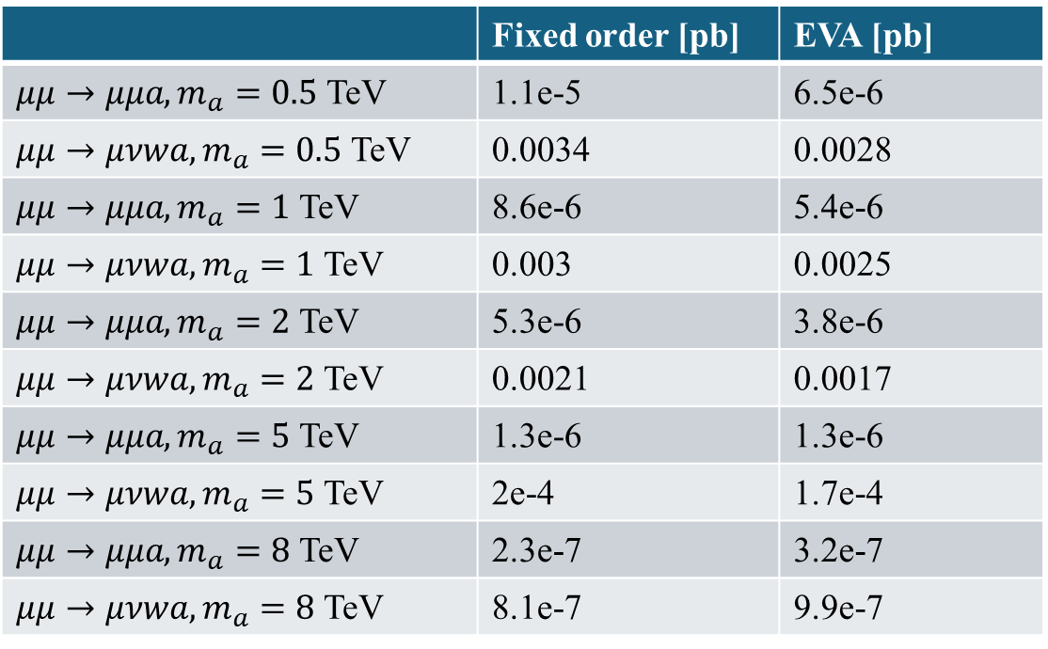
Fixed order vs. PDF computation
$f_{a}=1000$ GeV
set caphi 0
set cgtil $\frac{α_{s}}{8π}$
set cbtil $\frac{α_{1}}{8π}$
set cwtil $\frac{α_{2}}{8π}$
 | Fixed order [pb] | EVA [pb]
$μμ→μμa, m_{a}=0.5$ TeV | 1.1e-5 | 6.5e-6
$μμ→μνwa, m_{a}=0.5$ TeV | 0.0034 | 0.0028
$μμ→μμa, m_{a}=1$ TeV | 8.6e-6 | 5.4e-6
$μμ→μνwa, m_{a}=1$ TeV | 0.003 | 0.0025
$μμ→μμa, m_{a}=2$ TeV | 5.3e-6 | 3.8e-6
$μμ→μνwa, m_{a}=2$ TeV | 0.0021 | 0.0017
$μμ→μμa, m_{a}=5$ TeV | 1.3e-6 | 1.3e-6
$μμ→μνwa, m_{a}=5$ TeV | 2e-4 | 1.7e-4
$μμ→μμa, m_{a}=8$ TeV | 2.3e-7 | 3.2e-7
$μμ→μνwa, m_{a}=8$ TeV | 8.1e-7 | 9.9e-7
For fixed order $μμ→μνwa$, $p_{T}\left(l\right)>10$ GeV and $η\left(l\right)<2.5$

Slide 20
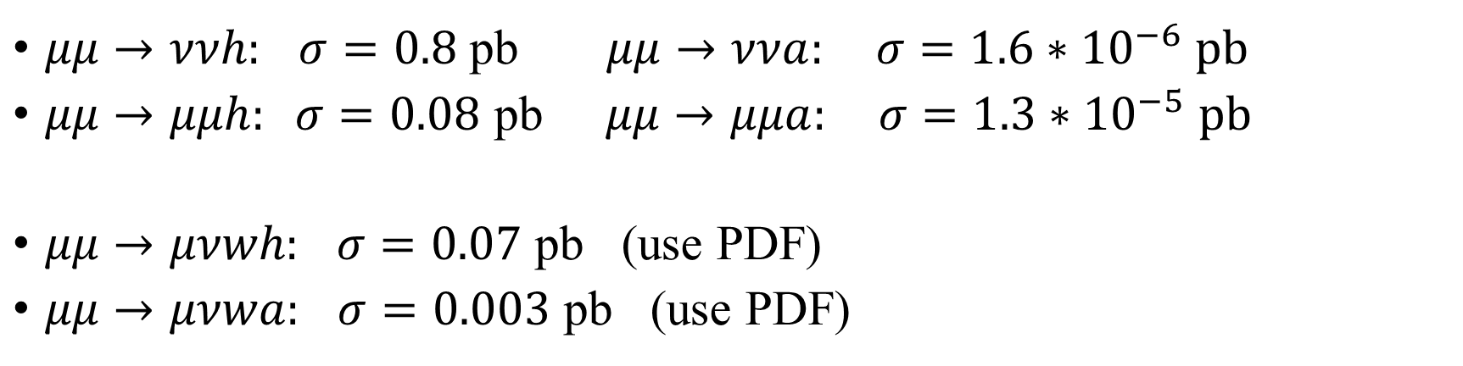
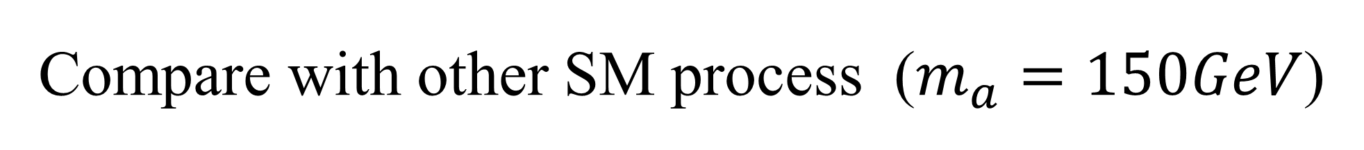
Compare with other SM process ($m_{a}=150GeV$)
$μμ→ννh:$ $σ=0.8$ pb $μμ→ννa: σ={1.6∗10}^{−6}$ pb
$μμ→μμh: σ=0.08$ pb $μμ→μμa: σ={1.3∗10}^{−5}$ pb
$μμ→μνwh:$ $σ=0.07$ pb (use PDF)
$μμ→μνwa:$ $σ=0.003$ pb (use PDF)
$$σ=∫∫f_{W_{L}}(x_{1})f_{γ}(x_{2})∗\hat{σ}\left(W_{L}γ→W+h\right)dx_{1}dx_{2}$$

Slide 21
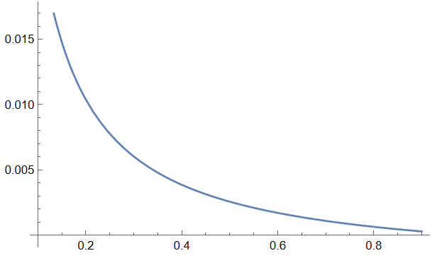
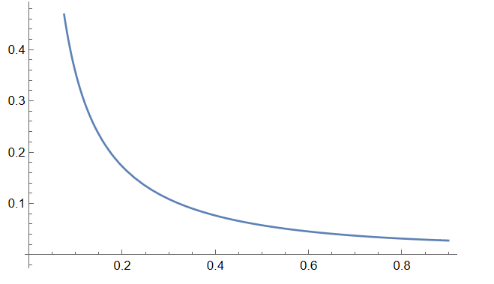



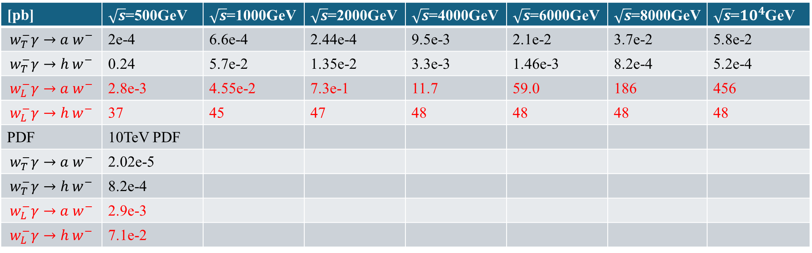

$m_{a}=125$ GeV
[pb] | $\sqrt{s}$=500GeV | $\sqrt{s}$=1000GeV | $\sqrt{s}$=2000GeV | $\sqrt{s}$=4000GeV | $\sqrt{s}$=6000GeV | $\sqrt{s}$=8000GeV | $\sqrt{s}$=$10^{4}$GeV
$$w_{T}^{−}γ→a w^{−}$$ | 2e-4 | 6.6e-4 | 2.44e-4 | 9.5e-3 | 2.1e-2 | 3.7e-2 | 5.8e-2
$$w_{T}^{−}γ→h w^{−}$$ | 0.24 | 5.7e-2 | 1.35e-2 | 3.3e-3 | 1.46e-3 | 8.2e-4 | 5.2e-4
$$w_{L}^{−}γ→a w^{−}$$ | 2.8e-3 | 4.55e-2 | 7.3e-1 | 11.7 | 59.0 | 186 | 456
$$w_{L}^{−}γ→h w^{−}$$ | 37 | 45 | 47 | 48 | 48 | 48 | 48
PDF | 10TeV PDF
$$w_{T}^{−}γ→a w^{−}$$ | 2.02e-5
$$w_{T}^{−}γ→h w^{−}$$ | 8.2e-4
$$w_{L}^{−}γ→a w^{−}$$ | 2.9e-3
$$w_{L}^{−}γ→h w^{−}$$ | 7.1e-2
$$σ\left(w_{L}^{−}γ→a w^{−}\right)\sim E^{4}$$
$$f_{W_{L}/μ}(x)$$
$$f_{γ/μ}(x)$$

Slide 22
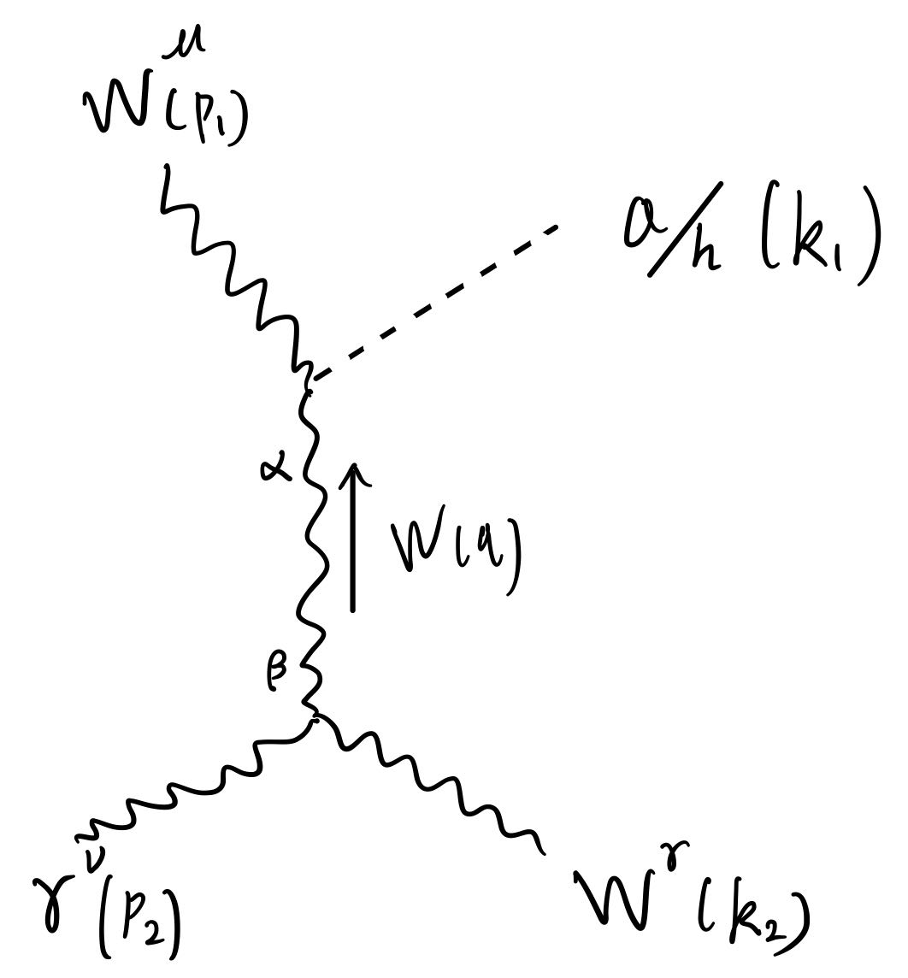



Feynman Amplitude
$ε^{ν}\left(p_{2}\right)\left(ie\right)\left[g^{νβ}{\left(p_{2}+q\right)}^{γ}+g^{βγ}{\left(−q−k_{2}\right)}^{ν}+g^{γν}{\left(k_{2}−p_{2}\right)}^{β}\right]ε^{γ}\left(k_{2}\right)$
$⋅\frac{i\left(−g_{βα}+\frac{q_{β}q_{α}}{m_{W}^{2}}\right)}{q^{2}−m_{W}^{2}}ε^{μ}\left(p_{1}\right)∗\left(\frac{−4i}{f_{a}}\frac{α_{2}}{8π}\right)q^{σ}p_{1}^{δ}ε^{αμσδ}$
$ε^{ν}\left(p_{2}\right)\left(ie\right)\left[g^{νβ}{\left(p_{2}+q\right)}^{γ}+g^{βγ}{\left(−q−k_{2}\right)}^{ν}+g^{γν}{\left(k_{2}−p_{2}\right)}^{β}\right]ε^{γ}\left(k_{2}\right)$
$⋅\frac{i\left(−g_{βα}+\frac{q_{β}q_{α}}{m_{W}^{2}}\right)}{q^{2}−m_{W}^{2}}ε^{μ}\left(p_{1}\right)∗\left(\frac{i}{2}v∗4πα_{2}\right)g^{μα}$
$$\frac{σ_{SM}}{σ_{BSM}}={\left(\frac{M_{h}}{M_{a}}\right)}^{2}\sim {\left(\frac{2πv}{4E^{2}}∗8πf_{a}\right)}^{2}={\left(\frac{4π^{2}{vf}_{a}}{E^{2}}\right)}^{2}={\left(\frac{{10}^{7}}{E^{2}}\right)}^{2}$$
$$q=k_{1}−p_{1}$$

Slide 23

Use current signal and background to get constraints, comparing with others.
$μμ→μμ a$
$μμ→νν a$
$μμ→Z/γ+a$
$μμ→μμ+jj$
$μμ→νν+jj$
Check the validity of $μμ→μνwa$
Convolute with muon PDF
$$σ=∫∫f_{W_{L}}(x_{1})f_{γ}(x_{2})∗\hat{σ}\left(W_{L}γ→W+a\right)dx_{1}dx_{2}$$

Slide 24






$gg→a→γγ$ run1
$$pp→H→γγ$$
$gg→a→γγ$ run2
$${m_{a}=f}_{a}$$
Signal cross section
( $|η\left(j\right)|<2.5$ )
https://arxiv.org/pdf/2102.08971

Slide 25




$$\frac{1}{4}⋅\frac{c_{γ}}{Λ}⋅aF\tilde{F}$$
$c_{γ}=c_{2}+c_{1}=2$
$\frac{1}{Λ}=\frac{α_{EM}}{2π}⋅\frac{1}{f_{a}}$
$Br_{a→gg}=0.97, Br_{a→γγ}=2.2×{10}^{−3}$
$σ_{pp→a}$ is large
$c_{γ}=1$
$\frac{1}{Λ}$
$Br_{a→γγ}=1$
$σ_{pp→a}$ is small
https://arxiv.org/pdf/2102.08971

Slide 26







1808.10323
Br($a→γγ$)= 2e-3
$$L=c_{γ}\frac{α_{γ}}{8π}\frac{a}{f_{a}}F\tilde{F}, c_{γ}=c_{1}+c_{2}=2$$
$$L=e^{2}\frac{C_{γγ}}{Λ}aF\tilde{F}$$
Br($a→γγ$)=100%
$\frac{α_{γ}}{4π}\frac{1}{f_{a}}=e^{2}\frac{C_{γγ}}{Λ} → f_{a}=$ $\frac{α_{γ}}{4πe^{2}}⋅{\left(\frac{C_{γγ}}{Λ}\right)}^{−1}$
If $\frac{C_{γγ}}{Λ}=0.1, f_{a}=0.06TeV=60GeV$

Slide 27







1911.12364
1212.3620
$$L=\frac{1}{4}g_{φBB}φB\tilde{B}+\frac{1}{4}g_{φGG}φG\tilde{G}$$
$$L=\frac{1}{4}g_{φγγ}φF\tilde{F}+\frac{1}{4}g_{φGG}φG\tilde{G}$$
$$\cos^{2}θ_{W}⋅g_{φBB}=g_{φγγ}$$
$$L=c_{γ}\frac{α_{γ}}{8π}\frac{a}{f_{a}}F\tilde{F}, c_{γ}=c_{1}+c_{2}=2$$
$$f_{a}=\frac{α_{γ}}{π}⋅\frac{1}{g_{φγγ}}$$
If $g_{φBB}=3×{10}^{−6}$, $f_{a}=1070GeV$
$$L=e^{2}\frac{C_{γγ}}{Λ}aF\tilde{F}$$

Slide 28


Slide 29

Model Benchmarks
Product group models
$c_{1}=c_{2}=c_{3}=1$ what’s the region it can cover on $f_{a}−m_{a}$ plane
Extra dimensional models
$c_{1}=c_{2}=c_{3}=1$ what’s the region it can cover on $f_{a}−m_{a}$ plane
Mirror models
$c_{1}=c_{2}=c_{3}=1$ what’s the region it can cover on $f_{a}−m_{a}$ plane
…

Slide 30

Model Benchmarks
Product group models
what’s the range of $\frac{c_{1}}{c_{2}}$
Extra dimensional models
what’s the range of $\frac{c_{1}}{c_{2}}$
Mirror models
what’s the range of $\frac{c_{1}}{c_{2}}$
…

Slide 31
https://arxiv.org/pdf/1911.12364

Slide 32



Calculate $μμ→μνwa$ and $μμ→μμa$ without using Madgraph
Get consistent results with Madgraph.
We are able to show and explain why $μμ→μνwa$ is larger.
xs [pb] ($m_{a}=1$TeV) | My calculation | Madgraph
$μμ→μμa$ | 4.03e-6 | 5.4e-6
$μμ→μνwa$ | 2.2e-3 | 2.5e-3

Slide 33



$μμ→μμa$/$μνwa$
$m_{a}=1$TeV
$σ=∫∫f_{1}(x_{1})f_{2}(x_{2})∗σ_{\left(\hat{s}\right)}dx_{1}dx_{2}$
$∵x_{1}x_{2}s=\hat{s}, s={\left(10TeV\right)}^{2}={10}^{8}$
$∴x_{2}=\frac{\hat{s}/s}{x_{1}}$
$σ=∫∫f_{1}\left(x_{1}\right)f_{2}\left(\frac{\hat{s}/s}{x_{1}}\right)∗σ_{\left(\hat{s}\right)}dx_{1}d\left(\frac{\hat{s}/s}{x_{1}}\right)$
$σ=∫∫f_{1}\left(x_{1}\right)f_{2}\left(\frac{{10}^{−8}\hat{s}}{x_{1}}\right)∗σ_{\left(\hat{s}\right)}∗\frac{{10}^{−8}}{x_{1}}dx_{1}d\hat{s}$
$σ=\int{{10}^{−8}d\hat{s} σ_{\left(\hat{s}\right)}}∗\int_{\hat{s}/s}^{1}{dx_{1} f_{1}\left(x_{1}\right)f_{2}\left(\frac{{10}^{−8}\hat{s}}{x_{1}}\right)∗\frac{1}{x_{1}}}$

Slide 34


$σ=\int{\frac{1}{s}d\hat{s} σ_{\left(\hat{s}\right)}}∗\int_{\hat{s}/s}^{1}{dx_{1} f_{1}\left(x_{1}\right)f_{2}\left(\frac{\hat{s}/s}{x_{1}}\right)∗\frac{1}{x_{1}}}=\int{\frac{1}{s}d\hat{s} σ_{\left(\hat{s}\right)}∗g(\hat{s})}$
$g\left(\hat{s}\right)=\int_{\hat{s}/s}^{1}{dx_{1} f_{1}\left(x_{1}\right)f_{2}\left(\frac{\hat{s}/s}{x_{1}}\right)∗\frac{1}{x_{1}}}$
Compare $μμ→μμa$/$μνwa$ via $σ_{(\hat{s})}$ and $g(\hat{s})$
$μμ→μμa:$ $σ_{(\hat{s}, γγ→a)}=\frac{1}{8π}\frac{α_{γ}^{2}}{f_{a}^{2}}m_{a}^{2} δ(\hat{s}−m_{a}^{2})$
$$σ=\int{\frac{1}{s}d\hat{s} σ_{\left(\hat{s}\right)}∗g(\hat{s})}=\int{\frac{1}{s}d\hat{s} σ_{\left(\hat{s}\right)}∗g(m_{a}^{2})}=\frac{1}{s}∗\frac{1}{8π}\frac{α_{γ}^{2}}{f_{a}^{2}}m_{a}^{2}∗g\left(m_{a}^{2}\right)={10}^{−8}∗2×{10}^{−6}∗0.488$$
$μμ→μνwa:$ $σ_{(\hat{s}, wγ→wa)}≈k^{′}∗E^{4}=k∗{\hat{s}}^{2}=1.2×{10}^{−22}∗{\hat{s}}^{2}$ [GeV^-2]
$$σ={10}^{−8}\int{d\hat{s} σ_{\left(\hat{s}\right)}∗g(\hat{s})}={10}^{−8}\int_{{10}^{6}+{80}^{2}}^{{10}^{8}}{d\hat{s} 1.2×{10}^{−22}∗{\hat{s}}^{2}∗g(\hat{s}})>{10}^{−8}∗Δ\hat{s}∗1.2×{10}^{−22}∗{\hat{s}}^{2}∗\overline{g\left(\hat{s}\right)}$$
$σ>{10}^{−8}∗1.2×{10}^{−2}∗\overline{g\left(\hat{s}\right)}$
$σ∼{10}^{−8}∗1.2∗\overline{g\left(\hat{s}\right)}$

Slide 35

Parton luminosity
Parton lumi: $\frac{dL}{d(\hat{s}/s)}=\int_{\hat{s}/s}^{1}{dx_{1} f_{1}\left(x_{1}\right)f_{2}\left(\frac{\hat{s}/s}{x_{1}}\right)∗\frac{1}{x_{1}}}$
$σ=\int{d\left(\frac{\hat{s}}{s}\right) σ_{\left(\hat{s}\right)}\frac{dL}{d(\hat{s}/s)}}=\int{dτ σ_{\left(\hat{s}\right)}\frac{dL}{dτ}} where τ=\hat{s}/s$

Slide 36


$σ=\int{\frac{1}{s}d\hat{s} σ_{\left(\hat{s}\right)}}∗\int_{\hat{s}/s}^{1}{dx_{1} f_{1}\left(x_{1}\right)f_{2}\left(\frac{\hat{s}/s}{x_{1}}\right)∗\frac{1}{x_{1}}}=\int{\frac{1}{s}d\hat{s} σ_{\left(\hat{s}\right)}∗g(\hat{s})}$
$g\left(\hat{s}\right)=\int_{\hat{s}/s}^{1}{dx_{1} f_{1}\left(x_{1}\right)f_{2}\left(\frac{\hat{s}/s}{x_{1}}\right)∗\frac{1}{x_{1}}}$ This $g\left(\hat{s}\right)$ is called parton luminosity.
Study $σ∼\left(∫g\left(\hat{s}\right)d\hat{s}/s\right)∗σ_{(\hat{s})}$
For $μμ→μμa$: $σ_{(\hat{s})}=\frac{4π}{m_{a}^{2}}\frac{Γ_{a→γγ}}{Γ}=\frac{4π}{m_{a}^{2}}\frac{α_{γ}^{2}c_{γ}^{2}}{8α_{s}^{2}c_{3}^{2}}=2.7×{10}^{−8}GeV^{−2}$
For $μμ→μνwa$: $σ_{(\hat{s})}=\frac{1}{24π}\frac{C_{W}^{2}g_{2}^{2}}{f_{a}^{2} M_{W}^{2}}{\hat{s}}^{2}=2.5×{10}^{−22}{\hat{s}}^{2}$

Slide 37






$$g(\hat{s})$$
Blue: $γγ→a$
Red: $Wγ→Wa$
$$\hat{s}/s$$
For $μμ→μμa$: $\int_{\frac{m_{a}^{2}}{s}\left(1−\frac{Γ}{m_{a}}\right)}^{\frac{m_{a}^{2}}{s}\left(1+\frac{Γ}{m_{a}}\right)}{g\left(\hat{s}\right)}d\left(\frac{\hat{s}}{s}\right)=1.4∗{10}^{−7}$
For $μμ→μνwa$: $\int_{\frac{m_{a}^{2}+m_{W}^{2}}{s}}^{1}{g\left(\hat{s}\right)}d\left(\frac{\hat{s}}{s}\right)=5.6∗{10}^{−4}$

Slide 38

$$g(\hat{s})$$
Blue: $γγ→a$
Red: $Wγ→Wa$
$$\hat{s}/s$$
For $μμ→μμa$: $\int_{\frac{m_{a}^{2}}{s}\left(1−\frac{Γ}{m_{a}}\right)}^{\frac{m_{a}^{2}}{s}\left(1+\frac{Γ}{m_{a}}\right)}{g\left(\hat{s}\right)δ(\frac{\hat{s}}{s}−0.01)}d\left(\frac{\hat{s}}{s}\right)=0.5$
For $μμ→μνwa$: $\int_{\frac{m_{a}^{2}+m_{W}^{2}}{s}}^{1}{g\left(\hat{s}\right)}d\left(\frac{\hat{s}}{s}\right)=5.6∗{10}^{−4}$

Slide 39



Compute $μμ→μνwa$ using PDF
[pb]
$$σ({\hat{s}}_{max})=\int_{m_{a}^{2}+m_{W}^{2}}^{{\hat{s}}_{max}}{\frac{dσ}{d\hat{s}}d\hat{s}}$$

Slide 40

Backup
q

Slide 41



$M=ieε^{μ}\left(p_{1}\right)\left[g^{αμ}{\left(q−p_{1}\right)}^{γ}+g^{μγ}{\left(p_{1}+k_{1}\right)}^{α}+g^{γα}{\left(−k_{1}−q\right)}^{μ}\right]ε^{γ}(k_{1})$
$⋅\frac{i(−g_{αβ}+q_{α}q_{β}/M_{V})}{q^{2}−M_{V}^{2}}ε^{ν}\left(p_{2}\right)\left(−\frac{4iC_{γ}}{f_{a}}\right){\left(−q\right)}_{σ}{\left(p_{2}\right)}_{δ}ε^{βνσδ}$
$M=\frac{−i4eC_{γ}/f_{a}}{(m_{a}^{2}−2EE_{a})(1−\cos{θ})}ε^{μ}\left(p_{1}\right)\left[g^{αμ}{\left(q−p_{1}\right)}^{γ}+g^{μγ}{\left(p_{1}+k_{1}\right)}^{α}+g^{γα}{\left(−k_{1}−q\right)}^{μ}\right]ε^{γ}(k_{1})ε^{ν}\left(p_{2}\right){\left(−q\right)}_{σ}{\left(p_{2}\right)}_{δ}ε^{ανσδ}$
$M=\frac{−i4eC_{γ}/f_{a}}{\left(m_{a}^{2}−2EE_{a}\right)\left(1−\cos{θ}\right)}\left(−2p_{1}⋅ε\left(k_{1}\right)\right)ε^{μ}\left(p_{1}\right)ε^{ν}\left(p_{2}\right){\left(k_{2}\right)}_{σ}{\left(p_{2}\right)}_{δ}ε^{μνσδ}$
$M=\frac{−8\sqrt{2}eC_{γ}}{f_{a}}\frac{E^{3}E_{W}^{2}}{\left(2EE_{a}−m_{a}^{2}\right)m_{W}^{2}}\frac{1−\cos{θ}}{1−\cos{θ}}\sin{θ}$
$$p_{2}⋅ε\left(k_{1}\right)=\left(E,0,0,E\right)\frac{E}{m_{W}}\left(1,\sin{θ},0,\cos{θ}\right)=\frac{E^{2}}{m_{W}}(1−\cos{θ})$$
$$q^{2}−M_{V}^{2}={\left(p_{2}−k_{2}\right)}^{2}=m_{a}^{2}−2p_{2}k_{2}=m_{a}^{2}−2(EE_{a}−Ep_{a}\cos{θ′})$$
$$=m_{a}^{2}−2\left(EE_{a}−EE_{a}\cos{θ^{′}}+E\frac{m_{a}^{2}}{2E}\cos{θ^{′}}\right)=(m_{a}^{2}−2EE_{a})(1−\cos{θ})$$
$$2E=E_{a}+E_{W}=E_{a}+p_{a}=E_{a}+\sqrt{E_{a}^{2}−m_{a}^{2}}$$
$$E_{a}=\frac{4E^{2}+m_{a}^{2}}{4E}, E_{W}=p_{W}=p_{a}=E_{a}−\frac{m_{a}^{2}}{2E}$$

Slide 42

$$ε^{μ}\left(p_{1}\right)ε^{ν}\left(p_{2}\right){\left(k_{2}\right)}_{σ}{\left(p_{2}\right)}_{δ}ε^{μνσδ}=\det{[ε\left(p_{1}\right),ε\left(p_{2}\right),k_{2},p_{2}]}=\frac{E}{m_{W}}\frac{1}{\sqrt{2}}E_{a}E\det{[below]}$$

