Slide 1
Simulations for Integration Time of 2.6 GHz cavity
Crispin Contreras-Martinez

Slide 2
Introduction
The purpose of this simulation is to estimate the field inside the receiver cavity with the frequency of the drift considered
The cavity is modeled as an LCR circuit, this model is widely used to simulate the cavity behavior
The excitation of from the dark photon is modeled as being driven from the fundamental power coupler
What is the best way to simulate how the dark photon excites the cavity

Slide 3
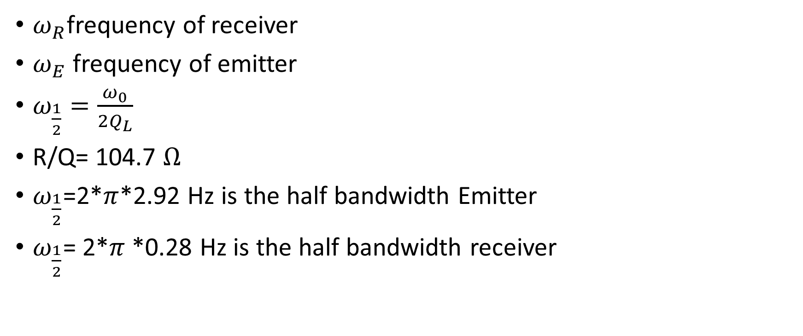
Parameters
$ω_{R}$frequency of receiver
$ω_{E}$ frequency of emitter
$ω_{\frac{1}{2}}=\frac{ω_{0}}{2Q_{L}}$
R/Q= 104.7 $Ω$
$ω_{\frac{1}{2}}$=2*$π$*2.92 Hz is the half bandwidth Emitter
$ω_{\frac{1}{2}}$= 2*$π$*0.28 Hz is the half bandwidth receiver

Slide 4
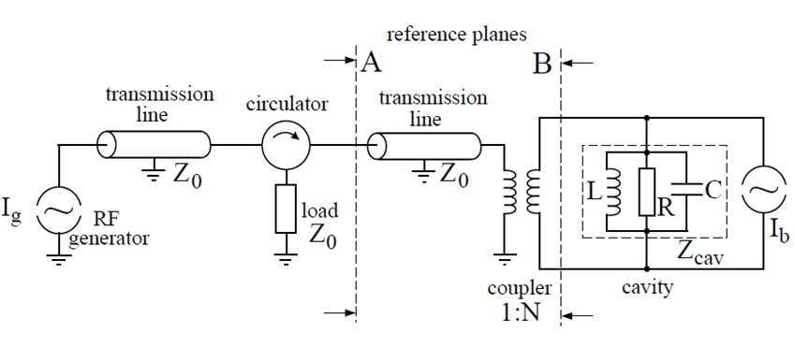
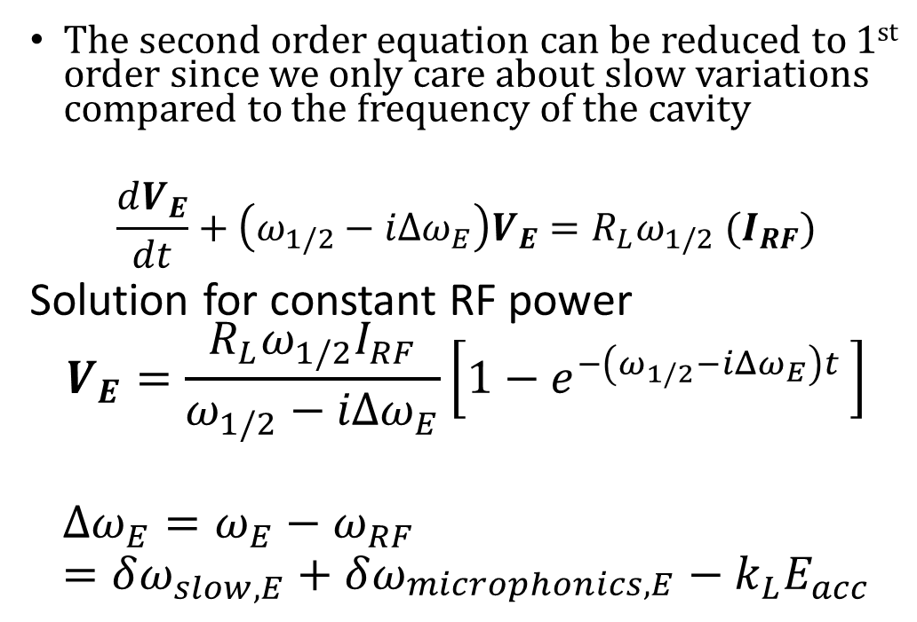
Emitter Cavity
The second order equation can be reduced to 1st order since we only care about slow variations compared to the frequency of the cavity
$$\frac{dV_{E}}{dt}+\left(ω_{1/2}−iΔω_{E}\right)V_{E}=R_{L}ω_{1/2} (I_{RF})$$
Solution for constant RF power
$$V_{E}=\frac{R_{L}ω_{1/2}I_{RF}}{ω_{1/2}−iΔω_{E}}\left[1−e^{−\left(ω_{1/2}−iΔω_{E}\right)t }\right]$$
$$Δω_{E}=ω_{E}−ω_{RF}=δω_{slow,E}+δω_{\begin{aligned}microphonics, E \\ \end{aligned}}−k_{L}E_{acc}$$

Slide 5
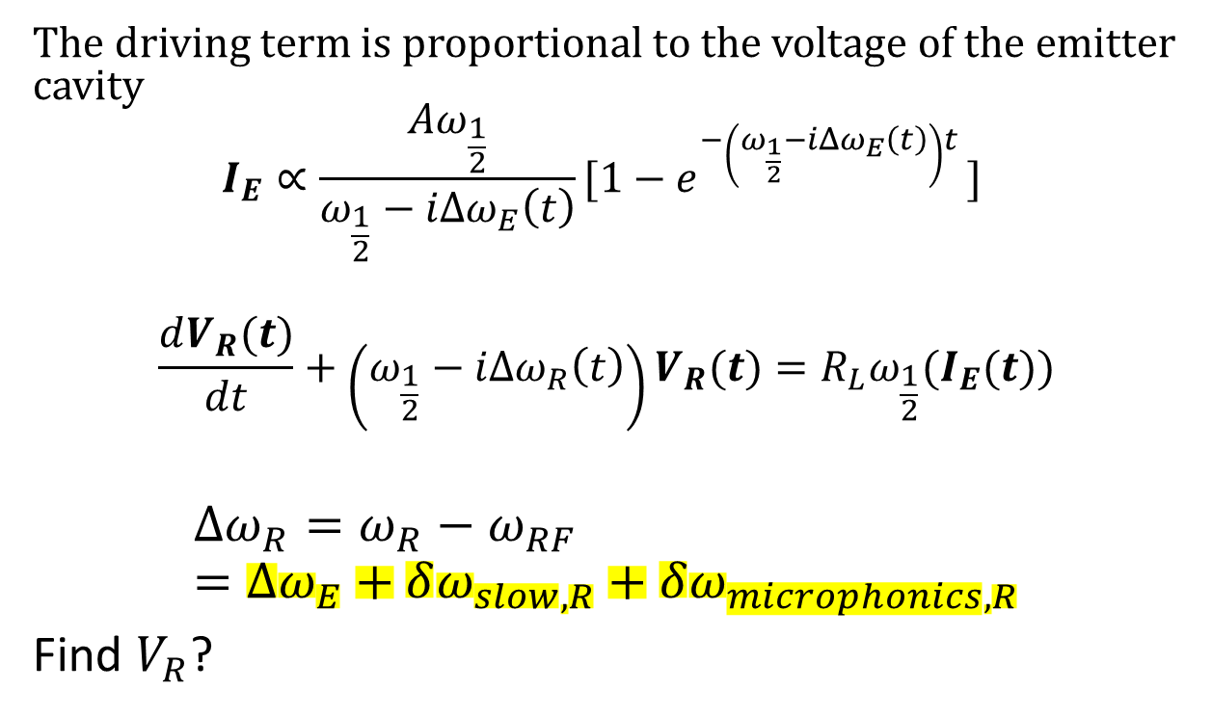
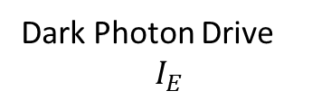
Receiver Cavity
The driving term is proportional to the voltage of the emitter cavity
$$I_{E}∝\frac{Aω_{\frac{1}{2}}}{ω_{\frac{1}{2}}−iΔω_{E}\left(t\right)}{[1−e}^{−\left(ω_{\frac{1}{2}}−iΔω_{E}\left(t\right)\right)t }]$$
$$\frac{dV_{R}(t)}{dt}+\left(ω_{\frac{1}{2}}−iΔω_{R}\left(t\right)\right)V_{R}(t)=R_{L}ω_{\frac{1}{2}}(I_{E}(t))$$
$$Δω_{R}=ω_{R}−ω_{RF}=Δω_{E}+δω_{slow,R}+δω_{microphonics, R}$$
Find $V_{R}$?
Dark Photon Drive
$$I_{E}$$

Slide 6
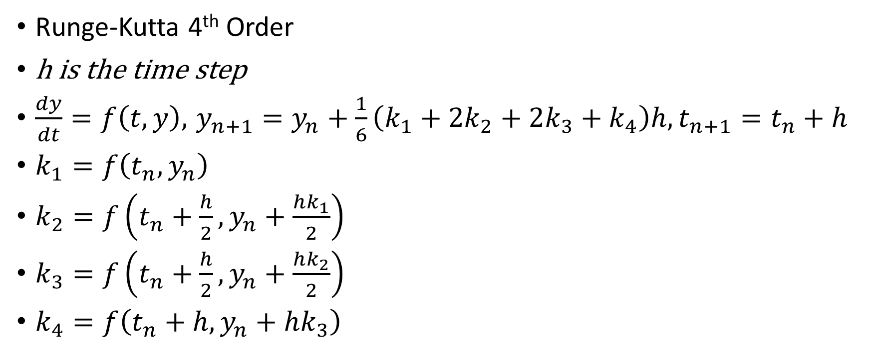
Equation Solver
Runge-Kutta 4th Order
h is the time step
$\frac{dy}{dt}=f\left(t,y\right), { y}_{n+1 }=y_{n}+\frac{1}{6}\left(k_{1}+2k_{2}+2k_{3}+k_{4}\right)h, t_{n+1}=t_{n}+h$
$k_{1}=f\left(t_{n}, y_{n}\right)$
$k_{2}=f\left(t_{n}+\frac{h}{2}, y_{n}+\frac{hk_{1}}{2}\right)$
$k_{3}=f\left(t_{n}+\frac{h}{2}, y_{n}+\frac{hk_{2}}{2}\right)$
$k_{4}=f\left(t_{n}+h, y_{n}+hk_{3}\right)$

Slide 7
Simulations
For the simulations at t=0 I assume that the frequency of the emitter and receiver are matched. The RF generator is set to this frequency
The simulations only contain the effects of the slow drift

Slide 8
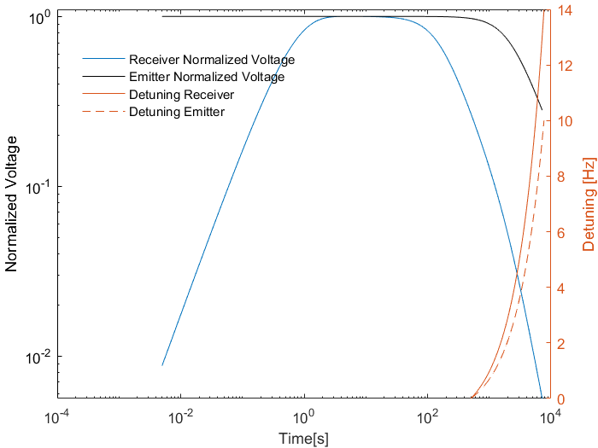
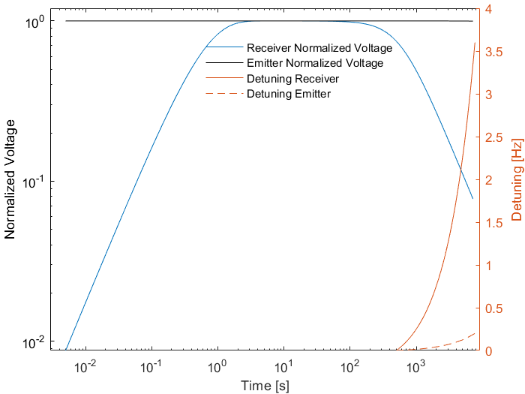



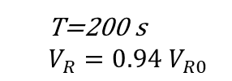
Results
T=200 s
$V_{R}=0.94 V_{R0}$
T=200 s
$$V_{R}=0.58 V_{R0}$$
T=3600 s
$$V_{R}=0.15 V_{R0}$$
T=3600 s
$$V_{R}=0.02 V_{R0}$$
No PI Loop
Cavity detuning linear
Emitter 5 Hz/hr
Receiver 2 H/hr
PI Loop on Emitter
Cavity detuning linear
Emitter 0.1 Hz/hr
Receiver 1.7 H/hr
Calculations are done for 2 hrs
The Emitter cavity is assumed to be at the nominal voltage and matched frequency with the receiver cavity at t=0
Takes ~18 s for the receiver cavity to reach 99% of nominal field
The results for the voltage of the receiver at different time is shown on the side of the plots

Slide 9
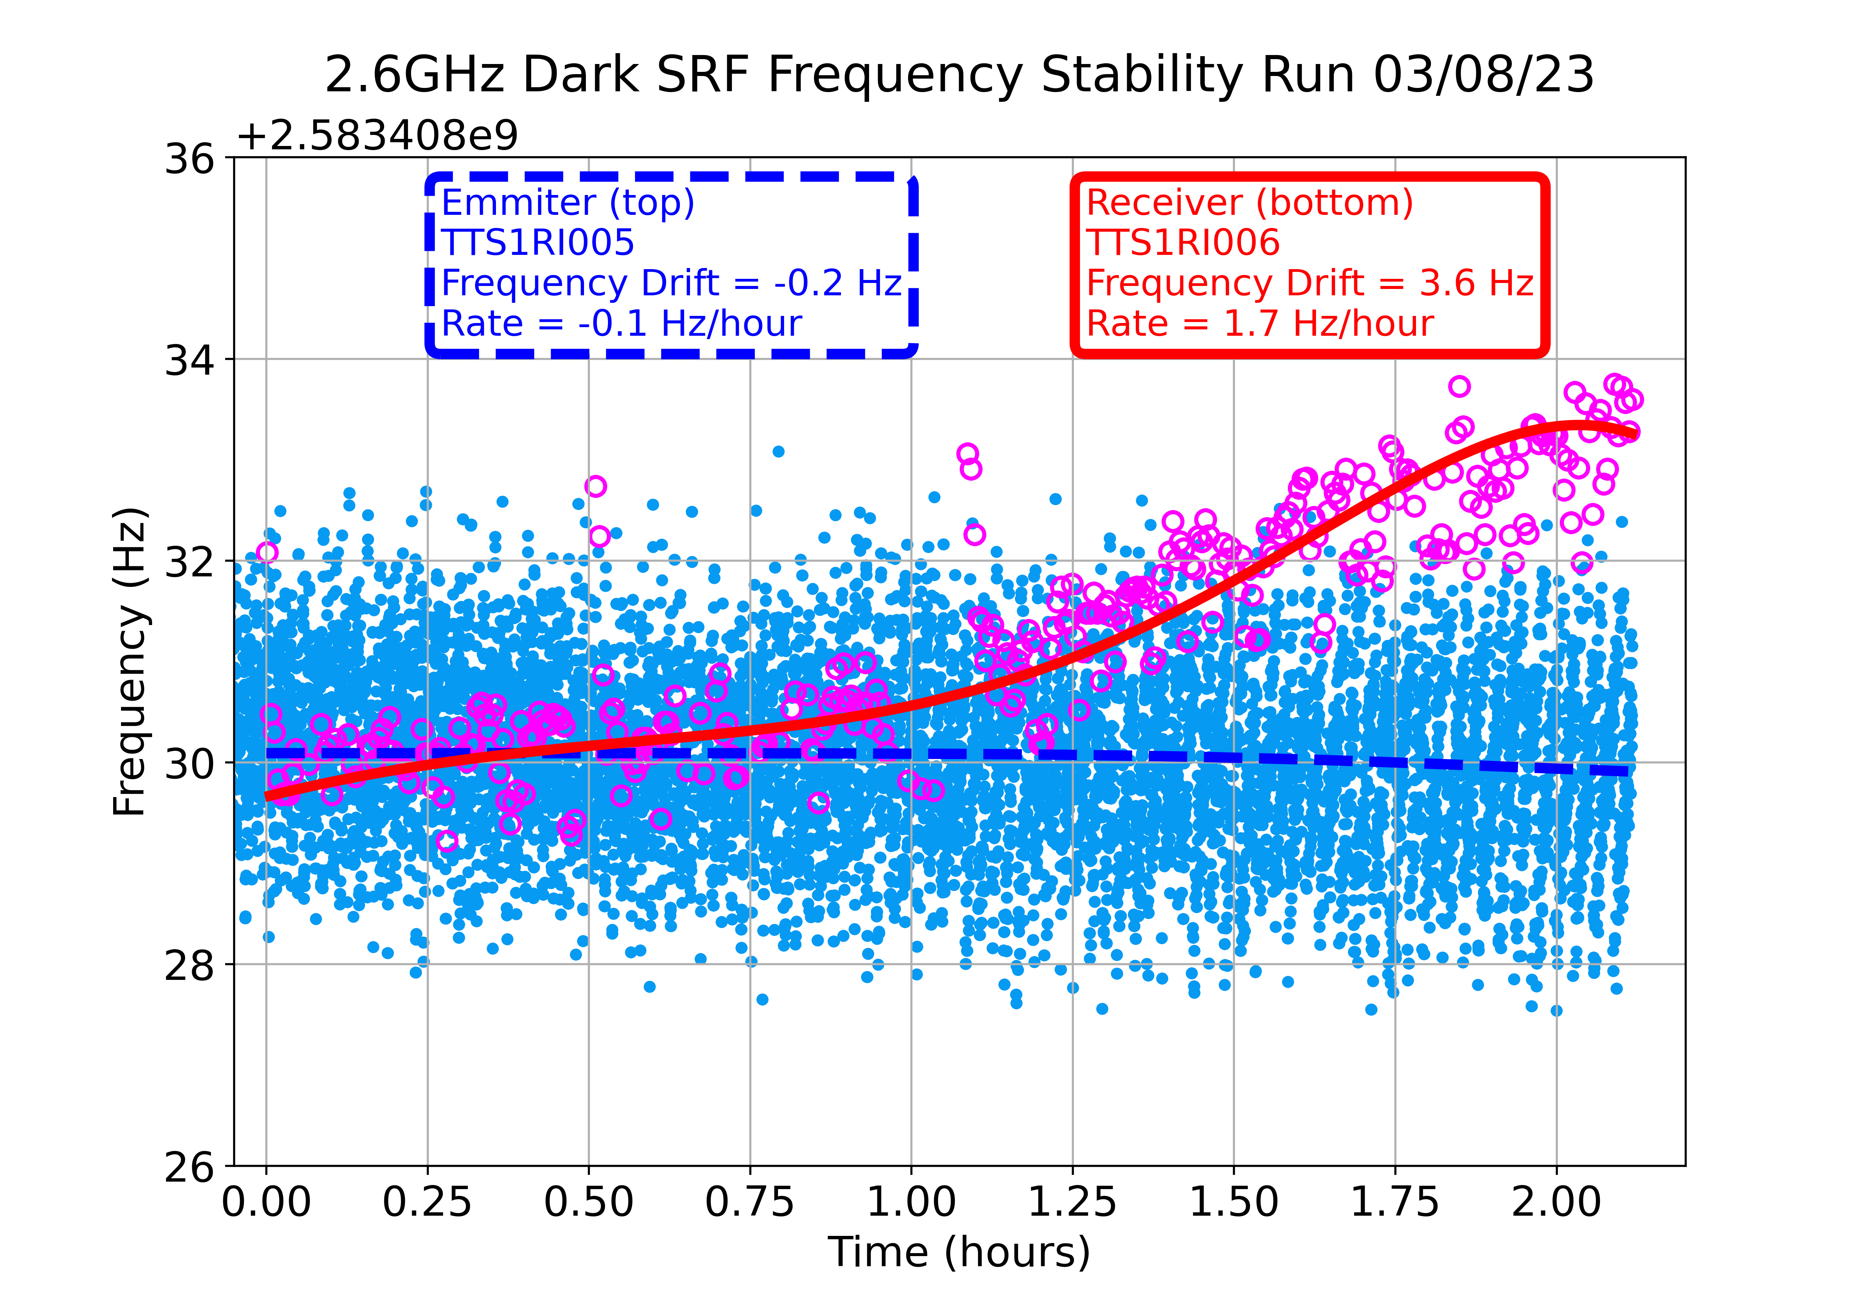
2 K Run Cavity Drifts

Slide 10
Summary
The results from the simulation show that without a PI loop on the emitter the receiver cavity field drops quickly
Even with a PI loop after 1 hour the field of the receiver drops to .15 of its initial value
This puts a constrain of integration time of ~200 s (if 94% of the field is ok)
This challenge arises due to the small bandwidth of the receiver cavity at 0.56 Hz

