Slide 1
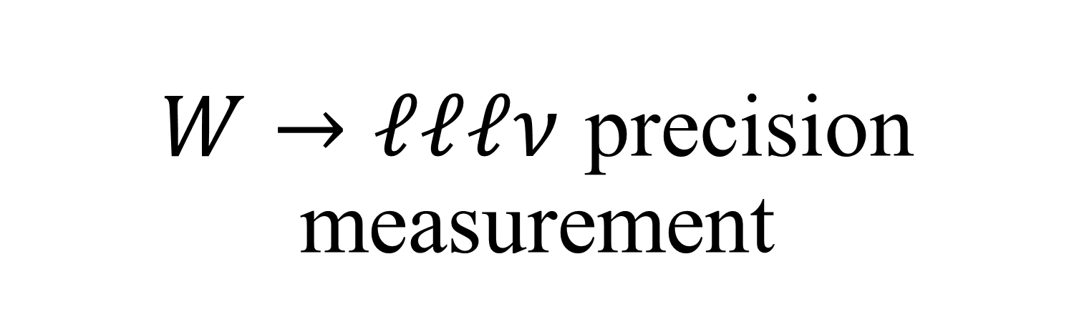
$W→ℓℓℓν$ precision measurement
Summary
Yifan Fei, Peiran Li, Zhen Liu, Kunfeng Lyu and

Slide 2


Branching ratio precision measurement
$Γ$=2.0476 GeV
Signal
$pp >lllv \left(M_{lllv}∈M_{W}±2Γ\right)$ xs=0.61pb
Bkg
$pp >lllv (M_{lllv}∉M_{W}±2Γ)$ xs=0.95pb
$pp >llll$ xs=0.34pb
$pp >t\overline{t}$ xs=688pb

Slide 3
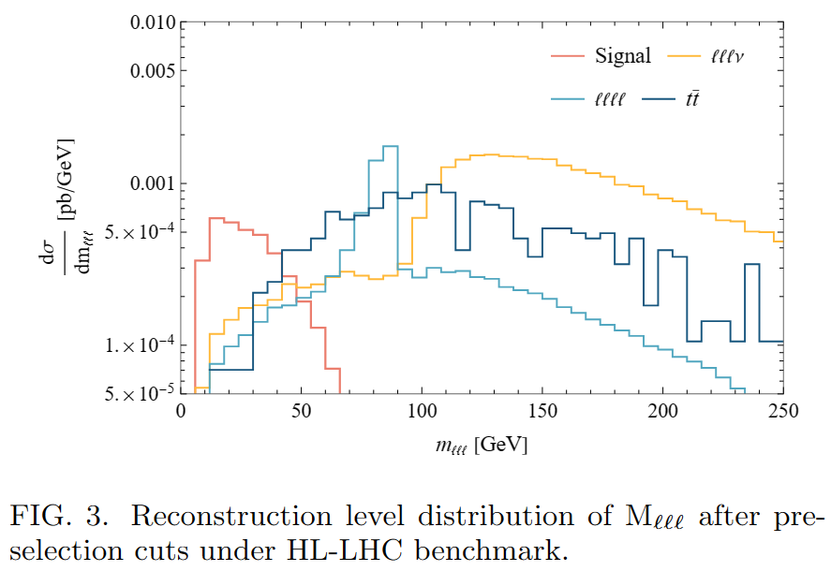
Cutflow analysis

Slide 4
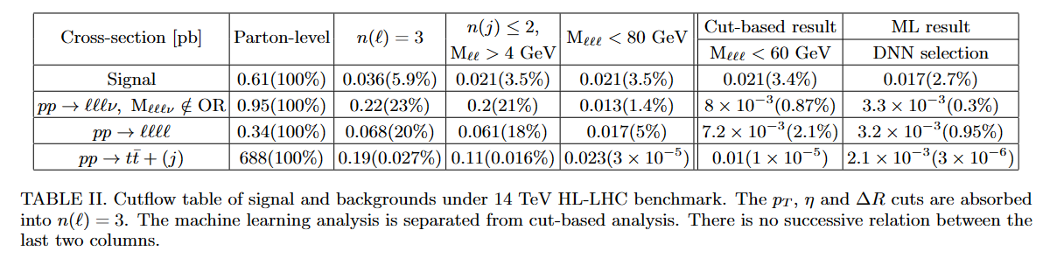
Cutflow analysis

Slide 5
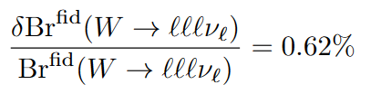
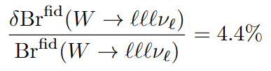

Precision
HL-LHC
  Extend rapidity coverage: $η\left(e,j\right)<5, η\left(μ\right)<2.8$
  High luminosity: $L=3000 {fb}^{−1}$
  Better resolution and reconstructed efficiency at low $p_{T}$
Run-2
  Current status: $η\left(ℓ,j\right)<2.5$
  $L=140 {fb}^{−1}$

Slide 6
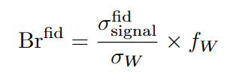
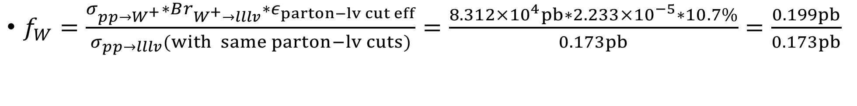
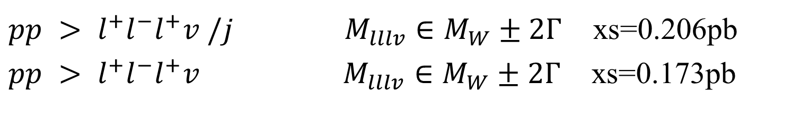

How we extract the branching ratio from signal
Signal: $pp >lllv \left(M_{lllv}∈M_{W}±2Γ\right)$
$f_{W}=\frac{σ_{pp→W^{+}}∗Br_{W^{+}→lllv}∗ε_{parton−lv cut eff}}{σ_{pp→lllv}(with same parton−lv cuts)}=\frac{8.312×{10}^{4}pb∗2.233×{10}^{−5}∗10.7\%}{0.173pb}=\frac{0.199pb}{0.173pb}$
Only s channel
$pp > l^{+}l^{−}l^{+}v /j$ $M_{lllv}∈M_{W}±2Γ$ xs=0.206pb
$pp > l^{+}l^{−}l^{+}v M_{lllv}∈M_{W}±2Γ$ xs=0.173pb
s+t channel

Slide 7
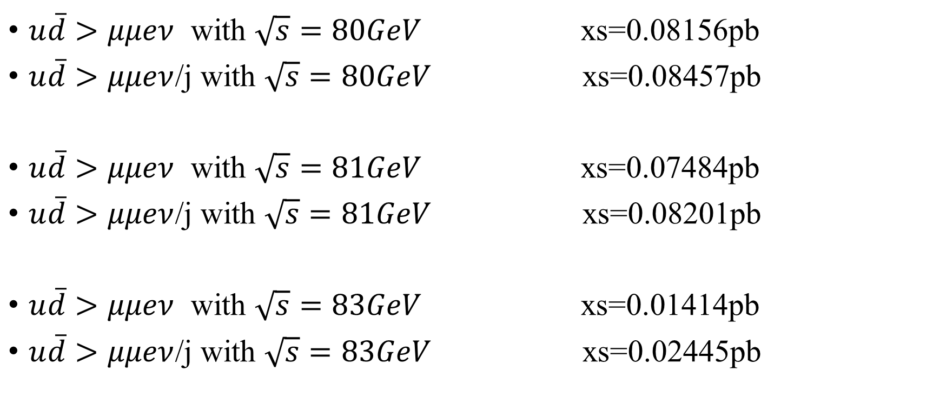
Check the interference
$u\overline{d}>μμeν$ with $\sqrt{s}=80GeV$ xs=0.08156pb
$u\overline{d}>μμeν$/j with $\sqrt{s}=80GeV$ xs=0.08457pb
$u\overline{d}>μμeν$ with $\sqrt{s}=81GeV$ xs=0.07484pb
$u\overline{d}>μμeν$/j with $\sqrt{s}=81GeV$ xs=0.08201pb
$u\overline{d}>μμeν$ with $\sqrt{s}=83GeV$ xs=0.01414pb
$u\overline{d}>μμeν$/j with $\sqrt{s}=83GeV$ xs=0.02445pb

Slide 8
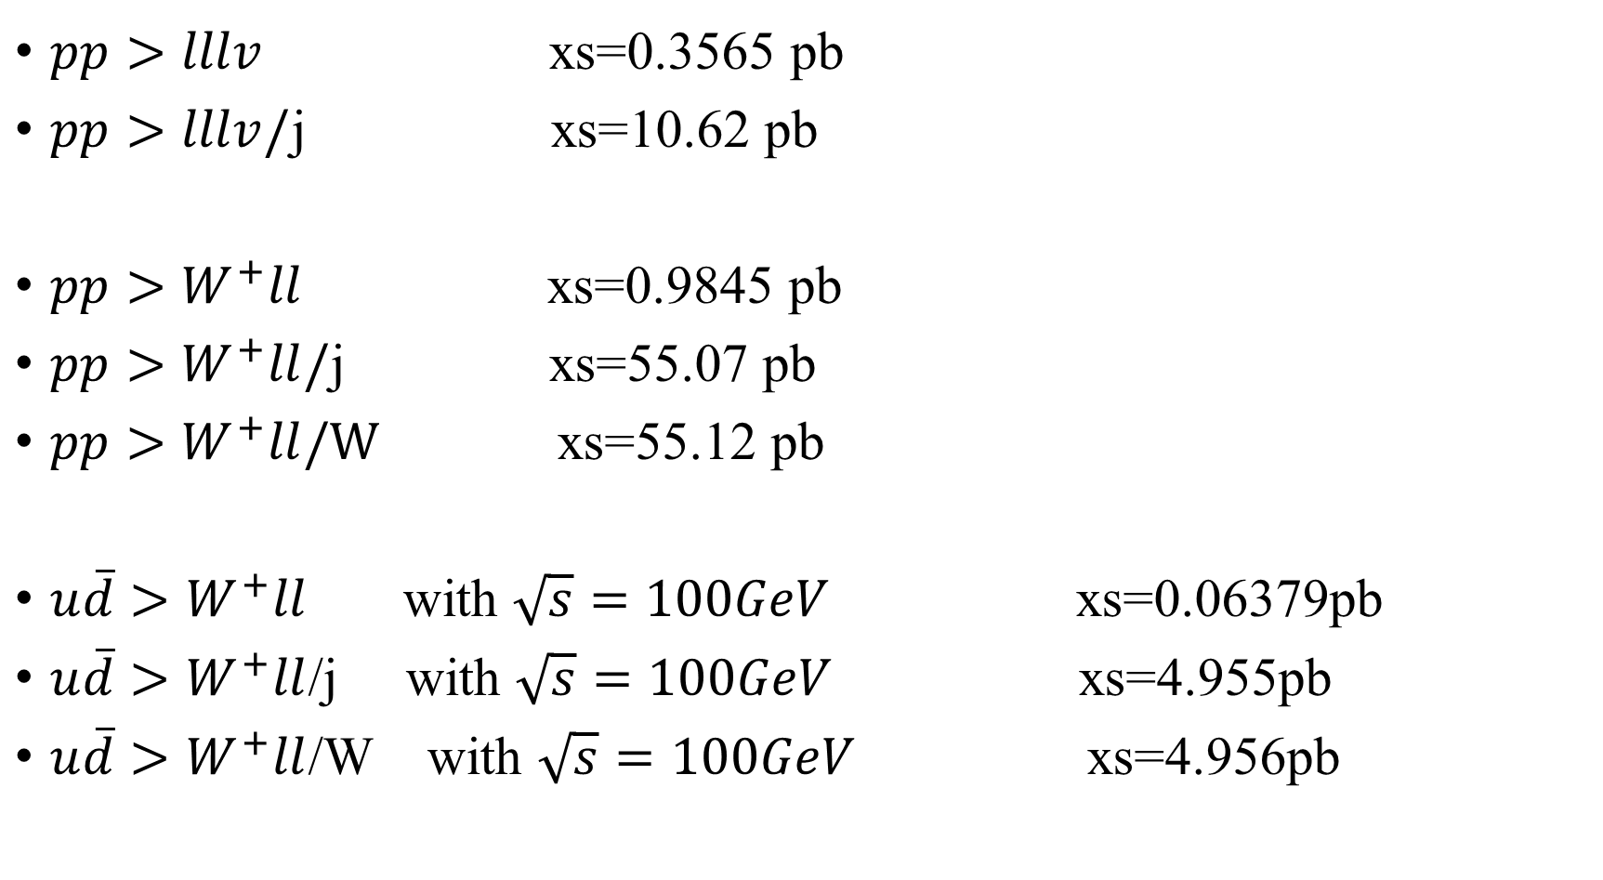
Further test
physical
$pp>lllv$ xs=0.3565 pb
$pp>lllv/$j xs=10.62 pb
$pp>W^{+}ll$ xs=0.9845 pb
$pp>W^{+}ll/$j xs=55.07 pb
$pp>W^{+}ll/W$ xs=55.12 pb
$u\overline{d}>W^{+}ll$ with $\sqrt{s}=100GeV$ xs=0.06379pb
$u\overline{d}>W^{+}ll$/j with $\sqrt{s}=100GeV$ xs=4.955pb
$u\overline{d}>W^{+}ll$/W with $\sqrt{s}=100GeV$ xs=4.956pb
s channel
physical
s channel
t channel
physical
s channel
t channel

Slide 9
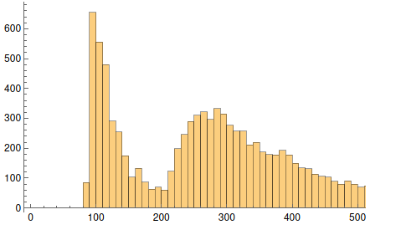
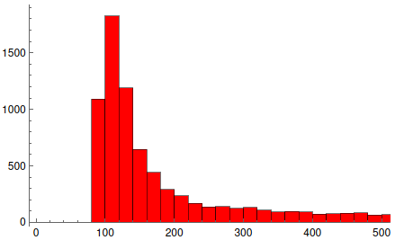
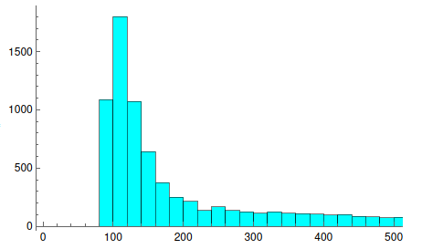
M(Wll) distribution
physical
s channel
t channel

Slide 10



Test on $pp>W^{+}γ$
Parton-lv cuts: $p_{T}\left(γ\right)>3GeV, η\left(γ\right)<2.5$
physical
$u\overline{d}>W^{+}γ$ with $\sqrt{s}=100GeV$ xs=34.41pb
$u\overline{d}>W^{+}γ$/j with $\sqrt{s}=100GeV$ xs=1.465pb
$u\overline{d}>W^{+}γ$/W with $\sqrt{s}=100GeV$ xs=36.47pb
s channel
t channel

Slide 11
How we extract the branching ratio from signal
Signal: $pp >lllv \left(M_{lllv}∈M_{W}±2Γ\right)$
$f_{W}=\frac{σ_{pp→W^{+}}∗Br_{W^{+}→lllv}∗ε_{parton−lv cut eff}}{σ_{pp→lllv}(with same parton−lv cuts)}=\frac{8.312×{10}^{4}pb∗2.233×{10}^{−5}∗10.7\%}{0.173pb}=\frac{0.199pb}{0.173pb}$
Only s channel
$pp > l^{+}l^{−}l^{+}v /j$ $M_{lllv}∈M_{W}±2Γ$ xs=0.206pb
$pp > l^{+}l^{−}l^{+}v M_{lllv}∈M_{W}±2Γ$ xs=0.173pb
s+t channel

Slide 12
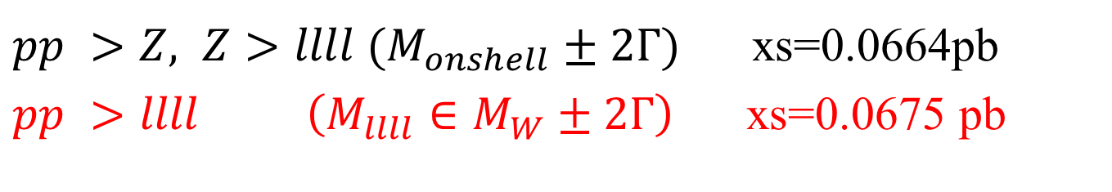
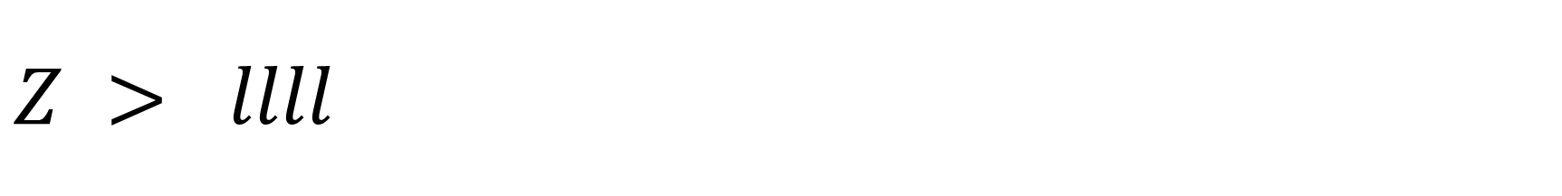

$Z > llll$
$pp >Z, Z>llll (M_{onshell}±2Γ)$ xs=0.0664pb
$pp >llll \left(M_{llll}∈M_{W}±2Γ\right)$ xs=0.0675 pb
$$f_{Z}=0.984$$
https://arxiv.org/pdf/2103.01918.pdf
Page 25

Slide 13
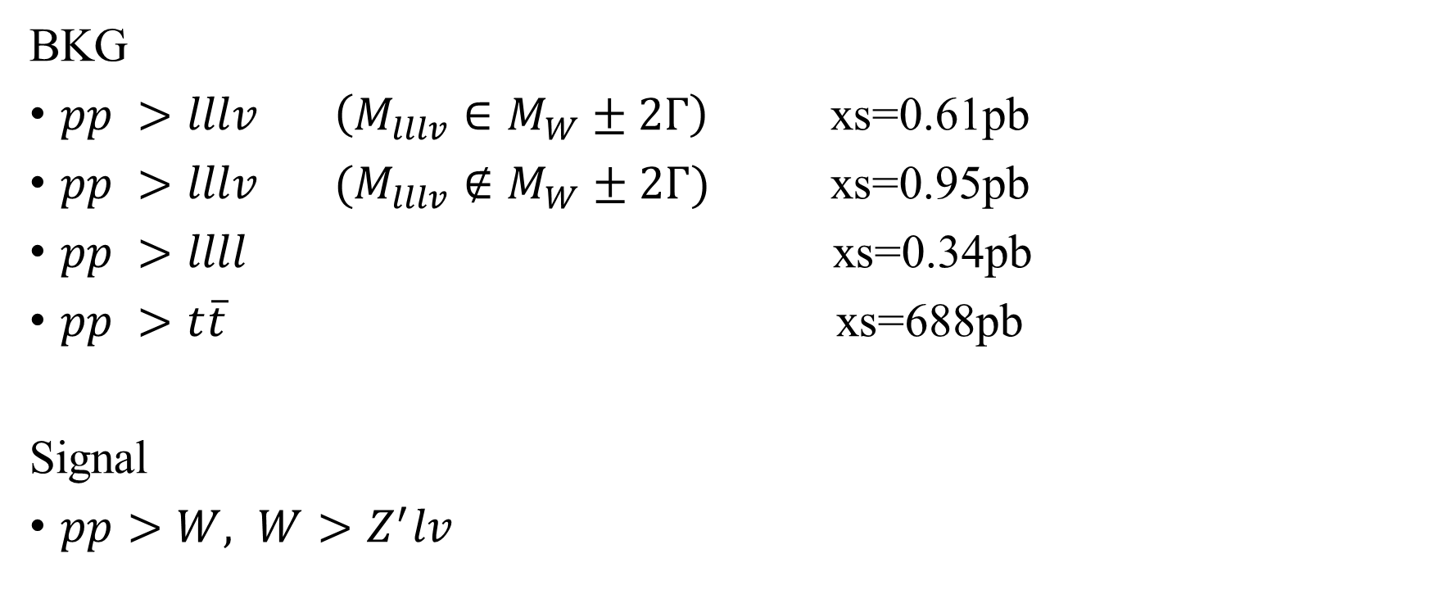
Z’ constraint
BKG
$pp >lllv \left(M_{lllv}∈M_{W}±2Γ\right)$ xs=0.61pb
$pp >lllv (M_{lllv}∉M_{W}±2Γ)$ xs=0.95pb
$pp >llll$ xs=0.34pb
$pp >t\overline{t}$ xs=688pb
Signal
$pp>W, W>Z^{′}lv$

Slide 14
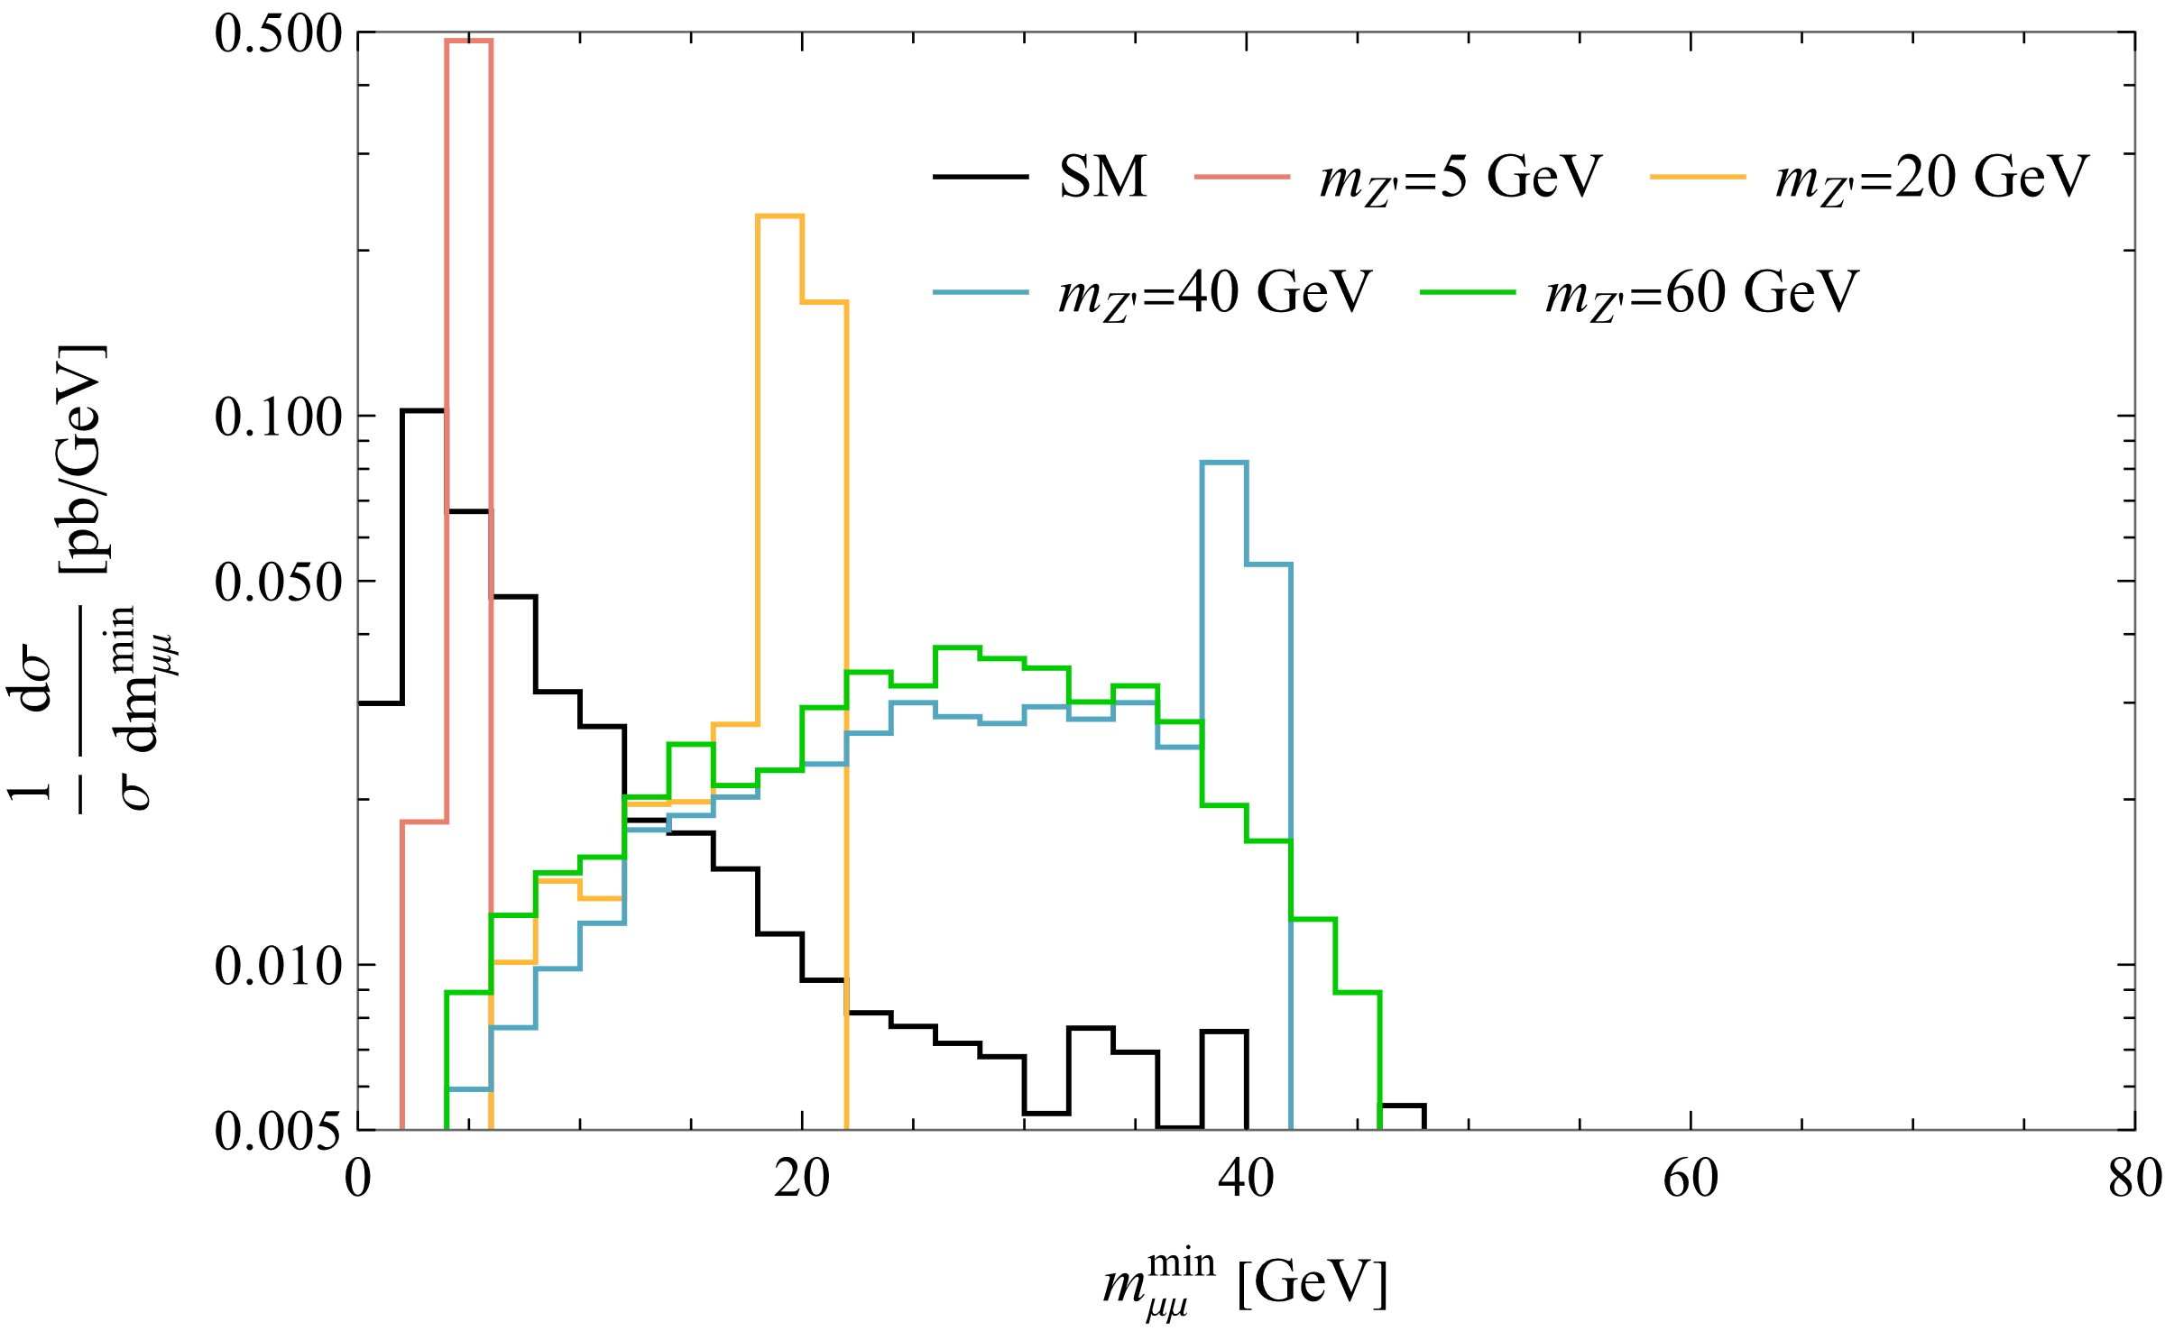

Slide 15
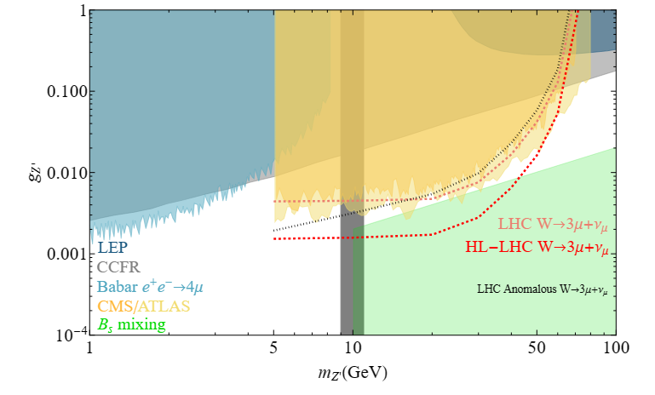
Sensitivity
Upsilon is around 10 GeV, but CMS/ATLAS didn’t mention at all.
Can we just put the anomalous benchmark into the plot?

Slide 16
Backup

Slide 18
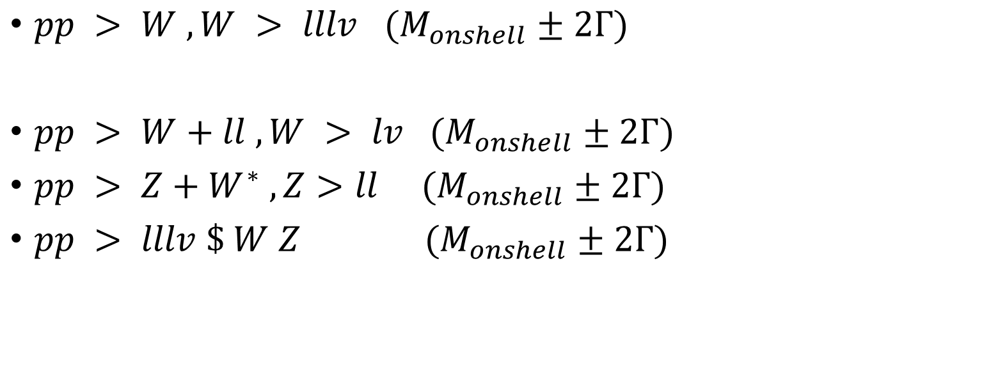


Previous scenario for $pp>lllv$
$pp > W , W > lllv (M_{onshell}±2Γ)$
$pp > W+ll , W > lv (M_{onshell}±2Γ)$
$pp > Z+W^{∗} , Z>ll (M_{onshell}±2Γ)$
$pp > lllv \$ W Z (M_{onshell}±2Γ)$
With onshell definition: $M_{lllv}∈M_{W}±2Γ$

Slide 19
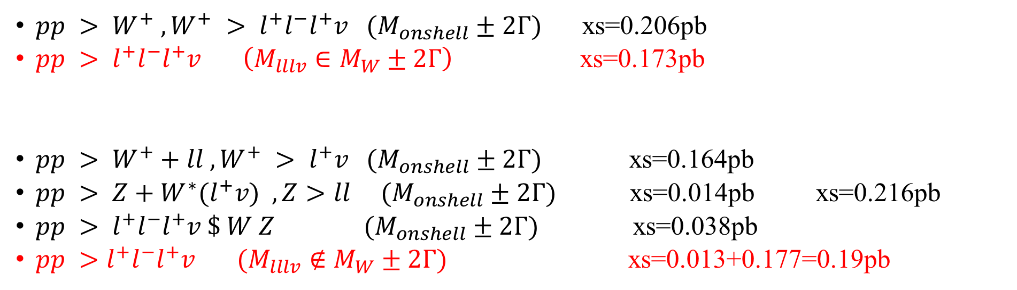
Comparison
$pp > W^{+} , W^{+} > l^{+}l^{−}l^{+}v (M_{onshell}±2Γ)$ xs=0.206pb
$pp > l^{+}l^{−}l^{+}v \left(M_{lllv}∈M_{W}±2Γ\right)$ xs=0.173pb
$pp > W^{+}+ll , W^{+} > l^{+}v (M_{onshell}±2Γ)$ xs=0.164pb
$pp > Z+W^{∗}(l^{+}v) ,Z>ll (M_{onshell}±2Γ)$ xs=0.014pb xs=0.216pb
$pp > l^{+}l^{−}l^{+}v \$ W Z (M_{onshell}±2Γ)$ xs=0.038pb
$pp >l^{+}l^{−}l^{+}v (M_{lllv}∉M_{W}±2Γ)$ xs=0.013+0.177=0.19pb

Slide 20
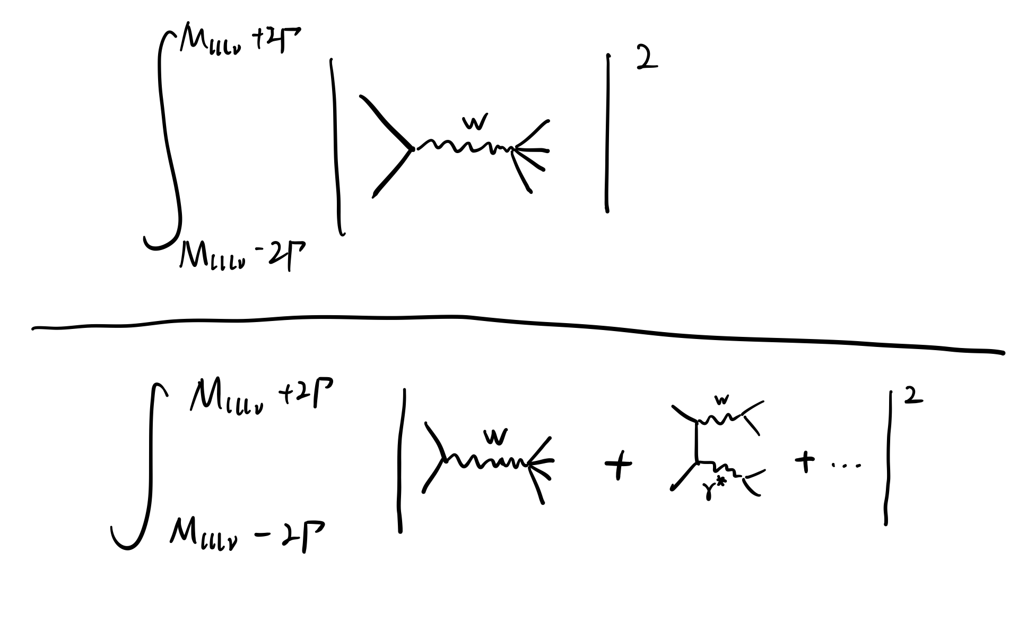
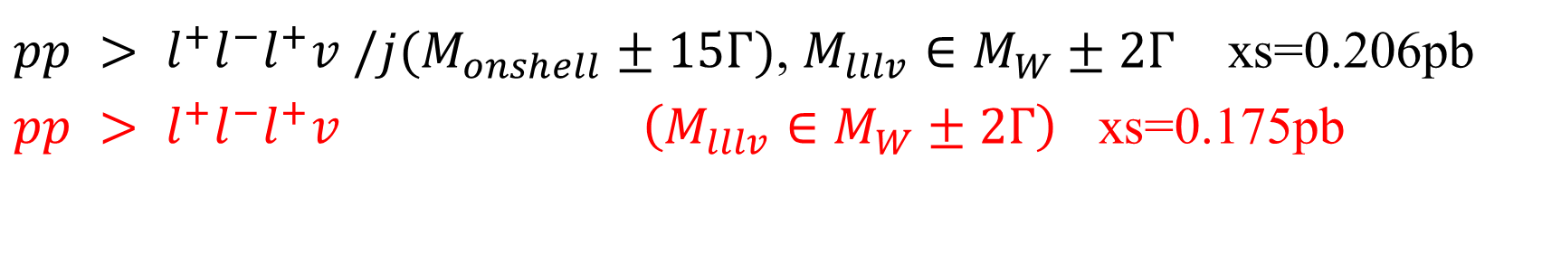


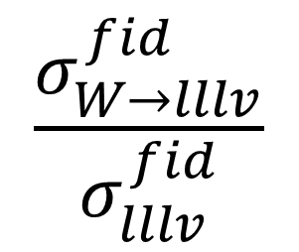
Extract pure W boson decay
$pp > l^{+}l^{−}l^{+}v /j(M_{onshell}±15Γ)$, $M_{lllv}∈M_{W}±2Γ$ xs=0.206pb
$pp > l^{+}l^{−}l^{+}v \left(M_{lllv}∈M_{W}±2Γ\right)$ xs=0.175pb
$$dPS$$
$$\frac{σ_{W→lllv}^{fid}}{σ_{lllv}^{fid}}$$
=
$$dPS$$

Slide 21
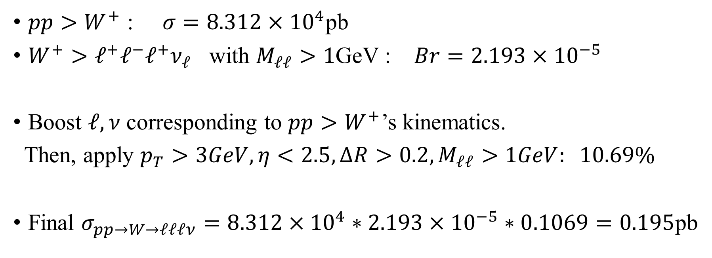
Break the steps
$pp>W^{+}$ : $σ=8.312×{10}^{4}$pb
$W^{+}>ℓ^{+}ℓ^{−}ℓ^{+}ν_{ℓ}$ with $M_{ℓℓ}>1$GeV : $Br=2.193×{10}^{−5}$
Boost $ℓ,ν$ corresponding to $pp>W^{+}$’s kinematics.
Then, apply $p_{T}>3GeV, η<2.5, ΔR>0.2,M_{ℓℓ}>1GeV: 10.69\%$
Final $σ_{pp→W→ℓℓℓν}=8.312×{10}^{4}∗2.193×{10}^{−5}∗0.1069=0.195$pb
Comparing with $pp>ℓ^{+}ℓ^{−}ℓ^{+}ν/j,$ $\left(M_{lllv}∈M_{W}±2Γ, p_{T},η,ΔR,M_{ℓℓ} cuts\right)$ : $σ=0.206$pb
Comparing with $pp>ℓ^{+}ℓ^{−}ℓ^{+}ν,$ $\left(M_{lllv}∈M_{W}±2Γ, p_{T},η,ΔR,M_{ℓℓ} cuts\right)$ : $σ=0.173$pb

