Slide 1
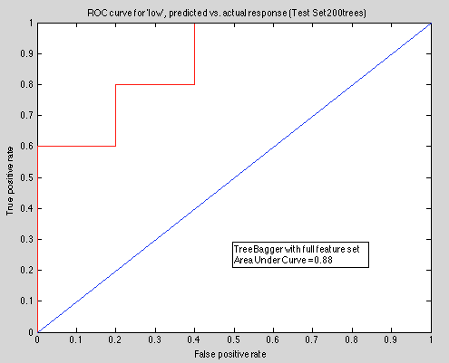
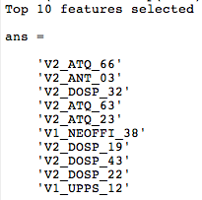
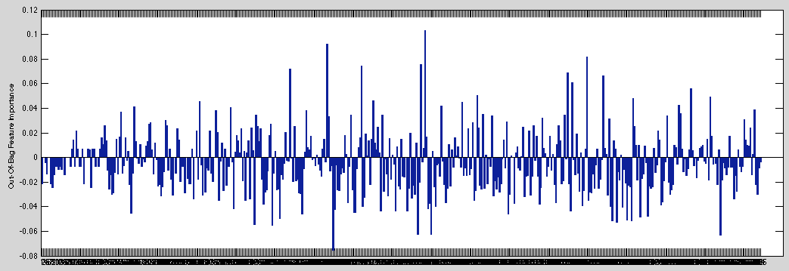
Individual questions: 10 folder cross-validation results with 90% of the data:

Slide 2
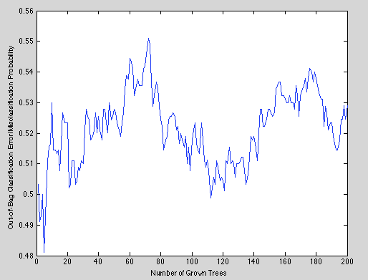
Overall accuracy (3.2+3.2)/10=64% |  | Predicted
 |  | Low | High
Actual (n=10) | Low (n=5) | 3.2 (64%) | 1.8 (36%)
 | High (n=5) | 1.8 (36%) | 3.2 (64%)

