Slide 1
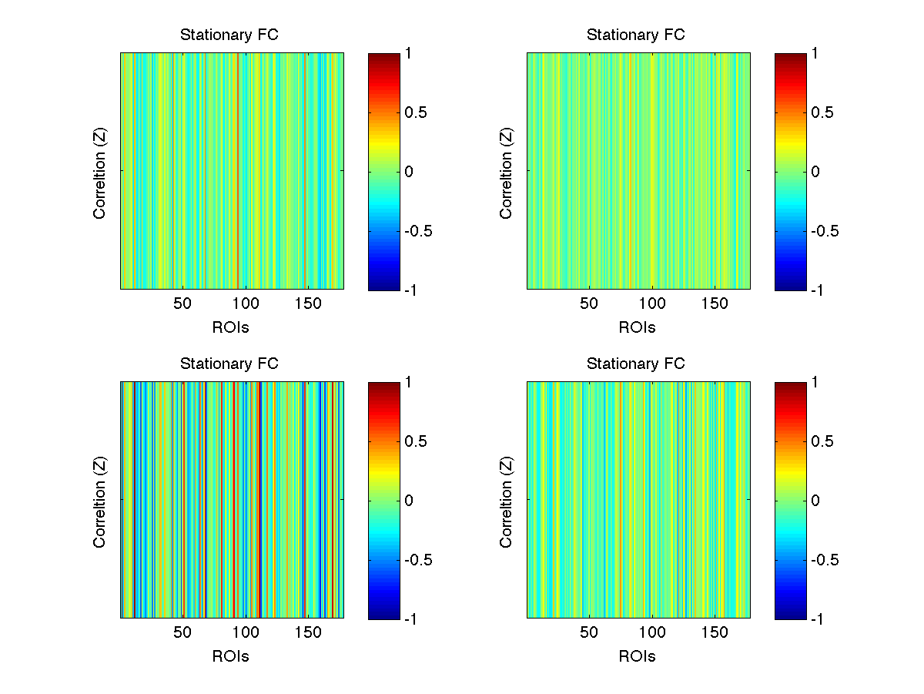
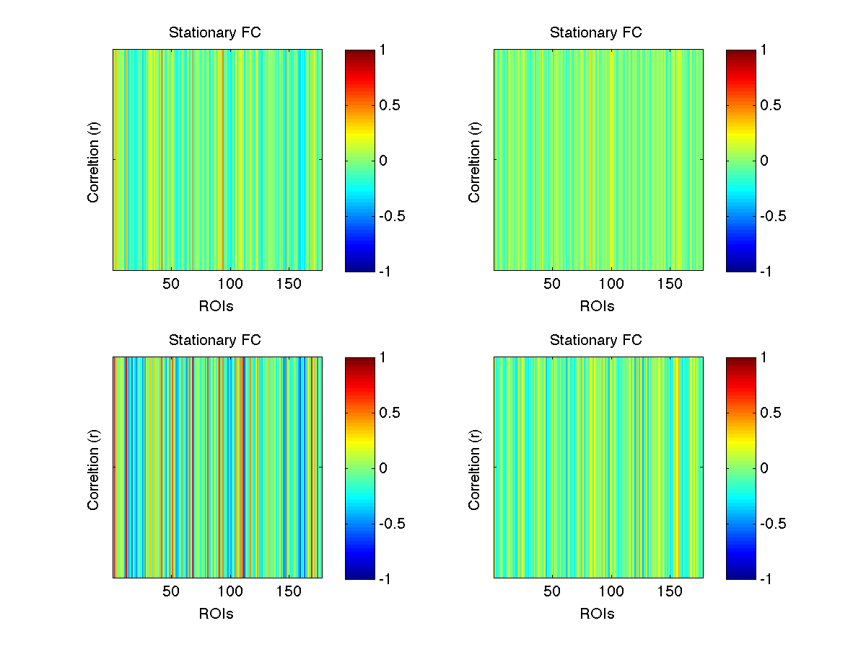
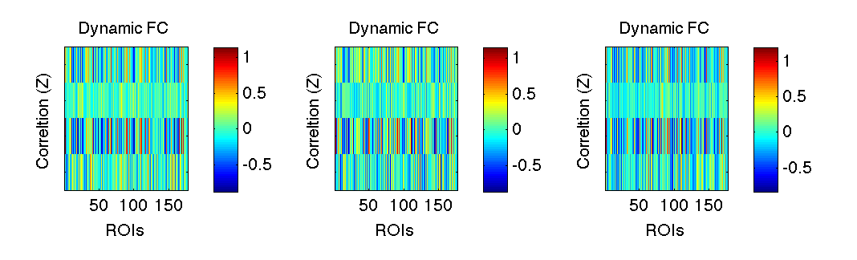
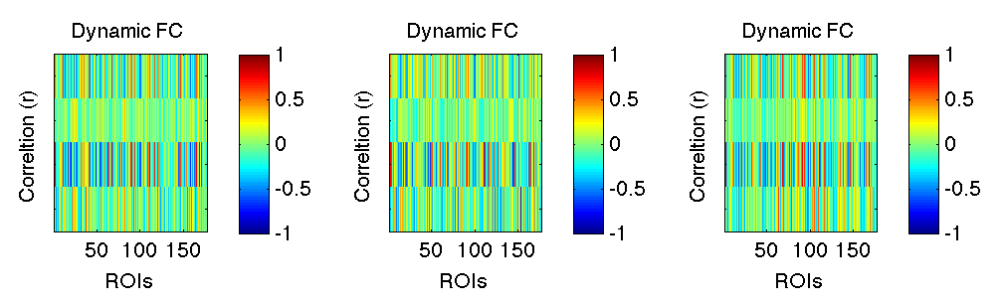
Stationary FC
W_width=69 TRs, Step = 3 TRs
Z scores
r values

Slide 2
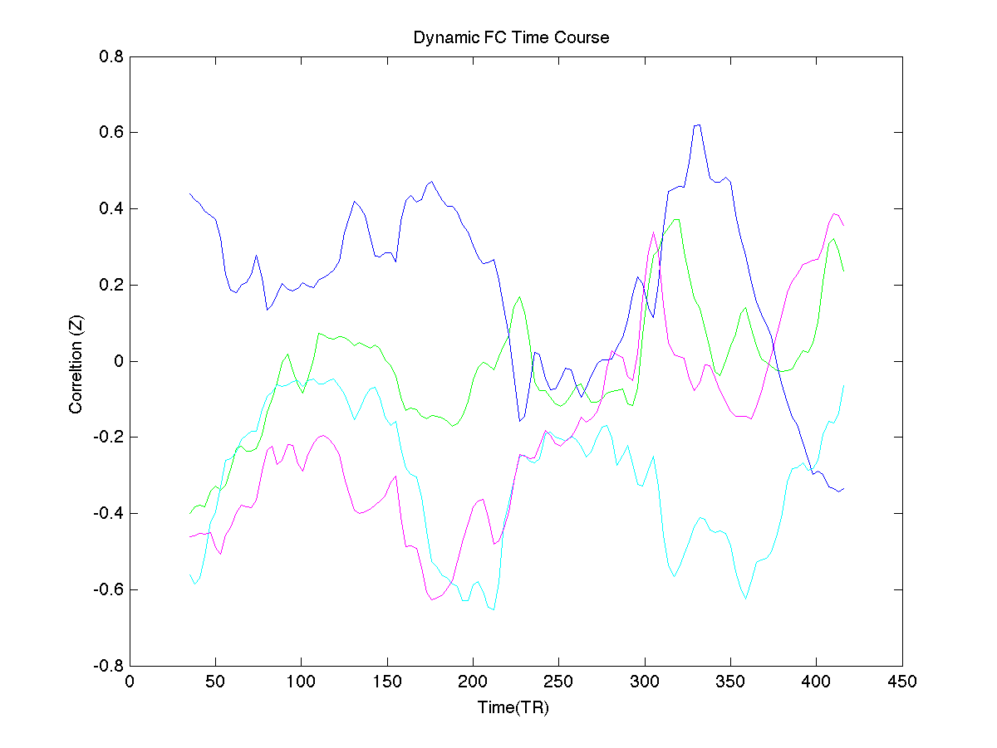
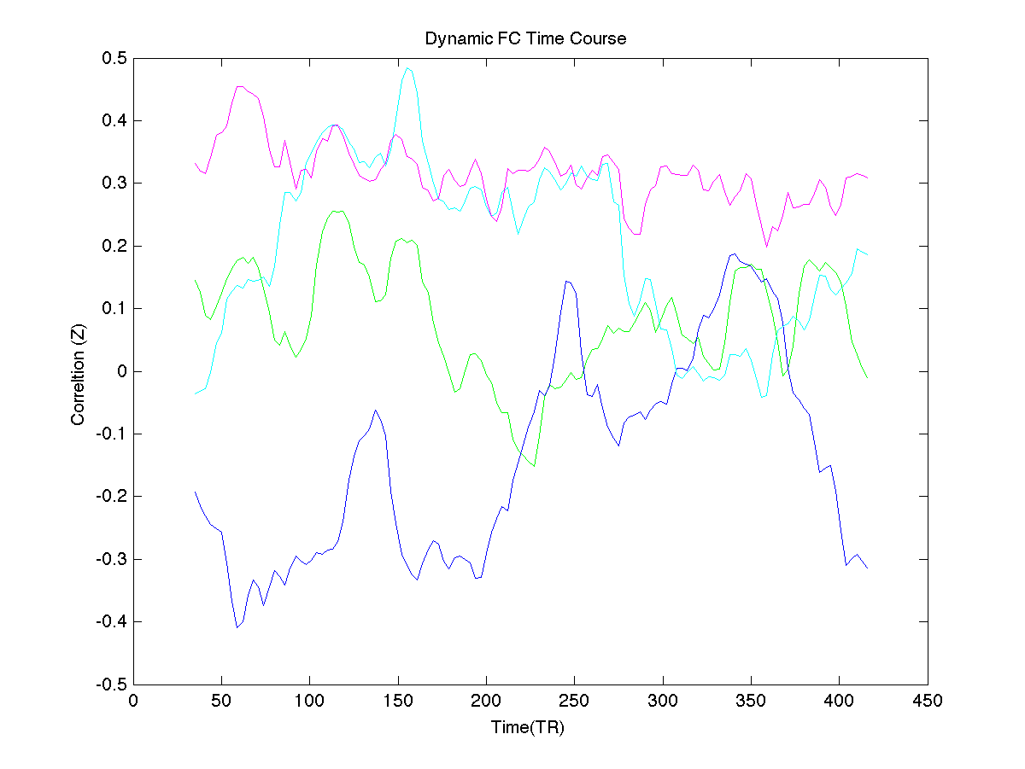
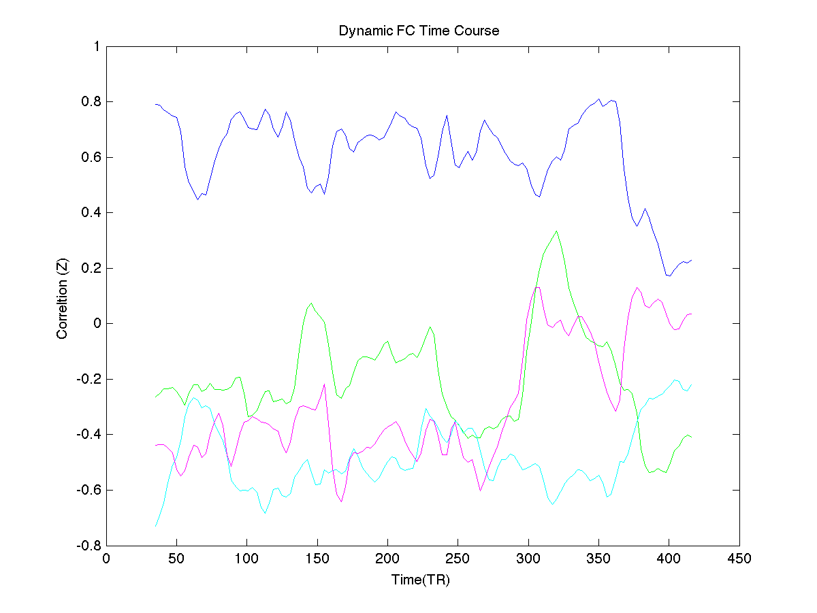
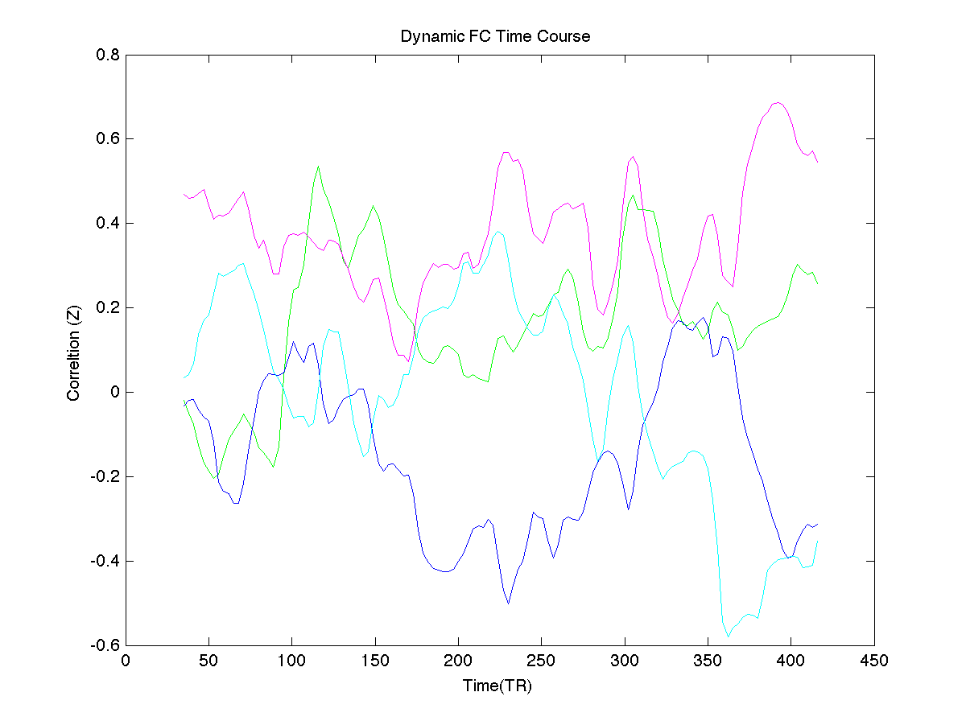
W_width=69 TRs, Step = 3 Trs, each figure represent TC of 1 seed

Slide 3
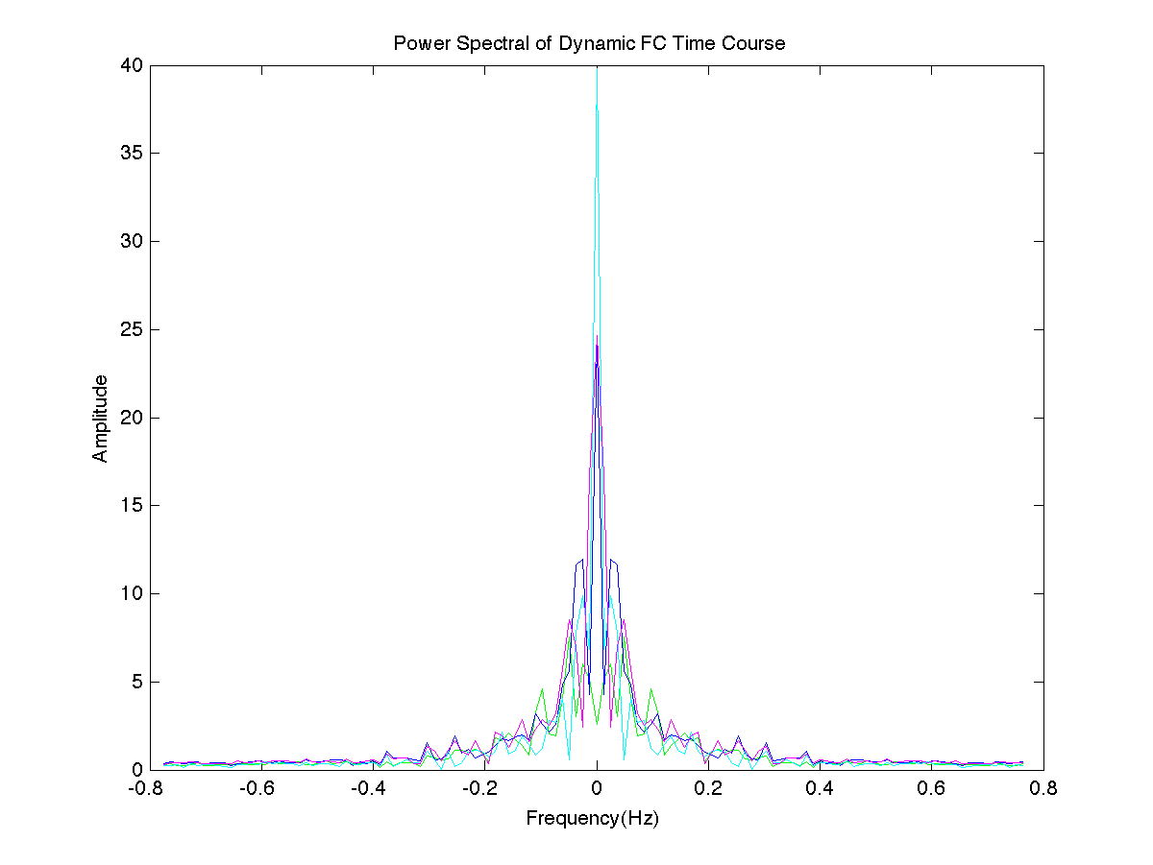
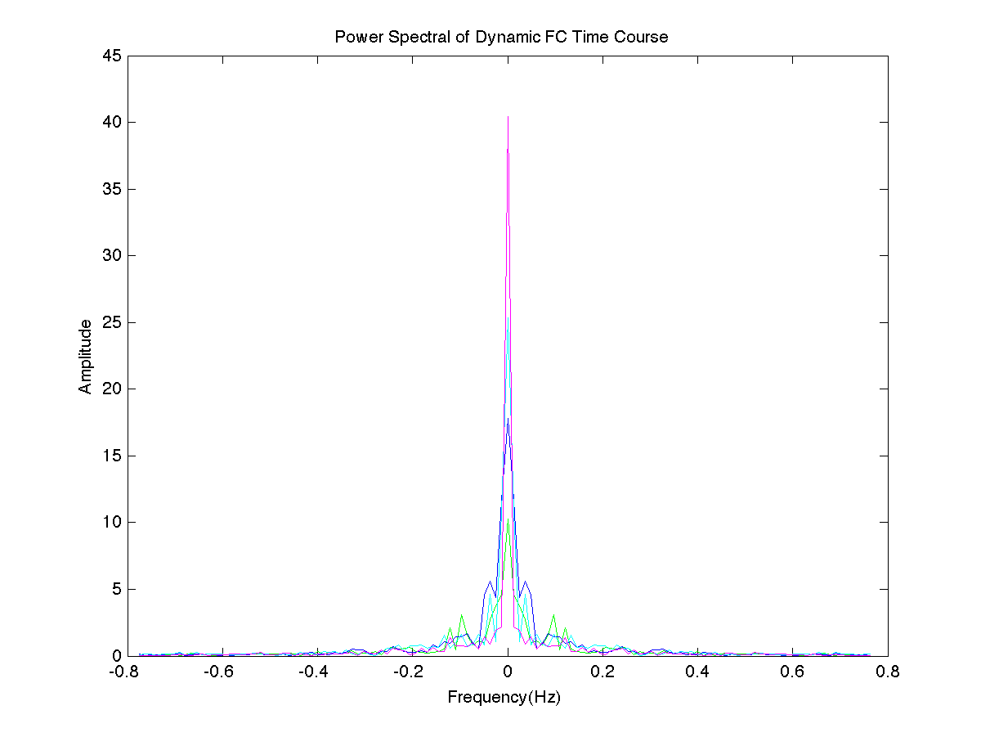
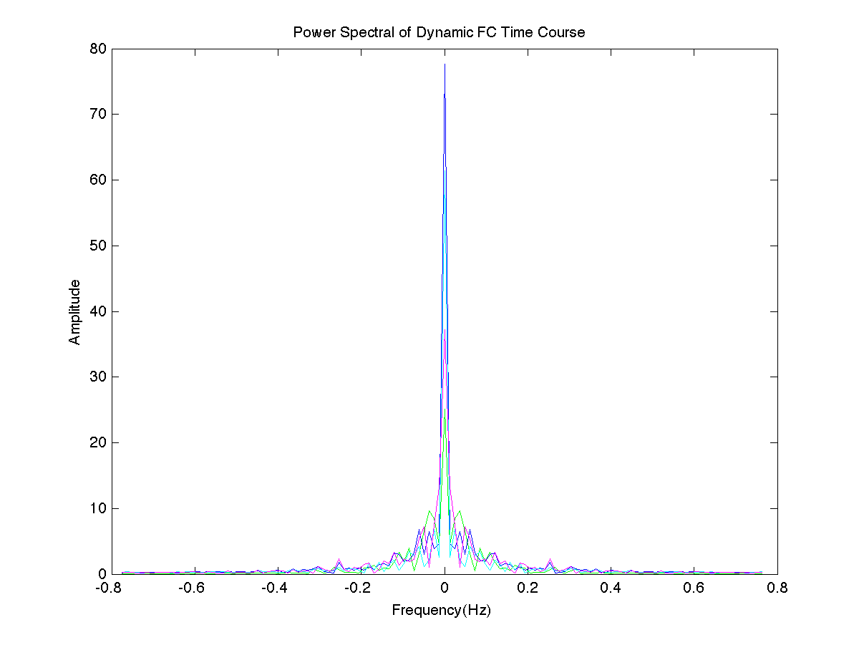
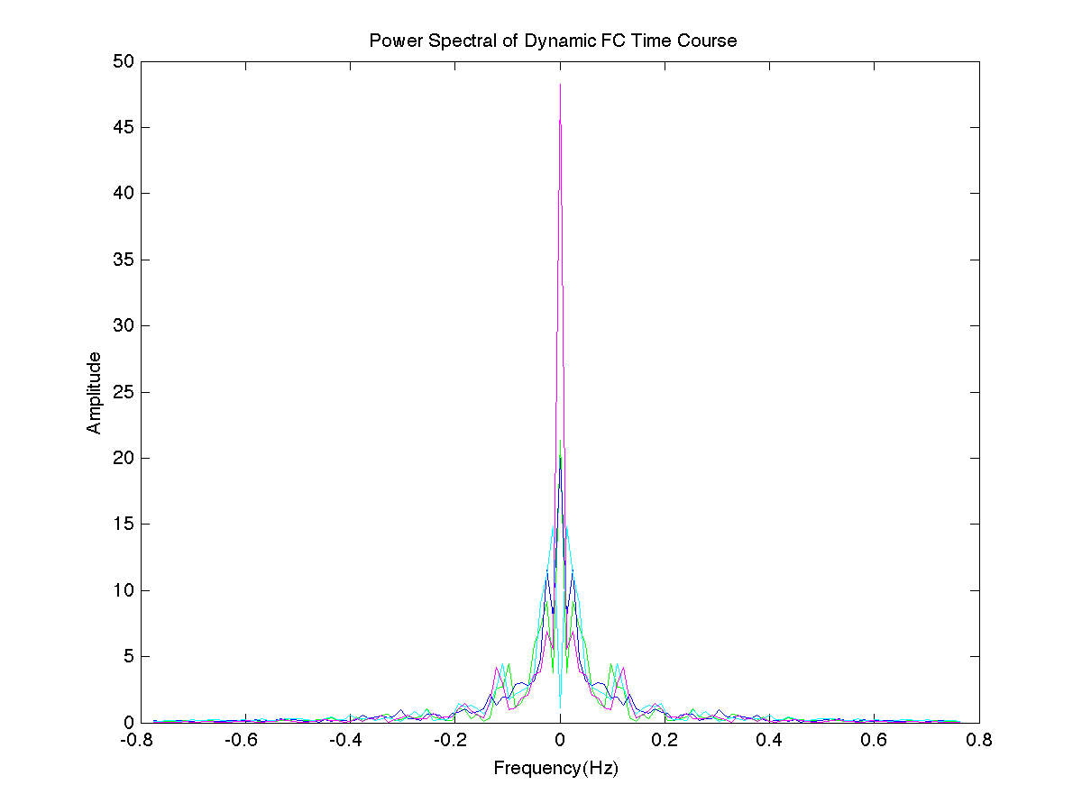
W_width=69 TRs, Step = 3 Trs, each figure represent PS of 1 seed

Slide 4
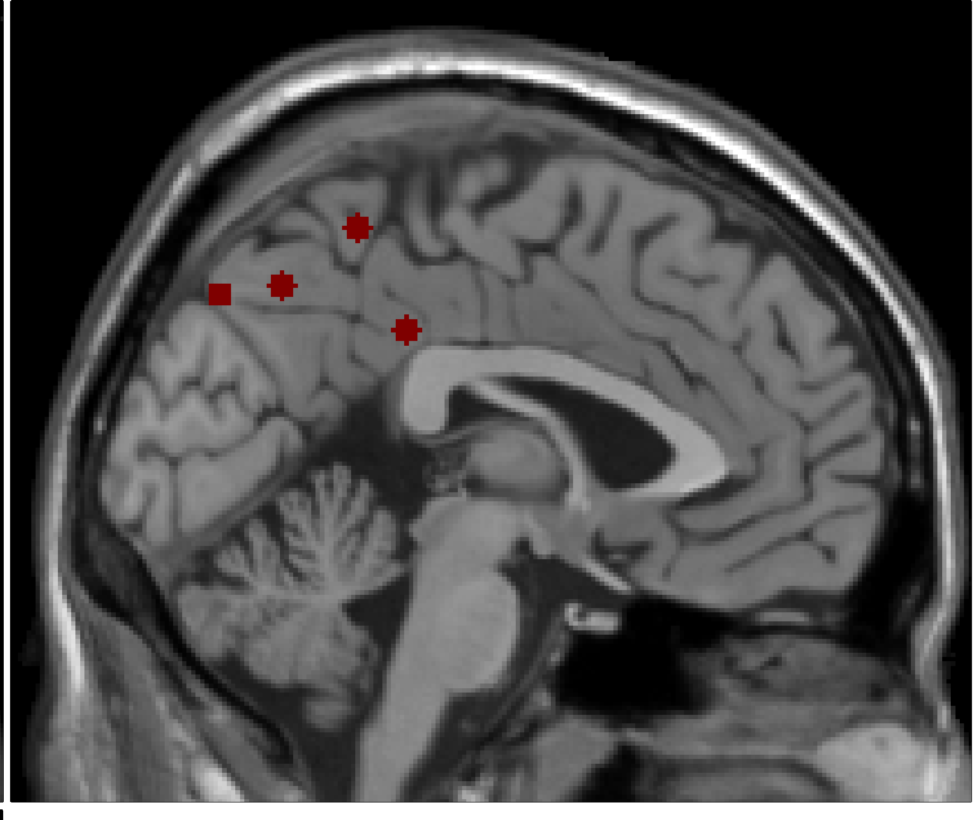
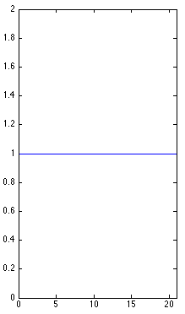
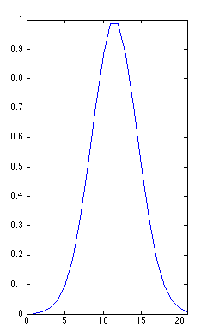
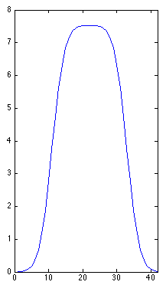
Data
(NKI-TRT, 25 subs,
2 sessions, TR=645ms,
N_vol=450,
Sub 1
1. -2/-36/35
2. -2/-47/58
3.-2/-64/45
4. -1/-78/43
4 seeds
(Margulis et al., 2009)
Preprocessing
(Friston-24, Smooth, Spatial norm,GR)
200 ROIs
(Functional atlas: Crad-200)
Z norm time series (TS)
of each voxel
Brain ROIs
23 overlap with Prec and PCC
(Anatomic atlas: H-O)
TS extraction (seeds and ROIs)
Concat into Matrix A: 450 x 181
177 ROIs
(Crad-200)
Stationary FC estimation
Dynamic FC estimation
Compute corrcoef on Matrix A
= Correlation Matrix B (181x181)
Sliding window creation
W_width, step
1. 69 TRs (45s), 3 TRs(1.9s)
2. 22 TRs (14s), 1 TR (0.6s)
Extract the FC for each seed
from Matrix B = Matrix C (4x177)
Applying the window to Matrix A
= Matrix F (69x181x128)
Fisher Z transform Matrix C
= Matrix D (4x177)
Perform the same correlation
analysis for each window
= Matrix J (4x177x128)
Data subsampling: Select win with
local maximum FC variance as exemplars
Centroids (State) and
the TC of States for each seed
Sort the columns of Matrix D
by lobe = Matrix E (4x177)
Primary k-means clustering:
exemplars, N_clusters, L1 distance,
replicate 500 times
Identify states for
each seed separately
Secondary k-means clustering:
all win, N_clusters, L1 distance,
centroids from primary clustering as
initial solution, 1 time
Index matrix used to compute
the Markov Chain Transition Matrix (TM)
Plot the stationary FC
for each seed
stationary probability vector (pie)
was calculated as the principal eigenvector
of the TM

Slide 5
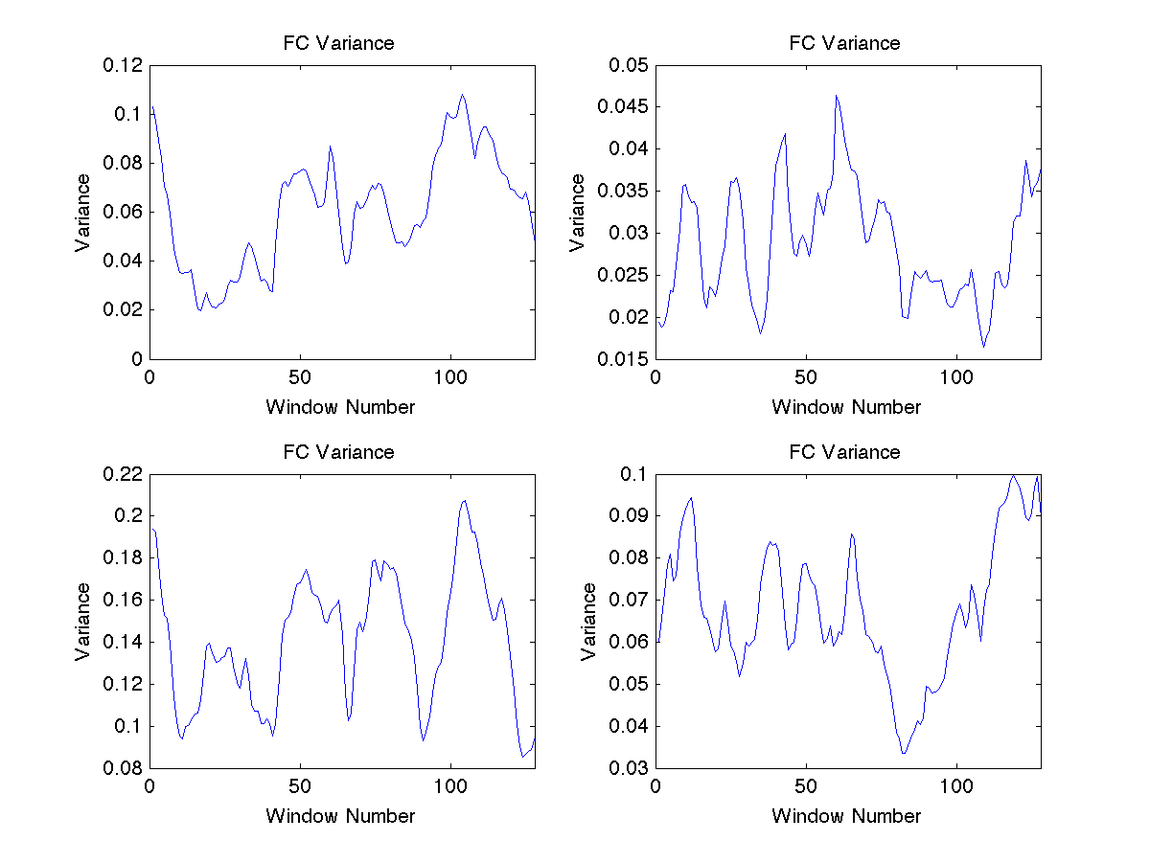
W_width=22 TRs, Step = 1 TRs

Slide 6
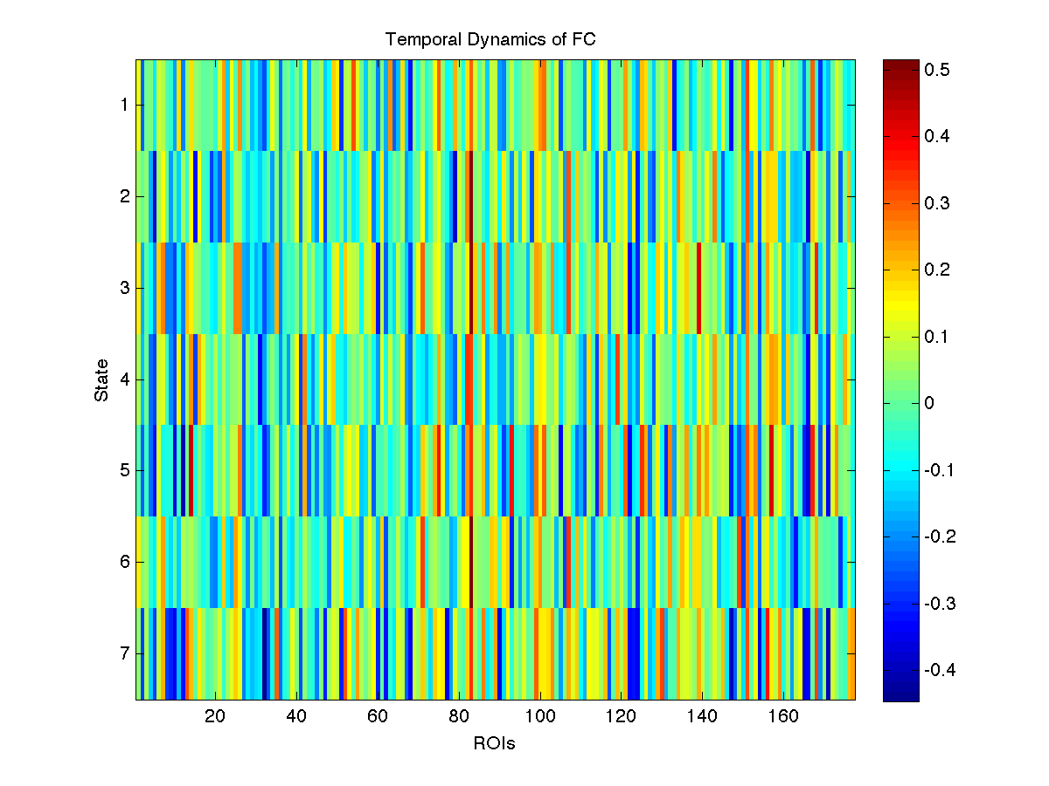
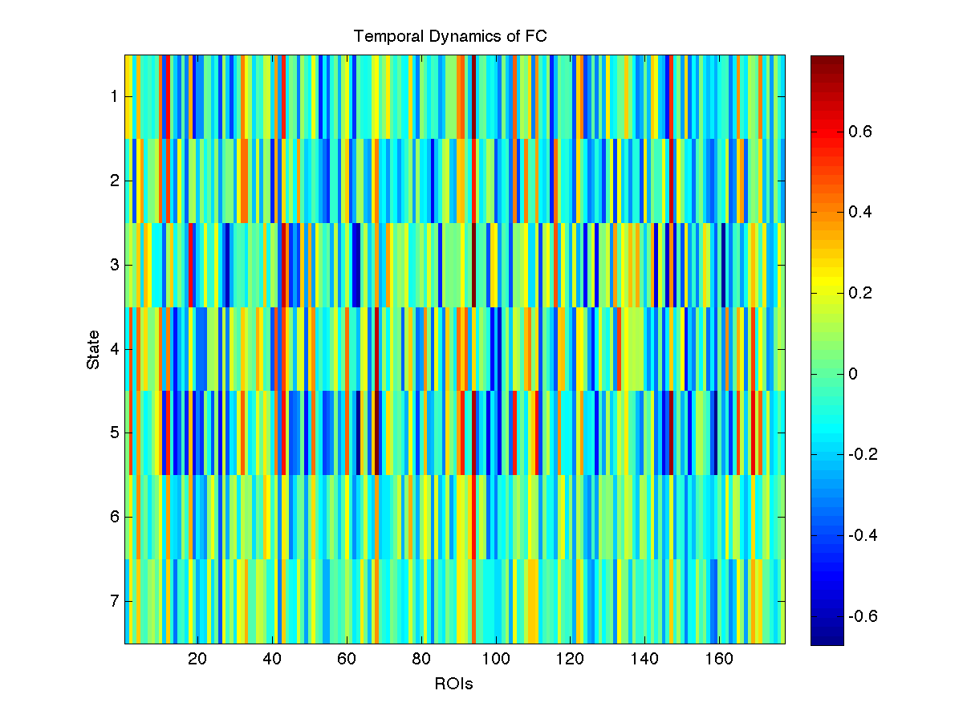
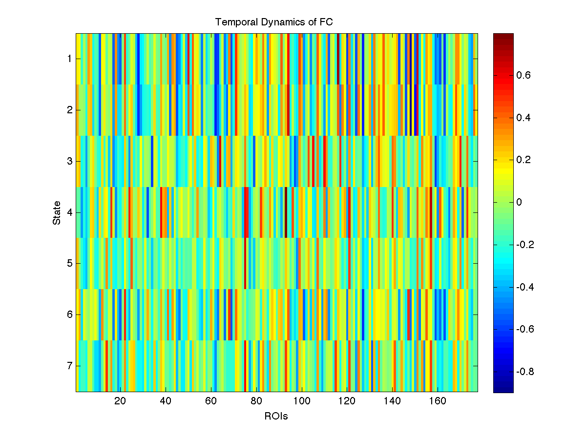
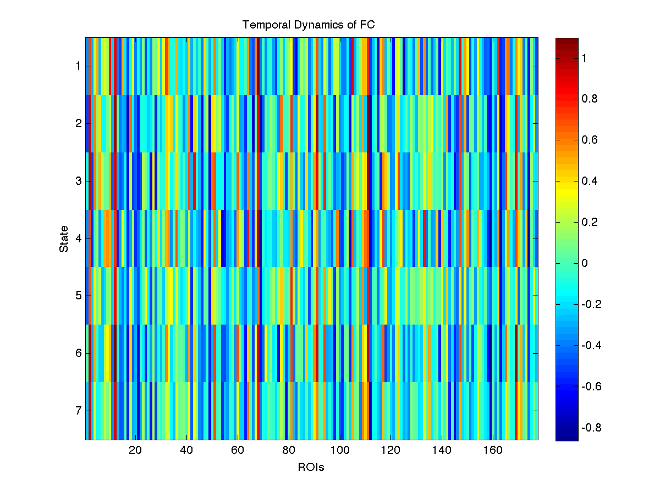

Slide 7
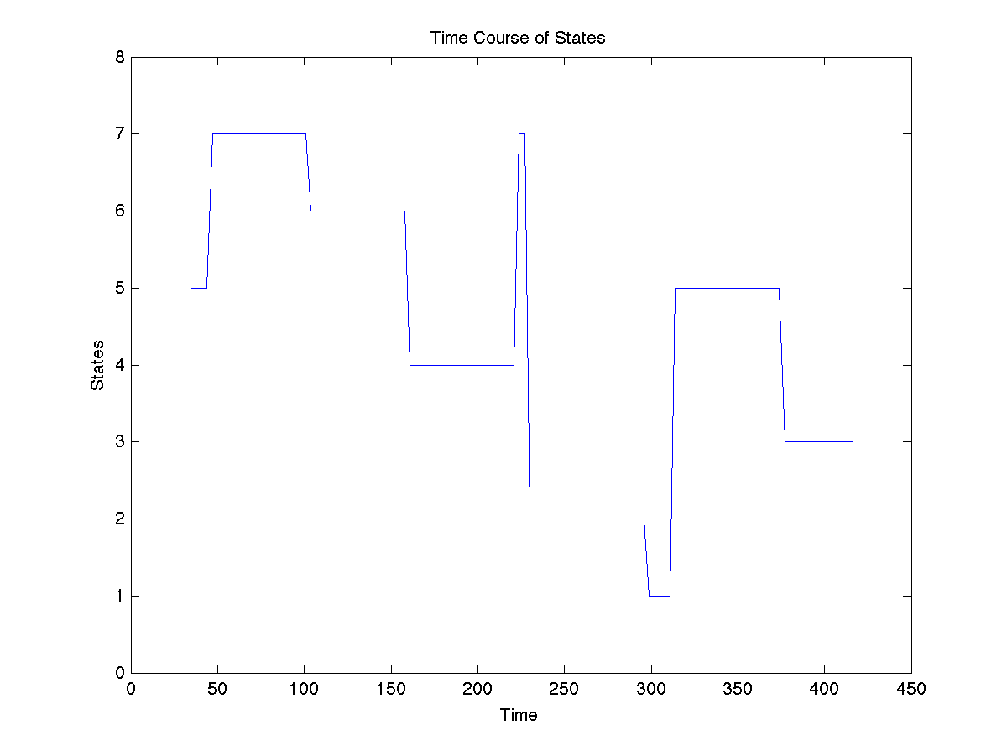
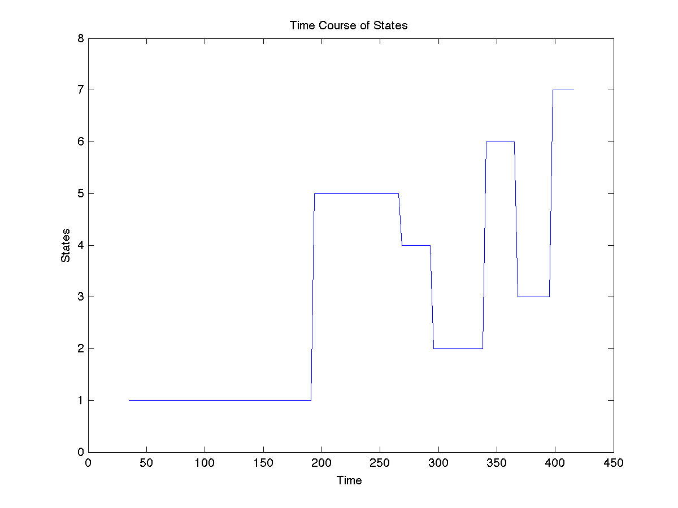
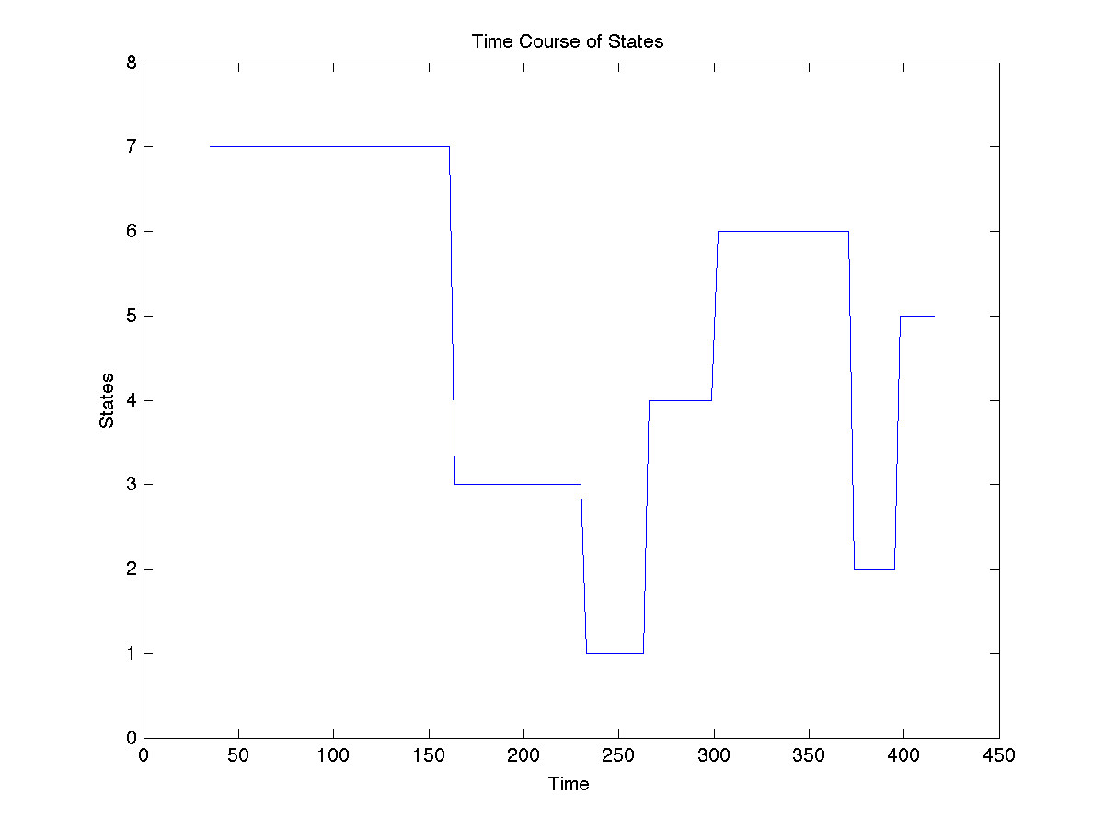
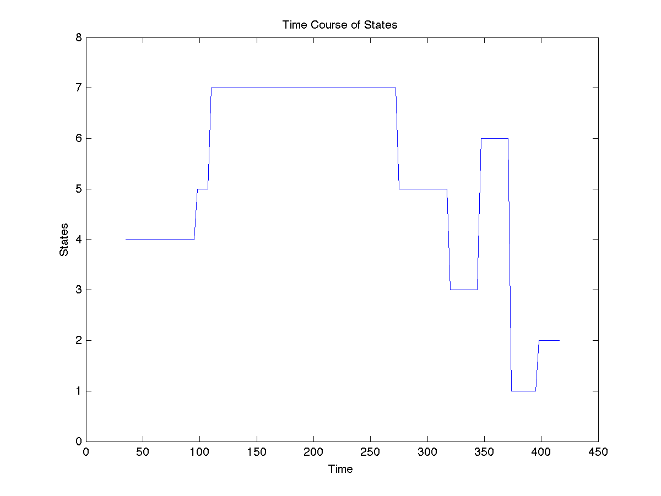

Slide 8
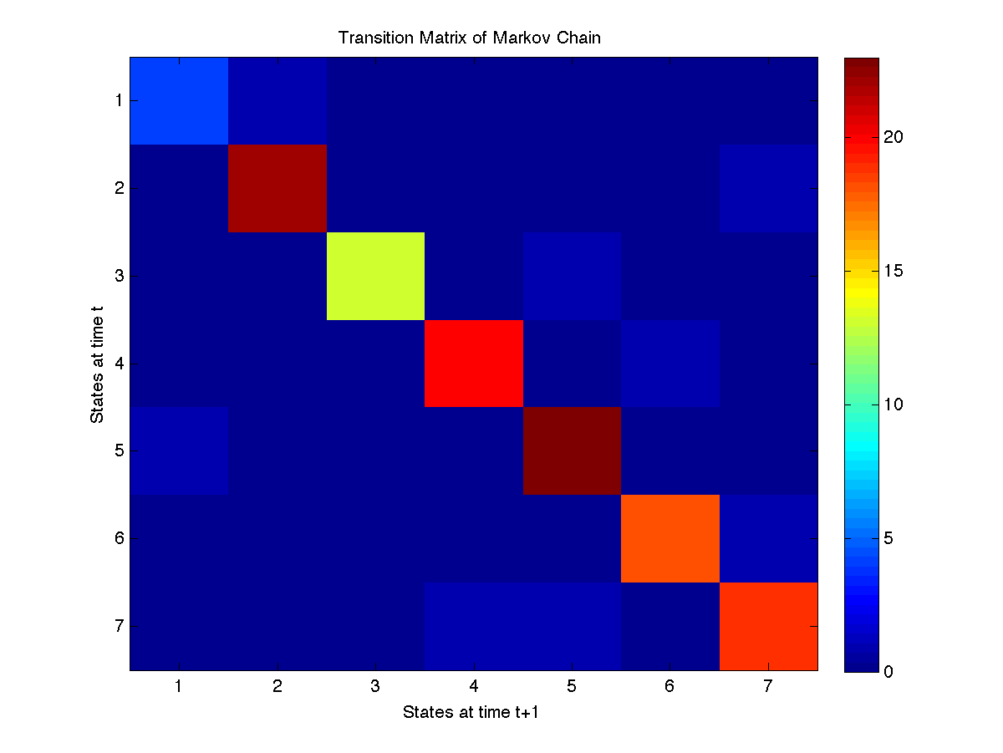
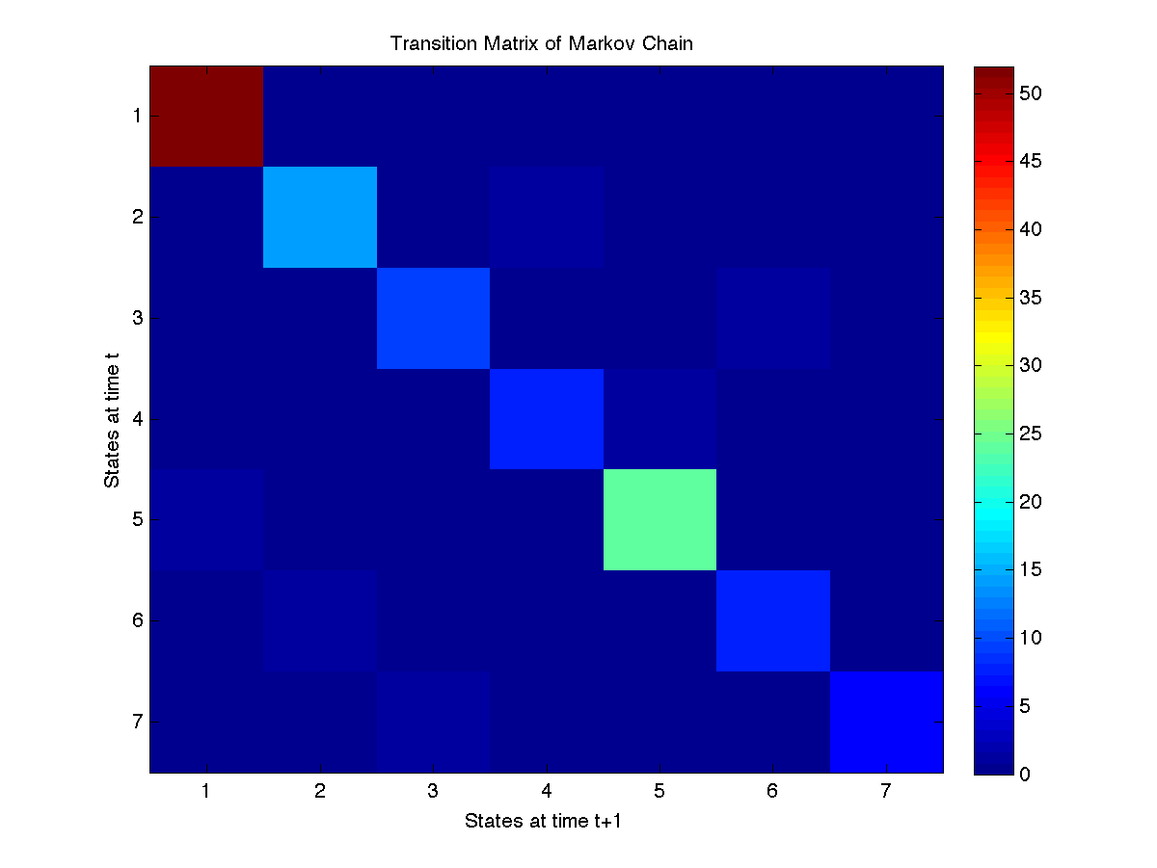
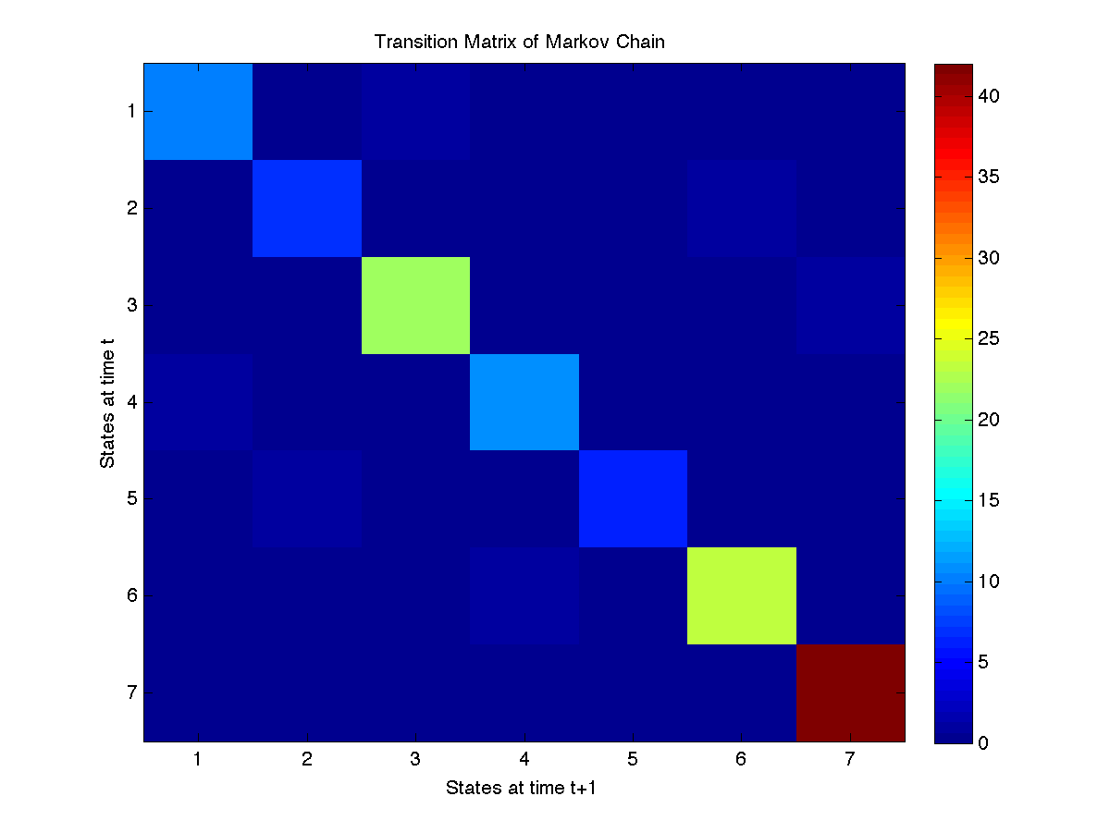
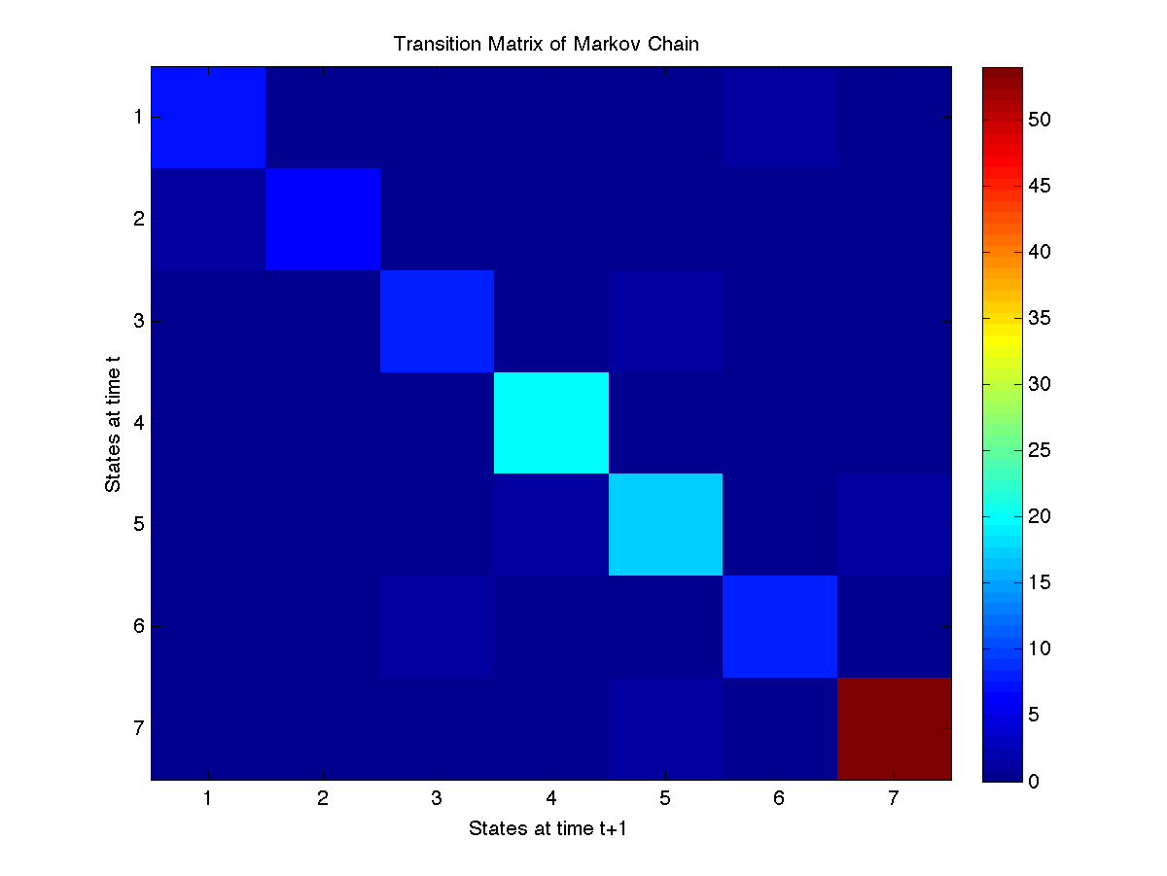

Slide 9
