Slide 1
Lecture 6: Exotic Markets
Modeling and Marketing Making in Foreign Exchange

Slide 2
Local Vol/Stoch Vol Mixture
The Street has largely converged on local volatility/stochastic volatility mixture models
The mixture parameter controls risk reversal beta
... but these models can be slow
Two-factor models (spot & volatility factor)
Numerical calibration
Numerical vanilla & exotic pricing
Even using backward induction, two factor models are slow
Quite uncommon to use Monte Carlo in FX

Slide 3
LV/SV Approximation
Some shops trade off model accuracy for computational speed by using a simpler model that has most of the same features as the full model
Model spot as a diffusive process still...
... but allow the stochastic volatility factor to take only a few discrete values instead of modeling as a diffusive process
eg two or three “layers” for stochastic volatility
Stochastic volatility factor jumps between the different discrete values according to a Markov process

Slide 4
LV/SV Approximation
One simple formulation
S(t) = spot at time t, σ(S,t) = local volatility function, v(t) = stochastic vol factor
Y(t) can be -1, 0, or +1
ε is something like a volatility of volatility

Slide 5
LV/SV Approximation
Need a way to define the transition probabilities for Y(t)
Markov transition matrix
Define transition probabilities to mimic a mean-reverting square root process for v(t) as closely as possible
An approximation to the Heston-like formulation of LV/SV
Notes:
The process there is the fully diffusive form for dv, in a model where v takes continuous values.
Our model restricts v to take discrete values, but we set the transition probabilities between the three states (Y=-1, 0, or +1) so that we get as close as we can to the diffusive process’s mean and variance for dv.

Slide 6
LV/SV Approximation
Six transition probabilities are required
Describe them as “frequencies” – probability of transition in a time period dt equals frequency * dt
Like a Poisson process jump
λ₀₊ and λ₀₋ represent the frequencies of jumping from Y=0 to Y=+1 or Y=-1 respectively
λ₊₀ and λ₊₋ represent the frequencies of jumping from Y=+1 to Y=0 or Y=-1 respectively
λ₋₀ and λ₋₊ represent the frequencies of jumping from Y=-1 to Y=0 or Y=+1 respectively
We’ll choose these frequencies to try to match the Heston-like diffusive process mean and variance in each state

Slide 7
LV/SV Approximation
Consider the middle state, Y=0
Here we want zero drift (already at the mean level)
Variance = α² dt to approximate the Heston process variance

Slide 8
LV/SV Approximation
Can rearrange those to solve for the transition frequencies that match the Heston-like process mean and variance from that state
Notes:
Notice that the up and down probabilities are a bit asymmetric; that’s because the vol moves are asymmetric as well (multiplying or dividing by a factor exp(epsilon)).
As you’d expect, the spacing between the layers depends on the volatility of volatility parameter alpha, again as you’d expect.

Slide 9
LV/SV Approximation
Now consider the high-volatility state Y=+1
Should have a negative expected value due to mean reversion

Slide 10
LV/SV Approximation
Similarly can write out the mean and variance required in the lower state
Expected value should be positive due to mean reversion

Slide 11
LV/SV Approximation
Can use those to solve for the other four transition frequencies
However: still one free parameter
The distance between the states parameter, ε
Choose that to make the probability zero of jumping from Y=+1 state to Y=-1 state, or vice versa
Means no really big vol jumps
And gives a reasonable state spacing as well

Slide 12
LV/SV Approximation
Choose e to be equal to
Notes:
State spacing is roughly proportional to the volatility of volatility parameter alpha, and inversely proportional to the square root of the mean reversion strength.
Variance then looks a lot like the long-run variance of a mean reverting process.

Slide 13
LV/SV Approximation
With this choice for ε
Notes:
This fully defines the transition probabilities between the three states.

Slide 14
LV/SV Approximation
What is the initial value of Y?
Could start with Y=0; that’s like starting with a known value of v(0) in a Heston-like model
Could also assume we don’t know the value of Y
Assume it takes its stationary distribution across the three states
Better: gives a large short-expiration smile than a fixed initial value of Y
Matches market behavior better

Slide 15
LV/SV Approximation
Stationary probabilities (where probability in matches probability out)
Price of a derivative is price weighted across the three layers
Notes:
P0 is the probability of Y being in the Y=0 state; P+ is the probability of Y being in the Y=+1 state; P- is the probability of Y being in the Y=-1 state.
v0 is the price of the derivative in the Y=0 state; v+ is the price of the derivative in the Y=+1 state; and v- is the price of the derivative in the Y=-1 state.

Slide 16
LV/SV Approximation
Local volatility uses a parametric form
Define a transformed spot variable
Then mark local volatility for five points in x
x=-1.28, -0.68, 0, +0.68, +1.28 (roughly ATM, 25d, and 10d points)
σ₀ is the local volatility for x=0
Cubic spline between them
Same extrapolation as we used for implied volatilities before
Cubic spline extrapolation parameter determines how quickly local volatilities flatten out outside x=-1.28 and x=+1.28

Slide 17
LV/SV Approximation
Pricing under the model can be done with backward induction
Two operations for each step
First, backward induct one time step for all three Y layers independently, solving the Y-specific PDE
Notes:
Different PDE for each layer because the value of Y is different for each layer.

Slide 18
LV/SV Approximation
Then, mix between layers according to the probabilities of transitioning between the layers
Repeat this two-step process for each time step as you move backward from the derivative expiration to t=0 (today)
Notes:
Ends up being about 6x as slow as pricing a standard local volatility model: three backward inductions, plus three mixings, per time step; vs just one backward induction for standard local volatility.
That is significantly faster than a full 2f model, which runs 50-100x as slow as a standard local volatility model.

Slide 19
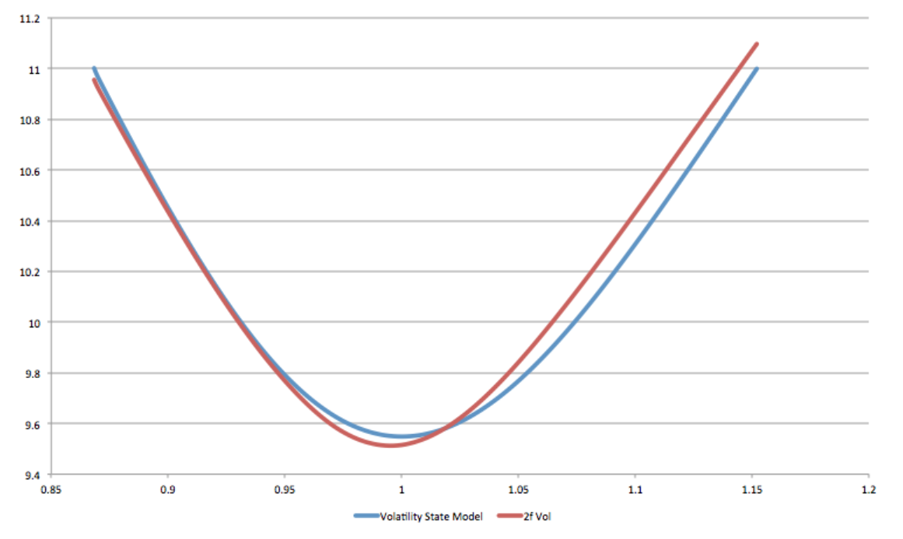
LV/SV Approximation
Gives very similar (but not identical) implied volatilities as the full two-factor model where stochastic factor diffuses like a Heston process
Notes:
Implied volatilities for 0.5y to expiration. x-axis is strike in units of the forward (so 1 means at-the-money forward). y-axis is implied volatility.
Model parameters alpha=1 and beta=1, with constant local volatility of 10% (constant because we want to compare the impact of the stochastic volatility piece).
The red line shows the implied volatilities for the full 2-factor model. The blue line shows the same for the 3-state approximation.
We don’t expect the vols to be exactly the same, since the two models are, after all, different. But they are really quite close for such different treatments of stochastic volatility.

Slide 20
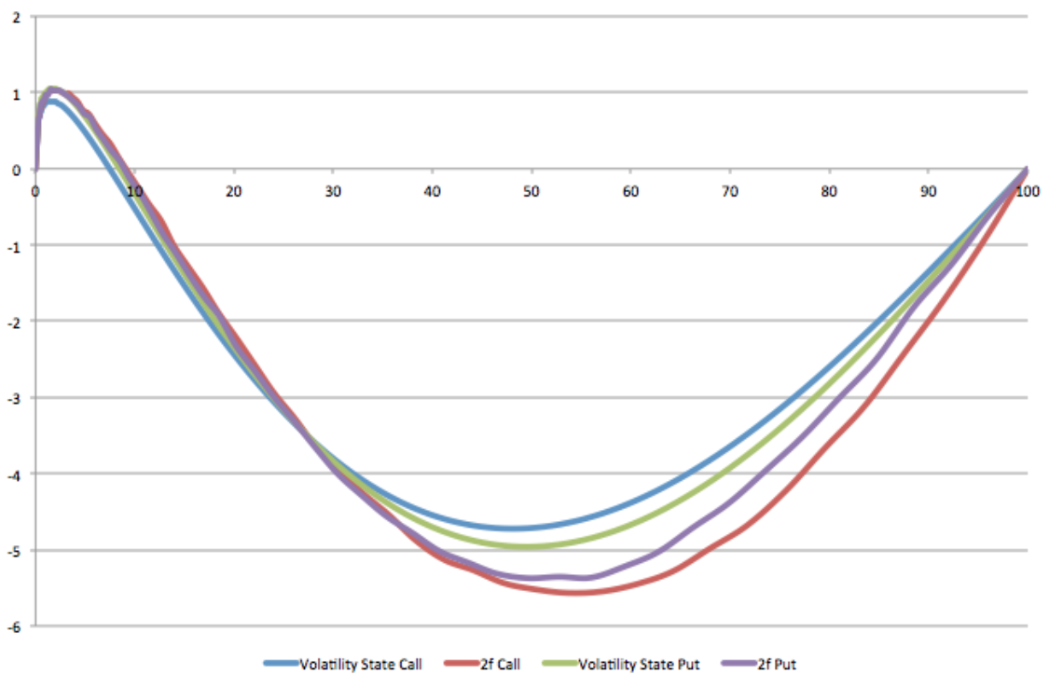
LV/SV Approximation
Gives very similar barrier option prices as well, as measured by one touch prices
Notes:
One touches: “call” means a one touch whose barrier is above spot, and “put” means a one touch with barrier below spot.
This plot shows information about pricing for one touches with 0.5y to expiration, again with alpha=beta=1 and a constant local volatility of 10%.
The x-axis shows a transformed one touch strike: it corresponds to the Black-Scholes price of the one touch. So for example, “70” means “the strike such that the Black-Scholes price of the one touch is 70%”. This is the analog of translating strike to delta for vanilla options: it gives a natural scale, in this case between 0% and 100%.
The y-axis shows the one touch model price as a difference to the Black-Scholes price. So “-4” means “the LV/SV model price of the one touch is 4% below the Black-Scholes price of that one touch”.
There are four lines here: two are for calls (red for the 2f model and blue for the 3-state approximation), and two are for puts (purple for the 2f model and green for the 3-state approximation).
The match here isn’t quite as good as it is for vanilla options, but still gives quite similar pricing behavior, for quite different market dynamics.

Slide 21
LV/SV Approximation
Calibration of the model means calibrating the local volatility parameters
Five local volatility parameters
Assumed to be piecewise-constant in time, between benchmark expiration dates
Bootstrap the parameters
Calculate the first set of five to match the five implied volatilities at the first expiration date
Then use those plus the five implied volatilities at the second expiration date to calibrate the second set of five local vols
... and so on
Assumes the α and β parameters are marked a priori
These are “exotic parameters”: not explicitly calibrated

Slide 22
LV/SV Approximation
Numerical root-finding to solve for the local vol parameters
Sped up by using “forward induction”
Lets you price vanilla options for many strikes in one pass
Analogous to pricing one vanilla option for many spots with backward induction
This is a powerful technique to reduce computation time
... but we don’t have time to go through the details today
You’ll use it in the assignment

Slide 23
LV/SV Approximation
With a calibrated model we can look at how barrier option prices are affected by the mixture parameter
First, we should look at what the model predicts for risk reversal beta
Risk reversal beta is the most important dynamic for pricing barrier options
Risk reversal beta in the model is determined by how risk reversal moves as spot moves and accesses different local vols
Still averaging across the three Y layers

Slide 24
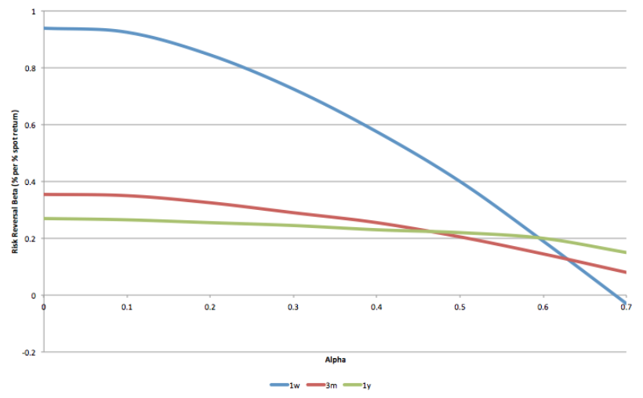
LV/SV Approximation
Risk reversal beta for different expiration tenors, as a function of the volatility of volatility parameter α
Notes:
For a representative FX market – see paper for details.
The x-axis shows the alpha parameter, ranging from zero (pure local volatility) to 0.7 (a high value where local vol mostly has skew, no smile).
The blue line shows RR beta for 1w expiration tenor; the red for 3m tenor, and the green for 1y tenor.
All three risk reversal betas decline significantly as alpha increases, which is what we’d expect: the local volatility limit should have the highest RR betas, and the stochastic vol limit the lowest.

Slide 25
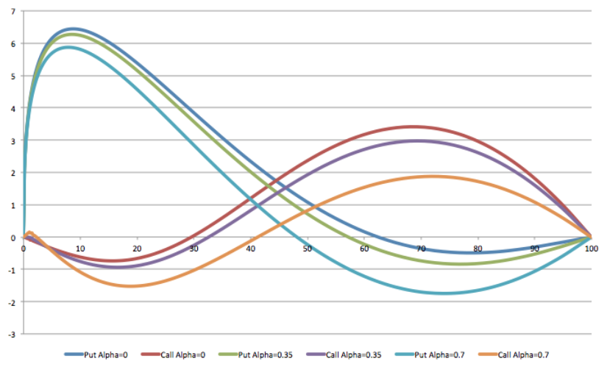
LV/SV Approximation
Can then look at impact of changing α (and recalibrating local vols) on one touch prices
Notes:
There are three lines for one touch calls (red for alpha=0, purple for alpha=0.35, and orange for alpha=0.7) and three for one touch puts (blue for alpha=0, green for alpha=0.35, and light blue for alpha=0.7). All expirations are 6m.
Again, the x-axis is Black-Scholes one touch price as a transformed one touch barrier level; and the y-axis is model price less Black-Scholes price.
Note that changing alpha over this range changes the model price by up to about 2%, which is about the bid/ask spread of one touches. So even for this relatively long expiration, changing alpha can significantly impact one touch pricing.

Slide 26
Numerical Frameworks
Pricing exotics under a model like this is computationally expensive
Generally want to delegate pricing to C++ for faster performance
Often an order of magnitude or two faster than in Python
But you want to be able to play around with pricing for new exotic structures in Python
Want to be able to define contract terms in Python but delegate pricing to C++
Right way: build a backward induction engine in C++ and expose it in Python
Notes:
Here “C++” and “Python” should be read as stand-ins for low level and high level languages.
Most quant libraries are written in C++, so not much variation there – maybe a few are in Java but not many.
There is a fairly wide spread of high level languages used on the street. Python is increasingly popular these days, though Scala is mentioned a fair bit, as are vendor languages like MatLab.

Slide 27
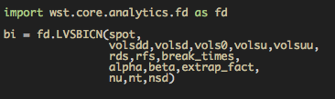
Numerical Frameworks
Example: pricing under the LV/SV approximation model in the WST environment
Since I have it available!
First step: create a backward induction engine
Notes:
The class LVSBICN contracts a backward induction engine, onto which later we’ll set contract terms as boundary conditions and make it backward induct. The arguments are market inputs, model parameters, and numerical parameters.
spot is the current FX spot price
volsdd, volsd, vols0, volsu, volsuu: these are lists of 5-element lists corresponding to the 5 local vol parameters for each of the times in break_times. volsdd corresponds to x=-1.28; volsd to x=-0.68, vols0 to x=0; volsu to x=+0.68; and volsuu to x=+1.28.
rds and rfs are the piecewise-constant forward interest rates between the break_times for the denominated and asset currencies respectively.
alpha and beta are the vol of vol and mean reversion parameters for the stochastic vol part of the model.
extrap_fact is the cubic spline extrapolation factor used to extrapolate the local vols.
nu is the number of grid points in the spot direction in the finite difference scheme, and nt is the number of grid points in the time direction. nsd is the number of spot standard deviations to include.

Slide 28

Numerical Frameworks
Next step: construct a payoff and add it to the engine as a boundary condition
Example: a vanilla option payoff
The payoff defines a payoff in the spot direction only...
... and is applied onto the engine at some specific time
Can add in payoffs as backward induction proceeds
Notes:
is_call is True if the payoff is a call payoff, False if it’s a put payoff. strike is the strike of the payoff; eg for a call payoff the payoff vs spot is max(spot-strike,0).
Note that the time to expiration of the option isn’t specified in the payoff: that’s just a function of spot.
The time to expiration comes in when you initialize the backward induction engine with a payoff on some specific payoff time; that sets the starting time for the backward induction engine as well.

Slide 29

Numerical Frameworks
Variation: include a knockout barrier in the contract terms
For this we add a knockout first, which constrains the limits of the grid
Then we initialize the grid with the option payoff
Notes:
The add_knockout method takes the barrier price and a True/False flag that defines whether it’s an up-and-out or a down-and-out barrier. The barriers are always knock-outs in this implementation.
By adding the knockout to the backward inductor, it includes a new boundary condition that the price of the derivative is always zero at the barrier level.

Slide 30

Numerical Frameworks
Now the backward induction!
To get the price today, backward induct to t=0
But could backward induct to an intermediate time, add on a new payoff, and then go back further, etc
After backward inducting, you get a price by asking the engine to interpolate a price at the spot level you want
Notes:
That’s it, you’re done.

Slide 31
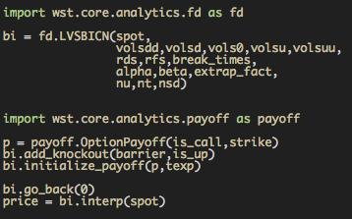
Numerical Framework
All the code together to price a knockout option
Not very much of it! It’s easy to price new structures
Notes:
Of course need to define what the inputs are, which I’ve left generic in this example.
And you need to figure out what numerical parameters (nu, nt, and nsd) to pass to the engine. That’s a bit of an art, really – you just have to look at a lot of examples and make sure the pricing is always converged. Sometimes you can get away with constant values for these; sometimes you might need to customize them by parameters of the structure (like time to expiry). Making them functions of market data is a poor idea in general, though, because then bumping market inputs to get risk numbers can result in changes to numerical parameters and noisy partial derivatives.

Slide 32
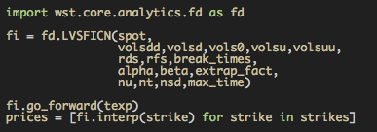
Numerical Framework
Can use forward induction to get call option prices for a range of strikes with one call to the forward inductor
Notes:
Note there’s no need to define the payoff: forward inductors always price call options.
And note the forward inductor starts at t=0 and inducts forward in time to some future expiration time: the opposite to the backward inductor, which starts in the future and inducts backward to today.
Calling the interp method on the forward inductor interpolates a call option price for that strike, expiring on whatever time you’ve forward-inducted to.

Slide 33
Pricing with Copulas
Consider a European “dual digital” option
Pays 1 unit of currency if spot₁>strike₁ and spot₂>strike₂ on some expiration date
A regular European digital is a measure of the risk neutral probability that spot>strike
A dual digital is a measure of the joint probability that both spots are above the two strikes
Depends on correlation
What does correlation mean outside Black-Scholes?

Slide 34
Pricing with Copulas
Copulas let you piece together known marginal distributions
If I know vanilla prices in the two markets, I know the two marginal distributions
The choice of copula defines the specific correlation structure that gets applied
Defines the joint distribution
Many different kinds of copulas
... and many different kinds of correlation structure
We’ll focus on just one: Gaussian copula

Slide 35
Pricing with Copulas
Basic idea for a Gaussian copula
Translate each spot to a standard normal variable
State that the joint distribution of those two standard normal variables is bivariate standard normal with a fixed correlation
Then can price any European payoff on the two spots
Payoff at expiration in terms of the two spots
Translate to a payoff in terms of the two standard normals
Integrate the payoff over the joint distribution

Slide 36
Pricing with Copulas
First step: translate spot to a standard normal variable
Match them up via the cumulative distribution functions
f_{n}(x) = standard normal PDF, N(X) = standard normal CDF
f_{S}(S) = risk neutral PDF of spot, F(S) = CDF of spot
F(S) is the (undiscounted) digital put price
Notes:
So now I can get a value of x given a value of S, by calculating F(S) (the undiscounted digital put price struck at S) and then passing that to the inverse standard cumulative normal distribution function.
Or, I can go the other way: given a value of x I calculate N(x), then find the strike of an undiscounted digital put such that its price equals N(x).
Except when skew or smile is really extreme, the map x(S) is pretty smooth – it looks a lot like ln(S), with some minor wiggles for skew & smile adjustments.

Slide 37
Pricing with Copulas
Now I can price any payoff on two spots by asserting a bivariate normal distribution with a fixed correlation
Here, P(S₁,S₂) is the payoff in terms of the two spots, which we write as functions of the two standard normal variables x₁ and x₂
f₁₂(x₁,x₂) is the bivariate standard normal distribution function
Notes:
I’ve left off discounting here to keep the notation clearer, but you can always easily add that in at the end for a European payoff.

Slide 38
Pricing with Copulas
The joint distribution is defined by a correlation parameter ρ

Slide 39
Pricing with Copulas
European joint digital price is pretty simple
Find x_{1K}(S₁=K₁) and x_{2K}(S₂=K₂) from the maps
Just the bivariate standard cumulative normal distribution function
No closed form, but efficient closed-form approximations

Slide 40
Risk with Copulas
There is only one parameter that defines correlation structure in a Gaussian copula
The correlation parameter r
We can calibrate to ATM volatility of the cross pair
eg asset 1 = EURUSD, asset 2 = GBPUSD
Cross spot is then EURGBP and we see those volatilities
Use the copula model to price the ATM EURGBP option and set ρ so that the model reproduces its price

Slide 41
Risk with Copulas
The model then is calibrated only to EURGBP ATM volatility, not to its RR/BF levels
In general a Gaussian copula will not hit the cross RR/BF
Tends to underestimate cross BF in particular
One way to think about this: correlation is not really constant
It is stochastic, and if a derivative has non-linear exposure to a stochastic asset, its price should incorporate value from that gamma
If it is correlated with the spots, there is cross gamma to price as well
Notes:
This approach to thinking about the weaknesses of Gaussian copulas can lead to better copulas, as we’ll see in the assignment.

Slide 42
Variance Swaps
A variance swap contract pays out against realized volatility squared
σ² is the realized vol squared swapped against a fixed strike
N_{d} is the number of trading days/year: specified in contract
N is the number of daily spot returns in the contract period
S_{i} is the spot fixing for fixing date i

Slide 43
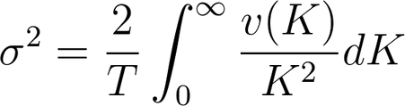
Variance Swaps
Variance swaps with continuous fixings, on an asset with no jumps, can be replicated by a vanilla portfolio
σ² here represents the fair strike for a variance swap settling time T in the future
v(K) is a call option price for K>forward, put otherwise
Notes:
As we saw in the first vanilla options lecture, while variance swaps can be replicated with vanillas, they depend on details of vanilla vol extrapolation that regular vanilla portfolios are only weakly sensitive to. So effectively the extrapolation behavior risk is a new kind of exotic risk that variance swaps are exposed to.
Don’t forget, btw, that the replication works only when there are no jumps in the asset price. That’s true for G7 FX. But people often use this formula without remembering that constraint, which can be a big deal in other markets like single name equities.

Slide 44
Volatility Swaps
Volatility swaps pay off against realized volatility
Not volatility squared, like a variance swap
You can think about pricing these as a square-root payoff on an asset that is the variance swap
The average of that asset is the fair strike for the variance swap
Need to model volatility of variance swap fair strikes

Slide 45
Volatility Swaps
Hedging strategy for a volatility swap:
Buy the volatility swap, a contract with a square root payoff against the “asset”, the variance swap
Sell an appropriate amount of the variance swap against it
Notional 1/2/sqrt(var swap fair strike), from derivative of square root
When the market moves and the variance fair strike moves, the variance swap notional needs to be adjusted
Negative gamma to moves in the variance swap fair strike

Slide 46
Volatility Fair Strike
Because of the negative convexity, the volatility swap fair strike is less than the square root of the variance swap fair strike
Buy vol swap, dynamically hedge with variance swap, lose money due to negative gamma
The spread there is a function of the realized volatility of the variance swap fair strike
Pretty close to the realized volatility of ATM volatility
This is the dynamic that you need to model for vol swaps
Very different to what barrier derivatives care about!

