Slide 1
Lecture 7: Algorithmic Indexes
Modeling and Marketing Making in Foreign Exchange

Slide 2
Regular Indexes
An index is meant to be a representation of a particular market
eg S&P 500 Index: representative average of the US large-cap equity market
eg GSCI: representative average of the commodity markets
Indexes are used as benchmarks for real trading strategies
Most indexes are not themselves tradable
eg S&P 500: there is no set of trades you can put on such that the portfolio value tracks the index level exactly

Slide 3
Tradable Indexes
Tradable indexes are meant to track the value of a real trading strategy
Bid/ask spreads
Dividends/interest
Actual securities
A market making desk can offer derivative products on tradable indexes
Swaps
Can hedge the risk exactly by trading the underlying strategy
Options
Trickier if the underlying portfolio isn’t very simple

Slide 4
Tradable Indexes
Trading strategies are defined by a set of rules
Rules rarely, if ever, change for a given index
No discretion by index publisher in choice of investments at all
The index defines a “synthetic portfolio”
The result of all the synthetic trades done via the index rules
The synthetic portfolio ages over time and rules must account for its evolution
Paying/receiving interest on currencies
Paying/receiving dividend payments on equities
Exercising/expiring options

Slide 5
Tradable Index
eg: EUR tracker index
Non-tradable index
Equal to EURUSD spot: the price of a EUR in USD
Tries to represent the value of a strategy where you hold 1 EUR
Does not represent the interest you get paid on your EUR
Tradable index
Equals the price of a portfolio that holds 1 EUR and receives interest on it
Accounts for bid/ask on interest payments

Slide 6
EUR Tracker Index
Rules:
Day 1: buy $100 of EUR at spot at the ECB fix
Portfolio is a EUR zero coupon bond
Notional 100/(fix on day 1), value date = spot date of initial date
Day i>1: roll the EUR (now T+1, not T+2) back to spot using tom/next forward points
Notional increases every day at the appropriate EUR rate
Value date of EUR keeps stepping ahead
Day i value: EUR notional * (fix on day i)
Use the FX forward curve to roll because that is how, in practice, one access the short-term interest rate market in EUR

Slide 7
EUR Tracker Index
Let’s consider the roll process in practice
Start with N EUR value date T+1
Was T+2 (spot) yesterday, but now it’s only T+1
Short a forward contract value date T+1 for N EUR
Sell N EUR T+1, buy N F₁ USD T+1
F₁ is the forward to T+1
Long a forward contract value date T+2 (spot) for N EUR
Buy N’ EUR T+2, sell N’ S USD T+2
S is spot: the forward to T+2

Slide 8
EUR Tracker Index
Now we’ve got a portfolio which is a little complex
+N F₁ USD T+1
+N’ EUR T+2
-N’ S USD T+2
We need to roll that USD T+1 to USD T+2
Also need the USD rate in here! Use Fed funds effective rate as the fix (where a bank can roll overnight)
Not quite right since that’s a T+0 to T+1 rate, but pretty close
Sell N F₁ USD T+1, buy N F₁ (1+r Δt) USD T+2
Δt equals [ number of calendar days from T+1 to T+2 ] / 360
Need to know holiday calendars now <SIGH>
These details matter if you don’t want to bleed away your fee

Slide 9
EUR Tracker Index
Now we have a portfolio all on T+2
N’ EUR T+2
[ N F₁ (1+r Δt) – N’ S ] USD T+2
We’ll choose N’ such that the USD notional is zero
N’ = N F₁ (1+r Δt)/S
Remember that F₁ is the forward to T+1
F₁ = S (1+q Δt)/(1+r Δt), so N’ = N (1+q Δt)
q = EUR interest rate; so accruing up at EUR interest rate implied from forwards and the Fed funds effective rate
Lot of work just to figure out how to roll!
Typical of index construction – loads of finicky little details

Slide 10
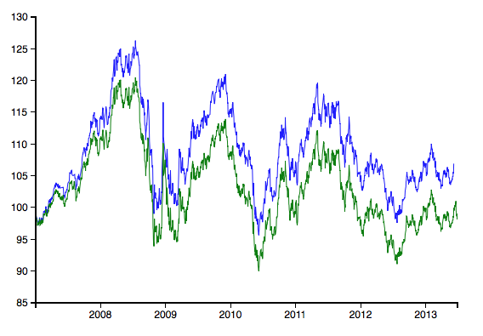
EUR Tracker Index
Notes:
Blue line is the EUR tracker index, green line is EUR spot/initial spot*100 (so not including any rolling).
The difference between the two is pretty small in the short term but becomes significant over time.

Slide 11
EUR Tracker Index
This EUR tracker index wouldn’t be marketable, though!
We used Bloomberg LN close forward points
Where do those come from?
Bloomberg’s not saying! Some opaque aggregation.
The fixes in the index need to be transparent
Published by a trusted 3rd party (government, exchange)
Or based on tradable levels (eg WMR fixes)
We could replace the tom/next forward point fixes with WMR forward point fixes
Index publisher must pay license fees to be able to use & view those
Also no bid/ask
Need to include that in tom/next forward points, not USD rates
Notes:
Bid/ask on tom/next rolls is small on a per-transaction basis, but you have to pay it every single day, and that can get relatively expensive.

Slide 12
EUR Tracker Index
Other constructions are possible
Trade FX forwards with value dates further out on the curve
Initially trade a 3m forward
Hold it until it’s spot, then roll it to 3m again
Results in lower bid/ask but doesn’t track spot as closely
Trade FX futures contracts
Hold the prompt contract
Roll into the next contract when the futures settles

Slide 13
Index Trading
Swaps
Payoff is [ (Index at End)/(Index at Start) – 1 ] * Notional
Notes
Bond that pays Notional * (Index at End)/(Index at Start)
Normally zero coupon
Notes with principal protection
Bond that pays Notional * Max(1,(Index at End)/(Index at Start))
Equivalent to a zero coupon bond paying Notional plus a call option on the index level struck ATM

Slide 14
Hedging a Tradable Index
A market maker always sells the tradable index; client always buys
Needs to be direction-specific since the bid/ask is built into the index value
Can construct two indexes, one for a long position and one for a short position, but client always buys the index
Client receives the synthetic trades, which means dealer delivers them
Dealer then executes real trades to offset the synthetic trade risk

Slide 15
Hedging a Tradable Index
Really important to think about hedging process when constructing an index
eg EUR tracker index example
What bid/ask will we really pay on tom/next rolls when hedging with the forwards desk?
What rate do we receive from the internal treasury when rolling USD cash balances? Is it really Fed funds effective rate?

Slide 16
Tradable Indexes & OTC
Tradable indexes are hard to sell if they include fixes that are not transparent and based off dealable prices
Clients are concerned that dealers will manipulate fixes against them
LIBOR scandal
WMR FX scandal even
Big deal for mostly-OTC markets like FX
Often index products will use the futures markets to avoid this
Exchange settles are canonical example of a good fix
... but futures markets often only cover a corner of the real market
Notes:
In FX, the liquid futures markets cover only the most liquid developed currencies vs the USD: EUR, GBP, AUD, JPY, CAD, and CHF.
Hard to even use less liquid futures markets based in other countries, since if the product does well then the traded notional through indexes might exceed the available liquidity in that futures market.

Slide 17
Fees in Tradable Indexes
Some fees are explicitly defined in the index rules
eg: index decays at 25bp/year all else being equal
That decay for the client is a pickup for the dealer
Some fees are wrapped up in internal bid/ask logic in the index
Generally rules-defined bid/ask is bigger than market bid/ask
Way of getting paid, but also a way of protecting against widening bid/ask in crisis events etc
Fees are almost always very transparent in tradable indexes
Clients demand it

Slide 18
Beta Indexes
A “beta” index is one where the index is meant to track some particular market factor
“Beta” from the CAPM beta parameter that regresses an asset price against an index representing a broad market
Not meant to have any particular edge
No smart analytics inside
Just a way to access a particular market
Lets someone trade a simply financially-settled swap and get access to a market they might not know the operational details of
Pay a fee in return for access – usually quite small for simple beta indexes

Slide 19
Beta Indexes
Beta indexes are usually not big money-makers for dealers
Fees are low
Lots of competition
Other dealers offering similar indexes
Other products (eg ETFs) that give similar exposure
Big investors can trade the markets directly
Don’t need an access vehicle
Exceptions for harder-to-access markets like EM
Notes:
With EM, though, reliable fixings are hard to come by, so it’s often difficult to create indexes that are sufficient transparent for big investors to look at.

Slide 20
Carry Indexes
A “carry” trade in general is one where you get paid a risk premium in return for taking tail risk
Like an insurance premium
Not risk-neutral!
In FX it means something more specific
Borrow money in a low-interest rate currency
Invest it in a high-interest rate currency
Make the interest rate differential...
... so long as spot doesn’t move against you!

Slide 21
Carry Indexes
Idea is that a country in trouble will need to raise interest rates significantly to attract investment, and will try to defend its currency against devaluation
While that’s true, the carry trade works well
Not much spot PNL, so just make the interest rate differential
But eventually the country’s central bank runs out of bullets
Currency devalues
Carry trade gets creamed
Very common trade in the FX world
Especially with EM currencies vs G10 currencies

Slide 22
Short Vol Indexes
Another risk premium: implied volatility vs realized volatility
Implied volatility tends to be higher than realized volatility
Options price in some “insurance premium” above the theoretical value from Black-Scholes-style risk neutral pricing
Most of the time shorting options makes money, picking up the premium
In a big move, the short option position gets creamed
Few people are able to weather the drawdowns even if on average the returns are positive

Slide 23
Short Vol Indexes
Simple strategy: sell ATM EURUSD 3m options every day
Delta hedge the aging portfolio
Need to be able to calculate the price of the options to sell on each new day
What fixing sources do you use for spot, forward points, and vol?
Note that the new options are benchmark options (ATM, 3m)
Need to be able to value the aging portfolio
How do you value an arbitrary portfolio?
Aging options do not have benchmark expiration dates or strikes
Need to define some volatility interpolation scheme

Slide 24
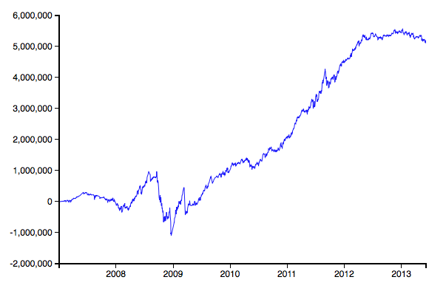
Short Vol Indexes
Notes:
Strategy: every day sell a new 3m ATM option, 1M EUR notional. Delta hedge the aging portfolio.
Note that this is not an index: it starts at zero, goes negative, etc. An index should start at 100 and always stay positive. Typically that’s done by making the notional of stuff traded in the index a fraction of the index level, so it levers up as the index goes up and down as the index goes down. That’s not enough to definitely stop the index from going negative, though, so generally index rules will include a provision that says that if the index ever touches zero, the synthetic portfolio goes away and all future trading stops, and the index stays at zero forever.

Slide 25
Short Vol Indexes
Most short vol indexes add some intelligence about which asset to sell options in
Normally some measure of the spread of current implied to recent realized vol
Many tradable indexes include signals like this
Want some intelligence to improve performance
Not too complex or no investor will understand/believe it
Have to be very careful about overfitting!
Investors always want to see real, live performance
Too easy to get good backtested performance due to overfitting

Slide 26
Short Vol Indexes
Really need to be careful about bid/ask when trading vol index products
Think about hedging
Every time a dealer sells/buys the index to/from a client, they need to rebalance the hedges
Hedges correspond to the exact synthetic portfolio underlying the index
With vol index products, that synthetic portfolio contains a lot of discrete aging options
This affects the ability of a client to eg unwind an index swap before the settlement date
Notes:
Clients generally want “daily liquidity”, which means they want to be able to trade in and out of the index at the daily index fixes with no bid/ask spread.
Dealers usually let clients trade into an index swap at the fix, with no spread, since the index level itself includes fees and spreads.
But if a client wants to exit before the swap settlement date, they will often be extra spreads charged to cover the cost of the dealer having to rebalance the hedges.

Slide 27
Vol Control
One way of trading index products is with a note with principal protection
Note pays Max(1,(Index at End)/(Index at Start))
Equivalent to a zero coupon bond paying 1 plus a call option Max((Index at End/Index at Start)-1,0)
If a dealer sells such a note, they are selling options on the index
What volatility should one use?
Simple tracker indexes, fairly easy to hedge
Complex strategy indexes (eg short vol index), no obvious option market to use

Slide 28
Vol Control
To make this easier, dealers invented “vol control”
Idea: construct a new index that allocates between the real index and cash
When index vol is higher, allocate more to cash
Define a volatility target and set the allocation based on that
Assume that future index volatility equals eg recent realized vol of index
Choose cash vs index allocation so that mixed index volatility will match the target

Slide 29
Vol Control
Imagine a portfolio with some fraction α allocated to the underlying index and remaining value allocated to cash
Cash is valued at 1 always, notional of cash = C
Here the volatility σ is a time-dependent estimate of volatility, usually realized volatility over some rolling window
σ_{Target} is the target level of volatility
Should be lower than the index volatility will ever go
Notes:
As the index volatility sigma changes over time (as realized volatility realizes at different levels), alpha changes and the meta-index M reallocates between the underlying index S and the cash notional C.
This keeps the volatility of M as close to the target volatility as possible.

Slide 30
Vol Control
That’s just one vol control scheme – lots of different (but similar) ways to define how the allocation works between the index and cash
Instead of cash might be a treasury bond portfolio or similar
Basic idea is to create the new (meta-)index M that has a fixed volatility equal to the target volatility
Then can write options on M with a lot more confidence

Slide 31
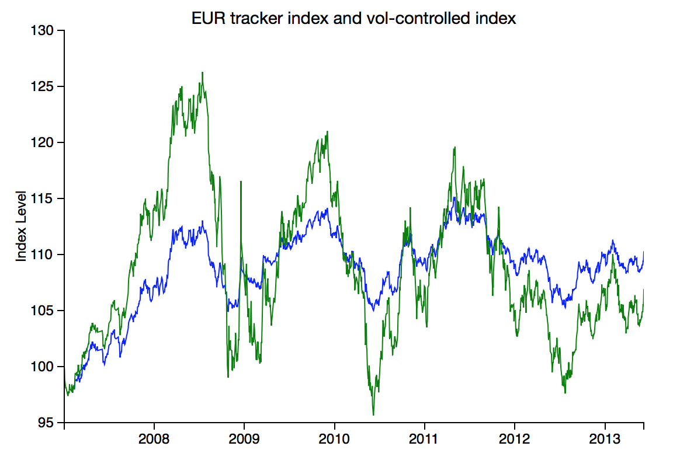
Vol Control
Notes:
Using a 4% vol target.
Green is regular EUR Tracker index, blue is the vol-controlled version.

Slide 32
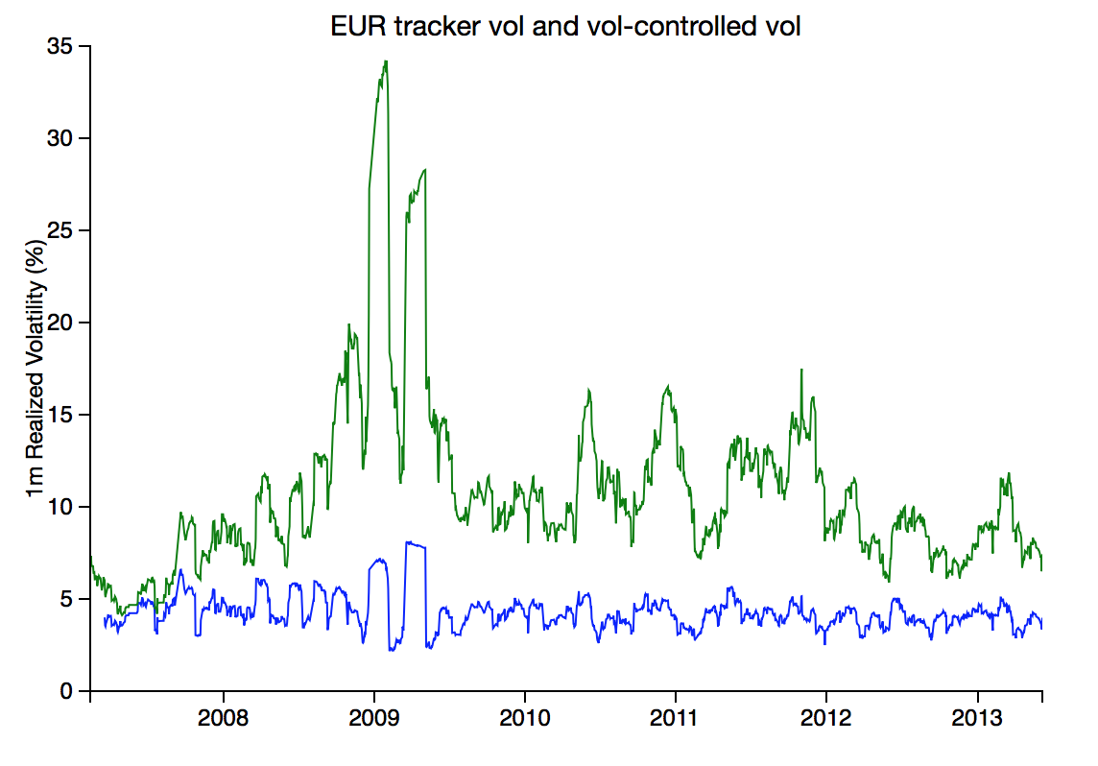
Vol Control
Notes:
Note that the realized vol for the vol-controlled index (blue) averages close to the 4% vol target, and most of the time is quite close to it.

Slide 33
Course Summary
Stuff to focus on
Spot
OTC voice business model & roles
OTC electronic business model & roles
Basics of electronic price-making algos & hedging algos
Forwards
Spot vs forward arb and how it works in practice
Why FX forwards businesses are really short-term rates businesses
Ways of reducing dimensionality of risk

Slide 34
Course Summary
Options
Conventions (delta, risk reversal, butterfly)
Risk reversal beta
Vol interpolation in the strike direction
Vol interpolation in the time direction & trading time/theta
Why vega gamma and vega dspot lead to skew & smile
Definition of delta/volatility market models
Regarding cross pair volatility in terms of correlation
Volatility relative value

Slide 35
Course Summary
Exotics
Pricing European payoffs through replication
Why RR beta drives barrier option pricing
LV/SV mixture model definitions
The local vol 3-state model
Pricing vanillas using characteristic functions
Gaussian copulas
Why realized vol of implied volatility drives vol swap pricing
Index
What makes an index tradable
Types of tradable index strategy
How vol control works

Slide 36
Final Exam
Final exam is Wed Dec 17, 6-8pm
Written exam only
No calculators, computers, notes, etc
Questions will of course not be numerical
Qualitative questions about market structure, market dynamics involved in pricing, etc
Math questions like the ones in the assignments

