Slide 1
IBM Technology Recommender
WatsonX-Singapore-Lions

Slide 2
Key Challenges
IBM Technology discussion in a Consulting led deal sometimes happens late in the RFP process which is leading to an unsuccessful IBM technology positioning in the deal.
Lack of a detailed understanding on broad IBM technology offerings and mapping them to client’s requirements are some of the key reasons for a consulting architect/SSC not being able to infuse IBM technology.
Architect/SSC/Service Line typically prefer to lead with the technology that they are familiar with for meeting specific client’s requirements instead of using equivalent IBM technology that they are not quite familiar with.
Complex RFPs run into few hundred pages and takes time to capture all requirements well.
There is an increased need to infuse IBM technology in consulting-led opportunities to improve margins/profitability through ITCA/ITSP programs.

Slide 3
Proposed Solution
Proposing a Watsonx-based solution to address the above challenges
A bLLM will be trained/fine-tuned with all IBM/Red Hat technology offerings documentation and other solutions collateral.
LLM will have the capability to extract key requirements from an RFP document and summarize the same.
LLM will also be trained/tuned to map key requirements with IBM/Red Hat technology offerings

Slide 4
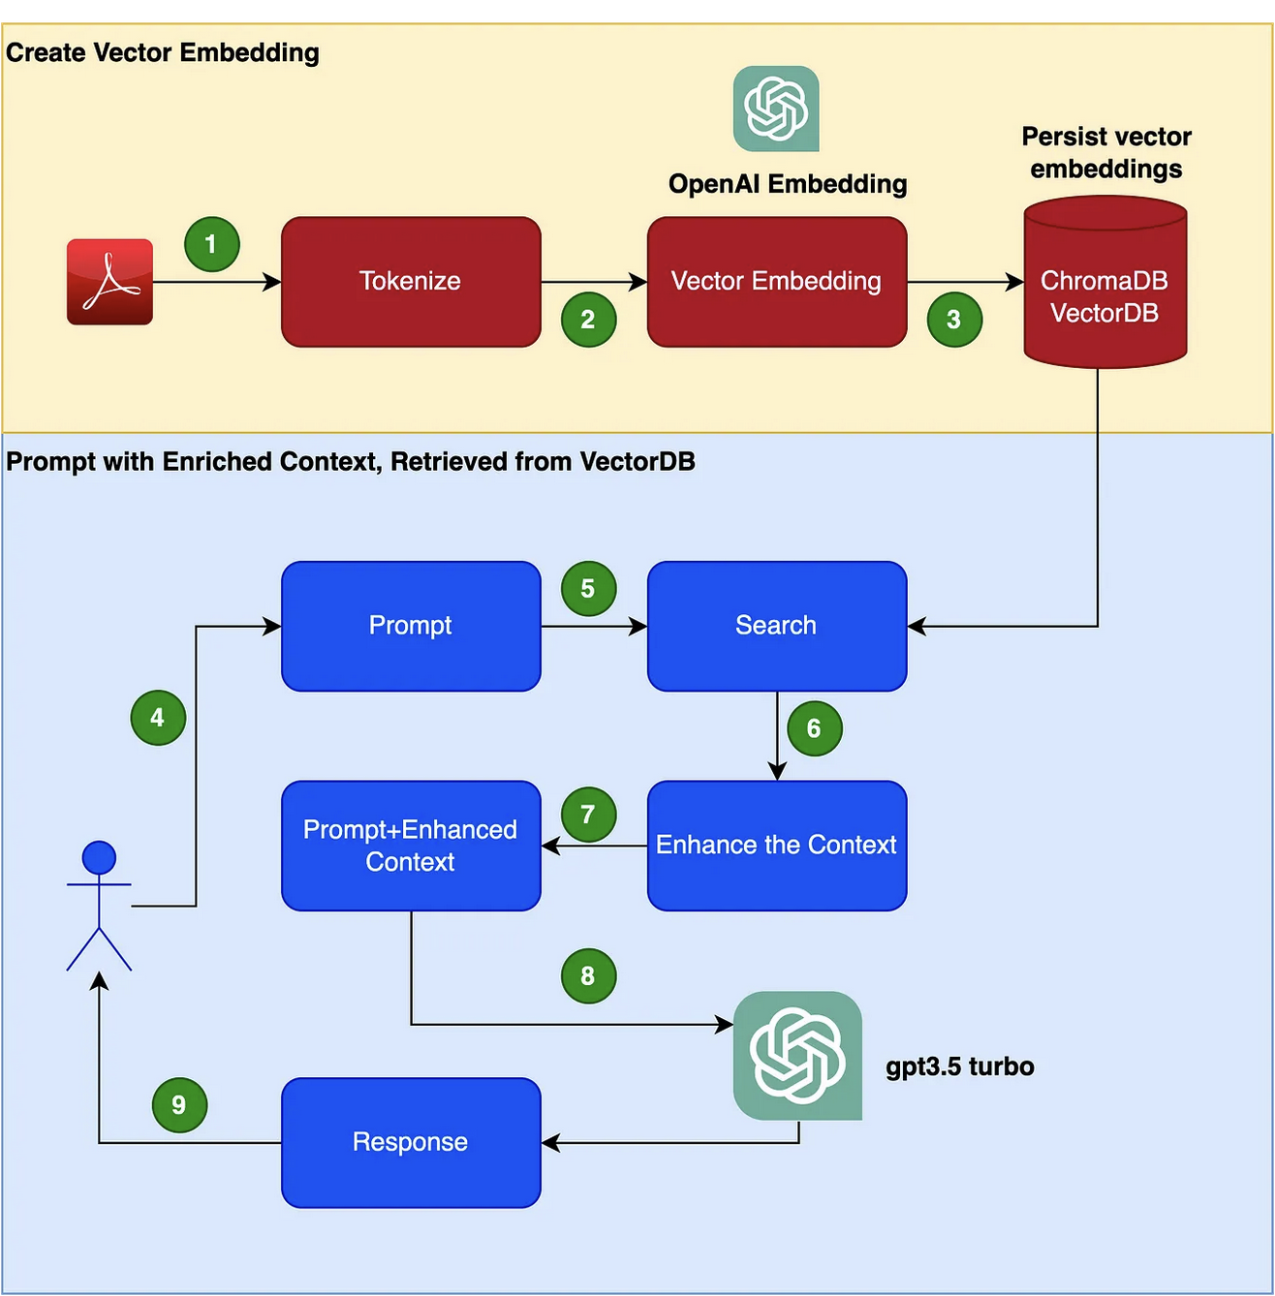
Build Search for the Content RAG Pattern
https://abvijaykumar.medium.com/prompt-engineering-retrieval-augmented-generation-rag-cd63cdc6b00

Slide 5
Overall Architecture
Query
Watson Assistant
Search and Retrieval
(IBM Cloud)
Custom Extension
Response
IBM Large Language Model from Watsonx.AI
Custom Knowledge

Slide 6
Conceptual View of the Solution
User
Watson Assistant
LLM
User asks a question that needs clarification
Watson Assistant clarifies the response and sends to query to LLM
LLM looks at the query and searches the local repository and returns the response.

Slide 7


Candidate Architecture Overview: Uses RAG Pattern
Knowledge Base
Mapping
PDF, Text Documents
(Ex: APIC, CD4D etc.,)
Used as source of information
Read the Docs
Split the document in manageable chunks + Tokenize the chunks
Embeddings API
Vector
DB
Augment searched result with context
Watsonx.ai
Splitter
Function
Chosen LLM model/s
IBM Tech or RH Tech production description / documentation.
We will have this created and curated for this exercise
Create response –based on the query & context. Human readable
Search & Retrieve based on Query
Querying
Python Code
(Swagger API, Open API)
Input
Text / Query
Watson Assistant
Create
Extension
Invoke
Python API
Output
Solution Product
/ Summary
Response
Response
Inputs can be probing queries based on Functional / Non-Functional requirements from the RFP.
Output can be the name of the IBM Tech or RH Tech solution component with or without summary.
Example:
Input: What is the IBM Tech component supporting the requirement ‘REST API based integration between partner systems and the solution’
Output: IBM API Connect. IBM APIC is an API Management Solution and provides the means to create, assemble, manage, secure and socialize APIs enabling REST based integrations.

Slide 8
Solution Components
Github
WatsonX.AI large language Models
IBM Openshift with Python runtime
Vector Database Chromadb
Watson Assistant

Slide 9
Skills Required
Watson Assistant
Python
IBM Cloud – Hosting applications using Python Flask
IBM and Redhat Products Knowledge for Gathering Data
WatsonX.AI with IBM/OpenSource LLMs
Git – Basics of git add , git commit , git push

Slide 10
Required Data Sets
Data Set | Source of Data | Do we have access? (Yes/No)
IBM Technology Products | Seismic / IBM Websites | Yes
IBM Redhat Product | Redhat Websites | Yes
RFP Requirements | Old Repository of RFP | Yes

Slide 11
Roles
Role | Name | Required Skills
Product Owner / Architects |  | Vision for the Product Product Roadmap Feature Release Architecture and Design Module Design and Architecture Knowledge of IBM and Redhat Products
Developer 1 |  | IBM Cloud , Watson
Developer 2 |  | Knowledge of Python, Git, API , LLM
Prompt Engineer |  | Understanding Prompt Template Building the Relevant Prompts Data Preparation Data Engineering
Documentation |  | Document Key decisions Prepare Product Documentation Prepare for the Presentations

Slide 12
Background Learning ( 100 )
Learn Python Basics
Environment, Pip commands
Loops and Datatypes , Arrays, List
Functions in Python
Watson Assistant https://www.youtube.com/watch?v=0sgjH5NWbNw
WatsonX.AI GA
For Python, you can do the Udemy Course.
Install Github Desktop
Optional:
Learn GenAI (needs to fund your own OpenAI if interested to do this course)
https://cognitiveclass.ai/courses/coursev1:IBMSkillsNetwork+GPXX0W2REN+v1

Slide 13
Next Steps ( Now to 5th August)
Create IBM Cloud Account account. Use your IBM Intranet ID like name@sg.ibm.com
Complete Education – Links and other enablement's on WatsonX.AI
Play with Watson Assistant and WatsonX.AI
Install Python Environment and Visual Studio Code and play with the code snippets
Be Active on the Slack Channel #Watsonx-Singapore-lions

